Slide 1
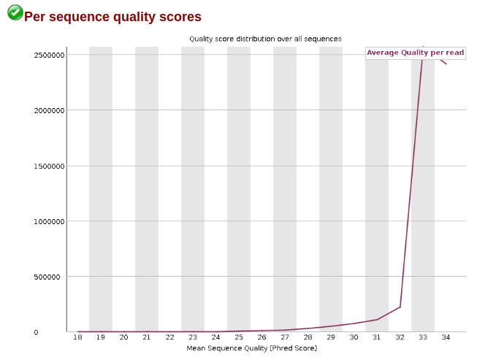
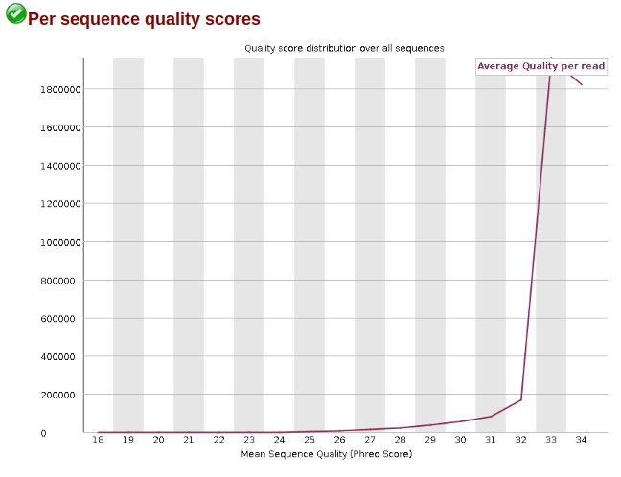
Filter sequences with a 2 bp window with quality <= 32
FASTQ size was reduced by 8 % on average
trimmomatic PE ... CROP:72 MINLEN:72 SLIDINGWINDOW:32:2

Slide 2
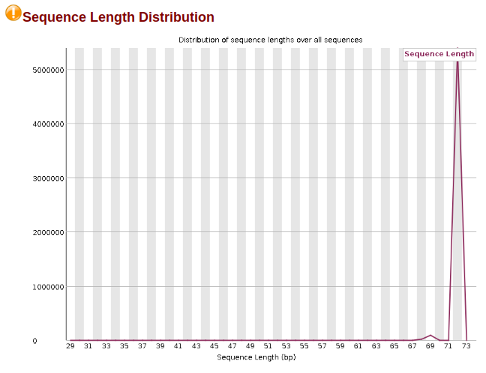
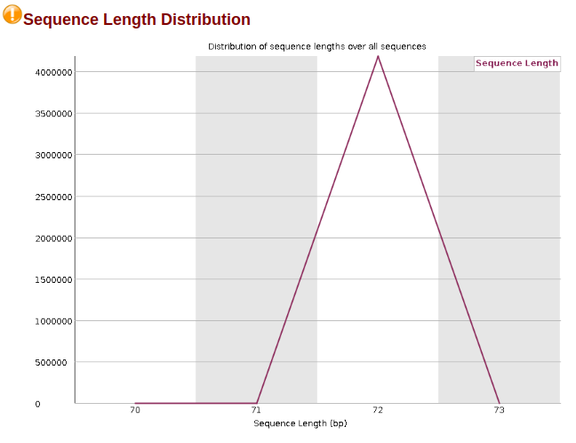
Crop reads to 72 bp and filter out reads < 72 bp
FASTQ size was reduced by 8 % on average
trimmomatic PE ... CROP:72 MINLEN:72 SLIDINGWINDOW:32:2

Slide 3
Prototype 2: quantify the impact of mixing gene annotations and approach to minimise its impact
Baseline approach: map genes based on the gene id
Limitations
Gene ids change
Gene models identified under the same gene id also change
Hypothesis: comparing two or more gene annotation versions we will be able to identify those genes that have identical gene and transcripts models and hence 1) quantify the difference between two or more gene annotations and 2) identify a subset of genes that can be jointly analysed using different gene annotations without the need for upstream reanalysis
Approach: two genes are considered identical when the start and end coordinates of the gene and every exon of every transcript are identical. This approach is identified agnostic.
Gene coordinates are matched by exact match
Exon coordinates are matched using a hash after sorting all of them

Slide 4
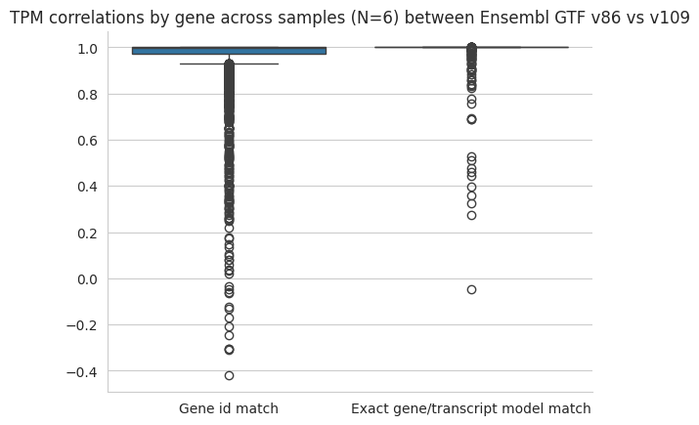
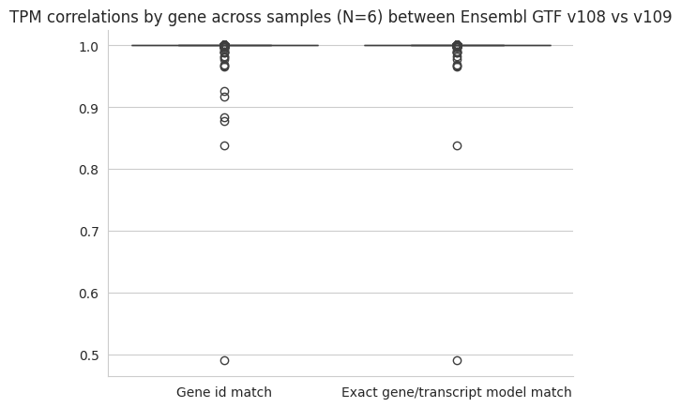
Prototype 2: quantify the impact of mixing gene annotations and approach to minimise its impact
Matching gene ids: 3219
Jaccard by matching gene ids: 0.94
Identical genes: 1235
Identical genes with different ids : 13
Jaccard by exact model: 0.23
Matching gene ids: 3361
Jaccard by matching gene ids: 1.0
Identical genes: 3347
Identical genes with different ids : 0
Jaccard by exact model: 0.99

