Slide 1
DASS TEAM 16
TELUGU SENTENCE AUTO-COMPLETION

Slide 2
Team Members
Siddharth Agarwal
Shreyansh
Garvit Gupta
Priet Ukani

Slide 3
PROBLEM STATEMENT
Typing Telugu script on traditional keyboards is a tedious process.
The objective of the project is to ensure ease of typing for users in languages other than English, currently working with Telugu.
The project thus, focuses on chrome extension development which enables users to leverage the much-needed sentence autocomplete functionality, so typing in Telugu is easier and much less time-consuming.
The abstract idea of the project is to predict the intended sentence by the user priority, before they complete their sentence and if users find their choice in the options provided to them, then they will choose it and will move further ahead.

Slide 4
APPROACH TO THE SOLUTION
We aim to develop a Chrome Extension which enhances the typing experience by providing valuable predictions to user as they type in Telugu language. The Extension uses a ML Model at backend to generate predictions for sentence completion.
This will enable users to type in their own language scripts with efficiency & accuracy.

Slide 5
STEPS TAKEN AND TECHNOLOGY USED
BACKEND SERVER DEPLOYMENT
Our first step was to determine whether to host the model locally at users end, or to host it at some cloud server.
Since, the size of model is > 300MBs, so we decided to search for an optimal cloud service which would be best fitting for our model deployment.
We concluded our search with AWS Lambda as our final cloud service, required for deployment of our model remotely.
Cloud Models proposed Amazon AWS(Lambda function).
Other cloud models like Microsoft Azure , Google GCP were also considered for model deployment but due to higher cost per request and less number of functions as compared to AWS they were rejected.

Slide 6
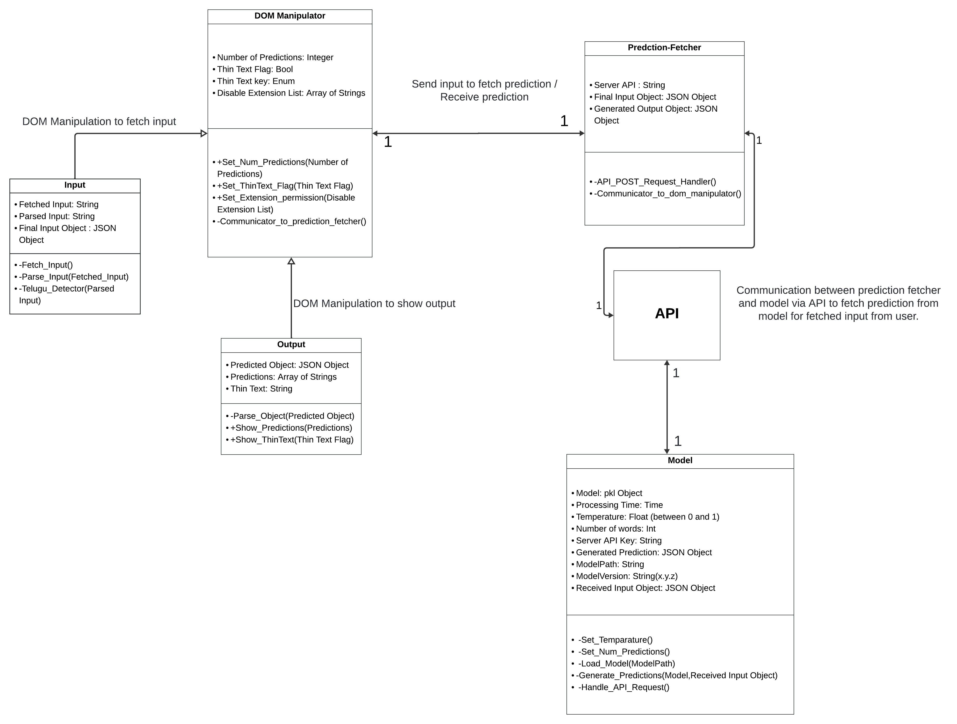
STEPS TAKEN AND TECHNOLOGY USED
FINALISING the design

Slide 7
STEPS TAKEN AND TECHNOLOGY USED
FINALISING the design
Class Diagram Link
Sequence Diagram Link

Slide 8
STEPS TAKEN AND TECHNOLOGY USED
FRONTEND CHROME EXTENSION (fetching & parsing user input)
Our next step was to develop basic structure of chrome extension, content.js to manipulate DOM & background.js to fetch predictions.
Then we worked on fetching user input from live website and parsing the input to send for prediction generation.
We used HTML, CSS & Javascript to develop extension, fetch input and parse input.
First we worked on recognizing the input fields to fetch user inputs from.
Then we fetched inputs from input fields while being typed and we parsed those inputs to get desirable format and to detect valid telugu inputs.
We printed the fetched input into console to mock up the processing of input.

Slide 9
STEPS TAKEN AND TECHNOLOGY USED
FRONTEND CHROME EXTENSION
(Sending mock INPUT TO Backend and FETCHING RESPONSE)
Parallelly, we had a constant mock Telegu text input be sent from the user end to the backend model.
The received output from the model was then sent back to the extension and displayed in console to check if connection was being established between the user and local server. (Mocking up display of predictions to user by printing received predictions in console.)
Technologies used were flask to handle REST API requests on server side & Javascript to handle communication on extension side. We are using ngrok to create secure tunnels to our localhost to expose our local server to internet.

Slide 10
STEPS TAKEN AND TECHNOLOGY USED
Integrating Actual input to prediction generation
We integrated extension and backend server to send the fetched user input to backend model for prediction generation and to receive the generated prediction from backend model.
Here we replaced the mock input in previous step by the actual fetched input from user.
Here also mainly JavaScript and Flask was used.

Slide 11
STEPS TAKEN AND TECHNOLOGY USED
FRONTEND CHROME EXTENSION
(Showing mock RESPONSES FROM BACKEND TO FRONTEnD)
Our next step was to work on display of output to user.
We mocked prediction generation by hardcoding some strings like 'prediction1', 'prediction2' and 'prediction3'.
We then developed a floating display box, which auto-appears whenever predictions are received, to display the predictions.
We also developed the functionality that enables user to select any prediction being shown to append that to the text being written in input field.
By this we were able to display the mock predictions to the user on live website by using technologies Javascript, HTML and CSS.

Slide 12
STEPS TAKEN AND TECHNOLOGY USED
Integrating Actual output to prediction display
Here we integrated the extension's output display to the actual generated predictions.
In the last step we were using hardcoded mock predictions to display that to user on live website.
In this step we replaced those mock predictions by the actual predictions generated from the actual fetched user inputs.
So now the extension is fetching real time input from user, it is sending that to backend model for prediction generation and then it is displaying the generated output to user on live webpage.
Here also JavaScript and Flask have been used.

Slide 13
REASONS FOR TechnologIES USED
JavaScript(JS) for Extension backend functionality like sending request and fetching response from server , DOM Manipulation , detecting user input and Telugu language.
Flask and NGROK: For creating local server and hosting NLP model locally.
HTML, CSS were used for displaying output in a presentable manner to the user.
We used HTML, CSS and JavaScript mainly to develop Chrome Extension because an Extension doesn't require sophisticated functionalities to be implemented. It just requires some minimal functionalities like DOM Manipulation to fetch inputs and display outputs, which can be developed by using HTML, CSS & JavaScript only.

Slide 14
Progress made till r1
We are able to extract data from most input fields in a website.
The text is being processed by the model on local server.
Output received by the extension is shown to the user in a dropdown.
The prediction on selection gets written on the input field.
Only Telugu text triggers the extension. Other languages are ignored.

Slide 15
PROgress to be made till r2
We aim to develop a Extension Menu with various moderation options for the user.
Thin Text functionality: The best prediction would be shown in thin text which user can accept based on some custom key-bindings. (The way co-pilot works)
More work to be done to make the displaying of predictions look more perfect and elegant.
Deploying the model on cloud service(based on availibility, optional).
To make the extension work on more general websites.

Slide 16
Challenges faced and how we tackled them
We were asked to search for optimal cloud server, to deploy model. After we came up with AWS solution, then the clients were not able to provide us the AWS service account.
Clients then asked us to deploy our model temporarily on Google Colab.
We deployed model on Colab, but Colab was lacking persistency and also latency was huge while fetching predictions.
So we switched to local server, it improved persistency and also latency was reduced.
If client would provide AWS service account to us in future, then we will switch to AWS Cloud server for our backend.

Slide 17
VIDEO LINK​​

Slide 18
THANK YOU
Team 16
VIDEO LINK​

