Slide 1
Architecture design
Siddharth Agarwal
Shreyansh
Garvit Gupta
Priet Ukani

Slide 2
AGENDA
Cloud Models
Timeline

Slide 3
INTRODUCTION
We plan to figure out a cost effective, easy to use cloud service provider for deploying the ML model and provide an approximate timeline of the project.

Slide 4
Cloud Models

Slide 5
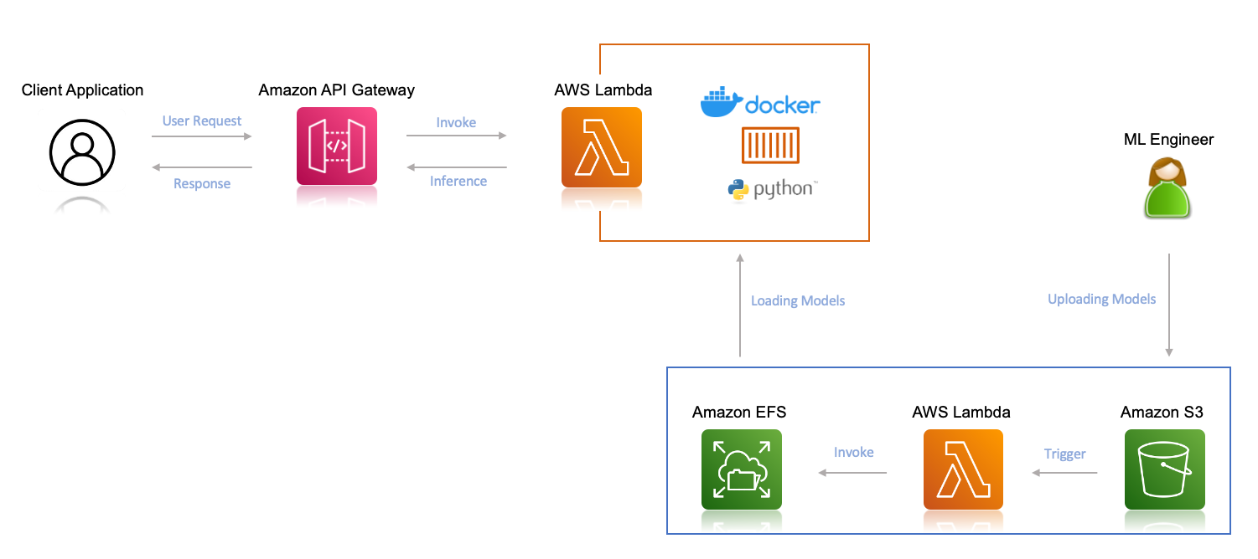
Amazon LAMBDA + S3 + EFS

Slide 6
Amazon LAMBDA + S3 + EFS
Simple and cost-effective. Charges will be applicable as per inferences.
Due to the complexity of deploying a pre-trained model on Sagemaker and its high cost, we would prefer to deploy on lambda + S3 now, and when monitoring and more scaling is required, we can add Sagemaker to our architecture.
Pros: Simple & best suitable for our current situation, cost-efficient (as per inference) & easy to handle. (We can switch to Sagemaker whenever required)
Cons: Less automatic MLOps functionalities available, also less scalable than sagemaker. Manual handling of the retraining process

Slide 7
Google Cloud function
Step 1- Training the model on your local machine.
Step 2- Creating a new Google Cloud Project.
Step 3- Storing the pre-trained model in a Google Cloud Storage.
Step 4- Writing the Google Cloud Function for deployment
Quite similar to lambda function architecture.
Pros: simple and easy to use like lambda with S3 & cost efficient
Cons: Will need manual implementation to retrain model.
Others Cloud Services by Google: EC2, Google App engine, Vertex AI etc.

Slide 8
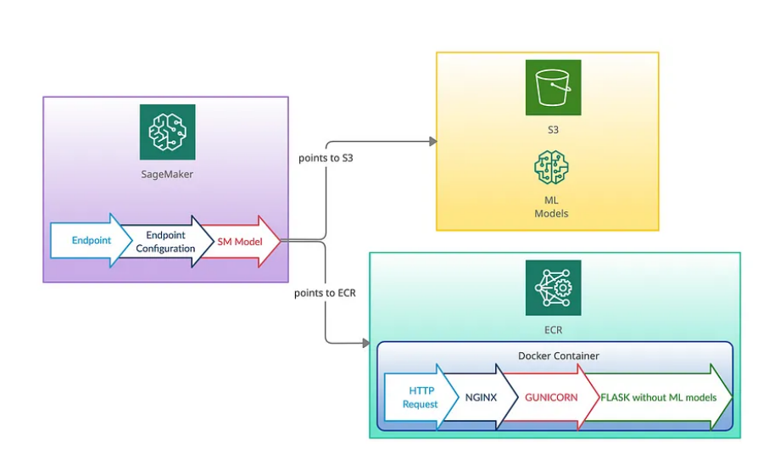
AMAZON Sagemaker
Amazon Sagemaker with other services of AWS like S3 Buckets, AWS ECR, AWS lambda & api Gateway.

Slide 9
AMAZON SAGEMAKER
Amazon SageMaker is a fully managed machine learning service. It helps data scientists and developers to prepare, build, train, and deploy high-quality machine learning (ML) models quickly.
It provides an integrated Jupyter authoring notebook instance to easily access your data sources for exploration and analysis.
Pros: automatic MLOps functionalities, Make monitoring & analysis of ML models easy (but we don’t have to delve into model monitoring right now, we have to focus on how to provide users access of the service model).
Cons: Higher cost than Lambda function architecture & a little bit complicated while deploying pretrained model on sagemaker endpoint instead of building and training model on sagemaker and then deploying it on the endpoint.

Slide 10
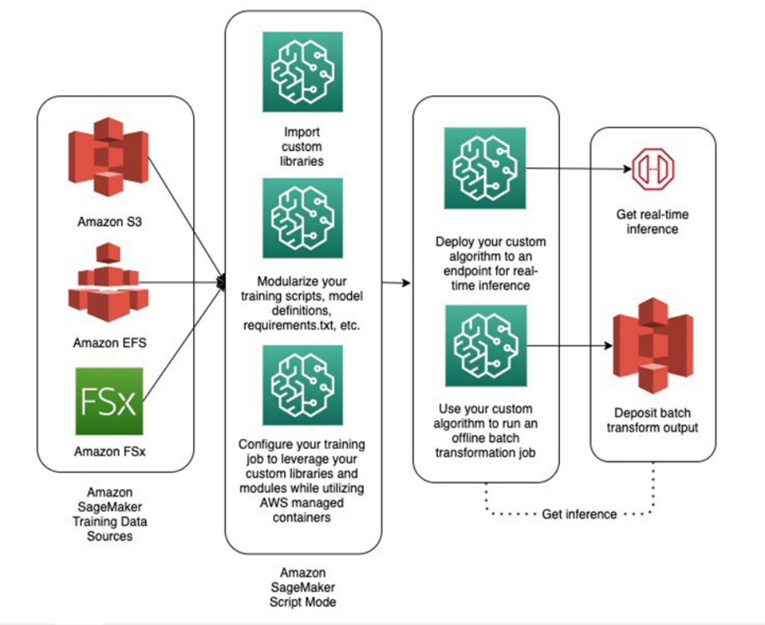
Amazon Sagemaker script mode

Slide 11
AMAZON SAGEMAKER SCRIPT MODE
Script mode enables you to write custom training and inference code while still utilizing common ML framework containers maintained by AWS. Script mode is easy to use and flexible.
Pros: We can customize libraries we want to use, we can customize code to train-retrain model & we can also customize inference code by giving our own scripts. (quite similar to Sagemaker + S3 + ECR).
Cons: Since Sagemaker is involved so all the previous cons are applicable here too.

Slide 12
Other alternatives
Other alternatives are Amazon EC2, Google App Engine, Vertex AI etc.
Google App Engine (GAE) is a platform for building and hosting scalable web applications and mobile backends. It's a fully managed, serverless platform that allows developers to build applications in any programming language.
Vertex AI is analogous to Sagemaker in AWS.
Amazon Elastic Compute Cloud (Amazon EC2) is a web service that provides secure, scalable computing capacity in the Amazon Web Services (AWS) Cloud

Slide 13
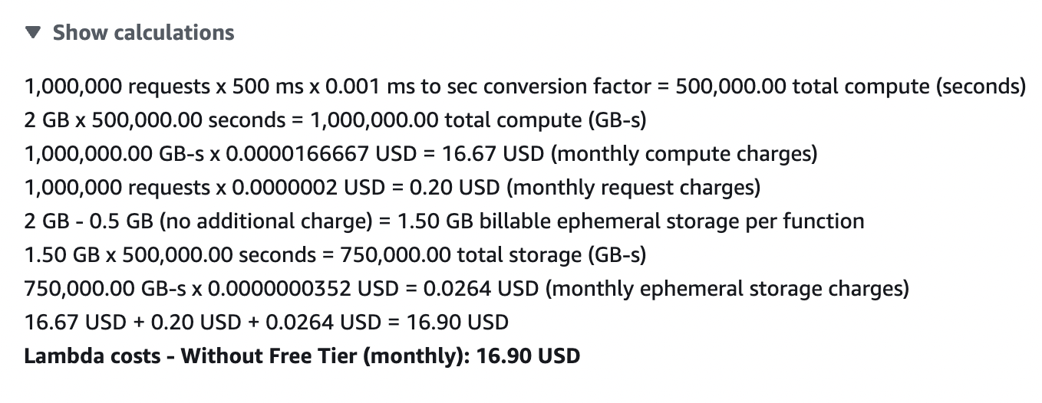
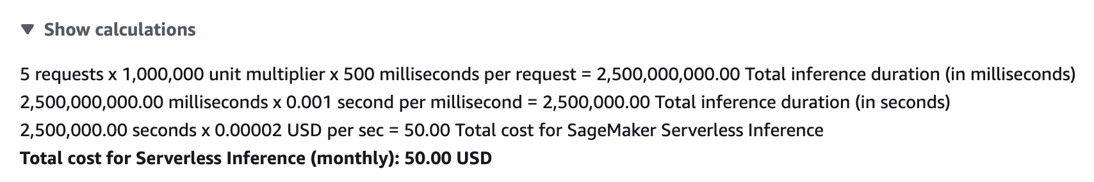
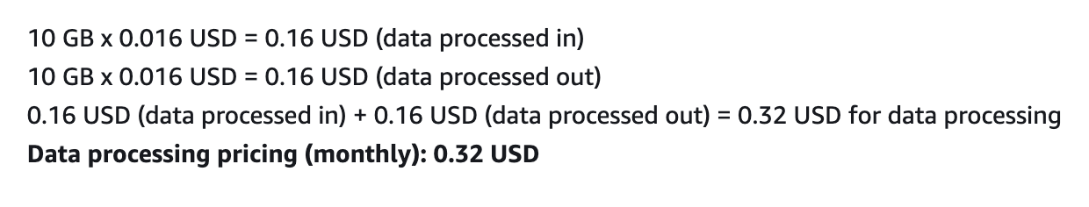
Costing
AWS Lambda (Without Free Tier)
AWS SageMaker

Slide 14
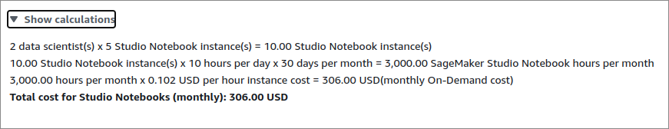
Sagemaker PRicing (notebook)

Slide 15
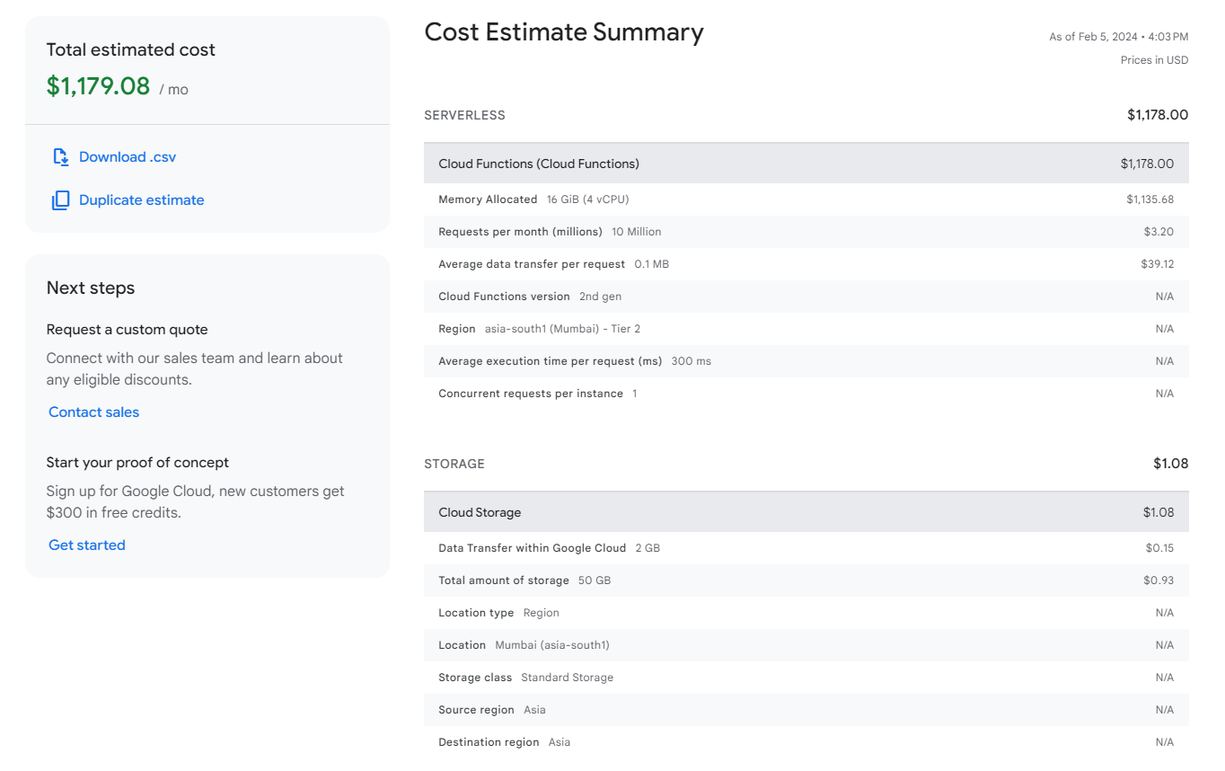
Costing
GCP
COST
ESTIMATE
(1 concurrent request)
https://cloud.google.com/products/calculator/estimate-preview/18c96da0-1fd0-4637-9194-64196783bbe7?hl=en

Slide 16
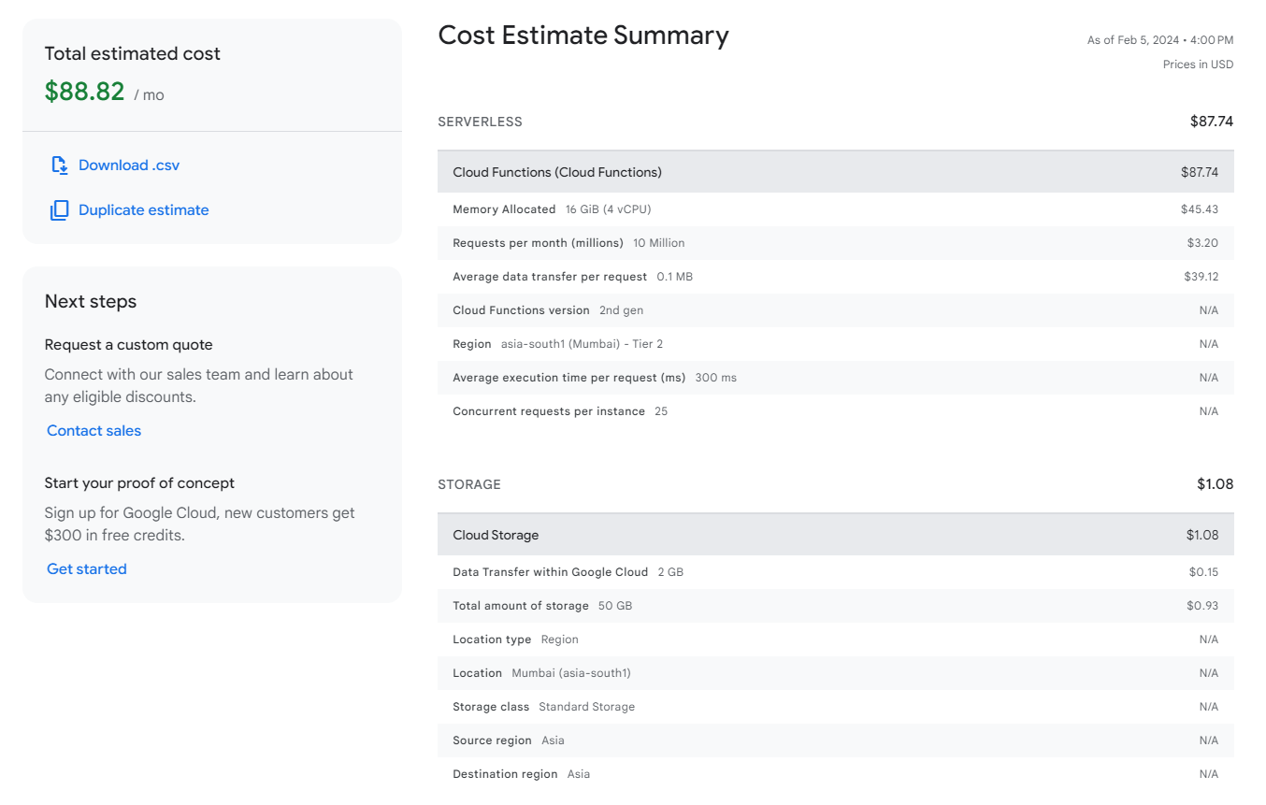
Costing
GCP
COST
ESTIMATE (25 concurrent requests)
https://cloud.google.com/products/calculator/estimate-preview/271ada9b-8954-4d5d-a612-e5d42f8e1177?hl=en

Slide 17
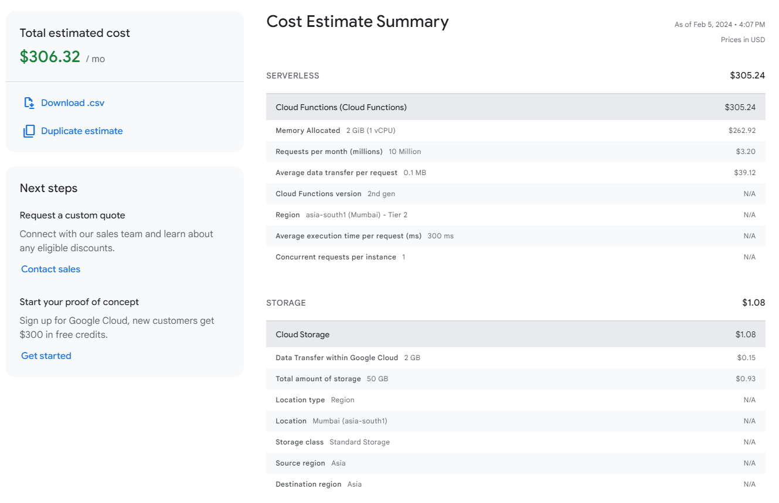
Costing
GCP
COST
ESTIMATE (1 concurrent request)
https://cloud.google.com/products/calculator/estimate-preview/2f0b6e94-8508-482c-920e-72497ba7fc07?hl=en
More realistic 2GB WITH 1 CONCURRENT REQUEST PER INSTANCE.
Increasing minimum number of instances to 1 will help remove cold start latency and cost only increases by 50$ in the above cost estimation

Slide 18
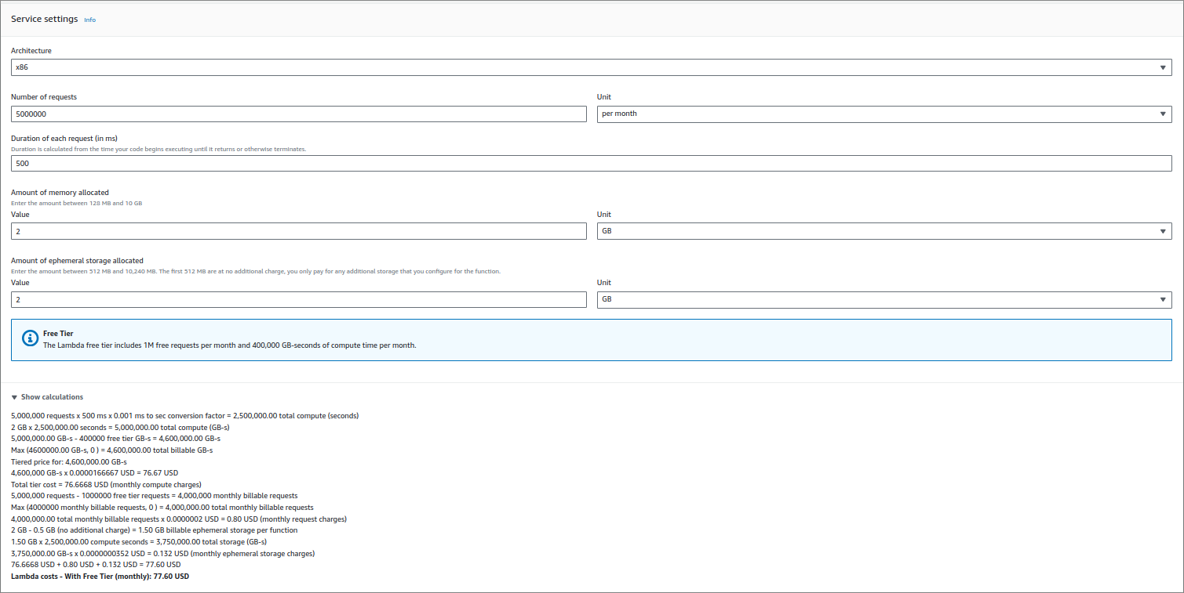
Lambda PRicing (Lambda function )

Slide 19
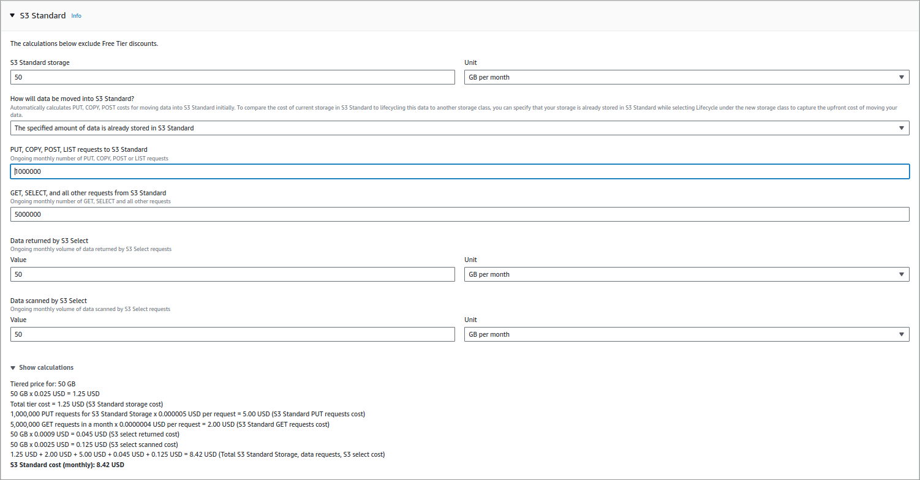
Lambda PRicing (s3 storage)

Slide 20
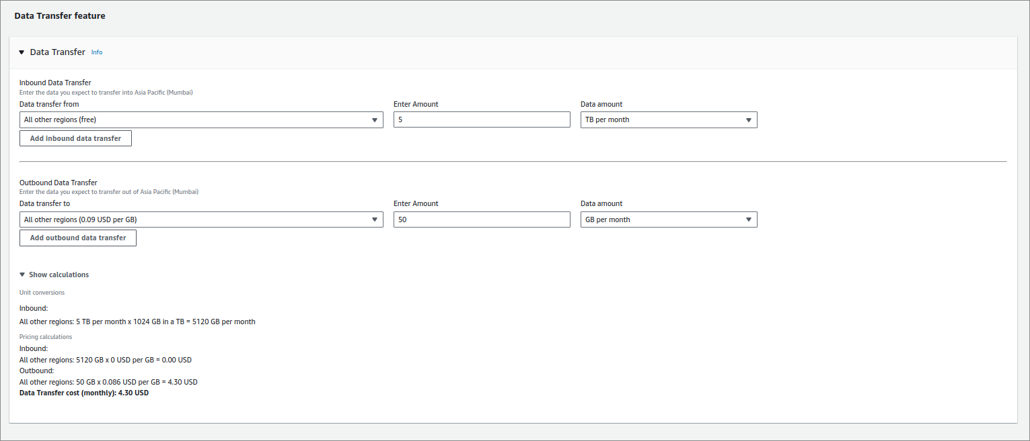
Lambda PRicing (s3 Data transfer)

Slide 21
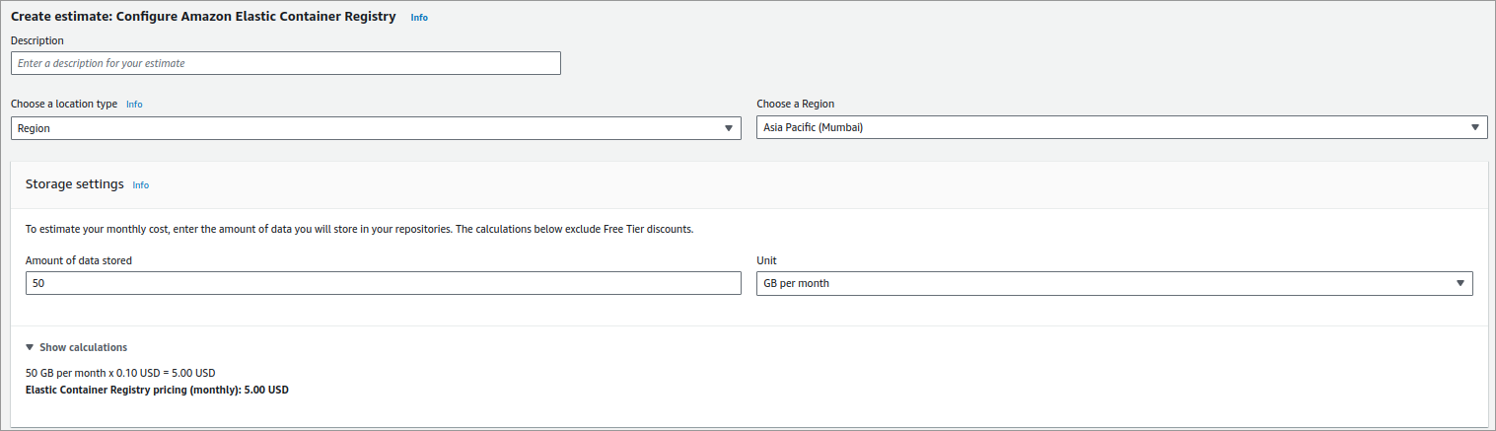
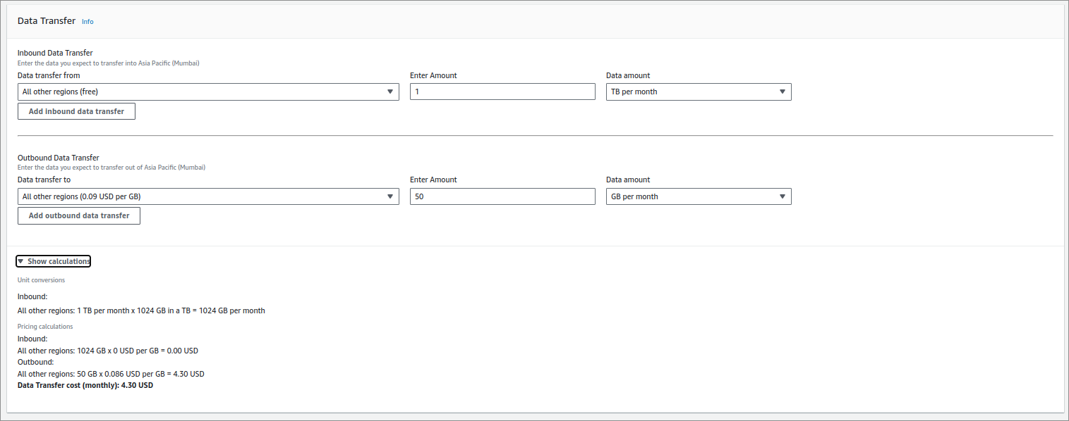
Lambda PRicing (ecr container)

Slide 22
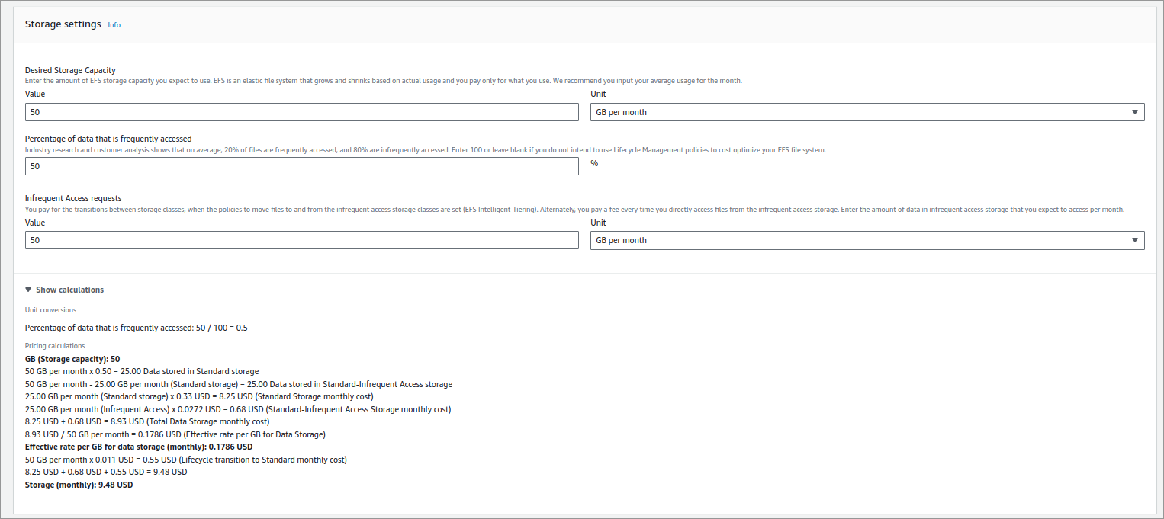
Lambda PRicing (EFS)

Slide 23
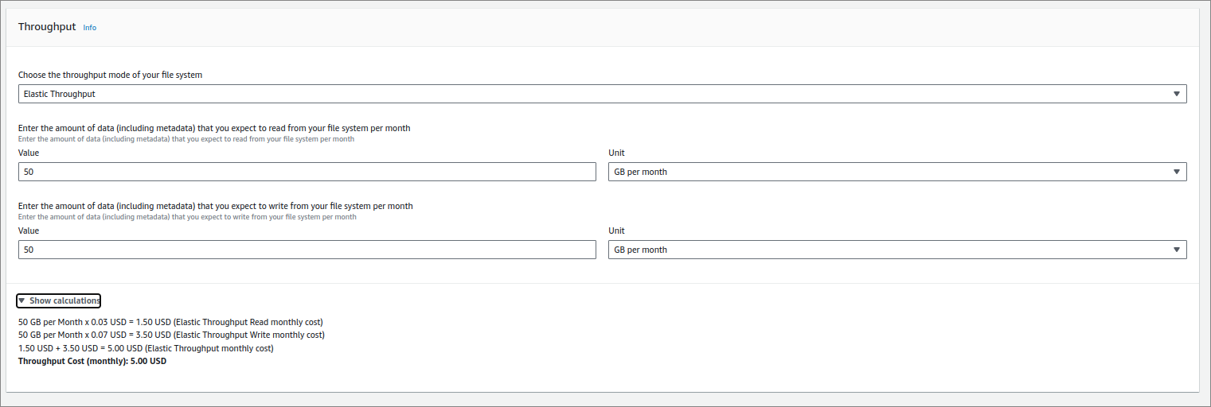
Lambda PRicing (EFS ELASTIC THROUGHPUT)

Slide 24
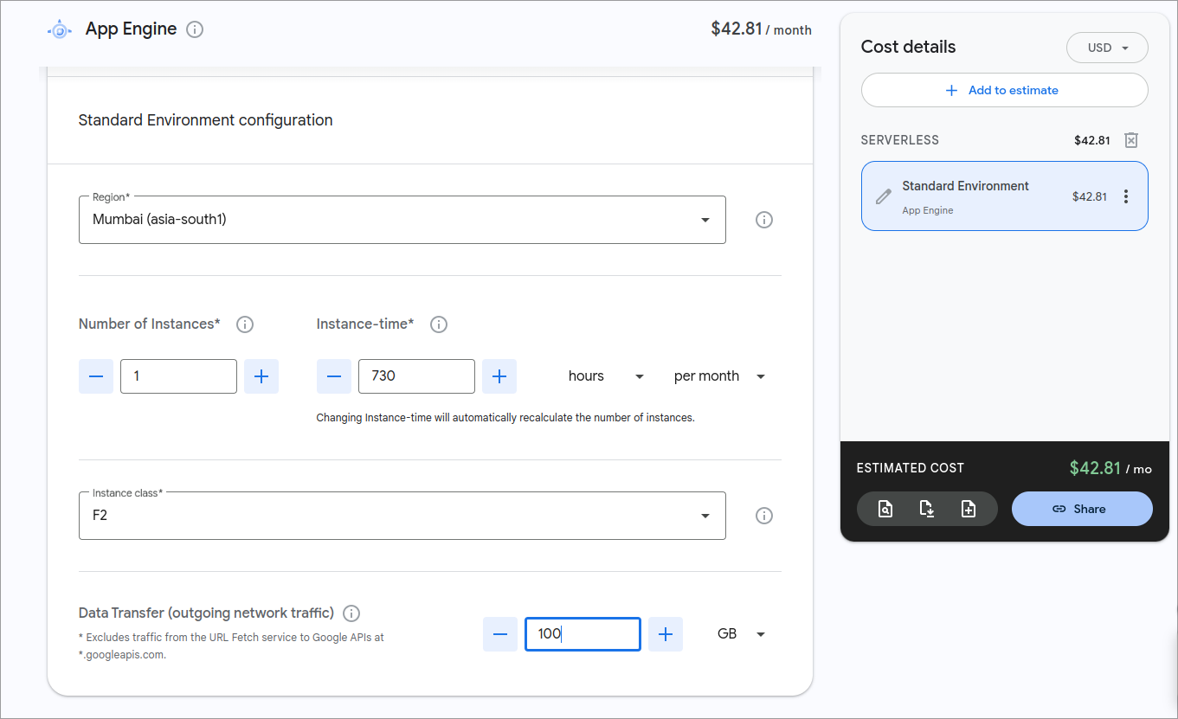
SUGGESTION: APP ENGINE

Slide 25
TIMELINE
Milestone | Due Date | Release | Deliverable?
Draft temporary document for architecture & timeline | 1/2/24 | R1 | Yes
Finalizing architecture | 5/2/24 | R1 | Yes
Making the high level design for extension | 20/2/24 | R1 | Yes
Deciding on tools to use based on design | 23/2/24 | R1 | Yes
Distribution of implementation work | 23/2/24 | R1 | No
Building a primitive version of the app | 5/3/24 | R1 | No
Testing the primitive app for bugs or faults | 10/3/24 | R2 | No
Building the final version of the app | 20/3/24 | R2 | Yes
Reiterations & modifications | 15/4/24 | R2 | Yes
Final extensive testing and fixing | 18/4/24 | R2 | No
Deployment and Final release of the app | 20/4/24 | R2 | Yes

Slide 26
Links to refer
https://course19.fast.ai/
https://developer.nvidia.com/blog/machine-learning-in-practice-deploy-an-ml-model-on-google-cloud-platform/
https://medium.com/geekculture/84af8989d065
https://aws.amazon.com/blogs/machine-learning/bring-your-own-model-with-amazon-sagemaker-script-mode/
https://calculator.aws/#/addService (For Cost Estimation)
https://cloud.google.com/products/calculator?hl=en&dl=CiQ5MzExZWE5My1iOGZlLTRkNmItYmRiNC1jM2U3YjRmZGYyZGIQExokNjhCODYzOTUtNDc3RS00N0Y1LTg5OEEtRThEMTlBMENDMTlD (For GCP Cost Estimation)

Slide 27
Links to Trustable references regarding architecture
https://www.appsruntheworld.com/customers-database/purchases/view/grammarly-usa-selects-amazon-sagemaker-for-machine-learning-and-data-science-platform?amp=1 (Grammarly selects sagemaker)
https://aws.amazon.com/sagemaker/customers/ (Grammarly listed as customer at sagemaker's official site)
https://course19.fast.ai/deployment_aws_lambda.html (Fast.ai's documentation for deployment on aws lambda)
https://course19.fast.ai/deployment_amzn_sagemaker.html (Fast.ai's documentation for deployment on sagemaker)
https://www.grammarly.com/blog/engineering/building-flexible-deployment-system-fsharp-fparsec/ (Grammarly using lambda function and talks abount the benefits of using lambda on it's official site)

Slide 28
THANK YOU
- Priet, Garvit, Siddharth, shreyansh

