Slide 1

CORTEX
Empowering Linguistic Discovery | Open & Free

Slide 2
CORTEX
Next-Gen AI-Powered Corpus Analysis

Slide 3

🤖 AI-Powered Analysis
• First platform to natively integrate GenAI (Ollama & Gemini)
• Acts as your personal Corpus Research Assistant
• Interprets complex linguistic patterns in plain language
• Explain concordance lines and collocations instantly

Slide 4
🎭 Sentiment Intelligence
• Automated Lexical Sentiment Analysis
• Categorise tokens: Positive, Neutral, Negative
• Build specialized sub-corpora based on emotion
• Perfect for Digital Humanities and Discourse Analysis

Slide 5
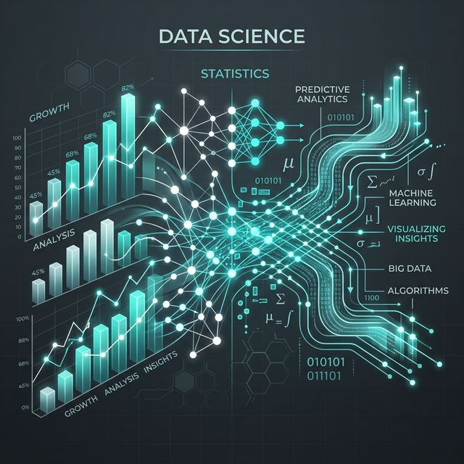
📈 High-Performance Statistics
• Comprehensive Statistical Suite built-in
• Chi-square, Log-Likelihood, and Correlation
• Automated Authorship Attribution tests
• Zero dependency on external software like R or SPSS

Slide 6
🔍 Comparative Analysis
• Advanced Keyword extraction by metadata or filename
• Robust side-by-side Comparison Mode
• Visualize differences between corpora instantly

Slide 7
⚡ Concordance & Distribution
• Standardized KWIC (Key Word In Context) view
• Automatic collocate highlighting in real-time
• Interactive Lexical Distribution across the corpus

Slide 8
🧩 Advanced N-Grams
• Extremely flexible N-Gram generation
• Mix tokens and POS tags in specific positions
• Custom display options for complex pattern discovery

Slide 9
📖 Corpus-Based Dictionary
• Fully data-driven Lexicography tools
• Integrated Collocation Pattern Grammar (CPG)
• Real-time usage examples with context

Slide 10
🌐 Global Multilingual Support
• Seamless support for multiple languages
• High-accuracy Lemmatization and POS tagging
• Handles XML, TXT, CSV, and XLSX formats natively

Slide 11
✨ NEW: Word Profiler
• NEW: Analyse coverage against custom wordlists
• Supports Plain and Categorized wordlists (e.g. CEFR)
• Identify OOV (Out of Vocabulary) trends
• Interactive tables and stacked bar visualizations

Slide 12
🚀 The CORTEX Advantage
• AI + Statistics + Corpus Linguistics All-in-one
• Modern Streamlit interface for maximum usability
• Free, Open Source, and Accessible to everyone

