Slide 1
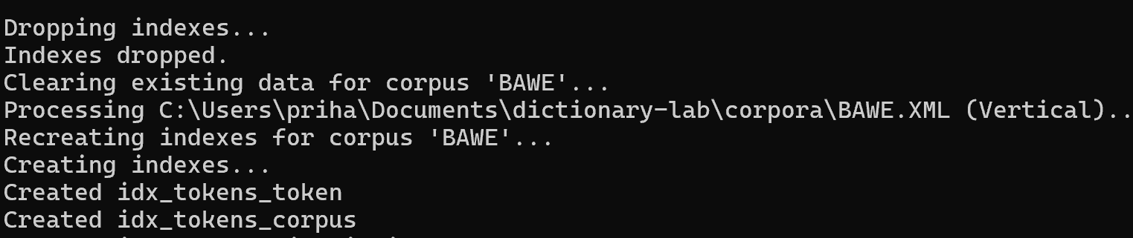
CORTEX Dictionary Lab
PRIHANTORO
UNIVERSITAS DIPONEGORO
prihantoro@live.undip.ac.id
https://www.prihantoro.com/

Slide 2
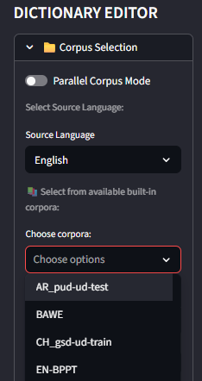
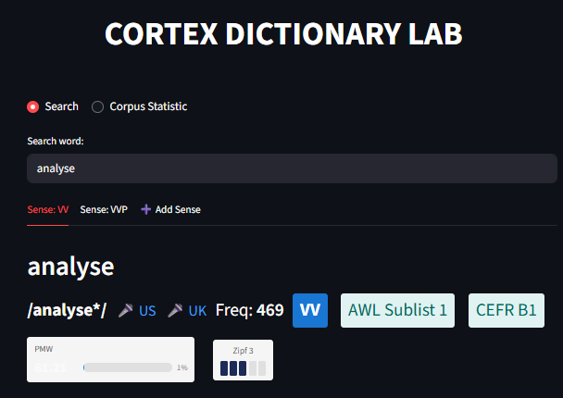
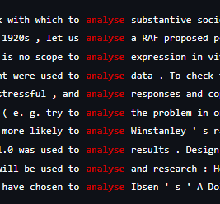
What is CORTEX Dictionary Lab?
A powerful corpus-based dictionary query and editor app.
Context-Aware: Analyzes corpus examples, N-grams, and Collocates
Python: streamlit, duckdb, stanza, pandas, numpy, levensthein (fuzzy matching), requests (ollama integration), openpyxl, xlswriter
prihantoro@live.undip.ac.id
https://www.prihantoro.com/

Slide 3
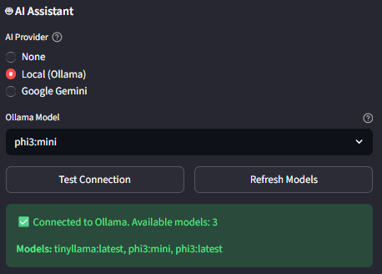
✨ AI-Powered Dictionary Generation
Supports AI integration.
Drastically speeds up the lexicography workflow [post-editing].
prihantoro@live.undip.ac.id
https://www.prihantoro.com/

Slide 4
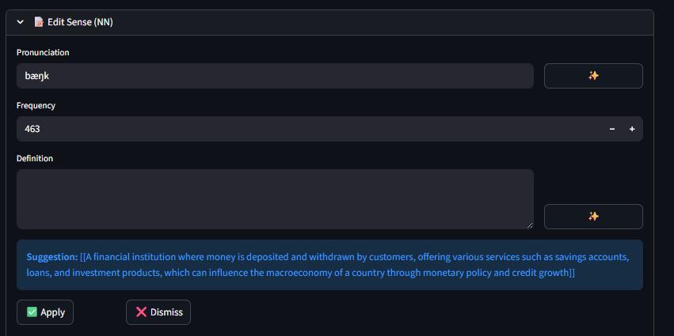
✨ AI-Powered Dictionary EDITOR
prihantoro@live.undip.ac.id
https://www.prihantoro.com/

Slide 5
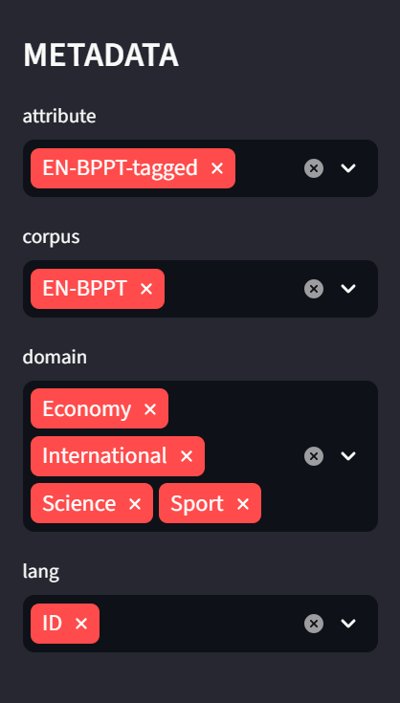
🧠 Advanced NLP Processing
Stanza Integration: Auto-tokenizes, POS-tags, and lemmatizes raw texts.
Flexible Metadata: Ingests complex XML tags (<text id>, <structure segment>).
Intelligent Sentence Splitting: Advanced regex detection wrapped in <s> tags.
Supports dual input formats: Raw text (.txt) and Vertical/Tagged (.xml).
prihantoro@live.undip.ac.id
https://www.prihantoro.com/

Slide 6
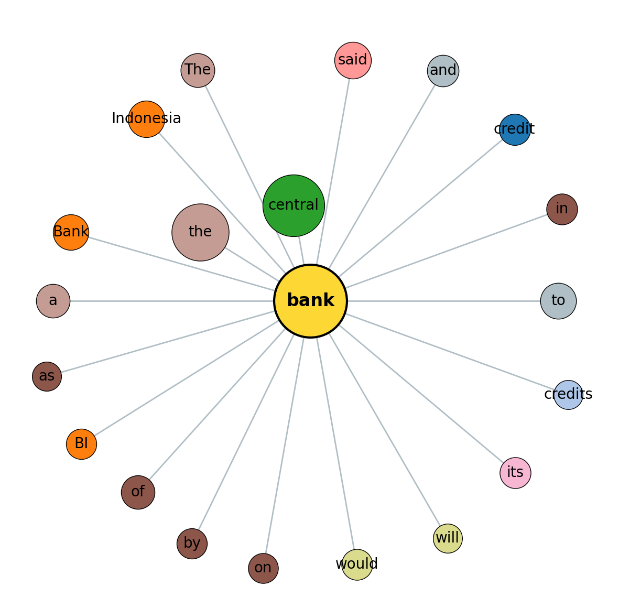
📊 Interactive Collocation Networks
Extracts statistically significant word associated to node.
Network Visualizations:
- Bubble Size = Association Score
- Distance to Center = Strength
- Color = Part of Speech
Powerful Collocate filters/whitelists to drill down on target vocabulary.
prihantoro@live.undip.ac.id
https://www.prihantoro.com/

Slide 7
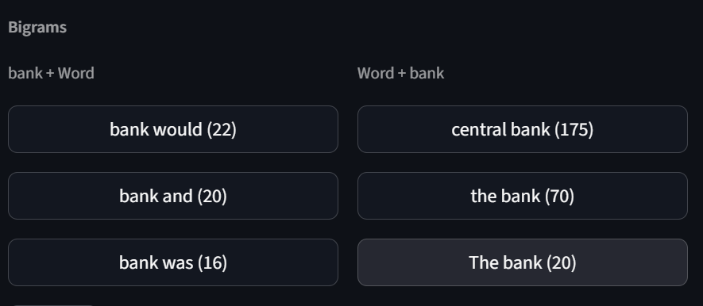
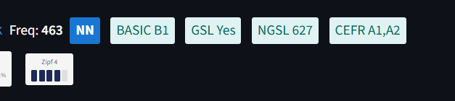
📈 Deep N-Gram & Frequency Analysis
Extracts Bigrams and Trigrams instantly across millions of tokens.
Directional Analysis: See what usually precedes vs. follows a word.
ZIPF Bands & Per Million Words (PMW) frequency scoring.
Explore global corpus statistics and POS distribution at a glance.
prihantoro@live.undip.ac.id
https://www.prihantoro.com/

Slide 8
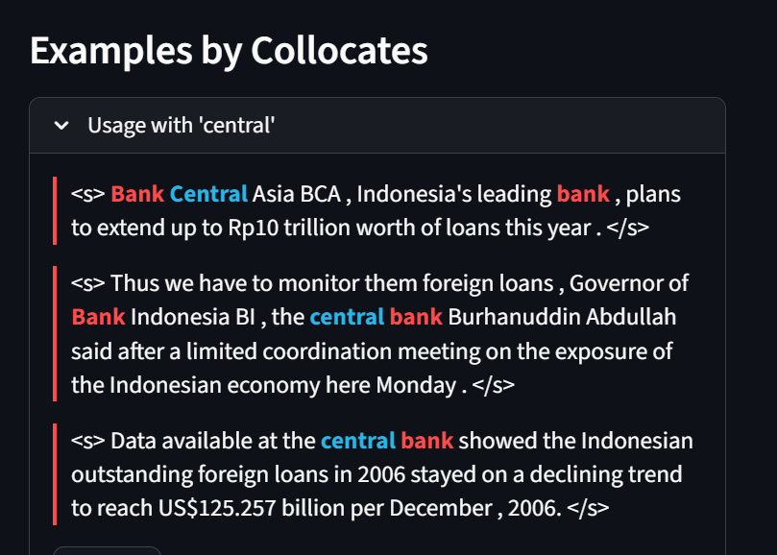
🎯 Advanced KWIC Examples
Key Word In Context (KWIC) displayed at the full sentence level.
Custom Highlighted Context: Search node in Red, Collocates in Blue.
Expandable Top Collocate sections to view how specific words cluster in real text.
Filter examples instantly by Genre, Year, Author, or XML Structure Segments.
prihantoro@live.undip.ac.id
https://www.prihantoro.com/

Slide 9
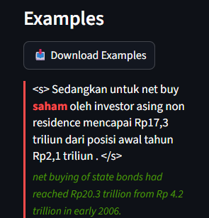
🌐 Parallel Corpus Mode
Analyze aligned bilingual texts side-by-side.
Automatic Sentence Alignment based on document IDs and sentence numbers.
Reveal translation patterns and cross-linguistic collocations.
Perfect for translation studies and bilingual dictionary compilation.
prihantoro@live.undip.ac.id
https://www.prihantoro.com/

Slide 10
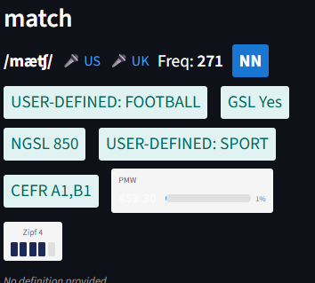
📝 Custom Wordlist Integrations
Built-in Academic & General lists: GSL, AWL, CEFR limits.
Upload entirely custom User-Defined Wordlists (.txt).
Vocabulary lists automatically render as visual Badges on word searches.
Easily track domain-specific vocabulary across enormous corpora.
prihantoro@live.undip.ac.id
https://www.prihantoro.com/

Slide 11
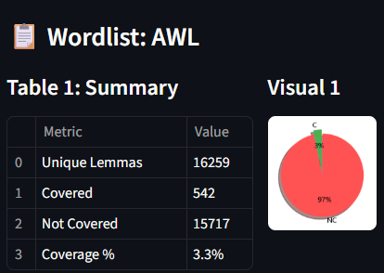
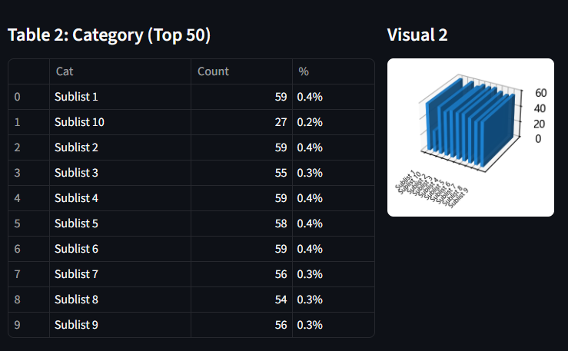
📝 Vocabulary profiling
Based on existing wordlist.
Coverage of words from wordlist in the corpus.
Table and visualisation
prihantoro@live.undip.ac.id
https://www.prihantoro.com/

Slide 12
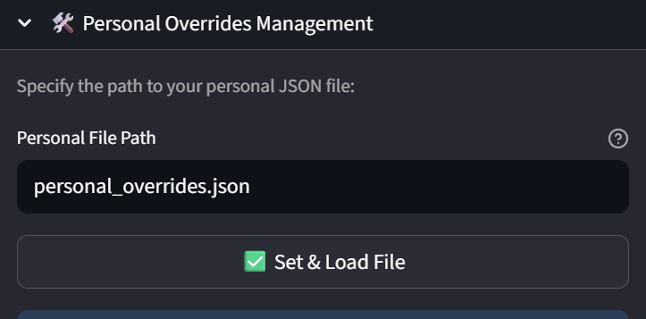
✏️ Personal Overrides & Export
Save manual definitions, frequencies, and examples to persistent JSON storage.
Combine automated corpus statistics directly with human-curated edits.
Take full absolute control over your lexicographical data.
prihantoro@live.undip.ac.id
https://www.prihantoro.com/

Slide 13
✏️ Known issues
Pure corpus based – cannot create entry inexistent in the corpus
Slow, crashed when accessed by many people at the same time
Cause: deployed on the Streamlit community cloud, limited server powers
Solution 1: install to local server
Challenge: need to run via CLI first, not a simple click
Solution 2: move to private server, modify app to work faster without having to rely on streamlit, focus on corpus-indexing, compute on cache not on the fly
Challenge: no funding available
University aims for publication, so if published in a good journal may receive incentives
prihantoro@live.undip.ac.id
https://www.prihantoro.com/

