Slide 1

Car Price Prediction
Submitted by:
Priyanka Yadav

Slide 2
Introduction
Car becomes one of the necessary need of each and every person around the globe. It is a very large market and there are various companies working in the domain. Data science comes as a very important tool to solve problems in the domain to help the companies increase their overall revenue, profits, improving their marketing strategies and focusing on changing trends in car sales and purchases. Predictive modelling, Market mix modelling, recommendation systems are some of the machine learning techniques used for achieving the business goals for car companies.
By the means of this reports, I will be summarizing and explaining:
- Which variables are important to predict the price of variable?
- How do these variables describe the price of the car?

Slide 3
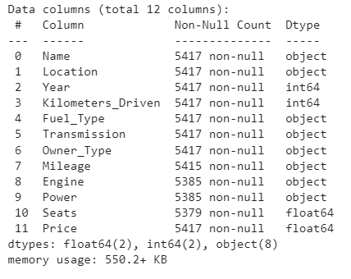
Dataset and Features
About the datasets
Data was extracted from the Car Dekho website. Using web scrapping we extracted the dataset from the cardekho.com
Features

Slide 4
Data Pre-Processing & Cleansing
For keeping the only the useful data we used feature engineering. We removed the data if unnecessary by qualifying them on certain conditions like their uniqueness, their correlation with target variable and the no of outliers present in that particular variable.
We then tried the change the data into the form they belong to either by changing their type or by bifurcating the complex variables.
We also tried to treat the outliers and skewness present in the data.
We also scaled the data so that the data is standardized.

Slide 5
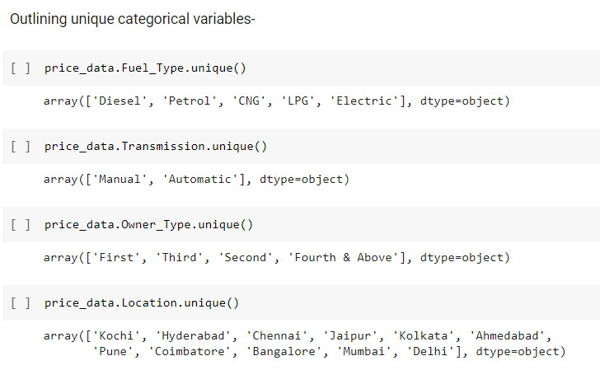

Slide 6
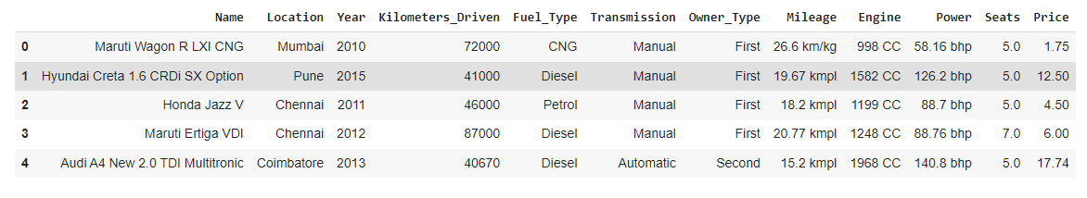

Slide 7
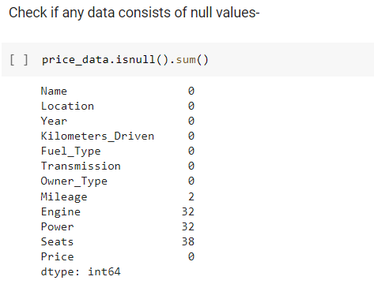

Slide 8
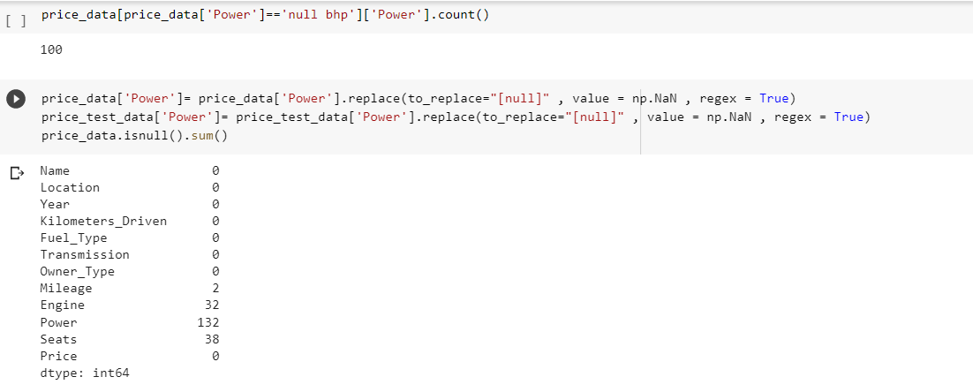

Slide 9
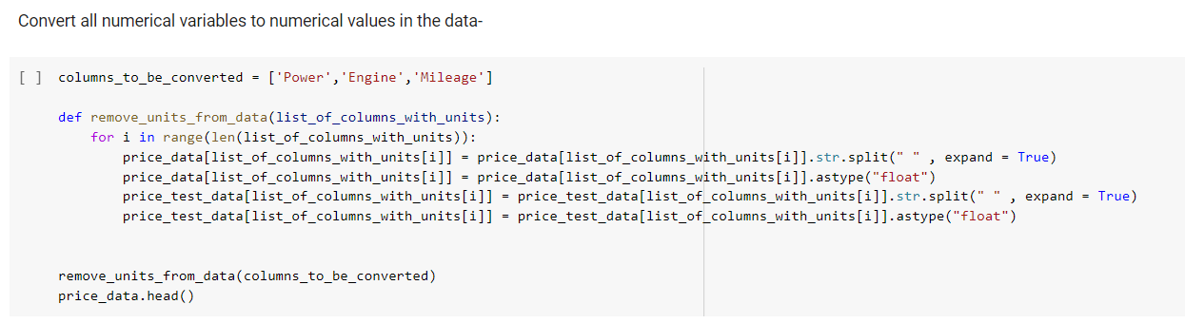

Slide 10
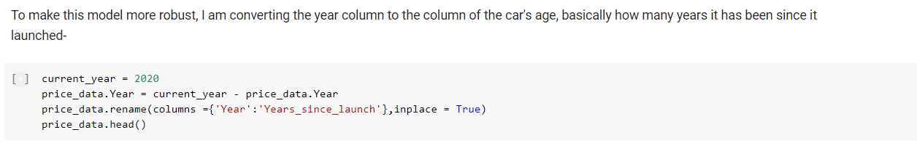

Slide 11
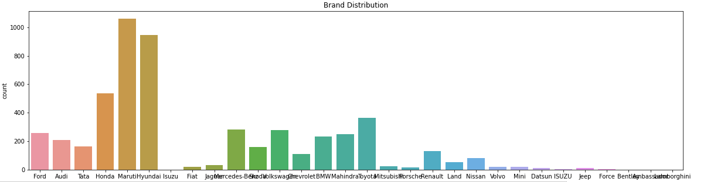
Data Analysis & Visualization

Slide 12
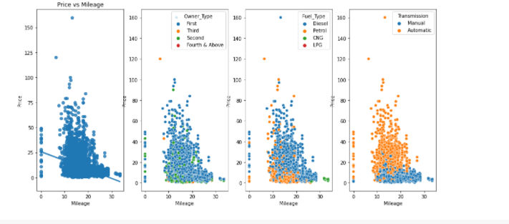

Slide 13
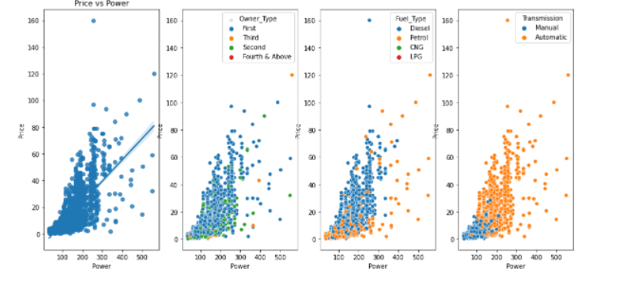

Slide 14
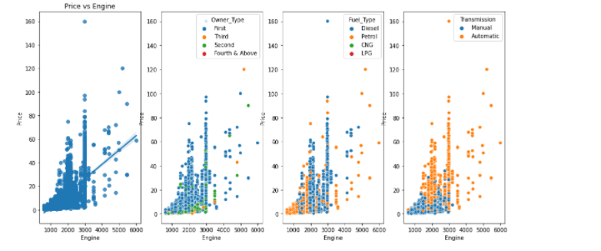

Slide 15
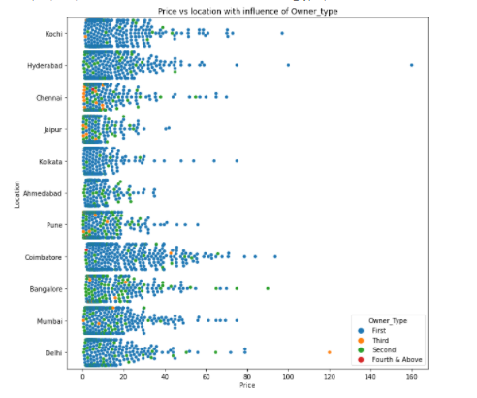

Slide 16
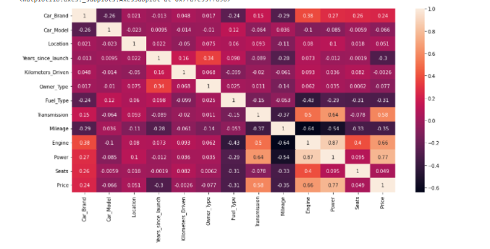

Slide 17
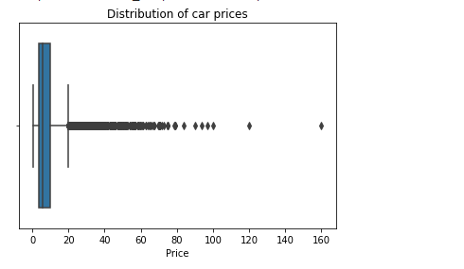

Slide 18
Correlations

Slide 20
Plotting Outliers

Slide 22
Model Pre-Proecessing

Slide 25
Model Building, Development and Evaluation

Slide 26
In this analysis, we have used multiple algorithms and three ensemble techniques to boost the predictive scores for better results. With the help of this approach, we will be able to successfully predict price of houses.
ALGORITHM USED:
Linear Regression - L1(Lasso), L2(Ridge) & ElasticNet Regressor
Decision Tree Regressor
K-Neighbour Regressor
ENSEMBLE TECHNIQUE USED:
Gradient Boosting Regressor
AdaBoost Regressor
Random Forest Regressor
We ran these algorithms in order to find best fitting model and best accuracy and other different parameters.

Slide 27
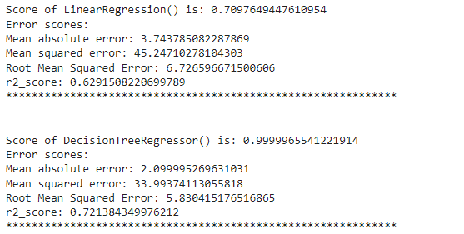
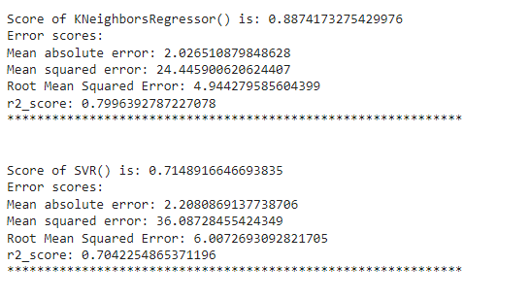
Scores and Errors for Different Models

Slide 28
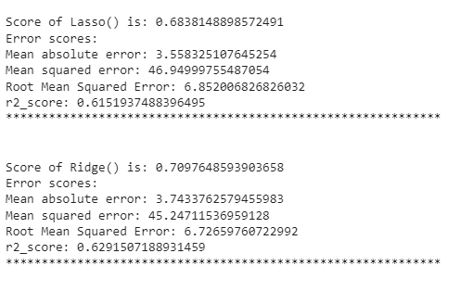
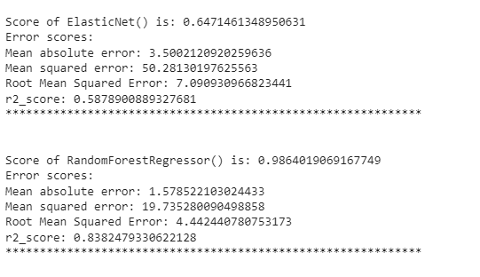

Slide 29
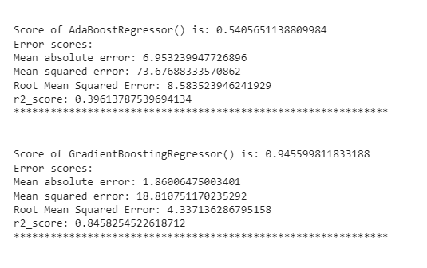

Slide 30
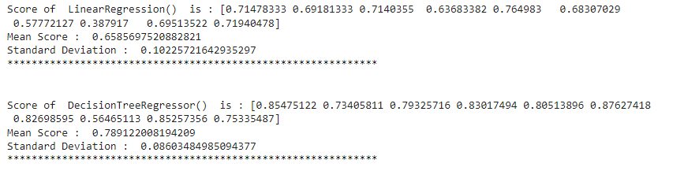
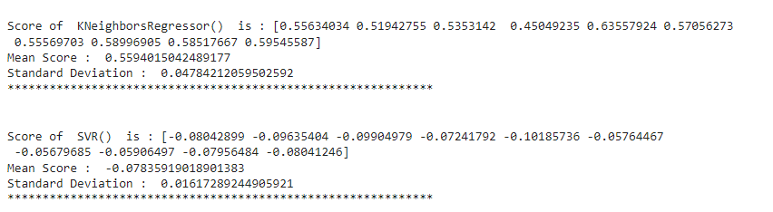
Cross Validation Scores for Models

Slide 31
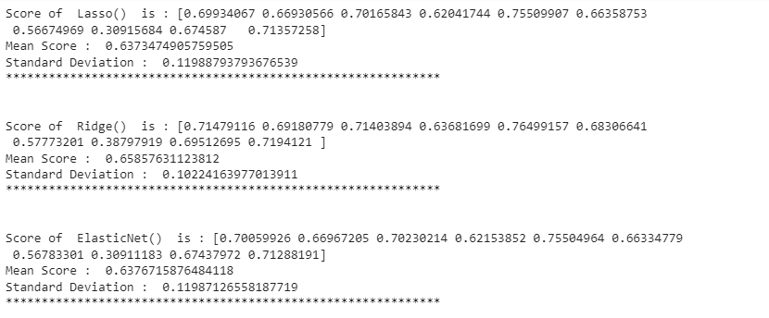
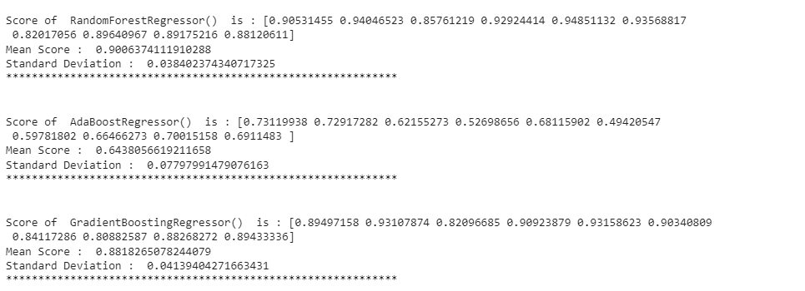

Slide 32
Summary Of Result of Best-fitted Model

Slide 33
