Slide 1

Image Scraping and Classification Project
Submitted by: Priyanka Yadav

Slide 2
ACKNOWLEDGMENT
I would like to thank FlipRobo Technologies to provide me this opportunity to
perform this analysis. I would also like to thank my mentor Swati Mahaseth for helping me throughout this project.

Slide 3
Import libraries.
# Core
import numpy as np import pandas as pd
import matplotlib.pyplot as plt
import seaborn as sns import glob
import random import os import cv2
#tesor fow & keras
import tensorflow as tf from tensorflow import keras
from keras.regularizers import l2 from sklearn.utils import shuffle
from sklearn.model_selection import train_test_split from tensorflow.keras.utils import to_categorical from keras.models import load_model
from tensorflow.keras import Sequential
from tensorflow.keras.layers import Flatten,
Dense,BatchNormalization,Dropout,Input from keras.models import Sequential, Model
from keras.layers import Conv2D,GlobalMaxPooling2D from tensorflow.keras.applications import
Xception,VGG16,InceptionResNetV2
from tensorflow.keras.preprocessing.image import ImageDataGenerator
#cnn
from tensorflow.keras import datasets, layers, models
from keras.layers import Input, Conv2D, MaxPooling2D, UpSampling2D, concatenate, Conv2DTranspose, BatchNormalization, Dropout, Lambda from keras.engine.base_layer import Layer
from sklearn.metrics import classification_report,confusion_matrix from sklearn.metrics import accuracy_score
from sklearn.metrics import f1_score from sklearn.metrics import recall_score
from sklearn.metrics import precision_score
seed = 42 np.random.seed =seed
image_path = './'
Helper Function
#this function used to get code simple
# get label Name

Slide 4
def get_Label(number):
labels = {0:'saree', 1:'jeans', 2:'trouser'}
return labels[number]
#plot predction function
def plot_predection(model_name):
plt.figure(figsize=(20,15)) plt.suptitle("Predection Images", fontsize=20) images = []
path =image_path+'/'+'test/' count = 0 #val_images,val_labels
for i,files in enumerate(os.listdir(path)) :
img = plt.imread(path+files) img = cv2.resize(img,(128,128))
plt.imshow(img,cmap=plt.cm.binary) img = np.expand_dims(img, axis=0) feature = model_name.predict(img)
predection = np.argmax(feature, axis=1) plt.subplot(5,7,i+1)
plt.xticks([])
plt.yticks([]) plt.grid(False)
plt.xlabel("Predicted"+get_Label(int(predection))) count += 1
if count == 34 :
break
Data Preperation
Load Labels
collect all image label and add it in data frame. Load Images
Train images
Test images
Validation images
# 0 for saree ,1 for jeans ,2 for trouser
all_categories = []
images = os.listdir(image_path+'/'+'train')
for file in images:
if file.split('.')[0] == 'saree': all_categories.append(0)
elif file.split('.')[0] == 'jeans':
all_categories.append(1)
else:
all_categories.append(2)

Slide 5
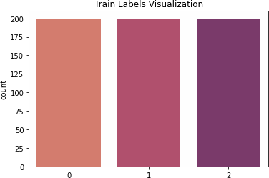
#creat data fram to save each image with its label
df =pd.DataFrame({ 'image': images,
'category':all_categories
})
df.head(5)
0 | image saree.0.jpg | category 0
1 | saree.2.jpg | 0
2 | saree.1.jpg | 0
3 | saree.10.jpg | 0
4 | saree.3.jpg | 0
df['category'].value_counts()
0 | 200
1 | 200
2 | 200
Name: category, dtype: int64
Virsialization Train Images
plt.title('Train Labels Visualization') sns.countplot(x=all_categories,palette='flare') plt.show()
Frome Here We Find Data is Totaly Balanced.

Slide 6
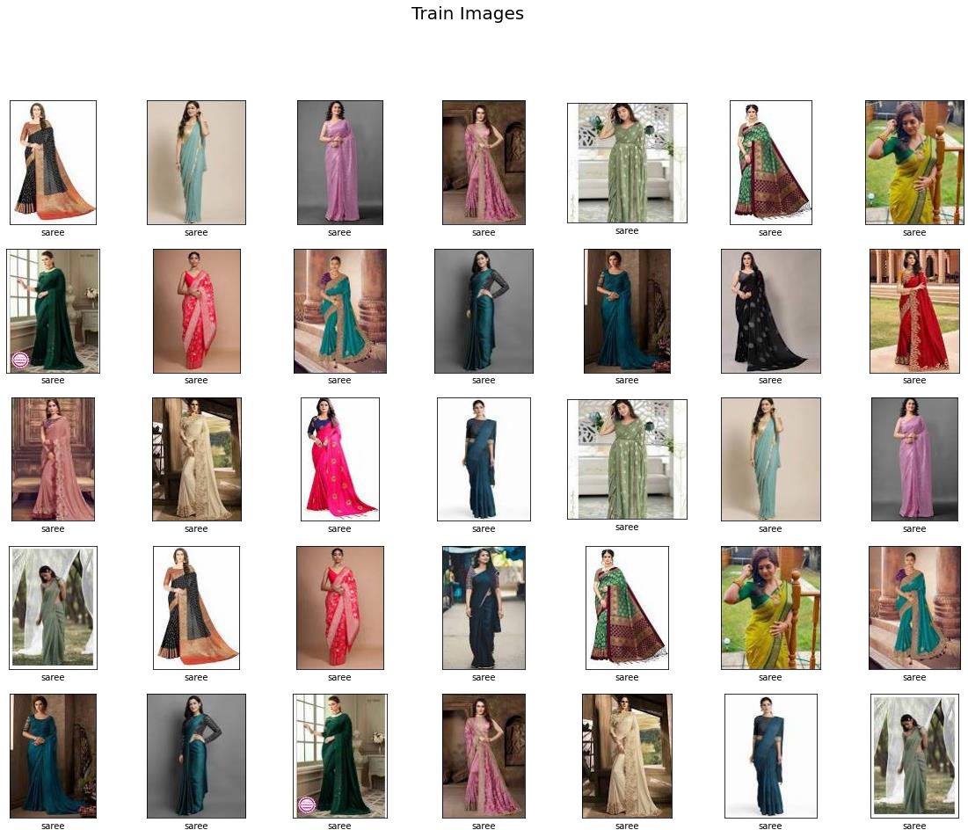
plt.figure(figsize=(20,15)) plt.suptitle("Train Images", fontsize=20) path =image_path+'/'+'train/'
counter =0
for i,img in enumerate(os.listdir(path)) :
plt.subplot(5,7,i+1)
full_image= plt.imread(path+img) plt.xticks([])
plt.yticks([]) plt.grid(False)
plt.xlabel(get_Label(all_categories[i])) plt.imshow(full_image, cmap=plt.cm.binary)
if i == 34:
break
#conver label to categorical in stead of numerical value to use feature of image generator
df['category'] = df['category'].replace({1:'jeans',0:'saree',2:'trouser'}) df.head(10)

Slide 7
0 saree.0.jpg
saree.2.jpg
saree.1.jpg
saree.10.jpg
saree.3.jpg
saree.6.jpg
saree.8.jpg
saree.9.jpg
saree.4.jpg
saree.7.jpg
image category
saree saree saree saree saree saree saree saree saree saree
df['category'].value_counts()
saree | 200
jeans | 200
trouser | 200
Name: category, dtype: int64
Data Preperation
Data speliting
re index to spleated data to order data
get shape of data
#splid data to train and test
x_train,x_val =
train_test_split(df ,random_state=42,shuffle=True,test_size=0.1)
x_train['category'].value_counts()
jeans | 187
trouser | 180
saree | 173
Name: category, dtype: int64 x_val['category'].value_counts()
saree | 27
trouser | 20
jeans | 13
Name: category, dtype: int64
# reindex Data Frame
x_train = x_train.reset_index(drop=True) x_val = x_val.reset_index(drop=True)
print('Train Images shape is : ',x_train.shape) print('Validation Images shape is : ',x_val.shape)
Train Images shape is Validation Images shape is :
: (540, 2)
(60, 2)

Slide 8
Buliding CNN Model
i will use Data augmentation,as it is a set of techniques to artificially increase the amount of data by generating new data points from existing data. This includes making small changes to data or using deep learning models to generate new data points.
batch_size = 64
#create image generator for images
image_gen = ImageDataGenerator(
rescale = 1./255, shear_range = 0.2,
zoom_range = 0.5,
height_shift_range=0.2, width_shift_range=0.2, fill_mode='nearest',
horizontal_flip=True,
rotation_range = 20,
)
# Create Image Data Generator for Test/Validation Set
test_data_gen = ImageDataGenerator(
rescale = 1./255, shear_range = 0.2,
zoom_range = 0.5,
height_shift_range=0.2, width_shift_range=0.2, fill_mode='nearest',
horizontal_flip=True, rotation_range = 20,)
train = image_gen.flow_from_dataframe( x_train, image_path+'/'+'train/', x_col='image', y_col='category', target_size=(128,128), class_mode='categorical', shuffle=True, batch_size=batch_size
)
validate = test_data_gen.flow_from_dataframe( x_val,
image_path+'/'+'train/',
x_col='image', y_col='category', target_size=(128,128), class_mode='categorical',

Slide 9
shuffle=True, batch_size=batch_size
)
Found 540 validated image filenames belonging to 3 classes. Found 60 validated image filenames belonging to 3 classes.
# get shape of train data
for train_img , train_label in train :
print('image shape ',train_img.shape) print('label shape ',train_label.shape) break
image shape (64, 128, 128, 3)
label shape (64, 3)
# get shape of train data
for v_img , v_label in validate :
print('image shape ',v_img.shape) print('label shape ',v_label.shape) break
image shape (60, 128, 128, 3)
label shape (60, 3)
#start bulding CNN Model cnn_model = Sequential() cnn_model = models.Sequential()
cnn_model.add(layers.Conv2D(64,(3,3),padding ='Same',activation = 'relu',input_shape=(128,128,3))) cnn_model.add(layers.MaxPooling2D(2,2)) cnn_model.add(layers.Conv2D(64,(3,3) ,padding
='same',activation='relu')) cnn_model.add(layers.MaxPooling2D(2,2)) cnn_model.add(layers.Conv2D(128,(3,3),padding
='same',activation='relu')) cnn_model.add(layers.MaxPooling2D(2,2)) cnn_model.add(layers.Conv2D(128,(3,3) ,padding
='same',activation='relu')) cnn_model.add(layers.MaxPooling2D(2,2))
cnn_model.add(layers.Conv2D(256,(3,3) ,padding
='same',activation='relu')) cnn_model.add(layers.MaxPooling2D(2,2)) cnn_model.add(BatchNormalization()) cnn_model.add(layers.Conv2D(256,(3,3) ,padding
='same',activation='relu'))
cnn_model.add(layers.MaxPooling2D(2,2)) cnn_model.add(BatchNormalization()) cnn_model.summary()
# cnn_model.add(Dropout(0.2))

Slide 10
Model: "sequential_3"
Layer (type) Output Shape
Param #
=================================================================
conv2d_6 (Conv2D) (None, 128, 128, 64)
1792
max_pooling2d_6 (MaxPooling (None, 64, 64, 64) 2D)
conv2d_7 (Conv2D) (None, 64, 64, 64)
max_pooling2d_7 (MaxPooling (None, 32, 32, 64) 2D)
conv2d_8 (Conv2D) (None, 32, 32, 128)
max_pooling2d_8 (MaxPooling (None, 16, 16, 128) 2D)
conv2d_9 (Conv2D) (None, 16, 16, 128)
max_pooling2d_9 (MaxPooling (None, 8, 8, 128) 2D)
conv2d_10 (Conv2D) (None, 8, 8, 256)
max_pooling2d_10 (MaxPoolin (None, 4, 4, 256) g2D)
batch_normalization_4 (Batc (None, 4, 4, 256) hNormalization)
conv2d_11 (Conv2D) (None, 4, 4, 256)
max_pooling2d_11 (MaxPoolin (None, 2, 2, 256) g2D)
batch_normalization_5 (Batc (None, 2, 2, 256) hNormalization)
0
36928
0
73856
0
147584
0
295168
0
1024
590080
0
1024
=================================================================
Total params: 1,147,456
Trainable params: 1,146,432
Non-trainable params: 1,024
cnn_model.add(layers.Flatten()) cnn_model.add(layers.Dense(1024, activation='relu')) cnn_model.add(BatchNormalization())
# cnn_model.add(Dropout(0.7))

Slide 11
cnn_model.add(layers.Dense(512, activation='relu')) cnn_model.add(BatchNormalization())
# cnn_model.add(Dropout(0.3))
cnn_model.add(layers.Dense(3, activation ='softmax')) cnn_model.summary()
Model: "sequential_3"
Layer (type) Output Shape
Param #
=================================================================
conv2d_6 (Conv2D) (None, 128, 128, 64)
1792
max_pooling2d_6 (MaxPooling (None, 64, 64, 64) 2D)
conv2d_7 (Conv2D) (None, 64, 64, 64)
max_pooling2d_7 (MaxPooling (None, 32, 32, 64) 2D)
conv2d_8 (Conv2D) (None, 32, 32, 128)
max_pooling2d_8 (MaxPooling (None, 16, 16, 128) 2D)
conv2d_9 (Conv2D) (None, 16, 16, 128)
max_pooling2d_9 (MaxPooling (None, 8, 8, 128) 2D)
conv2d_10 (Conv2D) (None, 8, 8, 256)
max_pooling2d_10 (MaxPoolin (None, 4, 4, 256) g2D)
batch_normalization_4 (Batc (None, 4, 4, 256) hNormalization)
conv2d_11 (Conv2D) (None, 4, 4, 256)
max_pooling2d_11 (MaxPoolin (None, 2, 2, 256) g2D)
batch_normalization_5 (Batc (None, 2, 2, 256) hNormalization)
0
36928
0
73856
0
147584
0
295168
0
1024
590080
0
1024
flatten_1 (Flatten) | (None, 1024) | 0
dense_3 (Dense) | (None, 1024) | 1049600

Slide 12
batch_normalization_6 (Batc hNormalization)
(None, 1024)
4096
dense_4 (Dense)
(None, 512)
524800
batch_normalization_7 (Batc hNormalization)
(None, 512)
2048
dense_5 (Dense) (None, 3) 1539
=================================================================
Total params: 2,729,539
Trainable params: 2,725,443
Non-trainable params: 4,096
cnn_model.compile(optimizer='adam',loss='categorical_crossentropy',met rics=['accuracy'],)
Defining Callbacks
  A callback is an object that can perform actions at various stages of training (e.g. at the start or end of an epoch, before or after a single batch, etc)
Reduce Learning Rate on Plateau
  Is used to reduce the learning rate when a metric has stopped improving.
from tensorflow.keras.callbacks import EarlyStopping,ReduceLROnPlateau early = EarlyStopping(monitor="loss", mode="min",min_delta = 0,
patience = 10,
verbose = 1, restore_best_weights = True)
learning_rate_reduction = ReduceLROnPlateau(monitor='loss', patience = 2, verbose=1,factor=0.3, min_lr=0.000001)
callbacks_list = [ early, learning_rate_reduction]
# Training model
n_training_samples = len(train) n_validation_samples = len(validate) history = cnn_model.fit(
train,
epochs=60, validation_data=validate,
validation_steps=n_validation_samples//batch_size,
# steps_per_epoch =n_training_samples//batch_size,
shuffle = True, callbacks=callbacks_list
)
Epoch 1/60
9/9 [==============================] - 34s 4s/step - loss: 1.2073 -

Slide 13
accuracy: 0.6444 - lr: 0.0010 Epoch 2/60
9/9 [==============================] - 29s 3s/step - loss: 0.5689 -
accuracy: 0.7741 - lr: 0.0010 Epoch 3/60
9/9 [==============================] - 29s 3s/step - loss: 0.4743 -
accuracy: 0.8204 - lr: 0.0010 Epoch 4/60
9/9 [==============================] - 29s 3s/step - loss: 0.3617 -
accuracy: 0.8593 - lr: 0.0010 Epoch 5/60
9/9 [==============================] - 29s 3s/step - loss: 0.4050 -
accuracy: 0.8463 - lr: 0.0010 Epoch 6/60
9/9 [==============================] - 30s 3s/step - loss: 0.3134 -
accuracy: 0.8944 - lr: 0.0010 Epoch 7/60
9/9 [==============================] - 29s 3s/step - loss: 0.2262 -
accuracy: 0.9000 - lr: 0.0010 Epoch 8/60
9/9 [==============================] - 29s 3s/step - loss: 0.1601 -
accuracy: 0.9370 - lr: 0.0010 Epoch 9/60
9/9 [==============================] - 29s 3s/step - loss: 0.2468 -
accuracy: 0.9111 - lr: 0.0010 Epoch 10/60
9/9 [==============================] - 29s 3s/step - loss: 0.1391 -
accuracy: 0.9556 - lr: 0.0010 Epoch 11/60
9/9 [==============================] - 29s 3s/step - loss: 0.1742 -
accuracy: 0.9352 - lr: 0.0010 Epoch 12/60
9/9 [==============================] - ETA: 0s - loss: 0.1721 -
accuracy: 0.9278
Epoch 12: ReduceLROnPlateau reducing learning rate to 0.0003000000142492354.
9/9 [==============================] - 29s 3s/step - loss: 0.1721 -
accuracy: 0.9278 - lr: 0.0010 Epoch 13/60
9/9 [==============================] - 29s 3s/step - loss: 0.1375 -
accuracy: 0.9426 - lr: 3.0000e-04 Epoch 14/60
9/9 [==============================] - 29s 3s/step - loss: 0.0924 -
accuracy: 0.9704 - lr: 3.0000e-04 Epoch 15/60
9/9 [==============================] - 29s 3s/step - loss: 0.0850 -
accuracy: 0.9722 - lr: 3.0000e-04 Epoch 16/60
9/9 [==============================] - 29s 3s/step - loss: 0.0653 -
accuracy: 0.9759 - lr: 3.0000e-04

Slide 14
Epoch 17/60
9/9 [==============================] - 29s 3s/step - loss: 0.0806 -
accuracy: 0.9685 - lr: 3.0000e-04 Epoch 18/60
9/9 [==============================] - ETA: 0s - loss: 0.0961 -
accuracy: 0.9685
Epoch 18: ReduceLROnPlateau reducing learning rate to 9.000000427477062e-05.
9/9 [==============================] - 29s 3s/step - loss: 0.0961 -
accuracy: 0.9685 - lr: 3.0000e-04 Epoch 19/60
9/9 [==============================] - 29s 3s/step - loss: 0.0679 -
accuracy: 0.9796 - lr: 9.0000e-05 Epoch 20/60
9/9 [==============================] - ETA: 0s - loss: 0.0822 -
accuracy: 0.9722
Epoch 20: ReduceLROnPlateau reducing learning rate to 2.700000040931627e-05.
9/9 [==============================] - 29s 3s/step - loss: 0.0822 -
accuracy: 0.9722 - lr: 9.0000e-05 Epoch 21/60
9/9 [==============================] - 29s 3s/step - loss: 0.0487 -
accuracy: 0.9796 - lr: 2.7000e-05 Epoch 22/60
9/9 [==============================] - 29s 3s/step - loss: 0.0478 -
accuracy: 0.9833 - lr: 2.7000e-05 Epoch 23/60
9/9 [==============================] - 29s 3s/step - loss: 0.0447 -
accuracy: 0.9889 - lr: 2.7000e-05 Epoch 24/60
9/9 [==============================] - 28s 3s/step - loss: 0.0527 -
accuracy: 0.9796 - lr: 2.7000e-05 Epoch 25/60
9/9 [==============================] - ETA: 0s - loss: 0.0519 -
accuracy: 0.9778
Epoch 25: ReduceLROnPlateau reducing learning rate to 8.100000013655517e-06.
9/9 [==============================] - 29s 3s/step - loss: 0.0519 -
accuracy: 0.9778 - lr: 2.7000e-05 Epoch 26/60
9/9 [==============================] - 29s 3s/step - loss: 0.0357 -
accuracy: 0.9944 - lr: 8.1000e-06 Epoch 27/60
9/9 [==============================] - 29s 3s/step - loss: 0.0872 -
accuracy: 0.9796 - lr: 8.1000e-06 Epoch 28/60
9/9 [==============================] - ETA: 0s - loss: 0.0449 -
accuracy: 0.9870
Epoch 28: ReduceLROnPlateau reducing learning rate to 2.429999949526973e-06.

Slide 15
9/9 [==============================] - 29s 3s/step - loss: 0.0449 -
accuracy: 0.9870 - lr: 8.1000e-06 Epoch 29/60
9/9 [==============================] - 29s 3s/step - loss: 0.0402 -
accuracy: 0.9833 - lr: 2.4300e-06 Epoch 30/60
9/9 [==============================] - ETA: 0s - loss: 0.0666 -
accuracy: 0.9815
Epoch 30: ReduceLROnPlateau reducing learning rate to 1e-06.
9/9 [==============================] - 29s 3s/step - loss: 0.0666 -
accuracy: 0.9815 - lr: 2.4300e-06 Epoch 31/60
9/9 [==============================] - 29s 3s/step - loss: 0.0281 -
accuracy: 0.9926 - lr: 1.0000e-06 Epoch 32/60
9/9 [==============================] - 29s 3s/step - loss: 0.0496 -
accuracy: 0.9852 - lr: 1.0000e-06 Epoch 33/60
9/9 [==============================] - 29s 3s/step - loss: 0.0368 -
accuracy: 0.9889 - lr: 1.0000e-06 Epoch 34/60
9/9 [==============================] - 29s 3s/step - loss: 0.0380 -
accuracy: 0.9926 - lr: 1.0000e-06 Epoch 35/60
9/9 [==============================] - 29s 3s/step - loss: 0.0413 -
accuracy: 0.9870 - lr: 1.0000e-06 Epoch 36/60
9/9 [==============================] - 29s 3s/step - loss: 0.0515 -
accuracy: 0.9852 - lr: 1.0000e-06 Epoch 37/60
9/9 [==============================] - 29s 3s/step - loss: 0.0316 -
accuracy: 0.9926 - lr: 1.0000e-06 Epoch 38/60
9/9 [==============================] - 29s 3s/step - loss: 0.0501 -
accuracy: 0.9796 - lr: 1.0000e-06 Epoch 39/60
9/9 [==============================] - 29s 3s/step - loss: 0.0683 -
accuracy: 0.9833 - lr: 1.0000e-06 Epoch 40/60
9/9 [==============================] - 33s 3s/step - loss: 0.0488 -
accuracy: 0.9815 - lr: 1.0000e-06 Epoch 41/60
9/9 [==============================] - ETA: 0s - loss: 0.0540 -
accuracy: 0.9778Restoring model weights from the end of the best epoch: 31.
9/9 [==============================] - 29s 3s/step - loss: 0.0540 -
accuracy: 0.9778 - lr: 1.0000e-06 Epoch 41: early stopping

Slide 16
score, acc = cnn_model.evaluate(validate,batch_size=batch_size)
print('Test score:', score) print('Test accuracy:', acc)
1/1 [==============================] - 1s 1s/step - loss: | 0.7665 | -
accuracy: 0.5833
Test score: 0.766460657119751 Test accuracy: 0.5833333134651184
cnn_prediction = cnn_model.predict(validate) cnn_prediction
array([[6.0740672e-03, [4.7305265e-01, | 4.3969736e-01, 3.0753916e-04, | 5.5422860e-01], 5.2663976e-01],
[9.9928409e-01, | 3.8402650e-05, | 6.7763252e-04],
[7.4064070e-01, | 1.6429554e-01, | 9.5063761e-02],
[9.9933052e-01, | 1.6761982e-05, | 6.5274647e-04],
[5.5768162e-01, | 2.5943507e-04, | 4.4205898e-01],
[1.1244741e-03, | 8.4340709e-01, | 1.5546840e-01],
[2.2699898e-02, [3.2665182e-03, | 5.5012858e-01, 9.4743294e-01, | 4.2717159e-01], 4.9300544e-02],
[9.6781865e-02, | 3.0162296e-04, | 9.0291649e-01],
[2.9386247e-03, | 1.8956615e-01, | 8.0749518e-01],
[3.8221413e-01, | 6.1053562e-01, | 7.2502135e-03],
[3.6263054e-03, | 4.8065420e-02, | 9.4830829e-01],
[6.7344820e-01, | 2.9335389e-04, | 3.2625845e-01],
[1.3854073e-01, | 4.9493503e-04, | 8.6096436e-01],
[1.8495403e-02, [2.9311559e-01, | 7.5790805e-01, 1.2287203e-03, | 2.2359657e-01], 7.0565563e-01],
[9.9999177e-01, | 6.0371722e-06, | 2.1204394e-06],
[3.0496912e-03, | 4.5857016e-02, | 9.5109332e-01],
[2.0478843e-03, | 8.7778315e-02, | 9.1017383e-01],
[1.5935677e-01, | 6.0889709e-01, | 2.3174617e-01],
[2.4250823e-03, | 3.2274777e-01, | 6.7482710e-01],
[9.9825639e-01, | 6.9058486e-05, | 1.6745300e-03],
[6.7467064e-01, [4.4254243e-01, | 4.6162342e-04, 1.2800260e-04, | 3.2486770e-01], 5.5732954e-01],
[4.2883912e-01, | 1.4337914e-01, | 4.2778170e-01],
[2.2990194e-03, | 4.7549218e-01, | 5.2220881e-01],
[1.4494804e-01, | 3.3754350e-03, | 8.5167646e-01],
[6.0540473e-01, | 4.6156641e-04, | 3.9413369e-01],
[8.4831873e-03, | 2.9771195e-03, | 9.8853964e-01],
[9.9953663e-01, | 2.0721576e-05, | 4.4270387e-04],
[7.8166276e-01, [3.9737341e-03, | 7.4751005e-02, 1.2506818e-03, | 1.4358619e-01], 9.9477553e-01],
[1.0304729e-01, | 6.8670532e-05, | 8.9688396e-01],
[2.4468587e-03, | 4.7023818e-01, | 5.2731496e-01],
[6.2474656e-01, | 1.9672934e-04, | 3.7505674e-01],
[7.2963673e-01, | 2.1797017e-04, | 2.7014533e-01],
[3.4616049e-02, | 1.1217857e-01, | 8.5320538e-01],

Slide 17
[9.9999213e-01, [7.1206033e-01, [1.7661953e-02, [9.9995399e-01, [5.4799408e-01, [9.8033798e-01, [8.3318172e-04, [4.5199049e-01, [9.9931014e-01, [2.6206675e-01, [5.1502228e-01, [9.9299532e-01, [9.9924880e-01, [2.4061392e-01, [8.3407557e-01, [2.6968198e-03, [3.6481342e-01, [9.9257267e-01, [2.1000134e-03, [2.2793360e-01,
5.1779721e-06,
2.8794897e-03,
5.4212469e-01,
1.4710591e-05,
2.5055784e-01,
1.1842236e-03,
8.4269887e-01,
5.2081835e-03,
3.3473730e-04,
4.8412481e-01,
5.2471957e-03,
2.7947510e-03,
2.5154385e-04,
7.0892781e-01,
6.4706593e-04,
3.2859525e-01,
2.1256846e-01,
7.2424468e-06,
3.5732456e-02,
1.2578903e-03,
2.6852465e-06],
2.8506020e-01],
4.4021326e-01],
3.1391424e-05],
2.0144817e-01],
1.8477876e-02],
1.5646794e-01],
5.4280126e-01],
3.5509953e-04],
2.5380847e-01],
4.7973043e-01],
4.2099394e-03],
4.9963343e-04],
5.0458238e-02],
1.6527739e-01],
6.6870791e-01],
4.2261812e-01],
7.4200686e-03],
9.6216756e-01],
7.7080852e-01],
[5.3928500e-01, 2.6196602e-01, 1.9874898e-01],
[8.1827445e-04, 7.9394680e-01, 2.0523483e-01]], dtype=float32)
plt.plot(history.history['accuracy'], label='accuracy') plt.plot(history.history['val_accuracy'], label = 'val_accuracy') plt.xlabel('Epoch')
plt.ylabel('Accuracy')
plt.ylim([0.5, 1]) plt.legend(loc='lower right') plt.show()
KeyError Traceback (most recent call last)
<ipython-input-44-f4ff4840f5bd> in <module>()
1 plt.plot(history.history['accuracy'], label='accuracy')
----> 2 plt.plot(history.history['val_accuracy'], label = 'val_accuracy')
plt.xlabel('Epoch')
plt.ylabel('Accuracy') 5 plt.ylim([0.5, 1])
KeyError: 'val_accuracy'

Slide 18
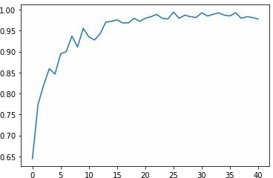
prepare data for predection.
#get image path
test_images = os.listdir(image_path+'/'+'test')
#creat data frame
df_test =pd.DataFrame({ 'image': test_images,
})
df_test.head()
#prepare generator
val_data_gen = ImageDataGenerator( rescale = 1./255, )
testing = val_data_gen.flow_from_dataframe( df_test,
image_path+'/'+'test/',
x_col='image', y_col= None,
target_size=(128,128), class_mode=None,
shuffle=True, batch_size=batch_size
)
Found 300 validated image filenames.

Slide 19
Predction Using CNN.
predection = cnn_model.predict(testing) predection
array([[9.9828088e-01, [2.4121670e-01, | 2.0129165e-04, 7.1161896e-01, | 1.5178961e-03], 4.7164325e-02],
[9.9995387e-01, | 1.5913571e-05, | 3.0276049e-05],
[4.2148307e-01, | 2.3551409e-04, | 5.7828134e-01],
[1.9690374e-01, | 4.6537718e-01, | 3.3771905e-01],
[3.6556481e-03, | 3.8270804e-03, | 9.9251723e-01],
[5.0667960e-02, | 9.9274970e-05, | 9.4923276e-01],
[9.3969893e-01, | 4.0891377e-05, | 6.0260154e-02],
[8.0193632e-04, [6.8162203e-01, | 9.9667102e-01, 2.9663473e-01, | 2.5270446e-03], 2.1743212e-02],
[9.9515659e-01, | 6.4511078e-06, | 4.8370031e-03],
[2.9665694e-01, | 4.0969037e-04, | 7.0293331e-01],
[2.3660478e-03, | 2.2710459e-01, | 7.7052933e-01],
[2.3359541e-02, | 2.7761620e-04, | 9.7636288e-01],
[6.8452051e-03, | 4.9811995e-01, | 4.9503487e-01],
[1.3979766e-01, | 1.2548368e-03, | 8.5894746e-01],
[3.4633341e-01, [9.8789740e-01, | 5.9526461e-01, 5.9893867e-03, | 5.8401983e-02], 6.1133089e-03],
[9.9912924e-01, | 2.5582558e-04, | 6.1493804e-04],
[9.9372572e-01, | 2.3019368e-04, | 6.0440870e-03],
[9.9977642e-01, | 1.8566201e-04, | 3.7878857e-05],
[8.7758362e-01, | 2.7597805e-03, | 1.1965655e-01],
[8.0193632e-04, | 9.9667102e-01, | 2.5270446e-03],
[2.1991836e-02, [9.2812634e-01, | 6.5768582e-01, 5.1498733e-02, | 3.2032239e-01], 2.0374915e-02],
[1.6488686e-03, | 4.5081678e-01, | 5.4753441e-01],
[2.4121670e-01, | 7.1161896e-01, | 4.7164325e-02],
[9.9995434e-01, | 3.8402581e-05, | 7.2279381e-06],
[9.9914062e-01, | 5.2614265e-05, | 8.0666086e-04],
[9.8789740e-01, | 5.9893867e-03, | 6.1133089e-03],
[1.7117316e-02, | 7.5299782e-01, | 2.2988485e-01],
[9.2812634e-01, [2.8870048e-02, | 5.1498733e-02, 3.4802771e-01, | 2.0374915e-02], 6.2310231e-01],
[9.3969893e-01, | 4.0891377e-05, | 6.0260154e-02],
[4.9046475e-01, | 5.8280525e-04, | 5.0895244e-01],
[9.9977642e-01, | 1.8566201e-04, | 3.7878857e-05],
[9.3268780e-03, | 1.7129911e-04, | 9.9050176e-01],
[7.4946320e-01, | 2.8282314e-04, | 2.5025392e-01],
[8.7758362e-01, | 2.7597805e-03, | 1.1965655e-01],
[9.9828088e-01, [4.7587799e-03, | 2.0129165e-04, 9.6232802e-02, | 1.5178961e-03], 8.9900839e-01],
[9.9976712e-01, | 4.3191627e-05, | 1.8972480e-04],
[9.9992836e-01, | 4.9762970e-05, | 2.1956963e-05],
[9.2946231e-02, | 5.8283787e-03, | 9.0122545e-01],
[2.3660478e-03, | 2.2710459e-01, | 7.7052933e-01],
[9.8789740e-01, | 5.9893867e-03, | 6.1133089e-03],

Slide 20
[3.6556481e-03, [9.9977571e-01, | 3.8270804e-03, 1.6301816e-05, | 9.9251723e-01], 2.0794869e-04],
[2.4121670e-01, | 7.1161896e-01, | 4.7164325e-02],
[9.6974462e-01, | 2.0089166e-03, | 2.8246393e-02],
[9.9998128e-01, | 1.0557359e-05, | 8.1413300e-06],
[8.7758362e-01, | 2.7597805e-03, | 1.1965655e-01],
[9.9998128e-01, | 1.0557359e-05, | 8.1413300e-06],
[1.3979766e-01, | 1.2548368e-03, | 8.5894746e-01],
[4.2148307e-01, | 2.3551409e-04, | 5.7828134e-01],
[9.9976712e-01, [9.9972755e-01, | 4.3191627e-05, 2.7142967e-05, | 1.8972480e-04], 2.4521991e-04],
[3.2025689e-01, | 1.0829883e-03, | 6.7866015e-01],
[5.2731745e-02, | 1.0332831e-03, | 9.4623500e-01],
[1.8305203e-01, | 3.6701714e-04, | 8.1658095e-01],
[9.6974462e-01, | 2.0089166e-03, | 2.8246393e-02],
[9.9515659e-01, | 6.4511078e-06, | 4.8370031e-03],
[3.2025689e-01, | 1.0829883e-03, | 6.7866015e-01],
[1.3979766e-01, [9.9995387e-01, | 1.2548368e-03, 1.5913571e-05, | 8.5894746e-01], 3.0276049e-05],
[7.3360247e-03, | 5.3420341e-01, | 4.5846057e-01],
[4.4167370e-01, | 2.4710665e-04, | 5.5807912e-01],
[5.2731745e-02, | 1.0332831e-03, | 9.4623500e-01],
[9.3969893e-01, | 4.0891377e-05, | 6.0260154e-02],
[9.9372572e-01, | 2.3019368e-04, | 6.0440870e-03],
[2.1991836e-02, | 6.5768582e-01, | 3.2032239e-01],
[4.8109978e-01, [2.3660478e-03, | 3.0605334e-01, 2.2710459e-01, | 2.1284688e-01], 7.7052933e-01],
[2.3660478e-03, | 2.2710459e-01, | 7.7052933e-01],
[1.7754199e-01, | 8.2154214e-01, | 9.1590441e-04],
[9.2946231e-02, | 5.8283787e-03, | 9.0122545e-01],
[2.9665694e-01, | 4.0969037e-04, | 7.0293331e-01],
[4.7587799e-03, | 9.6232802e-02, | 8.9900839e-01],
[9.9948776e-01, [4.4167370e-01, | 2.6086860e-04, 2.4710665e-04, | 2.5135145e-04], 5.5807912e-01],
[9.9997878e-01, | 1.3199990e-05, | 7.9596593e-06],
[8.7758362e-01, | 2.7597805e-03, | 1.1965655e-01],
[8.0193632e-04, | 9.9667102e-01, | 2.5270446e-03],
[9.9997878e-01, | 1.3199990e-05, | 7.9596593e-06],
[9.9988723e-01, | 2.6010881e-05, | 8.6722292e-05],
[1.7754199e-01, | 8.2154214e-01, | 9.1590441e-04],
[4.2148307e-01, [6.8452051e-03, | 2.3551409e-04, 4.9811995e-01, | 5.7828134e-01], 4.9503487e-01],
[2.1991836e-02, | 6.5768582e-01, | 3.2032239e-01],
[7.3360247e-03, | 5.3420341e-01, | 4.5846057e-01],
[1.8124431e-01, | 1.3581369e-04, | 8.1861985e-01],
[1.3979766e-01, | 1.2548368e-03, | 8.5894746e-01],
[2.3359541e-02, | 2.7761620e-04, | 9.7636288e-01],
[5.0667960e-02, | 9.9274970e-05, | 9.4923276e-01],
[4.8109978e-01, [9.9972755e-01, | 3.0605334e-01, 2.7142967e-05, | 2.1284688e-01], 2.4521991e-04],

Slide 21
[1.8305203e-01, [8.0193632e-04, | 3.6701714e-04, 9.9667102e-01, | 8.1658095e-01], 2.5270446e-03],
[9.6092962e-02, | 3.9883092e-04, | 9.0350825e-01],
[9.9996245e-01, | 2.0008356e-06, | 3.5515037e-05],
[9.9977571e-01, | 1.6301816e-05, | 2.0794869e-04],
[9.9996245e-01, | 2.0008356e-06, | 3.5515037e-05],
[9.9914062e-01, | 5.2614265e-05, | 8.0666086e-04],
[9.6092962e-02, | 3.9883092e-04, | 9.0350825e-01],
[9.9995387e-01, | 1.5913571e-05, | 3.0276049e-05],
[9.3268780e-03, [1.7754199e-01, | 1.7129911e-04, 8.2154214e-01, | 9.9050176e-01], 9.1590441e-04],
[9.9988723e-01, | 2.6010881e-05, | 8.6722292e-05],
[3.1707939e-03, | 9.9211520e-01, | 4.7139917e-03],
[9.9948776e-01, | 2.6086860e-04, | 2.5135145e-04],
[9.9995387e-01, | 1.5913571e-05, | 3.0276049e-05],
[9.9976712e-01, | 4.3191627e-05, | 1.8972480e-04],
[2.3359541e-02, | 2.7761620e-04, | 9.7636288e-01],
[7.4946320e-01, [9.9996245e-01, | 2.8282314e-04, 2.0008356e-06, | 2.5025392e-01], 3.5515037e-05],
[7.1024038e-03, | 7.2984193e-03, | 9.8559916e-01],
[9.9992836e-01, | 4.9762970e-05, | 2.1956963e-05],
[3.4633341e-01, | 5.9526461e-01, | 5.8401983e-02],
[9.9996245e-01, | 2.0008356e-06, | 3.5515037e-05],
[9.9998164e-01, | 7.6255260e-06, | 1.0673826e-05],
[4.9046475e-01, | 5.8280525e-04, | 5.0895244e-01],
[1.8124431e-01, [9.9948776e-01, | 1.3581369e-04, 2.6086860e-04, | 8.1861985e-01], 2.5135145e-04],
[7.3360247e-03, | 5.3420341e-01, | 4.5846057e-01],
[3.4633341e-01, | 5.9526461e-01, | 5.8401983e-02],
[1.8305203e-01, | 3.6701714e-04, | 8.1658095e-01],
[2.8870048e-02, | 3.4802771e-01, | 6.2310231e-01],
[7.1024038e-03, | 7.2984193e-03, | 9.8559916e-01],
[1.8124431e-01, [9.9912924e-01, | 1.3581369e-04, 2.5582558e-04, | 8.1861985e-01], 6.1493804e-04],
[9.9972755e-01, | 2.7142967e-05, | 2.4521991e-04],
[9.9998128e-01, | 1.0557359e-05, | 8.1413300e-06],
[3.6556481e-03, | 3.8270804e-03, | 9.9251723e-01],
[1.8124431e-01, | 1.3581369e-04, | 8.1861985e-01],
[2.6272081e-02, | 8.3888775e-01, | 1.3484021e-01],
[2.1991836e-02, | 6.5768582e-01, | 3.2032239e-01],
[9.9976712e-01, [2.3660478e-03, | 4.3191627e-05, 2.2710459e-01, | 1.8972480e-04], 7.7052933e-01],
[1.8855730e-01, | 2.1288090e-03, | 8.0931389e-01],
[2.3359541e-02, | 2.7761620e-04, | 9.7636288e-01],
[4.8109978e-01, | 3.0605334e-01, | 2.1284688e-01],
[7.4946320e-01, | 2.8282314e-04, | 2.5025392e-01],
[9.9828088e-01, | 2.0129165e-04, | 1.5178961e-03],
[9.9972755e-01, | 2.7142967e-05, | 2.4521991e-04],
[9.6974462e-01, [1.9690374e-01, | 2.0089166e-03, 4.6537718e-01, | 2.8246393e-02], 3.3771905e-01],

Slide 22
[9.9997878e-01, [9.8789740e-01, | 1.3199990e-05, 5.9893867e-03, | 7.9596593e-06], 6.1133089e-03],
[9.9995434e-01, | 3.8402581e-05, | 7.2279381e-06],
[9.6092962e-02, | 3.9883092e-04, | 9.0350825e-01],
[9.9914062e-01, | 5.2614265e-05, | 8.0666086e-04],
[4.2148307e-01, | 2.3551409e-04, | 5.7828134e-01],
[1.9690374e-01, | 4.6537718e-01, | 3.3771905e-01],
[4.4167370e-01, | 2.4710665e-04, | 5.5807912e-01],
[9.9998164e-01, | 7.6255260e-06, | 1.0673826e-05],
[6.8162203e-01, [9.9992836e-01, | 2.9663473e-01, 4.9762970e-05, | 2.1743212e-02], 2.1956963e-05],
[4.8109978e-01, | 3.0605334e-01, | 2.1284688e-01],
[9.2946231e-02, | 5.8283787e-03, | 9.0122545e-01],
[9.9977642e-01, | 1.8566201e-04, | 3.7878857e-05],
[3.4633341e-01, | 5.9526461e-01, | 5.8401983e-02],
[4.1224059e-01, | 3.8392053e-03, | 5.8392018e-01],
[9.9988723e-01, | 2.6010881e-05, | 8.6722292e-05],
[3.1102851e-01, [9.9992836e-01, | 6.7663401e-01, 4.9762970e-05, | 1.2337525e-02], 2.1956963e-05],
[1.7117316e-02, | 7.5299782e-01, | 2.2988485e-01],
[9.9988723e-01, | 2.6010881e-05, | 8.6722292e-05],
[8.7758362e-01, | 2.7597805e-03, | 1.1965655e-01],
[9.3969893e-01, | 4.0891377e-05, | 6.0260154e-02],
[9.9997878e-01, | 1.3199990e-05, | 7.9596593e-06],
[1.7117316e-02, | 7.5299782e-01, | 2.2988485e-01],
[6.8452051e-03, [4.4167370e-01, | 4.9811995e-01, 2.4710665e-04, | 4.9503487e-01], 5.5807912e-01],
[7.4946320e-01, | 2.8282314e-04, | 2.5025392e-01],
[4.7587799e-03, | 9.6232802e-02, | 8.9900839e-01],
[9.9977571e-01, | 1.6301816e-05, | 2.0794869e-04],
[4.9046475e-01, | 5.8280525e-04, | 5.0895244e-01],
[4.7587799e-03, | 9.6232802e-02, | 8.9900839e-01],
[9.9948776e-01, [7.1024038e-03, | 2.6086860e-04, 7.2984193e-03, | 2.5135145e-04], 9.8559916e-01],
[2.6272081e-02, | 8.3888775e-01, | 1.3484021e-01],
[4.1224059e-01, | 3.8392053e-03, | 5.8392018e-01],
[9.9998128e-01, | 1.0557359e-05, | 8.1413300e-06],
[9.9995434e-01, | 3.8402581e-05, | 7.2279381e-06],
[9.2812634e-01, | 5.1498733e-02, | 2.0374915e-02],
[9.3969893e-01, | 4.0891377e-05, | 6.0260154e-02],
[1.7754199e-01, [7.4946320e-01, | 8.2154214e-01, 2.8282314e-04, | 9.1590441e-04], 2.5025392e-01],
[1.7754199e-01, | 8.2154214e-01, | 9.1590441e-04],
[4.1224059e-01, | 3.8392053e-03, | 5.8392018e-01],
[9.9828088e-01, | 2.0129165e-04, | 1.5178961e-03],
[9.8789740e-01, | 5.9893867e-03, | 6.1133089e-03],
[2.8870048e-02, | 3.4802771e-01, | 6.2310231e-01],
[2.6272081e-02, | 8.3888775e-01, | 1.3484021e-01],
[1.8855730e-01, [3.2025689e-01, | 2.1288090e-03, 1.0829883e-03, | 8.0931389e-01], 6.7866015e-01],

Slide 23
[1.8124431e-01, [1.3979766e-01, | 1.3581369e-04, 1.2548368e-03, | 8.1861985e-01], 8.5894746e-01],
[3.1102851e-01, | 6.7663401e-01, | 1.2337525e-02],
[9.9995434e-01, | 3.8402581e-05, | 7.2279381e-06],
[6.8452051e-03, | 4.9811995e-01, | 4.9503487e-01],
[4.7587799e-03, | 9.6232802e-02, | 8.9900839e-01],
[8.0193632e-04, | 9.9667102e-01, | 2.5270446e-03],
[9.9912924e-01, | 2.5582558e-04, | 6.1493804e-04],
[9.9998128e-01, | 1.0557359e-05, | 8.1413300e-06],
[9.9995387e-01, [3.1707939e-03, | 1.5913571e-05, 9.9211520e-01, | 3.0276049e-05], 4.7139917e-03],
[2.6272081e-02, | 8.3888775e-01, | 1.3484021e-01],
[3.1707939e-03, | 9.9211520e-01, | 4.7139917e-03],
[7.3360247e-03, | 5.3420341e-01, | 4.5846057e-01],
[9.9515659e-01, | 6.4511078e-06, | 4.8370031e-03],
[9.3268780e-03, | 1.7129911e-04, | 9.9050176e-01],
[9.9977571e-01, | 1.6301816e-05, | 2.0794869e-04],
[9.3268780e-03, [3.1102851e-01, | 1.7129911e-04, 6.7663401e-01, | 9.9050176e-01], 1.2337525e-02],
[5.2731745e-02, | 1.0332831e-03, | 9.4623500e-01],
[9.9998164e-01, | 7.6255260e-06, | 1.0673826e-05],
[2.8870048e-02, | 3.4802771e-01, | 6.2310231e-01],
[3.6556481e-03, | 3.8270804e-03, | 9.9251723e-01],
[9.9914062e-01, | 5.2614265e-05, | 8.0666086e-04],
[3.6556481e-03, | 3.8270804e-03, | 9.9251723e-01],
[9.2946231e-02, [3.2025689e-01, | 5.8283787e-03, 1.0829883e-03, | 9.0122545e-01], 6.7866015e-01],
[2.6272081e-02, | 8.3888775e-01, | 1.3484021e-01],
[1.6488686e-03, | 4.5081678e-01, | 5.4753441e-01],
[7.1024038e-03, | 7.2984193e-03, | 9.8559916e-01],
[7.1024038e-03, | 7.2984193e-03, | 9.8559916e-01],
[9.9977642e-01, | 1.8566201e-04, | 3.7878857e-05],
[1.8855730e-01, [9.9998164e-01, | 2.1288090e-03, 7.6255260e-06, | 8.0931389e-01], 1.0673826e-05],
[7.3360247e-03, | 5.3420341e-01, | 4.5846057e-01],
[2.9665694e-01, | 4.0969037e-04, | 7.0293331e-01],
[3.2025689e-01, | 1.0829883e-03, | 6.7866015e-01],
[6.8162203e-01, | 2.9663473e-01, | 2.1743212e-02],
[2.9665694e-01, | 4.0969037e-04, | 7.0293331e-01],
[9.9988723e-01, | 2.6010881e-05, | 8.6722292e-05],
[4.4167370e-01, [2.4121670e-01, | 2.4710665e-04, 7.1161896e-01, | 5.5807912e-01], 4.7164325e-02],
[4.1224059e-01, | 3.8392053e-03, | 5.8392018e-01],
[9.9976712e-01, | 4.3191627e-05, | 1.8972480e-04],
[6.8452051e-03, | 4.9811995e-01, | 4.9503487e-01],
[1.8855730e-01, | 2.1288090e-03, | 8.0931389e-01],
[9.9372572e-01, | 2.3019368e-04, | 6.0440870e-03],
[9.9998164e-01, | 7.6255260e-06, | 1.0673826e-05],
[5.0667960e-02, [9.2812634e-01, | 9.9274970e-05, 5.1498733e-02, | 9.4923276e-01], 2.0374915e-02],

Slide 24
[9.9977642e-01, [9.6092962e-02, | 1.8566201e-04, 3.9883092e-04, | 3.7878857e-05], 9.0350825e-01],
[5.0667960e-02, | 9.9274970e-05, | 9.4923276e-01],
[3.1102851e-01, | 6.7663401e-01, | 1.2337525e-02],
[3.1707939e-03, | 9.9211520e-01, | 4.7139917e-03],
[9.9828088e-01, | 2.0129165e-04, | 1.5178961e-03],
[6.8162203e-01, | 2.9663473e-01, | 2.1743212e-02],
[1.9690374e-01, | 4.6537718e-01, | 3.3771905e-01],
[5.2731745e-02, | 1.0332831e-03, | 9.4623500e-01],
[9.9912924e-01, [1.8305203e-01, | 2.5582558e-04, 3.6701714e-04, | 6.1493804e-04], 8.1658095e-01],
[1.6488686e-03, | 4.5081678e-01, | 5.4753441e-01],
[4.1224059e-01, | 3.8392053e-03, | 5.8392018e-01],
[9.6974462e-01, | 2.0089166e-03, | 2.8246393e-02],
[1.6488686e-03, | 4.5081678e-01, | 5.4753441e-01],
[2.9665694e-01, | 4.0969037e-04, | 7.0293331e-01],
[1.7117316e-02, | 7.5299782e-01, | 2.2988485e-01],
[9.9997878e-01, [4.2148307e-01, | 1.3199990e-05, 2.3551409e-04, | 7.9596593e-06], 5.7828134e-01],
[9.9372572e-01, | 2.3019368e-04, | 6.0440870e-03],
[4.8109978e-01, | 3.0605334e-01, | 2.1284688e-01],
[1.7117316e-02, | 7.5299782e-01, | 2.2988485e-01],
[5.0667960e-02, | 9.9274970e-05, | 9.4923276e-01],
[9.6092962e-02, | 3.9883092e-04, | 9.0350825e-01],
[5.2731745e-02, | 1.0332831e-03, | 9.4623500e-01],
[3.1102851e-01, [9.3268780e-03, | 6.7663401e-01, 1.7129911e-04, | 1.2337525e-02], 9.9050176e-01],
[9.9515659e-01, | 6.4511078e-06, | 4.8370031e-03],
[9.9914062e-01, | 5.2614265e-05, | 8.0666086e-04],
[9.9912924e-01, | 2.5582558e-04, | 6.1493804e-04],
[1.6488686e-03, | 4.5081678e-01, | 5.4753441e-01],
[2.1991836e-02, | 6.5768582e-01, | 3.2032239e-01],
[6.8162203e-01, [3.4633341e-01, | 2.9663473e-01, 5.9526461e-01, | 2.1743212e-02], 5.8401983e-02],
[9.9515659e-01, | 6.4511078e-06, | 4.8370031e-03],
[9.2812634e-01, | 5.1498733e-02, | 2.0374915e-02],
[9.2946231e-02, | 5.8283787e-03, | 9.0122545e-01],
[9.9372572e-01, | 2.3019368e-04, | 6.0440870e-03],
[9.9996245e-01, | 2.0008356e-06, | 3.5515037e-05],
[1.8855730e-01, | 2.1288090e-03, | 8.0931389e-01],
[3.1707939e-03, [9.9972755e-01, | 9.9211520e-01, 2.7142967e-05, | 4.7139917e-03], 2.4521991e-04],
[9.9948776e-01, | 2.6086860e-04, | 2.5135145e-04],
[1.9690374e-01, | 4.6537718e-01, | 3.3771905e-01],
[9.6974462e-01, | 2.0089166e-03, | 2.8246393e-02],
[2.4121670e-01, | 7.1161896e-01, | 4.7164325e-02],
[9.9992836e-01, | 4.9762970e-05, | 2.1956963e-05],
[2.8870048e-02, | 3.4802771e-01, | 6.2310231e-01],
[2.3359541e-02, [4.9046475e-01, | 2.7761620e-04, 5.8280525e-04, | 9.7636288e-01], 5.0895244e-01],

Slide 25
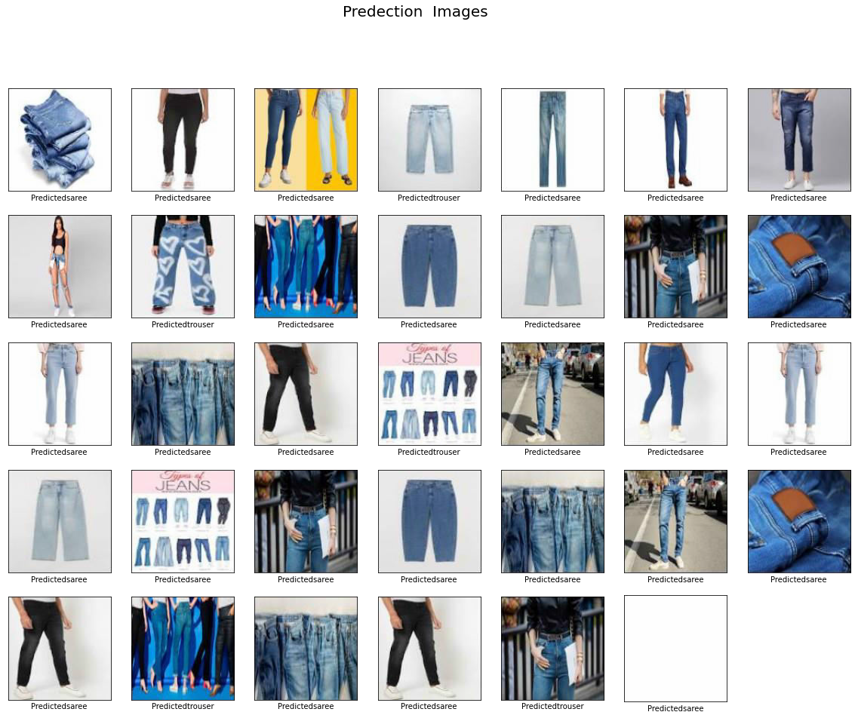
[9.9977571e-01, 1.6301816e-05, 2.0794869e-04], [4.9046475e-01, 5.8280525e-04, 5.0895244e-01], [1.8305206e-01, 3.6701711e-04, 8.1658089e-01],
[9.9995434e-01, 3.8402581e-05, 7.2279381e-06]], dtype=float32)
np.argmax(predection,axis=1)[0:100]
array([0, | 1, | 0, | 2, | 1, | 2, | 2, | 0, | 1, | 0, | 0, | 2, | 2, | 2, | 1, | 2, | 1, | 0, | 0, | 0, | 0,
0,
1, | 1, | 0, | 2, | 1, | 0, | 0, | 0, | 1, | 0, | 2, | 0, | 2, | 0, | 2, | 0, | 0, | 0, | 2, | 0, | 0,
2,
2, 0, 2, 0, 1, 0, 0, 0, 0, 2, 2, 0, 0, 2, 2, 2, 0, 0, 2, 2, 0,
1,
2, 2, 0, 0, 1, 0, 2, 2, 1, 2, 2, 2, 0, 2, 0, 0, 1, 0, 0, 1, 2,
1,
1, 1, 2, 2, 2, 2, 0, 0, 2, 1, 2, 0])
plot_predection(cnn_model)

