Slide 1
SUPERVISED MACHINE LEARNING
Smart Manufacturing
Equipment Failure Prediction
& Maintenance Cost Control
Predictive maintenance using sensor data, risk scoring and actionable maintenance recommendations
R. Padmapriya | PGA43
Project Presentation / Viva
AI4I 2020 Predictive Maintenance Dataset • 10,000 records

Slide 2
Project at a Glance
Business problem → ML prediction → risk-based maintenance
10,000
14
3.4%
0.965
0.859
machine records
original columns
failure rate
final ROC-AUC
final F1-score
Objective
Solution
Business Output
Predict machine failure from operating conditions before failure occurs, so maintenance can move from reactive to proactive.
Build a leakage-safe supervised classification pipeline using Logistic Regression, Random Forest and XGBoost.
Failure probability → risk level → health score → maintenance recommendation, ready for dashboard use.
Key result: Random Forest was selected using F1 first, then ROC-AUC, and the tuned pipeline became the final production model.
Smart Manufacturing Equipment Failure Prediction & Maintenance Cost Control
2

Slide 3
Problem Statement & Objectives
WHY THIS MATTERS
PROJECT FLOW
Manufacturing machines operate continuously. Unexpected failures can cause downtime, emergency repair and higher maintenance cost.
Sensor data
Clean & select
• Use sensor readings to predict failure before it happens.
• Handle the rare-failure class without relying on misleading accuracy alone.
• Identify the operating variables that drive predictions.
• Translate model probability into practical maintenance action.
Engineer features
Train models
Predict risk
Maintain
Smart Manufacturing Equipment Failure Prediction & Maintenance Cost Control
3

Slide 4
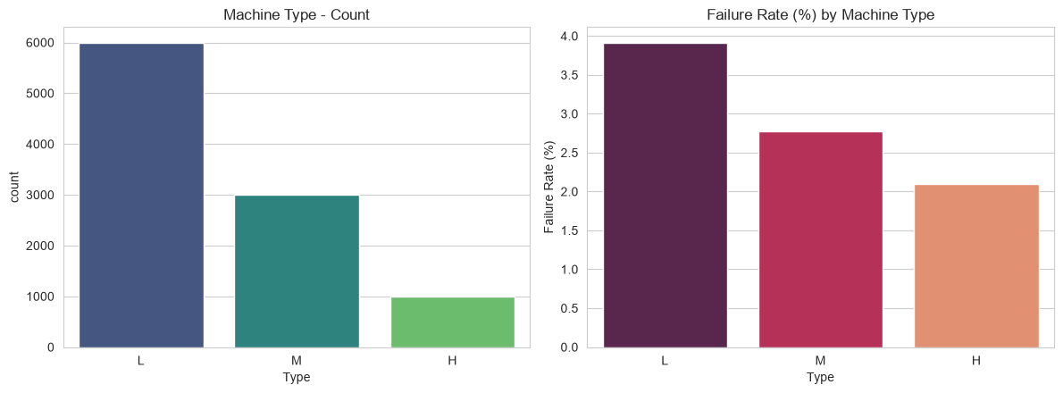
Dataset & Data Preparation
AI4I 2020 Predictive Maintenance Dataset
9,661
339
80 / 20
0
0
no-failure rows
failure rows
stratified split
missing values
duplicate rows
Important preprocessing decisions
• UDI and Product ID were removed because they are identifiers, not generalizable predictors.
• TWF, HDF, PWF, OSF and RNF were excluded from modelling to prevent target leakage.
• Outliers were investigated with IQR and retained because they represent plausible extreme operating conditions.
• Type was retained and one-hot encoded.
Machine type distribution and failure rate by type
Smart Manufacturing Equipment Failure Prediction & Maintenance Cost Control
4

Slide 5
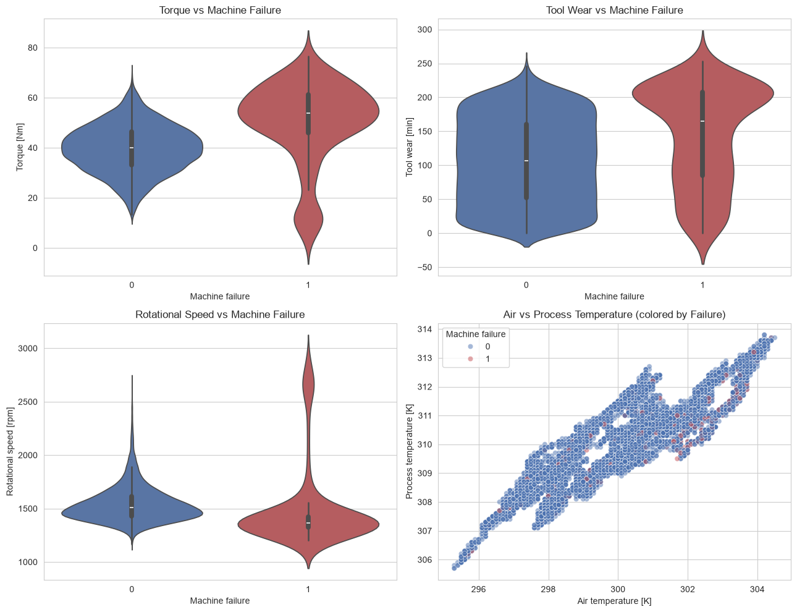
Exploratory Data Analysis
What the sensor data tells us before modelling
Failure signal
Failure cases cluster at higher torque and higher tool wear.
Mechanical relationship
Rotational speed and torque show a strong inverse relationship; extreme combinations can indicate overload.
Temperature insight
Air and process temperature are tightly related, motivating a temperature-difference feature.
Smart Manufacturing Equipment Failure Prediction & Maintenance Cost Control
5

Slide 6
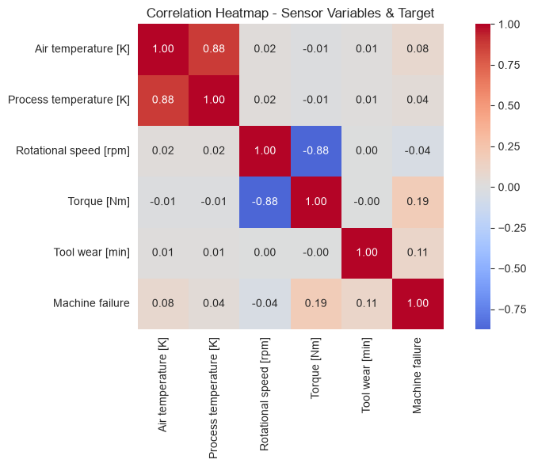
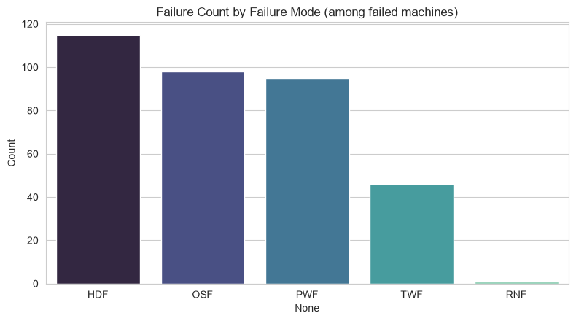
Correlation & Failure Modes
Multivariate relationships and exploratory failure context
Failure-mode counts are exploratory only. These post-failure flags are not model inputs because using them would leak the target.
Correlation highlights
Air ↔ Process temperature: 0.88 | Rotational speed ↔ Torque: −0.88 | Failure association is strongest with Torque and Tool wear.
Smart Manufacturing Equipment Failure Prediction & Maintenance Cost Control
6

Slide 7
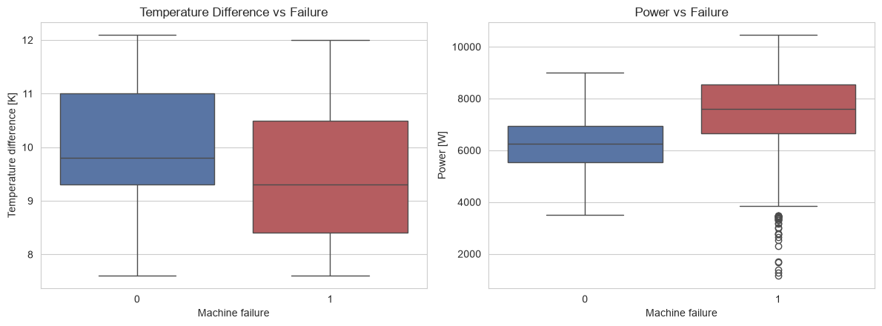
Feature Engineering & Preprocessing
Temperature difference
Process temperature − Air temperature. Captures heat build-up beyond ambient conditions.
Power
Torque × angular speed, converted to Watts. Represents mechanical load more directly.
Preprocessing pipeline
Tool wear category
Numeric
features
StandardScaler
(Logistic)
One-Hot
Type
Classifier
pipeline
Low / Medium / High bands used for business-facing interpretation.
Tree models use the same feature engineering and encoding, but do not require scaling.
Smart Manufacturing Equipment Failure Prediction & Maintenance Cost Control
7

Slide 8
Model Building Strategy
Three supervised binary-classification models
Logistic Regression
Random Forest
XGBoost
Linear baseline
Scaled numeric features
class_weight='balanced'
Non-linear ensemble
300 trees baseline
class_weight='balanced'
Gradient boosting
300 estimators baseline
scale_pos_weight for imbalance
Evaluation strategy
• Stratified 80/20 train-test split to preserve the rare-failure ratio.
• Compare Accuracy, Precision, Recall, F1 and ROC-AUC.
• Prioritize Recall / F1 / ROC-AUC because the positive class is only ~3.4%.
• Use 5-fold stratified cross-validation for the selected candidate.
• Tune hyperparameters with RandomizedSearchCV using F1 as the scoring metric.
Smart Manufacturing Equipment Failure Prediction & Maintenance Cost Control
8

Slide 9
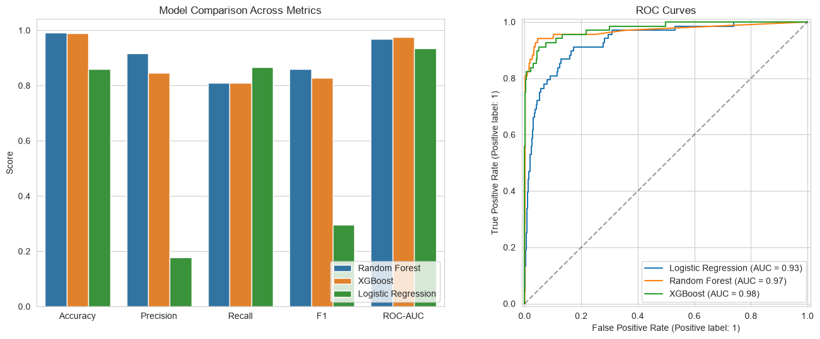
Model Comparison
Test-set comparison and ROC curves
Random Forest achieved the strongest overall balance: Accuracy 99.10%, Precision 91.67%, Recall 80.88%, F1 85.94%, ROC-AUC 0.9699.
Smart Manufacturing Equipment Failure Prediction & Maintenance Cost Control
9

Slide 10
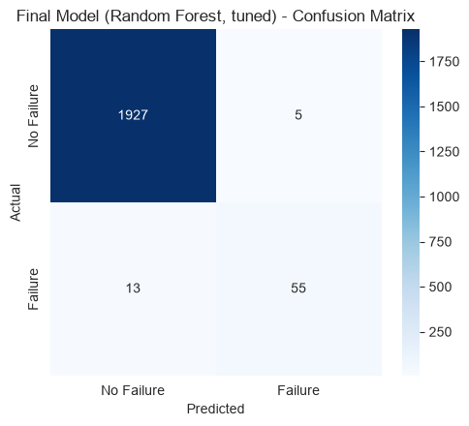
Final Model: Tuned Random Forest
Selected by F1 first, then ROC-AUC; validated on the untouched test set
99.10%
91.67%
80.88%
Accuracy
Precision
Recall
85.94%
0.965
2,000
F1-score
ROC-AUC
test records
Confusion matrix interpretation
1,927 true negatives • 55 true positives • 13 false negatives • 5 false positives. The model detects most failures while keeping false alarms low.
Tuning result
Best parameters: 200 trees, unrestricted depth, min_samples_split=2, min_samples_leaf=1.
Smart Manufacturing Equipment Failure Prediction & Maintenance Cost Control
10

Slide 11
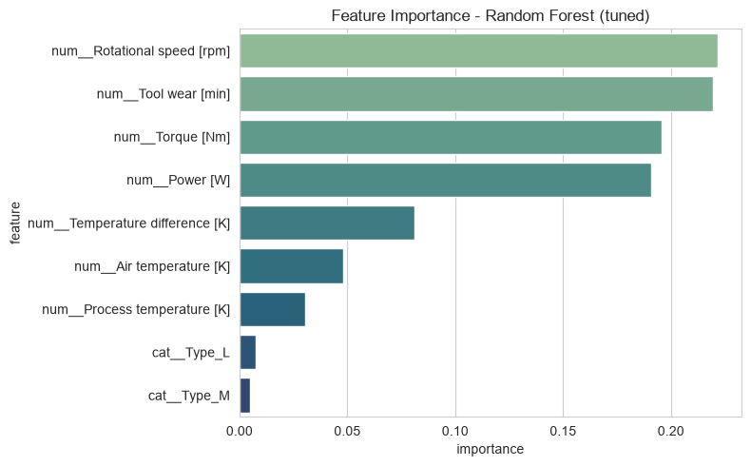
What Drives the Predictions?
Random Forest feature importance from the final pipeline
Top predictive signals
1
Rotational speed
0.2216
2
Tool wear
0.2195
3
Torque
0.1955
4
Power
0.1907
Interpretation
Mechanical load and tool condition dominate the model's learned signal; engineered Power is also highly influential.
Smart Manufacturing Equipment Failure Prediction & Maintenance Cost Control
11

Slide 12
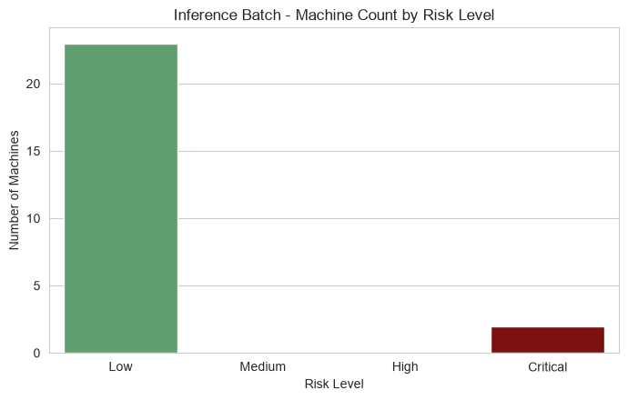
Inference: From Probability to Maintenance Action
A production-style batch of 25 unseen machine observations
Business rules
0–30%
Low
Continue monitoring
30–60%
Medium
Schedule inspection
60–80%
High
Schedule preventive maintenance
80–100%
Critical
Prioritize maintenance
In the sample inference batch, 2 machines were High/Critical risk; both were Critical.
Health Score = 100 − Failure Probability
Smart Manufacturing Equipment Failure Prediction & Maintenance Cost Control
12

Slide 13
Business Impact: Maintenance Cost Control
Illustrative impact using explicitly documented assumptions
Emergency scenario
Estimated cost for the 2 high/critical machines
Assumed emergency repair = 50,000 units
Assumed downtime = 6 hours
Assumed downtime cost = 5,000/hour
If left until emergency failure
160,000
Preventive scenario
If addressed preventively
Assumed preventive maintenance = 12,000 units per high/critical machine.
24,000
Important caveat
Estimated potential saving: 136,000 units
These are estimates, not audited real-world savings. Replace with actual finance and maintenance records before budgeting.
The model therefore supports a business workflow: identify high-risk machines early and prioritize preventive action.
Smart Manufacturing Equipment Failure Prediction & Maintenance Cost Control
13

Slide 14
Project Conclusion
From raw sensor readings to an actionable predictive-maintenance workflow
Leakage-safe modelling
Post-failure mode flags were excluded from model inputs; identifiers were removed.
01
Strong final performance
Random Forest reached 99.10% accuracy, 85.94% F1 and 0.965 ROC-AUC on the test set.
02
Explainable signals
Rotational speed, tool wear, torque and power were the most influential features.
03
Business-ready inference
Predictions become probability, risk, health score and maintenance recommendation.
04
Overall takeaway: Predict failure early → prioritize maintenance → reduce avoidable operational disruption.
Smart Manufacturing Equipment Failure Prediction & Maintenance Cost Control
14

Slide 15
Thank You
Smart Manufacturing Equipment Failure Prediction & Maintenance Cost Control
R. Padmapriya | PGA43
Questions & Discussion

