Slide 1
5G Mobile Network
By Mr. Pritesh Gandhi
Guidance by Prof. Robert Cannistra

Slide 2
Abstract
Mobile is the important device nowadays
Now people are using 4 generations of network: 1G,2G,3G,4G
This research focuses on the need of 5G,comparison among them, challenges in developing 5G, potential services provided by 5G, new technologies required for 5G & applications of 5G.
This paper also discusses about the prospective 5G architecture & on-going research on 5G

Slide 3
Objectives
Describe the evolution of mobile network.
Need of 5G
Different prospective services availed by 5G
Different protocols or technologies like software defined radio(SDR),IEEE 802.21, All-IP used in 5G for supporting the prospective services
On-going research on 5G
Applications of 5G

Slide 4
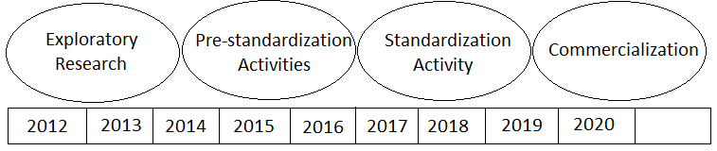
Evolution
1G introduces in 1981, 2G in 1991,3G in 1998,4G in 2008
It is said that a new generation of mobile network standard appears in every approximately 10 years.
Evolution of 5G :

Slide 5
Need of 5G :
Very high data rate : 1000 times current
Massive number of devices : approx. 50 billion devices
Low latency
Uninterrupted service

Slide 6
Challenges/ Services availed by 5G :
Cognitive radio : New ways of using the spectrum
Software defined radio : Reconfigure or add more devices while use
Interoperability within heterogeneous networks : IEEE 802.21- Handover between different networks
All IP Network : All data through IP address, security issues
Cloud Computing :Install apps once, store data at one place
Device-to-Device communication

Slide 7
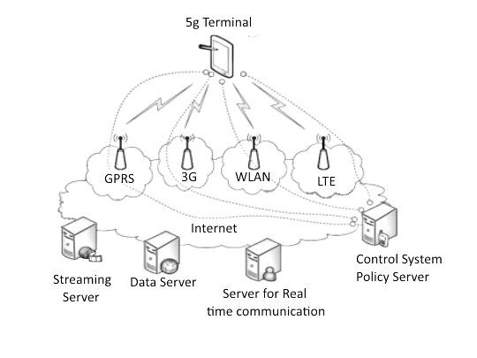
5G functional Architecture :

Slide 8
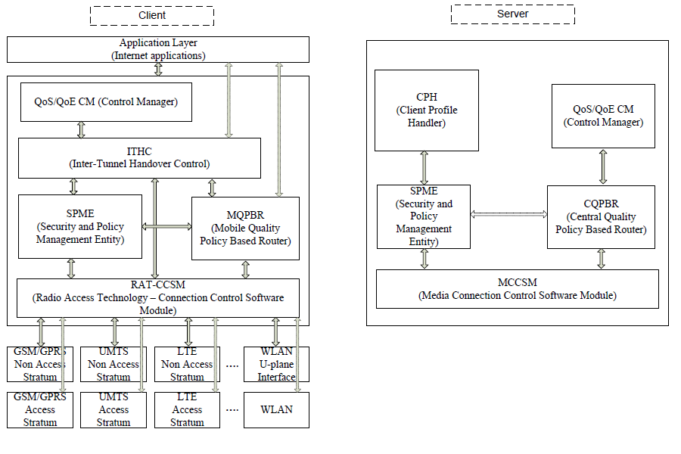

Slide 9
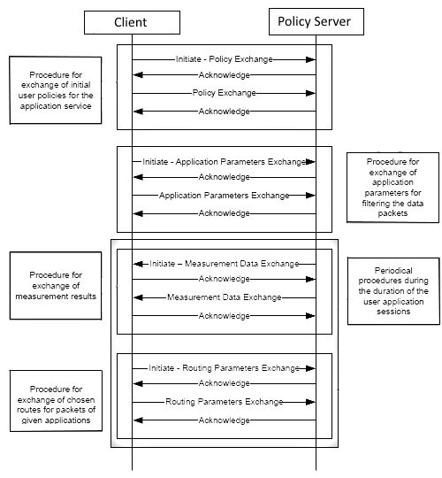
Use Case :

Slide 10
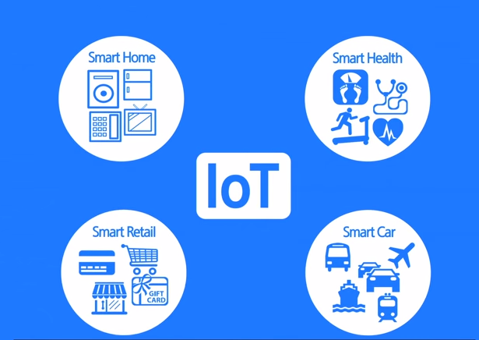
Applications of 5G:
Visualize the whole universe or planet lively
Enable calling based on IP
Wearable devices with AI
Hologram or 3D phone calls

Slide 11
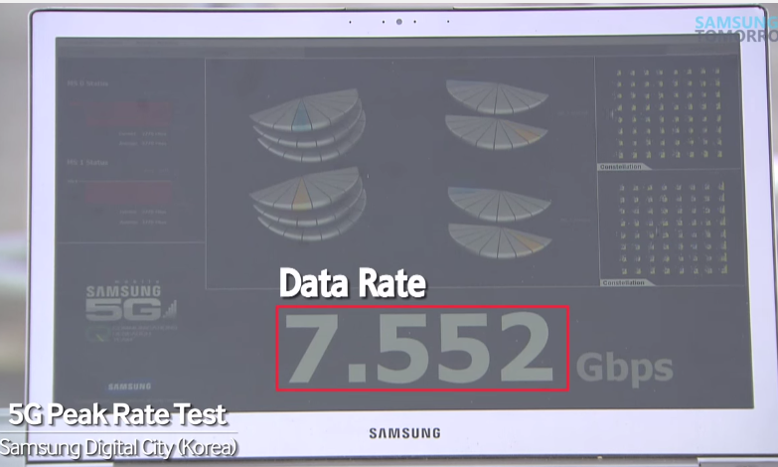
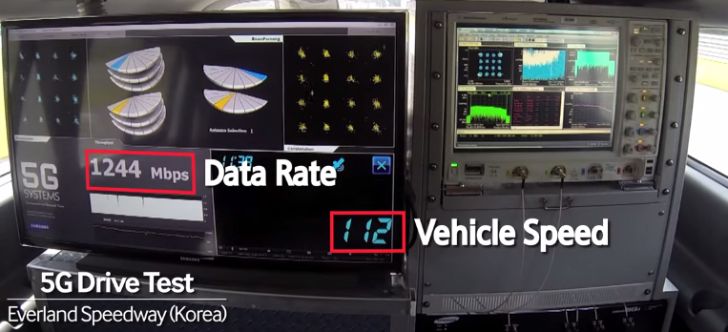
On-Going Research :
Huawai – collaboration with 20 universities
NASA partnered with Geoff Brown and Machine-to-Machine Intelligence (M2Mi) Corp
UK's University of Surrey partnered with Samsung,Huawei, Telefonica Europe, Fujitsu Laboratories Europe, Rohde & Schwarz, and Aircom International
Samsung claims first 5G demo :

Slide 12
Conclusion :
Now a days the mobile devices have been become an integral part of human life. They are advancing in the processing power & storage.
There have been 4 generations of mobile network till now.
With the time, the technologies will require far better & efficient network than what we have now.
According to the prospective services provided by 5G, All-IP, SDR, Congnitive Radio , IEEE 802.21 will be used.
With the services provided by 5G, it will initiate a new era of mobile networking.

Slide 13
THANK YOU!!!!

