Slide 1
EmAGnet
PROJECT TEAM:
UMEAZ KHERADIA
APOORVA JOSHI
KSHITIJ KAUSHIK
POOJA GAIKWAD
PRIYABRATA PUROHIT
SANDEEP KUMAR BETHI

Slide 2
Problem statement
Any employee in an organization have to fill the timesheet for their work . In an organization, a person would normally need approximately 10 minutes to fill timesheet manually, out of 8hours. Manually filling timesheets may also tend to error.
Manager cannot keep task details of every employee. Developer generally has to verbally inform next team member after committing code . If a company uses multiple software ,a simple task will need to be created multiple times over all these software.

Slide 3
Project overview
Goals – To develop an application which will solve the problem of filling timesheets by providing a convenient solution which will be easy to use, provide efficiency and will save money and time.
Objective- To monitor the time by application which will eliminate the manual work
To provide notification to all other employers about any requirement change done by any developer
To develop a calendar system in which a developer can actually see the task of other project team members and schedule an appointment through it

Slide 4
EMagnet
Automatic Timesheets
JIRA and GIT Integration
Calendar Management

Slide 5
Requirements
To eliminate the manual filling of time-sheets.
To reduce time and increase productivity
We should be able to access the API’s from GitHub and JIRA, to get proper authorization and data retrieval
Our tool should interface efficiently with GitHub and JIRA or any other project management tool
The tool should be able to make transitions from GitHub and JIRA, as and when required by users

Slide 6
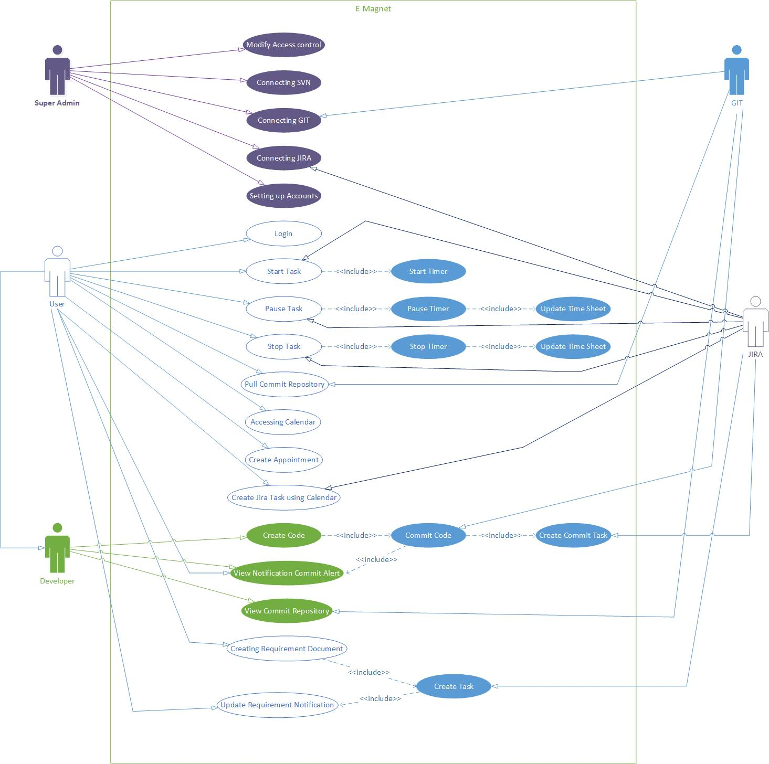
Use Case

Slide 7
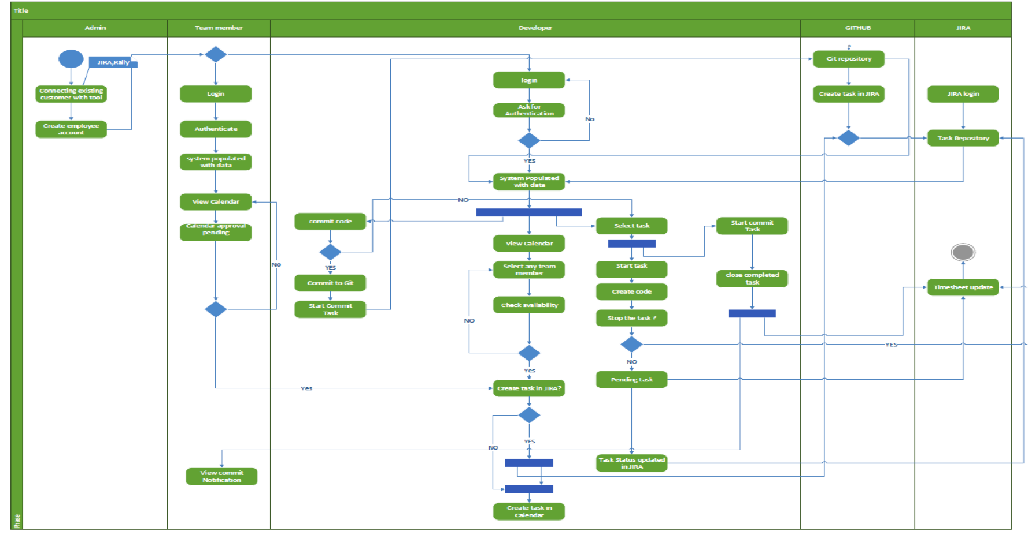
Activity Diagram

Slide 8
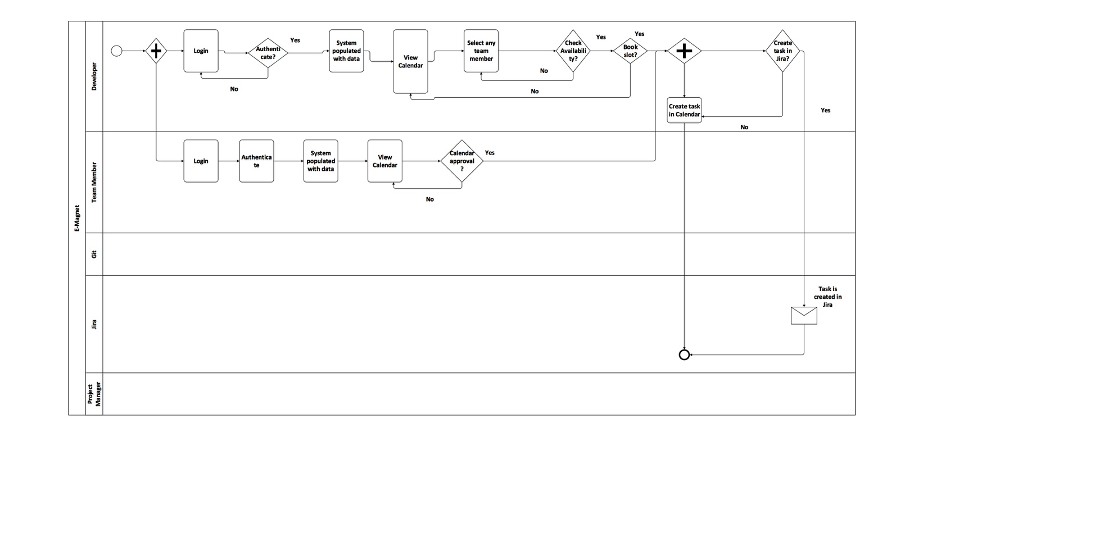
BPMN: Calendar

Slide 9
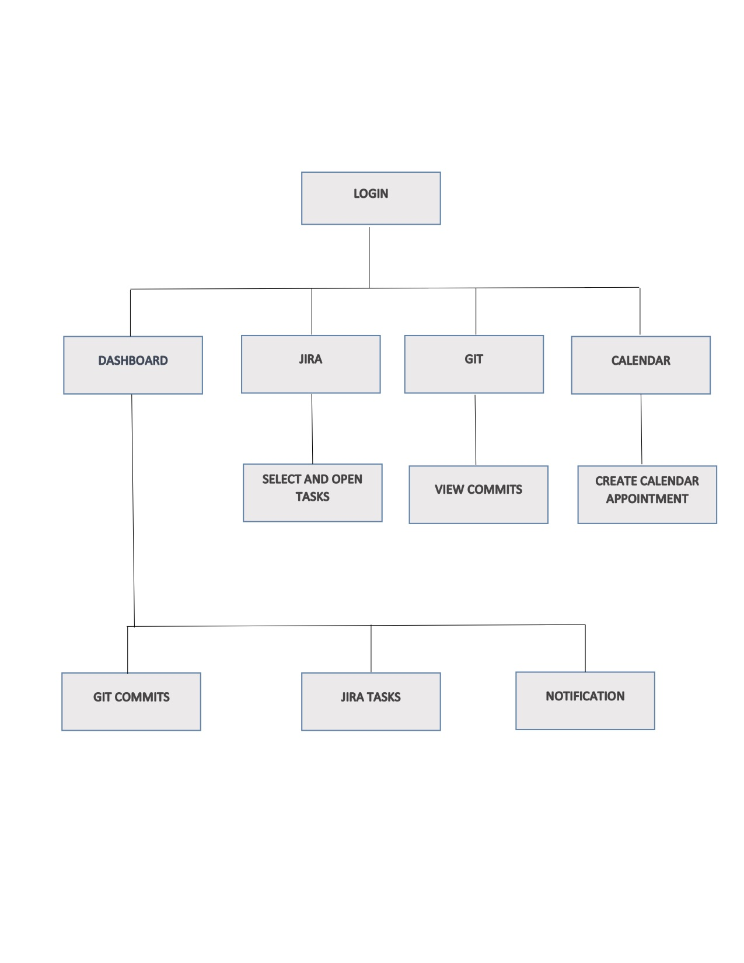
Windows Navigation Diagram

Slide 10
User Interface
Consistency & Simplicity
3 Click Rule
Layout
User Experience

Slide 11
Thank You

