Slide 1
Business Intelligence Project

Slide 2
BI Tool Comparison - Tableau
Direct drag and drop of the tables and Joins
No bar charts in maps
No data load editor
Dropdown filters
Good for Business users
We can add the Action filters in the Dashboard
Slower Performance

Slide 3
BI Tool Comparison - QlikSense
No drag and drop of sources
Data load editor with SQL queries
Synthetic keys
Better Performance
Suited for IT developers
Great visualization feature
We can publish it

Slide 4
BI Tool Comparison – MS Excel
No drag and drop option
No load editor
Story Boards not present
Poor performance
We can add the bar charts in GeoMaps
Not good while loading large amount of data

Slide 5
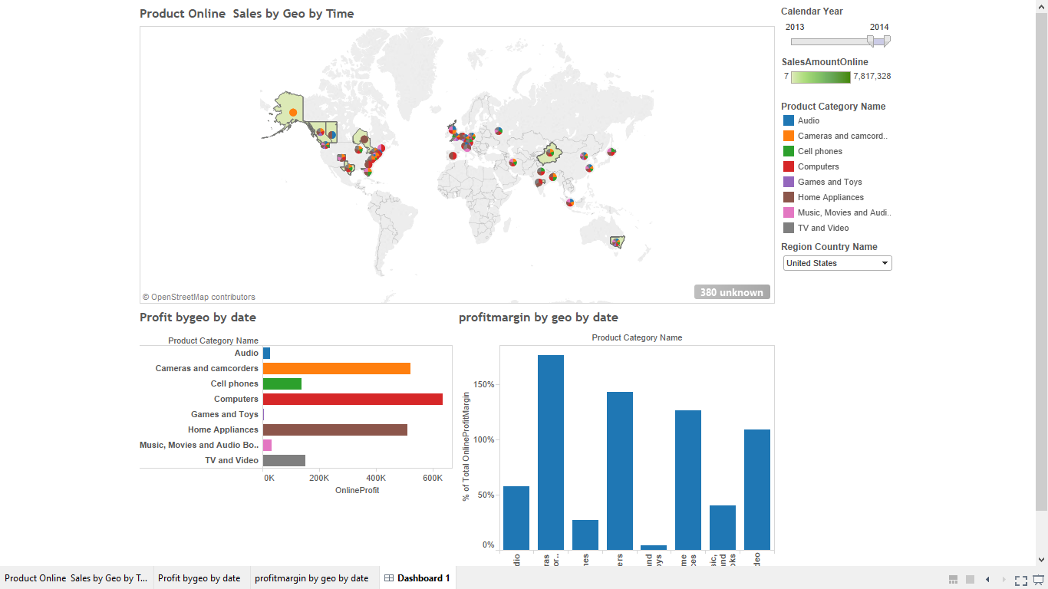
Tableau – Online Store Analysis

Slide 6
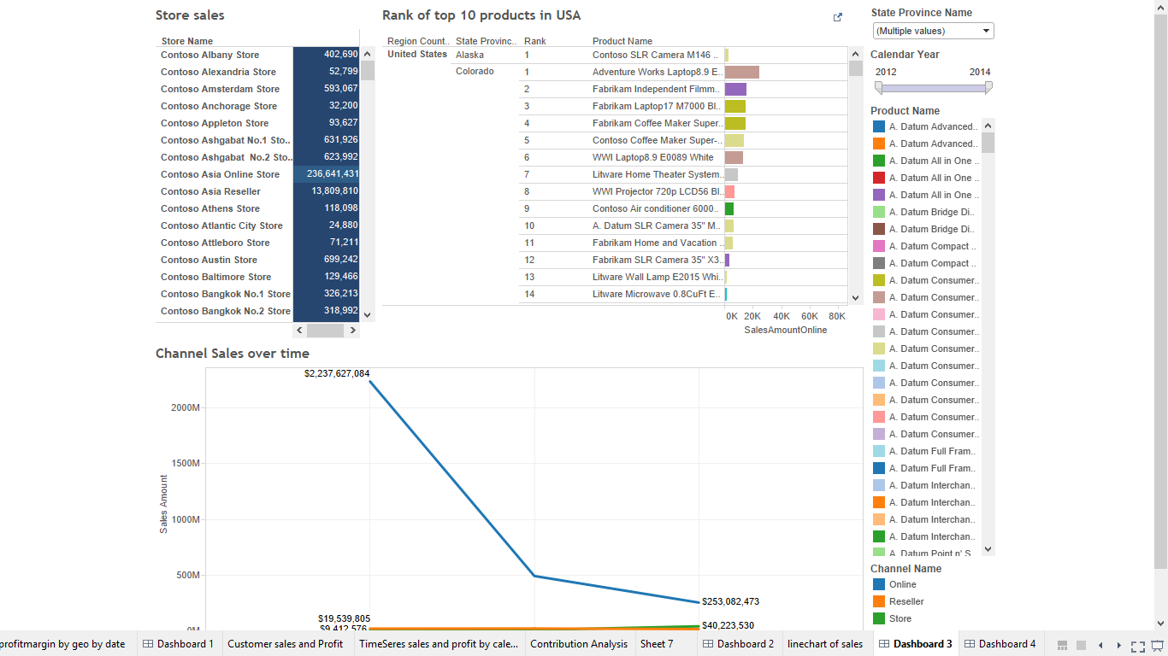
Tableau -Rank of Products and Store sales based on Geography

Slide 7
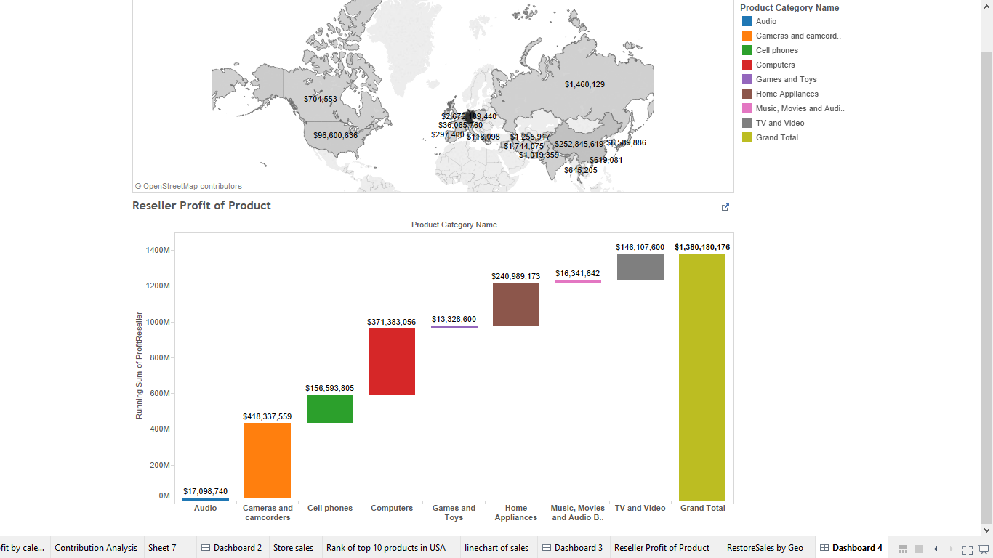
Tableau -Waterfall chart – Sales Analysis

Slide 8
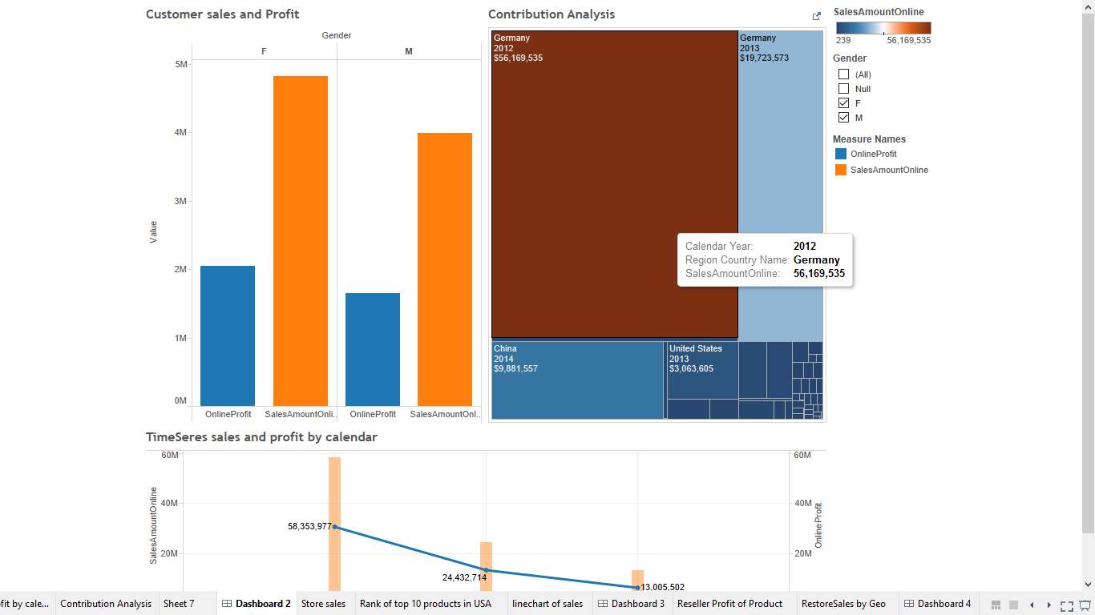
Tableau - Sales and Profit by Demographics- Customer Gender

Slide 9
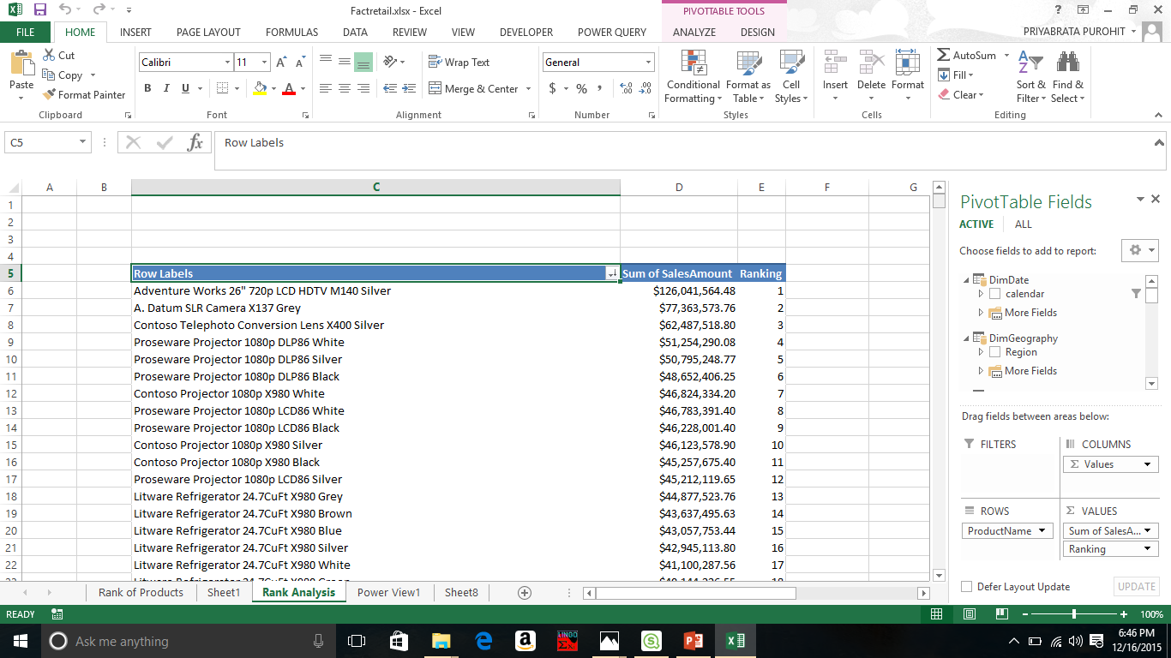
Excel- Rank of Products based on Online sales

Slide 10
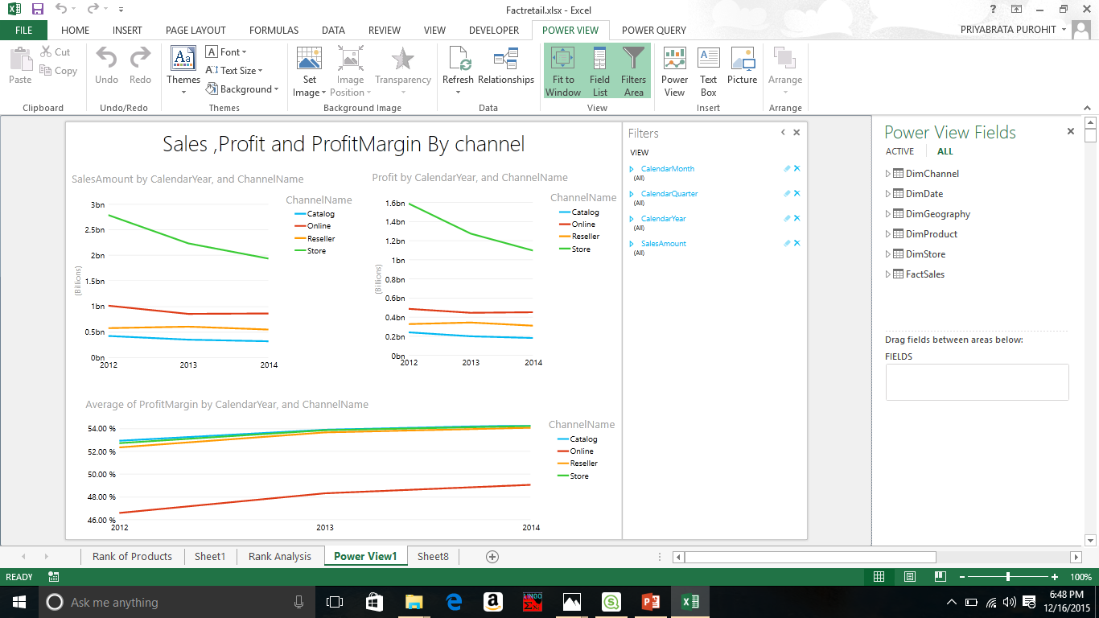
PowerView - Sales,Profit and Profit Margin By Channel

Slide 11
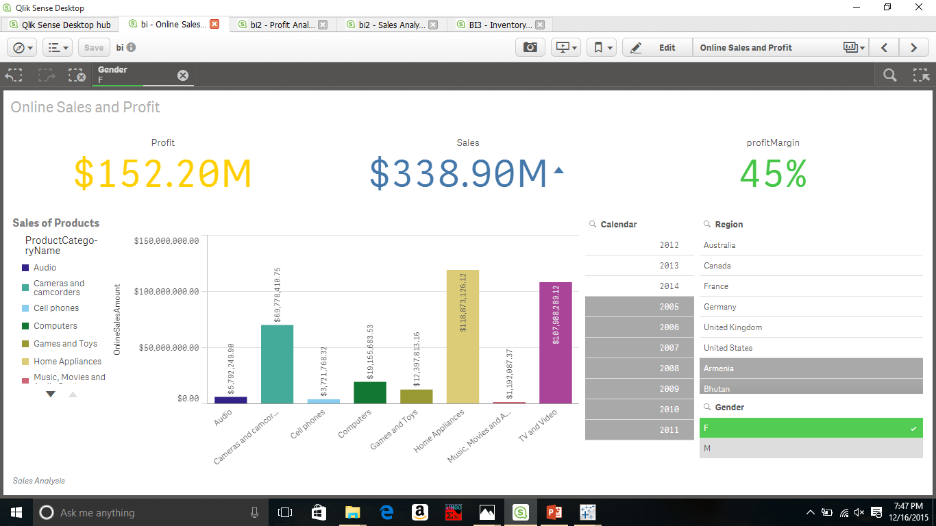
QlikSense - Online Sales ,Profit,Profit Margin by Geo,Date,Product (OLAP)

Slide 12
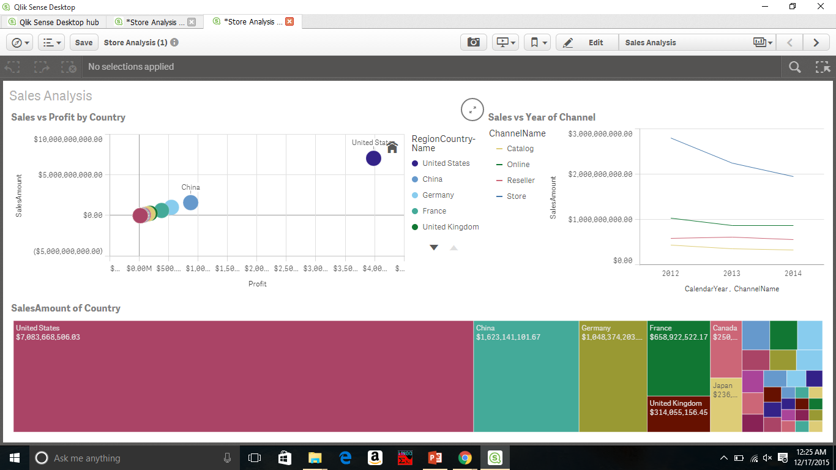
QlikSense – StoreAnalysis

Slide 13
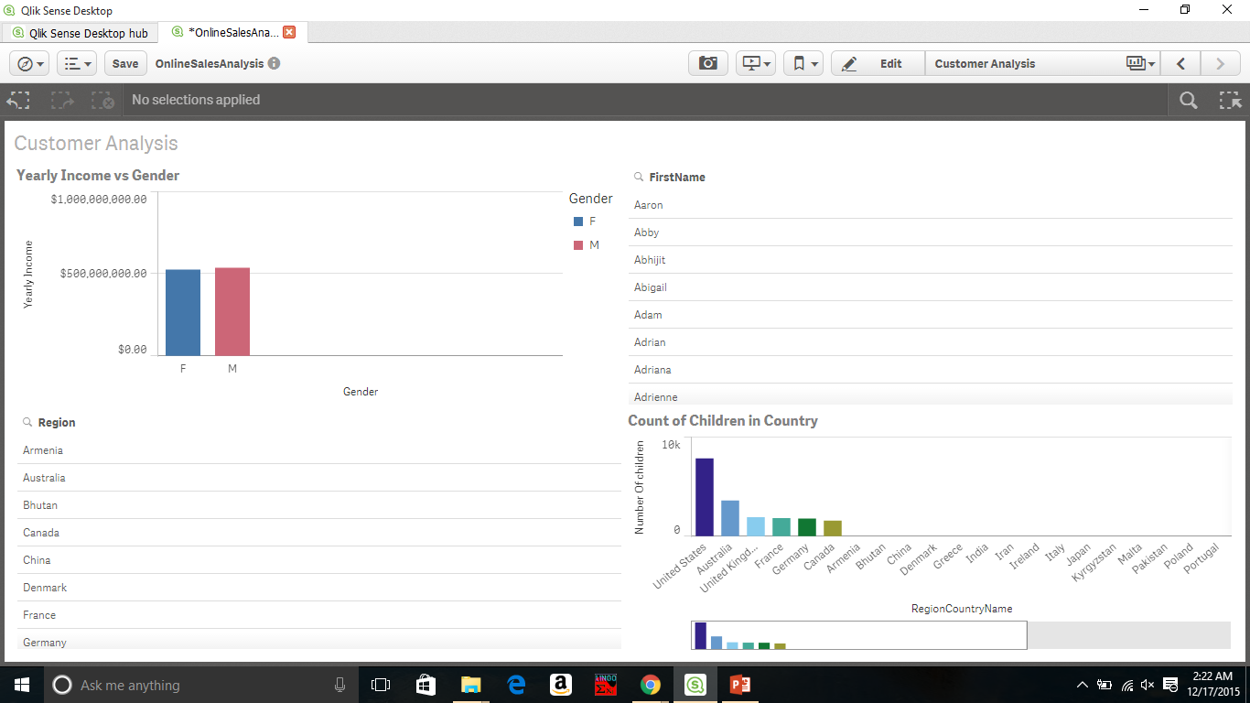
QlikSense - Analysis based on customer demographics

Slide 14
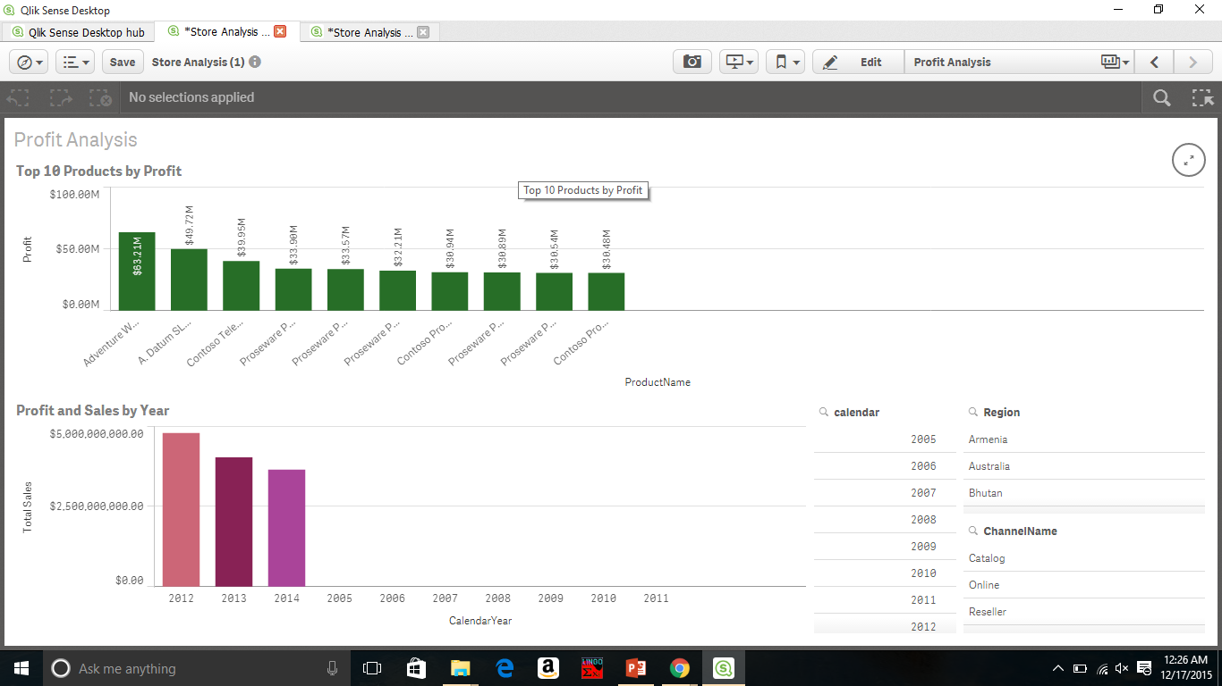
QlikSense -Store analysis –Top 10 Products

Slide 15
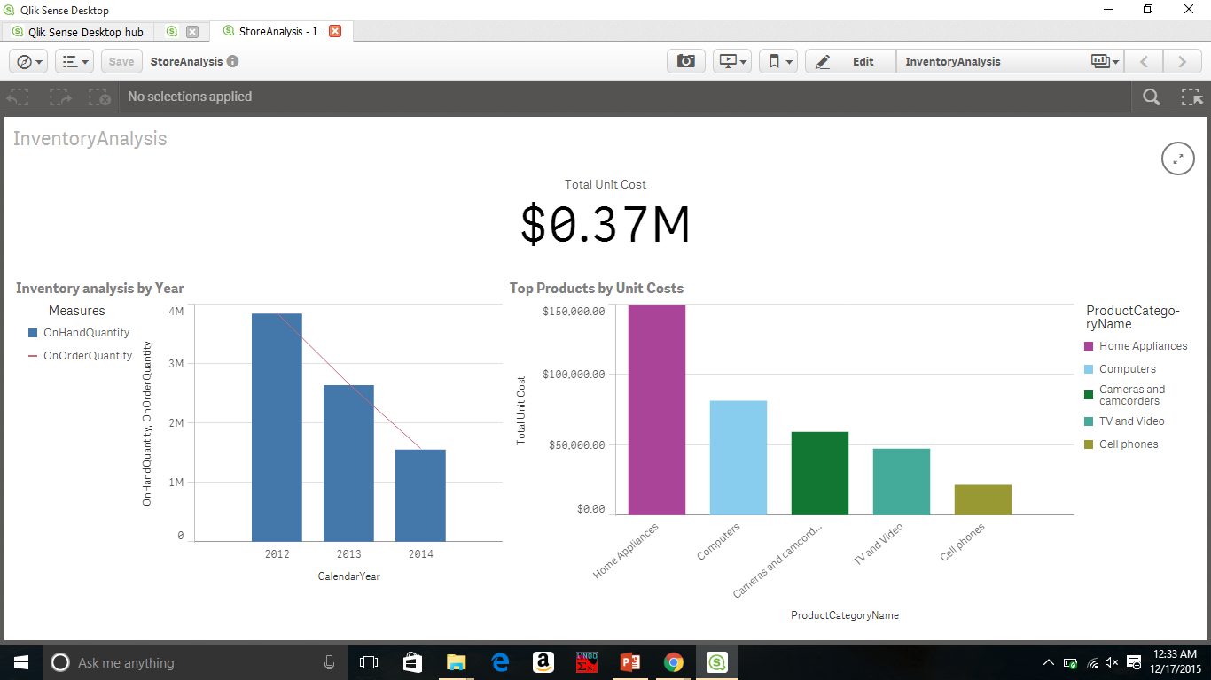
QlikSense – Inventory Analysis

Slide 16
Thank you

