Slide 1
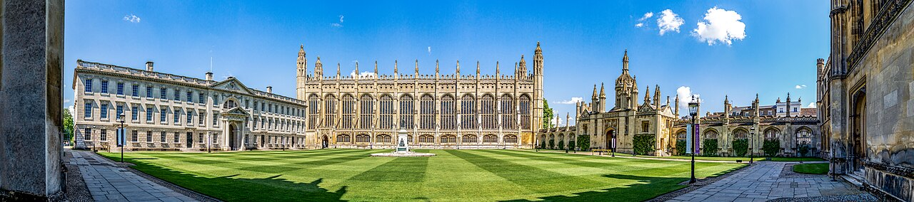
Modelling House Prices in Cambridgeshire
Rapid Report — the challenges so far
Diana · Matt · Davies · Natsani · Xiangjun · Vedanta

Slide 2
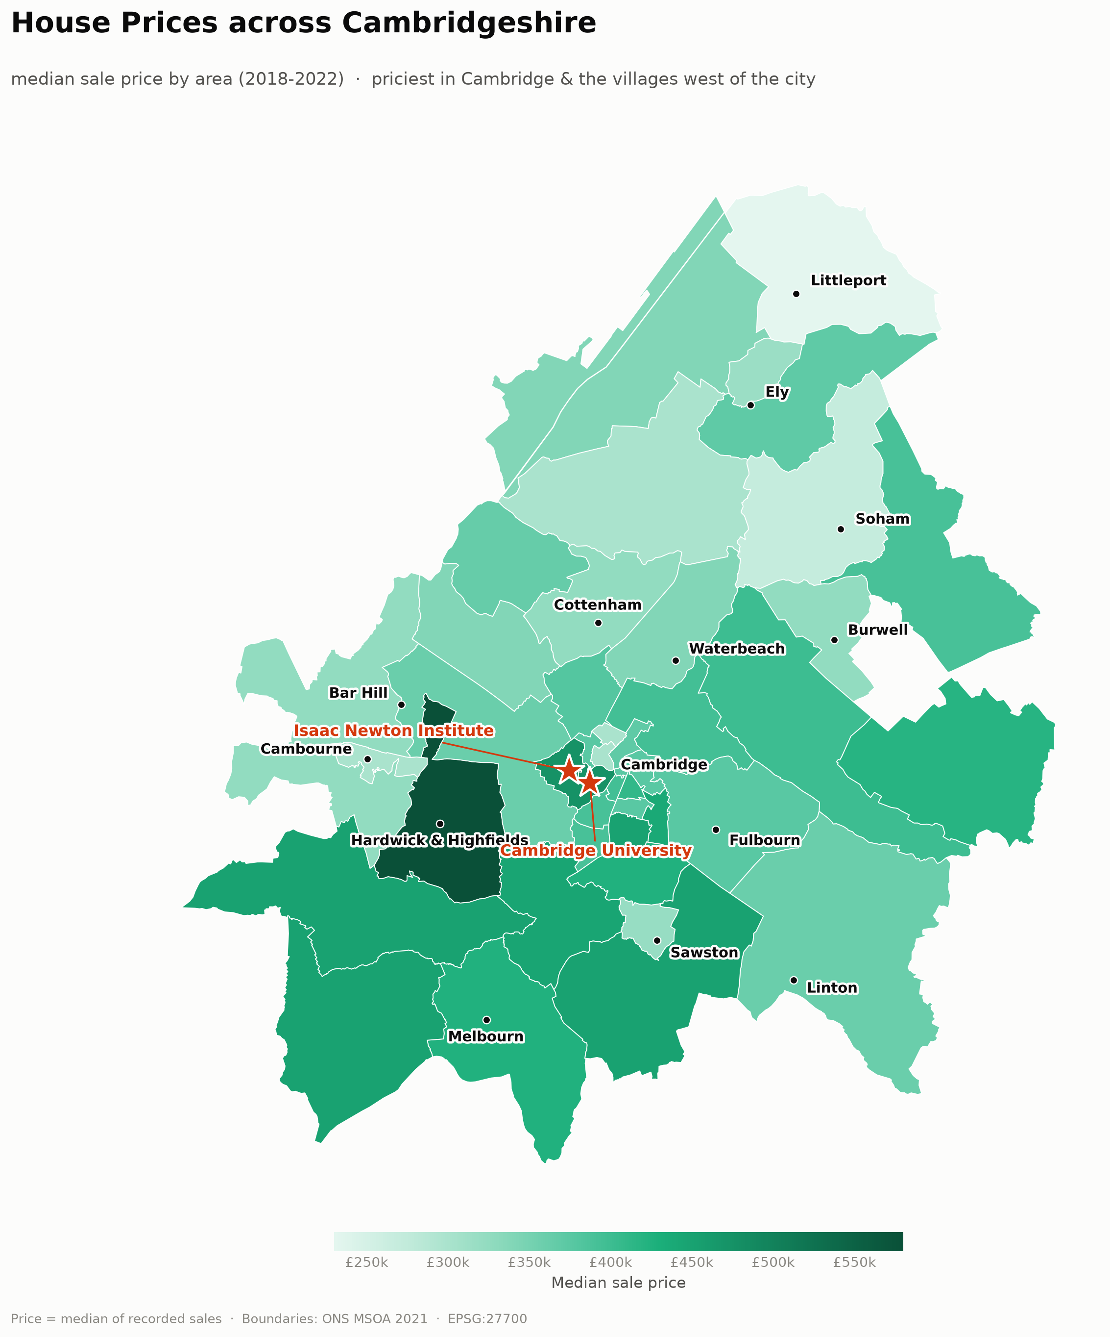
THE DATASET
What we’re modelling
59,787
24
sold prices
property types
43
£350k
areas (MSOAs)
median price
▪ Sold prices 2018–22 across Cambridge & its districts
▪ Three feature families: property, location, social profile
▪ Rich — but every family brought its own challenges
Modelling House Prices in Cambridgeshire

Slide 3
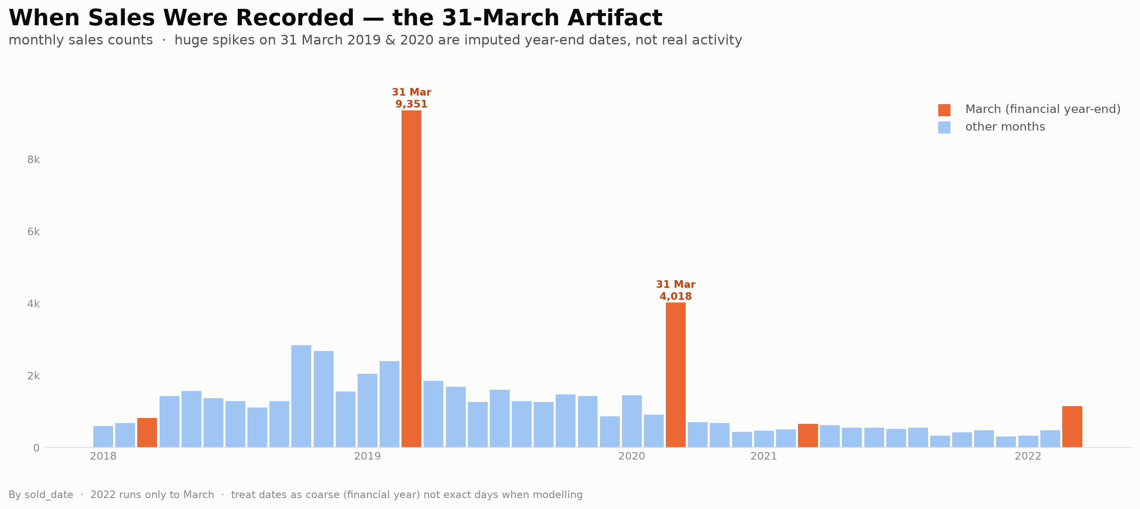
CHALLENGE 1 · THE DATA FIGHTS BACK
Time, duplicates & missing values
▪ Sold dates imputed to 31 March (year-end) — not real timing, and not a time series
▪ 59% of rows are exact duplicates — must de-duplicate before modelling
▪ Bedrooms / bathrooms coded 0 = missing (12k baths fixed, 16k receptions to handle)
Modelling House Prices in Cambridgeshire

Slide 4
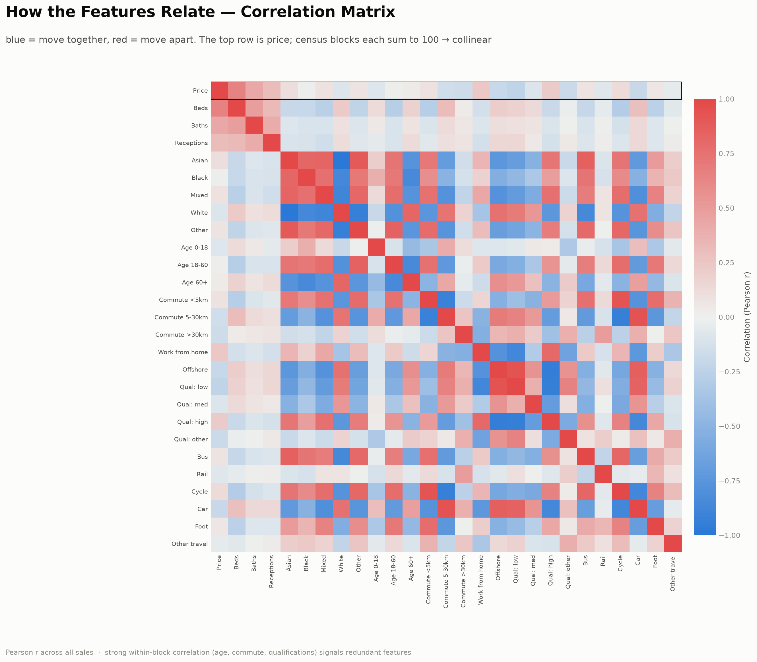
CHALLENGE 2 · TOO MANY VARIABLES
High-dimensional — and highly redundant
▪ 24 types + ~25 census variables → high-dimensional
▪ Census blocks (age, commute, quals) each sum to 100% → collinear
▪ Selection: intuitive vs optimised; Stepwise vs RFE
▪ Baseline linear vs complex non-linear models
Modelling House Prices in Cambridgeshire

Slide 5
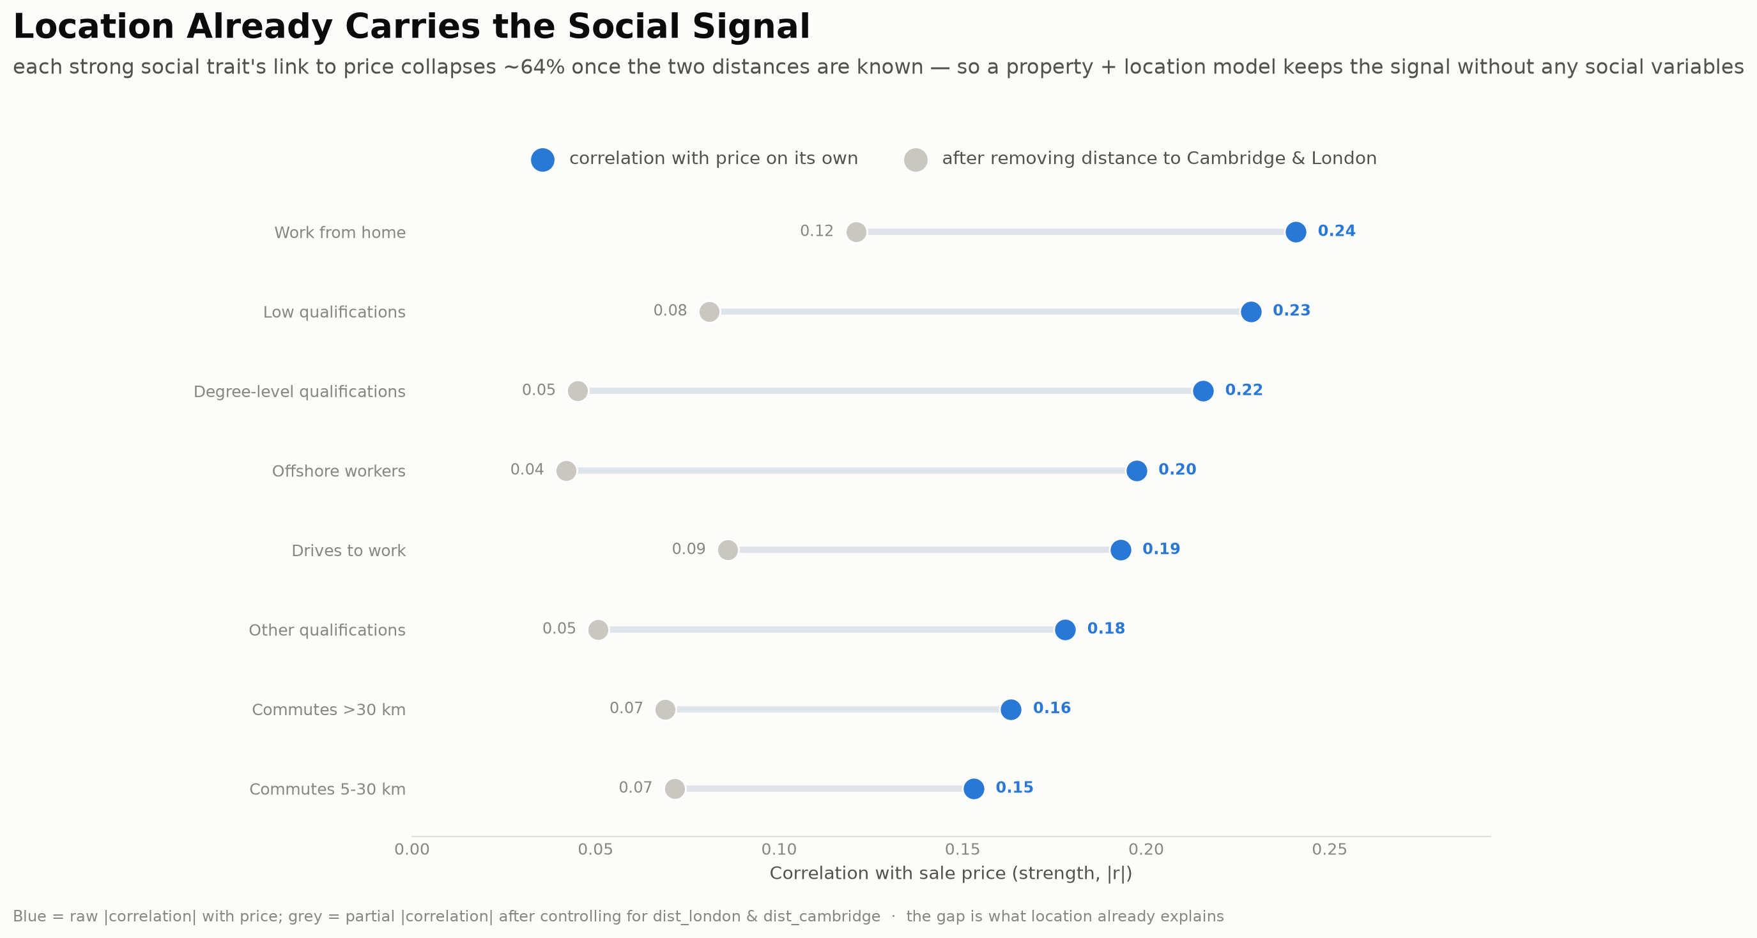
CHALLENGE 3 · WHAT TO KEEP & HOW
Location already carries the social signal
▪ Strong social→price links collapse ~64% once distance to Cambridge & London is known
▪ So we model property + location only — no social variables, almost no signal lost
▪ Target is skewed & bounded → model log(price)
Modelling House Prices in Cambridgeshire

