Slide 1

RAPID REPORT
/
2018 – 2022
Modelling House Prices in Cambridgeshire
A rapid statistical study of residential sale prices and the models that predict them.
PREPARED BY
Diana
·
Matt
·
Davies
·
Natsani
·
Xiangjun
·
Vedanta
EST. AGENT
FOR SALE
CAMBS · 2018–22
Notes:
Introduce the rapid report: modelling residential house prices across Cambridgeshire, 2018–2022. Team of six.

Slide 2
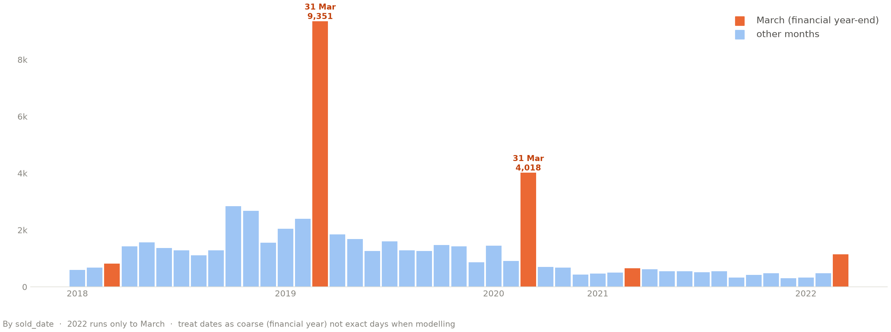
01 / THE DATA
5 yrs
24
Complexity & Concerns
2018 – 2022
property types
VARIABLES IN PLAY
When sales were recorded
Room profile
Monthly sales counts, 2018 – 2022
Bedrooms · Bathrooms · Reception rooms
Location
MSOA & LSOA
Social profile
Ethnicity · Age · Education · Distance to work
CONCERN → SOLUTION
Dimension inconsistency
→ handled in preprocessing
Bedroom / bathroom counts
→ resolved in implementation
Date of sale is not exact
Why the two 31-March spikes?
2020 — rush to beat the 6 Apr CGT overhaul (Private Residence & Lettings Relief cut, 30-day reporting) + Section 24 & MEES → landlords sell.
2019 — SDLT filing cut to 14 days from 1 Mar (HMRC: pre/post figures ‘not comparable’); Brexit’s 29 Mar deadline froze activity.
Caveat — records are duplicated & imputed to the year-end, so we treat sale dates as coarse (financial year), not exact.
Sources: GOV.UK (CGT · monthly property transactions · MEES) · Crowe UK · LandlordZone
→ framed as prediction, not forecast
Notes:
Sold prices 2018–2022 across 24 property types, with variables like rooms, location, distance to work, social profiles. Three data concerns and how we addressed each — the chart shows the date-of-sale artifact where financial year-end dates get imputed as 31 March.

Slide 3
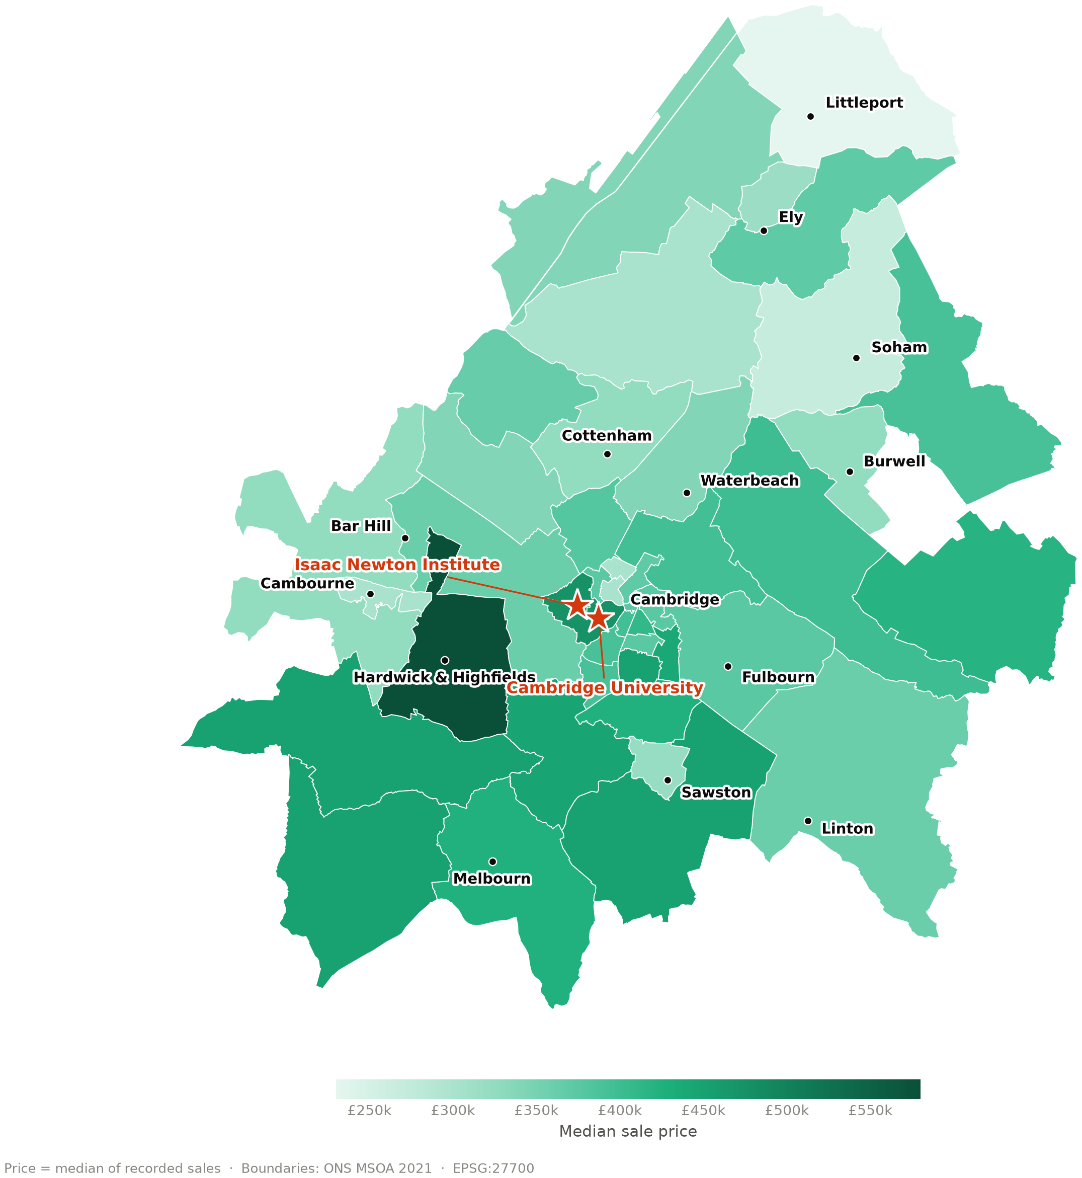
02 / METHODOLOGY
Three Modelling Decisions
01 — PHILOSOPHY
House prices across Cambridgeshire
Intuitive
Optimised
Median sale price by area, 2018 – 2022
vs
02 — FEATURE SELECTION
Stepwise
Recursive Feature Elimination
vs
03 — MODEL FRAMEWORK
Baseline Linear
Complex Non-linear
vs
Priciest in Cambridge and the villages west of the city.
Notes:
Three modelling decisions: intuitive vs optimised variable selection; stepwise vs recursive feature elimination; baseline linear vs complex non-linear models for high dimensionality. Map shows median sale price by area — priciest in Cambridge and villages west of the city.

