Slide 1
SPORTS MANAGEMENT SYSTEM
Presented By
Jannatul Arefin Prima
UG02-44-17-013
Department Of CSE
State University Of Bangladesh

Slide 2
Contents
Objectives
Project Purpose
Project Output
System Requirements
Sequence Diagram
Data Flow Diagram
Development Work
Limitations
Conclusion & Future Scope
References

Slide 3
Objectives
SPORTS MANAGEMENT SYSTEM - CASE STUDY IN BANGLADESH is a platform for enjoy the sports entertainment. User can enjoy any type of international sports in this application. The sports lover people take the entertainment and refresh their mind through the sports. User can easily buy their desirable product from this application.
Today we are living in a world of technology. We are using technology as our daily needs. Thus, as a part of technology internet has become most important thing. Cause now each and every kind of devices are connected to cloud.
Thus, many of our daily tasks are become dependent on web based. Today many companies or organization even little shops using web-based technology for maintaining their business or organization.

Slide 4
MOTIVATION
Motivation can be defined as an activated state within a sport consumer that leads to using the Internet for sport-related activities. To date, several studies have been conducted to investigate motivational factors of online consumers. Web Motivation Inventory that highlights four primary online consumption motivation factors: researching (e.g., getting information, finding news and facts), communicating (e.g., emailing, chatting, connecting with friends), surfing (e.g., exploring news sites, finding interesting Web pages), and shopping (e.g., making a purchase).

Slide 5
Project Purpose
To make sure users can easily enjoy their desirable sports without any problem or error. Sports lover entertainment is more important for me.
To make sure users’ information is more secured in our system.

Slide 6
Project Expected outcome
Making a full furnish web application.
Well written clean code for developing.
Understanding pattern of relational database and relationship.
Easy installation software system.
Well managed front-site manager.
More simple and easy UI to navigate.
Get user comment and problem in one click help desk.
Transfer event management access to volunteer.
All users can register for club easily.
Integrated blood bank will help to find blood doner easily.

Slide 7





System Requirements

Slide 8
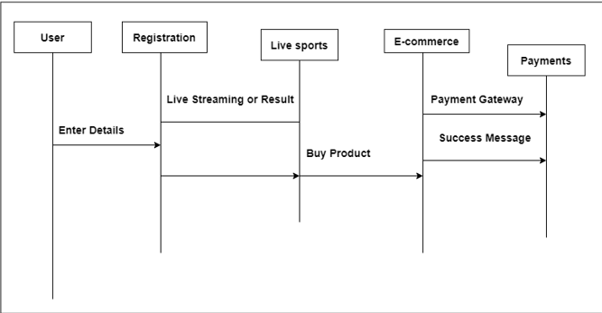
Sequence Diagram
8

Slide 9
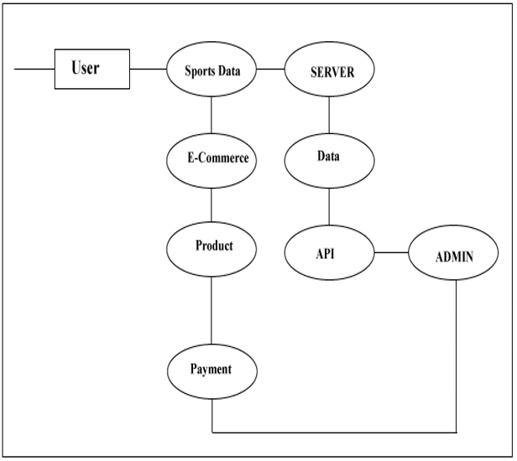
Business Model

Slide 10
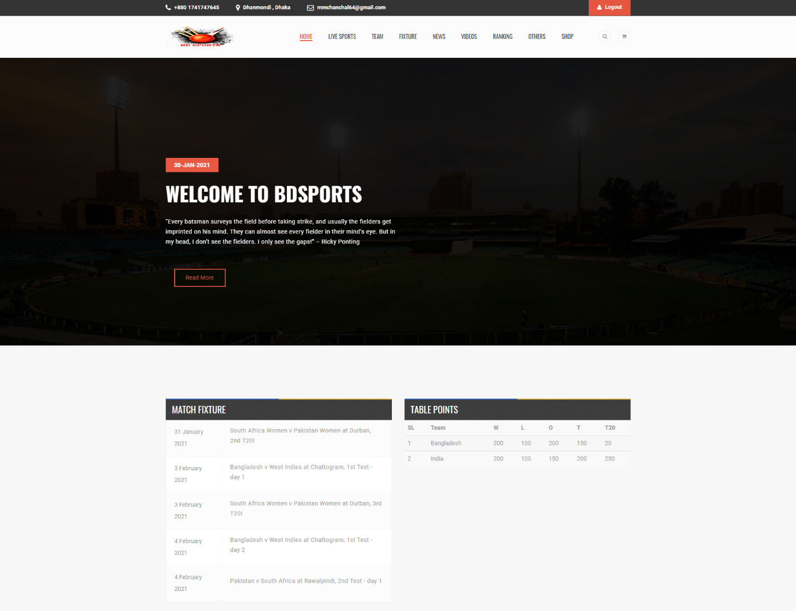
Development Work

Slide 11
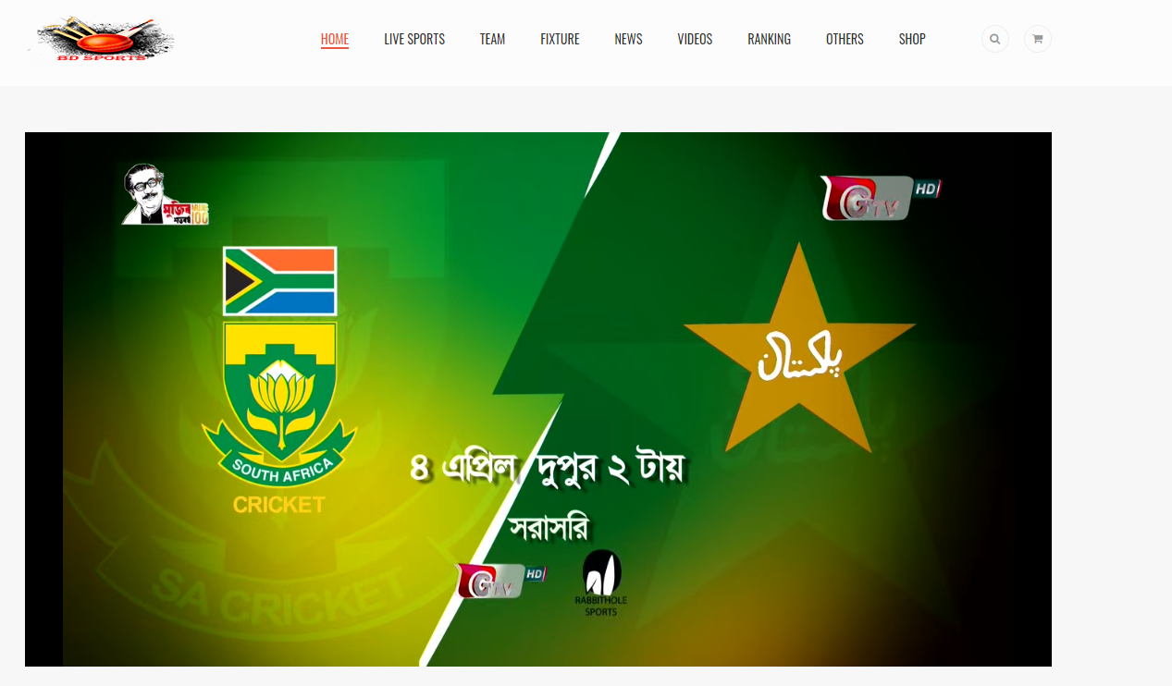
Live Sports
11

Slide 12
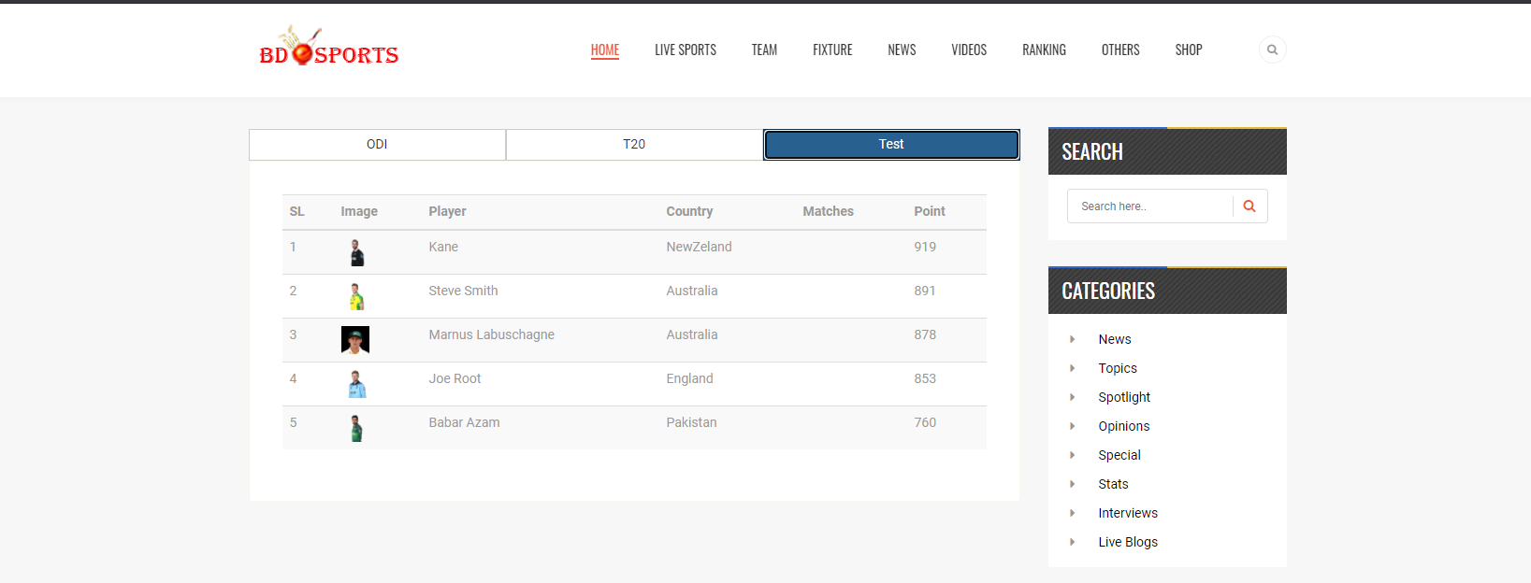
Ranking Page
12

Slide 13
Conclusion & Future Scope
SPORTS MANAGEMENT SYSTEM - CASE STUDY IN BANGLADESH is a sports related application. Here users can see their favorite sports. Some users are living far away from their family, for this reason they don’t enjoy the games. Many of them are stay is mess or hostel, there have no facility to enjoy entertainment.
Build a mobile apps.
Easy to use for every users.
Integrated Secured payment gateway.
Integrated all sports which are available in Bangladesh.

Slide 14
THANK YOU

