Slide 1
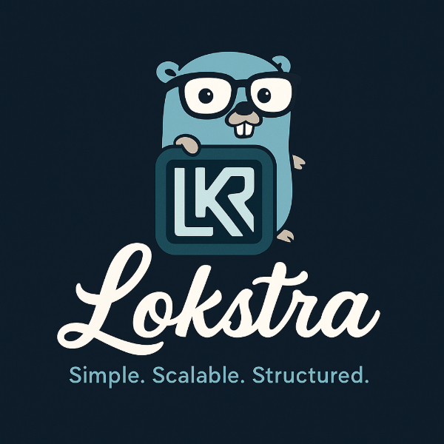
Lokstra
A Modern Go Framework for Business Applications
Primadi Setiawan
@Sevima, Oct 31 2025

Slide 2
Why Lokstra Exists
Go web frameworks are fast but limited:
❌ No clean architecture support
❌ Hard to scale from monolith to microservices
❌ Tight coupling between HTTP and business logic
👉 Lokstra was built to bridge that gap — simple for small apps, scalable for large systems.

Slide 3
Presentation Overview
This talk is divided into three parts:
1️⃣ Lokstra as Router — familiar, fast, and flexible
2️⃣ Lokstra as Business Application Framework — scalable and structured
3️⃣ Q&A — open discussion about Lokstra
“In this presentation, we’ll explore a lot of code together.”

Slide 4
Part 1 — Lokstra as Router
Familiar router features, but with more power

Slide 5
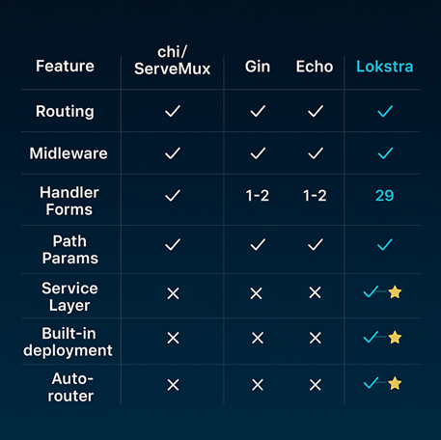
Router
Comparison

Slide 6
Handler Forms
Why 29+ forms?
- Type-safe request/response
- Auto JSON/XML
- Less boilerplate
- Context & dependency aware

Slide 7
Middleware Levels
1️⃣ Router-level or group level
2️⃣ Handler-Level

Slide 8
Part 2 — Lokstra as Business Application Framework
Clean architecture +
flexible deployment

Slide 9
Service Layer Concept
Problem: Business logic mixed in handlers
Solution: Clean separation — SERVICE, Application, Infrastructure
✅ Testable, ✅ Reusable, ✅Maintainable

Slide 10
3 Service Types
1️⃣ Infrastructure (DB, Cache, Logger) — local
2️⃣ External (Stripe, Twilio) — remote
3️⃣ ⭐ Business (User, Order) — local or remote depending on config

Slide 11
Config-Driven Deployment
Same code, different config:
- dev → monolith
- staging → single server
- prod → microservices
✅ Zero code change

Slide 12
Built-in DI & Lazy Loading
✅ No manual wiring
✅ Framework resolves dependencies automatically
✅ Lazy load = fast startup & low memory

Slide 13
Lokstra Value Summary
Not just a router — a business application framework!
✅ Clean architecture
✅ Built-in DI
✅ Config-driven deployment
✅ Monolith ↔ Microservices with no rewrite

Slide 14
Q&A — Discussion
Ideas • Feedback • Collaboration

