Slide 1

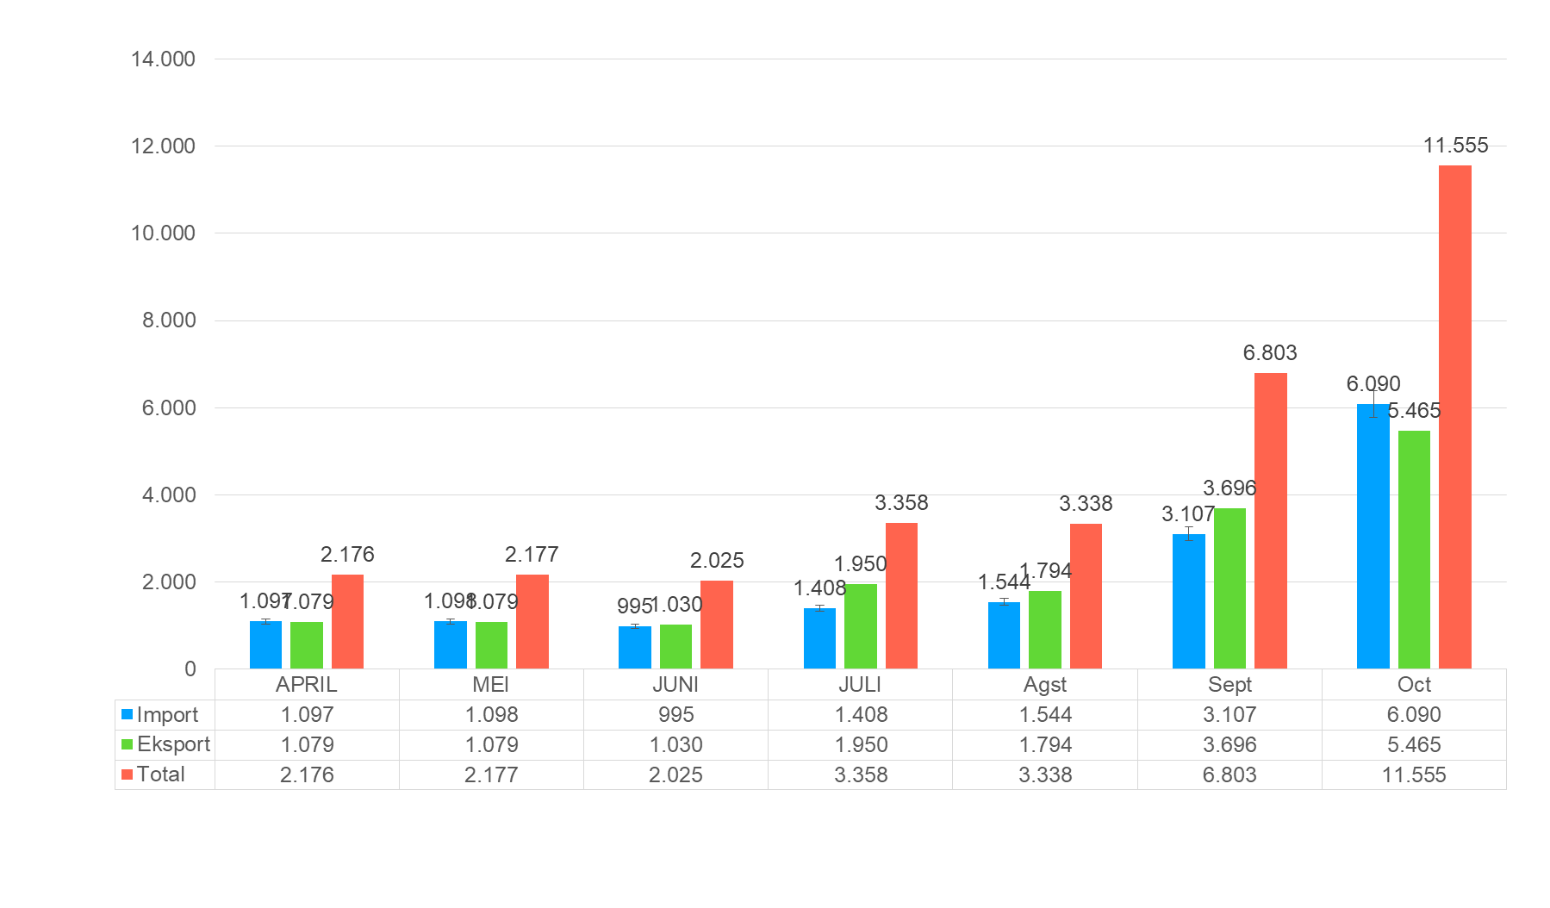
Kunjungan Kapal & Throughput Peti Kemas s.d. Oktober 2021
No | Uraian | Sat | Realisasi Tahun 2020 | RKAP Tahun 2021 | RKAP s.d October 2021 | Realisasi sd October 2021 | Est Real Tahun 2021 | RASIO
 |  |  |  |  |  |  |  | 7 : 5 | 7 : 6 | 8 : 7
1 | 2 | 3 | 4 | 5 | 6 | 7 | 8 | 10 | 11 | 12
I | PELAYANAN JASA KAPAL
 | Tambat | Call | - | 26 | 22 | 27 | 50 | 103% | 122% | 185%
 |  | Gt.Etmal | - | 481.390 | 407.330 | 321.211 | 925.756 | 66 % | 78 % | 288%
II | BONGKAR MUAT PETIKEMAS
 |  | Box | - | 25.493 | 21.571 | 31.423 | 49.274 | 123% | 145% | 156%
 |  | Teus | - | 29.316 | 24.805 | 40.526 | 62.853 | 138% | 163% | 155%

Slide 2
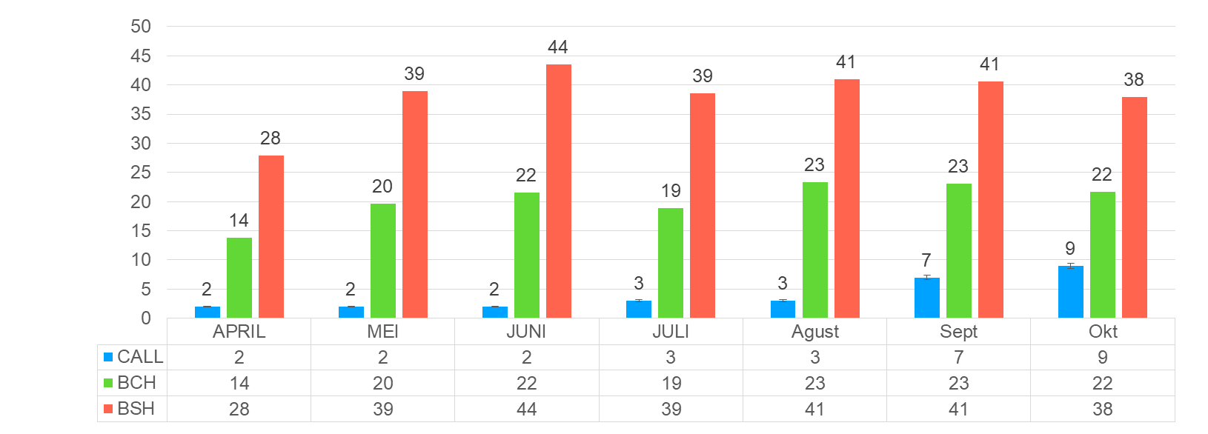
Kinerja Operasional s.d September 2021,

Slide 3
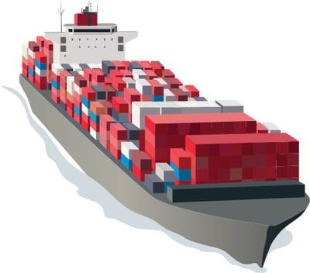
Kinerja Operasional s.d September 2021,

Slide 4
Kinerja Operasional 2019 – 2021 (sd September), RKAP 2022
No | Uraian | Sat | Realisasi Tahun 2020 | RKAP Tahun 2021 | RKAP sd Oktober 2021 | Realisasi sd Oktober 2021 | Est Real Tahun 2021 | RASIO
 |  |  |  |  |  |  |  | 7 : 5 | 7: 6 | 8 : 7
1 | 2 | 3 | 4 | 5 | 6 | 7 | 8 | 9 | 10 | 11
A. | SERVICE TIME
1 | Waiting Time (WT) | J/K | - | 1,00 | 1,00 | 0,01 | 0,50 | 1 | 1 | 50
2 | Approach Time (AT) | J/K | - | 1,50 | 1,50 | 1,18 | 1,50 | 78 | 78 | 127
3 | ET/BT | % | - | 70,00 | 70,00 | 80,71 | 84,60 | 115 | 84 | 104
B. | UTILIZATION
1 | Dermaga
 | Berth Occupancy Ratio (BOR) | % | - | 60,00 | 60,00 | 27,00 | 45,00 | 2 | 2 | 166
2 | Lapangan Penumpukan
 | Yard Occupancy Ratio (YOR) | % | - | 70,00 | 70,00 | 20,00 | 30,00 | 10 | 10 | 150
C. | PRODUKTIVITY
 | Container | BCH | - | 22,00 | 22,00 | 20,24 | 22,00 | 92 | 92 | 108
 |  | BSH | - | 32,00 | 32,00 | 38,33 | 40,00 | 119 | 119 | 104
D. | DWELLING TIME
 | Impor | Hari | - | 1,50 | 1,50 |  | 1,10
 | Ekspor | Hari | - | 1,80 | 1,80 |  | 1,80

Slide 5
Kinerja Operasional s.d September 2021,

Slide 6
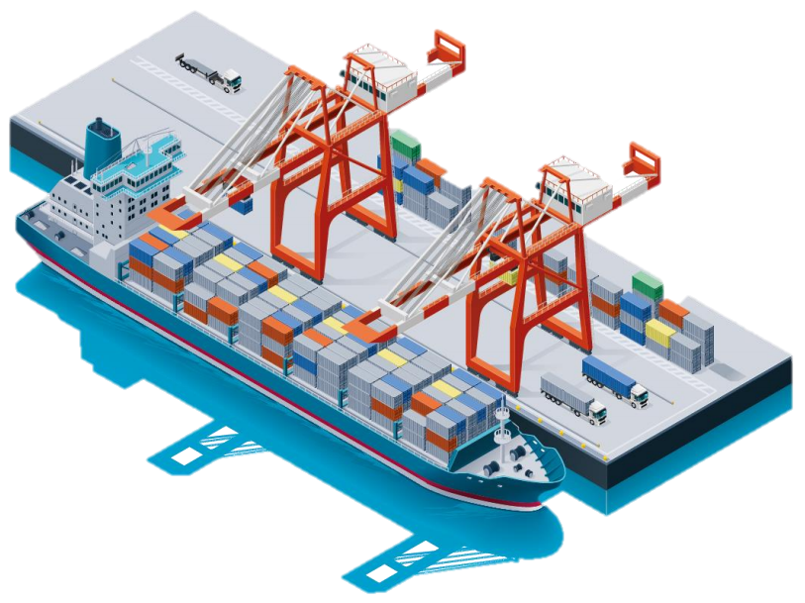
Throughput Peti Kemas s.d September 2021

