Slide 1
Cyclistic: How can bike-sharing be improved?
Author: Hardik Naik
August 2023

Slide 2
Background:
In 2016, Cyclistic launched a successful bike-share offering. Since then, the program has grown to a fleet of 5,824 bicycles that are geotracked and locked into a network of 692 stations across Chicago. The bikes can be unlocked from one station and returned to any other station in the system anytime.
The project involves analyzing Cyclistic’s historical bike trip data to segment customers into two groups: annual members and casual riders. By understanding the demographic, behavioral, and psychographic differences between these groups, we can tailor marketing strategies more effectively.

Slide 3
Goals
To find out “How do annual members and casual riders use Cyclistic bikes differently?”
Why would casual riders buy Cyclistic annual memberships?
How can Cyclistic use digital media to influence casual riders to become members?

Slide 4
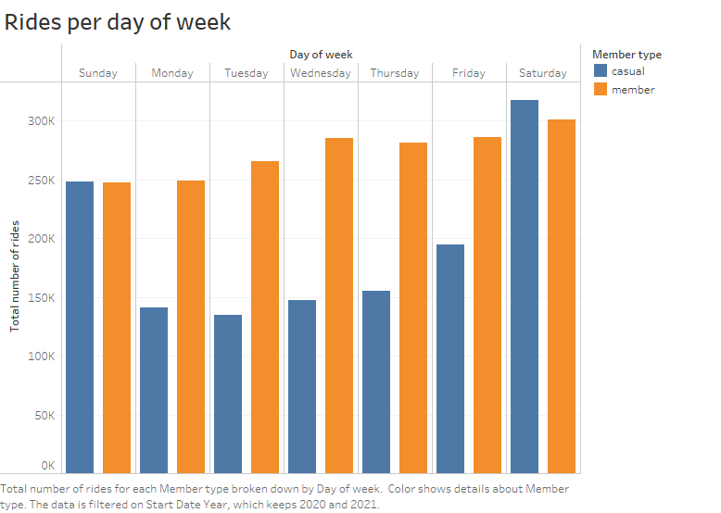
As per Rides per day of week analysis we found that during each Saturday and Sunday we get almost same rides from both casual and members
And for all other day there is only fall in causal rides and the annual members are increasing.

Slide 5
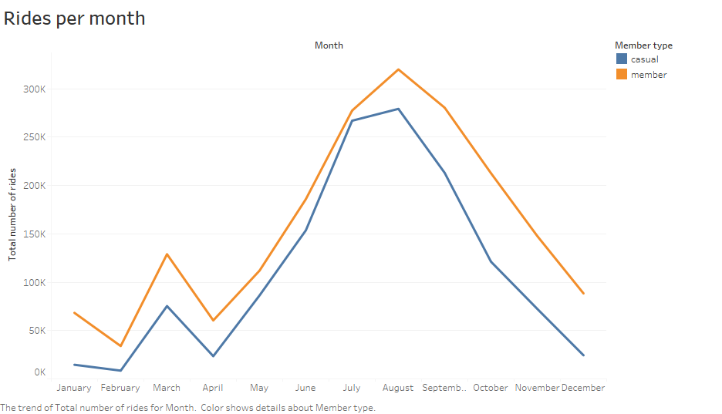
In this chart we can see the trend of total number of rides for each month.
It shows that trend rise up from April to August and then again fall.
So we are getting more rides from both casual and members between May to Sep as compare to other months.

Slide 6
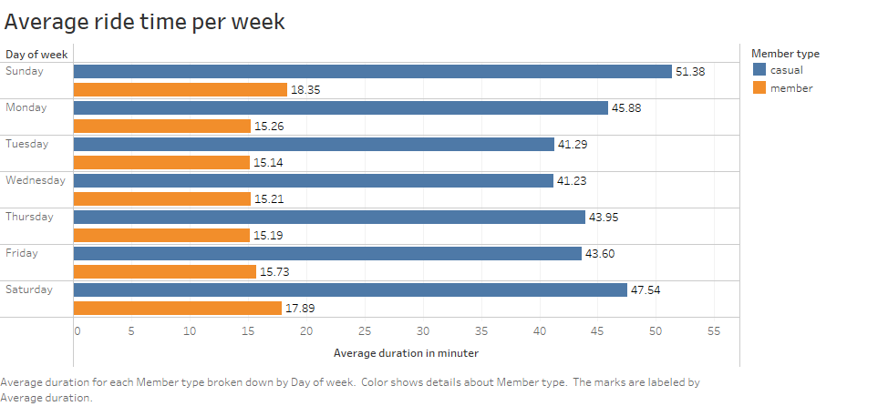
As per the reports it shows that casual members taking rides longer than annual members.
The annual members using rides for less time the average is 15 minutes and the casual members using rides on average for 45 minutes.

Slide 7
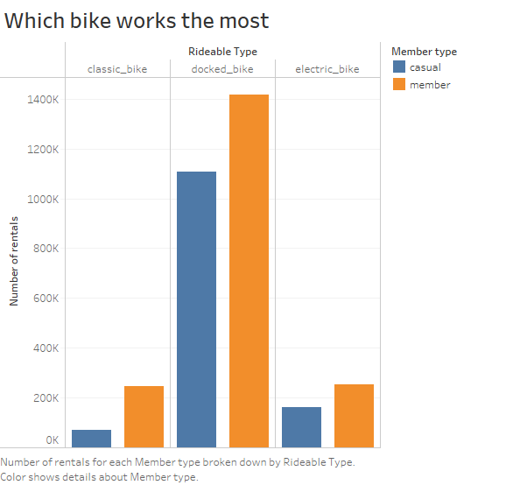
We did our analysis on which type of bike used most and by whom, Is it by casual members or annual.
After analysis we found out that Docked bikes are in demand by both causal members and annual members.
Other two classic and electric bike is on lesser demand by both users.

Slide 8
Key findings and recommendation:
How do annual members and casual riders use Cyclistic bikes differently?
As per the analysis we found that casual members use cyclsitc bike more on Sunday and Saturday and for all the other day uses falling. On the other hand annual members uses from Sunday to Saturday it’s getting rise up.
And if we go for monthly rides by both casual and annual so we come to this conclusion the annual members using cyclistic bike more than casual members and between June to September the uses on peak for both members but yes annual members were ahead of casual members.
The calculated average rented time take for both members are given bellow.
The casual members uses cyclistic bikes for average 45 minutes and the Annual members uses bike for average 15 minutes.
As there are there types of bikes classic bike, docked bike, and electric bike so both casual and annual members prefer docked bike on larger scale and all others are less in demand.

Slide 9
Why would casual riders buy Cyclistic annual memberships?
We can run some program or discount on annual membership, Also if the use buys the annual membership so the total cost will be less than daily spendings or compare to casual members.
Also for those who buys annual membership over the casual one will get 10%-20% discount.
If possible we can add first particular amount of rides free for particular distance for annual members if they buys annual membership.
Also we can add refer and earn program if someone refer their family or friends to become a annual members so they will get some kind of bonuses or free ride or discounts.
3. How can Cyclistic use digital media to influence casual riders to become members?
We can utilize digital media platforms like Instagram, Facebook, online posts, and blogs, as well as advertisements, to promote our latest offers and new plans in order to attract more annual members.
Additionally, we can distribute pamphlets to our existing users to inform them about our new agenda and offers. To further boost our promotional efforts, we can place simple and concise stickers on bikes and use them as mobile advertisements.

Slide 10
Tools used for analysis:
Data source: https://divvy-tripdata.s3.amazonaws.com/index.html
I used SQL (Big query) and Python to merge all the 12 csv files and for cleaning data, removing duplicates and blank, null values and also for negative values.
I organized the data using SQL and then connect big query with tableau to make visuals.
For presentation I used Power point.
As the data was large that’s why was not able to use excel for merging and cleaning.

Slide 11
Thank you for your time

