Slide 1

Voice Conversion
Reporter: Jiang Liuyang & Luo Sijie
Date: Dec 25, 2018
Notes:
更多模板请关注：https://haosc.taobao.com

Slide 2
01
Overview
02
Model
Content
03
Demo
04
Summary

Slide 3
Part 01
Overview

Slide 4
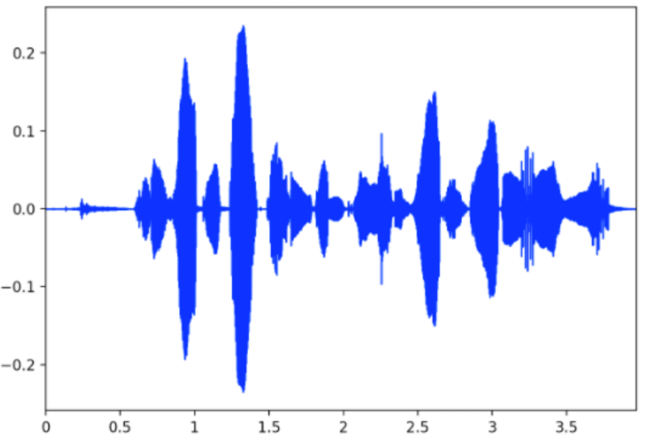
Goal
Given target voice, transfer its style to the source voice, so that the converted voice sounds the same as the target.
source voice
voice style transfer
target voice
converted voice

Slide 5

Frontend
HTML + CSS(3) + Javascript

Slide 6
Backend
01
02
03
Python
FLASK
Ajax
jQuery
A Microframework For Python

Slide 7
Part 02
Model

Slide 8
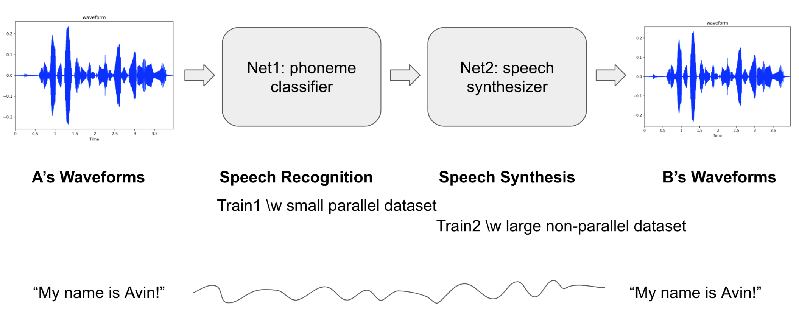
Architecture
The model architecture consists of two modules
Net1 - phoneme classification
Net2 - speech synthesis

Slide 9
Architecture
Net1 – classifier
Process: wav -> spectrogram -> mfccs -> phoneme dict
For each timestep, the input is log magnitude spectrogram and the target is phoneme dictionary
Net2 – synthesizer
Process: net1(wav -> spectrogram -> mfccs -> phoneme dist) -> spectrogram -> wav
The input/target is a set of target speaker's utterances
Griffin-Lim reconstruction when reverting wav from spectrogram

Slide 10
Training
Training the model requires two steps
Train Net1:
Datasets: TIMIT, contains recordings of 630 speakers reading ten sentences
Train Net2:
Datasets: Arctic, contains 1130 recordings of different speakers with different accents.
Specifically for this project, we select standard female voice and Indian-accent male voice as our targets

Slide 11
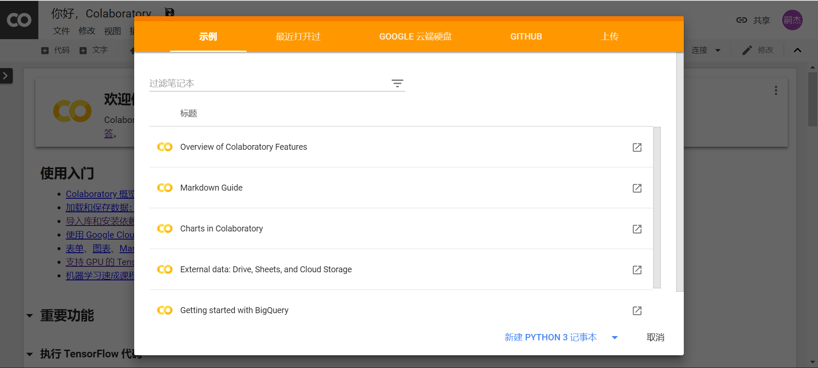
Training
Training process needs GPU acceleration
Use Google Colab platform, which provides cloud service with free GPU

Slide 12
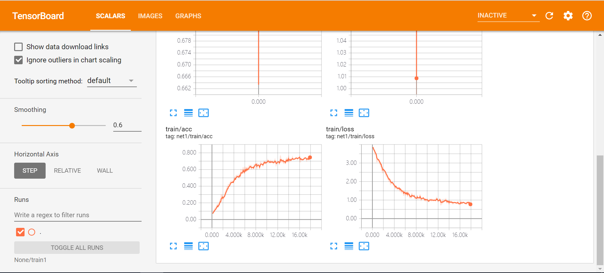
Training
Use tensorboard to supervise training process

Slide 13
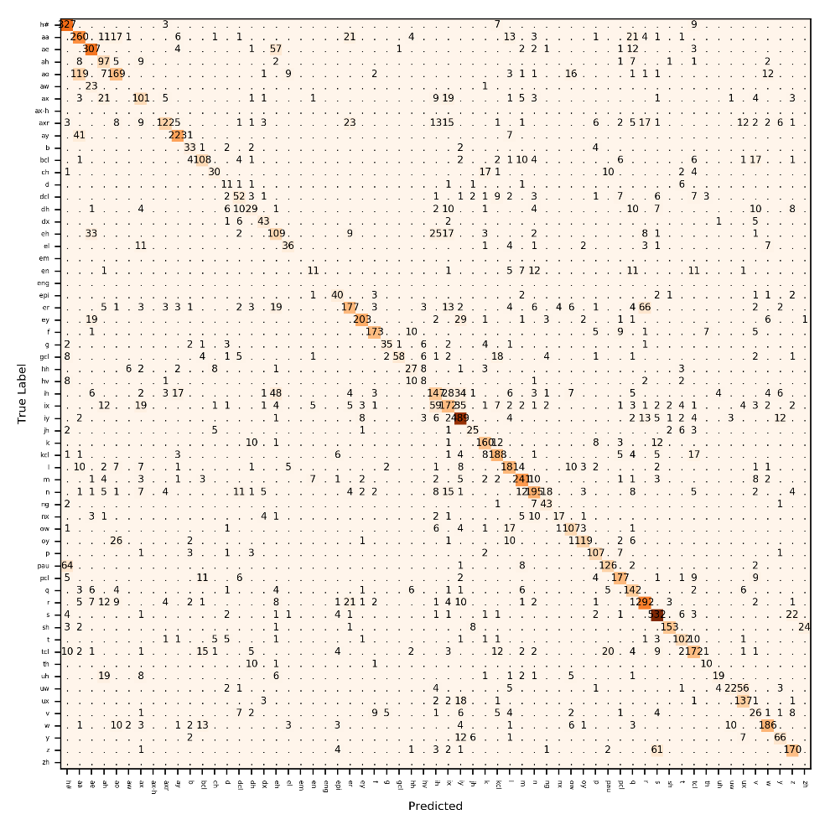
Training
Net1 training result
confusion matrix

Slide 14
Part 03
Demo

Slide 15
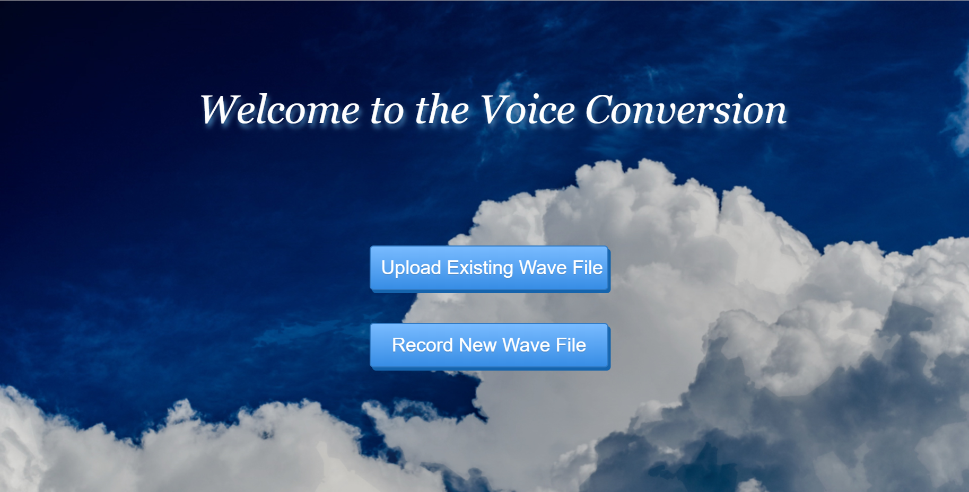
Demo

Slide 16
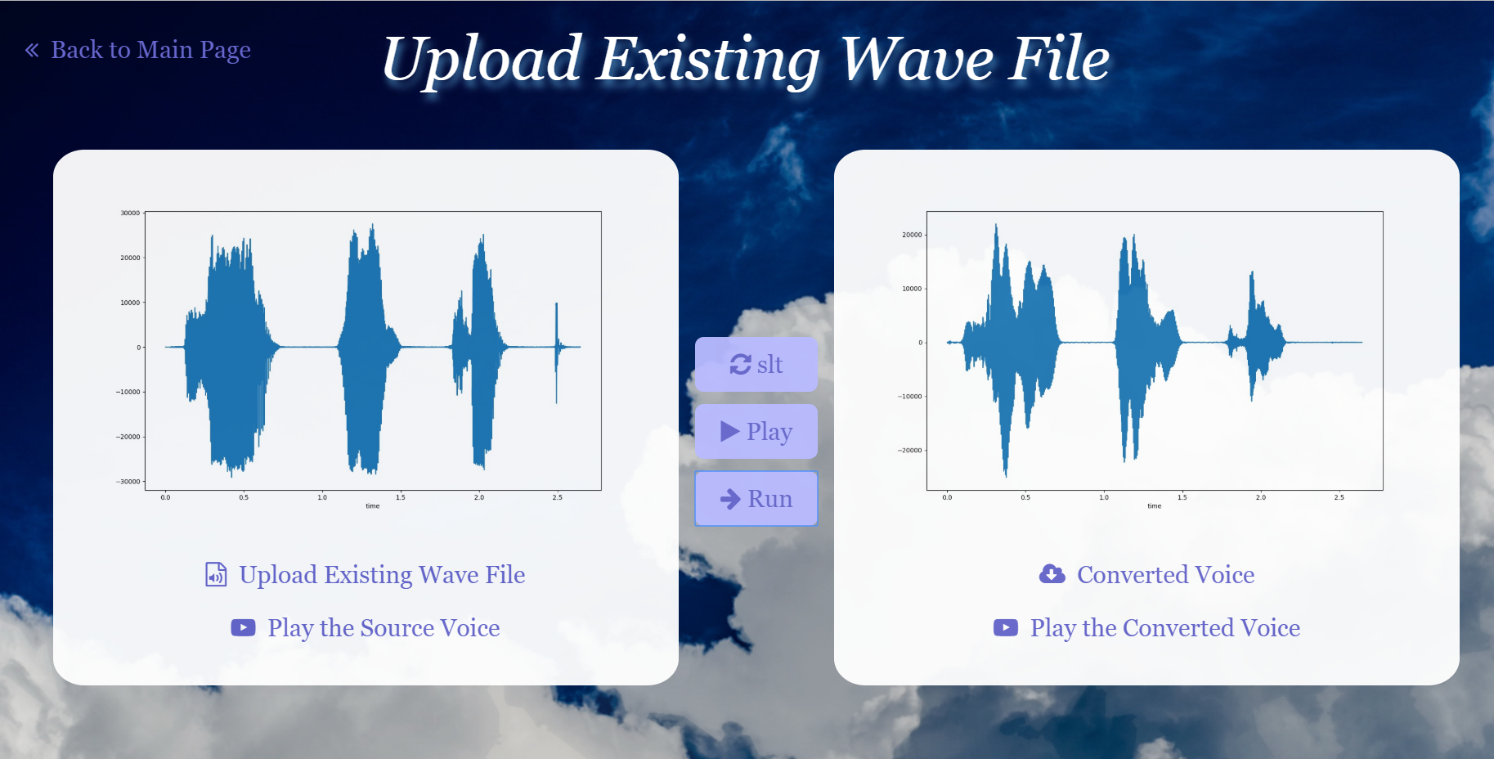
Demo

Slide 17
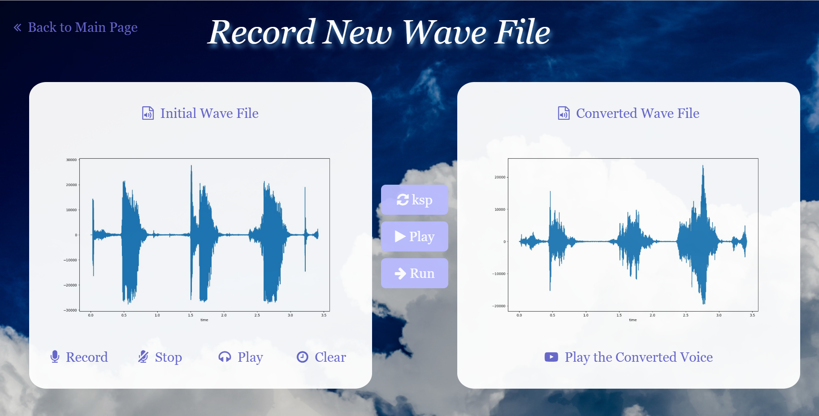
Demo

Slide 18
Part 04
Summary

Slide 19
Summary
Achieves the goal of transferring one’s voice style to another with about 74% accuracy on the test dataset
No more parallel datasets, many-to-one conversion model
GPU acceleration is critical during the process of training on large datasets
Further exploration on different methods of speech processing other than feature engineering

Slide 20
Summary
Problems:
Fixed time of audio
Backend frame is not stable enough
Future improvement:
Use better tool for reverting wav from spectrogram
Increase the language options
More stable backend framework

Slide 21
References
TACOTRON: TOWARDS END-TO-END SPEECH SYNTHESIS
Deep neural networks for voice conversion (voice style transfer) in Tensorflow

Slide 22
Shares
Jiang Liuyang:
Frontend & Backend Developing
Paper Reading & Datasets Collecting
Train Model Building
Luo Sijie:
Frontend & Backend Developing
Paper Reading & Datasets Collecting
Train Model Building

Slide 23
Thanks
Q&A
Notes:
更多模板请关注：https://haosc.taobao.com

