Slide 1


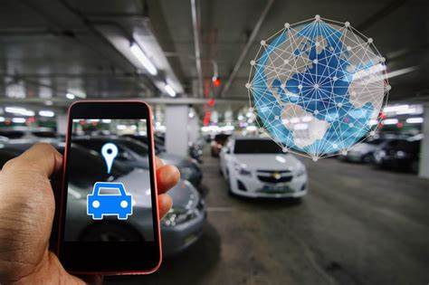


Smart Parking System: Enhancing Efficiency with IoT
DRONE AND IOT CLUB
MADAN MOHAN MALAVIYA UNIVERSITY OF TECHNOLOGY
Created by
PRIYANSHU KASHYAP (ECE first year)
Guidance of
Prof. SK Soni

Slide 2
WHAT IS SMART PARKING SYSTEM…
A smart parking system is an innovative solution that utilizes technology to manage parking spaces more efficiently. It typically involves a combination of sensors, cameras, software, and mobile applications to provide real-time information about parking availability, parking locations across an area and is energy efficient.

Slide 3
Minimizing Parking Search and Delays
Real-time Availability
Automated Entrance System
Optimized Navigation
Utilizing IoT, the system provides real-time data of parking space availability, enabling drivers to quickly locate an open spot, thereby reducing the time spent searching for parking.
Implementing IoT-integrated entrance systems to automate ticketing and entry, mitigating delays at parking entrances, and enhancing the overall efficiency of the parking process.
Integrating IoT technology to offer optimized parking navigation, directing drivers to the nearest open parking spots, effectively reducing congestion and streamlining the parking experience.

Slide 4

E-Ticket Generation & Paper Reduction
Contactless Transactions
Digital Ticketing
The adoption of e-tickets facilitates contactless transactions, enhancing the overall user experience while aligning with the current trend towards digital and touchless solutions in parking facilities.
By implementing e-ticket generation through IoT devices, the system significantly reduces the need for paper tickets, contributing to environmental sustainability and reduced operational costs.
Photos provided by Pexels

Slide 5
Benefits of Real-Time Parking Availability
Enhanced User Experience
Optimized Travel Planning
Sustainability and Reduced Emissions
Real-time parking availability allows users to locate parking spaces efficiently, saving time and reducing frustration. It enhances the overall user experience by providing convenience and peace of mind.
With access to real-time parking availability, users can plan their trips effectively. It helps in reducing traffic congestion and enhances navigation through pre-planned parking.
Access to real-time parking availability promotes sustainable transportation as it reduces urban traffic congestion and lowers vehicle emissions, contributing to a cleaner environment.

Slide 6

Security and Reservation Process
Facilitated Reservation
Vehicle Security
Users are guided through a straightforward reservation process, enabling them to secure parking spaces with ease and flexibility, improving their overall parking experience.
The process involves recording vehicle registration plates for enhanced security measures in the parking area, ensuring a safe environment for vehicles and their owners.
Photos provided by Pexels

Slide 7

Recordkeeping Process
Data Entry
NAME | ENTRY TIME | EXPECTED EXIT | EXIT TIME | BILL STATUS
Priyanshu | 9:00 | 11:00 | 11:20 | PAID
Akars | 8:15 | 9:00 | 9:00 | PAID
Divas | 13:40 | 14:30 | 15:00 | PAID
Records are entered into Google Sheets using structured formats, ensuring consistency and ease of data capture.
Photos provided by Pexels

Slide 8
Data Management Benefits
Accessibility
Real-time Updates
Version History
Google Sheets allows easy access to records from any device with an internet connection, facilitating remote collaboration and data sharing.
Records can be updated in real-time, ensuring that all users view the most current data, enhancing accuracy and efficiency.
Google Sheets maintains a version history, allowing users to track changes, revert to previous versions, and assess data integrity.

Slide 9
Energy Efficiency
Implement Smart Lighting Systems
Benefits
Maintenance Cost Reduction
The implementation of smart lighting systems involves the use of sensors to adjust the brightness based on parking area occupancy. This not only reduces energy consumption but also lowers maintenance costs. Smart lighting ensures adequate lighting for safety and security, enhancing the overall parking experience.
By reducing energy use and maintenance, the smart lighting system contributes to sustainability efforts, cost savings, and improved operational efficiency. Additionally, it enhances safety and security within the parking areas, fostering a better customer experience.
The adaptive nature of smart lighting systems minimizes unnecessary usage, thus extending the lifespan of lighting fixtures and reducing replacement and maintenance costs.

Slide 10

Occupancy Monitoring
Space Allocation Optimization
Real-time Parking Occupancy Monitoring
The collected occupancy data can be analyzed to identify peak utilization periods, enabling effective space allocation strategies. This optimization improves operational efficiency and reduces congestion within the parking facility, resulting in a seamless parking experience for users.
Utilizing sensors to monitor real-time parking occupancy enables data-driven insights for optimizing space allocation and utilization. This proactive approach enhances customer satisfaction by ensuring available parking spaces at all times.
Photos provided by Pexels

Slide 11

Space Reservation with Time Flexibility
Flexible Reservation System
The introduction of a flexible parking reservation system allows users to reserve parking spaces within a specified time window, catering to those with unpredictable schedules. By promoting better space utilization throughout the day, this approach enhances accessibility and convenience for drivers, leading to improved overall facility efficiency.
Photos provided by Pexels

Slide 12
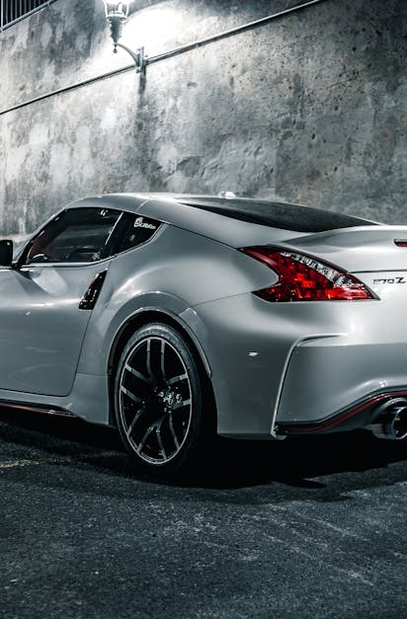
Ultrasonic Sensors
Detection of Vehicle Presence
The installation of ultrasonic sensors within parking spaces enables precise detection of vehicle presence through changes in ultrasonic waves. Each parking spot is assigned a unique sensor ID, allowing the system to accurately identify and monitor individual vehicles within the parking facility. This enhances security, operational efficiency, and user convenience.
Photos provided by Pexels

Slide 13
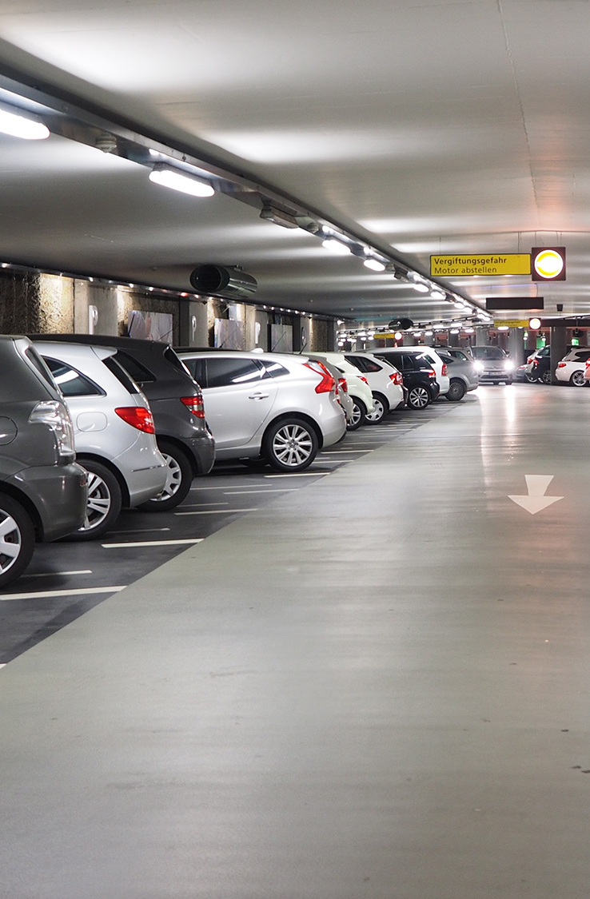
PASSIVE INFRARED SENSOR
improve security and surveillance
The use of a PIR sensor-based detection system can significantly improve security and surveillance in parking lots. This enhancement promotes safety by minimizing unauthorized access and addressing suspicious activities within the facility.

