Slide 1
BANGKOK AIRBNB
Market Intelligence Report
Expernetic Data Engineer Intern Assessment | Primesh Marasinghe | June 2026
28,806
฿1,359
31.5%
583K
Listings
Median Price
Avg Occupancy
Reviews
Inside Airbnb Dataset · Bangkok, Thailand · September 2025 Scrape

Slide 2
Presentation Agenda
01
Market Overview
Scale, structure, and key market characteristics
02
Pricing Analysis
Price drivers, room type premiums, neighbourhood dynamics
03
Host Intelligence
Market concentration, superhost impact, segmentation
04
Demand & Seasonality
Peak seasons, COVID recovery, booking patterns
05
Statistical Findings
5 hypothesis tests with effect sizes
06
ML & AI
Price prediction, NLP, RAG system, recommendations
07
Business Recommendations
Actionable insights for hosts, investors, operators

Slide 3
01 Market Overview
28,806
8,874
50
10.5M
Active Listings
Unique Hosts
Neighbourhoods
Calendar Records
🏙️ Bangkok is one of SE Asia's most dynamic short-term rental markets
📈 2024 review volume hit all-time high: 148,869 reviews (+152% vs 2019 pre-COVID)
🏢 Market dominated by commercial operators: 10.6% of hosts control 57% of listings
💰 Median nightly price: ฿1,359 THB (~$38 USD) — affordable by global standards
⭐ 81.4% of listings rated above 4.5 — classic rating inflation pattern confirmed
🚇 BTS Skytrain proximity is the #1 guest decision factor (2,513 review mentions)

Slide 4
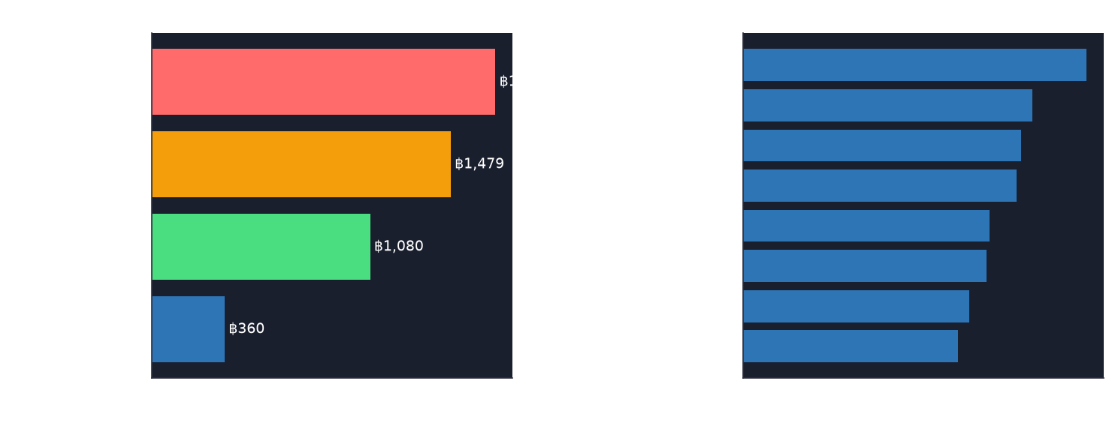
02 Pricing Analysis
💡 Key Insights
• Entire homes: 38% premium over private rooms (p<0.0001)
• Parthum Wan commands highest prices at ฿2,225 median
• TV amenity adds +68.6% price premium
• Hot tub: +49.8% | Kitchen: +36.9%
• Neighbourhood explains 10.5% of price variance (η²=0.11)

Slide 5
03 Host Market Intelligence
Non-Superhost
⭐ Superhost
฿25,968
฿114,431
Median Annual Revenue
Median Annual Revenue (+340%)
Avg Rating: 4.575
Avg Rating: 4.858 (Cohen's d=0.54)
⚠️ Market Concentration Alert
10.6% of hosts
Top host 243 listings
6 host segments
62.7% casual hosts
Control 57% of listings
Single operator
K-Means clustering
Single listing only

Slide 6
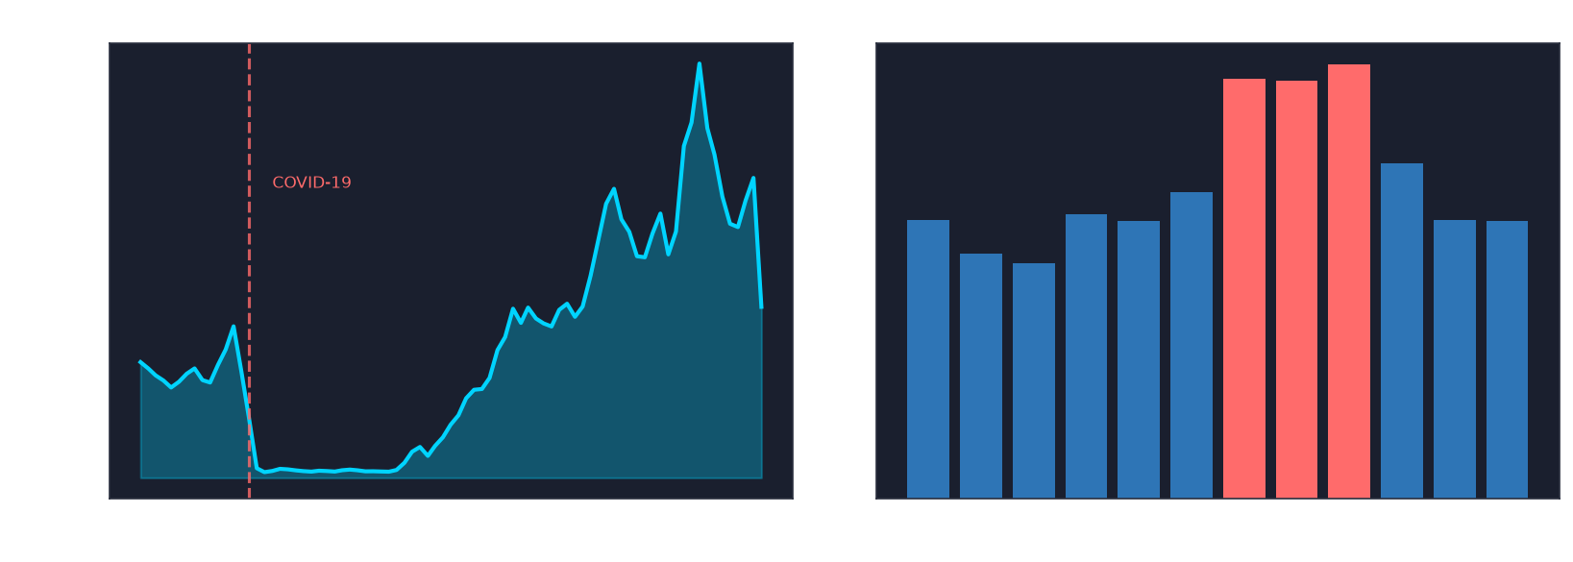
04 Demand & Seasonality
📊 Key Demand Insights
• Peak: Jul–Sep (43% occupancy)
• Trough: Feb–Mar (~24%)
• 2024: All-time high 148,869
• +152% vs 2019 pre-COVID
• No weekend premium (p=0.526)

Slide 7
05 Statistical Findings
ID
Hypothesis
Decision
P-value
Effect Size
H1
Entire home > Private room price
REJECT H₀
p<0.0001
r=0.29 moderate
H2
Superhost > Non-superhost rating
REJECT H₀
p<0.0001
d=0.54 medium
H3
>10 reviews affects price
REJECT H₀*
p=0.000005
r=0.037 negligible
H4
Neighbourhood price differences
REJECT H₀
p<0.0001
η²=0.11 moderate
H5
Weekend vs weekday pricing
FAIL TO REJECT
p=0.526
d=0.012 negligible
* H3: Statistically significant but effect size negligible — large n amplifies trivial differences

Slide 8
06 Machine Learning & AI
Price Prediction (3 Models + 5-Fold CV)
NLP & AI Components
Model
MAE
R²
MAPE
🎭 VADER Sentiment
72.9% positive · r=0.089 vs scores
Ridge Regression
฿655
0.449
42.1%
📚 LDA Topic Modeling
Random Forest
฿501
0.652
29.2%
6 topics · 40% non-English detected
🔍 Named Entity Recognition
Gradient Boosting ✓
฿504
0.662
29.1%
BTS #1 landmark · Small #1 complaint
🤖 RAG Q&A System
Top Price Drivers (Gradient Boosting):
TF-IDF retrieval over 10K reviews
Bedrooms: 43.2%
🎯 Recommendation System
Neighbourhood Median Price: 16.9%
Cosine similarity · 0.99+ scores
Accommodates: 12.2%
💡 Listing Advisor
Data-driven improvement recommendations
Host Tenure: 4.3%
Host Listings: 4.3%

Slide 9
07 Business Recommendations
🏠 FOR HOSTS
📈 FOR INVESTORS
🏢 FOR OPERATORS
• Pursue Superhost status — revenue jumps 340% (฿25,968 → ฿114,431)
• Bangkok market at all-time high — 2024 reviews +152% vs 2019
• Monitor commercial concentration — 57% supply risk
• Implement weekend pricing premium — zero competition currently
• Target Bang Rak / Vadhana for premium positioning
• Address rating inflation — 81.4% above 4.5
• Highlight BTS/MRT proximity — #1 guest decision factor
• Mid-market ฿1,000–2,500 captures peak demand concentration
• Deploy multilingual NLP for full review coverage
• Upgrade amenities: TV (+68.6%), Hot tub (+49.8%), Kitchen (+36.9%)
• High Demand segment achieves 61% occupancy
• Introduce weekend pricing tools for hosts
• Dynamic pricing for Jul–Sep peak (43% vs 24% Feb trough)
• Avoid shared rooms — only 11.6% occupancy rate
• Proactive regulatory engagement — Bangkok mirrors Amsterdam

Slide 10
Technical Architecture & Stack
⚙️ Pipeline
📊 Analysis
🤖 AI/ML
🎨 Products
☁️ Architecture
• Python 3.11
• scipy / statsmodels
• Gradient Boosting
• Streamlit Dashboard
• AWS Cloud Design
• pandas / numpy
• scikit-learn
• K-Means Clustering
• AI Analyst Chatbot
• Kafka Streaming
• DuckDB SQL
• matplotlib / seaborn
• TF-IDF RAG
• ReportLab PDF
• Star Schema
• dbt models
• plotly
• LDA Topics
• Stream Sim
• 21 Unit Tests
• Docker
• VADER NLP
• Rule-based NER
• PPTX Deck
• Git + GitHub
GitHub: github.com/primemarasinghe/airbnb-market-intelligence

Slide 11
Thank You
Bangkok Airbnb Market Intelligence
✅ 8 Jupyter Notebooks | ✅ 21 Unit Tests | ✅ Docker Containerized
✅ Streamlit Dashboard | ✅ AI Analyst Chatbot | ✅ Automated PDF Reports
✅ dbt Models | ✅ Stream Processing Sim | ✅ AWS Architecture Design
Primesh Marasinghe | BSc (Hons) Data Science, SLIIT | June 2026
github.com/primemarasinghe/airbnb-market-intelligence

