Slide 1






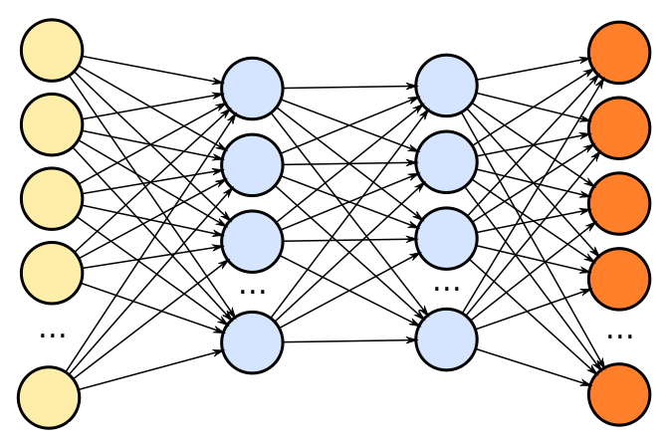


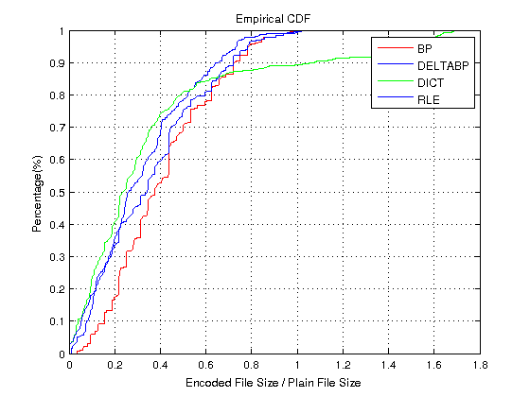
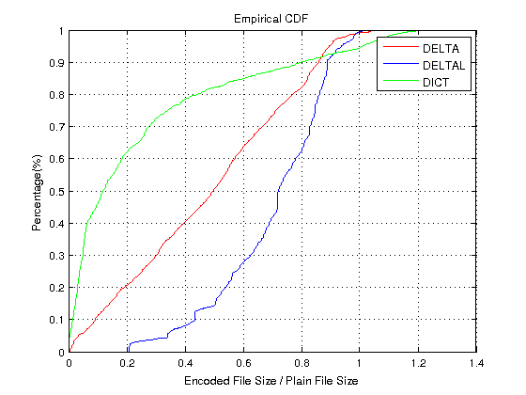
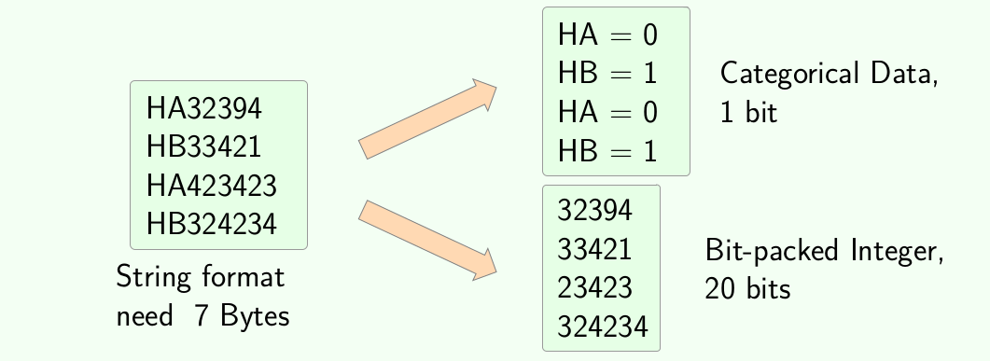
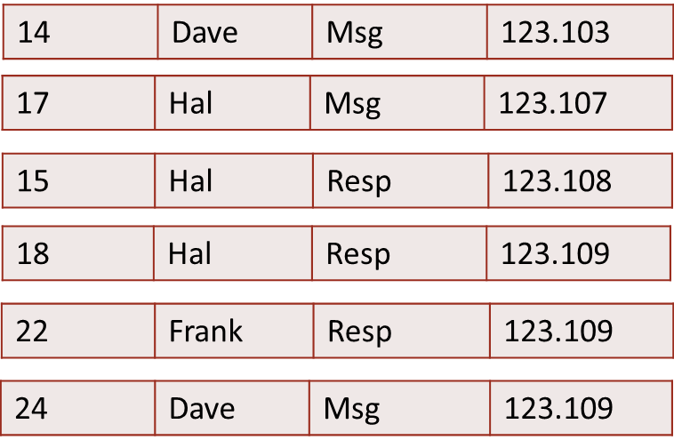
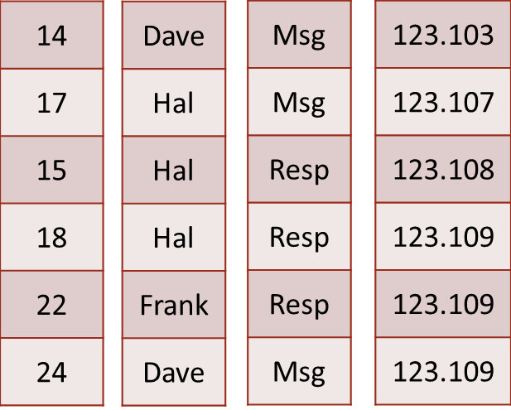
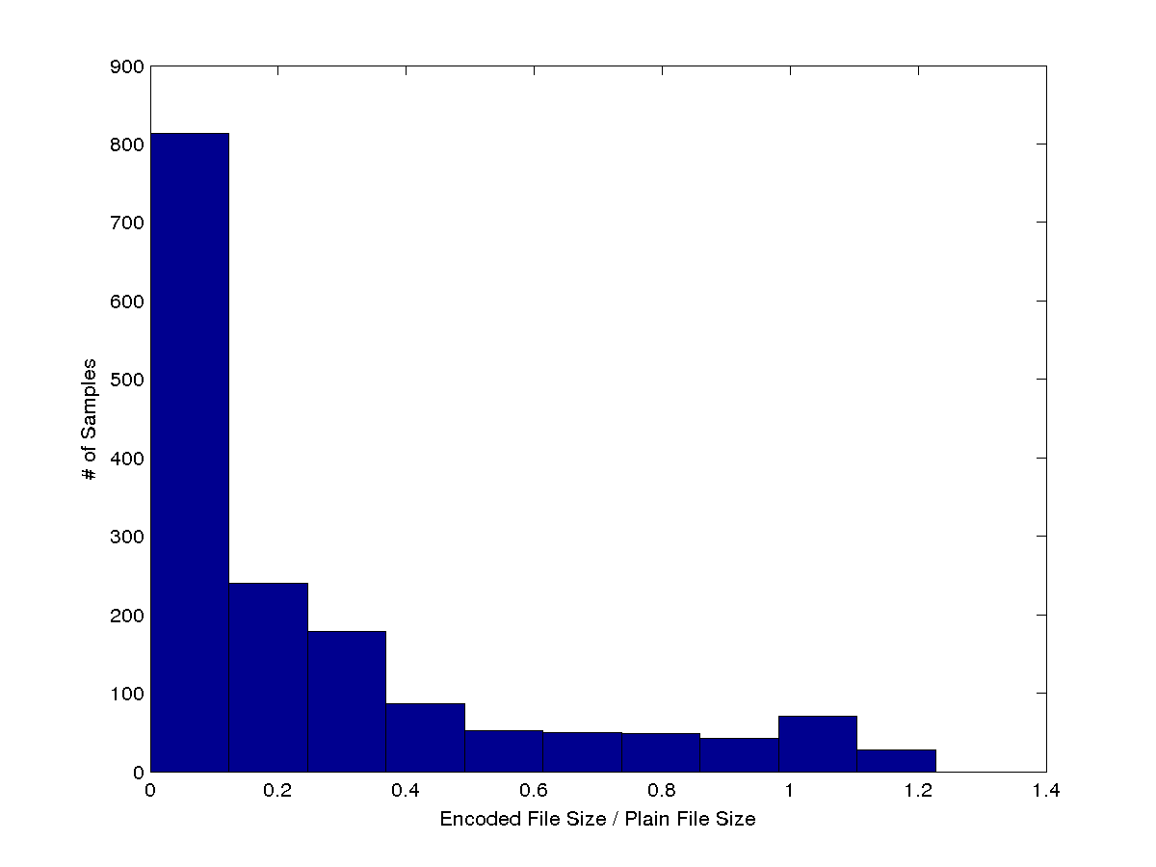
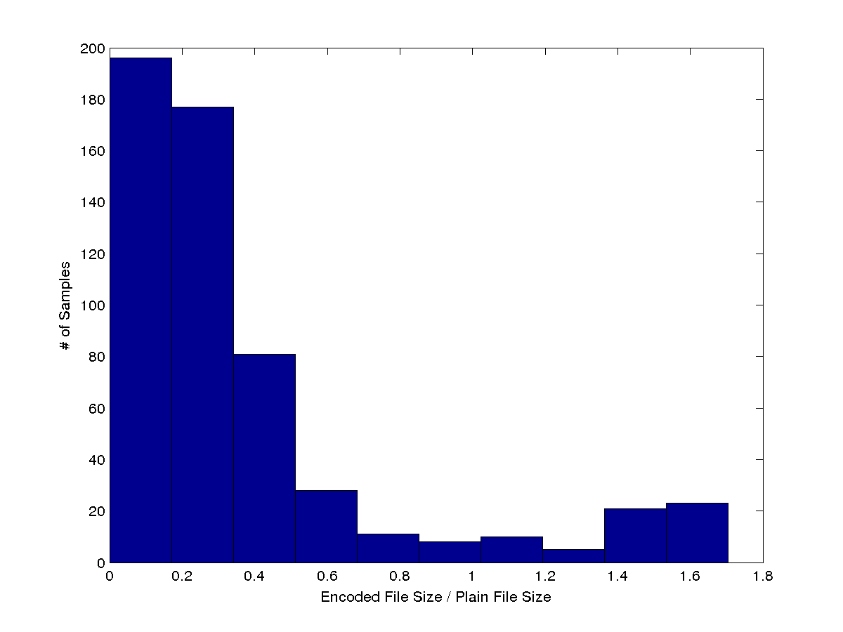
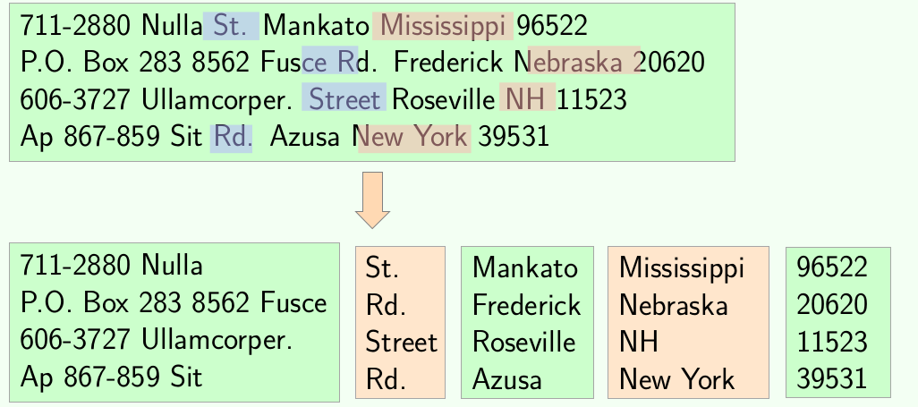
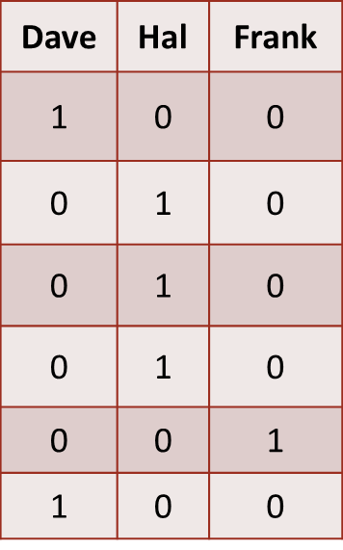
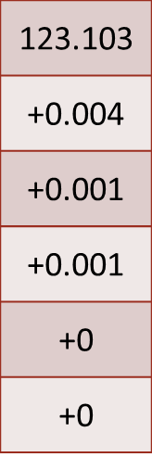
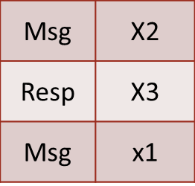
EDIS: Efficient Data Management for IoT and Data Streams
Hao Jiang, Aaron J. Elmore
Data-Driven Lightweight Encoding Selection
Datasets
Pattern Mining
Prediction Network
Efficient Encoding
What is Encoding?
Dataset Analysis
New Opportunities
Space saving and query efficient data format, used in Dremel, Carbon, Parquet, Vertica, etc.
We have collected over 7000 columns from approximately 1200 datasets, and applied various encodings to them
Sub-attributes and embedded data does not encode well, can we identify this data and decompose attributes?
Record
Oriented
Data
Compression Ratio for Integer Columns
Compression Ratio for String Columns
Observing the pattern <STR><NUM> from dataset allowing us to separate them and apply more efficient encoding for each part
Column Oriented Data
There is no single best encoding scheme.
Encoded Data
Dictionary Encoding is often adopted as default in many systems, however it performs sub-optimal in many cases
One pass a\encoding selector in progress
Use NLP techniques to look for similar words in text and extract patterns

