Slide 1



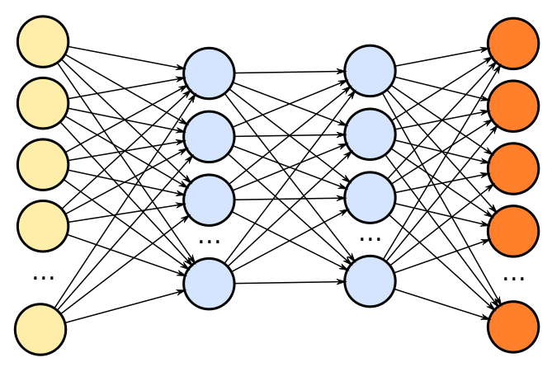





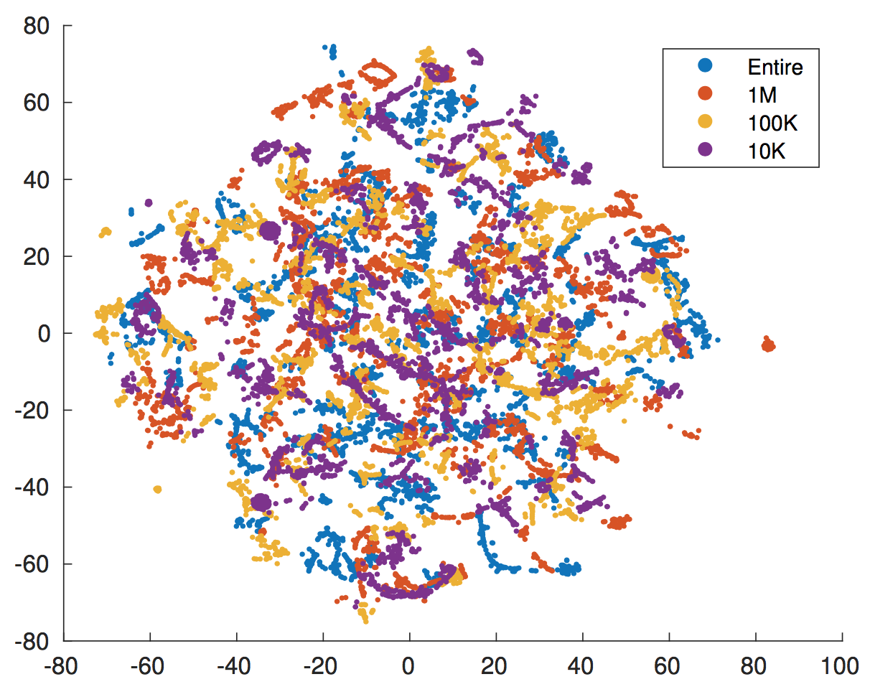
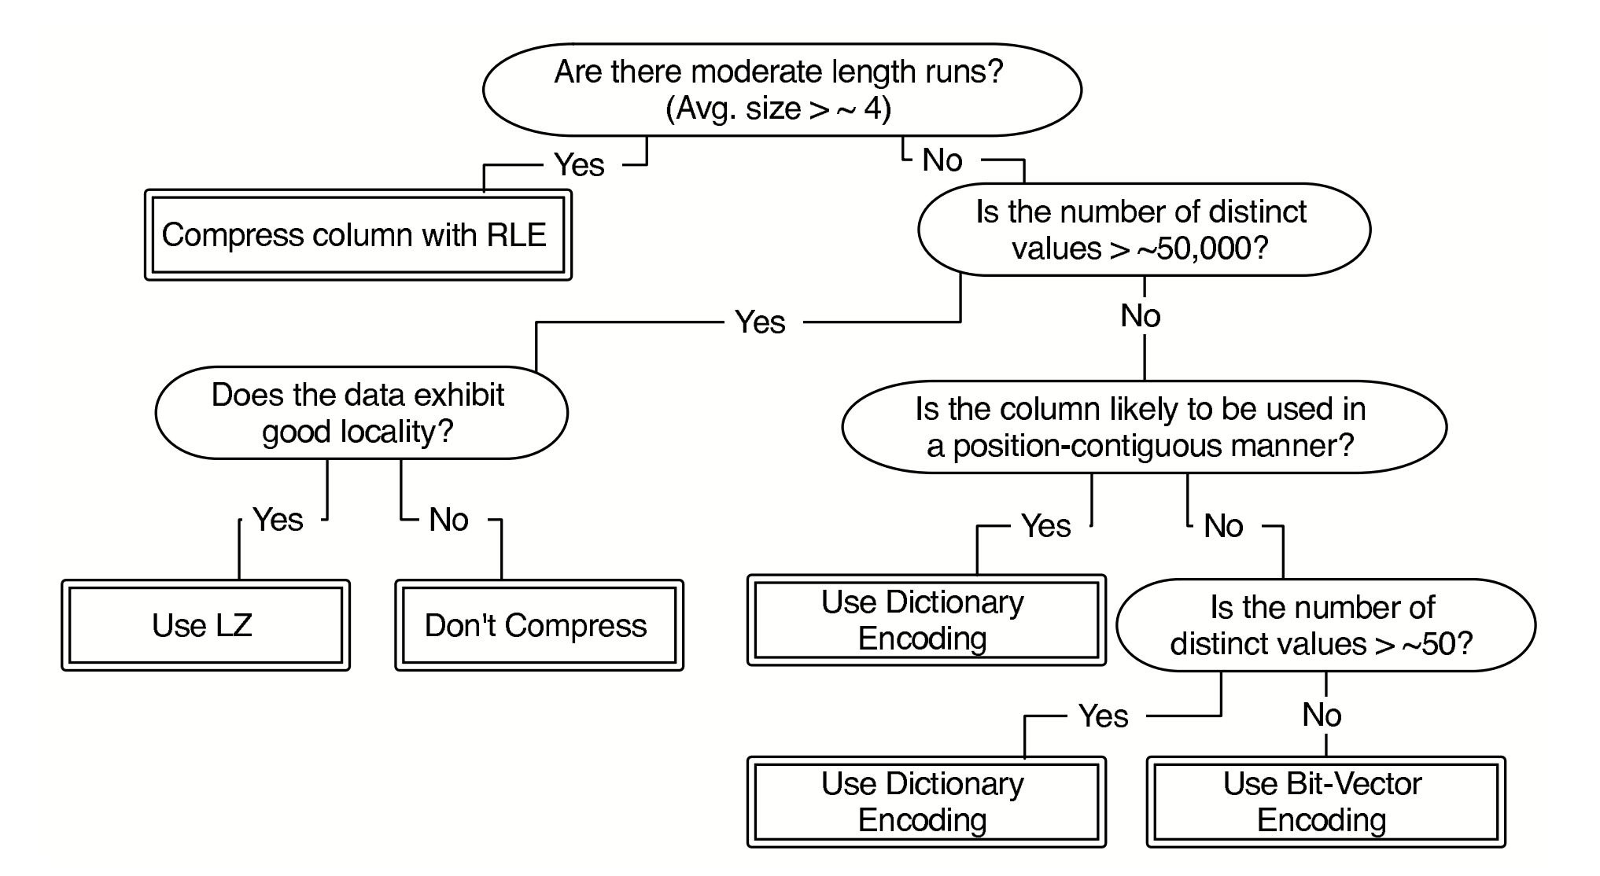
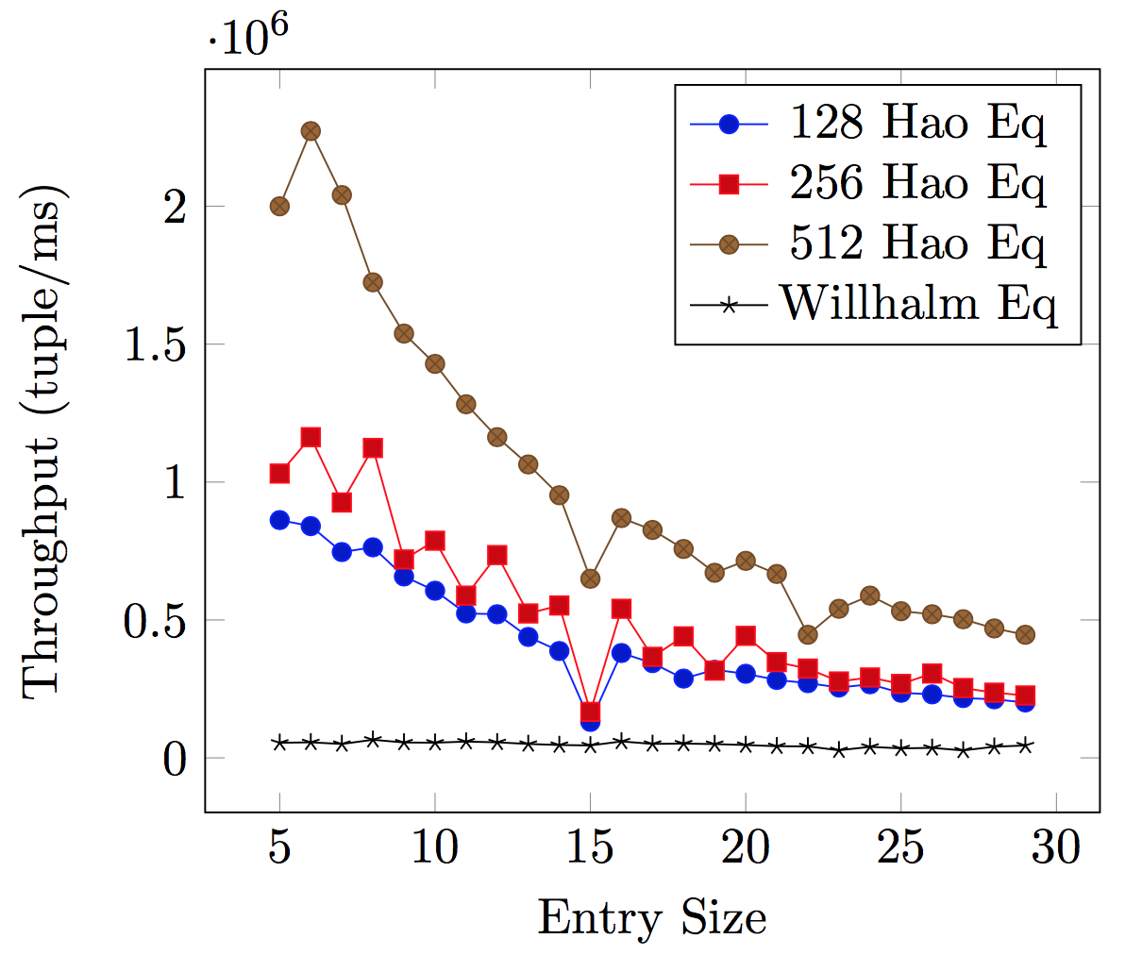
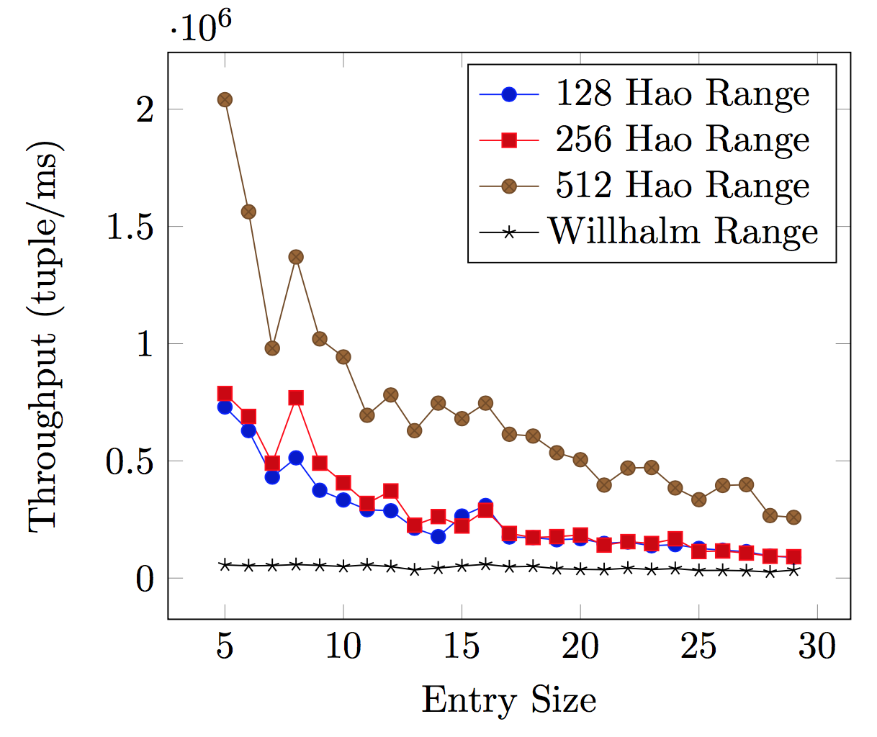
EDIS: Efficient Data Management for IoT and Data Streams
Hao Jiang, Aaron J. Elmore, Andrew A. Chien
Data-Driven Encoding in Columnar Database
Datasets
Pattern Mining
Prediction Network
Efficient Encoding
Features Selection
Accuracy of ANN on Encoding Selection
How good is an encoding?
The following features are computed from datasets as input to ANN
We compute features on partial dataset, which makes system performance independent from dataset size
We evaluate encoding performance on both storage size and query speed.
Cardinality Ratio
cardinality vs. num of records
-------------
-----------
-------------
-----------
----------
…….
Features
Features
Features
vs.
Features
Features
Features
Sortness (num of inverted pairs)
Absolute Kendall’s 𝜏
93%
String, Entire Dataset: Integer, Entire Dataset:
87%
Fast Predicate Execution on Bit-Packed Data with SIMD
Record Length
mean and variance of record length
String, first 100K records: 93%
Integer, first 100K records: 85%
Comparison with other methods
We introduce a new algorithm to directly query bit-packed data without decoding with
better performance
40x
Dataset Entropy
Per-line Entropy
max, min, mean and variance of
per-line entropy
Parquet’s built-in method
Abadi’s Decision Tree
Dict Encoding
70%
Fallback
RLE / Plain
Non-empty Ratio
non-empty records vs. num of records
Other ML methods
Decision Tree: ~50%
34%

