Slide 1
Execute Predicate on Bit-packed Data
Most scan operation in Columnar Database can be viewed as Predicate Execution
Common Predicates include Equal / Non-equal / Greater / Less
Bit-packed Encoding has wide applications
Bit-packed Integer data has good compression rate
With order-preserving dictionary, String data can be converted to bit-packed Integer, which supports wildcard search.

Slide 2
Previous Methods
Scalar method
Extract and read number one by one using bit-operations
Low throughput
Willhalm 2009:
Use 128-bit SIMD instructions to extract 4 integers at a time, each in a 32-bit lane (Parallel Decoding)
Use 32-bit comparison instruction to obtain predicate result
Has ~3x throughput comparing to scalar method
Only works in 128-bit even with latest 512-bit SIMD CPU

Slide 3
Our Method
High Efficiency
Directly manipulate bit-packed data, no decoding process at all
High Parallelization
Works with 128 / 256 / 512 bit SIMD
Process all entries in a SIMD register at a time
Better performance
40x ~ 5x throughput compared to Willhalm’s method

Slide 4
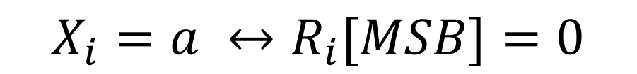
Equal / NonEqual
Bit-Packed Entry
X =
X1
X2
X3
X4
X5
X6
SIMD Register
A =
a
a
a
a
a
a
D = X⊕A R = D|((D& ∼ M)+ ∼ M)
M is MSB-Mask, everything except for MSB is 0
Most-Significant-Bit
R =
1
1
0
1
R2
R5
R6
R1
0
0
R4
R3
$$X_{i}=a ↔R_{i}[MSB]=0$$

Slide 5
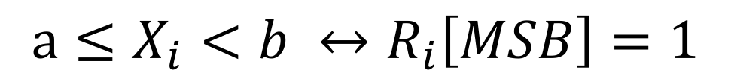
Range Comparison
X =
X1
X2
X3
X4
X5
X6
A =
a
a
a
a
a
a
B =
b
b
b
b
b
b
L = X|M − (A& ∼ M)
U = X|M − (B& ∼ M)
EL = (X| ∼ A)&((X& ∼ A)|L)
EU = (X| ∼ B)&((X& ∼ B)|L)
R = EL ⊕ EU
$$a≤X_{i}<b ↔R_{i}\left[MSB\right]=1$$

Slide 6
SIMD Arithmetic Operation
We implement 256 / 512 bit SIMD Arithmetic Operation
Our algorithm requires doing math on entire SIMD lane, while Intel only provides 64-bit arithmetic operations
Basic Idea: Compute and handle carry bit among the 64-bit lanes
a carry is generated if a+b < a
We introduce a faster method to compute carry bit in parallel
30% faster in 256 bit lane comparing to compute 4 carry bit separately
1.5x faster in 512 bit lane comparing to compute 8 carry bit separately

Slide 7
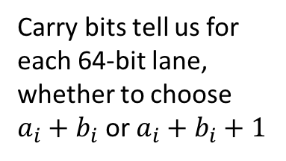
Compute carry bit in parallel (take add as example)
64 bit numbers
carry bits
a1
a2
a3
a4
256 bit lane
b1
b2
b3
b4
Carry bits tell us for each 64-bit lane, whether to choose $a_{i}+b_{i}$ or $a_{i}+b_{i}+1$
64 bit add
64 bit compare
BLEND INSTRUCTION
a1+b1
a2+b2
a3+b3
a4+b4
a1+b1
a2+b2+1
a3+b3+1
a4+b4+1
BLENDED RESULT

Slide 8
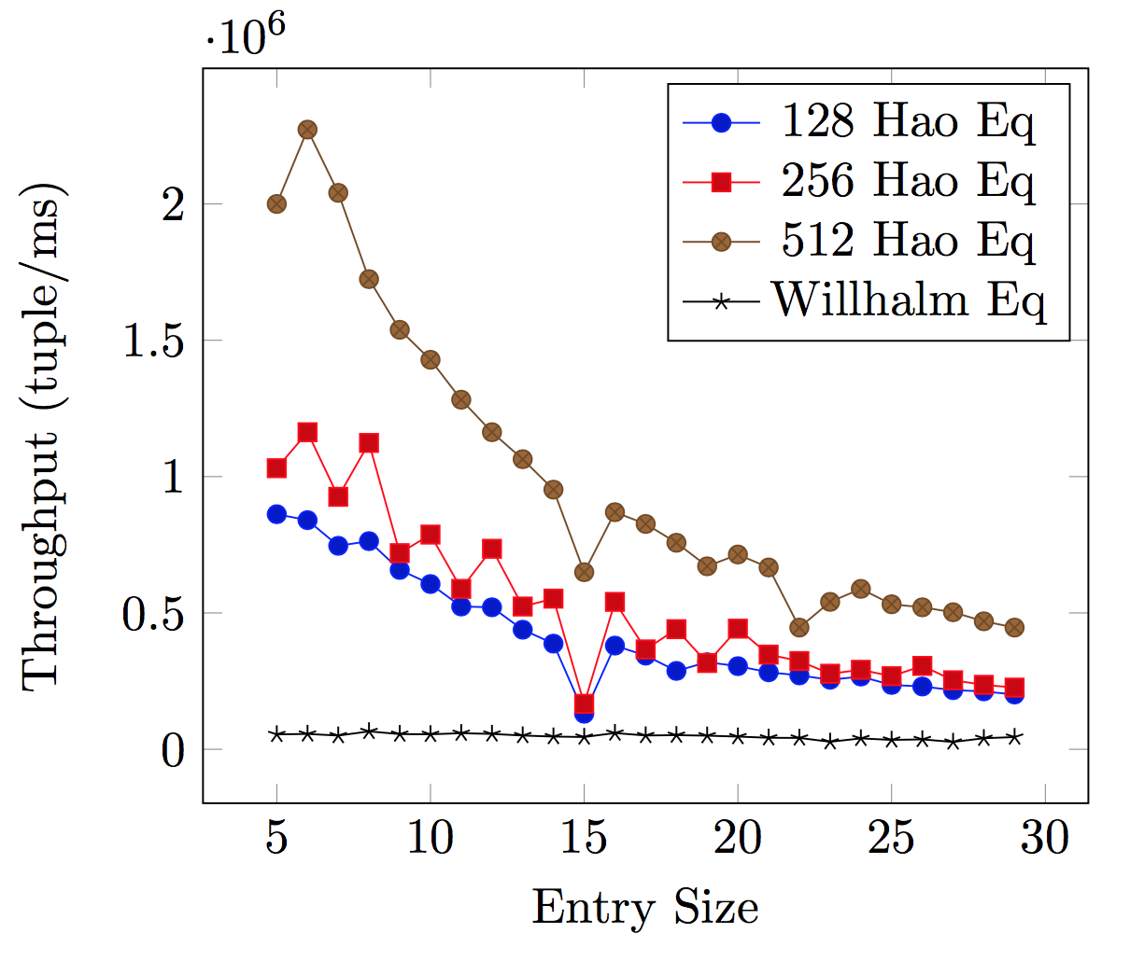
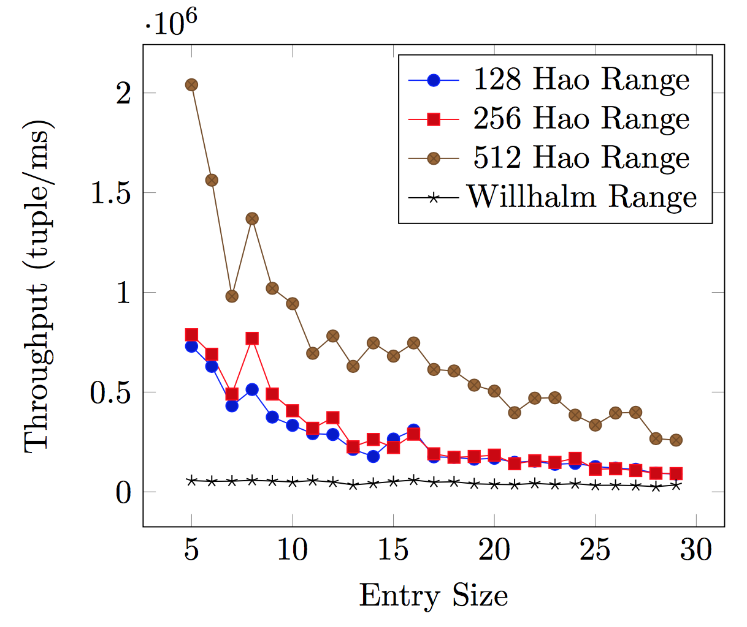
Experiment
We perform our experiment on Google Cloud Platform with Skylake CPU that supports AVX-512

Slide 9
Performance Analysis
Higher Throughput with smaller entry size
Higher Parallelization with smaller entry as we process all entries in a SIMD lane at the same time
512 bit has double performance comparing to 256 bit, while 256 bit is just a bit better than 128 bit
Most time is consumed on the arithmetic operations
This time is almost identical among architectures, and higher parallelization on 512 bit compensate it

