Slide 1
Web Design Principles
5th Edition
Chapter Four
Introducing Cascading Style Sheets

Slide 2
Objectives
When you complete this chapter, you will be able to:
Recognize the benefits of using CSS
Build a basic style sheet
Use inheritance to write simpler style rules
Examine basic selection techniques
Apply basic selection techniques
Use class and id selectors
Use the <div> and <span> elements
Use other selectors
Web Design Principles 5th Ed.

Slide 3
Recognizing the Benefits of
Using CSS

Slide 4
The Evolution of CSS
CSS was developed to standardize display information
CSS was slow to be supported by browsers
Newer browsers offer more complete support
Latest release is CSS3
CSS3 is not yet evenly supported
Web Design Principles 5th Ed.

Slide 5
CSS Style Rules
In CSS, style rules express the style characteristics for an HTML element
A set of style rules is called a style sheet
Style rules are easy to write and interpret
Web Design Principles 5th Ed.

Slide 6
CSS Style Rules
Style rules are composed of two parts: a selector and a declaration
The selector determines the element to which the rule is applied
The declaration details the exact property values
Web Design Principles 5th Ed.

Slide 7
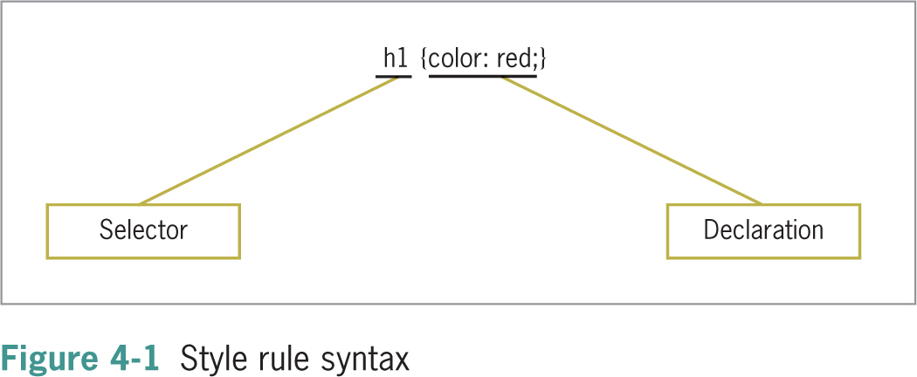
Web Design Principles 5th Ed.

Slide 8
CSS Style Rules
The declaration contains a property and a value
The property is a quality or characteristic
The precise specification of the property is contained in the value
CSS includes a wide variety of different properties, each with a specific number of values
Web Design Principles 5th Ed.

Slide 9
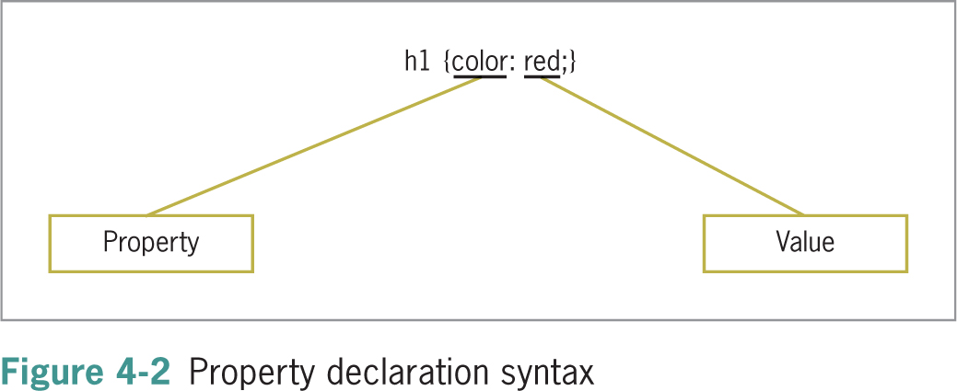
Web Design Principles 5th Ed.

Slide 10
Combining CSS Style Rules with HTML
You combine CSS with HTML in three ways:
Inline style
Internal style sheet
External style sheet
Web Design Principles 5th Ed.

Slide 11
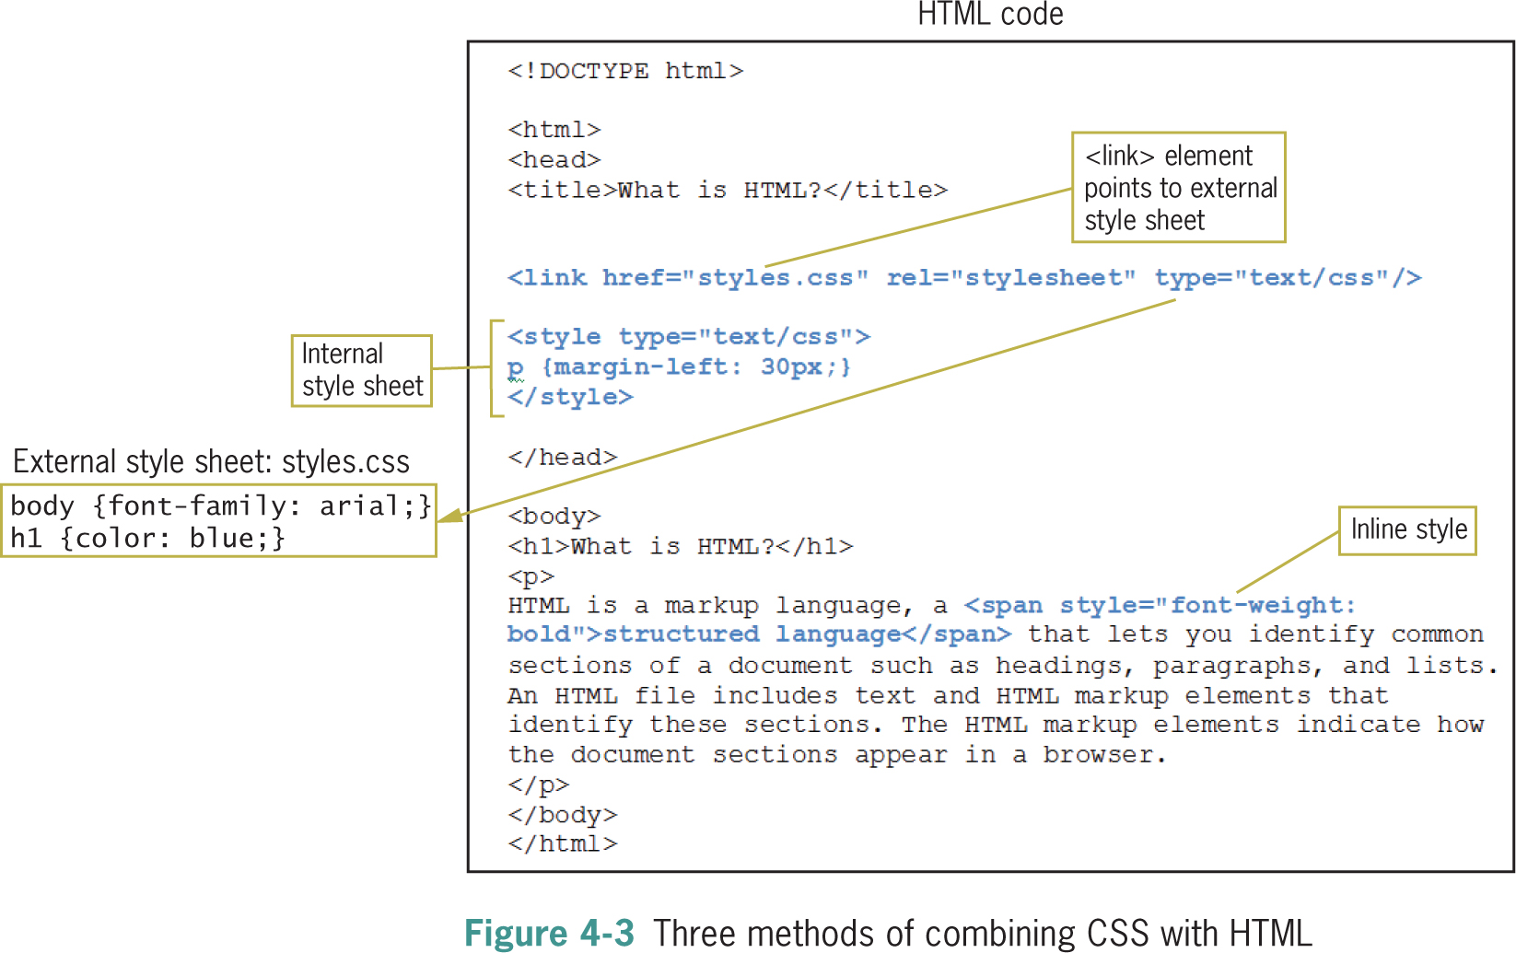
Principles of Web Design 5th Ed.

Slide 12
Using External Style Sheets
External style sheets let you specify rules for multiple Web pages
These are text documents that contain style rules
External style sheets have a .css extension
Web Design Principles 5th Ed.

Slide 13
Linking to an External Style Sheet
The link element lets you specify an external style sheet
It is used within the <head> section of a document
<head>
<title>Sample Document</title>
<link href="styles.css" rel="stylesheet" type="text/css" />
</head>
Web Design Principles 5th Ed.

Slide 14
Using Internal Style Sheets
Internal style sheets are contained within the <style> element
The style element is contained within the <head> section of the document
Style rules contained in an internal style sheet only affect the document in which they reside
<head>
<title>Sample Document</title>
<style type="text/css">
h1 {color: red;}
</style>
</head>
Web Design Principles 5th Ed.

Slide 15
Using Inline Styles
You can define styles for a single element with the style attribute
The style attribute can be used to override a style that was set at a higher level
The style attribute is useful for testing styles during development
This is the least used method of applying CSS styles
<h1 style="color: blue">Some Text</h1>
Web Design Principles 5th Ed.

Slide 16
Writing Clean CSS Code
Write CSS code that is consistent and easy to read
Correct but hard-to-read:
p {font-family: arial, helvetica, sans-serif; font-size: 85%; line-height: 110%; margin-left: 30px;}
Better:
p {
font-family: arial, helvetica, sans-serif;
font-size: 85%;
line-height: 110%;
margin-left: 30px;
}
Use comments in your code
Web Design Principles 5th Ed.

Slide 17
Using Inheritance to Write Simpler Style Rules

Slide 18
Using Inheritance to Write Simpler Style Rules
Elements in an HTML document are structured in a hierarchy
Parent elements contain child elements
Elements can be both parent and child elements
The CSS properties inherit from parent to child
The property descriptions list whether a property is inherited
You can style multiple document elements with just a few style rules using inheritance
Web Design Principles 5th Ed.

Slide 19
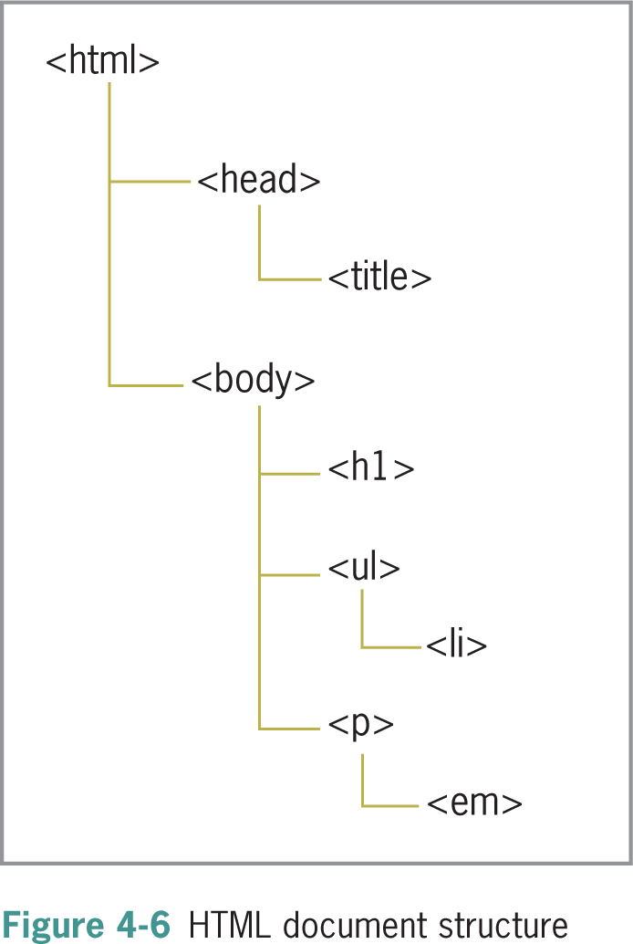
Web Design Principles 5th Ed.

Slide 20
Using Inheritance to Write Simpler Style Rules
Specific style rules:
<style type="text/css">
h1 {color: red;}
p {color: red;}
ul {color: red;}
em {color: red;}
li {color: red;}
</style>
Using inheritance:
<style type="text/css">
body {color: red;}
</style>
Web Design Principles 5th Ed.

Slide 21
Examining Basic Selection Techniques

Slide 22
Examining Basic Selection Techniques
In this section, you will review style rule syntax and learn about the following basic selection techniques:
  Using type selectors
  Grouping selectors
  Combining declarations
  Using descendant selectors
Web Design Principles 5th Ed.

Slide 23
Using Type Selectors
The selector determines the element to which a style declaration is applied
Type selectors are the simplest form of selector
They select every element in the document that matches the style rule
In the following example, all h1 elements are red
Web Design Principles 5th Ed.

Slide 24
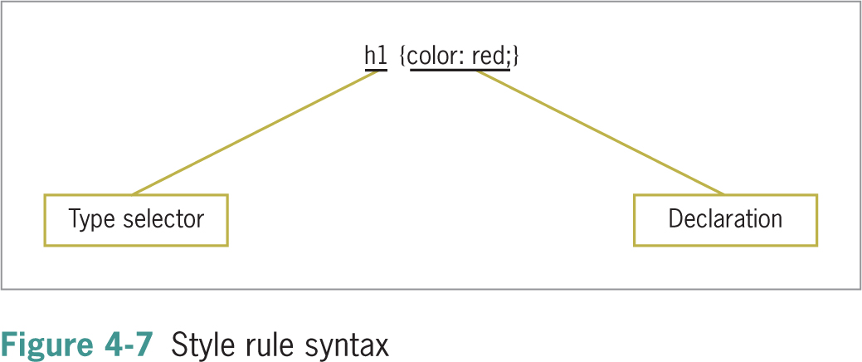
Web Design Principles 5th Ed.

Slide 25
Grouping Selectors
You can group selectors to which the same rules apply
Specific style rules:
h1 {color: red;}
h2 {color: red;}
Grouping selectors:
h1, h2 {color: red;}
Web Design Principles 5th Ed.

Slide 26
Combining Declarations
You can state multiple property declarations for the same selector
Specific style rules:
p {color: blue;}
p {font-size: 125%;}
Combining declarations:
p {
color: blue;
font-size: 125%;
}
Web Design Principles 5th Ed.

Slide 27
Using Descendant Selectors
You can select elements that are descendents of other elements
Selecting only <em> elements that are contained within <p> elements
p em {color: blue;}
Web Design Principles 5th Ed.

Slide 28
Using the Universal Selector
Universal selector lets you select groups of elements
Selecting all children of the dead element:
div * {font-family: sans-serif;}
Web Design Principles 5th Ed.

Slide 29
Using Class and ID Selectors

Slide 30
Using Class and ID Selectors
You will learn to select elements of an HTML document using the following methods:
  The class selector
  The id selector
  The <div> and <span> elements
  The pseudo-class and pseudo-element selectors
Web Design Principles 5th Ed.

Slide 31
Using the Class Selector
The class selector lets you write rules and give them a name
You can apply that name to any element you choose
The class attribute lets you apply the style rule name to an element
The period (.) flag character indicates the selector is a class selector
Web Design Principles 5th Ed.

Slide 32
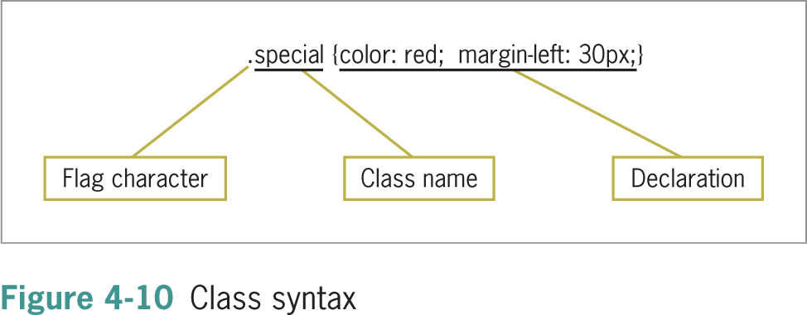
Web Design Principles 5th Ed.

Slide 33
Using the Class Selector
Style rule:
.intro {font-size: 125%; font-family: sans-serif;}
Applied in document:
<p class="intro">This is the first paragraph of the document. It has a different style based on the "intro”class selector.</p>
Web Design Principles 5th Ed.

Slide 34
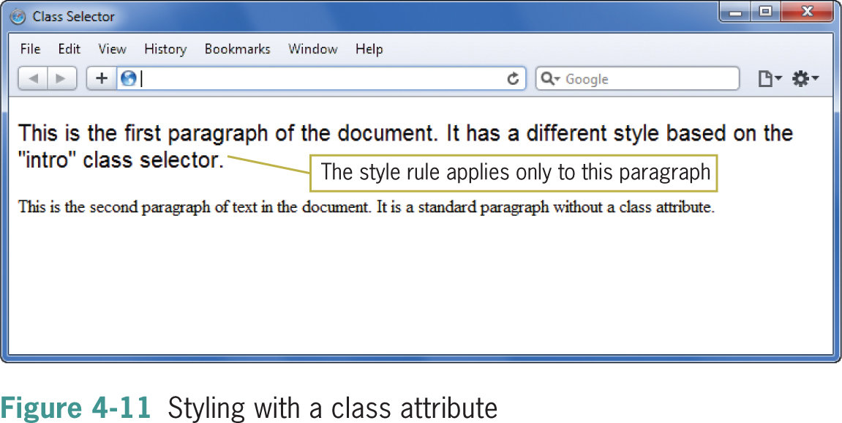
Web Design Principles 5th Ed.

Slide 35
Using the id Attribute Selector
The difference between id and class is that id refers to only one instance of the id attribute value within a document
The ID attribute is used to identify layout sections of the page
The ID attribute uses a pound sign (#) flag character
Web Design Principles 5th Ed.

Slide 36
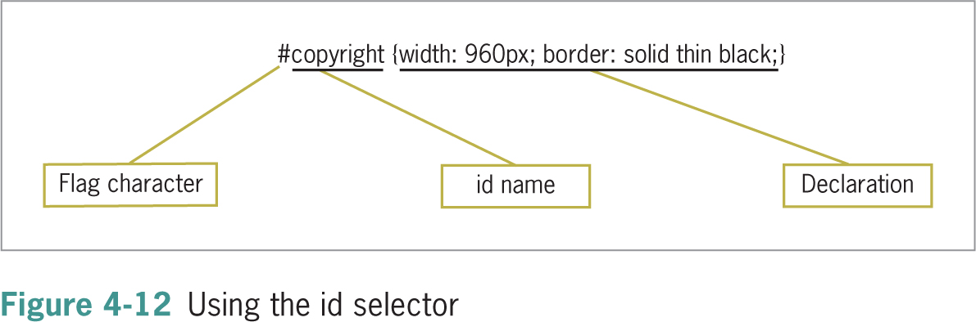
Web Design Principles 5th Ed.

Slide 37
Using the id Attribute Selector
Style rule:
<p id="copyright">This is the copyright information for the page.</p>
Applied in document:
<p class="intro">This is the first paragraph of the document. It has a different style based on the "intro” class selector.</p>
Web Design Principles 5th Ed.

Slide 38
Using the <div> and <span> Elements

Slide 39
Using the <div> and <span> Elements
The <div> (division) and <span> (span of words) elements are designed to be used with CSS
They let you specify logical divisions within a document that have their own name and style properties
Web Design Principles 5th Ed.

Slide 40
Working with <div> elements
Use <div> with the class and ID attributes to create logical divisions on a Web page
A division with an id named column as the selector:
div#column {
width: 200px;
height: auto;
padding: 15px;
border: thin solid;
}
Applied in the document:
<div id="column">This division displays… </div>
Web Design Principles 5th Ed.

Slide 41
Working with Span Elements
The span element lets you specify in-line elements that have their own name and style properties
In-line elements reside within a line of text
Web Design Principles 5th Ed.

Slide 42
Working with Span Elements
Style rule:
span.logo {
color: white;
background-color: black;
}
Applied in document:
<p>Welcome to the <span class="logo">Wonder Software</span>Web site.</p>
Web Design Principles 5th Ed.

Slide 43

Web Design Principles 5th Ed.

Slide 44
Using Other Selectors

Slide 45
Using Attribute Selectors
Attribute selectors let you select an element based on whether the element contains an attribute
Elements can be selected based on a specific value the attribute contains
Web Design Principles 5th Ed.

Slide 46
Using Attribute Selectors
Attribute selectors match against attributes and their values
To select this element:
<img src="images/home.gif" title="home" alt="Home navigation button" />
using attribute selectors, you could use the value that the title attribute contains, as shown:
img[title=home] {border-color: red;}
Web Design Principles 5th Ed.

Slide 47
Using Pseudo-Class and Pseudo-Element Selectors
Pseudo-classes select elements based on characteristics other than their element name
For example, you can change the characteristics of hypertext links with pseudo-classes
Pseudo-elements let you change other aspects of a document that are not classified by standard elements such as the first letter or line of a paragraph
Web Design Principles 5th Ed.

Slide 48
Using the Link Pseudo-Classes
The link pseudo-classes let you change the style characteristics for four different hypertext link states
These pseudo-classes only apply to the <a> element with an href attribute
Web Design Principles 5th Ed.

Slide 49
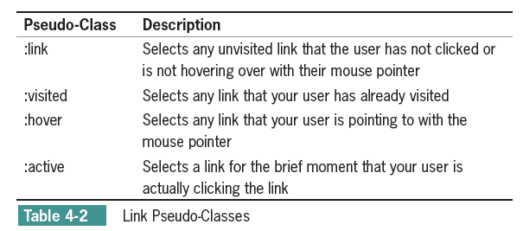
Web Design Principles 5th Ed.

Slide 50
Using the Link Pseudo-Classes
Because of the specificity of the pseudo-class selectors, you should always place your link pseudo-class in the following order:
1. Link
2. Visited
3. Hover
4. Active
Web Design Principles 5th Ed.

Slide 51
Using the Link Pseudo-Classes
The following rules change the colors of the hypertext links:
:link {color: red;}
:visited {color: green;}
Web Design Principles 5th Ed.

Slide 52
Using the :hover Pseudo-Class
The :hover pseudo-class lets you apply a style that appears when the user points to an element with a pointing device
a:hover {background-color: yellow;}
Web Design Principles 5th Ed.

Slide 53
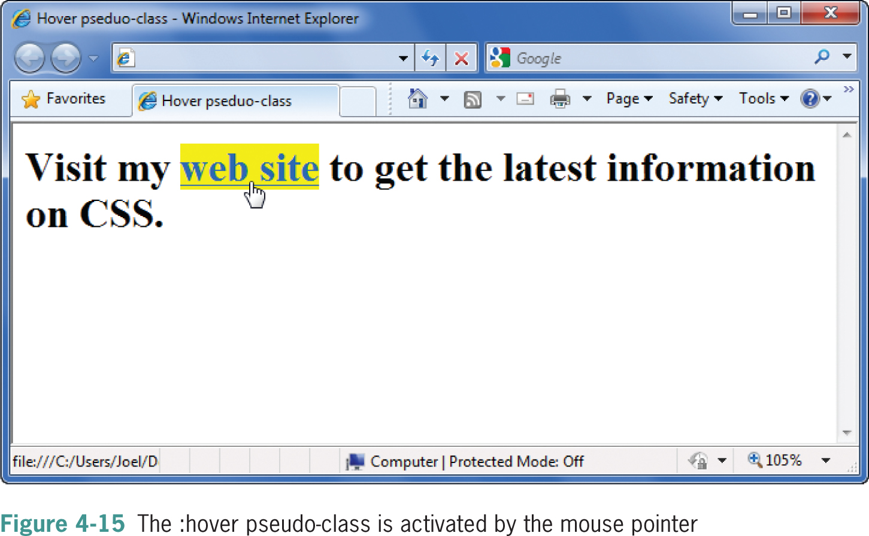
Web Design Principles 5th Ed.

Slide 54
Using the :first-letter Pseudo-Element
Use the :first-letter pseudo-element to apply style rules to the first letter of any element:
p:first-letter {
font-weight: bold;
font-size: 200%;
}
Web Design Principles 5th Ed.

Slide 55
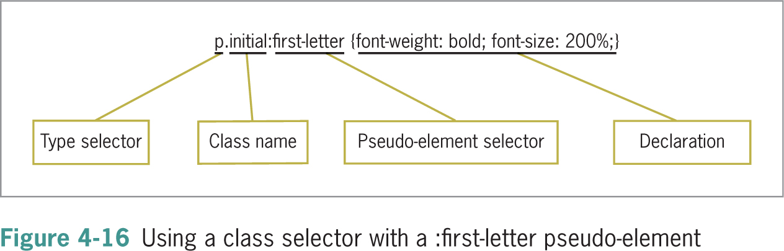
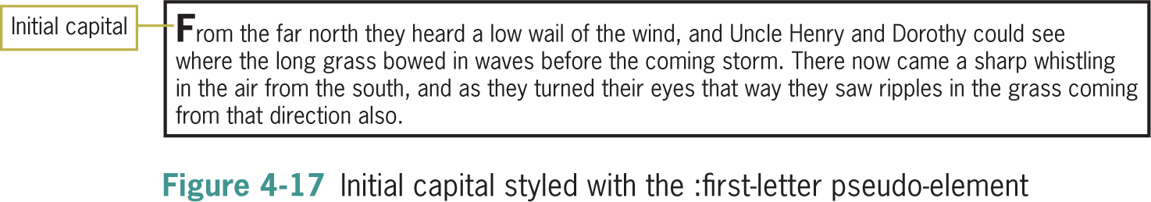
Web Design Principles 5th Ed.

Slide 56
Using the :first-line Pseudo-Element
The :first-line pseudo-element works in much the same way as :first-letter
It affects the first line of text in an element:
p:first-line {text-transform: uppercase;}
Web Design Principles 5th Ed.

Slide 57
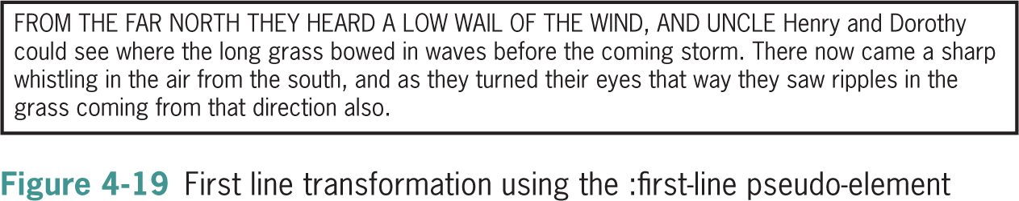
Web Design Principles 5th Ed.

Slide 58
Understanding How the Cascade Affects Style Rules
To cascade means that multiple style sheets and style rules can apply to the same document
Only one rule can apply to an element
The CSS cascading mechanism determines which rules apply based on three variables:
  Specificity of the selector
  Order of the rule in the style sheet
  Use of the !important keyword
Web Design Principles 5th Ed.

Slide 59
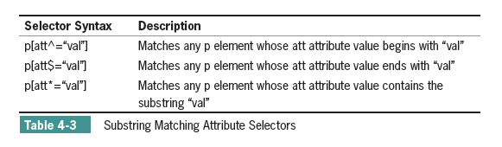
CSS3 Selectors
Web Design Principles 5th Ed.

Slide 60
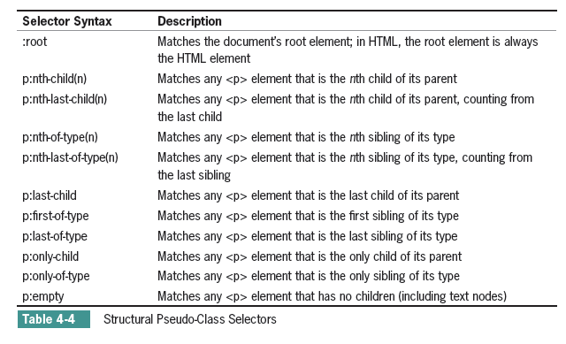
Web Design Principles 5th Ed.

Slide 61
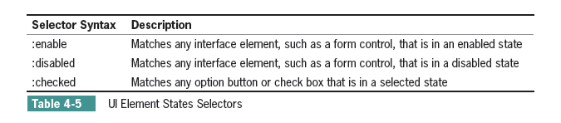
Web Design Principles 5th Ed.

Slide 62
Summary
CSS rules can be combined with the HTML code in a number of ways
CSS is easy to read and write
CSS uses inheritance and cascading to determine which style rules take precedence
You can combine selectors and declarations in multiple ways
There are many ways to select elements
Web Design Principles 5th Ed.

Slide 63
Summary
Class and ID attribute selectors are often paired with <div> and <span> elements to create layout elements
The pseudo-class and pseudo-element selectors let you change color and styling of links and other elements of a document
Web Design Principles 5th Ed.

