Slide 1
A TOP-LEVEL VIEW OF COMPUTER FUNCTION AND INTERCONNECTION

Slide 2
3.1 COMPUTER COMPONENTS
Virtually all contemporary computer designs are based on concepts developed by John von Neumann at the Institute for Advanced Studies, Princeton.
Such a design is referred to as the von Neumann architecture and is based on three key concepts:
Data and instructions are stored in a single read–write memory.
The contents of this memory are addressable by location, without regard to the type of data contained there.
Execution occurs in a sequential fashion (unless explicitly modified) from one instruction to the next.

Slide 3
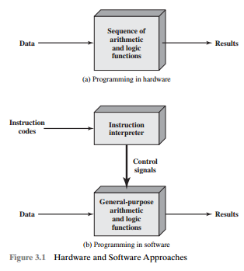
3.1 COMPUTER COMPONENTS
Notes:
Hardwired programs
Programming in software

Slide 4
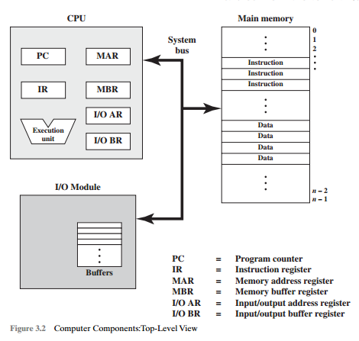
3.1 COMPUTER COMPONENTS
The CPU exchanges data with memory. For this purpose, it typically makes use of two internal (to the CPU) registers: a memory address register (MAR), which specifies the address in memory for the next read or write, and a memory buffer register (MBR), which contains the data to be written into memory or receives the data read from memory.
Notes:
The CPU exchanges data with memory. For this purpose, it typically makes use of two internal (to the CPU) registers: a memory address register (MAR), which specifies the address in memory for the next read or write, and a memory buffer register (MBR), which contains the data to be written into memory or receives the data read from memory.
A memory module consists of a set of locations, defined by sequentially numbered addresses. Each location contains a binary number that can be interpreted as either an instruction or data. An I/O module transfers data from external devices to CPU and memory, and vice versa. It contains internal buffers for temporarily holding these data until they can be sent on.

Slide 5
3.1 COMPUTER COMPONENTS
Similarly, an I/O address register (I/OAR) specifies a particular I/O device. An I/O buffer (I/OBR) register is used for the ex- change of data between an I/O module and the CPU.
Notes:
The CPU exchanges data with memory. For this purpose, it typically makes use of two internal (to the CPU) registers: a memory address register (MAR), which specifies the address in memory for the next read or write, and a memory buffer register (MBR), which contains the data to be written into memory or receives the data read from memory.
Similarly, an I/O address register (I/OAR) specifies a particular I/O device. An I/O buffer (I/OBR) register is used for the ex- change of data between an I/O module and the CPU.
A memory module consists of a set of locations, defined by sequentially numbered addresses. Each location contains a binary number that can be interpreted as either an instruction or data. An I/O module transfers data from external devices to CPU and memory, and vice versa. It contains internal buffers for temporarily holding these data until they can be sent on.

Slide 6
3.1 COMPUTER COMPONENTS
A memory module consists of a set of locations, defined by sequentially numbered addresses. Each location contains a binary number that can be interpreted as either an instruction or data. An I/O module transfers data from external devices to CPU and memory, and vice versa. It contains internal buffers for temporarily holding these data until they can be sent on.
Notes:
The CPU exchanges data with memory. For this purpose, it typically makes use of two internal (to the CPU) registers: a memory address register (MAR), which specifies the address in memory for the next read or write, and a memory buffer register (MBR), which contains the data to be written into memory or receives the data read from memory.
Similarly, an I/O address register (I/OAR) specifies a particular I/O device. An I/O buffer (I/OBR) register is used for the ex- change of data between an I/O module and the CPU.
A memory module consists of a set of locations, defined by sequentially numbered addresses. Each location contains a binary number that can be interpreted as either an instruction or data. An I/O module transfers data from external devices to CPU and memory, and vice versa. It contains internal buffers for temporarily holding these data until they can be sent on.

Slide 7
3.2 COMPUTER FUNCTION
The basic function performed by a computer is execution of a program, which consists of a set of instructions stored in memory.
The processor does the actual work by executing instructions specified in the program.
In its simplest form, instruction processing consists of two steps:
The processor reads (fetches) instructions from memory one at a time and executes each instruction.
Program execution consists of repeating the process of instruction fetch and instruction execution.
The instruction execution may involve several operations and depends on the nature of the instruction

Slide 8
3.2 COMPUTER FUNCTION
The processing required for a single instruction is called an instruction cycle.
The two steps are referred to as the fetch cycle and the execute cycle.
Program execution halts only if the machine is turned off, some sort of unrecoverable error occurs, or a program instruction that halts the computer is encountered.

Slide 9

3.2 COMPUTER FUNCTION

Slide 10
3.2 COMPUTER FUNCTION
Instruction Fetch and Execute
At the beginning of each instruction cycle, the processor fetches an instruction from memory.
In a typical processor, a register called the program counter (PC) holds the address of the instruction to be fetched next. Unless told otherwise, the processor always increments the PC after each instruction fetch so that it will fetch the next instruction in sequence.

Slide 11
3.2 COMPUTER FUNCTION
Instruction Fetch and Execute
The fetched instruction is loaded into a register in the processor known as the instruction register (IR).
The instruction contains bits that specify the action the processor is to take. The processor interprets the instruction and performs the required action.

Slide 12
3.2 COMPUTER FUNCTION
In general, these actions fall into four categories:
Processor-memory:
Data may be transferred from processor to memory or from memory to processor.
Processor-I/O:
Data may be transferred to or from a peripheral device by transferring between the processor and an I/O module.
Data processing:
The processor may perform some arithmetic or logic operation on data.
Control:
An instruction may specify that the sequence of execution be altered.
For example, the processor may fetch an instruction from location 149, which specifies that the next instruction be from location 182.
The processor will remember this fact by setting the program counter to 182.Thus, on the next fetch cycle, the instruction will be fetched from location 182 rather than 150.

Slide 13
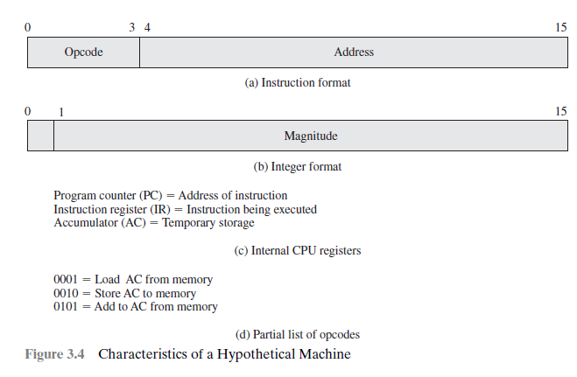
3.2 COMPUTER FUNCTION

Slide 14
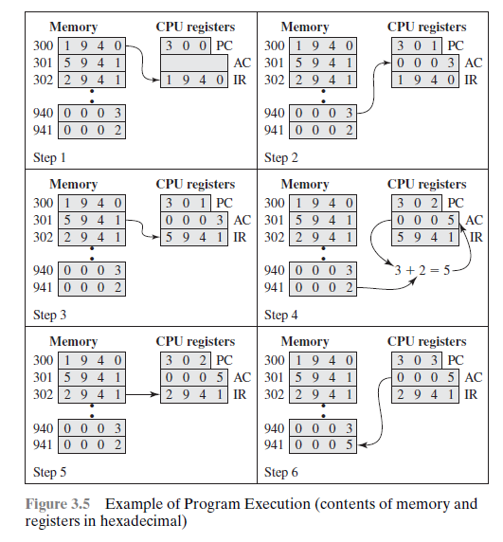
1. The PC contains 300, the address of the first instruction. This instruction (the value 1940 in hexadecimal) is loaded into the instruction register IR and the PC is incremented. Note that this process involves the use of a memory address register (MAR) and a memory buffer register (MBR). For simplicity, these intermediate registers are ignored.
2. The first 4 bits (first hexadecimal digit) in the IR indicate that the AC is to be loaded. The remaining 12 bits (three hexadecimal digits) specify the address
(940) from which data are to be loaded.
3. The next instruction (5941) is fetched from location 301 and the PC is
incremented.

Slide 15
4. The old contents of the AC and the contents of location 941 are added and the
result is stored in the AC.
5. The next instruction (2941) is fetched from location 302 and the PC is
incremented.
6. The contents of the AC are stored in location 941.

Slide 16
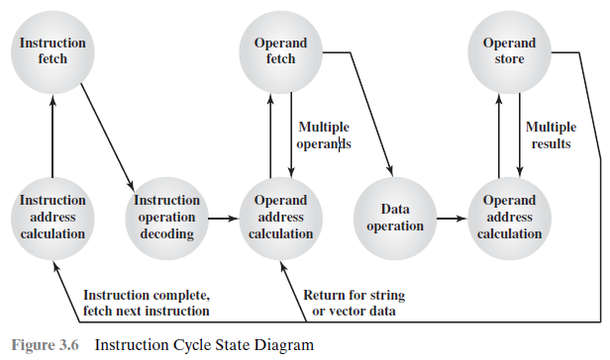
3.2 COMPUTER FUNCTION

Slide 17
3.2 COMPUTER FUNCTION
Instruction address calculation (iac):
Determine the address of the next instruction to be executed.
Usually, this involves adding a fixed number to the address of the previous instruction.
For example, if each instruction is 16 bits long and memory is organized into 16-bit words, then add 1 to the previous address.
If, instead, memory is organized as individually addressable 8-bit bytes, then add 2 to the previous address.

Slide 18
3.2 COMPUTER FUNCTION
Instruction fetch (if):
Read instruction from its memory location into the processor.
Instruction operation decoding (iod):
Analyze instruction to determine type of operation to be performed and operand(s) to be used.
Operand address calculation (oac):
If the operation involves reference to an operand in memory or available via I/O, then determine the address of the operand.
Operand fetch (of):
Fetch the operand from memory or read it in from I/O.
Data operation (do):
Perform the operation indicated in the instruction.
Operand store (os):
Write the result into memory or out to I/O.

Slide 19
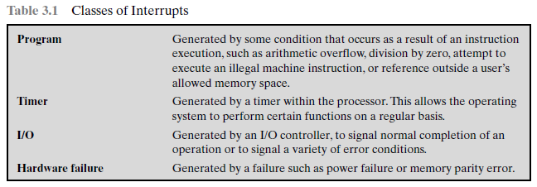
Interrupts
Virtually all computers provide a mechanism by which other modules (I/O, memory) may interrupt the normal processing of the processor.

Slide 20
Interrupts
Interrupts are provided primarily as a way to improve processing efficiency.
For example, most external devices are much slower than the processor.

Slide 21
Seatwork

Slide 22
