Slide 1
Excel Tutorial 6
Managing Multiple Worksheets and Workbooks

Slide 2
Objectives
Format and edit multiple worksheets at once
Create cell references to other worksheets
Consolidate information from multiple worksheets using 3-D references
Create and print a worksheet group
Create a link to data in another workbook
Create a workbook reference
New Perspectives on Microsoft Office Excel 2007

Slide 3
Objectives
Learn how to edit links
Create and use an Excel workspace
Insert a hyperlink in a cell
Create a custom template
Create a Web page
New Perspectives on Microsoft Office Excel 2007

Slide 4
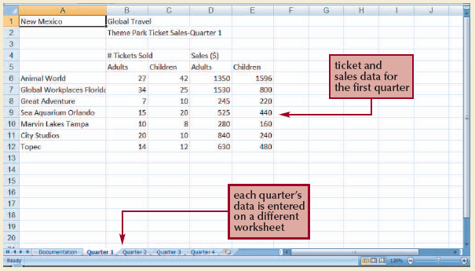
Using Multiple Worksheets
Using multiple worksheets makes it easier to group and summarize data
New Perspectives on Microsoft Office Excel 2007

Slide 5
Grouping and Ungrouping Worksheets
A worksheet group is a collection of two or more selected worksheets
To select an adjacent group, click the sheet tab of the first worksheet in the group, press and hold the Shift key, then click the sheet tab of the last worksheet in the group
To select a nonadjacent group, click the sheet tab of one worksheet in the group, press and hold the Ctrl key, then click the sheet tabs of the remaining worksheets in the group
To ungroup the worksheets, click the sheet tab of a worksheet not in the group (or right-click the sheet tab of one worksheet in the group, then click Ungroup Sheets on the shortcut menu)
New Perspectives on Microsoft Office Excel 2007

Slide 6
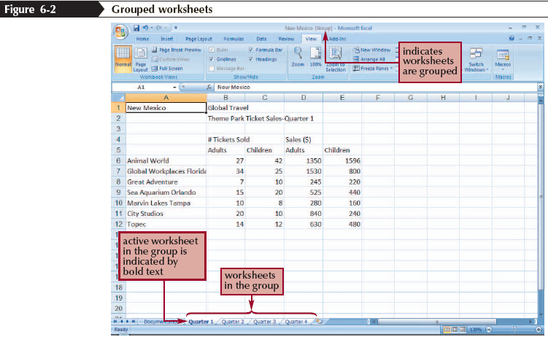
Grouping and Ungrouping Worksheets
New Perspectives on Microsoft Office Excel 2007

Slide 7
Copying Worksheets to Another Workbook
Select the sheet tabs of the worksheets you want to copy
Right-click the sheet tabs, and then click Move or Copy on the shortcut menu
In the Move or Copy dialog box, select the worksheets you want to move or copy to another workbook
Click the To book arrow, and then click an existing workbook name or (new book) to create a new workbook for the worksheets
New Perspectives on Microsoft Office Excel 2007

Slide 8
Copying Worksheets to Another Workbook
Click the Create a copy check box to insert a check mark if you want to copy the worksheets to another workbook, leaving the originals in the current workbook; uncheck the Create a copy check box to move the worksheets
Click the OK button
New Perspectives on Microsoft Office Excel 2007

Slide 9
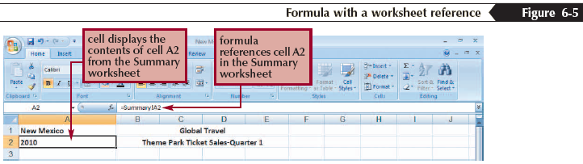
Entering a Formula That References Another Worksheet
Click the cell where you want to enter the formula
Type = and enter the formula. To insert a reference from another worksheet, click the sheet tab for the worksheet, and then click the cell or select the range you want to reference
When the formula is complete, press the Enter key
New Perspectives on Microsoft Office Excel 2007

Slide 10
Using 3-D References to Add Values Across Worksheets
A 3-D reference refers to the same cell or range in multiple worksheets in the same workbook
Click the cell where you want to enter the formula
Type = to begin the formula, type the name of the function, and then type ( to indicate the beginning of the argument
Click the sheet tab for the first worksheet in the worksheet range, press and hold the Shift key, and then click the tab for the last worksheet in the worksheet range
Select the cell or range to reference, and then press the Enter key
New Perspectives on Microsoft Office Excel 2007

Slide 11
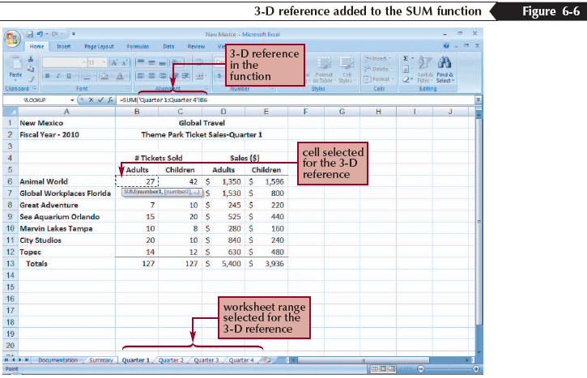
Using 3-D References to Add Values Across Worksheets
New Perspectives on Microsoft Office Excel 2007

Slide 12
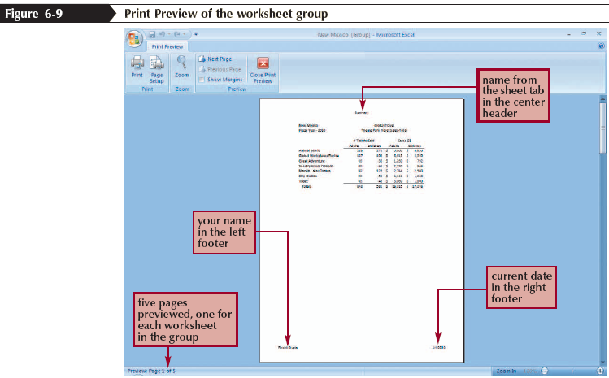
Printing a Worksheet Group
Select the worksheets you wish to print
If necessary, change the page setup
Print the worksheet group
New Perspectives on Microsoft Office Excel 2007

Slide 13
Linking Workbooks
A link is a connection between files that allows data to be transferred from one file to the other
When two files are linked, the source file is the workbook that contains the data, and the destination file (sometimes referred to as the dependent file) is the workbook that receives the data
New Perspectives on Microsoft Office Excel 2007

Slide 14
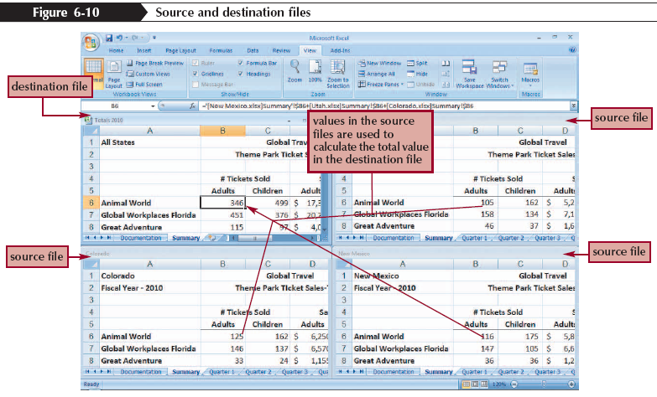
Linking Workbooks
New Perspectives on Microsoft Office Excel 2007

Slide 15
Arranging Workbooks
In the Window group on the View tab, click the Arrange All button
Select the desired option for arranging the workbook: Tiled, Horizontal, Vertical, or Cascade
When arranging multiple workbooks, uncheck the Windows of active workbook option unless you are arranging worksheets within one workbook
Click the OK button
New Perspectives on Microsoft Office Excel 2007

Slide 16
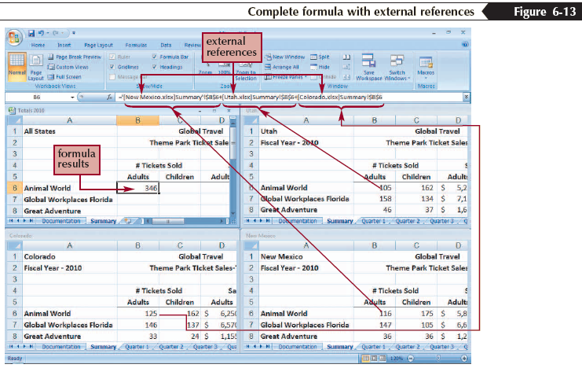
External References in Formulas
New Perspectives on Microsoft Office Excel 2007

Slide 17
Updating Linked Workbooks
When workbooks are linked, it is important that the data in the destination file accurately reflects the contents of the source file
If both the source and destination files are open when you make a change, the destination file is updated automatically
If the destination file is closed when you make a change in the source file, you choose whether to update the link to display the current values when you open the destination file or continue to display the older values from the destination file
New Perspectives on Microsoft Office Excel 2007

Slide 18
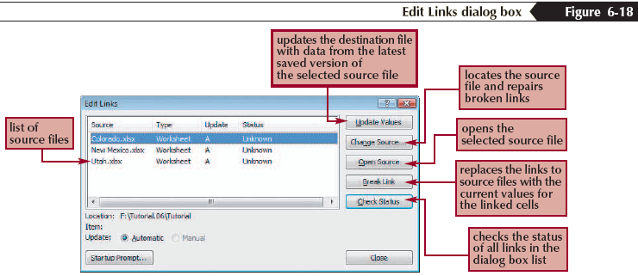
Opening Destination Workbooks with Source Workbooks Closed
After making the necessary changes, click the Data tab on the Ribbon, and then click the Edit Links button
New Perspectives on Microsoft Office Excel 2007

Slide 19
Creating an Excel Workspace
A workspace is an Excel file that saves information about all of the currently opened workbooks, such as their locations, window sizes, zoom magnifications, and other settings
To create a workspace, open all workbooks, click the View tab on the Ribbon, click Arrange All, click Cascade, and then click OK
Click the Save Workspace button on the View tab
New Perspectives on Microsoft Office Excel 2007

Slide 20
Creating a Hyperlink
A hyperlink is a link in a file, such as a workbook, to information within that file or another file
Select the text, graphic, or cell in which you want to insert the hyperlink
In the Links group on the Insert tab, click the Hyperlink button
To link to a file or Web page, click Existing File or Web Page in the Link to list, then select the file or Web page from the Look in box
New Perspectives on Microsoft Office Excel 2007

Slide 21
Creating a Hyperlink
To link to a location in the current workbook, click Place in This Document in the Link to list, then select the worksheet, cell, or range in the current workbook
To link to a new document, click Create New Document in the Link to list, and then specify the filename and path of the new document
To link to an e-mail address, click E-mail Address in the Link to list, and then enter the e-mail address of the recipient and a subject line for the e-mail message
Click the OK button
New Perspectives on Microsoft Office Excel 2007

Slide 22
Templates
An Excel workbook that has labels, formats, and formulas already build into it is called a template
Click the Office Button, and then click New
In the Templates pane, click a template category for the type of workbook you want to create
In the center pane, click the template you want to use, and then click the Download button
Click the Continue button to let Microsoft verify your software
Save the workbook with a new filename
New Perspectives on Microsoft Office Excel 2007

Slide 23
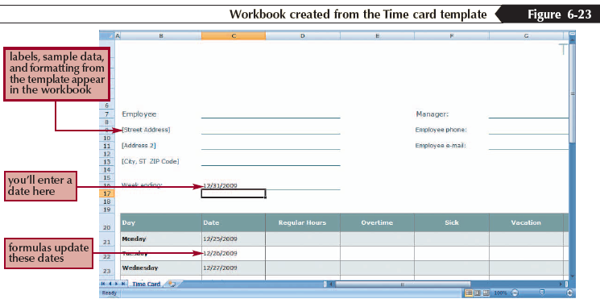
Templates
New Perspectives on Microsoft Office Excel 2007

Slide 24
Creating a Custom Workbook Template
A custom template is a workbook template you create that is ready to run with the formulas for all calculations included as well as all formatting
Prepare the workbook: enter values, text, and formulas as needed; apply formatting; and replace data values with zeros or blank cells
Click the Office Button, and then click Save As
New Perspectives on Microsoft Office Excel 2007

Slide 25
Creating a Custom Workbook Template
In the File name box, enter the template name
Click the Save as type button, and then click Excel Template
Save the file in the Templates folder or select an alternative folder location
Click the Save button
New Perspectives on Microsoft Office Excel 2007

Slide 26
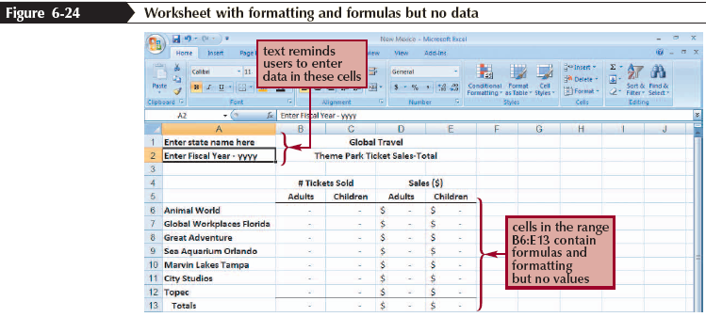
Creating a Custom Workbook Template
New Perspectives on Microsoft Office Excel 2007

Slide 27
Saving a Workbook as a Web Page
You can convert Excel workbooks, worksheets, or ranges into Web pages that can be placed on the Web to be viewed by others
Click the Office Button, and then click Save As
Click the Save as type button, and then click Web Page or Single File Web Page
Click the Publish button
Click the Choose arrow, and select which portion of the workbook you want to publish as a Web page
New Perspectives on Microsoft Office Excel 2007

Slide 28
Saving a Workbook as a Web Page
Click the Change button to change the title of the Web page
Click the Browse button to change the filename and location for the Web page
Check or clear the AutoRepublish every time this workbook is saved check box
Check or clear the Open published web page in browser check box
Click the Publish button
New Perspectives on Microsoft Office Excel 2007

Slide 29
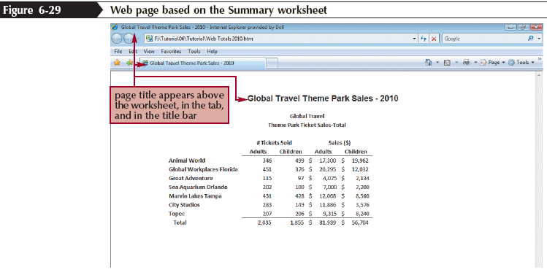
Saving a Workbook as a Web Page
New Perspectives on Microsoft Office Excel 2007

