Slide 1
Excel Tutorial 3
Working with Formulas and Functions

Slide 2
Objectives
Copy formulas
Build formulas containing relative, absolute, and mixed references
Review function syntax
Insert a function with the Insert Function dialog box
Search for a function
Type a function directly in a cell
New Perspectives on Microsoft Office 2007: Windows XP Edition

Slide 3
Objectives
Use AutoFill to fill in a formula and complete a series
Enter the IF logical function
Insert the date with the TODAY function
Calculate monthly mortgage payments with the PMT financial function
New Perspectives on Microsoft Office 2007: Windows XP Edition

Slide 4
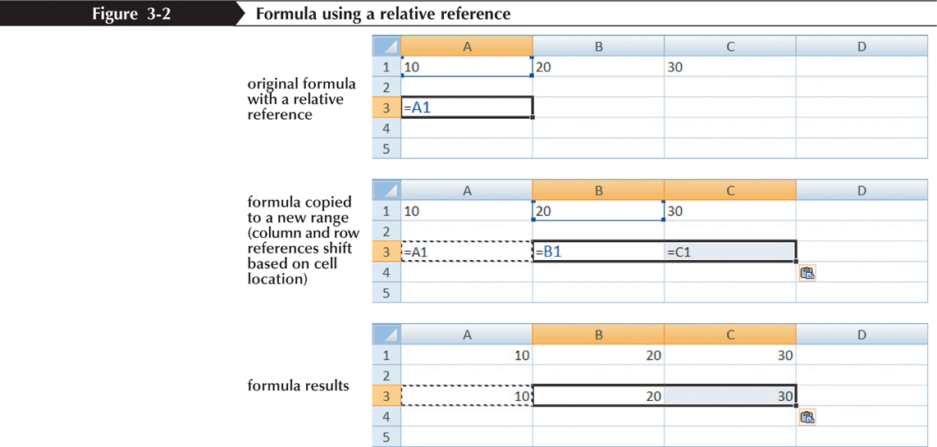
Using Relative References
New Perspectives on Microsoft Office 2007: Windows XP Edition

Slide 5
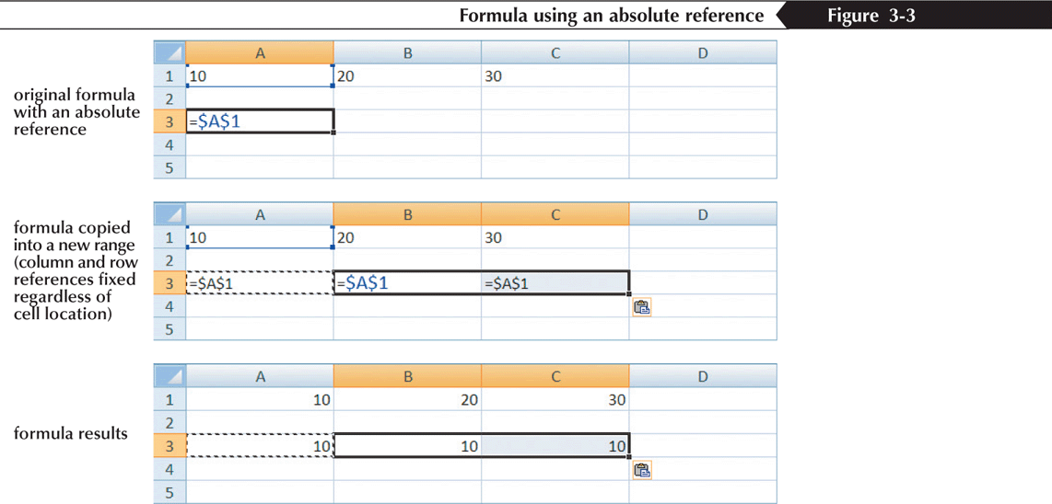
Using Absolute References
New Perspectives on Microsoft Office 2007: Windows XP Edition

Slide 6
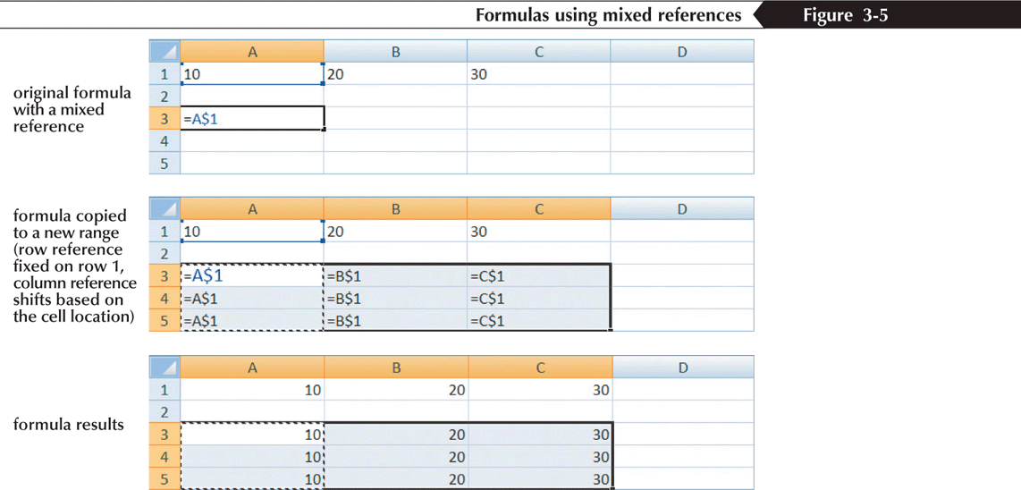
Using Mixed References
New Perspectives on Microsoft Office 2007: Windows XP Edition

Slide 7
Entering Relative, Absolute, and Mixed References
To enter a relative reference, type the cell reference as it appears in the worksheet. For example, enter B2 for cell B2
To enter an absolute reference, type $ (a dollar sign) before both the row and column references. For example, enter $B$2
To enter a mixed reference, type $ before either the row or column reference. For example, enter $B2 or B$2
or
Select the cell reference you want to change
Press the F4 key to cycle the reference from relative to absolute to mixed and then back to relative
New Perspectives on Microsoft Office 2007: Windows XP Edition

Slide 8
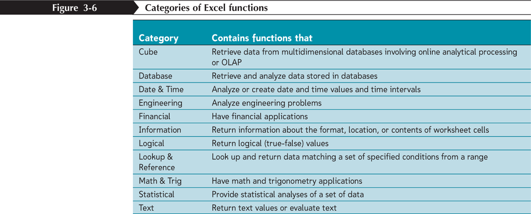
Understanding Function Syntax
Every function has to follow a set of rules, or syntax, which specifies how the function should be written
  Arguments
New Perspectives on Microsoft Office 2007: Windows XP Edition

Slide 9
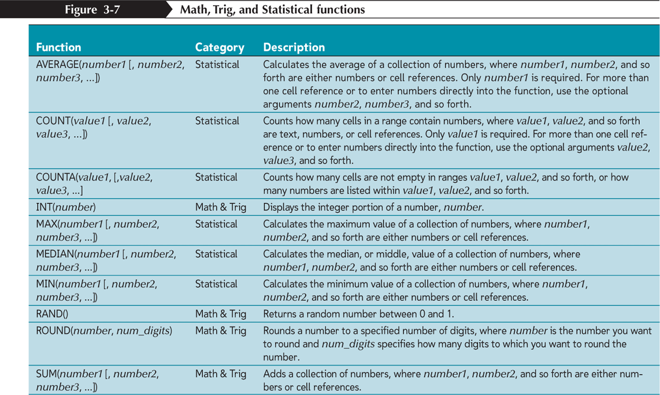
Understanding Function Syntax
New Perspectives on Microsoft Office 2007: Windows XP Edition

Slide 10
Inserting a Function
Click the Formulas tab on the Ribbon
To insert a function from a specific category, click the appropriate category button in the Function Library group. To search for a function, click the Insert Function button in the Function Library group, enter a description of the function, and then click the Go button
Select the appropriate function from the list of functions
Enter the argument values in the Function Arguments dialog box, and then click the OK button
New Perspectives on Microsoft Office 2007: Windows XP Edition

Slide 11
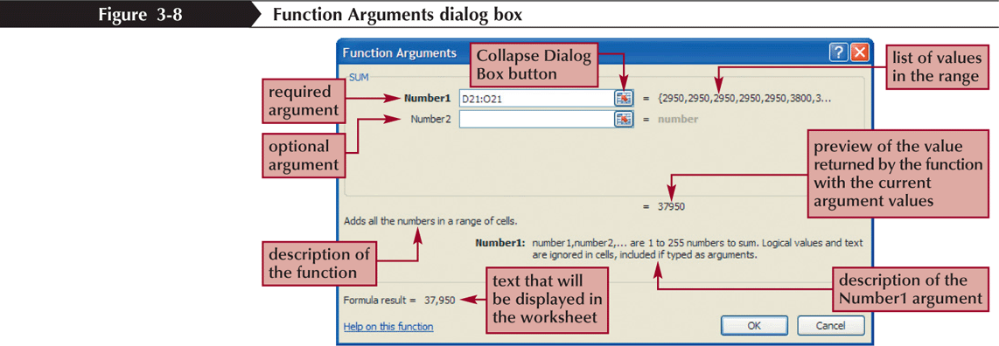
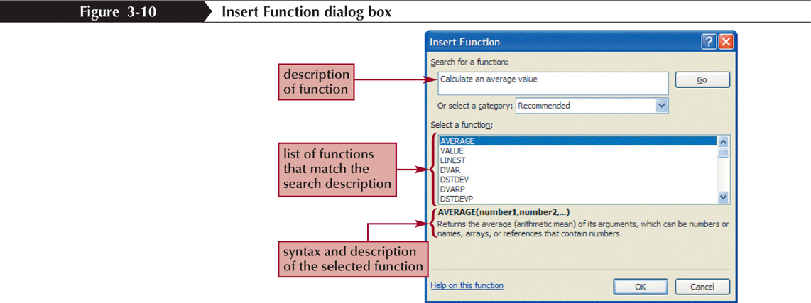
Inserting a Function
New Perspectives on Microsoft Office 2007: Windows XP Edition

Slide 12
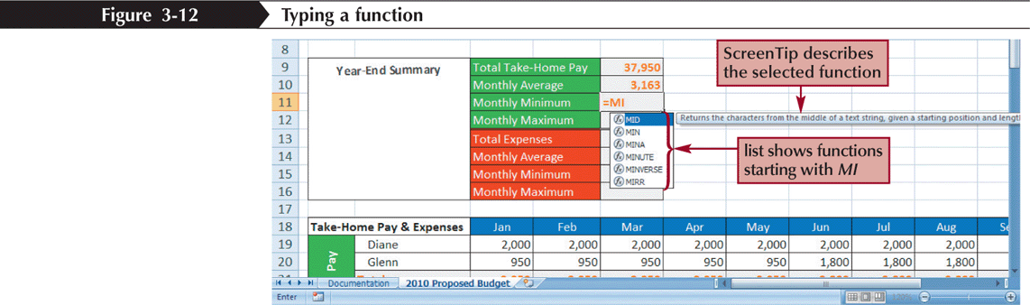
Typing a Function
As you begin to type a function name within a formula, a list of functions that begin with the letters you typed appears
New Perspectives on Microsoft Office 2007: Windows XP Edition

Slide 13
Working with AutoFill
AutoFill copies content and formats from a cell or range into an adjacent cell or range
Select the cell or range that contains the formula or formulas you want to copy
Drag the fill handle in the direction you want to copy the formula(s) and then release the mouse button
To copy only the formats or only the formulas, click the AutoFill Options button and select the appropriate option
New Perspectives on Microsoft Office 2007: Windows XP Edition

Slide 14
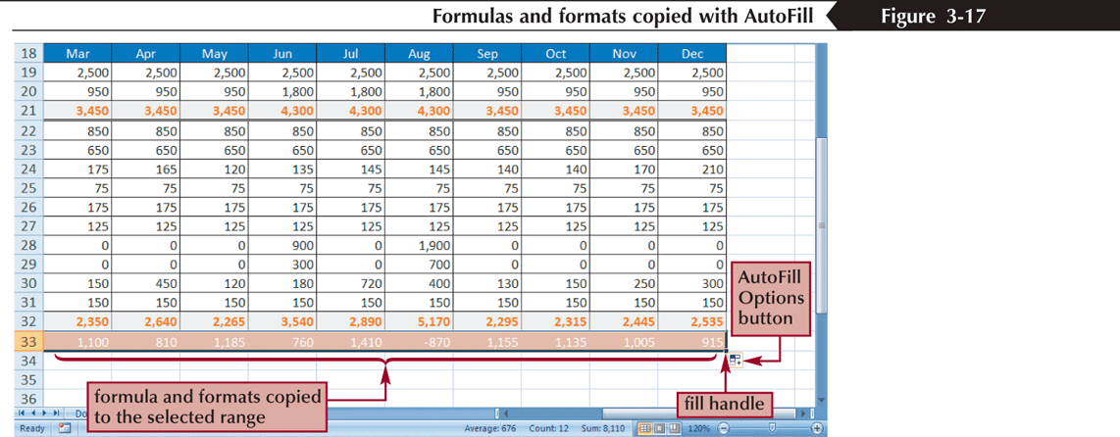
Working with AutoFill
or
Select the cell or range that contains the formula or formulas you want to copy
In the Editing group on the Home tab, click the Fill button
Select the appropriate fill direction and fill type (or click Series, enter the desired fill series options, and then click the OK button)
New Perspectives on Microsoft Office 2007: Windows XP Edition

Slide 15
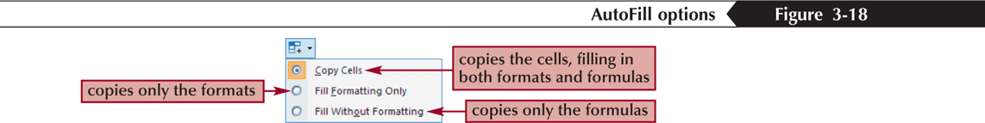
Using the AutoFill Options Button
By default, AutoFill copies both the formulas and the formats of the original range to the selected range
You can specify what is copied by using the AutoFill Options button that appears after you release the mouse button
New Perspectives on Microsoft Office 2007: Windows XP Edition

Slide 16
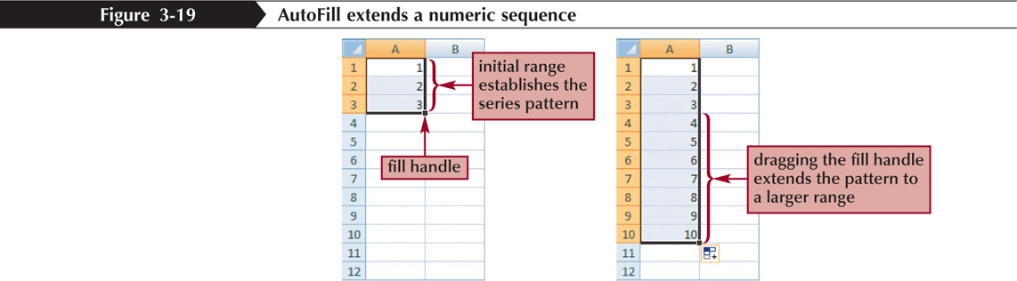
Filling a Series
AutoFill can also be used to create a series of numbers, dates, or text based on a pattern
New Perspectives on Microsoft Office 2007: Windows XP Edition

Slide 17
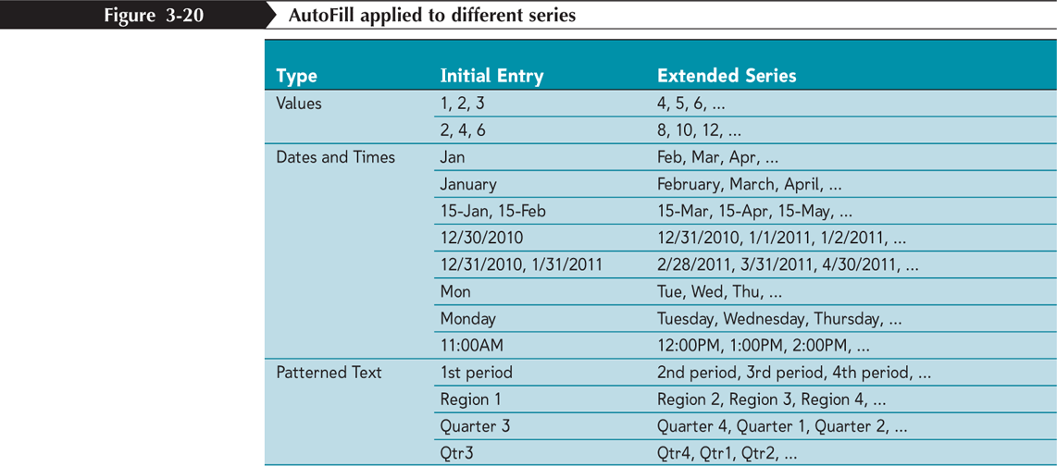
Filling a Series
New Perspectives on Microsoft Office 2007: Windows XP Edition

Slide 18
Creating a Series with AutoFill
Enter the first few values of the series into a range
Select the range, and then drag the fill handle of the selected range over the cells you want to fill
or
Enter the first few values of the series into a range
Select the entire range into which you want to extend the series
In the Editing group on the Home tab, click the Fill button, and then click Down, Right, Up, Left, Series, or Justify to set the direction you want to extend the series
New Perspectives on Microsoft Office 2007: Windows XP Edition

Slide 19
Working with Logical Functions
A logical function is a function that works with values that are either true or false
The IF function is a logical function that returns one value if the statement is true and returns a different value if the statement is false
IF(logical_test, value_if_true, [value_if_false])
New Perspectives on Microsoft Office 2007: Windows XP Edition

Slide 20
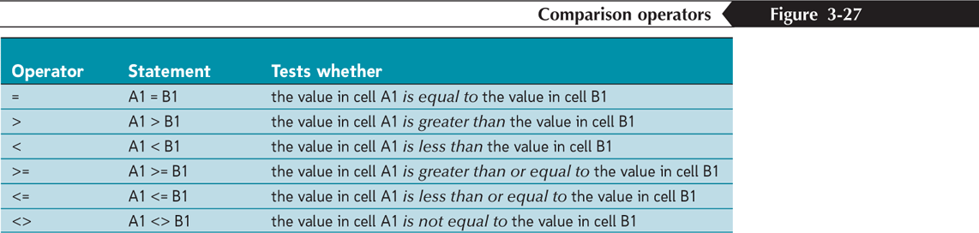
Working with Logical Functions
A comparison operator is a symbol that indicates the relationship between two values
New Perspectives on Microsoft Office 2007: Windows XP Edition

Slide 21
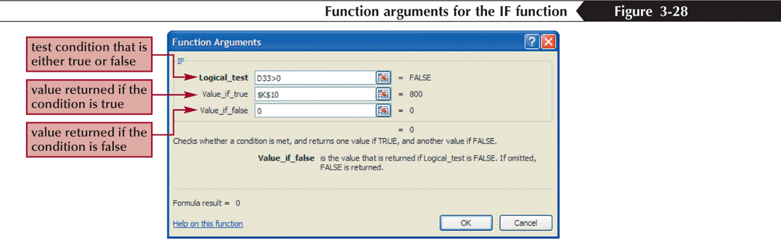
Working with Logical Functions
=IF(A1="YES", "DONE", "RESTART")
=IF(A1="MAXIMUM", MAX(B1:B10), MIN(B1:B10))
=IF(D33>0, $K$10, 0)
New Perspectives on Microsoft Office 2007: Windows XP Edition

Slide 22
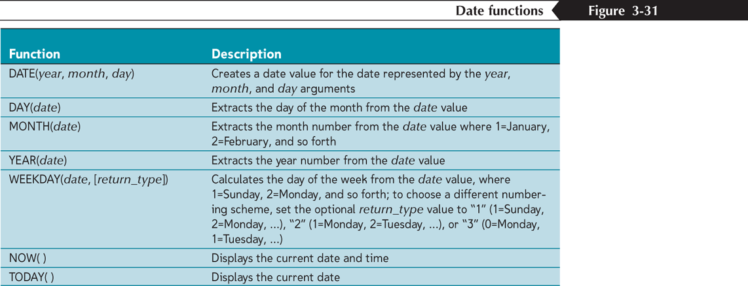
Working with Date Functions
New Perspectives on Microsoft Office 2007: Windows XP Edition

Slide 23
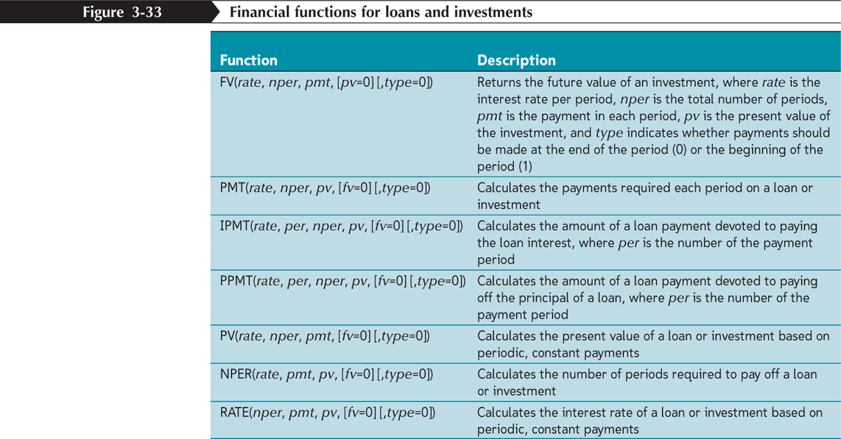
Working with Financial Functions
New Perspectives on Microsoft Office 2007: Windows XP Edition

Slide 24
Using the PMT Function to
Determine a Monthly Loan Payment
For loan or investment calculations, you need to know the following information:
  The annual interest rate
  The payment period, or how often payments are due and interest is compounded
  The length of the loan in terms of the number of payment periods
  The amount being borrowed or invested
PMT(rate, nper, pv, [fv=0] [type=0])
New Perspectives on Microsoft Office 2007: Windows XP Edition

Slide 25
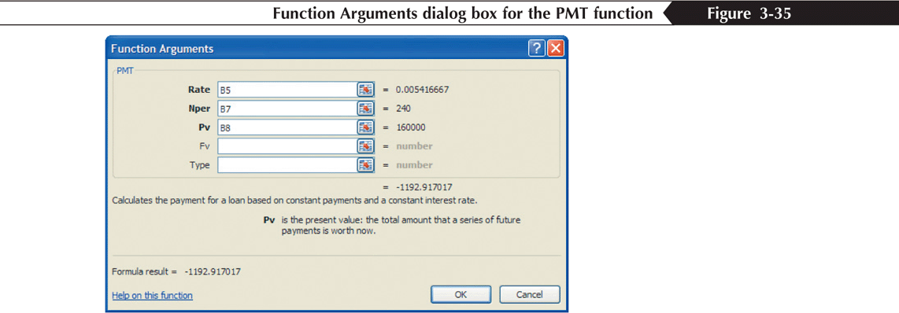
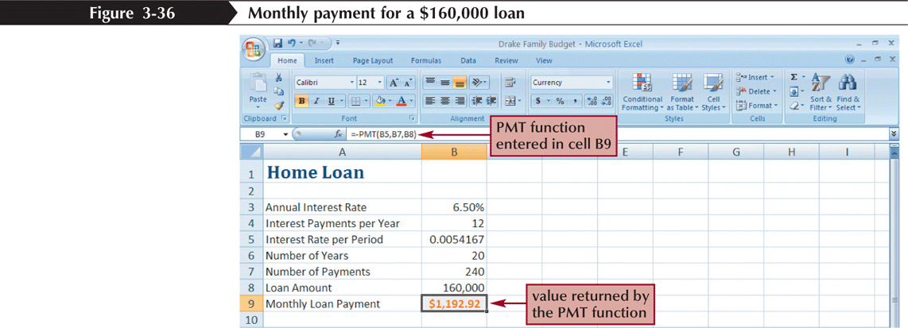
Using the PMT Function to Determine a Monthly Loan Payment
New Perspectives on Microsoft Office 2007: Windows XP Edition

