Slide 1
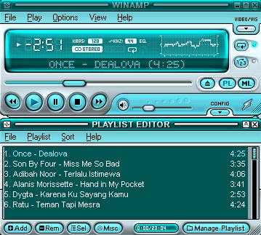
CHAPTER 4
SOUND

Slide 2
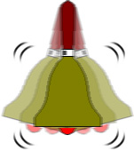
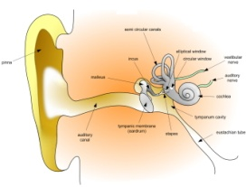
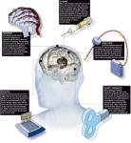
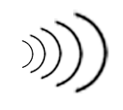
What is SOUND?
Sound comprises the spoken word, voices, music and even noise.
It is a complex relationship involving:
a vibrating object (sound source)
a transmission medium (usually air)
a receiver (ear) and;
a preceptor (brain).

Slide 3
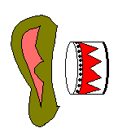
4.1 The Power of Sound
Something vibrates
in the air
Waves of pressure
Ear drums will translate
these changes in wave
Forms as sound
Sound pressure is measured in → dB (decibel)
Sound waves are known as waveforms.

Slide 4
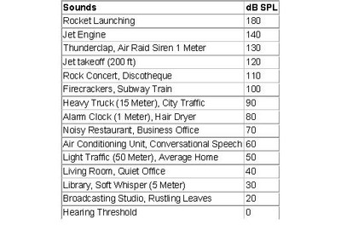
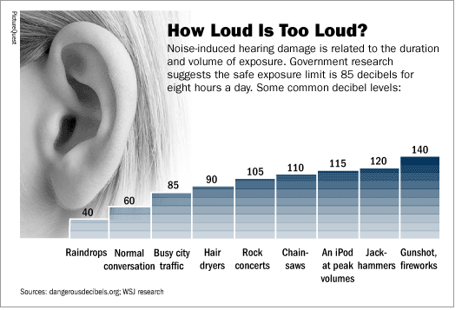
Decibel Table

Slide 5
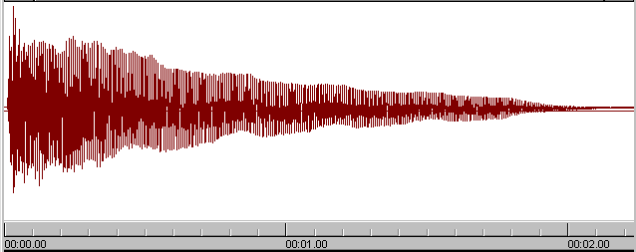
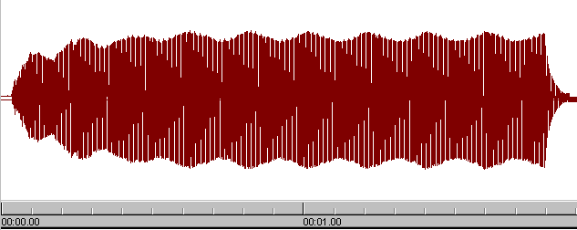
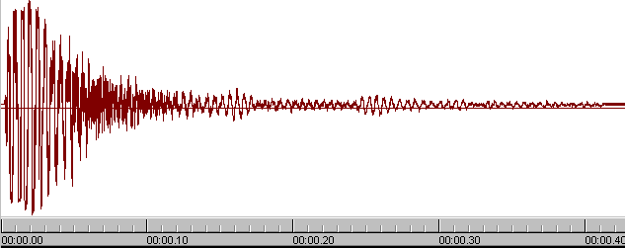
Example of Waveforms
Piano
Pan flute
Snare drum

Slide 6
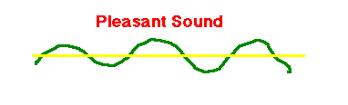
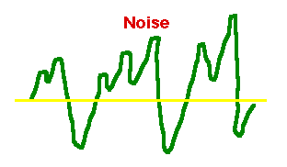
Sound
A pleasant sound has a regular wave pattern. The pattern is repeated over and over.
But the waves of noise are irregular. They do not have a repeated pattern.

Slide 7
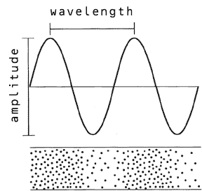
Characteristic of Sound Waves
Sound is described in terms of two characteristics:
Frequency (or pitch)
Amplitude (or loudness)

Slide 8
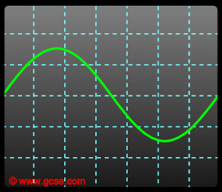
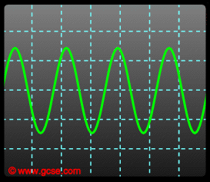
Frequency
Frequency is a measure of how many vibrations occur in one second. This is measured in Hertz (abbreviation Hz) and directly corresponds to the pitch of a sound.
The more frequent vibration occurs the higher the pitch of the sound.
Low pitch
High pitch
Optimally, people can hear from 20 Hz to 20,000 Hz (20 kHz)
Sounds below 20 Hz are infrasonic
sounds above 20 kHz are ultrasonic.

Slide 9
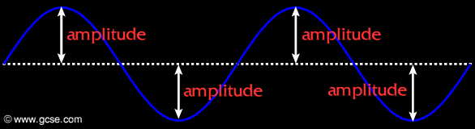
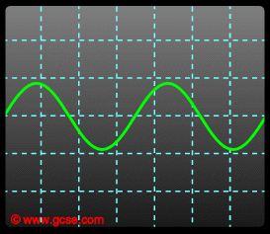
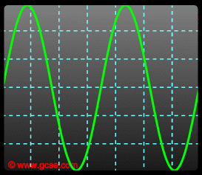
Amplitude
Amplitude is the maximum displacement of a wave from an equilibrium position.
The louder a sound, the more energy it has. This means loud sounds have a large amplitude.
Quiet
Loud
Low amplitude
High Amplitude
The amplitude relates to how loud a sound is.

Slide 10
Characteristic of Sound Waves
Time for one cycle
Amplitude
wavelength
distance
along wave
Cycle

Slide 11
4.2 The Power of Sound
Audio in Macintosh and Windows
Both Macintosh and Windows PC platform, have the default system sounds
MACINTOSH → Chu Toy, Glass, indigo, Laugh, Simple Beep
WINDOWS PC → ding.wav, chimes.wav, logoff.wav,start.wav
Basic Recording Software
Both MACINTOSH and WINDOWS have basic recording software

Slide 12
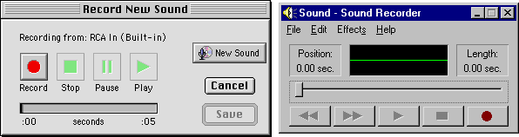
Audio Recording Software
MACINTOSH WINDOWS
Sound Recorders for Windows
Both Macintosh and Windows PC platform have the default sound.
This basic application could:
Record our own sounds
Edit & mix *.wav files
Simple Splicing and assembly
Increase volume & speed of *.wav files
Reverse the sound.
Add Echo effects
Some XP Version also provide wav to mp3 conversion.

Slide 13
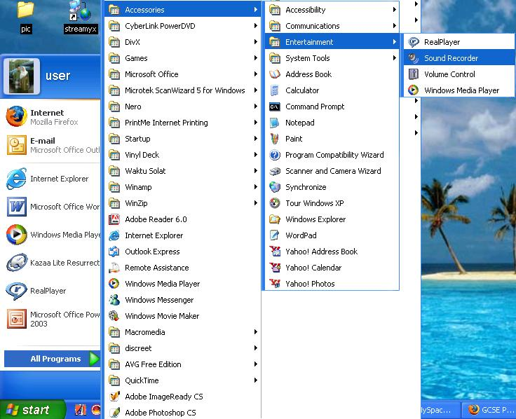

Slide 14
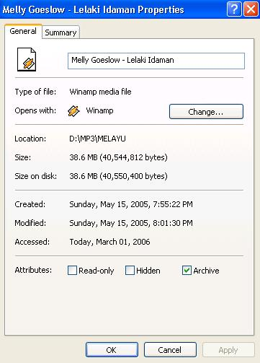
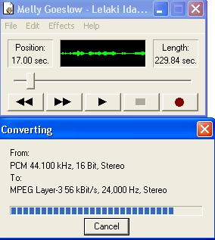
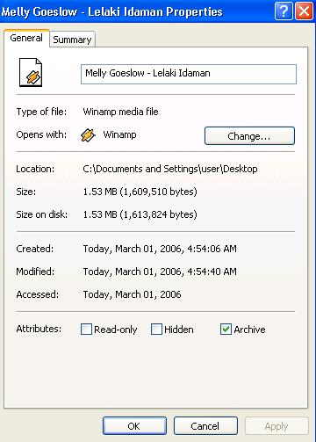
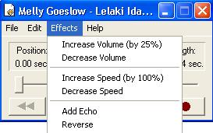
Basic Sound Recorder
Sound conversion
Basic Effects

Slide 15
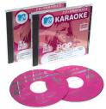
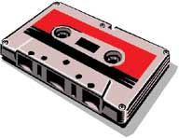
Analogue to Digital Audio
Analogue audio
The name for an electronic signal that carries its information of sound as continuous fluctuating voltage value.
non digital tape or audio tape recording of sound.
Digitizing
the process of converting an analog signal to a digital one.
A sound is recorded by making a measurement of the amplitude of the sound at regular intervals which are defined by the "sample rate".
The act of taking the measurement is often called "sampling" and each measurement is called a "sample point".

Slide 16
Capture & Playback of Digital Audio
Air pressure
variations
Digital to
Analogue
Converter
Converts back into voltage
DAC
Captured via
microphone
Signal is
converted into
binary (discrete form)
0101001101
0110101111
Analogue
to Digital
Converter
ADC
Air pressure
variations

Slide 17
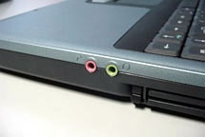
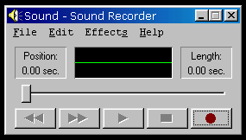
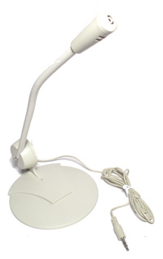
Recording Audio Files
Recording Audio Files on the pc
Uses either:
Microphone
connect microphone to the microphone port and record using sound recorder

Slide 18
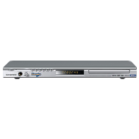
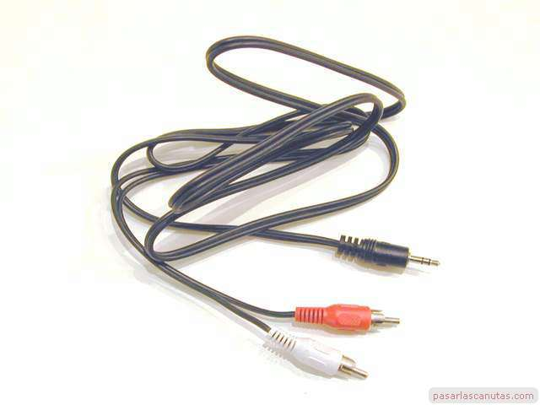
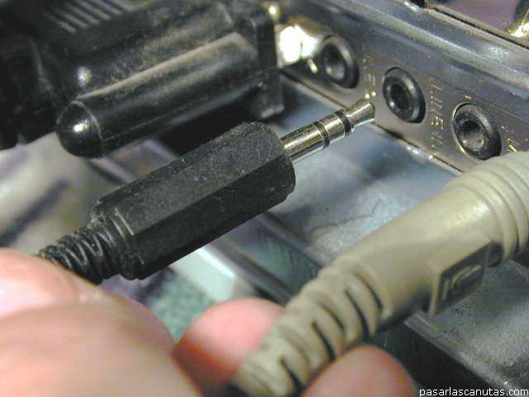
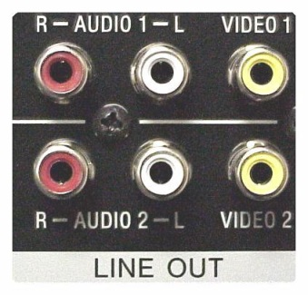
Recording Audio Files
CD-ROM Drive
Move music files from CD to hard drive or;
Play the cd and then record using the sound recorder.
Line-in
pressing play on the audio source, which is connected to the computer’s audio line-in socket. Record using the sound recorder.
Line in port on the pc
Audio cable

Slide 19
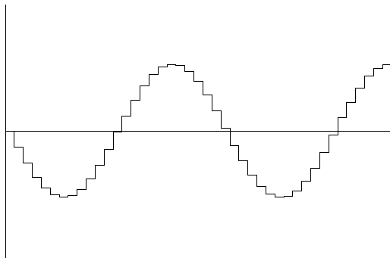
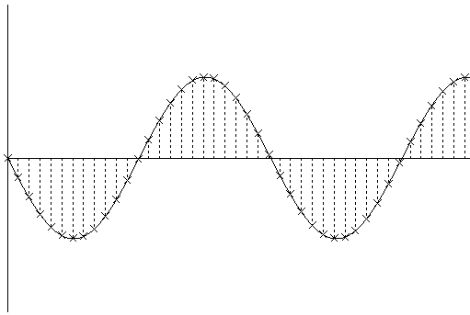
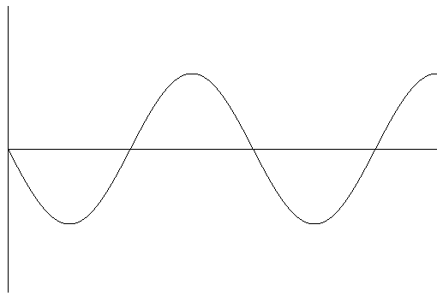
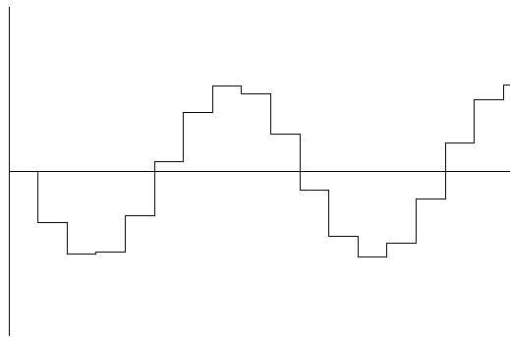
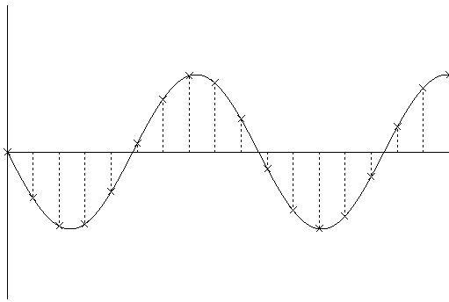
4.3 Digital Audio
Digital audio data is the representation of sound, stored in the form of samples point.
Quality of digital recording depends on the sampling rate, that is, the number of samples point taken per second (Hz).
High Sampling Rate
Samples stored in digital form
waveform
Low Sampling Rate

Slide 20
Digital Sampling

Slide 21
Digital Sampling

Slide 22
4.4 Digital Audio
The three sampling frequencies most often used in multimedia are 44.1 kHz, 22.05 kHz and 11.025 kHz.
The higher the sampling rate, the more the measurements are taken (better quality).
The lower the sampling rate, the lesser the measurements are taken (low quality).
High Sampling Rate
Low Sampling Rate

Slide 23
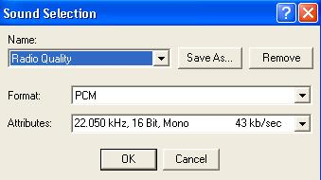
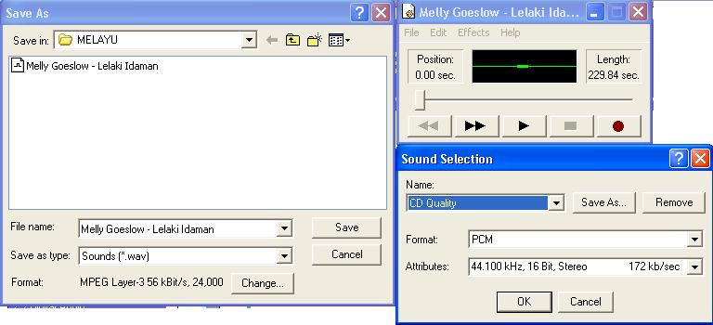
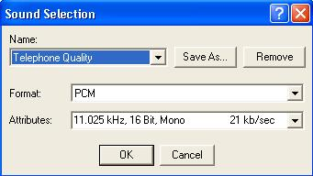
4.4 Digital Audio
Quality factors for digital audio file :
Sampling Rate
Sample Size (resolution)
the number of bits used to record the value of a sample in a digitized signal.
Sampling Rate
Sample size

Slide 24
4.4 Digital Audio
Other than that, it also depends on:
The quality of original audio source.
The quality of capture device & supporting hardware.
The characteristics used for capture.
The capability of the playback environment.

Slide 25
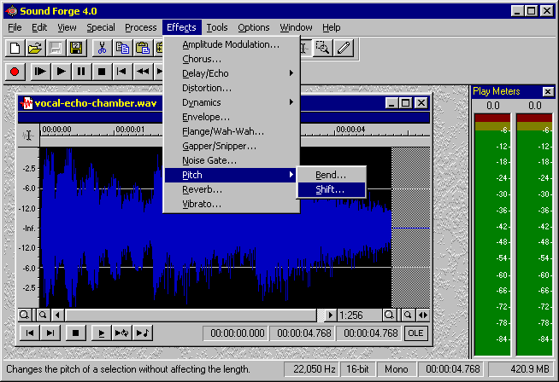
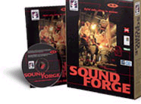
4.4 Digital Audio
More advanced Digital audio editing software:
One of the most powerful and professional PC-based packages is a tool called Sound Forge
http://www.sonicfoundry.com/
Others audio editing software:
COOL Edit Pro
Gold Wave
PROSONIQ SonicWORX
Samplitude Studio

Slide 26
4.5 Midi Audio
Musical Instrument Digital Interface
Before there was a wide use of mp3 and high bandwidth network, MIDI format audio is popular when an audio is required to be put on a website.
Provides a standardized and efficient means of conveying musical performance information as electronic data.
Is a easiest and quickest way to compose our own score.
(provided we have knowledge of musical instrument and composing)
It is in the form of music score and not samples or recording.

Slide 27
Midi Audio: Requirements
To make MIDI score, we need:
Midi keyboard / Midi keyboard software
Sequencer software
Sound synthesizer (built-in in to sound card)

Slide 28
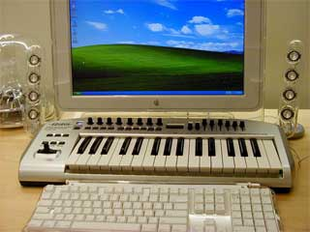
Midi Keyboard
MIDI keyboard is used to simplify the creation of music scores (MIDI information)
MIDI information is transmitted in "MIDI messages", which can be thought of as instructions which tell a music synthesizer how to play a piece of music.
The synthesizer receiving the MIDI data must generate the actual sounds.

Slide 29
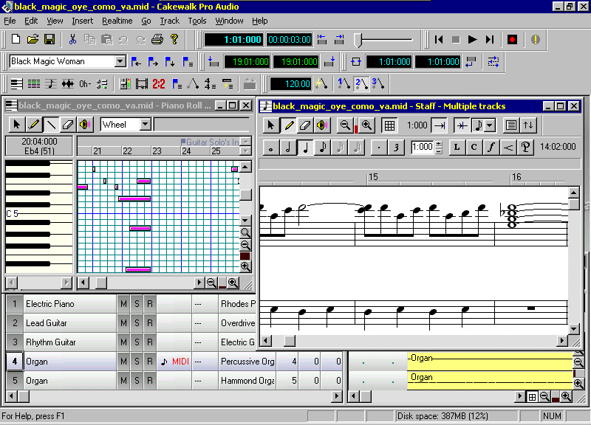
Midi Sequencer
A MIDI sequencer software lets us to record and edit MIDI data like a word processor
Cut and paste
Insert / delete

Slide 30
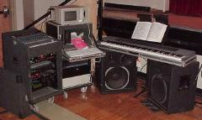

Midi Audio Facts
Since they are small, MIDI files embedded in web pages load and play.
Length of a MIDI file can be changed without affecting the pitch of the music or degrading audio quality.
Working with MIDI requires knowledge of music theory.

Slide 31
Recording MIDI Files
Recording MIDI Files
MIDI files can be generated:
by recording the MIDI data from a MIDI instrument (electronic keyboard) as it is played.
by using a MIDI sequencer software application.

Slide 32
Audio File Formats
MIDI
*.MID, *.KAR, *.MIDI, *.SMF
AUDIO DIGITAL
WINDOWS → *.WAV
MACINTOSH → *.AIFF
UNIX → *.AU
REALAUDIO → *.RA
MPEG3 → *.MP3

Slide 33
MIDI versus Digital Audio
Advantages of MIDI over digital audio:
MIDI files smaller that digital audio files.
Because small file, MIDI files embedded in web pages load and play more quickly.
If MIDI sound source are high quality – sound better.
Can change the length of MIDI files without changing the pitch of the music or degrading the audio quality.

Slide 34
MIDI versus Digital Audio
Disadvantages of MIDI over digital audio:
Because MIDI data does not represent the sound but musical instruments, playback will be accurate only if the MIDI playback (instrument) is identical to the device used in the production.
Higher cost and requires skill to edit.
Cannot emulate voice, other effects.

Slide 35
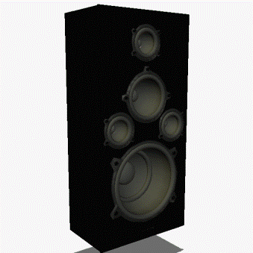
4.6 Factors considered before adding Sound to MM Project
File formats compatible with multimedia authoring software being used along with delivery mediums, must be determined.
Sound playback capabilities offered by end user’s system must be studied.
The type of sound, whether background music, special sound effects, or spoken dialog, must be decided.
Digital audio or MIDI data should be selected on the basis of the location and time of use.

Slide 36
Function of Audio
Content/ information
Background music
Ambience

Slide 37
Advantages & Disadvantages of Using Audio
Sound adds life to any multimedia application and plays important role in effective marketing presentations.
Advantages
Ensure important information is noticed.
Add interest.
Can communicate more directly than other media.

Slide 38
Advantages & Disadvantages of Using Audio
Disadvantages
Easily overused.
Requires special equipment for quality production.
Not as memorable as visual media.

Slide 39
Summary
There are two main types of digital audio
Sampled audio
Captured by sampling an analogue waveform at a set rate
MIDI data
Instructions on how to perform some musical composition
Sampled audio requires more storage space than MIDI information

