Slide 1
SUDOKU SOLVER using dsa
--Gyanendra Nath Shukla

Slide 2
AGENDA
Introduction​
Technologies Learnt
​Existing System
Implementations
​Learnings

Slide 3
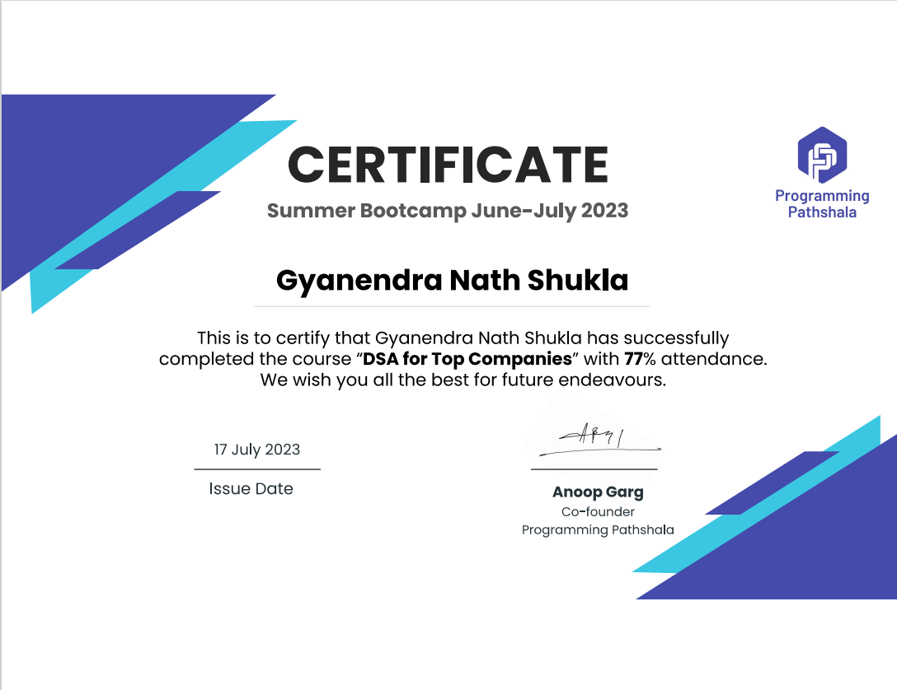

Slide 4
Introduction
The introduction of the document explains that Data Structures and Algorithms (DSA) are essential components of computer science and programming.
DSA helps us to develop strong problem-solving skills. It teaches us how to break down complex problems into smaller, manageable steps.
Learning DSA improves our coding skills. We'll write efficient and organized code, which is crucial in software development.
The introduction highlights the importance of studying DSA and developing practical applications, such as the Sudoku game, to enhance problem-solving skills, coding abilities, and user experience design.
Notes:
thinking capability, competitive coding,

Slide 5
Technologies learnt
Arrays: These are like lists where we can store things like numbers or words in order and easily find them using numbers to tell their position.
Searching: We figured out how to find things quickly in arrays, kind of like finding a word in a book by looking at the table of contents (linear search) or flipping to the right page (binary search).
Linked Lists: You learned about chains of items, each connected to the next one. You can add, remove, and move around these items easily.

Slide 6
Vector: A vector stores elements of a given type in a linear arrangement, and allows fast random access to any element.
Stacks: Imagine stacking plates on top of each other. The last plate you put on is the first one you take off. It's like a stack of things, and you can only work with the top one.
Recursion: This is a bit like solving a big puzzle by breaking it into smaller pieces, solving those pieces, and putting them back together until the big puzzle is solved

Slide 7
Existing system for dsa
The existing system for a Sudoku solver refers to the established algorithms, techniques, and implementations used to solve Sudoku puzzles.
Sudoku is a number placement puzzle played on a 9x9 grid, divided into nine 3x3 boxes. The goal is to fill the grid with digits from 1 to 9 such that each row, each column, and each of the nine 3x3 boxes contains all the digits without repetition.
The existing system for the sudoku solver game includes rules for gameplay, such as determining valid moves, detecting weather you have chosen correct value or not.

Slide 8
implementation
functions:
print_grid(int grid[DIM][DIM]): This function is responsible for printing the Sudoku grid. It iterates through the 9x9 grid and prints the numbers or spaces in the correct format to display the Sudoku grid.
used_in_row(int grid[DIM][DIM], int row, int num): This function checks whether the specified number num is already used in the given row of the Sudoku grid. It returns true if num is found in the row, otherwise false.
used_in_col(int grid[DIM][DIM], int col, int num): Similar to used_in_row, this function checks whether the specified number num is already used in the given column of the Sudoku grid.

Slide 9
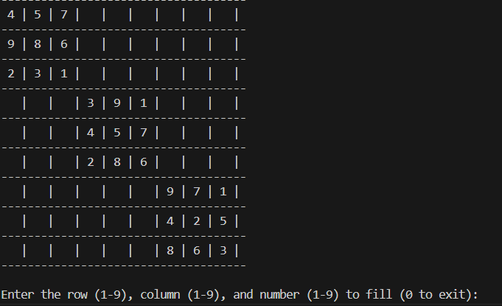
Game Model

Slide 10
More Functions used
used_in_box(int grid[DIM][DIM], int box_start_row, int box_start_col, int num): This function checks whether the specified number num is already used in the 3x3 box (subgrid) of the Sudoku grid starting at the specified row and column.
is_safe(int grid[DIM][DIM], int row, int col, int num): This function checks if it's safe to place the number num in the specified row and column of the Sudoku grid. It verifies that num is not already used in the row, column, or the 3x3 box.
get_unassigned_location(int grid[DIM][DIM]): This function searches for an unassigned (blank) location in the Sudoku grid (a cell with the value 0) and returns the row and column of the first unassigned location it finds.
solve_sudoku(int grid[DIM][DIM]): This is the main function responsible for solving the Sudoku puzzle using a backtracking algorithm. It recursively attempts to fill in the grid with numbers and backtracks if it encounters an invalid placement.it then copy the solved
puzzle in the solution grid.

Slide 11
generate_sudoku_puzzle(int grid[DIM][DIM]): This function generates a Sudoku puzzle with random numbers while ensuring each box contains unique values. It also initializes the rest of the grid as blanks.
main(): The main function of the program. It provides a user interface to play the Sudoku game. It generates a Sudoku puzzle, allows the user to input their moves, and checks if the puzzle is solved correctly. It also prints messages to guide the user through the game and handles input validation.

Slide 12
Learnings:
Understanding of fundamental data structures such as arrays, linked lists, stacks, queues Proficiency in implementing and manipulating various data structures efficiently.
Knowledge of essential algorithms for searching, sorting, graph traversal, recursion, and dynamic programming.
Ability to analyze the time and space complexity of algorithms.
Skill in selecting appropriate data structures and algorithms to solve specific problems.
Problem-solving and algorithmic thinking skills.

Slide 13
THANK YOU
-Gyanendra Nath Shukla
12113311
K21AH

