Slide 1


Intro to Programming Concepts
Creating the Future, One Step at a Time

Slide 2






Our Learning Roadmap
Understand
Identify
Create
What exactly is a computer program?
Find programs in your everyday life.
Start coding in Scratch confidently!

Slide 3

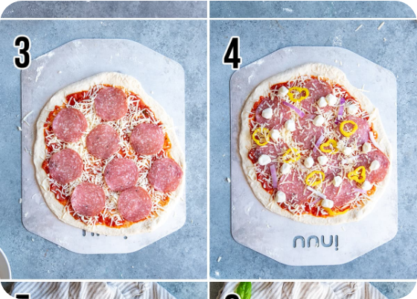
What is a Program?
The Recipe Analogy
Think of a computer program like a recipe for a pizza.
It is a specific sequence of instructions that a computer follows to get a job done.
Without the recipe, the computer has no idea what to do!

Slide 4



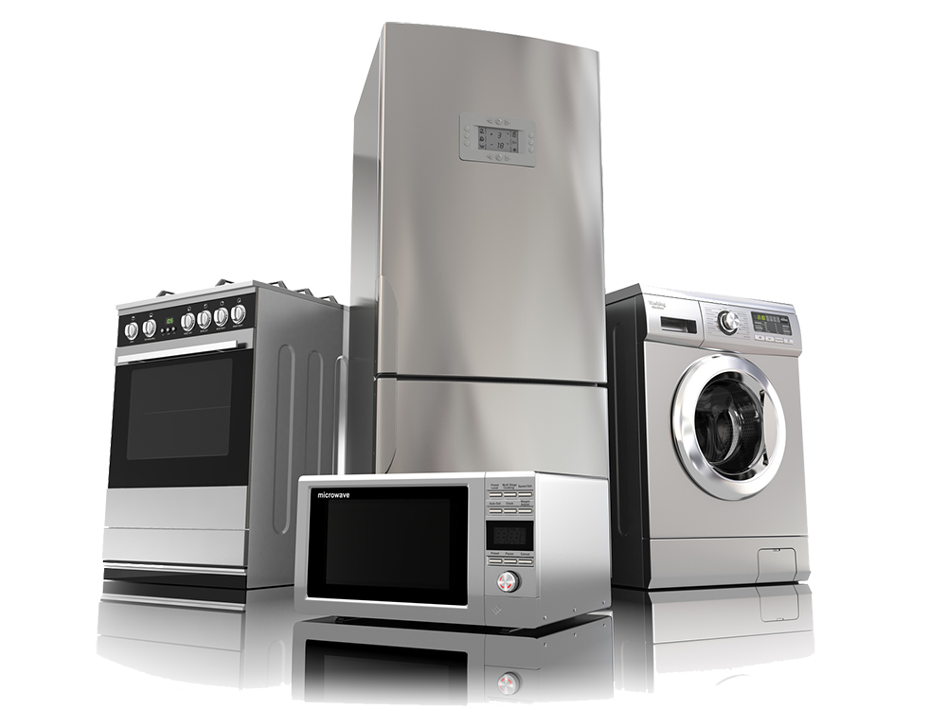
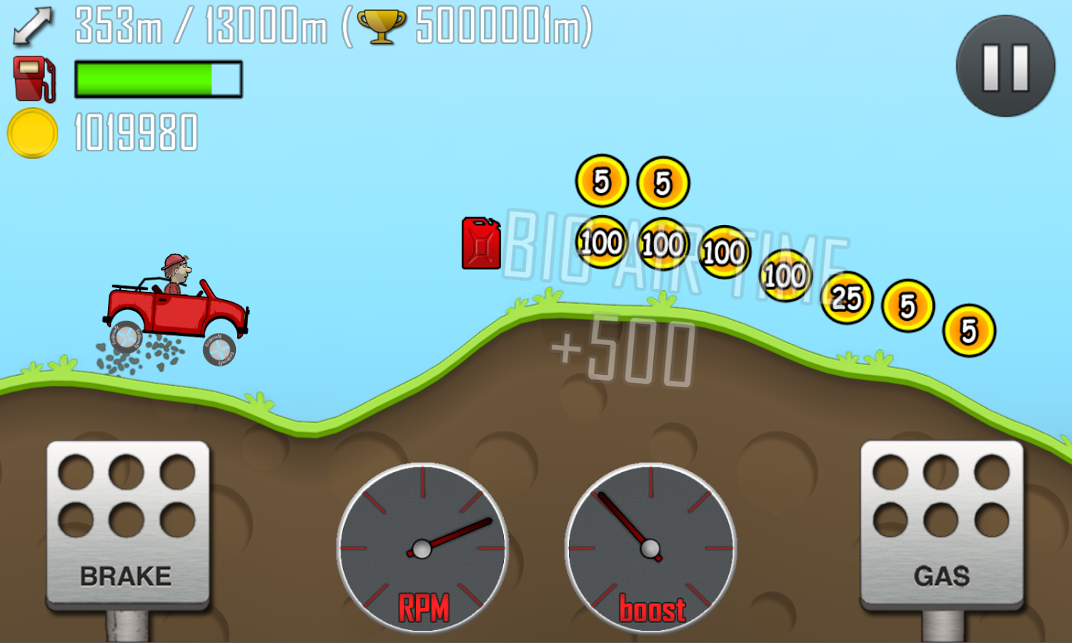


Programs are Everywhere!
Smart Tech
Cars, Traffic Lights, & Spacecraft!
Entertainment
Games & Apps

Slide 5
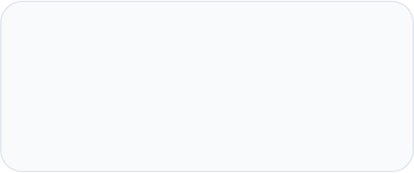
Why do we Program?
Problem Solving
Creative Expression
Programming allows us to solve massive problems, like calculating trajectories to Mars or helping doctors diagnose diseases faster.
It's an art form! You can build worlds, tell stories, and create interactive music that never existed before.

Slide 6
Activity: The "Human Robot"
Pick a Robot: One person is the "Robot", the other is the "Programmer".
The Goal: Guide the Robot to pick up a pen and draw a square.
The Rule: The Robot only understands basic commands: "Step forward", "Turn 90°", "Lower arm".
Reflection: Was it harder than it looks? Why?

Slide 7
Computers are... Dumb?
100%
Precision is Key
Computers don't "guess" what you mean. They do exactly what you tell them, even if it's a mistake!
If you tell a robot to "Walk through the door" without saying "Open it first", it will bump into it!
Literal Interpretation

Slide 8
The Language of Code
How we talk to machines

Slide 9
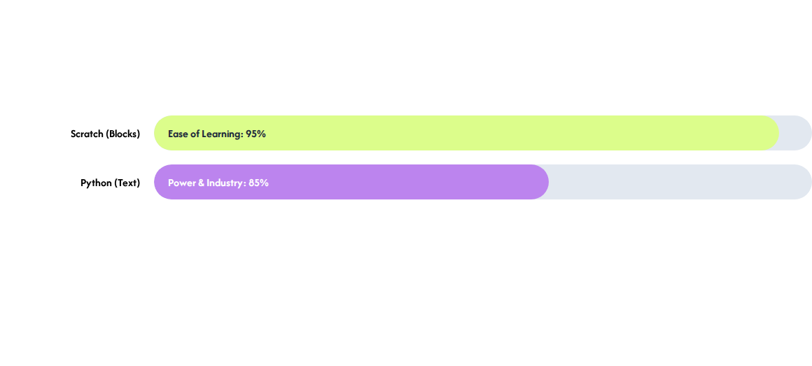
Block vs. Text Languages
We start with Scratch because blocks help us focus on logic without worrying about spelling mistakes!

Slide 10
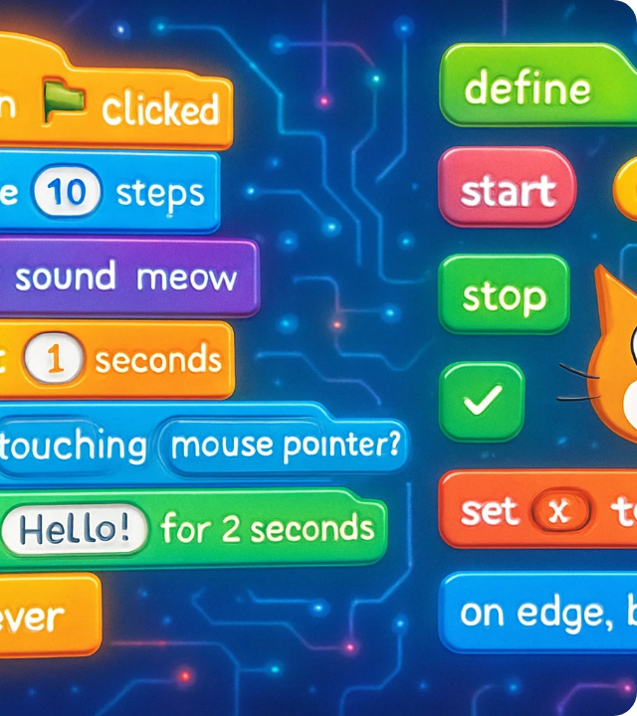
The Scratch Lab
Explore the Environment
1. Stage: Where the magic happens!
2. Blocks Palette: Your toolbox of commands.
3. Scripts Area: Drag and snap your blocks here to build your program.

Slide 11

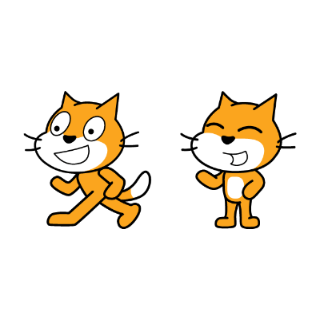
Meet your Character
What is a Sprite?
In programming, a Sprite is any object or character that can be controlled by code.
The Scratch Cat is our first sprite. We can make him move, dance, change color, or even talk using the blocks!

Slide 12
The Programmer's Cycle
1. Think
2. Code
3. Test
4. Debug
Plan your steps.
Snap the blocks.
Click the Green Flag!
Fix any errors.

Slide 13
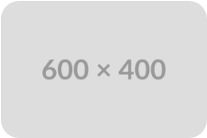
Mistakes are Good!
“
"Programming is 10% writing code and 90% figuring out why it doesn't work." — Every Programmer Ever
— Every Programmer Ever

Slide 14
Quick Knowledge Check
Term | What it means...
Algorithm | A step-by-step set of instructions.
Program | An algorithm that a computer can understand.
Debug | To find and fix errors in your code.
Sequence | The order in which instructions are followed.

Slide 15


Any Questions?
Ready to create your first script?

