Slide 1


🎮
Game Design Logic
Level Up Your Coding Skills!

Slide 2
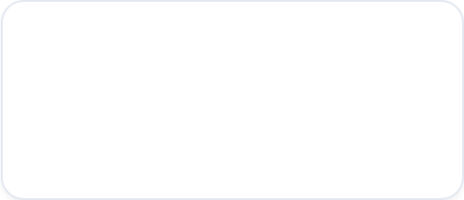
Your Mission Today...
Understand sequence, selection, and repetition.
Apply logical reasoning to explain algorithms.
Design your own game logic from scratch!

Slide 3

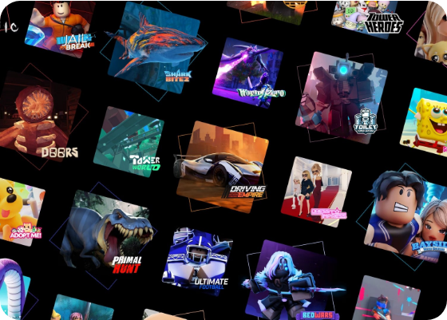
Starter: Inside the Game
Think-Pair-Share 🧠
Look at your favourite games like Minecraft or Roblox.
How does the game know you've clicked?
What happens if you touch lava?
How does it keep track of your score?
Every action is controlled by Logic!

Slide 4
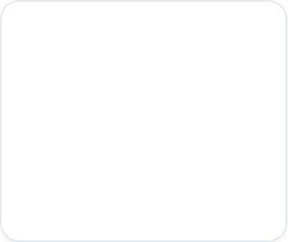
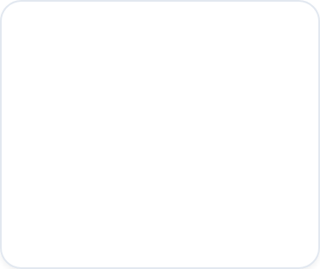
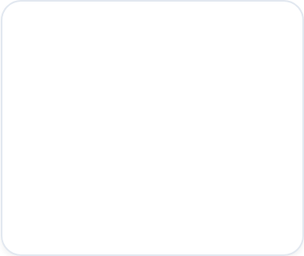



The Brain of the Game
Sequence
Selection
Repetition
The order that things happen.
Making choices using IF statements.
Doing things over and over (Loops).

Slide 5
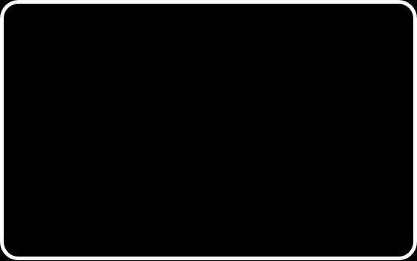
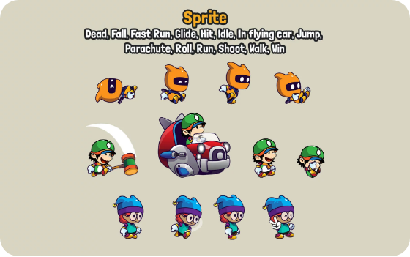
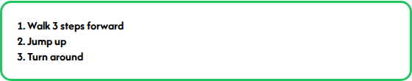
1. Sequence: The Order
Role-Play Activity! 🎭
A computer follows instructions top to bottom.
Challenge: What happens if we swap steps 1 and 2? Does the Sprite end up in the same place?

Slide 6
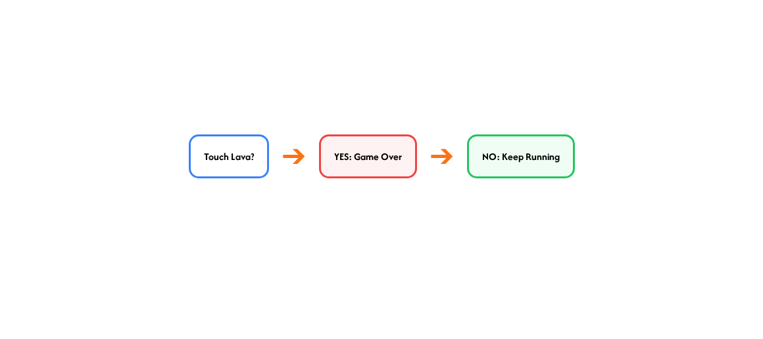

2. Selection: Decision Time!
Selection uses IF... THEN statements to change the game.

Slide 7

3. Repetition: The Loop
∞
Why use Loops?
Instead of writing "Walk forward" 100 times, we just write:
REPEAT 100 times:
Infinite Power!
Real World: Games use loops to constantly check if you've pressed a key or reached the finish line.

Slide 8
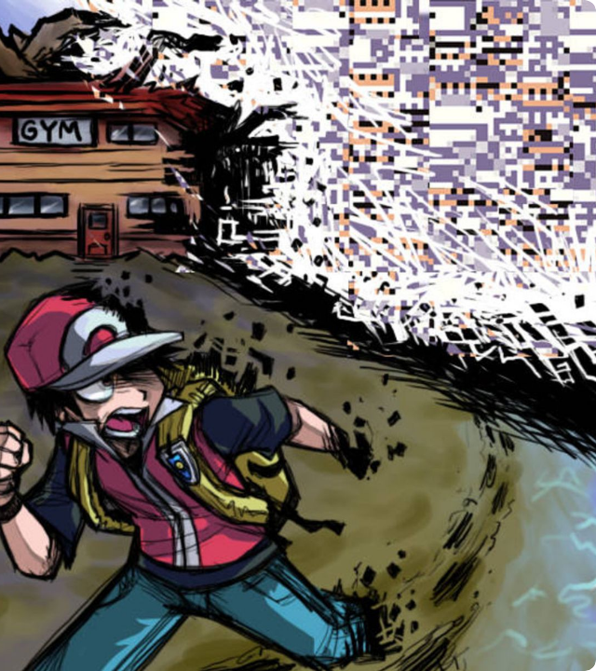
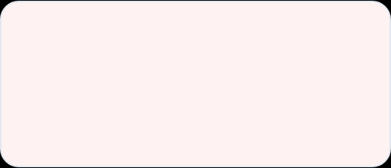

The Logic Doctor
Fix the Glitch! 🛠️
Debugging is finding and fixing errors in your logic.
The Bug: "Every time my player jumps, the game ends."
Why is this happening? Talk to your partner!

Slide 9
Mini Coding Challenge
Can you fill in the missing logic for these game actions?
Input / Condition | Logic Type | Action / Outcome
Player collects 10 coins | Selection (IF) | Level Up!
Enemy touches player | Selection (IF) | Lose 1 Life
Game is running | Repetition (Loop) | Update Background

Slide 10
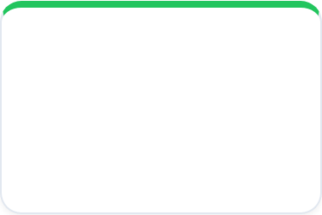
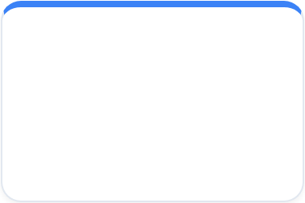
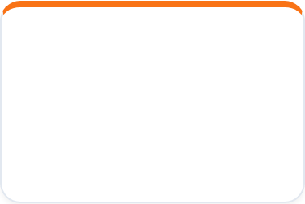
Project Alpha: Design Your Game
Support
Core
Challenge
Draw a flowchart for a simple Clicker Game.
Plan a Platformer using Sequence and Selection.
Design a Boss Battle using Loops and Variables.
Unplugged Task: Use paper & pencils to draw your logic flow!

Slide 11
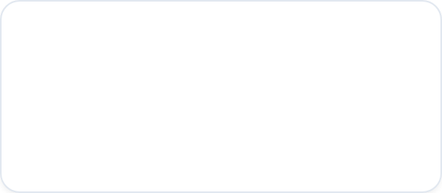
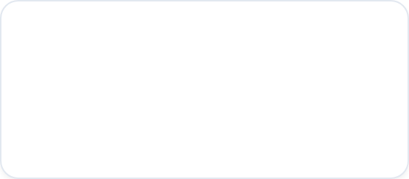
Level Up with Feedback
"Two Stars and a Wish"
⭐⭐ Stars
🧞 Wish
What are two things you LOVE about their logic design?
What is one thing they could add to make it even better?

Slide 12
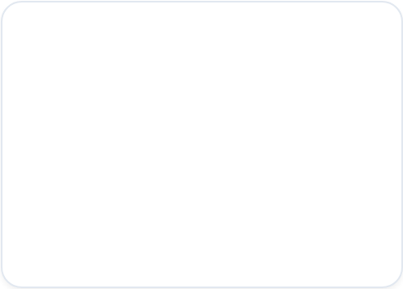
Game Over? Level Up!
Exit Ticket Check-In
1. Can you explain what a Loop does? 2. Can you give an example of an IF statement?
🤩 😐 🧐
(Choose an emoji to show how you feel about your learning!)

Slide 13



Image Sources
https://images.pushsquare.com/4627ac878d257/large.jpg
Source: www.pushsquare.com
https://img.craftpix.net/2023/07/Side-Scroll-Character-Sprites2.webp
Source: craftpix.net
https://mediaproxy.tvtropes.org/width/1200/https://static.tvtropes.org/pmwiki/pub/images/some_things_just_should_not_be_by_spookydoom_d2lrq42_375w_2x.jpg
Source: tvtropes.org

