Slide 1
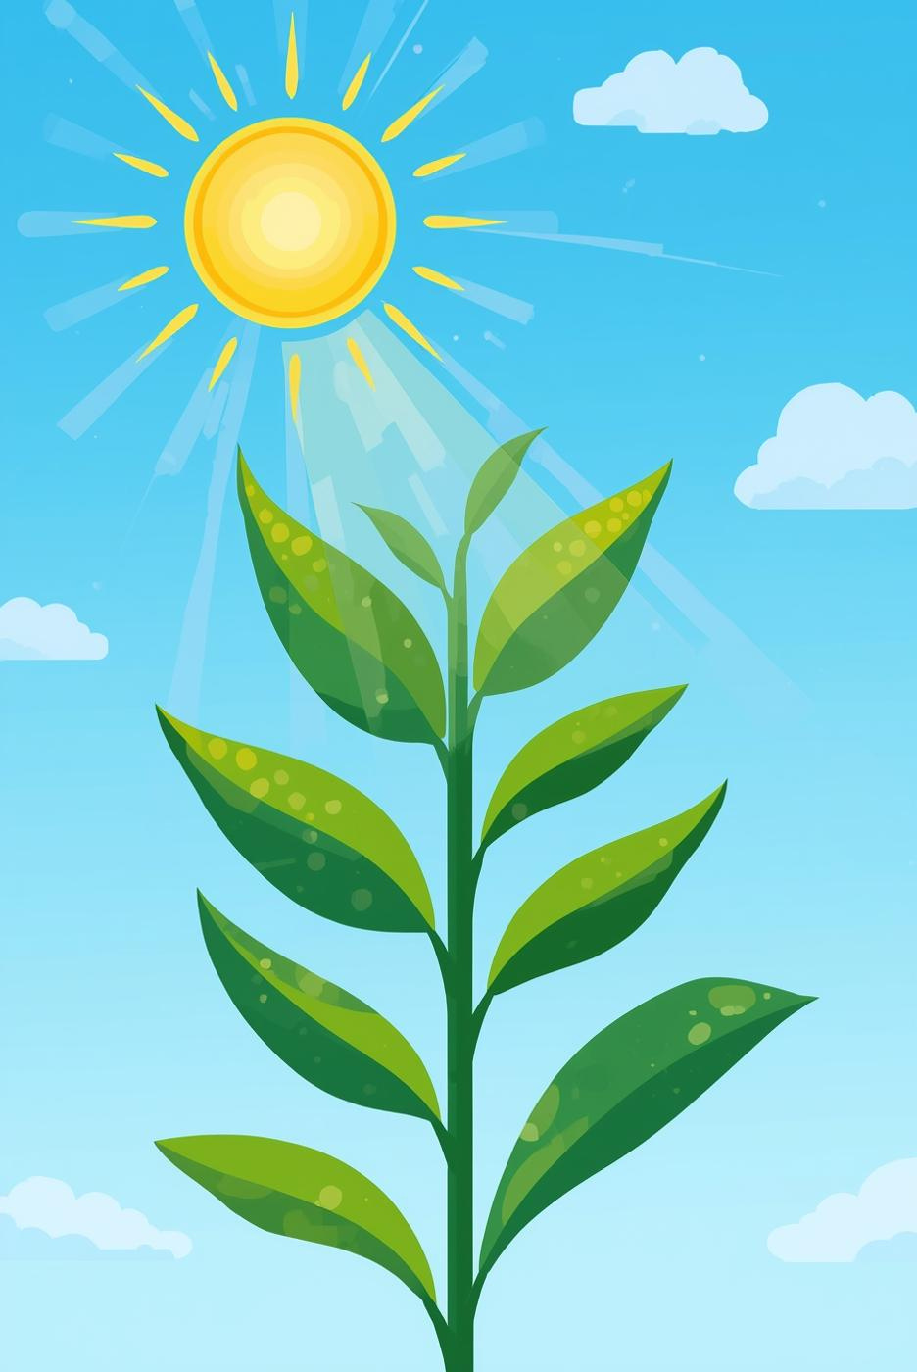
Photosynthesis: Powering Life
Presented by [Your Name]

Slide 2
Photosynthesis Overview
Understanding the Process and Its Importance
Photosynthesis is the process by which green plants and some organisms use sunlight to synthesize foods from carbon dioxide and water, occurring in chloroplasts, essential for ecosystems.

Slide 3
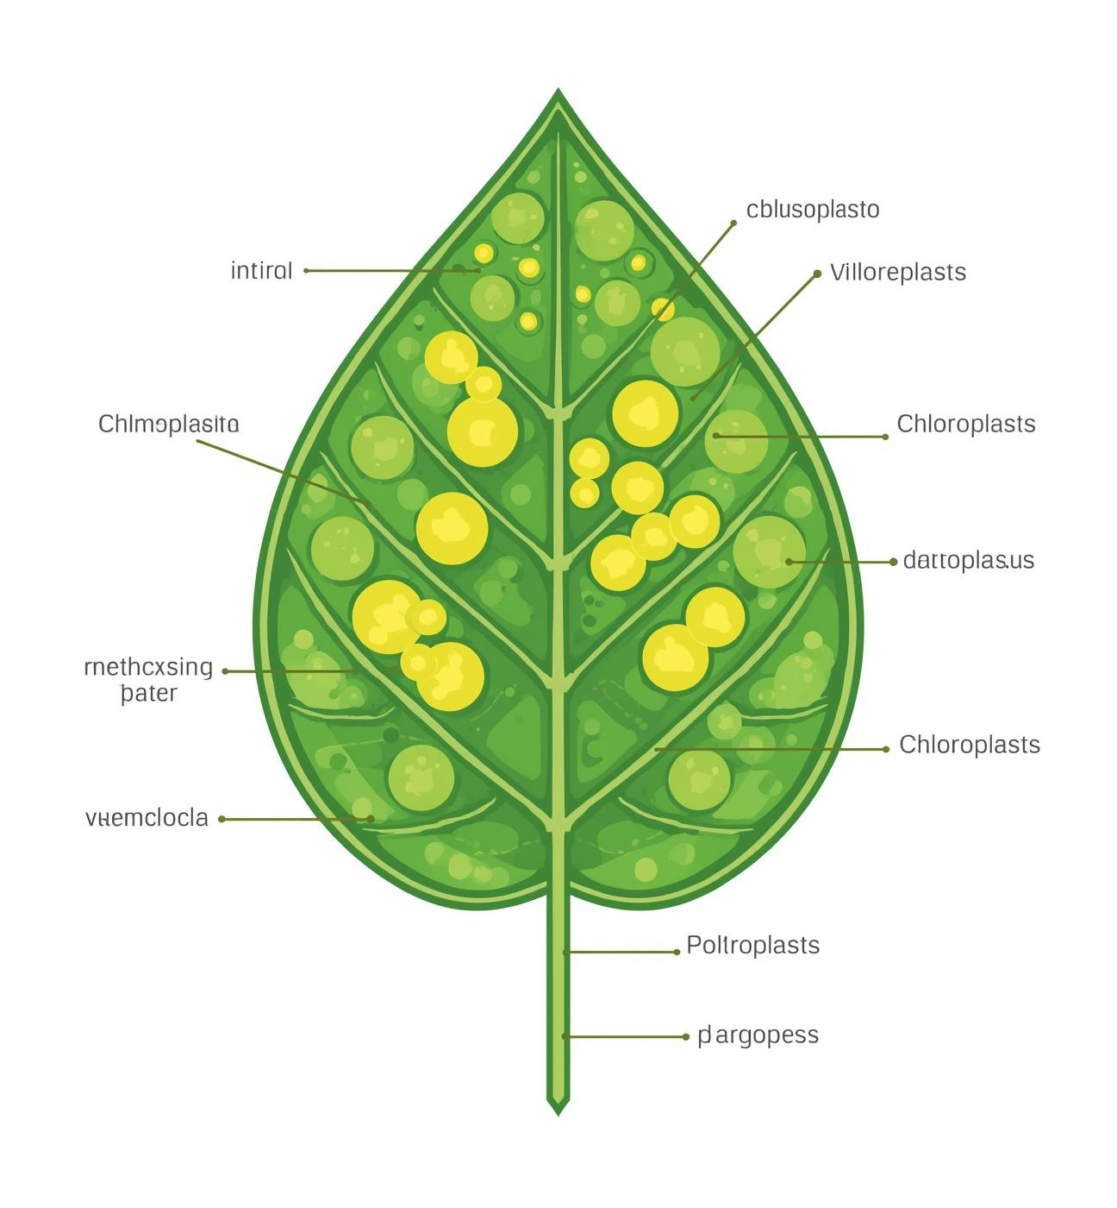
Foundation
Photosynthesis is the process where green plants use sunlight to synthesize foods from carbon dioxide and water.
Occurs in chloroplasts of plant cells.
Essential for ecosystems: basis of food chains, oxygen production.
Key questions: What is photosynthesis? Why is it important?

Slide 4
The Photosynthesis Process
Overview of Light Reactions and Calvin Cycle
Photosynthesis consists of two main stages: light-dependent reactions harness sunlight to produce energy carriers, while the Calvin cycle utilizes these carriers to convert carbon dioxide into glucose.

Slide 5
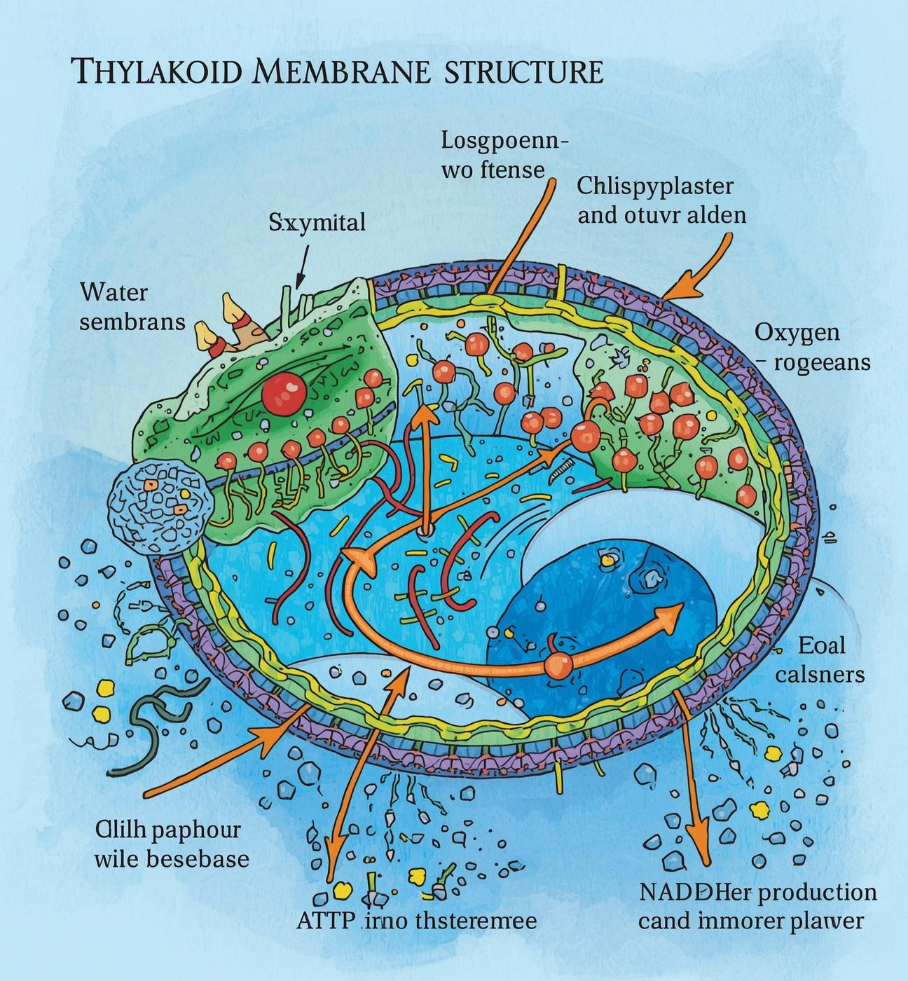
Light-Dependent
Sunlight is absorbed by chlorophyll in the thylakoid membranes.
Water molecules are split in a process called photolysis.
Oxygen is released as a byproduct.
ATP and NADPH are produced for the Calvin cycle.

Slide 6
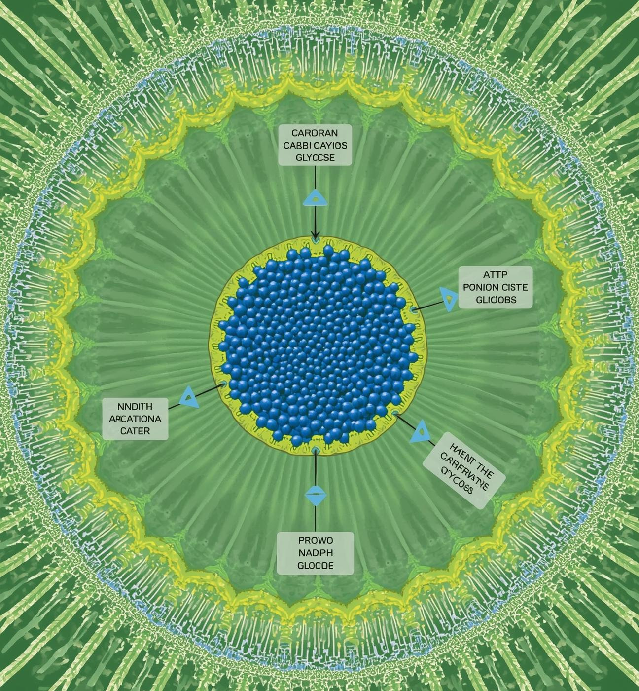
Calvin Cycle
Occurs in the stroma of chloroplasts
Uses ATP and NADPH from light-dependent reactions
Fixation of carbon dioxide into organic molecules
Formation of glucose as an energy source
Essential for plant growth and energy storage

Slide 7

Key Terms
Chlorophyll
Photolysis
Green pigment
Absorbs light
Water splitting
Releases oxygen

Slide 8
Importance of Photosynthesis
Essential process for life on Earth
Oxygen Production
Food Chain Basis
Photosynthesis produces oxygen essential for animal life, creating a breathable atmosphere. This process enables aerobic organisms to thrive, forming the foundation of diverse ecosystems across the planet.
As the primary source of energy, photosynthesis supports the entire food chain. Green plants convert sunlight into chemical energy, serving as the essential energy source for herbivores and, subsequently, carnivores.

Slide 9
Photosynthesis Impact
Carbon Cycle
Agriculture Advances
Climate regulation
Atmospheric balance
Crop yield
Renewable methods

Slide 10
Photosynthesis: A crucial ecological process
Photosynthesis is essential for sustaining life on Earth. Here are the key points to remember:
Definition: Photosynthesis is the process by which green plants and some organisms use sunlight to synthesize foods from carbon dioxide and water.
Process Steps:
Light-dependent reactions: Absorption of sunlight, photolysis of water, oxygen release, production of ATP and NADPH.
Light-independent reactions (Calvin cycle): Carbon fixation, glucose formation using ATP and NADPH.
Ecological Importance:
Produces oxygen vital for animal life.
Forms the basis of the food chain, providing energy for all living organisms.
Plays a critical role in the carbon cycle and climate regulation.
Encouraging further exploration of photosynthesis can enhance understanding of its impact on ecosystems. Did you know some bacteria also perform photosynthesis? This fascinating process not only sustains life but also inspires innovations in renewable energy and agriculture!

Slide 11
Thank You for Your Attention
Email
Social
Phone
hello@reallygreatsite.com
@reallygreatsite.com
123-456-7890

