Slide 1
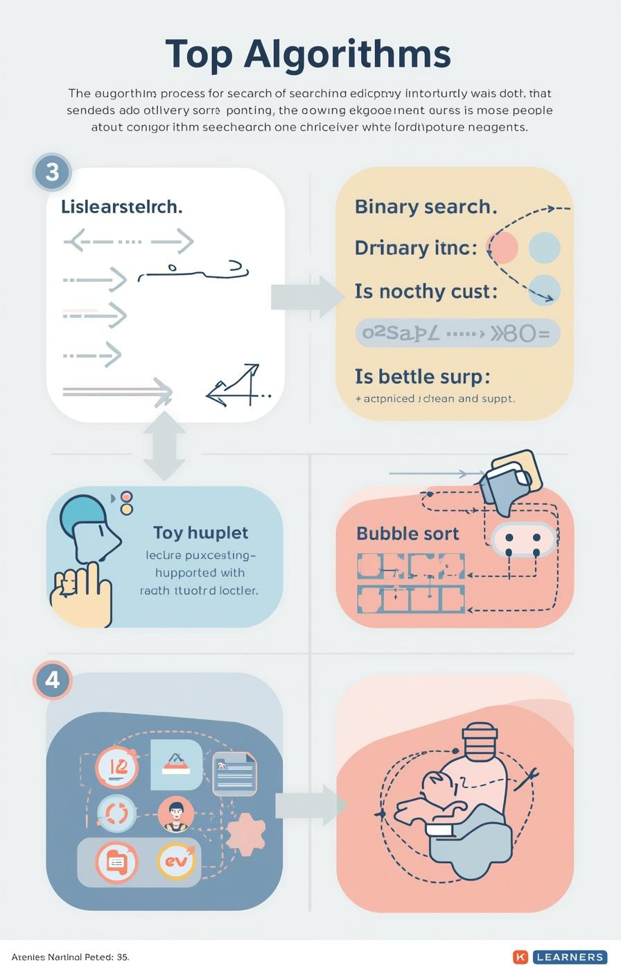

Algorithms: Searching and Sorting
by Mr. Edward Paul

Slide 2

Understanding Algorithms
Their Importance in Computer Science
Algorithms are essential, defined as step-by-step procedures for solving problems. They enable computers to efficiently process information, making them a fundamental aspect of computer science and programming.
2

Slide 3

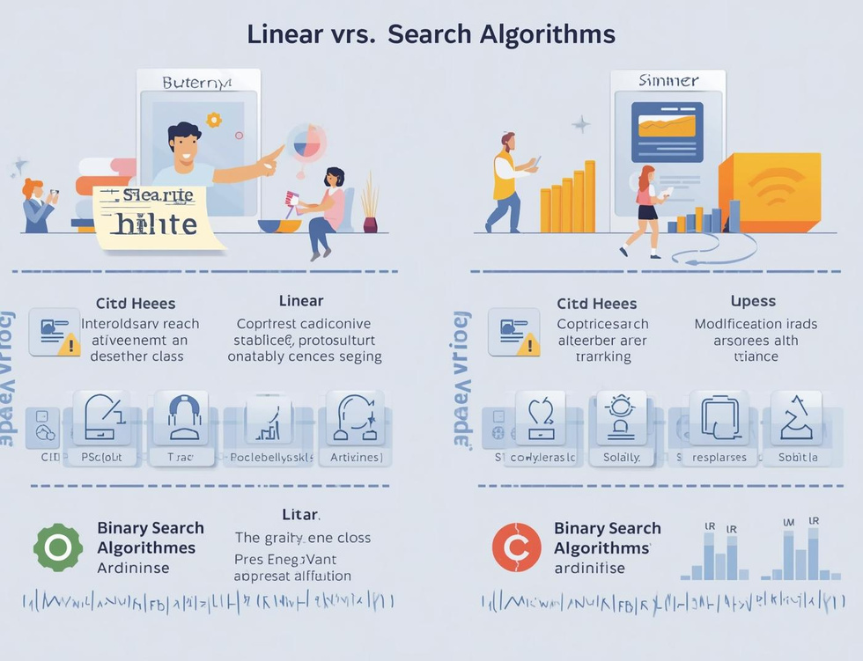
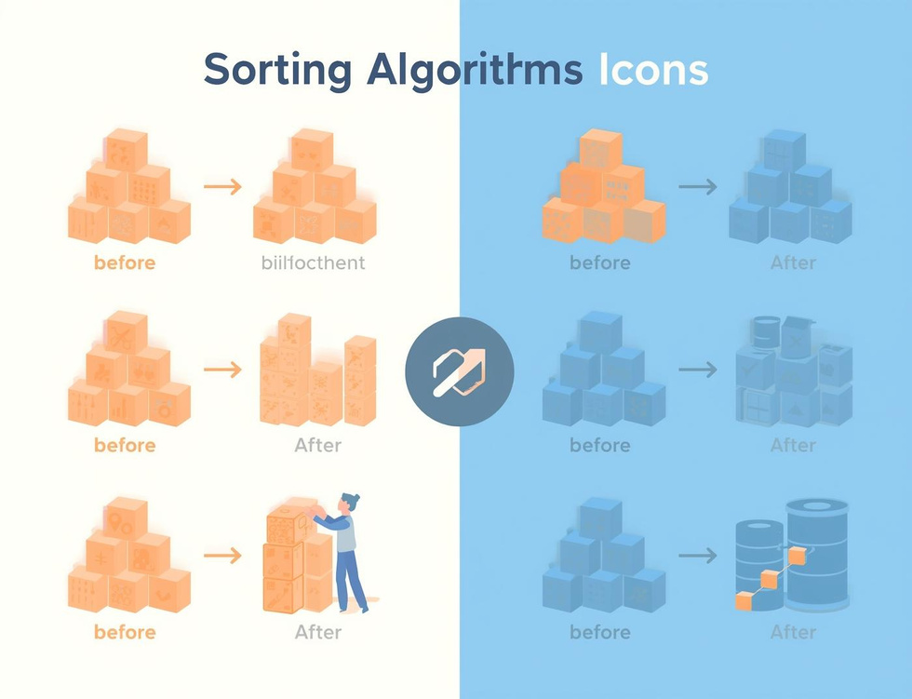
Learning Objectives
Search Algorithms
Compare Efficiencies
Bubble Sort
Understand how algorithms locate data effectively through different searching techniques.
Learn the efficiency differences between linear and binary search methods in data retrieval.
Understand the basics of bubble sort and how it organizes data through comparisons.

Slide 4
Linear Search
Sequential Scanning for Data Retrieval
Definition
Simple Mechanism
Use Cases
Linear search is a straightforward algorithm that checks each element in a list sequentially until it finds the target value or reaches the end of the list.
This method is easy to implement but can be inefficient for large datasets, as it might require examining every single item before locating the desired information.
Linear search is particularly useful for small or unsorted datasets where quick implementation is necessary, making it an ideal choice for simple search tasks.
4

Slide 5
Binary Search
Divide and Conquer Method Explained
Definition
Mechanism
Requirements
Binary search is a fast search algorithm that finds the position of a target value within a sorted array, using a divide-and-conquer strategy for efficiency.
The algorithm repeatedly divides the search interval in half; comparing the target value to the middle element, it narrows down the potential location until the target is found.
For binary search to work, the data must be sorted beforehand; this prerequisite allows the algorithm to efficiently eliminate half of the remaining elements with each comparison.
5

Slide 6
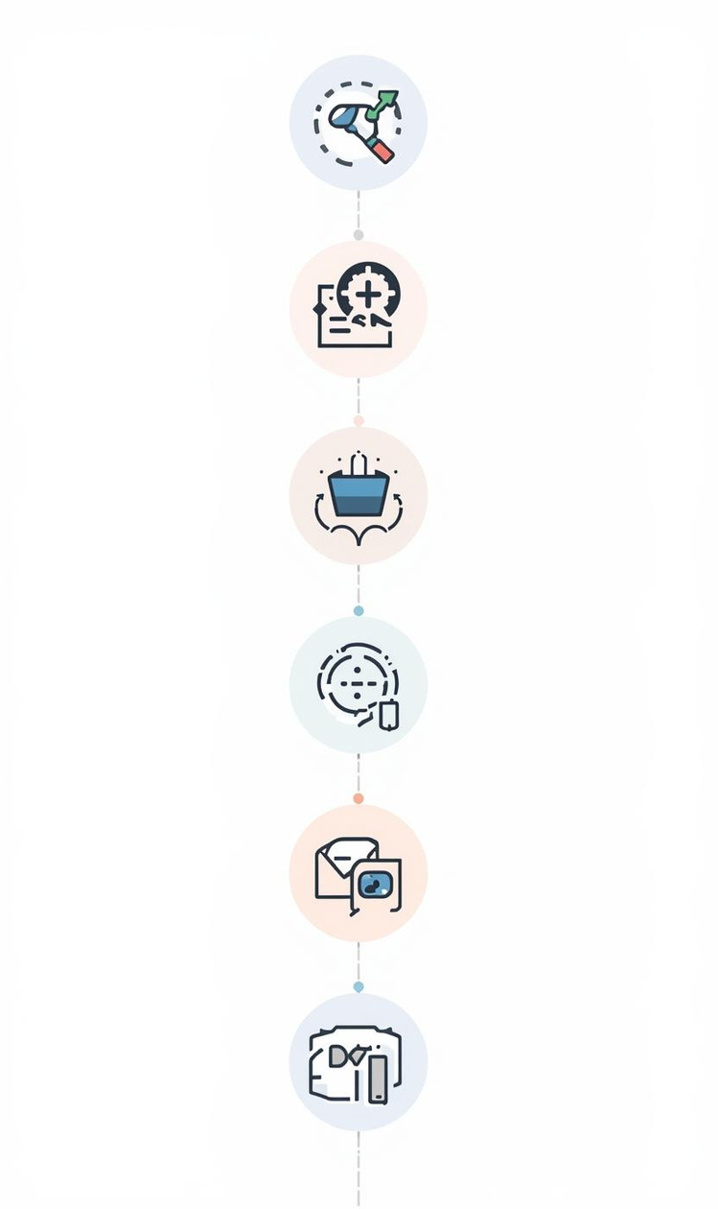
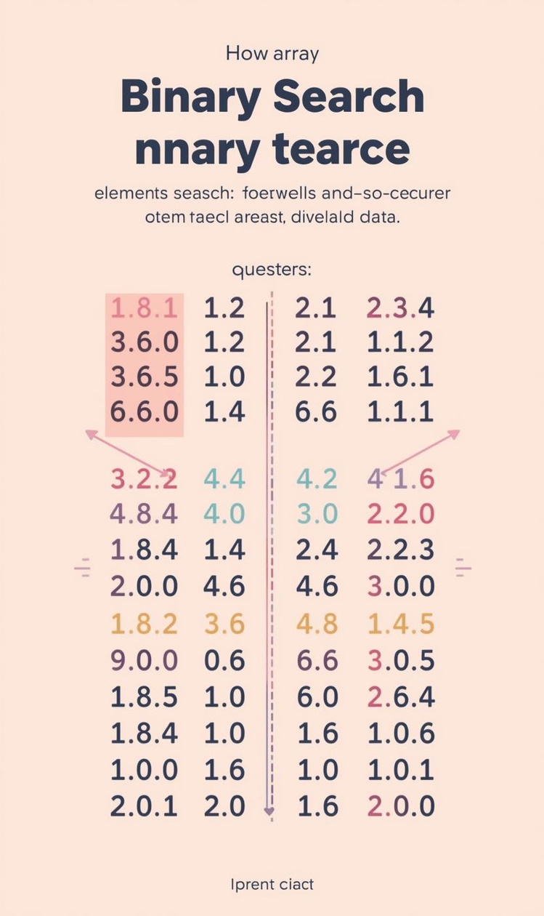

Comparing Efficiency of Search Algorithms
Efficiency
Pros and Cons
Linear search has O(n) time complexity.
Binary search is faster but needs sorted data.

Slide 7
Algorithm Tracing
Linear Search
Binary Search
Efficiency Comparison
In linear search, each element is examined sequentially until the target is found. This straightforward approach is effective for small or unsorted datasets, but can be slow for larger lists.
Binary search requires a sorted list, dividing the search space in half repeatedly, which drastically reduces the number of checks needed to find the target value, making it more efficient than linear search.
Comparing the two searches, linear search has a time complexity of O(n), while binary search operates at O(log n), highlighting the significant efficiency gained through the divide-and-conquer strategy of binary search.

Slide 8
Bubble Sort
Introducing Sorting Algorithms and Their Importance
8

Slide 9
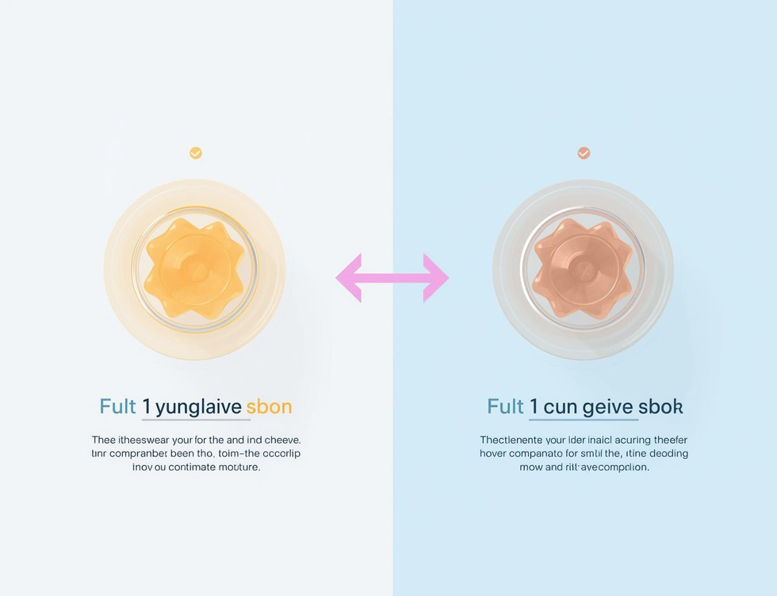

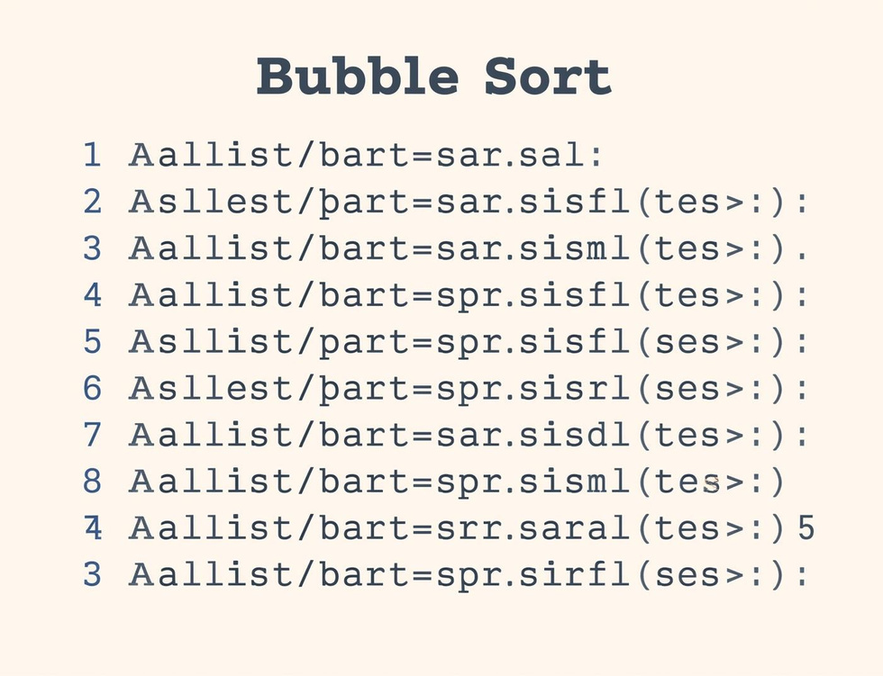
Bubble Sort Steps
Compare Elements
Swap if Needed
Repeat Passes
Compare adjacent elements to determine if they need swapping for sorting.
Elements are swapped if they are in the wrong order, ensuring sorting progress.
The sorting process continues with repeated passes until the entire list is sorted.

Slide 10
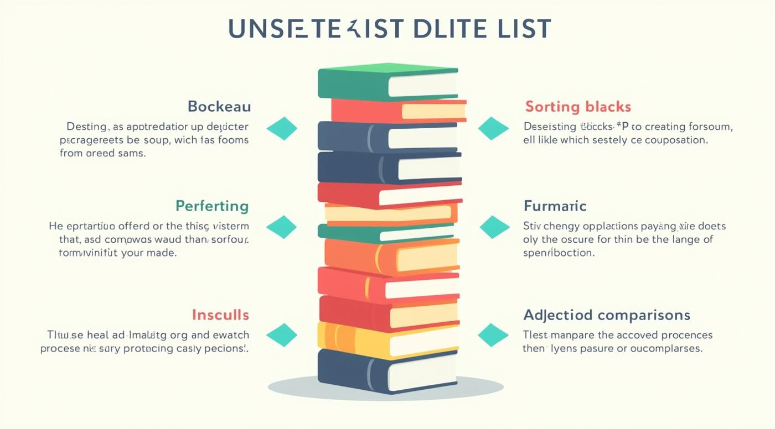
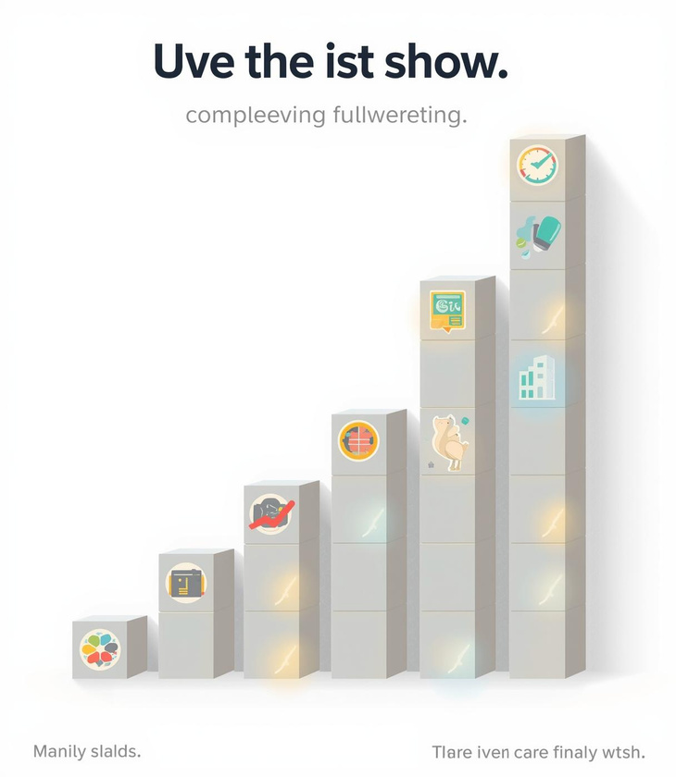
Tracing Bubble Sort Steps

Slide 11
Key Takeaways and Insights
01
Search Algorithms
Linear and binary searches each have distinct strengths.
02
Sorting Concepts
Bubble sort is an essential foundational sorting algorithm.
03
Tracing Importance
Understanding algorithms requires step-by-step tracing practice.

Slide 12

Continue Learning
Practice tracing algorithms today!

Slide 13
Lesson on Photosynthesis
AI-Generated Teaching Slides

Slide 14
As an expert teacher and PowerPoint creator, I've designed a comprehensive lesso
---
## Photosynthesis: How Plants Make Their Food!
### 1. Lesson Objectives
By the end of this lesson, students should be able to:
* **Define** photosynthesis in their own words.
* **Identify** the essential reactants (inputs) and products (outputs) of photosynthesis.
* **State** the word equation for photosynthesis.
* **Explain** the role of chlorophyll and chloroplasts in the process.
* **List and describe** the key environmental factors that affect the rate of photosynthesis.
* **Articulate** the significance of photosynthesis for life on Earth, including its role in food chains and oxygen production.
### 2. Introduction / Starter Activity
**Activity Title: "Plant's Essential Wishlist"**
**Time:** 5-7 minutes
**Materials:** Whiteboard/Projector, markers/pens, small slips of paper or mini whiteboards.
**Instructions:**

Slide 15
**Display:** Show an image of a thriving, healthy plant on the screen.

Slide 16
**Prompt:** "Imagine you are a plant. What three things do you absolutely *need*

Slide 17
**Think-Pair-Share:**
* **Think (2 minutes):** Students individually brainstorm and jot down their three essential needs.
* **Pair (2 minutes):** Students turn to a partner and share their lists, discussing any similarities or differences.
* **Share (1-2 minutes):** Invite a few pairs to share their ideas with the whole class.

Slide 18
**Teacher Link:** As students share, gently guide the discussion towards sunligh
### 3. Key Teaching Points
**A. What is Photosynthesis?**
* **Definition:** The process by which green plants and some other organisms use sunlight to synthesize foods from carbon dioxide and water.
* **Etymology:** "Photo" (light) + "Synthesis" (to make) = Making with Light.
* **Autotrophs:** Plants are 'self-feeders' (autotrophs) – they produce their own food.
**B. Where Does it Happen? (The Plant's Kitchen)**
* **Location:** Primarily in the leaves of plants.
* **Cellular Organelle:** Inside specialized structures within plant cells called **chloroplasts**.
* **Chlorophyll:** Chloroplasts contain a green pigment called **chlorophyll**.
* **Role:** Chlorophyll's job is to absorb light energy, especially red and blue light (it reflects green light, which is why plants look green).
**C. The Ingredients (Reactants)**
* **Carbon Dioxide (CO₂):**
* **Source:** Absorbed from the atmosphere.
* **Entry:** Enters the leaf through tiny pores on the underside called **stomata** (singular: stoma).
* **Water (H₂O):**
* **Source:** Absorbed from the soil by the plant's roots.
* **Transport:** Travels up the stem to the leaves through specialized tubes called xylem.
* **Light Energy:**
* **Source:** The sun (or artificial light).
* **Role:** Provides the energy needed to power the chemical reaction.
**D. The Products (The Plant's Food and By-product)**
* **Glucose (C₆H₁₂O₆):**
* **Role:** A sugar, the plant's primary food source.
* **Uses:**
* Used immediately for energy through respiration.
* Converted into other substances like cellulose for growth and repair.
* Stored as starch (a complex carbohydrate) for later use.
* **Oxygen (O₂):**
* **Role:** A waste product for the plant.
* **Release:** Diffuses out of the leaf through the stomata into the atmosphere.
* **Significance:** Essential for the respiration of most living organisms (including humans).
**E. The Word Equation**
* Carbon Dioxide + Water $\xrightarrow{\text{Light Energy (Chlorophyll)}}$ Glucose + Oxygen
* Emphasize that 'Light Energy' and 'Chlorophyll' are *conditions* necessary for the reaction, not reactants themselves, hence why they are written above the arrow.
**F. The Balanced Chemical Equation (Optional, depending on student level)**
* 6CO₂ + 6H₂O $\xrightarrow{\text{Light Energy (Chlorophyll)}}$ C₆H₁₂O₆ + 6O₂
* Briefly explain that the numbers in front (coefficients) ensure the same number of atoms of each element are present on both sides (conservation of mass).
**G. Factors Affecting the Rate of Photosynthesis (Limiting Factors Concept)**
* The rate at which a plant photosynthesise can be affected by the availability of its reactants and conditions.
* **Light Intensity:**
* **Effect:** As light intensity increases, the rate of photosynthesis increases (up to a point).
* **Limiting Factor:** If light is scarce, it becomes the limiting factor.
* **Carbon Dioxide Concentration:**
* **Effect:** As CO₂ concentration increases, the rate of photosynthesis increases (up to a point).
* **Limiting Factor:** If CO₂ is scarce, it becomes the limiting factor.
* **Temperature:**
* **Effect:** Photosynthesis is controlled by enzymes. There's an optimum temperature; too cold (slows enzyme activity) or too hot (denatures enzymes) will decrease the rate.
* **Limiting Factor:** Extreme temperatures.
* **Water Availability:**
* **Effect:** While usually not a primary limiting factor unless severely scarce, a lack of water can cause stomata to close, reducing CO₂ intake and thus photosynthesis.
**H. Importance of Photosynthesis for Life on Earth**
* **Food Source:** It forms the base of almost all food chains, providing food directly for herbivores and indirectly for carnivores and omnivores.
* **Oxygen Production:** It continuously replenishes the oxygen in the atmosphere, which is vital for aerobic respiration in most living organisms.
* **Carbon Cycle:** It removes carbon dioxide from the atmosphere, helping to regulate Earth's climate.
### 4. Guided Practice or Activities
**Activity 1: "Equation Builder Challenge"**
**Time:** 10 minutes
**Materials:** Printed cards with "Carbon Dioxide", "Water", "Glucose", "Oxygen", "Light Energy", "Chlorophyll", and an arrow symbol (→). One set per pair/small group.
**Instructions:**

Slide 19
Divide students into pairs or small groups.

Slide 20
Give each group a shuffled set of cards.

Slide 21
Challenge them to arrange the cards correctly to form the word equation for phot

Slide 22
Circulate and provide support. Once groups are confident, ask them to explain th

Slide 23
*Extension:* Challenge advanced groups to represent it pictorially using simple
**Activity 2: "Leaf's Day Job" Diagram Labeling**
**Time:** 8-10 minutes
**Materials:** Worksheet with a simple diagram of a plant leaf and a cross-section of a leaf showing stomata, veins, and ideally, chloroplasts within cells.
**Instructions:**

Slide 24
Students label the diagram, identifying where carbon dioxide enters, water arriv

Slide 25
Provide a word bank if needed (e.g., Stomata, Xylem, Chloroplast, Sunlight, Carb

Slide 26
**Discussion:** After labeling, ask students to explain *how* each part contribu
**Activity 3: "Photosynthesis Rate Predictor" (Graph Interpretation)**
**Time:** 10-12 minutes
**Materials:** Worksheet with 2-3 simple graphs showing the effect of light intensity, CO₂ concentration, and/or temperature on the rate of photosynthesis. Each graph should have clearly labeled axes.
**Instructions:**

Slide 27
Students analyze each graph individually or in pairs.

Slide 28
For each graph, they answer questions such as:
* "What happens to the rate of photosynthesis as [factor] increases?"
* "At what point does [factor] no longer increase the rate significantly?"
* "What do you think is limiting the rate at that point?"

Slide 29
**Class Discussion:** Review answers as a class, discussing the concept of limit
### 5. Assessment Ideas
* **Exit Ticket (5 minutes):**
* On a small slip of paper, students answer:
1. List two things a plant takes in for photosynthesis.
2. Name one product of photosynthesis.
3. Why is photosynthesis important for animals?
* Collect at the door to quickly gauge understanding of key concepts.
* **"Explain to a Friend" Task (Homework/Short in-class task):**
* "Imagine you need to explain photosynthesis to a friend who missed today's lesson. Write a short paragraph or draw a simple annotated diagram explaining the process, its ingredients, and its importance."
* This assesses their ability to synthesize information and communicate it clearly.
* **Quick Quiz (10 minutes):**
* A short multiple-choice or fill-in-the-blank quiz covering:
* Definition of photosynthesis.
* Reactants and products.
* Location (chloroplasts, chlorophyll).
* Role of stomata.
* Basic understanding of limiting factors.
* **Concept Map Creation (Project/Extended Activity):**
* Students create a concept map connecting key terms: Photosynthesis, Sunlight, Water, Carbon Dioxide, Glucose, Oxygen, Chlorophyll, Chloroplast, Stomata, Roots, Food Chain, Respiration, Starch, Cellulose.
### 6. Summary / Conclusion
**Activity Title: "The Big Picture Recap"**
**Time:** 5 minutes
**Instructions:**

Slide 30
**Review Objectives:** Revisit the lesson objectives displayed at the beginning.

Slide 31
**Quick Fire Questions:**
* "What's the main energy source for photosynthesis?" (Sunlight)
* "Which gas do plants take in from the air?" (Carbon Dioxide)
* "Which gas do plants release that we breathe?" (Oxygen)
* "What food do plants make for themselves?" (Glucose)
* "Where does the magic happen inside the plant cell?" (Chloroplasts)

Slide 32
**The Grand Finale:** "Remember, photosynthesis isn't just about plants making t

Slide 33
**Preview/Link:** Briefly mention that in the next lesson, we might explore how
### 7. PowerPoint Slide Outline
**Slide 1: Title Slide**
* **Title:** Photosynthesis: How Plants Make Their Food!
* **Subtitle:** The Basis of Life on Earth
* **Image:** Lush green plants bathed in sunlight, perhaps a stylized sun.
**Slide 2: Lesson Objectives**
* **Bullet Points:**
* Define photosynthesis.
* State the word equation for photosynthesis.
* Identify the reactants and products.
* Explain the role of chlorophyll and chloroplasts.
* List key factors affecting the rate of photosynthesis.
* Explain the importance of photosynthesis for life.
* **Image:** A small icon representing learning or a checklist.
**Slide 3: Starter Activity: Plant's Essential Wishlist**
* **Question:** "What three things do you absolutely *need* to survive and grow big and strong?"
* **Instructions:** Think-Pair-Share, jot down ideas.
* **Image:** A vibrant, healthy potted plant.
**Slide 4: Introduction to Photosynthesis**
* **Definition:** "Photo" (light) + "Synthesis" (to make) = "Making with Light"
* **Key Idea:** It's how green plants (and some other organisms) make their own food (glucose) using sunlight.
* **Impact:** Crucial for ALL life on Earth!
* **Image:** Diagram showing sunlight hitting a plant.
**Slide 5: Where Does It Happen? (The Plant's Kitchen)**
* **Location:** Mainly in the leaves.
* **Inside Cells:** In specialized organelles called **chloroplasts**.
* **The Green Stuff:** Chloroplasts contain **chlorophyll**, the green pigment that captures light energy.
* **Image:** A plant cell diagram with a magnified chloroplast, showing chlorophyll.
**Slide 6: The Ingredients (Reactants)**
* **Carbon Dioxide (CO₂):** From the air, enters via **stomata**.
* **Water (H₂O):** From the soil, absorbed by roots.
* **Light Energy:** From the sun, captured by chlorophyll.
* **Image:** Three arrows pointing towards a leaf: one from the sun (light), one from the air (CO₂), one from the roots (water).
**Slide 7: The Photosynthesis Process (Simplified Flow)**
* Light energy captured by chlorophyll powers the conversion of ingredients.
* It's like a plant cooking its food!
* **Image:** A simple flow diagram: CO₂ + H₂O + Light Energy → Glucose + O₂ (inside a leaf icon).
**Slide 8: The Products (Food & By-product)**
* **Glucose (C₆H₁₂O₆):**
* Plant's food for energy, growth, and storage (as starch).
* **Oxygen (O₂):**
* Released into the atmosphere.
* Essential for animal respiration.
* **Image:** Glucose molecule representation, oxygen bubbles rising from a leaf in water.
**Slide 9: The Word Equation**
* **Equation:** Carbon Dioxide + Water $\xrightarrow{\text{Light Energy (Chlorophyll)}}$ Glucose + Oxygen
* **Emphasis:** Highlight 'Light Energy' and 'Chlorophyll' as conditions above the arrow.
* **Image:** Visually appealing word equation, perhaps with small icons for each component.
**Slide 10: The Chemical Equation (Optional/Advanced)**
* **Equation:** 6CO₂ + 6H₂O $\xrightarrow{\text{Light Energy (Chlorophyll)}}$ C₆H₁₂O₆ + 6O₂
* **Note:** Explaining the balancing briefly.
* **Image:** Chemical formulas clearly displayed.
**Slide 11: Guided Practice: Equation Builder Challenge!**
* **Instructions:** Arrange the provided cards to form the correct word equation.
* **Image:** Scrambled word equation components, perhaps with a timer icon.
**Slide 12: Factors Affecting Photosynthesis Rate**
* **List:**
* Light Intensity
* Carbon Dioxide Concentration
* Temperature
* Water Availability
* **Concept:** Explain that one factor can 'limit' the rate if it's in short supply.
* **Image:** Small, simple graphs illustrating the effect of each factor on reaction rate.
**Slide 13: Activity: "Photosynthesis Rate Predictor"**
* **Instructions:** Analyze the graphs to understand how different factors affect the rate of photosynthesis.
* **Question Prompts:** What happens as [factor] increases? What's the limiting factor here?
* **Image:** Example graphs (e.g., light intensity vs. rate).
**Slide 14: Why is Photosynthesis So Important? (The Big Picture)**
* **Food Source:** Base of almost all food chains.
* **Oxygen Production:** Replenishes atmospheric oxygen for respiration.
* **Carbon Cycle:** Removes CO₂ from the atmosphere, helping climate regulation.
* **Image:** Food chain diagram, Earth with oxygen symbol, simplified carbon cycle.
**Slide 15: Assessment Check-in: Exit Ticket**
* **Questions:**
1. Name two things a plant needs for photosynthesis.
2. Name one product of photosynthesis.
3. Where does photosynthesis happen in a plant cell?
* **Instructions:** Write answers on a slip of paper.
* **Image:** An exit door icon or a pencil and paper icon.
**Slide 16: Summary & Conclusion**
* **Key Recap:** Definition, Reactants, Products, Location, Importance.
* **Final Thought:** The fundamental process sustaining life on Earth!
* **Image:** A beautiful, thriving natural landscape.
**Slide 17: Q&A / Further Exploration**
* **Title:** Questions?
* **Bullet Points:**
* What next? (e.g., measuring photosynthesis rate, plant adaptations).
* Thank you!
* **Image:** Lightbulb icon, or a plant with a question mark.

