Slide 1

INTRODUCTION TO Data science
BigMart Sale Dataset
Prince Jha – PES1201701608
Manoj Kumar S – PES1201700962
Siva Teja S – PES1201700988

Slide 2
Introduction to data set
The Data set choosen is BIG MART SALE from KAGGLE website.
The assignment is basically about choosing a dataset and visualising in the best possible way by cleaning the dataset.
Cleaning the Dataset is done by removing the outliers by the best possible method i.e by finding the mean or median.
EXPLORATORY ANALYSIS is done on the dataset by plotting all possible graphs, visualising it and drawing the conclusion.
Graphs are plotted with outliers as well as without outliers to understand the dataset in a better way by seeing it.
Removal of outliers is done by visualising the BOX PLOT and finding out all the possible outliers.

Slide 3

DATA SET
The data set contains the information the BIG MART SALE.
It consist of 11 columns and 5682 rows
The Data set consist of ,
The sale rate of the products.
What type of products are sold on what percentage
Category of the dataset contain the following information,
Item Weight, Item Fat content, Item Visibility, Item type,
Item MRP, Outlet Identifier, Outlet establishment, Outlet size, Outlet location type, Outlet type

Slide 4
DATA CLEANING
After plotting the box plot for each column in Dataset, we have found many outliers which must be cleaned.
Outliers have been removed/cleaned by finding the mean/median of all the data present in the respective column.
The process of data cleaning is done using the code written in PYTHON language where we import all the required modules, which is used in removing the outliers and plotting the graphs.
The process is continued to all the columns present in the dataset and the outliers are removed in each column.
The best possible way of finding the outliers is by drawing the box plot and finding the easiest way to remove the outliers present in the Dataset.
After all these process, we again draw the box plot and check whether the outliers are present or not by visualising those graphs .

Slide 5
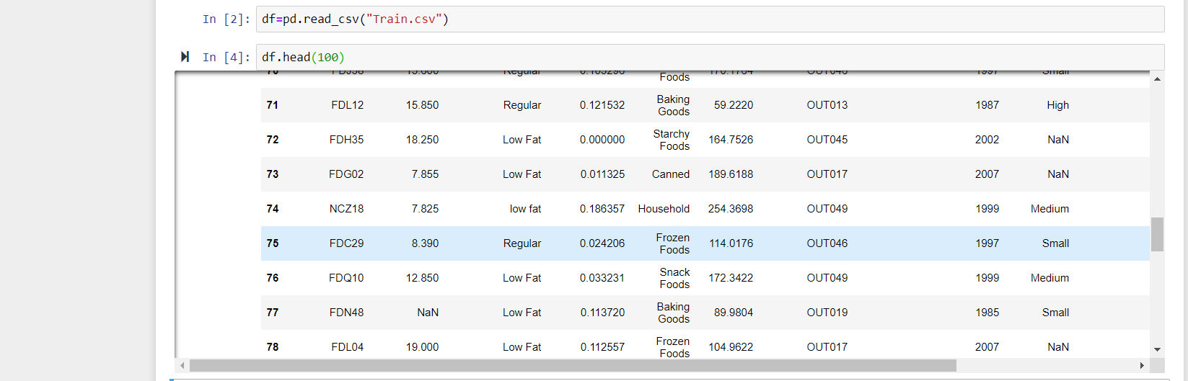
DIRTY DATA

Slide 6
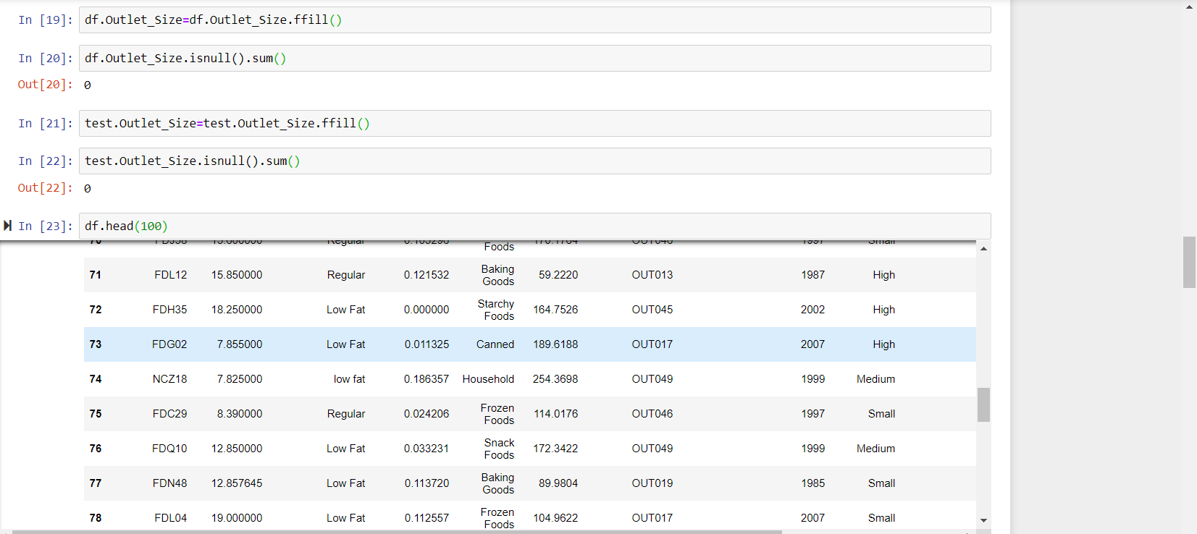
CLEANED USING ROW-COLUMN MEASURES.

Slide 7
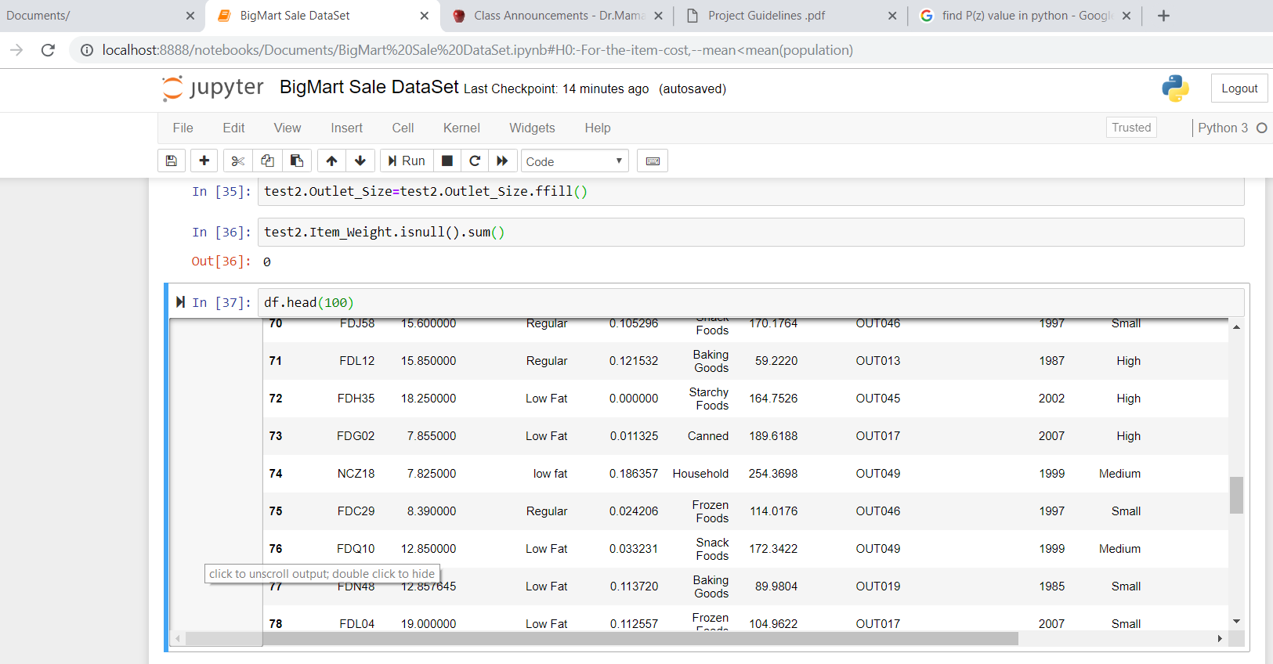
CLEANED USING INTER-POLATION METHOD.

Slide 8
EXPLORATORY ANALYSIS WITH GRAPHS

Slide 9
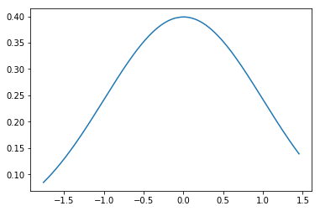
the actual and normal curve for Item MRP is shown one below the other above , note the mean 0 in the curve.Also SD is 1.
NORMALISATION AND STANDARDISATION

Slide 10
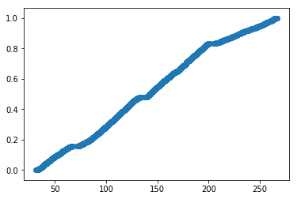
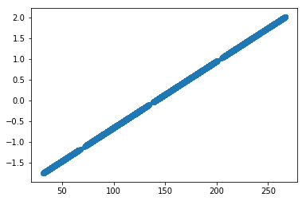
Scatter Plots. Before and After Data Cleaning of ITEM-MRP

Slide 11
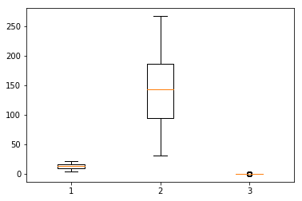
The Box And Whiskers Plot for Item-Weight , Item-MRP , Item-Visibility are shown from left to right
Note :the High Median of MRP And Low Median Of Visibility.
Its Obvious as item costs are scaled on a higher valued scale, While visibility is scaled on a smaller scale¶
In [42]:
The Box And Whiskers Plot for Item-Weight , Item-MRP , Item-Visibility are shown from left to right¶

Slide 12
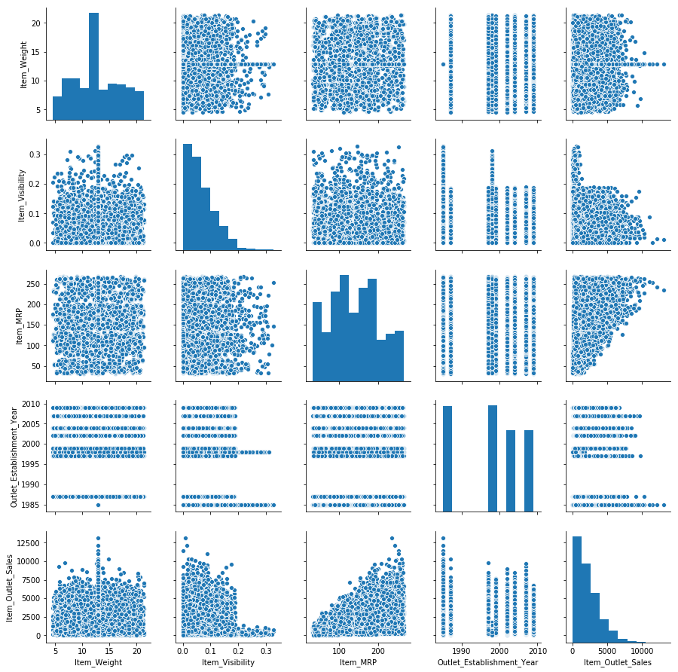
Pair plots

Slide 13

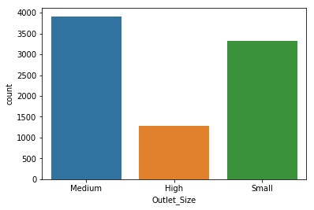
High Outlet Size items have a smaller count since area occupied for storage would be High which The Vendors Don't Prefer.

Slide 14
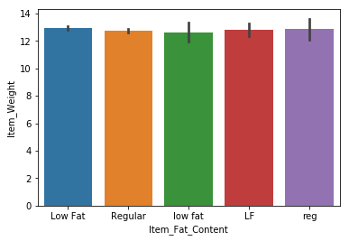
When Item-Weight and Item-FatContent are Plotted against each other, Its Difficult to even distinguish , implies
Weight of an Item Seems to be independent Of Fat-Content

Slide 15
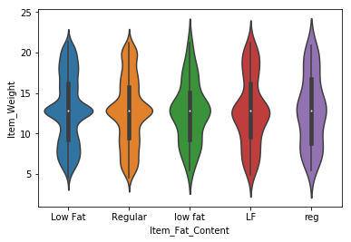
VIOLIN PLOTS

Slide 16
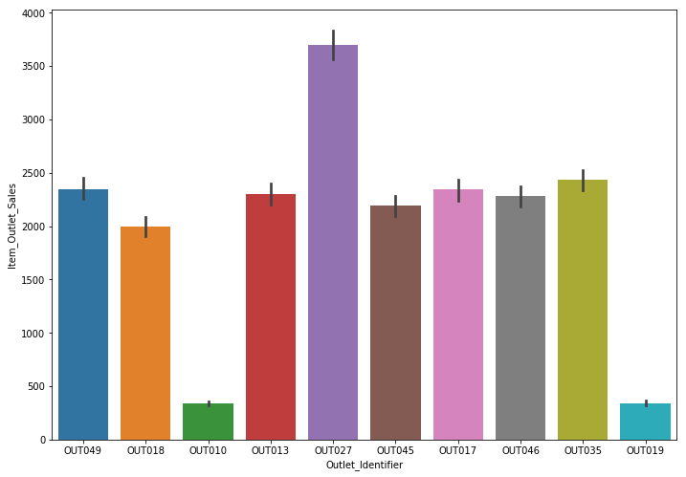
The Graph Below Shows the Outlet Sales of each item identified Uniquely¶

Slide 17
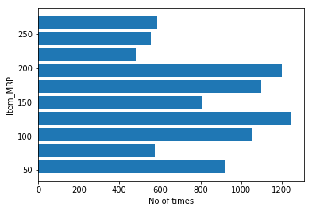
The Items of Price 100-150 have the highest Frequency while those above 250 are lowest

Slide 18
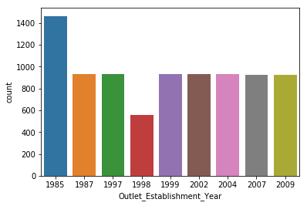
In 1985 , the count was highest, while in 1998 the count was lowest.

Slide 19
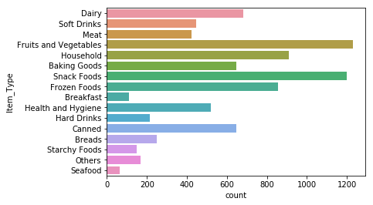
Note That The Count of Vegetables and Fruits is highest, Thus Vegetables are sold in abundance.
Note that Sea Food is sold the least, people hardly prefer Sea-Food.¶

Slide 20
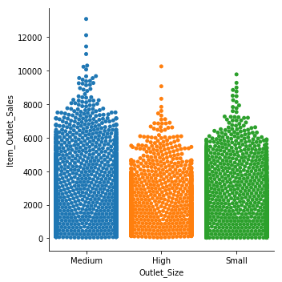
CATPLOT

Slide 21
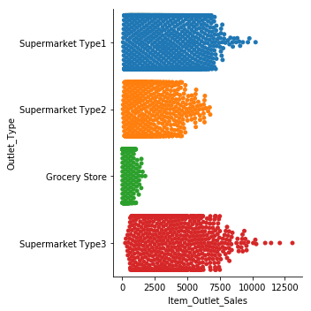
CATPLOT

Slide 22
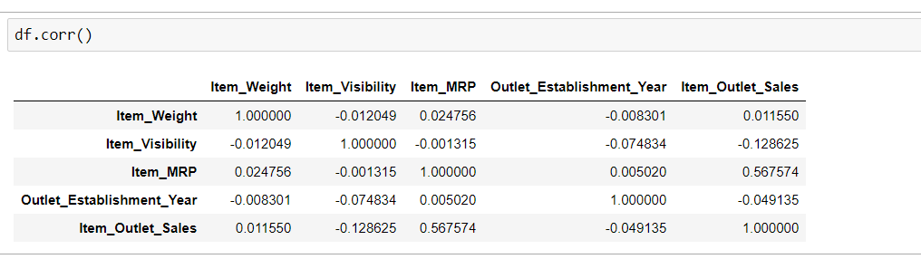
CORRELATION CHART
Item Outlet Sales has Highest Correlation with MRP.
Item Outlet Sales has Least Correlation with Weight

Slide 23
Item Outlet Establishment Year Has Highest Correlation With Visibility
Item Outlet Establishment Year Has Least Correlation with MRP
MRP has Highest Correlation with Outlet Sales
MRP has Least Correlation with Visibility
Visibility has Highest Correlation with Outlet Sales
Visibility has Least Correlation with MRP
Weight has Highest Correlation with MRP
Weight has Least Correlation with Outlet Establishment Year
The Smallest Value of correlation is Between Visibility and MRP
Its Obvious because the costlier the item, the lesser the number of people purchasing it, thus smaller the visibility

Slide 24
HYPOTHESIS TESTING
H0: For the item cost, mean>=150
H1: For the item cost, mean<150
Take A Random Sample And Perform Z Test

Slide 25
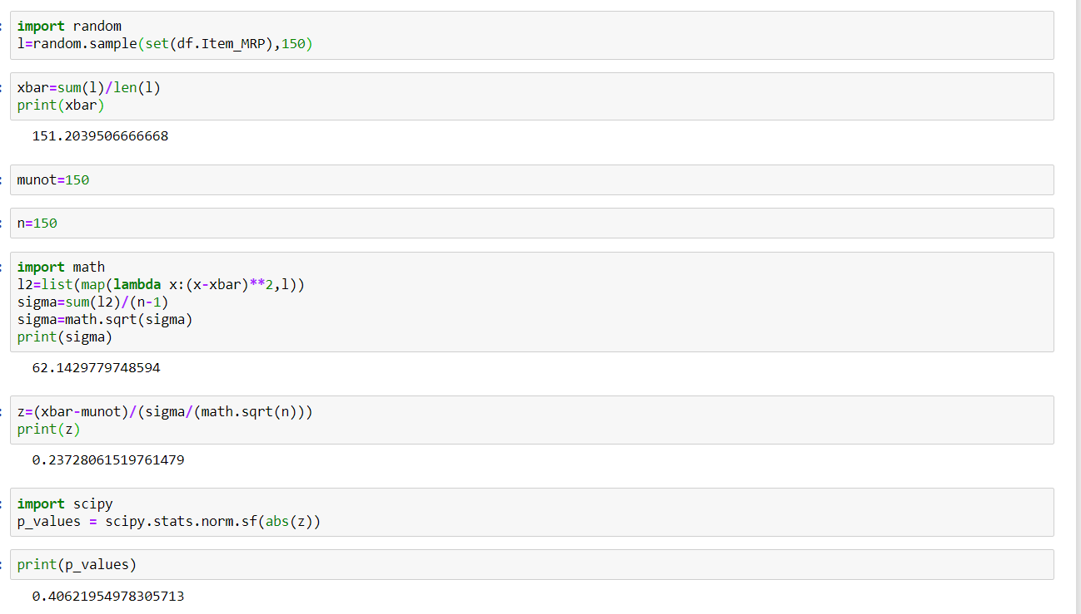
Keeping a 5% Significance Level. Alpha=0.05
Here p-value >alpha , p-value does not give sufficient evidence against NULL Hypothesis, Thus NULL hypothesis is Plausible
Else in the other case , p-value <= alpha and H0 would be rejected.
Note :: Result varies from sample to sample , samples are random. Output would vary each time code executes.

