Slide 1



Reatail_Sales_Analysis
View in Power BI
Last data refresh:
19/06/2022 12:23:48 UTC
Downloaded at:
10/07/2022 14:31:06 UTC
Notes:
Retail sales analysis report created by Power BI.

Slide 2
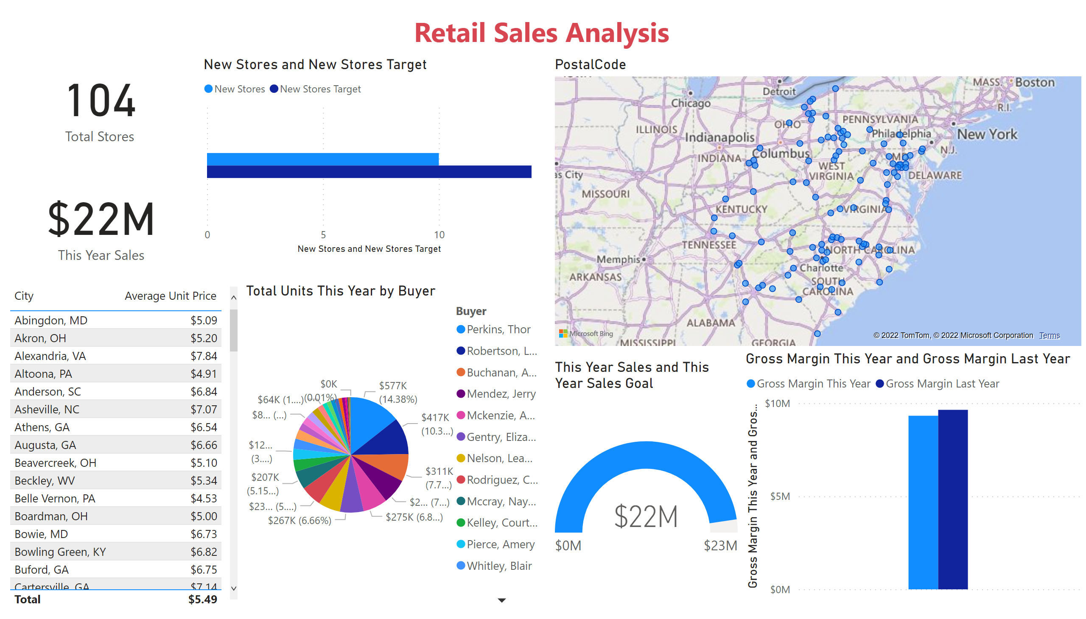
Page 1
Notes:
map
No alt text provided
lineClusteredColumnComboChart
No alt text provided
card
No alt text provided
card
No alt text provided
clusteredBarChart
No alt text provided
tableEx
No alt text provided
pieChart
No alt text provided
textbox
No alt text provided
gauge
No alt text provided

