Slide 1


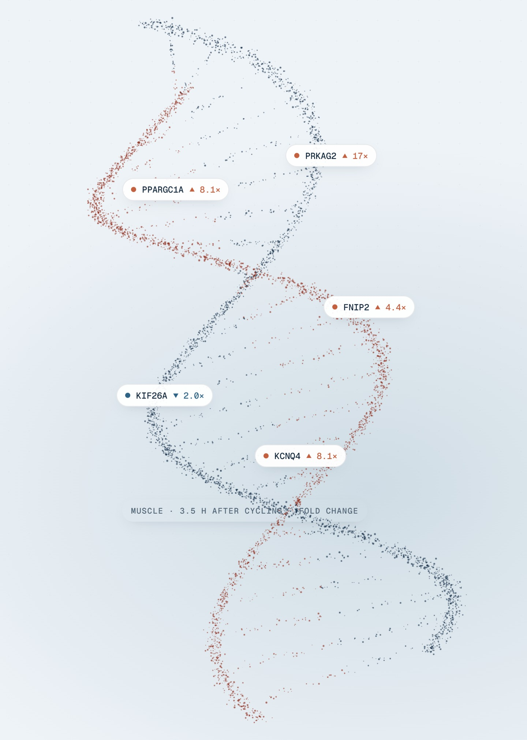


Finding approved drugs that copy exercise
TEJAS 2026 GRAND FINALE · AI FOR DRUG DISCOVERY & PERSONALIZED MEDICINE
A human-data, AI-powered screen of 29,680 compounds
Team TEJAS019 · SASTRA Deemed University, B.Tech Bioinformatics
Jahnavi Sai G (Team Leader) · Prince Kumar · Apurva V · Priyanka G · Vishnupriya K
Notes:
Speaker: Jahnavi (about 30 s)
Good morning. We are Team TEJAS019 from SASTRA. Our project, SynThera, finds approved drugs that switch genes on and off the way a workout does, using real human exercise data and an AI model. The image is the DNA helix from our website, with the genes exercise switches on most labelled.

Slide 2
Exercise is medicine, but millions cannot take it
Exercise lowers the risk of almost every chronic disease. For many patients it is impossible.
1.8 billion
THE GAP
Every published computational exercise-mimetic screen starts from rat or mouse data and assumes it transfers to humans. That assumption was never tested, because comparable human data did not exist.
adults worldwide (31%) are not active enough. In South Asia it is 45%.
WHO, 2024 release (2022 data)
Patients who cannot exercise at all
OUR QUESTION
Spinal cord injury
Advanced heart failure
Which approved drugs switch genes on and off the way a workout does, in real humans?
Intensive care & surgery
Cancer cachexia
Frail elderly
Long bed rest
TEAM TEJAS019 · SynThera 2 / 10
Notes:
Speaker: Jahnavi (about 1 min 15 s)
- Exercise protects against heart disease, diabetes, muscle loss and more.
- WHO: 1.8 billion adults (31%) were not active enough in 2022; in South Asia it is 45%.
- And some people cannot exercise at all: spinal cord injury, advanced heart failure, ICU and post-surgery, cancer cachexia, frail elderly.
- Scientists have looked for drugs that copy exercise for about twenty years. Every published computational screen starts from rat or mouse data and assumes it transfers to people. Nobody tested that, because human data did not exist.
- MoTrPAC has now released human exercise data. Our question: which approved drugs copy a workout in humans?
Source: WHO news release, 26 June 2024.

Slide 3





SynThera: from a human workout to a drug shortlist
One pipeline, five stages, built entirely on open data.
STEP 1
STEP 2
STEP 3
STEP 4
STEP 5
Exercise fingerprints
Drug fingerprints
AI scoring
Benefit filter
Shortlist
MoTrPAC: 175 adults, endurance and resistance, 3 tissues, 3 time points. 18 fingerprints.
LINCS L1000: 720,216 lab profiles, one per compound. 29,680 compounds.
4 methods incl. the GSFM foundation model, merged by Robust Rank Aggregation.
Keep exercise's adaptations, reject its stress. Cell-killing drugs removed.
Approved drugs for lab testing: 82 for endurance, 77 for resistance (weight) training.
Outputs ranked atlas of 29,680 compounds × 18 fingerprints · interactive website · FAIR open data (JSON-LD) · rat comparison arm
TEAM TEJAS019 · SynThera 3 / 10
Notes:
Speaker: Prince (about 1 min 15 s)
Walk left to right.
1. Exercise fingerprints: from 175 adults in MoTrPAC; which genes went up or down after one session of endurance exercise (cycling) or resistance exercise (weights), in muscle, blood and fat, at three time points. 2 exercise types x 3 tissues x 3 times = 18 fingerprints.
2. Drug fingerprints: LINCS L1000 tested compounds on human cells; 720,216 profiles collapsed to one per compound.
3. AI scoring: four methods, one of them the GSFM foundation model, merged so no single method decides.
4. Benefit filter: keep drugs that copy exercise's good adaptations, not its stress.
5. Shortlist: 82 approved drugs for endurance training, 77 for resistance (weight) training.

Slide 4
Six open datasets, one reproducible 10-step pipeline
Heavy computation runs once; every result is saved, versioned and traceable.
175
18
Dataset | What it gives us
MoTrPAC human (c2.0) | Exercise fingerprints
CMap LINCS 2020 L1000 | Drug fingerprints
Drug Repurposing Hub | Approval status, mechanism
MSigDB Hallmark + Reactome | Adaptive vs stress genes
MoTrPAC rat (PASS1B) | Comparison arm
GSFM, Hugging Face | Pretrained AI model
adults, vs a rested group
exercise fingerprints
720,216
29,680
drug profiles read (33 GB)
compounds scored
1,595
~430 M
approved drugs among them
scores computed
Stack Python 3.12 · NumPy · SciPy · pandas · PyTorch · UMAP · HTML/JS
Speed 29 min on a 6-core laptop; seed 19 gives identical runs
TEAM TEJAS019 · SynThera 4 / 10
Notes:
Speaker: Prince (about 1 min 15 s)
- Left: the scale. 175 people, 18 fingerprints, 720,216 drug profiles from a 33 GB file, 29,680 compounds, 1,595 of them approved. Scoring every compound against every fingerprint, plus 200 random versions each, is about 430 million scores.
- Right: the six datasets. MoTrPAC human and LINCS are the core; the Repurposing Hub tells us which drugs are approved; Hallmark and Reactome define good versus stress genes; rat data is a control arm; GSFM is the pretrained AI model.
- Python pipeline of 10 scripts, fixed random seed 19, so anyone gets identical results. Scoring takes 29 minutes on a laptop.

Slide 5
AI reads gene lists by meaning, and four methods vote
Four scorers, one fair vote
GSFM · Gene Set Foundation Model
Ma'ayan Lab, Patterns 2026 · autoencoder · 15.3 M parameters
Classic CMap
Rank correlation
WTCS
Spearman
Extreme genes
AI model
compared by cosine similarity
XSum
GSFM
Fair scoring each drug vs its own 200 random fingerprints
19,589
512
256
genes in
hidden
embedding
Robust Rank Aggregation merges the 4 ranks, then FDR
Turns any gene list into 256 numbers. Lists about the same biology land close together, even with few genes in common. Used as published: transfer learning, no retraining.
−38% top-50 overlap without GSFM: biggest drop
TEAM TEJAS019 · SynThera 5 / 10
Notes:
Speaker: Prince (about 1 min 45 s)
- GSFM, the Gene Set Foundation Model from the Ma'ayan Lab (Patterns, 2026), is a neural network called an autoencoder. It was pretrained, without labels, on a large collection of gene lists mined from published papers. It squeezes any gene list (19,589 possible genes) into 256 numbers. Lists about the same biology land close together even if they share few exact genes. We use it as published; we did not retrain it.
- We embed each drug's 100 most-raised and 100 most-lowered genes and each exercise list, and compare by cosine similarity.
- It is one of four scorers. The other three are classic connectivity-map methods. Each score is made fair by comparing every drug with its own scores against 200 random fingerprints, so drugs that change everything do not win everywhere. Robust Rank Aggregation merges the four rankings and permutations give a false discovery rate.
- When we remove GSFM, the top-50 overlap with the full ranking drops by 38%, the biggest change of any method.
If asked: this is not a trained classifier. There are too few known exercise drugs to train one, so it is an unsupervised similarity ranking, validated with controls.

Slide 6


Three design choices that set SynThera apart
Each one changes which drugs reach the shortlist.
Human data first
Benefit, not stress
Two exercise types
Rat
top 100
Human
top 100
×
×
×
×
×
Endurance
Resistance
Muscle
×
×
×
Blood
Fat
0 drugs in common
8 of 15 top hits are cell-killing drugs
18 fingerprints: 2 × 3 tissues × 3 times
Same pipeline, rat data: a completely different list (r = −0.20). 36% of the rat signal is lost converting genes to human.
Benefit index: 701 adaptive vs 872 stress genes. Drugs that copy only the stress of exercise are filtered out.
Two shortlists: endurance and resistance training are screened separately, so muscle-building gets its own list.
TEAM TEJAS019 · SynThera 6 / 10
Notes:
Speaker: Apurva (about 1 min 45 s)
Three choices at the heart of SynThera, and each one changes the answer.
1. Human data first, and we measured why it matters: running the identical pipeline on rat training data shares 0 of the top 100 drugs with the human result, ranking correlation -0.20, and 36% of the rat signal is lost converting rat genes to human genes. (Caveat if asked: rat data is weeks of training, human is one session.)
2. Benefit, not stress: a plain 'most similar to exercise' search puts cell-killing cancer drugs on top, 8 of the top 15 for endurance, because damage triggers the same alarm genes as a hard workout. Our benefit index scores 701 adaptive genes against 872 stress genes and removes them.
3. Two exercise types: endurance (cycling) and resistance (weights) screened separately, in three tissues at three times. Resistance training, which preserves muscle, gets its own shortlist.

Slide 7
82 and 77 approved drugs worth testing in the lab
Top candidates by benefit index. All are already approved for other uses.
Endurance (cycling)
Resistance (weight training)
# | Drug | Used for | Benefit
1 | Sitagliptin | Diabetes | +0.78
2 | Tioconazole | Yeast infection | +0.62
3 | Olmesartan | Hypertension | +0.57
4 | Phenytoin | Seizures | +0.55
5 | Mepacrine | Giardiasis | +0.50
6 | Sumatriptan | Migraine | +0.49
# | Drug | Used for | Benefit
1 | Phenytoin | Seizures | +1.11
2 | Sitagliptin | Diabetes | +1.07
3 | Sertraline | Depression | +0.87
4 | Thiothixene | Schizophrenia | +0.86
5 | Protriptyline | Depression | +0.76
6 | Sumatriptan | Migraine | +0.75
105 different approved drugs
54 on both lists
Top 5% of 29,680 to qualify
Leads for lab testing, not treatments.
TEAM TEJAS019 · SynThera 7 / 10
Notes:
Speaker: Apurva (about 1 min 30 s)
- Rule: approved drug, top 5% of all 29,680 compounds for exercise match, not a cell-killing mechanism, tested in at least 3 cell lines; then ranked by benefit index.
- Sitagliptin, a diabetes drug, is number 1 for endurance: overall rank 227 of 29,680, tested in 16 cell lines, benefit +0.78.
- 105 different drugs in total; 54 appear on both lists, such as sitagliptin, phenytoin and sumatriptan.
- Because they are already approved, their safety is known, which makes them faster to test.
- These are leads for laboratory testing, not treatments.

Slide 8


Can we trust the results? Four simple tests
We tested SynThera on questions where we already know the right answer.
Does it spot the opposite of exercise?
PASSED
Test 2 in detail: the list holds steady
Weight training builds muscle through mTOR. All 4 mTOR-blocking drugs ranked in the top 0.4% most opposite to it, unprompted.
Top-50 overlap with the original · 20% of data scrambled, 30 reruns
Does it hold up when data is messy?
PASSED
With 20% of the data scrambled, the top 50 still overlaps 48–77% with the original list. By chance: about 2%.
Do the four methods agree?
PASSED
Mostly (r = 0.46–0.65): the same overall picture, yet each method adds something of its own.
Does it find known 'exercise pills'?
PARTLY
β2-agonists return for weight training; GW-501516 reaches the top 9–12% in muscle; metformin and AICAR do not.
TEAM TEJAS019 · SynThera 8 / 10
Notes:
Speaker: Priyanka (about 1 min 30 s)
We asked four questions where we already know what a good answer looks like.
1. Does it spot the opposite of exercise? Weight training builds muscle through a switch called mTOR, so drugs that block mTOR should look like the opposite of a workout. Nobody told SynThera this, yet it ranked all four mTOR blockers in the top 0.4% of drugs most opposite to weight training (muscle, 24 h; p = 5 x 10^-5). Sirolimus is in the top 0.1%. Passed.
2. Does it hold up when the data is messy? We scrambled 20% of the gene data and reran everything 30 times per fingerprint. The top-50 list still overlaps 48 to 77% with the original (Jaccard overlap: drugs in both lists divided by drugs in either); by chance it would be about 2%. That is the chart. Passed.
3. Do the four methods agree? Mostly, correlations 0.46 to 0.65: the same overall picture, but no method is a copy of another, so the vote adds information. Passed.
4. Does it find the known 'exercise pills'? Partly. Beta-2 agonists, which are asthma drugs, come back for weight training, and GW-501516 reaches the top 9 to 12% in muscle. Metformin and AICAR do not. Most of these were discovered in mice, and the drug data comes from cancer cell lines, so a partial match is expected. We say this openly.

Slide 9
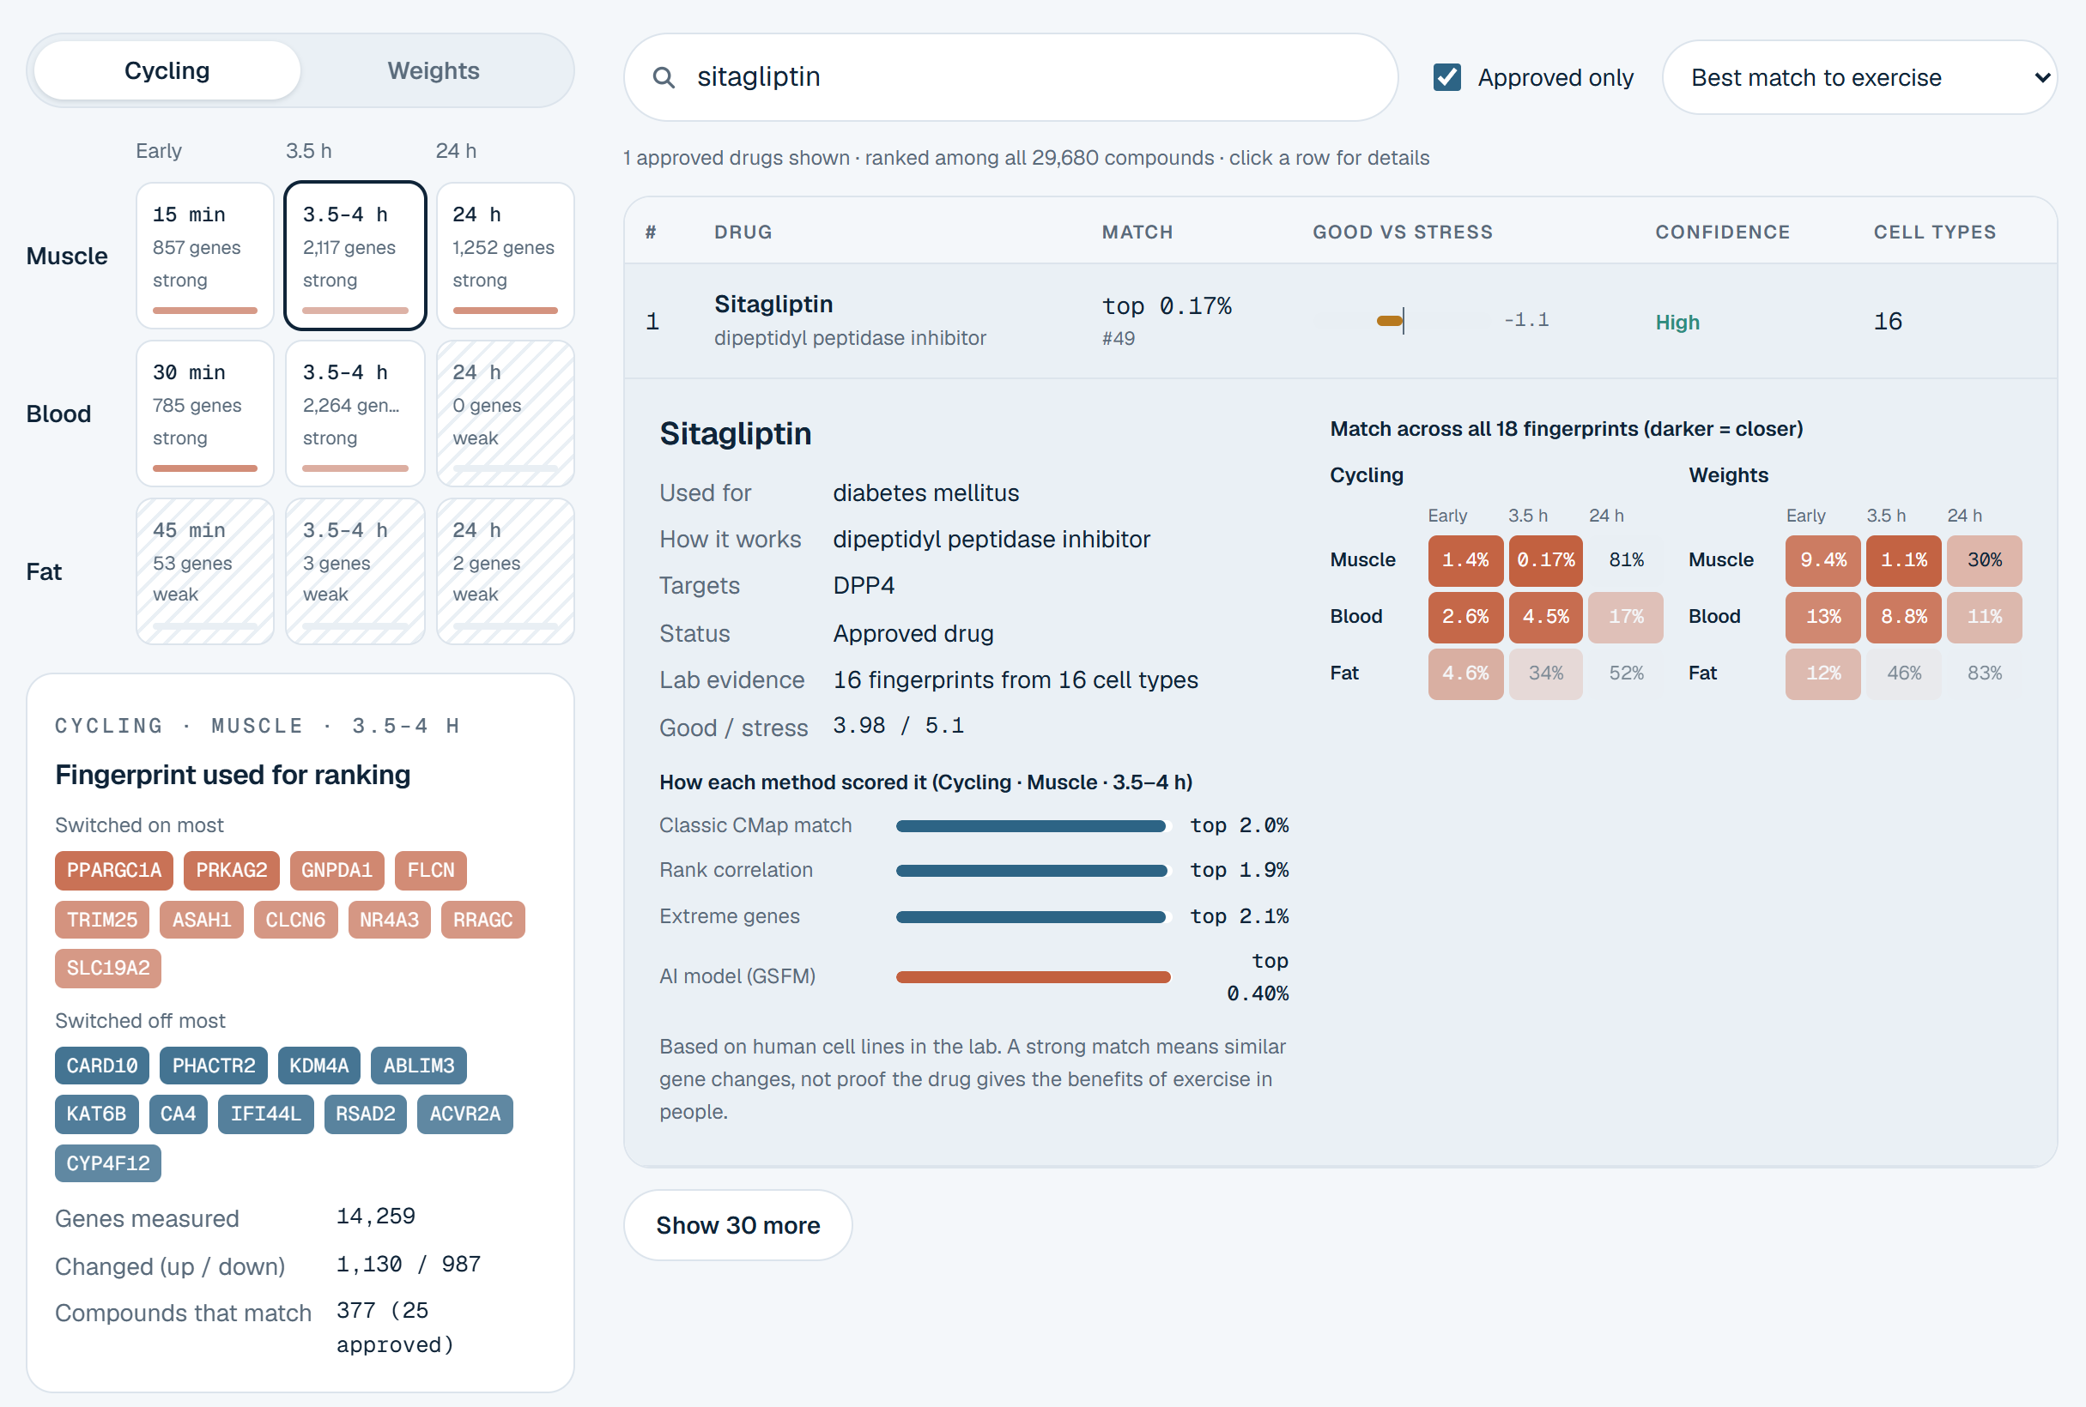
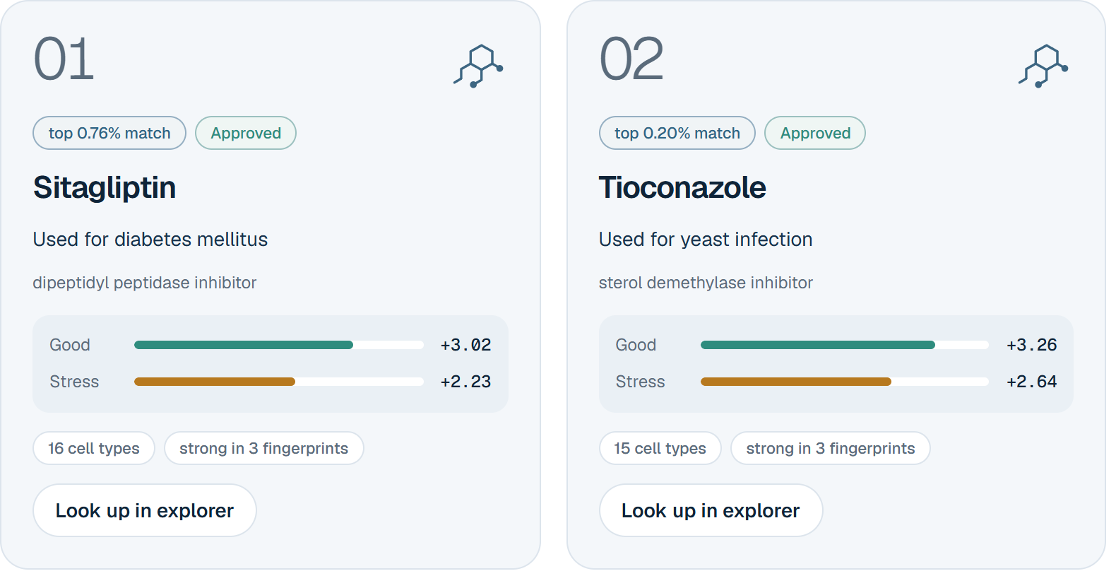
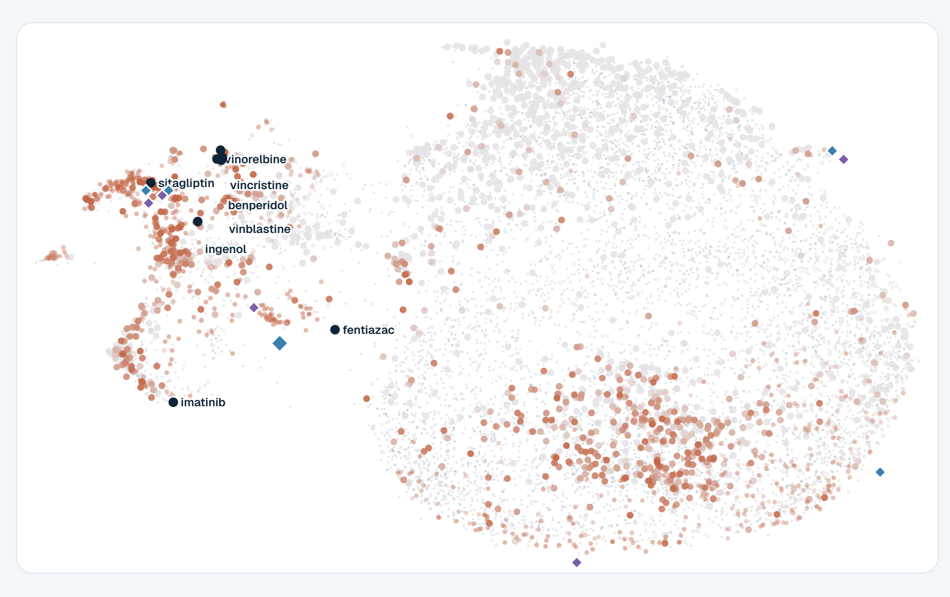
Working prototype: every result, live and explorable
Shortlist each candidate's good vs stress balance
Drug map · 29,680 compounds by AI
LIVE DEMO
Explorer sitagliptin in all 18 fingerprints · localhost:8000, works offline
TEAM TEJAS019 · SynThera 9 / 10
Notes:
Speaker: Vishnupriya (about 2 min 30 s, including the live demo)
Switch to the browser (http://localhost:8000, started with: py -m http.server 8000 in D:\Tejas\website).
Demo path (the website buttons say Cycling for endurance and Weights for resistance):
1. Candidates: switch Cycling / Weights; sitagliptin is number 1 for endurance.
2. Explorer: Weights > Muscle > 24 h, Approved only on, sort by 'Most opposite to exercise': sirolimus appears near the top, the mTOR control.
3. Explorer: Cycling > Muscle > 3.5 h: the top is cancer drugs tagged 'cell-stress drug', the stress trap our benefit index removes.
4. Press / and search any drug the jury names.
Backup if the laptop fails: the pitch video video/out/TEJAS019.mp4 and the screenshots on this slide.

Slide 10



Impact today, and how SynThera scales
Impact
Scalability
Next steps
Patients who cannot exercise get candidates already approved, with known safety records
Any human gene signature plugs in: new tissues, diseases, long-term training data
Test top candidates in human muscle cells
Researchers get an open FAIR atlas of 29,680 compounds
Each fingerprint scores independently; 29 min on a laptop today
Add protein and metabolite layers
A plain-language website anyone can explore
Static website: free to host anywhere
Partner with clinicians for patient groups
SDG 9
Industry, Innovation & Infrastructure Sub-theme: AI for Drug Discovery & Personalized Medicine
Honest limits one exercise session, not months of training · drug data from cancer cell lines · predictions to test, not treatments
Thank you. Questions welcome.
TEAM TEJAS019 · SynThera 10 / 10
Notes:
Speaker: Vishnupriya (about 1 min 15 s)
- Impact: patients who cannot exercise get candidates that are already approved, with known safety records, so lab and clinical testing can start sooner. Researchers get an open atlas of 29,680 compounds under FAIR principles, and anyone can explore it on the website.
- Scalability: the engine accepts any human gene signature, so new tissues, diseases or the MoTrPAC long-term training data plug straight in. Each fingerprint scores independently, so it parallelises; today it is 29 minutes on a laptop. The website is static and can be hosted anywhere for free.
- Next: test the top candidates in human muscle cells, add protein and metabolite data, and partner with clinicians.
- SDG 9, Industry, Innovation and Infrastructure: an open, reproducible AI pipeline and data atlas that others can build on.
- Limits, said plainly: one exercise session, cancer cell lines, predictions to test.
Close: Thank you. We are happy to take questions.

