Slide 1
Web Programming
The Web and HTML

Slide 2
What Web is
World Wide Web or WWW or W3 or the Web is an interconnected system of public web pages accessible through the Internet.
Proposed by Tim Berners-Lee and created in CERN Physics lab in 1990
World Wide Web Consortium (W3C) became the standard of web
https://developer.mozilla.org/en-US/docs/Glossary/World_Wide_Web

Slide 3
WWW
Components of Web:
HTTP Protocol
URL (Uniform Resource Locator) or URI (Uniform Resource Identifier)
HTML (HyperText Markup Language)

Slide 4

How the web works
The web provides you with web page(s) when you view it on your devices. The process happens in a Client-Server architecture. Clients are typically an internet-connected device such as your tablet, computer, laptop, etc. provided with web browser. Servers on the other hand, are computers that store the web pages, images, data, etc. and serve them to the client whenever requested

Slide 5
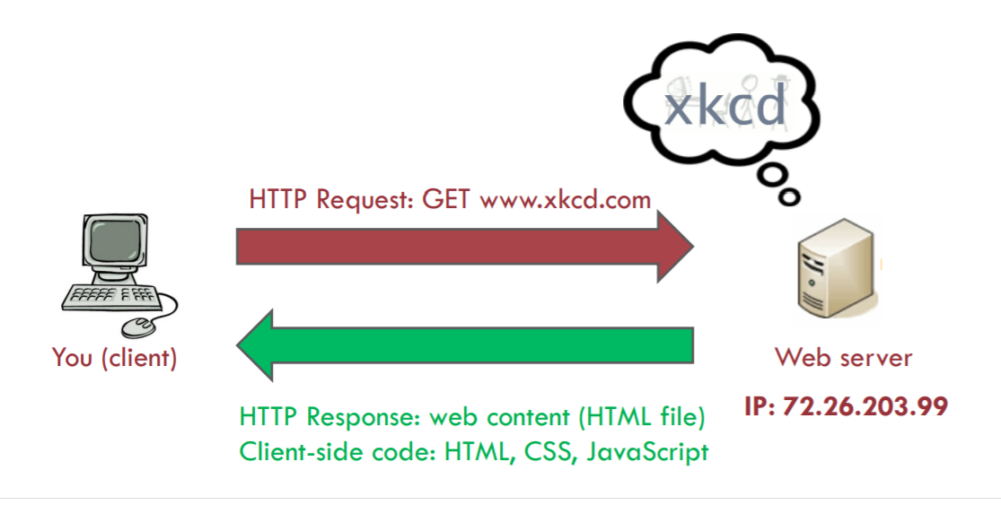
Web Client and Web Server

Slide 6



Tools and Frameworks
There are many tools and frameworks you could use to develop a web page or application, but the basic stuffs you need are only
Text Editor, to edit your code
Web Browser, to view the result of your code
Knowledge of HTML, CSS, and JavaScript

Slide 7
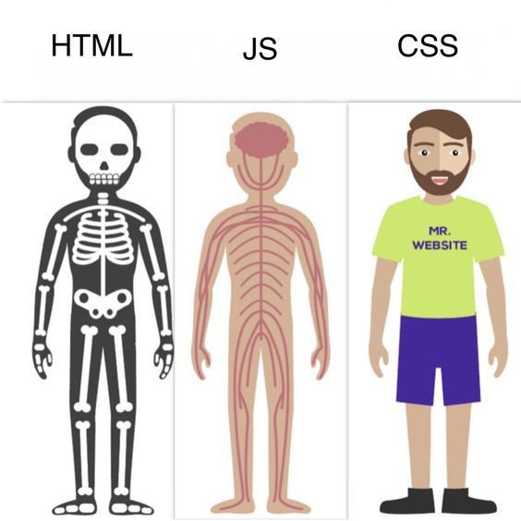
But why those three?

Slide 8
Popular Browsers
Google Chrome
Mozilla Firefox
Safari
Microsoft Edge
Brave
Opera
Chromium
IceWeasel
Konqueror
etc.

Slide 9






Popular Text Editors
Visual Studio Code
Sublime Text
Brackets
Notepad++
Vim
Neovim
Emacs
Gedit
Notepad
REPL IT
etc.

Slide 10


Popular Web Libraries
Bootstrap
jQuery
Moment.js
etc.

Slide 11




Popular Web Frameworks
React
Angular
Svelte
Vue.js
etc.

Slide 12
Download VS Code
Let’s use VS Code as our editor (https://code.visualstudio.com/Download )
(or if you prefer the online, use https://replit.com/ )

Slide 13
Hello World using HTML (HyperText Markup Language)
<html>
<head>
<title>My First Web Page</title>
</head>
<body>
<h1>Hello World</h1>
</body>
</html>

Slide 14
How to run?
Save the file name with anything you want, just make sure the extension is .html (e.g. home.html), then open the file in the web browser

Slide 15
HTML (HyperText Markup Language)
Standard markup language for the web. It defines the basic structure of the web page. It consists of elements (which consist of tags, attributes, and contents)

Slide 16
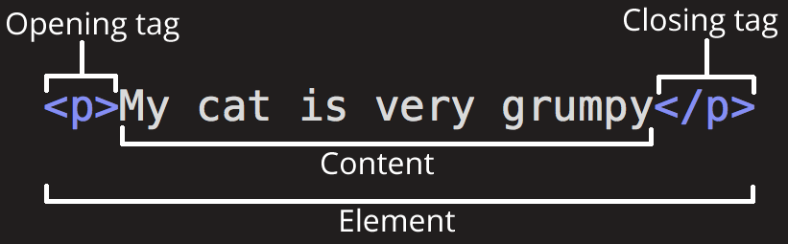
Anatomy of HTML

Slide 17
Attribute
Sometimes tags are not enough to be used to design our web pages. As an example, we use image tag <img> directly, but we do not know which image to put and what size the image (width or length) to put on our page.
Attributes are the characteristics of the tag that help us in defining additional characteristics for our HTML tag.
<img src="/path/to/image.jpg" width="100" length="100"/>

Slide 18
Starting up
To create HTML web page, we need to use a text editor and web browser. To start creating an HTML page, create a new file and save it as “index.html” in your designated folder. To show the result, we just need to right click on the file then open with a web browser.

Slide 19
HTML5
HTML has been there since a long time, and as other languages, it evolves. Now it is named HTML5. Before HTML5, we cannot embed media tags such as video and audio easily without Flash player. Another thing is we have more easy-to-use new tags, and so on.
https://www.geeksforgeeks.org/difference-between-html-and-html5/

Slide 20
Complete basic structure of HTML 5
<!-- this is a comment, !DOCTYPE is to tell web browser that the file is html5 file –->
<!DOCTYPE html>
<html lang="en">
<head>
<meta charset="UTF-8">
<meta name="viewport" content="width=device-width, initial-scale=1.0">
<title>Document</title>
</head>
<body>
</body>
</html>

Slide 21
Meta tag
Defines the metadata of the html document. The contents will not be shown on the page, but it is still parseable. The main usage of the meta tag is to put the description of our web pages, the author, encoding, etc. Meta tag will also help us in Search Engine Optimization (SEO) to make our web page visible in search engine results pages.

Slide 22
Meta
Meta tags are put inside <head> tag of the html document
<meta charset="UTF-8">
<meta name="description" content="Free Web tutorials">
<meta name="keywords" content="HTML, CSS, JavaScript">
<meta name="author" content="John Doe">

Slide 23
Before we go on
HTML tags usually follow several conventions:
Use lowercase letters in the tags
Use double quotes or single quotation marks for attributes
Every open tag must be closed with the same tag (except several standalone tags)

Slide 24
Comments
Along our journey in creating web pages, it is important to make sure we know what we did, and we could use comments in out HTML file. Comments, as in other languages, are useful to tell ourselves what part of the code does and means. To add comments, simply use the <!-- --> comment pairs. Comments will not be displayed in our web page.
example
<!-- this part is the main information of our web page -->
<h1>This is important</h1>
<h2>This is kinda important</h2>

Slide 25
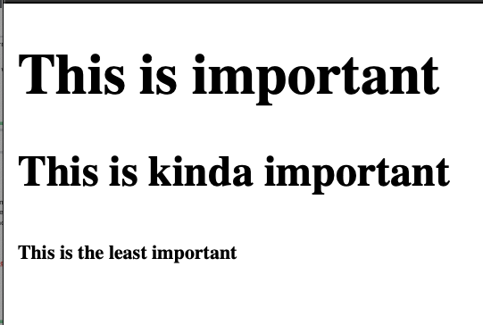
Heading
Heading is used to show important information in our web page. HTML has several heading levels starting from 1 up to 6 with 1 as the most important heading
<h1>This is important</h1>
<h2>This is kinda important</h2>
<h6>This is the least important</h6>

Slide 26
Paragraph
To add paragraph into our web page, we could use <p></p> tag
<p>This is a paragraph</p>
<p>This is another paragraph</p>

Slide 27
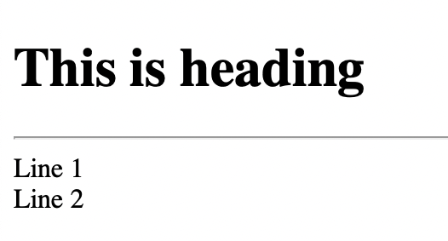
Line Breaks
There will be certain cases where we need to add newline (or “Enter” as we would usually say) in our HTML page. To add this newline, we could utilize the tag <br/> or <br>
<h1>This is heading</h1>
<hr/>
Line 1<br/>
Line 2

Slide 28
Horizontal Rule
Also, sometimes we would want to add a separating line in our HTML page. To add this line, we could use <hr> or <hr/> tag
This is the <hr/> tag result
<h1>This is heading</h1>
<hr/>
Line 1<br/>
Line 2

Slide 29
Try this
<p>
Computing is the first faculty in PresUniv
Computing consists of 5 study programs
First is Informatics
Second is Information System
Third is Visual Communication Design
Fourth is Interior Design
Fifth is Master of Information Technology
</p>

Slide 30
What happened?
Take a look at the result, the text will all be in one line instead of multiple lines as in the HTML script. To overcome this kind of problem, use the <pre> tag.
<pre> tag is the tag to make a preformatted text on our page. The result will be as similar as the script, but the content will be displayed with a fixed-width font (usually Courier) and it keeps the line breaks and spaces

Slide 31
Solution
<pre>
Computing is the first faculty in PresUniv
Computing consists of 5 study programs
First is Informatics
Second is Information System
Third is Visual Communication Design
Fourth is Interior Design
Fifth is Master of Information Technology
</pre>

Slide 32
Text Formatting
Tag | Function
<b> or <strong> | To make text into bold. The strong is used to give the sense of importance in the text
<i> or <em> | To make text into italic. The em is used to give more emphasize in the text
<u> or <ins> | To make text with underline. The ins is actually used to tell that the text is inserted
<s> or <del> | To give a text the strikethrough. The del is used to tell that the text is deleted
<mark> | To mark or highlight a text. Usually in yellow color
<big> and <small> | As expected, to make text bigger or smaller than the one in the same part
<sub> and <sup> | To create text with subscript or superscript such as H₂O or “e = m c²”

Slide 33
Text Formatting
Tag | Function
<span> | To contain or mark a section of a text
<q> | To put the text into quotation marks
<abbr title=”title”> | To tell that the text is abbreviation. The title attribute is to let the user see the title of the abbr. if hovered
<code> | To create a “source code”-like text

Slide 34
Several Examples of text formatting tags
<b>This is bold text</b> <br/>
<strong>This is bold, strong text</strong> <br/>
<i>This is italic text</i> <br/>
<em>This is italic, emphasized text</em> <br/>
<u>This is underlined text</u> <br/>
<ins>This is inserted text</ins> <br/>
I <s>hate</s> love programming! <br/>
HTML is a <del>Programming</del> Markup Language <br/>
Human lies, but <mark>Code</mark> does not <br/>
Elephant is <big>big</big>, and ant is <small>small</small> <br/>
Water in Chemistry: H<sub>2</sub>O <br/>
Oppenheimer and Einstein :) e = mc<sup>2</sup> <br/>

Slide 35
<span>Computing</span> tagline is <q>Be Strong, One, Determination</q> <br/>
Although <abbr title="Blue Screen of Death">BSOD</abbr>
has a different meaning in computer <br/>
<br/>
<code>
int a = 2;
</code>

Slide 36
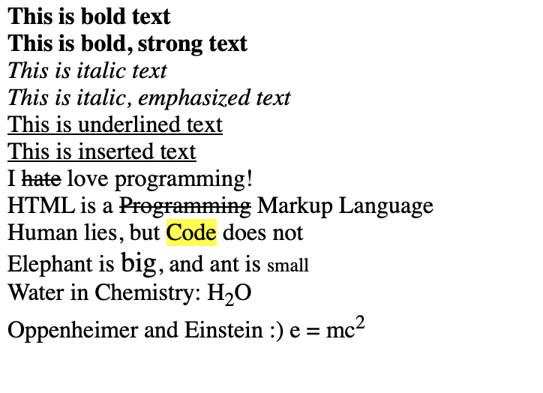
Result

Slide 37
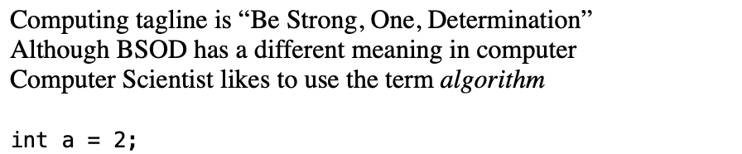

Slide 38
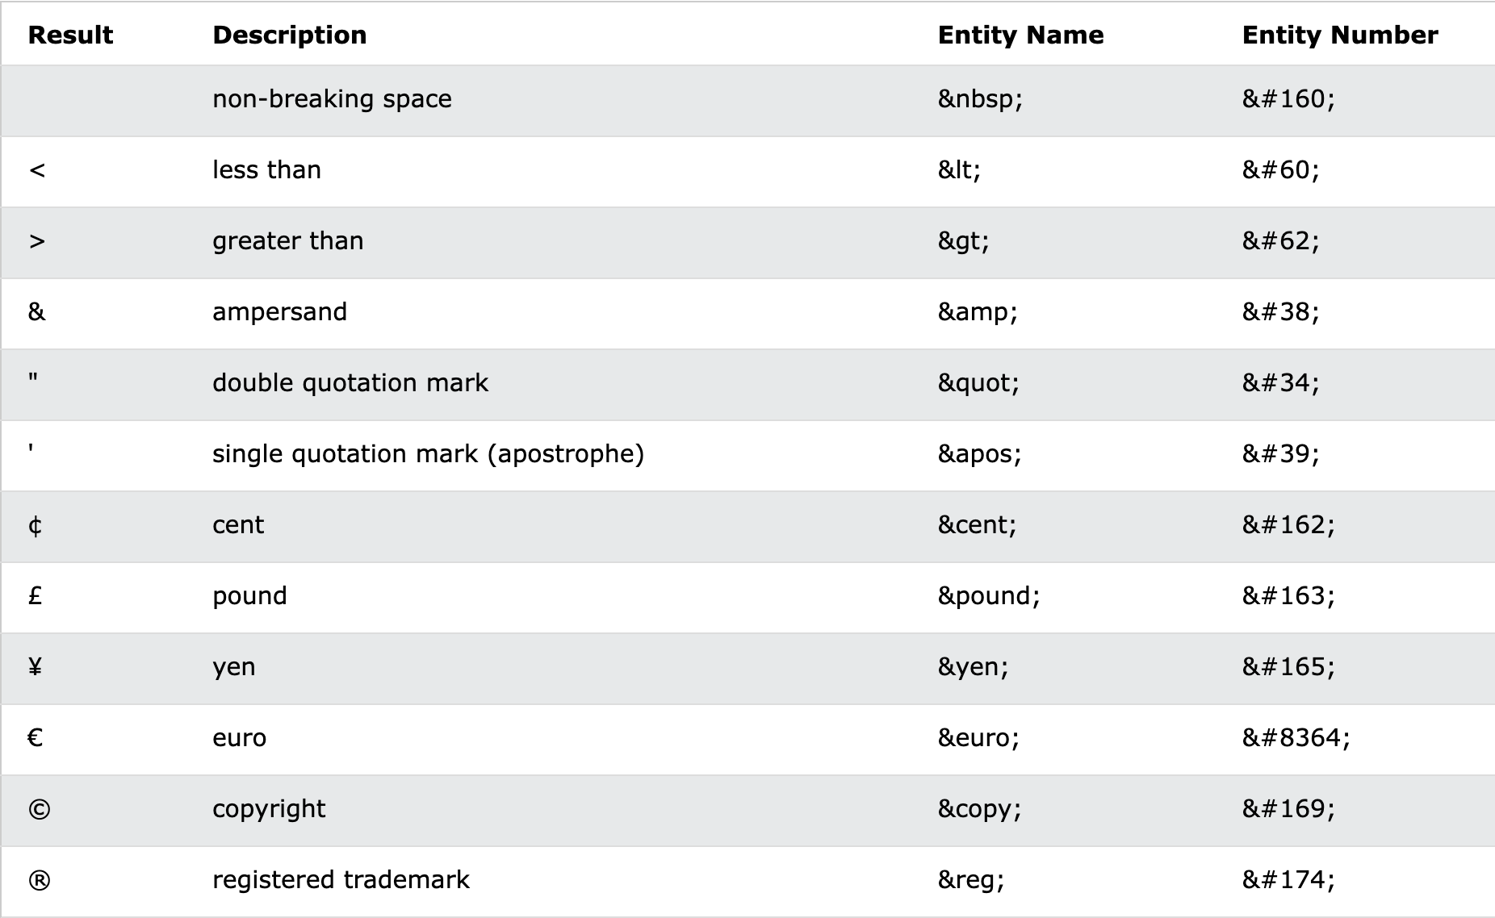
Symbols and Entities
Check here:https://www.w3schools.com/html/html_symbols.asp

Slide 39
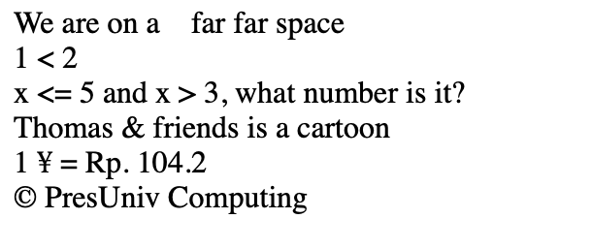
Let’s try!
We are on a&nbsp;&nbsp;&nbsp;&nbsp;far far space<br/>
1 &lt; 2 <br/>
x &lt;= 5 and x &gt; 3, what number is it? <br/>
Thomas &amp; friends is a cartoon <br/>
1 &yen; = Rp. 104.2 <br/>
&copy; PresUniv Computing

Slide 40
HTML Semantics
Semantic means “related to language or logic”. In HTML semantics mean the tag name represents the direct meaning of what it does. HTML semantics fall into three groups
Sectioning elements
Grouping elements
Text-level semantics

Slide 41
Sectioning Elements
Tag | Function
<main> | To define the main content of page (no more than 1 main content in a page). This tag is used to pack all other tags
<nav> | To wrap major navigation links, usually located on top of pages
<section> | To define a generic section of document, e.g. contact section, news section
<article> | To define a specific / self-contained piece of the content on the page. More specific than <section>
<aside> | To define a “side” component of a web page. Usually used as part to put ads or something not related to the main content
<header> | To use as header or introduction to a content (in <article>)
<footer> | To use as container to store other information, usually located on the bottom of a page

Slide 42
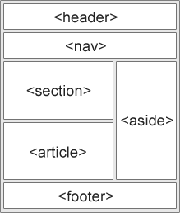
Sectioning Point of View
Look at the image to see the sectioning point of view
Although, do not take this as standard!
BUT, using these semantics will help your web pages being
Processed well in the SEO!

Slide 43
Let’s try!
<main>
<header>
<h1>Welcome to Web Programming Recipe!</h1>
</header>
<nav>
<span>Home</span>
<span>HTML</span>
<span>CSS</span>
<span>JavaScript</span>
</nav>
<section>
<p>
Web Programming is a fundamental topics to prepare you
to be able to develop a web-based software
</p>
</section>
<aside>
<p>
Ads: Join PUMA Computing!
</p>
</aside>
<footer>
Contact Computing: @pucomputing
</footer>
</main>

Slide 44
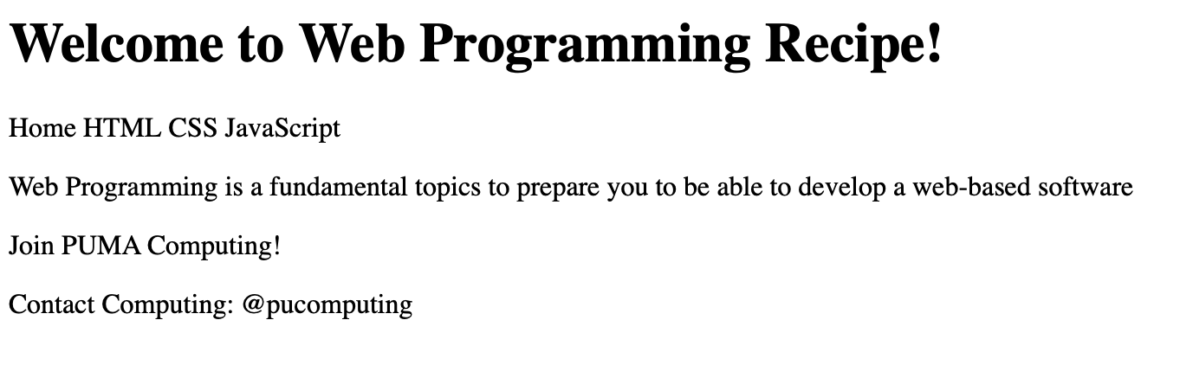

Slide 45
Grouping Elements
Tag | Function
<div> | To group a content. It means nothing except as division. Use this if you cannot think of anything else
<p> | To make a paragraph
<blockquote> | To mark up a text that is quoted from other sources
<details> and <summary> | The details is used to give a clickable section of text and summary is to give the text summary

Slide 46
Let’s try!
<div>
This is one division of a page
</div>
<p>
But this is a paragraph with a quote from someone:<br/>
<blockquote>To Be Or Not To Be</blockquote>
</p>
<details>
<summary>Click this to see what we learn in Web Programming</summary>
HTML<br/>
CSS<br/>
JavaScript<br/>
</details>

Slide 47
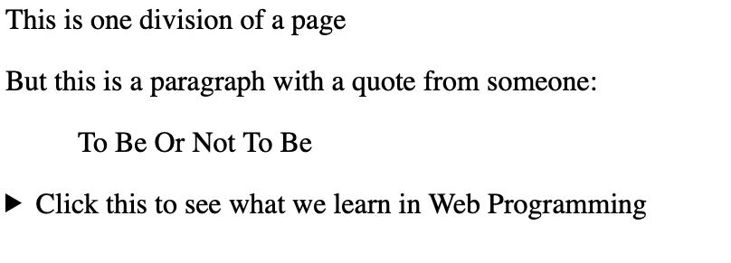
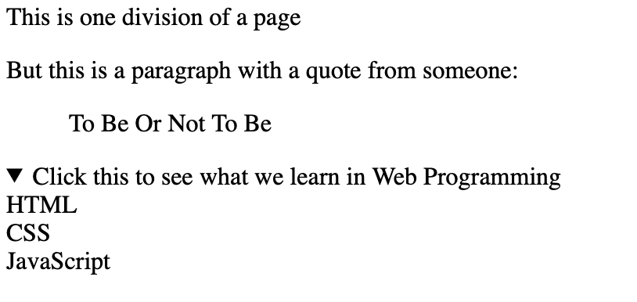
Click

Slide 48
List in HTML
Sometimes we need to create a list on our webpage. To do that we could use one of the following type:
Unordered list
Ordered list

Slide 49
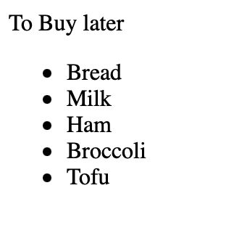
List (Ordered and Unordered)
To make a list, we could use <ul> or <ol> tag followed by <li> inside. Use <ol> to make ordered list, and <ul> to make the unordered one.
To Buy later
<ul>
<li>Bread</li>
<li>Milk</li>
<li>Ham</li>
<li>Broccoli</li>
<li>Tofu</li>
</ul>

Slide 50
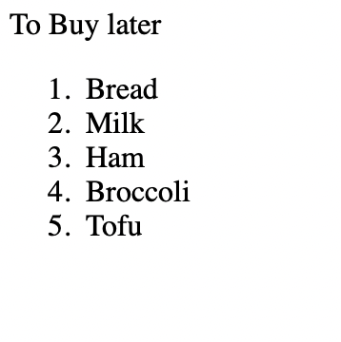
List (Ordered and Unordered)
To Buy later
<ol>
<li>Bread</li>
<li>Milk</li>
<li>Ham</li>
<li>Broccoli</li>
<li>Tofu</li>
</ol>

Slide 51
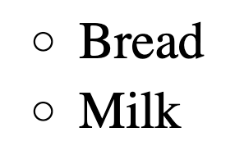
Unordered List - circle
<ul type="circle">
<li>Bread</li>
<li>Milk</li>
</ul>

Slide 52
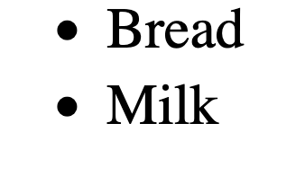
Unordered List - disc (default)
Default is type="disc"
<ul type="disc">
<li>Bread</li>
<li>Milk</li>
</ul>

Slide 53
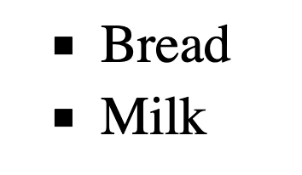
Unordered List - square
<ul type="square">
<li>Bread</li>
<li>Milk</li>
</ul>

Slide 54
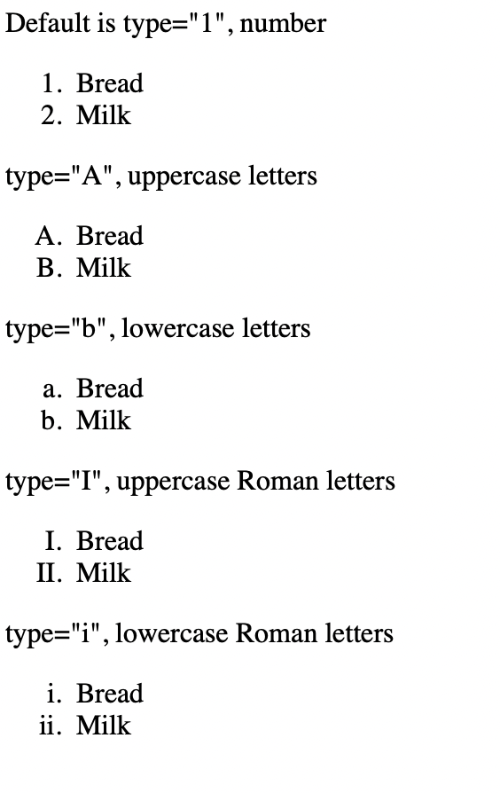
Ordered List - Arabic Numerals (default)
Default is type="1", number
<ol type="1">
<li>Bread</li>
<li>Milk</li>
</ol>

Slide 55
Ordered List - Uppercase Letters
type="A", uppercase letters
<ol type="A">
<li>Bread</li>
<li>Milk</li>
</ol>

Slide 56
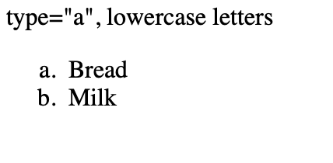
Ordered List - Lowercase Letters
type="a", lowercase letters
<ol type="a">
<li>Bread</li>
<li>Milk</li>
</ol>

Slide 57
Ordered List - Uppercase Roman
type="I", uppercase Roman letters
<ol type="I">
<li>Bread</li>
<li>Milk</li>
</ol>

Slide 58
Ordered List - Lowercase Roman
type="i", lowercase Roman letters
<ol type="i">
<li>Bread</li>
<li>Milk</li>
</ol>

Slide 59
Hyperlink (Anchor)
Use <a></a> to provide link to other pages
Attributes:
  href : determine the location of link / file (yes it is possible)
  target : determine where to open the link
Link color will change depending on the conditions:
  Blue: unopened
  Purple: visited
  Red: active link
<a href="https://puis.president.ac.id">PUIS</a>

Slide 60
Hyperlink Targets
_self: open in same window (default)
_blank: open in new window or tab
_parent: open in parent frame (using iframe)
_top: open in full body of window
<a href="https://puis.president.ac.id" target="_blank">PUIS</a>
<a href="https://puis.president.ac.id" target="_top">PUIS</a>

Slide 61


Bonus
<meter>: to show meter tag such as 2 out of 10
<progress>: to show progress bar percentage
And yes, HTML supports emojis now
https://www.w3schools.com/charsets/ref_emoji.asp

Slide 62
References
www.w3.org
https://developer.mozilla.org/en-US/docs/Learn/Getting_started_with_the_web/How_the_Web_works
https://www.techtarget.com/whatis/definition/HTTP-Hypertext-Transfer-Protocol
https://developer.mozilla.org/en-US/docs/Web/HTTP/Overview
https://code.visualstudio.com/Download

