Slide 1
Web Programming
HTML - Media Embedding and Table

Slide 2
Multi-Page handling
To create a multiple pages in the website:
Add the hyperlinks in file
Put the file name of the destination page in the href

Slide 3
Let’s try! Home Page (index.html)
<!DOCTYPE html>
<html lang="en">
<head>
<meta charset="UTF-8">
<title></title>
</head>
<body>
<main>
<nav>
<a href="index.html">Home</a>
<a href="picture.html">Picture</a>
</nav>
<h1>
Home Page
</h1>
</main>
</body>
</html>

Slide 4
Picture page (picture.html)
<nav>
<a href="index.html">Home</a>
<a href="picture.html">Picture</a>
</nav>
<h1>
Picture Page
</h1>

Slide 5
Let’s Imagine
We are working on a project, the requirements are:
Website must have 2 pages: Home and Picture
Home and Picture pages must be connected
Solution: add navigation in each page to go to each file

Slide 6
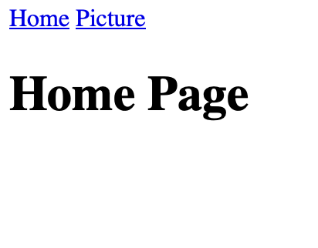
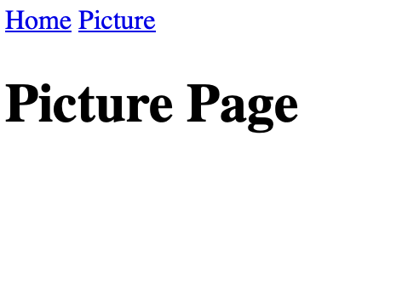
Result

Slide 7
Image
To embed image into HTML page, we could use <img> tag
Single tag, no need to close
Attributes:
  src : Point the location / source of image
  alt : If the picture has error, this is shown as text

Slide 8
Let’s download an image
Method 1 (static image):
Download image (e.g. flower) and give it a name (remember the name)
Put the image in same folder as HTML file
Put the image name in the src attribute
Method 2 (online image):
Get online image from URL
Put the link in the src attribute

Slide 9
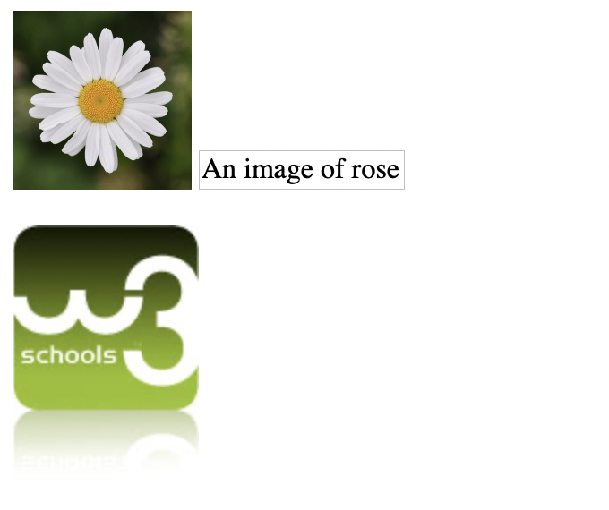
Try it
<img src="flower.jpg" alt="Flower" width="100" height="100">
<img src="rose.jpg" alt="An image of rose">
<p>
<img
src="https://www.w3schools.com/images/w3schools_green.jpg"
alt="Example of online image">
</p>

Slide 10
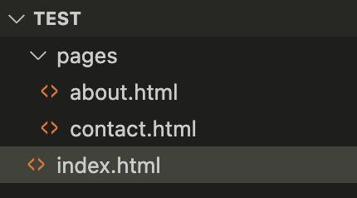
Relative and Absolute URL
Look at the image below

Slide 11

Relative URL
URL with location “relative” to current location
In index.html:
In about.html:
Add the content and see what happened

Slide 12

Absolute URL
URL with an absolute location, starting from the source (usually disk, e.g. C:)
In index.html:
In about.html:

Slide 13
Using image as link
It is super simple to use image as link, just put the image tag between anchor tag.
<a href="https://puis.president.ac.id">
<img src="/path/to/image"/>
</a>

Slide 14
Video
To add a video in HTML:
use the <video> tag
Put <source> tag inside <video>.
Attributes:
autoplay
controls
preload
width
height
Check: https://www.w3schools.com/tags/tag_video.asp

Slide 15
Video Example
<video width="320" height="240" controls autoplay>
<source
src="https://storage.googleapis.com/gtv-videos-bucket/sample/BigBuckBunny.mp4"
type="video/mp4"/>
Not supported
</video>

Slide 16
Audio
To add an audio in HTML page:
use the <audio> tag
Put <source> tag inside <audio> tag
Attributes:
autoplay
controls
preload
Check: https://www.w3schools.com/tags/tag_audio.asp

Slide 17
Audio Example
<audio controls autoplay>
<source
src="http://www.sousound.com/music/healing/healing_01.mp3"
type="audio/mp3"/>
</audio>

Slide 18
Important! Before we continue
Best practice:
add id and/or name as attribute in HTML tags especially if we want to differentiate them.
As an example
We will see the benefits of using this later ;)

Slide 19
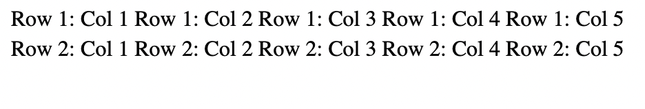
Table
To create table in HTML use:
<table>, <tr>, <td>, <th>
<table>
<tr>
<td>Row 1: Col 1</td>
<td>Row 1: Col 2</td>
<td>Row 1: Col 3</td>
<td>Row 1: Col 4</td>
<td>Row 1: Col 5</td>
</tr>
<tr>
<td>Row 2: Col 1</td>
<td>Row 2: Col 2</td>
<td>Row 2: Col 3</td>
<td>Row 2: Col 4</td>
<td>Row 2: Col 5</td>
</tr>
</table>

Slide 20
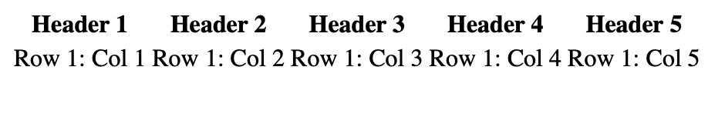
Table with header
<table>
<tr>
<th>Header 1</th>
<th>Header 2</th>
<th>Header 3</th>
<th>Header 4</th>
<th>Header 5</th>
</tr>
<tr>
<td>Row 1: Col 1</td>
<td>Row 1: Col 2</td>
<td>Row 1: Col 3</td>
<td>Row 1: Col 4</td>
<td>Row 1: Col 5</td>
</tr>
</table>

Slide 21
Alternatives
Table semantics in HTML:
<thead>
<tbody>
<tfoot>
Using these tags, if the table is long, then the header and footer will be printed on the next pages.

Slide 22
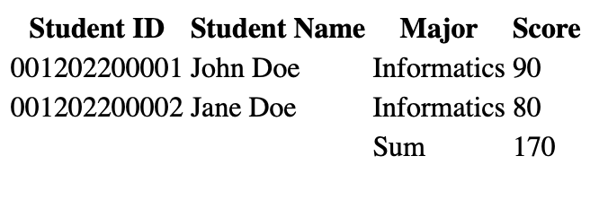
<table>
<thead>
<tr>
<th>Student ID</th>
<th>Student Name</th>
<th>Major</th>
<th>Score</th>
</tr>
</thead>
<tbody>
<tr>
<td>001202200001</td>
<td>John Doe</td>
<td>Informatics</td>
<td>90</td>
</tr>
<tr>
<td>001202200002</td>
<td>Jane Doe</td>
<td>Informatics</td>
<td>80</td>
</tr>
</tbody>
<tfoot>
<tr>
<td></td>
<td></td>
<td>Sum</td>
<td>170</td>
</tr>
</tfoot>
</table>

Slide 23
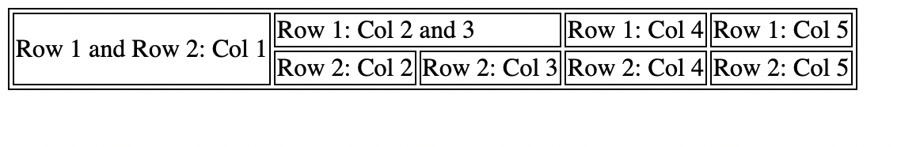
Where’s the border?
No Border by default
Use <style> tag to give border (sneak peek to CSS)
Put the code below inside the <head> tag
<style>
table, tr, td {
border: 1px solid black;
}
</style>

Slide 24
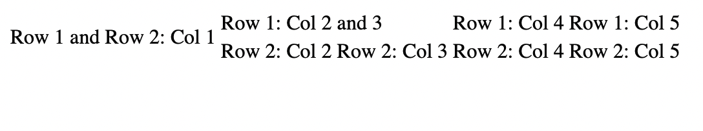
Merging cells
Use colspan or rowspan attributes with the length or range to merge in numbers
<table>
<tr>
<td rowspan="2">Row 1 and Row 2: Col 1</td>
<td colspan="2">Row 1: Col 2 and 3</td>
<td>Row 1: Col 4</td>
<td>Row 1: Col 5</td>
</tr>
<tr>
<td>Row 2: Col 2</td>
<td>Row 2: Col 3</td>
<td>Row 2: Col 4</td>
<td>Row 2: Col 5</td>
</tr>
</table>

Slide 25
A sneak peek to CSS
Notice we could add border using <style>, put inside the <head> tag
Other ways to add style is by using attribute style in the HTML tags and using separate files (we’ll talk about it in the future)

Slide 26
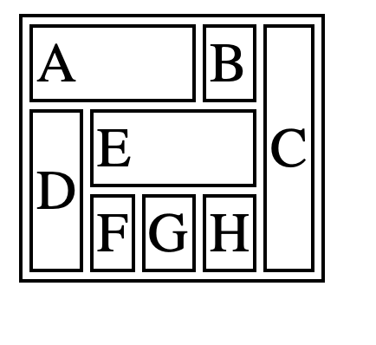
Exercise
Create the script for this table
Define the colspan correctly
Define the rowspan correctly

Slide 27
References
https://www.w3schools.com/html/html5_audio.asp
https://www.w3schools.com/html/html5_video.asp
https://picsum.photos/
https://www.w3schools.com/tags/tag_track.asp
https://www.w3schools.com/html/html_tables.asp
https://developer.mozilla.org/en-US/docs/Web/HTML/Element/table

