Slide 1
Web Programming
Form and Frame

Slide 2
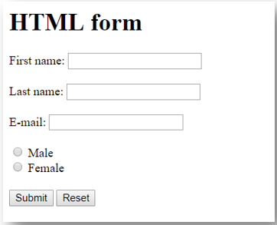
What is a form?
Form is a media to accept user inputs and send the process to server to be processed.

Slide 3
Form
<form></form>
Is used as the base to contain the user inputs.
Every form will have variety of inputs, boxes, buttons, etc

Slide 4
Input
Tag: <input />
Types of input: text, number, date, checkbox, etc
To give value, use attribute “value”
Note: It is a good practice to add id and name in out input tag like
<input type="text" id="fname" name="fname"/>
<input type="text" id="fname" name="fname"
value="John Doe"/>

Slide 5

Label
Label is a description of an input.
Using label will help user in identifying which input is currently in process.
Use “for” attribute containing the “id” of the input.
Example: the “label” is for input with id “fname”
<label for="fname">First name:</label><br/>
<input type="text" id="fname" name="fname"/>

Slide 6
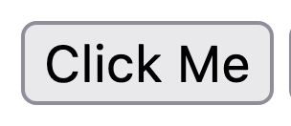
Button
A button is something that is clickable for our user. It is usually used as confirmation about an action, or when we want to trigger something in our form. To create a button we have two ways
Using <input type="button" value="Click Me"/>
Using <button>Click Me</button>

Slide 7
Button Types
We have two different main button types
button: the usual button
submit: same with input type submit and will call the form*

Slide 8
Let’s Try input types and add some values ;)
Date: <input type="date" name="myDate" id="myDate" /> <br/><br/>
Email: <input type="email" name="myEmail" id="myEmail" /> <br/><br/>
Tel: <input type="tel" name="myTel" id="myTel" /> <br/><br/>
File: <input type="file" name="myFile" id="myFile" /> <br/><br/>
Password: <input type="password" name="myPass" id="myPass" /> <br/><br/>
Number: <input type="number" name="myNumber" id="myNumber" /> <br/><br/>
Range: <input type="range" name="myRange" id="myRange" /> <br/><br/>
Hidden <input type="hidden" name="myHidden" id="myHidden" /> <br/><br/>

Slide 9
With values
Date: <input type="date" name="myDate" id="myDate" value="2023-02-14"/>
<br/><br/>
Email: <input type="email" name="myEmail" id="myEmail" value="john@test.com"/>
<br/><br/>
Tel: <input type="tel" name="myTel" id="myTel" value="+62 85484447" />
<br/><br/>
File: <input type="file" name="myFile" id="myFile" />
<br/><br/>
Password: <input type="password" name="myPass" id="myPass" value="secret" />
<br/><br/>
Number: <input type="number" name="myNumber" id="myNumber" value="13" />
<br/><br/>
Range: <input type="range" name="myRange" id="myRange" value="10" />
<br/><br/>
Hidden <input type="hidden" name="myHidden" id="myHidden" value="secret" />

Slide 10
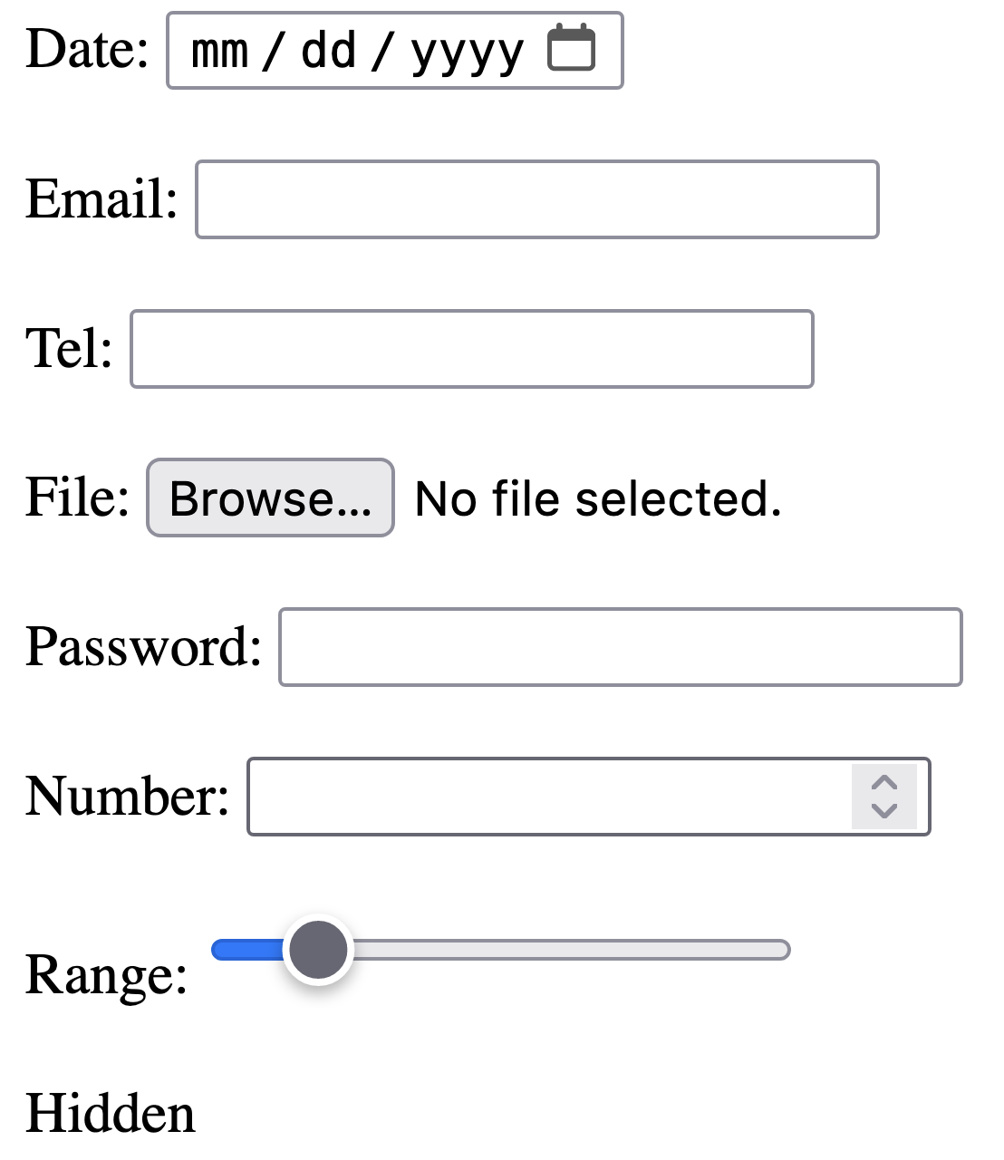
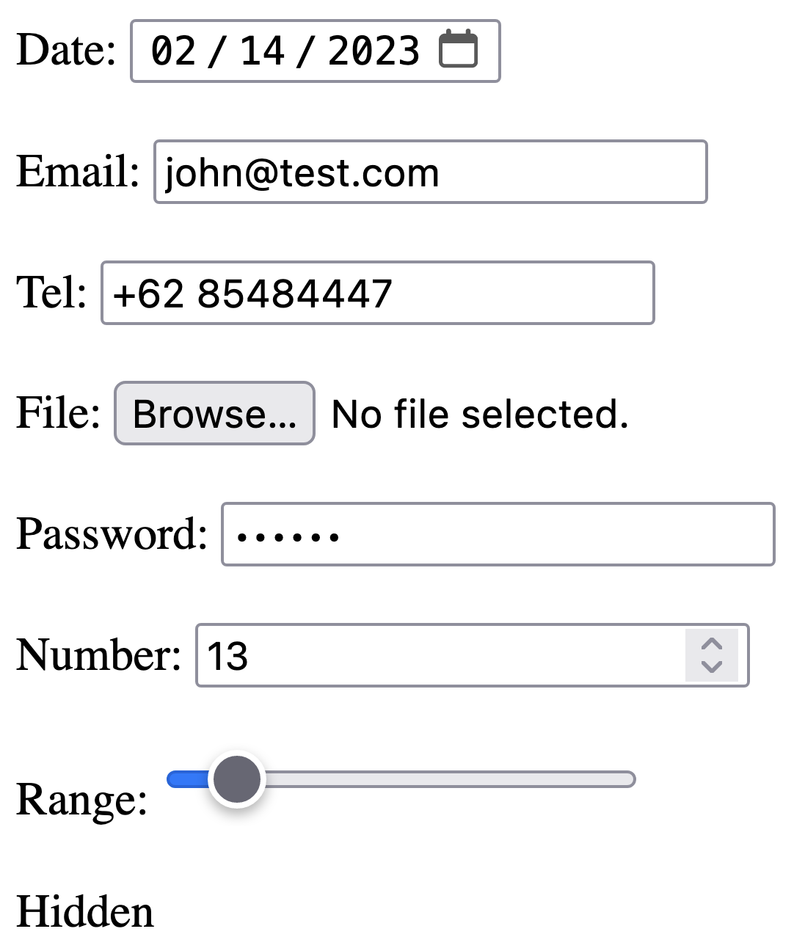

Slide 11
Input Attributes
<form>
Username: <input type="text" id="username" name="username" value="John" size="20"/>
<br/><br/>
Nickname: <input type="text" id="nickname" name="nickname" autofocus/>
<br/><br/>
StudentID: <input type="text" id="studentId" name="studentId" value="001" readonly/>
<br/><br/>
Major: <input type="text" id="major" name="major" value="IT" disabled/>
<br/><br/>
Hobby: <input type="text" id="hobby" name="hobby" placeholder="Sing"
maxlength="20" required/>
<br/><br/>
Rate: <input type="number" id="rate" name="rate" min="1" max="5"/>
<br/><br/>
<input type="submit" value="Submit Form"/>
</form>

Slide 12
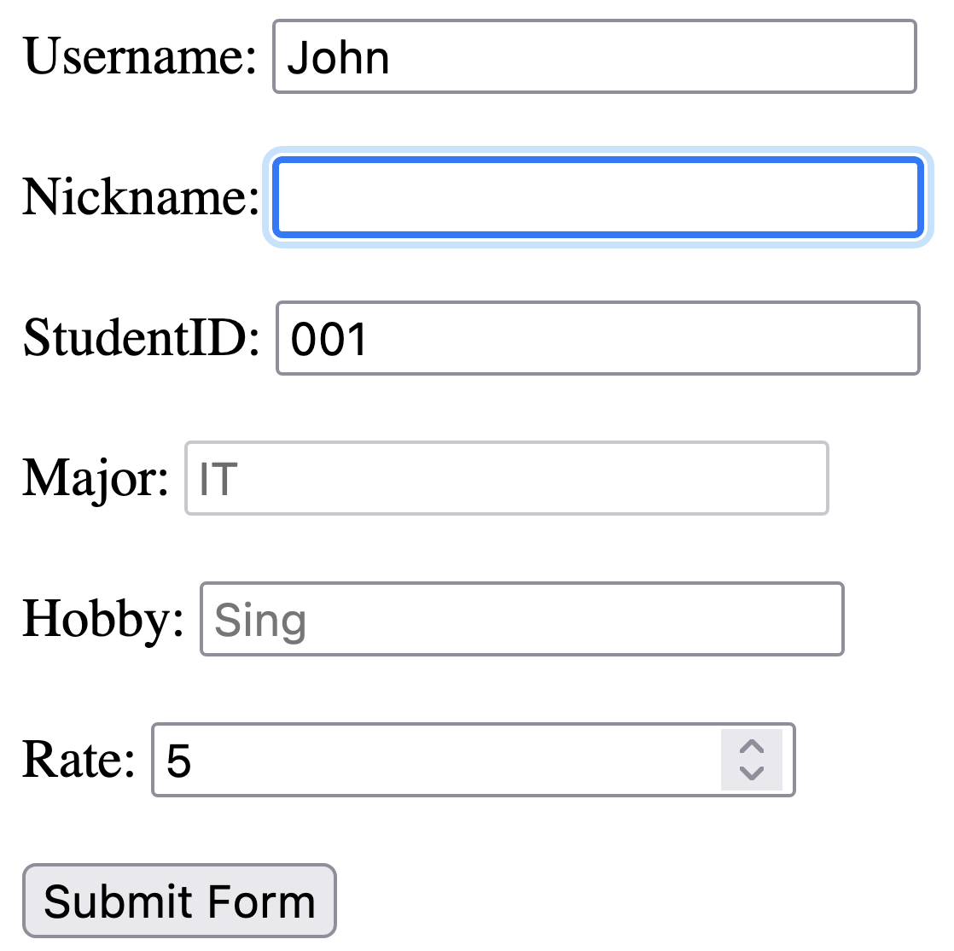
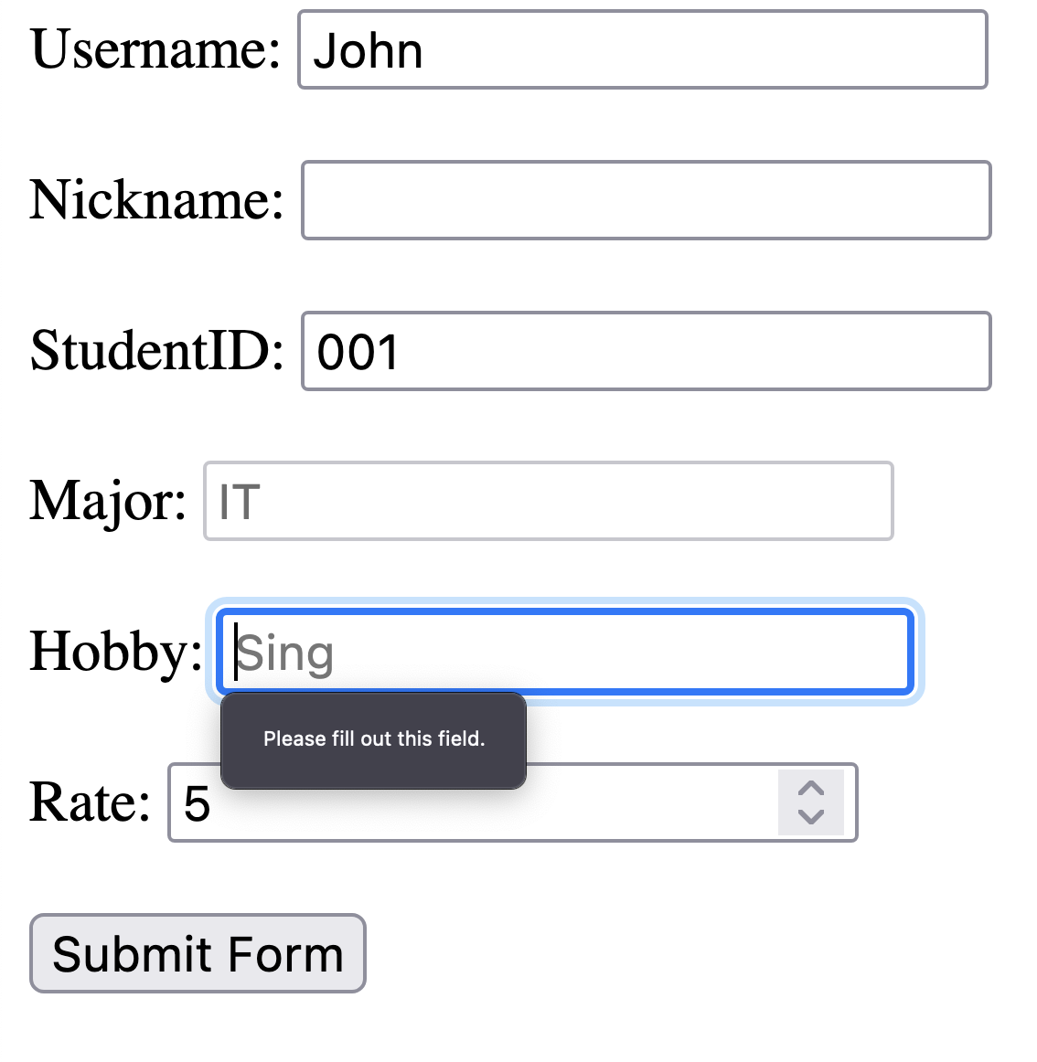

Slide 13
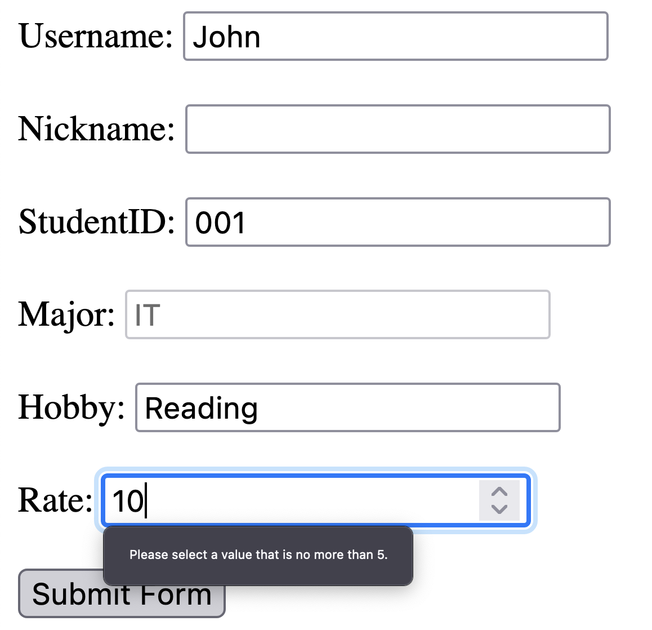

Slide 14
Radio
<p>Choose your favorite Web language:</p>
<form>
<input type="radio" id="html" name="fav_language" value="HTML"/>
<label for="html">HTML</label><br/>
<input type="radio" id="css" name="fav_language" value="CSS"/>
<label for="css">CSS</label><br/>
<input type="radio" id="javascript" name="fav_language" value="JavaScript"/>
<label for="javascript">JavaScript</label>
</form>

Slide 15
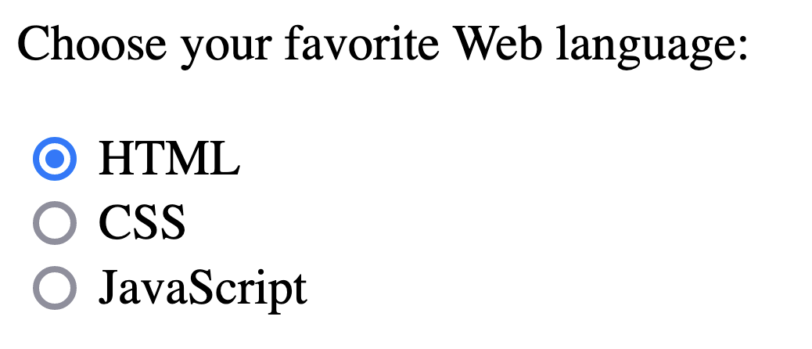

Slide 16

CheckBox
Different from radio, checkbox provides separate values that user could choose as she/he would like to,
<form>
<input type="checkbox" id="toppingA" name="topping" value="Peanut"/> Peanut
<input type="checkbox" id="toppingB" name="topping" value="Cookies"/> Cookies
<input type="checkbox" id="toppingC" name="topping" value="Almond"/> Almond
</form>

Slide 17
Notes on radio and checkbox
To make sure that our radio buttons provide different choices, we MUST give the same name, and different id value. The same applies to checkboxes too
Try to change the name into different names for each and see what happens

Slide 18
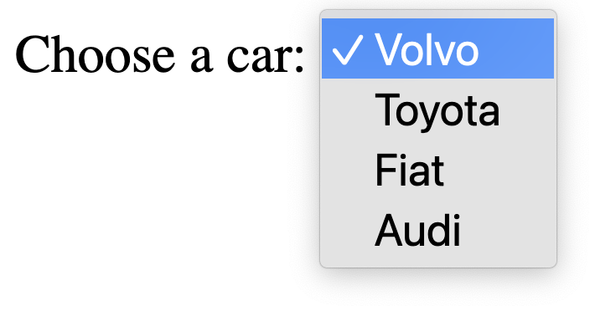
Select
<label for="cars">Choose a car:</label>
<select id="cars" name="cars">
<option value="volvo">Volvo</option>
<option value="toyota">Toyota</option>
<option value="fiat">Fiat</option>
<option value="audi">Audi</option>
</select>

Slide 19
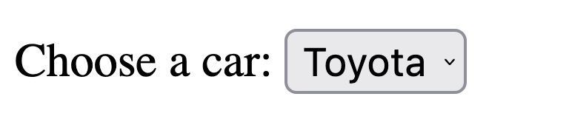
Auto Select
<label for="cars">Choose a car:</label>
<select id="cars" name="cars">
<option value="volvo">Volvo</option>
<option value="toyota" selected>Toyota</option>
<option value="fiat">Fiat</option>
<option value="audi">Audi</option>
</select>

Slide 20
Multiple Select
<label for="cars">Choose cars:</label>
<select id="cars" name="cars" multiple>
<option value="volvo">Volvo</option>
<option value="toyota">Toyota</option>
<option value="fiat">Fiat</option>
<option value="audi">Audi</option>
</select>

Slide 21
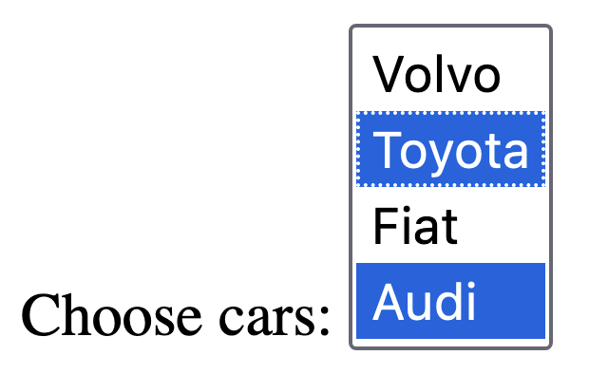

Slide 22
Optgroup
<label for="cars">Choose a car:</label>
<select name="cars" id="cars">
<optgroup label="Japan Cars">
<option value="toyota">Toyota</option>
<option value="honda">Honda</option>
</optgroup>
<optgroup label="German Cars">
<option value="mercedes">Mercedes</option>
<option value="bmw">BMW</option>
</optgroup>
</select>

Slide 23
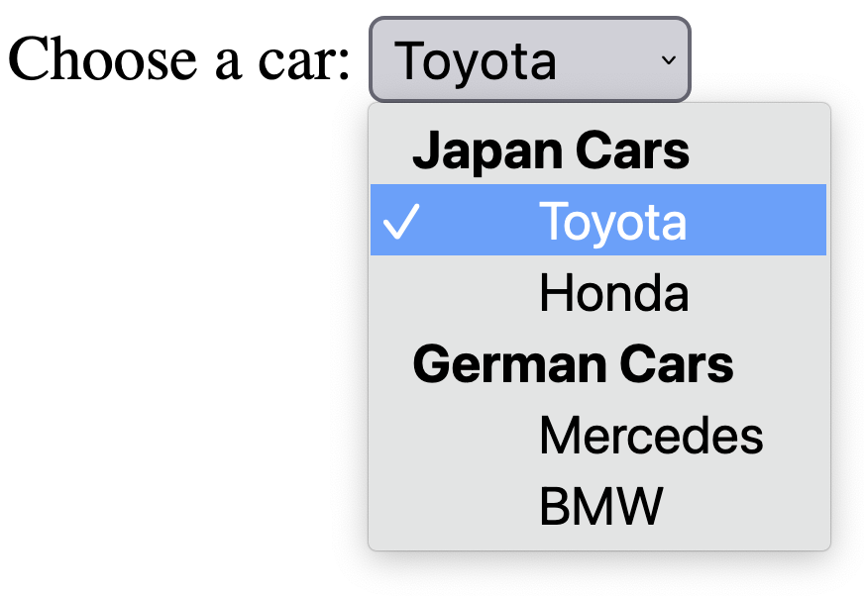

Slide 24
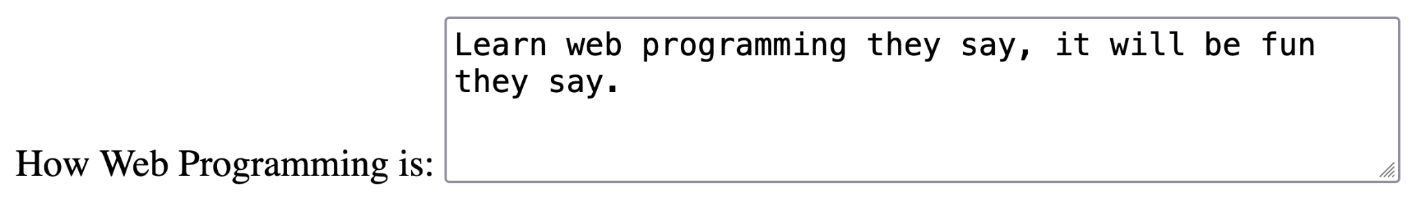
Textarea
<label for="web_programming">How Web Programming is:</label>
<textarea id="web_programming" name="web_programming" rows="4" cols="50">
Learn web programming they say, it will be fun they say.
</textarea>

Slide 25
Datalist
<form>
<input list="browsers" name="browser">
<datalist id="browsers">
<option value="Internet Explorer">
<option value="Firefox">
<option value="Chrome">
<option value="Opera">
<option value="Safari">
</datalist>
<input type="submit" value="Find Browser"/>
</form>

Slide 26
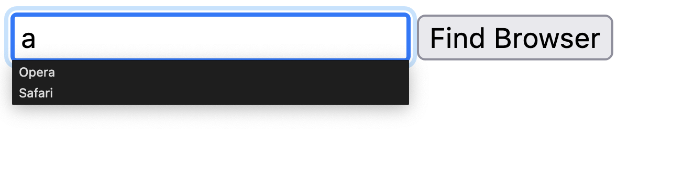

Slide 27
Frame and Frameset
Deprecated in HTML5, but still fun to use
Used to embed another html page inside a page
Frame could be nested
To add frame and frameset, need to remove some part of the html tags

Slide 28
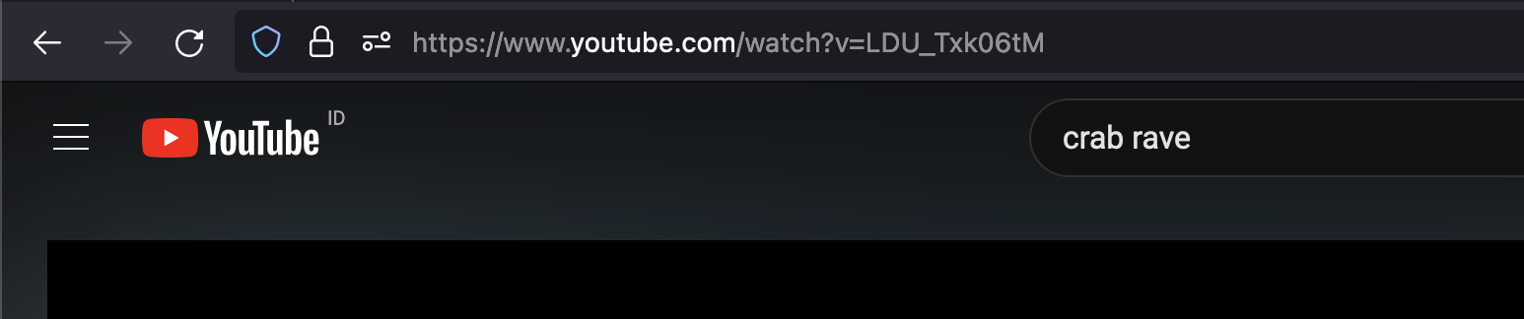
Iframe
Used in HTML5
To embed external pages or video sources
Example: YouTube videos will have the unique identifier

Slide 29
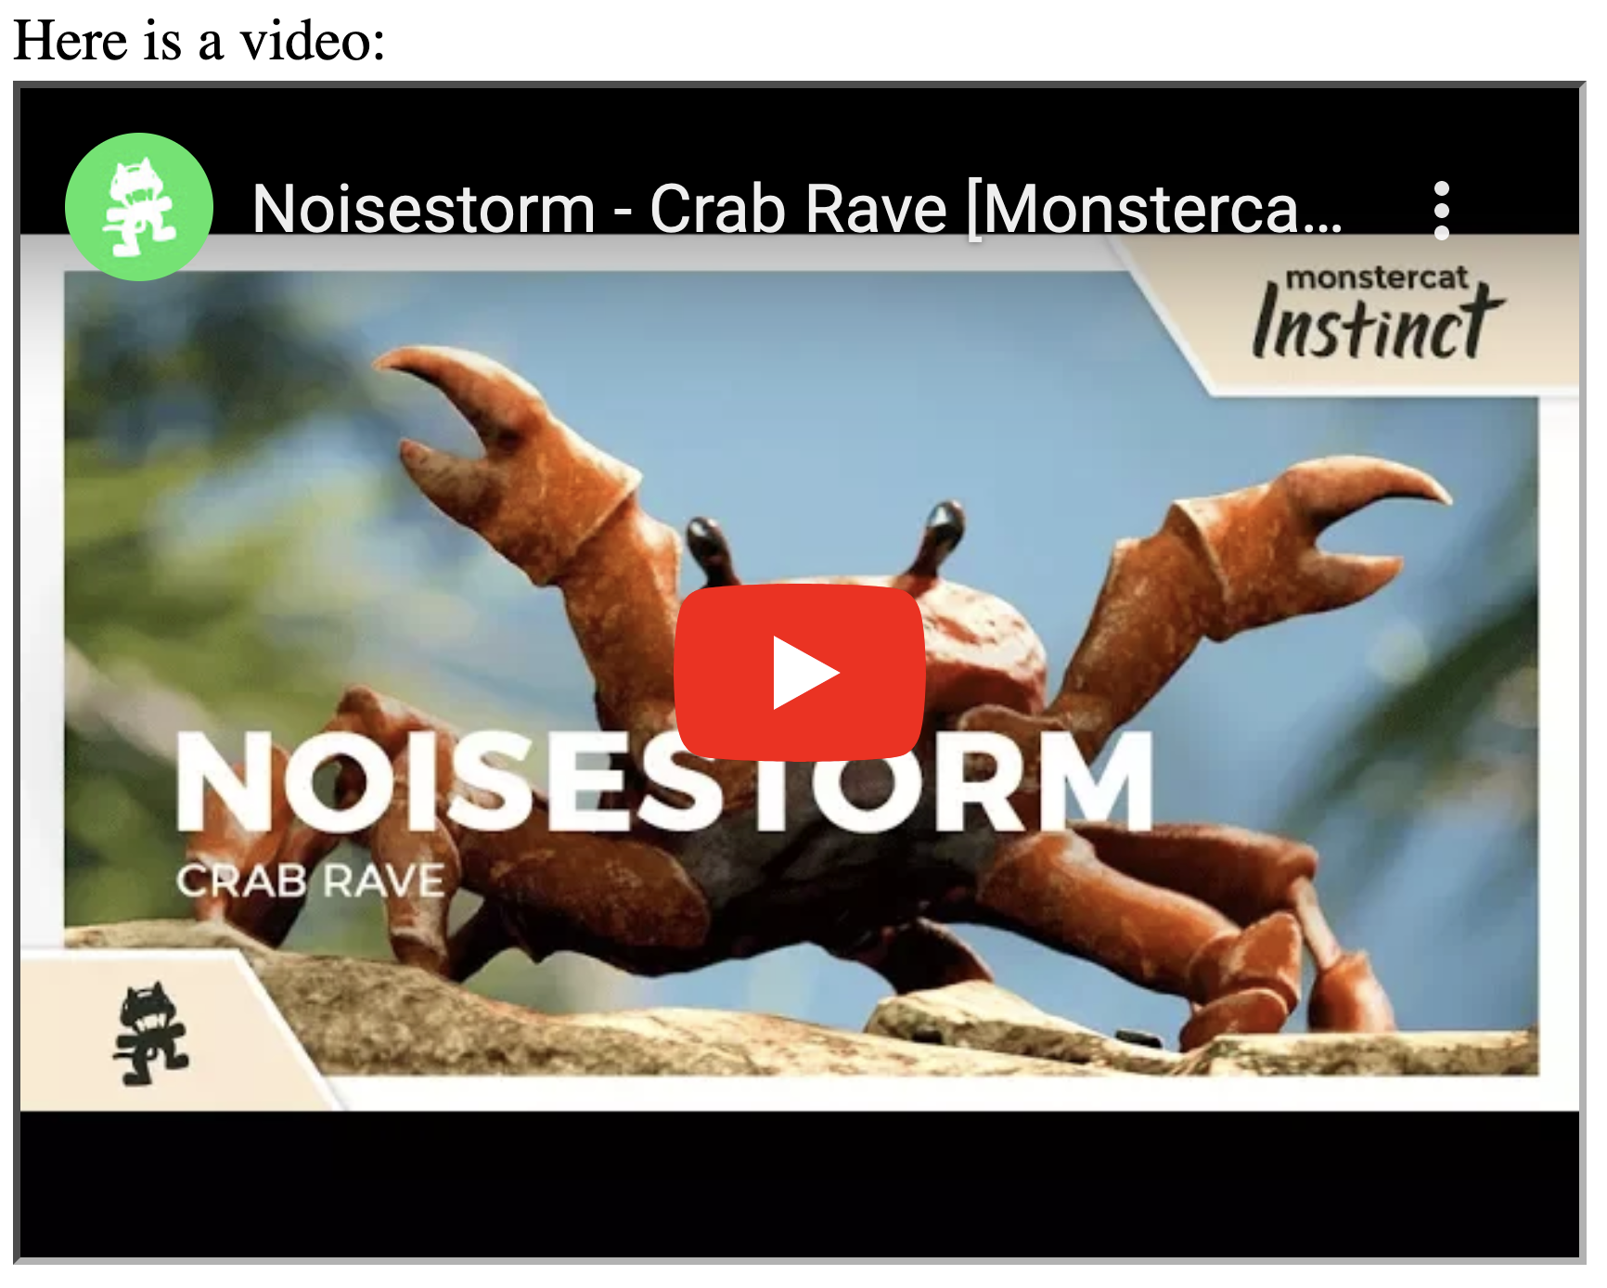
Iframe
Here is a video:<br/>
<iframe width="560" height="315" src="https://www.youtube.com/embed/LDU_Txk06tM?si=ibl1Qgu0rBislyKr" title="YouTube video player" frameborder="0" allow="accelerometer; autoplay; clipboard-write; encrypted-media; gyroscope; picture-in-picture; web-share" referrerpolicy="strict-origin-when-cross-origin" allowfullscreen></iframe>
Note: This will not work in normal situation due to updates in YouTube policy, but the idea is the same

Slide 30
Create these files in one folder:
Master page (with frame): index.html
Navigation: nav.html
Home page*: main.html
Form page*: form.html
About page*: about.html
Info page*: info.html
*Just put anything inside, do not need to ask :)

Slide 31
index.html
Use cols to create set of frames
110 means use 110 pixels first
* means use the rest
<frameset cols="110,*">
<frame name="leftframe" src="nav.html"/>
<frame name="main" src="main.html"/>
<noframes>
Not Supported
</noframes>
</frameset>
Add 2 frames with unique name, and add the source to load the HTML. Keep an eye on the name
If your browser does not support frames, show noframes

Slide 32
nav.html
<a href="main.html" target="main">Main Page</a><br/><br/>
<a href="form.html" target="main">Form</a><br/><br/>
<a href="about.html" target="main">About</a><br/><br/>
Create links, and fill the “target” attribute with the name of the frame to load, in this case the frame name is “main”

Slide 33
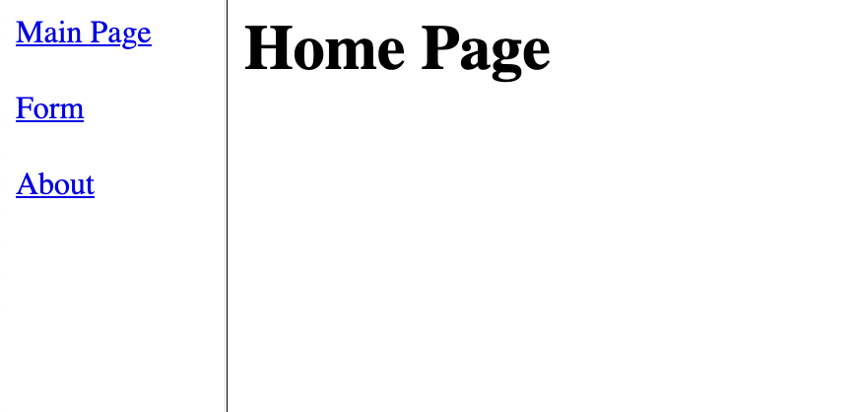
Open index.html

Slide 34
Nested Frame
Put another frameset inside
Use rows attribute to split the frame by rows
Use cols attribute to split the frame by columns

Slide 35
index.html (updated)
<frameset cols="110,*">
<frame name="leftframe" src="nav.html"/>
<frameset rows="100,*">
<frame name="info" src="info.html"/>
<frame name="main" src="main.html"/>
</frameset>
<noframes>
Not Supported
</noframes>
</frameset>
Add another frameset, split by rows
First row is 100 pixels

Slide 36
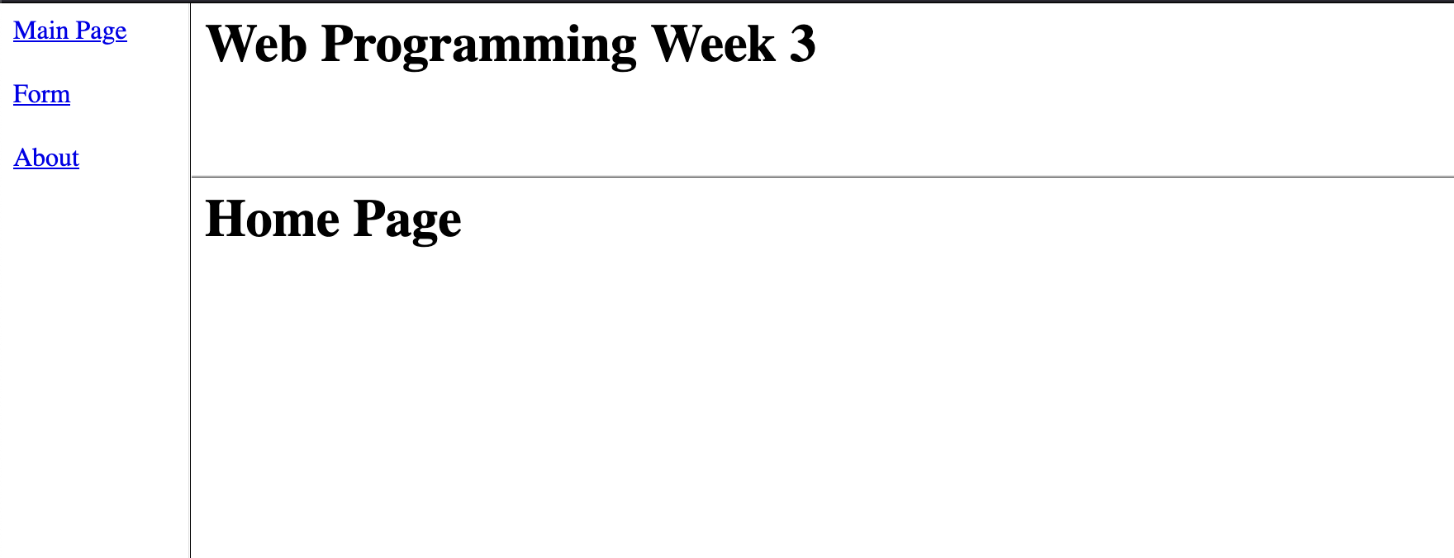

Slide 37
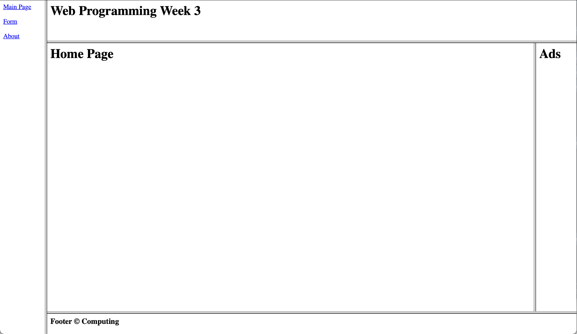
Exercise to challenge yourself
100
110
100
50

Slide 38
References
https://www.w3schools.com/html/html_form_elements.asp
https://www.w3schools.com/html/html_form_input_types.asp

