Slide 1
Web Programming
CSS (Cascading Style Sheet)

Slide 2
CSS (Cascading Style Sheet)
Language that describes the look or presentation of markup languages
Stylesheet language.
Three ways to use CSS:
Via style attribute (inline style)
Via style tag in head
Via separate files

Slide 3
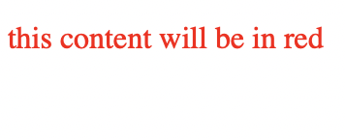
Method 1: Via style attribute (Inline Style)
<p style="color: red;">
this content will be in red
</p>

Slide 4
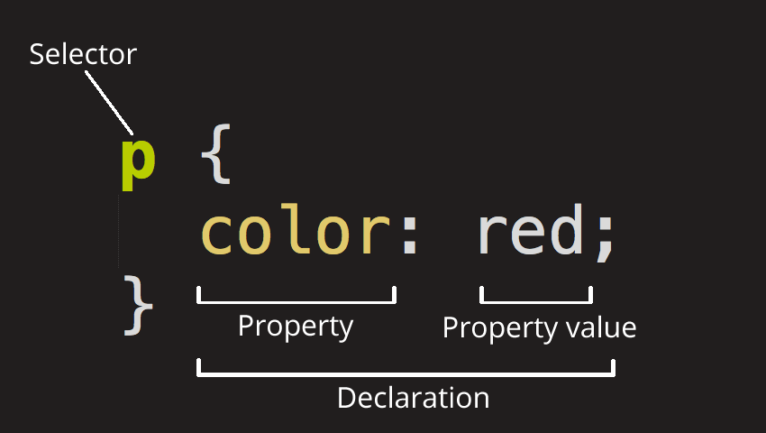
Anatomy of a CSS

Slide 5
Method 2: Via <style> tag
<!DOCTYPE html>
<html lang="en">
<head>
<meta charset="UTF-8">
<title></title>
<style>
p {
color: red;
font-size: 20pt;
}
</style>
</head>
<body>
<p>
this content will be in red and font-size is 20pt
</p>
</body>
</html>
Notice we call the tag name, followed by the curly braces and the style inside. Every style we add, we must end it with semicolon.
Using this style, all paragraph tags will have red font with font size as 20pt

Slide 6
Method 3: Via CSS files
What if:
We want to add many styles?
We put everything in HTML?
We want to use same styles for other pages?
We could use separate file for our CSS. The extension of the file is .css, and we could add the link to the file in <head> tag

Slide 7

Adding .css file
<!DOCTYPE html>
<html lang="en">
<head>
<title></title>
<link href="style.css" rel="stylesheet"/>
</head>
<body>
<p>
Web Programming is <span>fun</span>!
</p>
</body>
</html>
/* style.css I am a comment :D */
p {
text-decoration: underline;
color: purple;
}
span {
text-transform: uppercase;
}

Slide 8
Selector
The target of style in HTML is called selector.
What if we add the same selector with different value?
/* style.css */
p {
color: red;
}
p {
color: blue;
}
Result is BLUE because the last one is used. This is called “Cascading” rule

Slide 9
Multiple selectors
p, h1, div {
color: red;
}
This means make all contents of paragraph, header 1 and div with red font

Slide 10
What if
What if we use unknown property or value?
Nothing will happen, so it is safe and our document is not formatted
p, h1, div {
hohoho: red;
}

Slide 11
Types of selectors
Could we use different kind of selectors? We could and in fact we have 4 choices to use as selector in CSS:
Type: the one we have seen
Attributes: using HTML tag attribute
ID: the ID of HTML element
Class: the class of HTML element

Slide 12
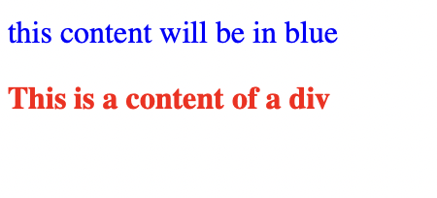
HTML id and name attribute
Format / style certain elements in our HTML with id or name or any attribute in the HTML.
<!DOCTYPE html>
<html lang="en">
<head>
<title></title>
<link href="style.css" rel="stylesheet"/>
</head>
<body>
<p id="myParagraph">
this content will be in blue
</p>
<div name="myDiv">
This is a content of a div
</div>
</body>
</html>
p[id=myParagraph] {
color: blue;
}
div[name=myDiv] {
color: red;
font-weight: bold;
}

Slide 13
Besides that, we could just use id selector
Use # before id in CSS to apply style only for elements with id “myParagraph”.
All elements with id=”myParagraph” will be blue
#myParagraph {
color: blue;
}

Slide 14

Class
Use class attribute in tag to give HTML certain style.
<!DOCTYPE html>
<html lang="en">
<head>
<title></title>
<link href="style.css" rel="stylesheet"/>
</head>
<body>
<div class="myClass">
White on Black
</div>
</body>
</html>
.myClass {
color: white;
background-color: black;
}

Slide 15
Selector with Class
Add specific style to specific selector with certain class.
Format: selector.className
p.myClass {
color: red;
}

Slide 16
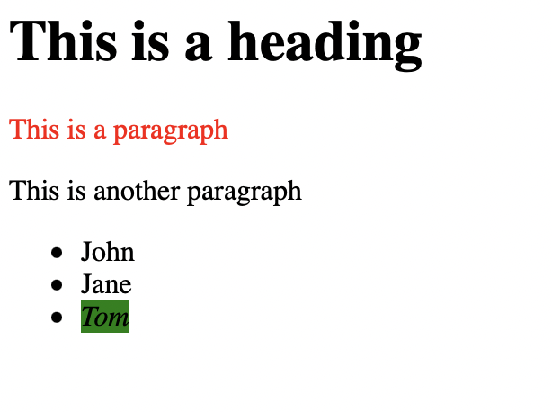
Combinator
Make one paragraph after the heading to have red text
Make the <em> inside <li> has background color of green
<h1>This is a heading</h1>
<p>This is a paragraph</p>
<p>This is another paragraph</p>
<ul>
<li>John</li>
<li>Jane</li>
<li><em>Tom</em></li>
</ul>

Slide 17
Combinator - Adjacent
If we want to change the style of element that comes exactly after an element, we use “adjacent sibling combinator” (with + sign).
h1 + p {
color: red;
}

Slide 18
Combinator - Descendant
If we want to change the style of element that is exactly inside an element, we use “descendant combinator” (separated by space)
li em {
background-color: green;
}

Slide 19
CSS based on state
Remember the hyperlink discussion? Where I stated that a link will change its color when you visit it but it didn’t? It is because we do not have distinguish style for our hyperlink element.
A hyperlink element has:
link (default): normal, unvisited link
visited: visited link
hover: when user hovers on the link
active: when user clicks on the link

Slide 20
Styling Links with Pseudoclass
<a href="https://puis.president.ac.id" target="_blank">PUIS</a>
a:link {
color: green;
}
a:visited {
color: black;
}
a:hover {
background-color: red;
}
a:active {
color: yellow;
}

Slide 21
Inheritance and Cascade
Cascade plays important roles in CSS (hence Cascading Style Sheet). This means if we have same element with same importance, the one applied is the last found in the file
<p>
This will be in red
</p>
p {
color: blue;
}
p {
color: red;
}

Slide 22
Inheritance and Cascade
Different with cascade, inheritance in css means all of the styles applied in the higher level of element will also be applied to the children
<!DOCTYPE html>
<html lang="en">
<head>
<title></title>
<link href="style.css" rel="stylesheet"/>
</head>
<body>
<p>
Because the body is blue, the paragraph inherits the blue color except <span>this part</span>
</p>
</body>
</html>
body {
color: blue;
}
span {
color: red;
}

Slide 23
NOW LET’S HAVE FUN
Let’s see what properties we could use
BUT do not limit yourself to these properties! Have fun and combine them :)
Remember: “Sky is the only limit”

Slide 24
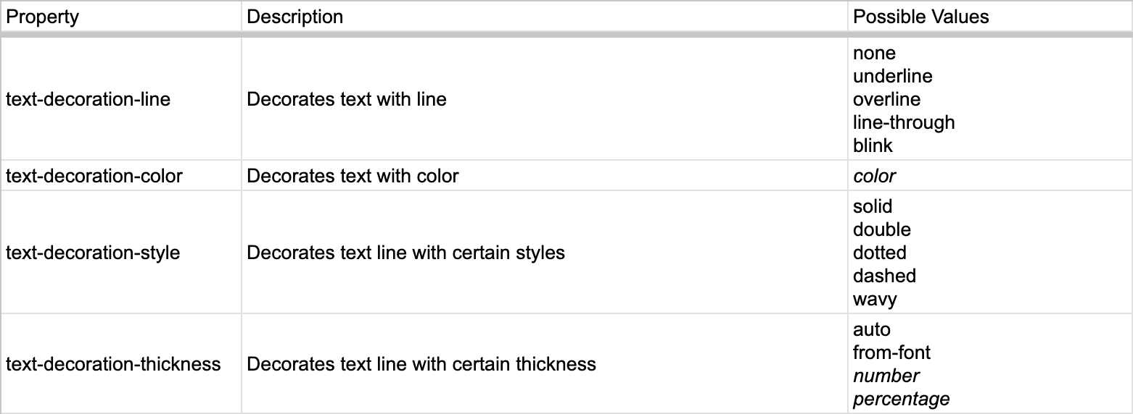
Text Decoration

Slide 25

CSS Shorthand
To simplify properties in certain cases
From previous slide, we could use text-decoration
span {
text-decoration-line: underline;
text-decoration-style: wavy;
text-decoration-color: green;
text-decoration-thickness: 1px;
}
CSS is also <span>Fun</span>
span {
text-decoration: underline wavy green 1px;
}
CSS is also <span>Fun</span>

Slide 26
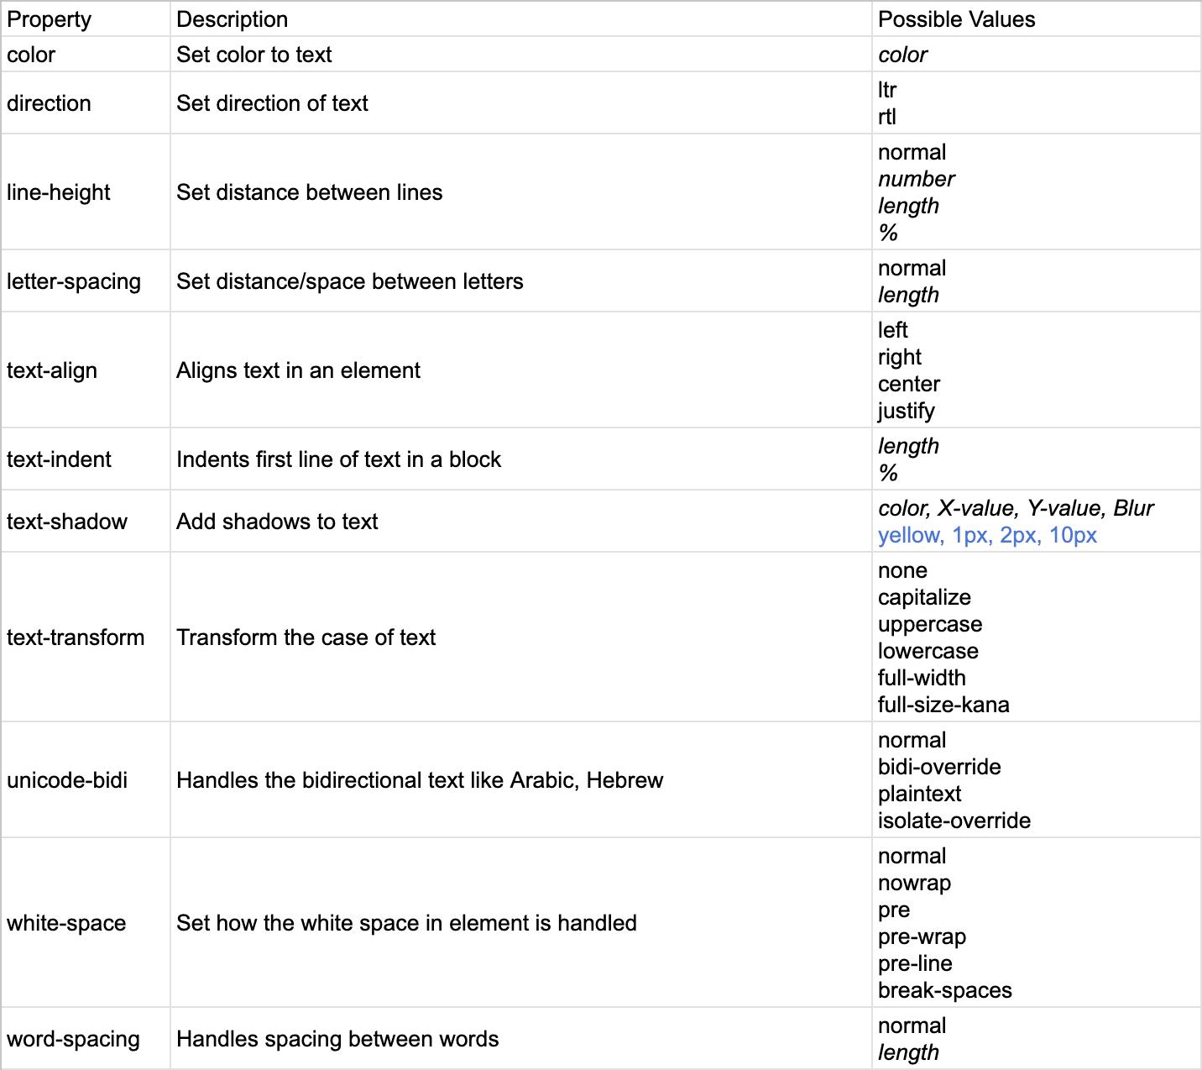
Text Properties
Note: text in italic is variable

Slide 27
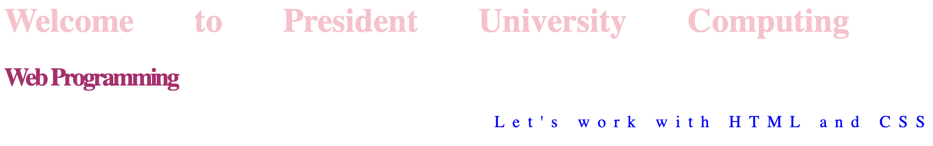
h1 {
color: pink;
word-spacing: 50px;
}
h2 {
color: #B31F6D;
letter-spacing: -2px;
}
p {
color: rgb(0, 0, 255);
letter-spacing: 0.2cm;
direction: rtl;
}
<h1>Welcome to President University Computing</h1>
<h2>Web Programming</h2>
<p>Let's work with HTML and CSS</p>

Slide 28
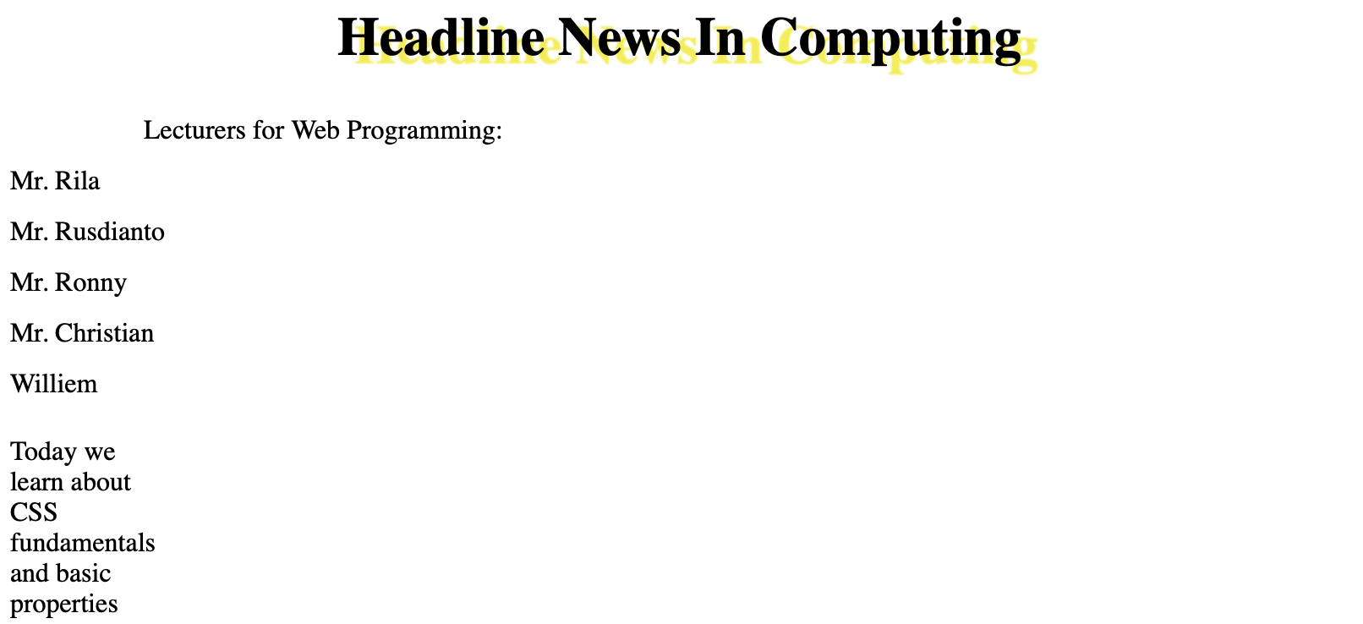
h1.headline {
text-align: center;
text-transform: capitalize;
text-shadow: #f4ed30 10px 5px 1px;
}
p {
text-indent: 10%;
line-height: 30px;
}
div {
width: 100px;
white-space: break-spaces;
}
<h1 class="headline">headline news in computing</h1>
<p>
Lecturers for Web Programming:<br/>
Mr. Rila<br/>
Mr. Rusdianto<br/>
Mr. Ronny<br/>
Mr. Christian<br/>
Williem<br/>
</p>
<div>Today we learn about CSS fundamentals and basic properties</div>

Slide 29
Let’s continue
https://docs.google.com/document/d/1lLeE7zlH7MKYUo7AWPXqv2CmRYQs3Pf3/edit?usp=sharing&ouid=112512321509221893227&rtpof=true&sd=true

Slide 30
References
https://developer.mozilla.org/en-US/docs/Learn/CSS/First_steps/Getting_started
https://developer.mozilla.org/en-US/docs/Learn/Getting_started_with_the_web/CSS_basics
https://developer.mozilla.org/en-US/docs/Learn/CSS/First_steps/How_CSS_is_structured#selectors
https://developer.mozilla.org/en-US/docs/Learn/CSS/Building_blocks/Cascade_and_inheritance
https://developer.mozilla.org/en-US/docs/Learn/CSS/First_steps/How_CSS_works
https://developer.mozilla.org/en-US/docs/Learn/CSS/Building_blocks

