Slide 1
Web Programming
CSS Responsive Web Design

Slide 2
Responsive Web Design
Design web page to be responsive
Responsive means working on all devices with wide range of size varieties
Responsive design could be achieved by using only HTML and CSS
Result could be seen by shrinking, resizing, and changing the layout of devices

Slide 3
Principles of Responsive Design
Cover most devices
Keep the design aesthetic
Must not leave out information, but adapt the content

Slide 4
Viewport
User’s visible area of a web page
Varies with the device dimension
HTML5 lets developer to manipulate the viewport using <meta> tag
It is a good practice to include the viewport in the meta tag in all the webpages to make sure it has the responsive capabilities

Slide 5
Using viewport in the <head> tag
<meta name="viewport" content="width=device-width, initial-scale=1.0">
Parts:
width=device-width
Set the width of page to follow the screen width of the device
initial-scale=1.0
Set the zoom level to 1 when page is first loaded by browser

Slide 6
Example: without viewport
<!DOCTYPE html>
<html lang="en">
<head>
<style>
img {
width: 50%;
height: 100%;
object-fit: contain;
}
</style>
</head>
<body>
<div>
<img src="picture.jpg" alt="Garden"/>
</div>
<div>
This is a garden with a beautiful view. In the middle of the garden we have a cottage and we could take a rest inside. This could be a fun experience to begin with!
</div>
</body>
</html>

Slide 7
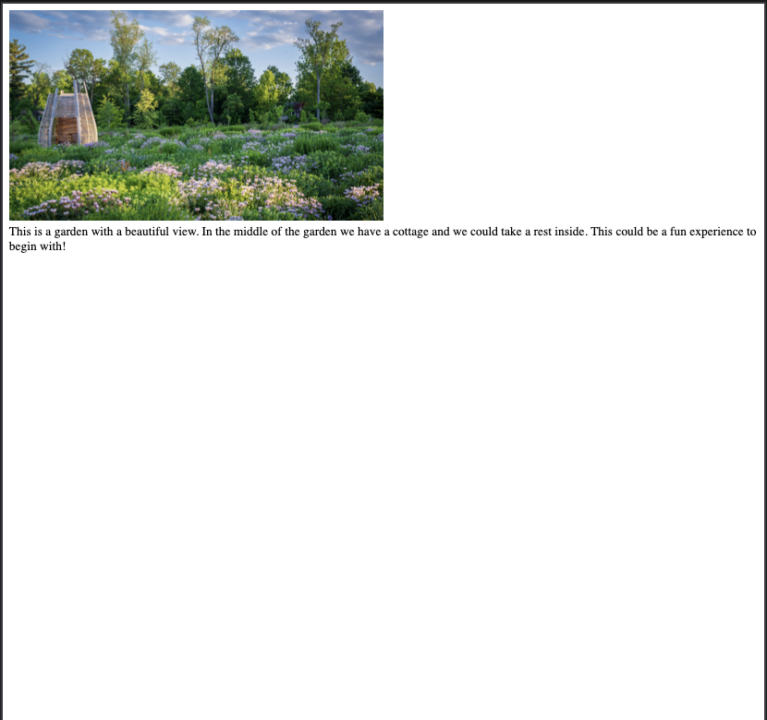

Slide 8
Example: with viewport
<!DOCTYPE html>
<html lang="en">
<head>
<meta name="viewport" content="width=device-width, initial-scale=1.0">
<style>
img {
width: 50%;
height: 100%;
object-fit: contain;
}
</style>
</head>
<body>
<div>
<img src="picture.jpg" alt="Garden"/>
</div>
<div>
This is a garden with a beautiful view. In the middle of the garden we have a cottage and we could take a rest inside. This could be a fun experience to begin with!
</div>
</body>
</html>

Slide 9
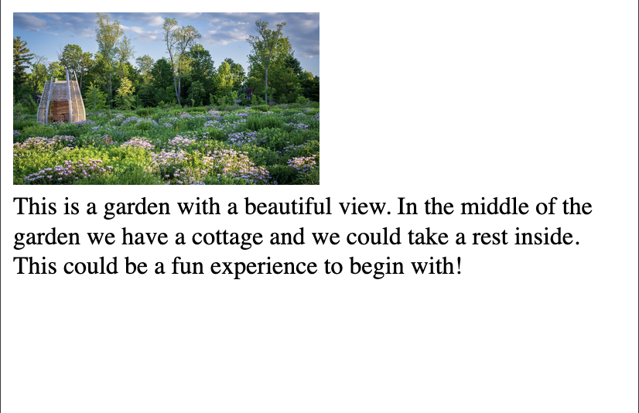

Slide 10
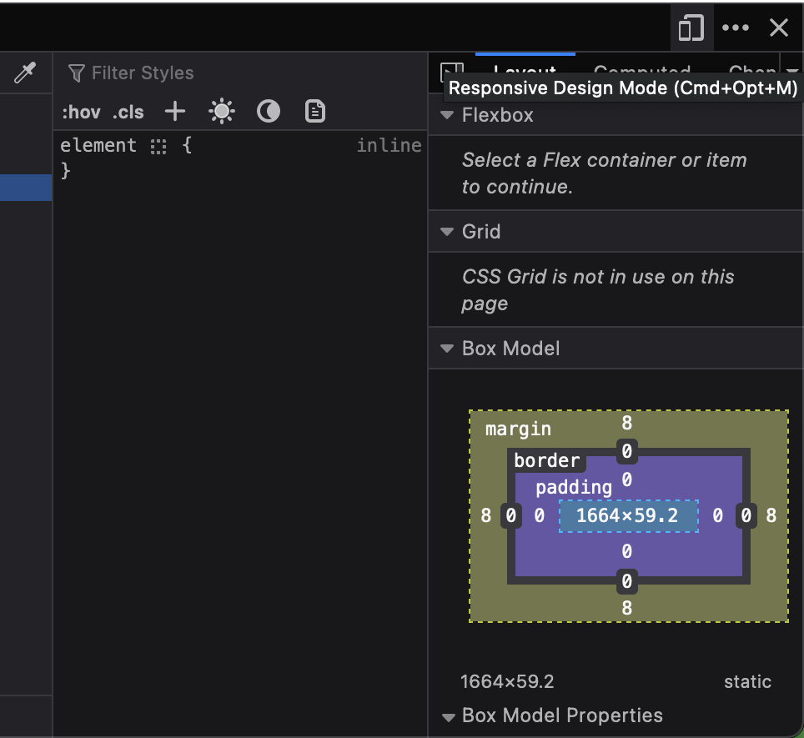
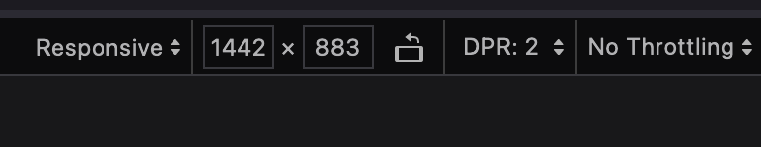
Trick
To resize the screen size, we could change the browser window size or use this steps:
Right click on the page
Select Inspect or Inspect Element depending on the browsers
Click the Responsive Design Mode icon
NOTE: select the size here

Slide 11
Rules to consider
Never use large fixed width elements
Never rely on a certain viewport size
Use CSS media queries to apply different style for small and large screens

Slide 12
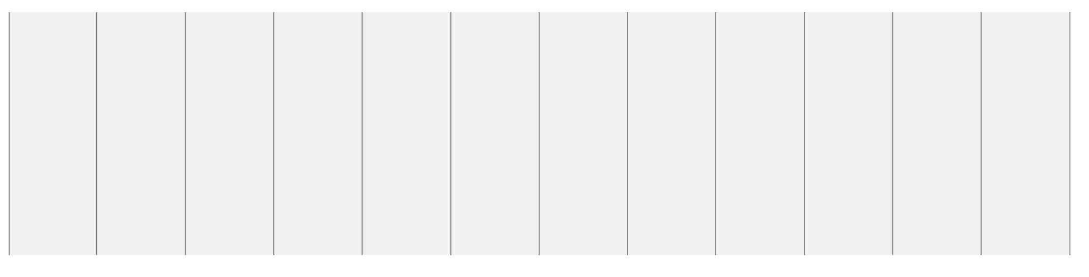
CSS Grid View
Pages are usually designed as grid view
The sections of the pages are separated by columns
Makes it easier to place components on a page
Responsive grid design has 12 columns in total with the total 100% width*
*The reason number 12 is used because it provides flexible number of possibilities such as 1, 2, 3, 4, 6, 12 allowing multitude of design options

Slide 13
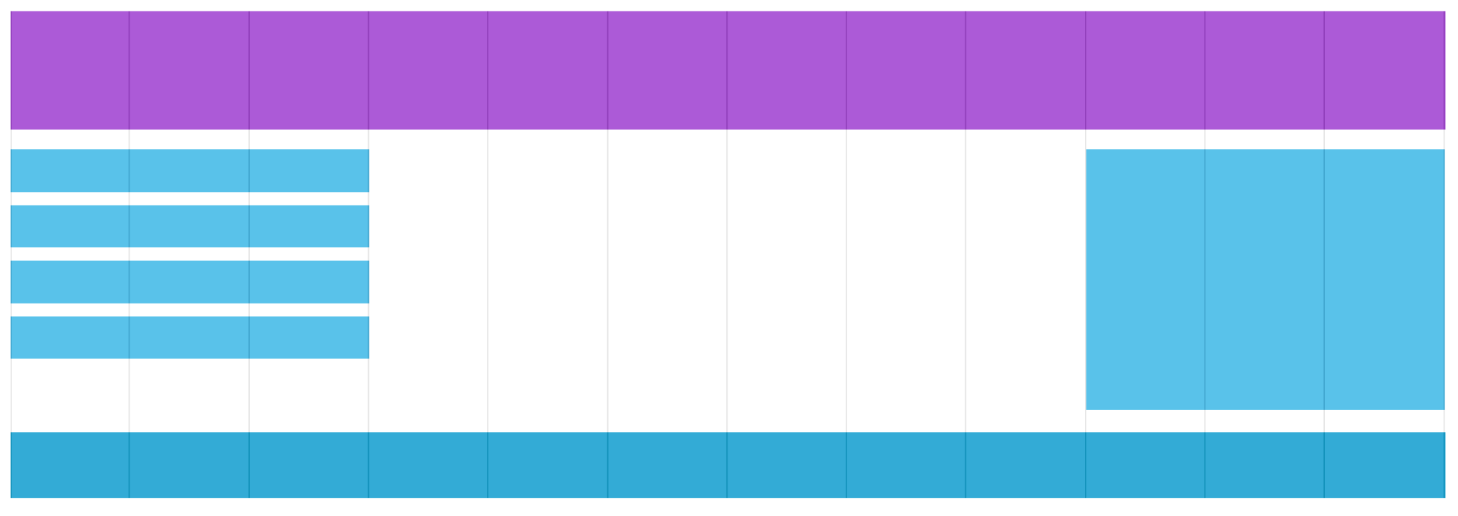
CSS Grid View

Slide 14
Non-Responsive Design and how to countermeasure
When we add width, height and padding, the actual calculation is like this:
Actual width = width + padding + border
Actual height = height + padding + border
To countermeasure this, we could use box-sizing property and set the value to border-box

Slide 15
Example of not using border-box
<head>
<style>
.div1 {
width: 300px;
height: 100px;
border: 1px solid blue;
}
.div2 {
width: 300px;
height: 100px;
padding: 50px;
border: 1px solid red;
}
</style>
</head>
<body>
<h1>Without box-sizing</h1>
<div class="div1">This div is smaller (width is 300px and height is 100px).</div>
<br/>
<div class="div2">This div is bigger (width is also 300px and height is 100px).</div>
</body>

Slide 16
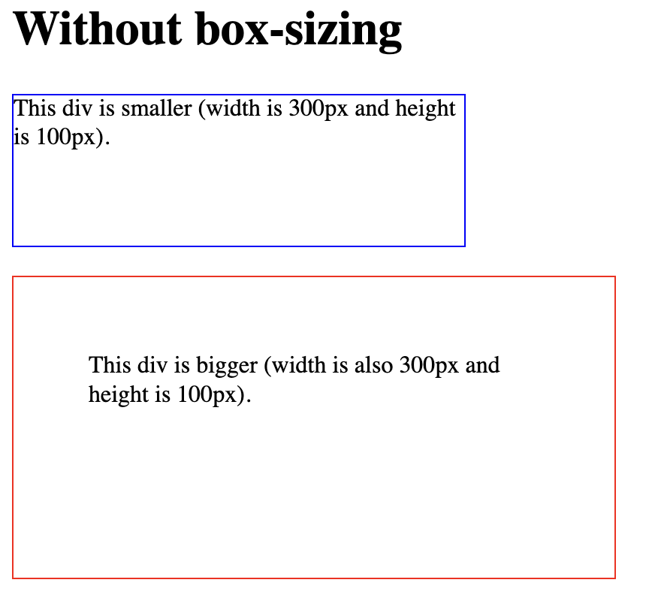
Same width and height but why different?
Note:
Actual width = padding + width + border
= 50px * 2 + 300px + 1px * 2
= 100px + 300px + 2px
= 402 px
Actual height = padding + height + border
= 50px * 2 + 100px + 1px * 2
= 100px + 100px + 2px
= 202 px

Slide 17
With box-sizing
<head>
<style>
.div1 {
width: 300px;
height: 100px;
border: 1px solid blue;
box-sizing: border-box;
}
.div2 {
width: 300px;
height: 100px;
padding: 50px;
border: 1px solid red;
box-sizing: border-box;
}
</style>
</head>
<body>
<h1>With box-sizing</h1>
<div class="div1">Both divs are the same size now!</div>
<br/>
<div class="div2">Hooray!</div>
</body>

Slide 18
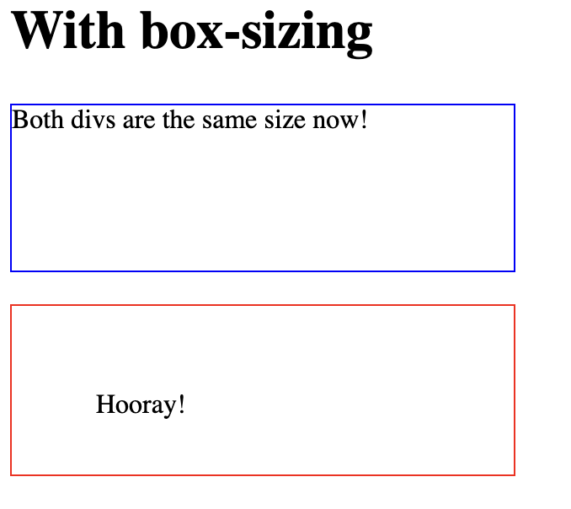
With box-sizing

Slide 19
Media Query
Technique in CSS to design responsive web pages
Use this to include a block of CSS based on a certain condition
Always remember to design from the smallest device screen first, so start from
Mobile Phones → Tablets → Desktop
Could also manipulate the orientation of the screens: portrait and landscape

Slide 20
Typical Device Breakpoints
/* Extra small devices (phones, 600px and down) */
@media only screen and (max-width: 600px) {
/* css here */
}
/* Small devices (portrait tablets and large phones, 600px and up) */
@media only screen and (min-width: 600px) {
/* css here */
}
/* Medium devices (landscape tablets, 768px and up) */
@media only screen and (min-width: 768px) {
/* css here */
}
/* Large devices (laptops/desktops, 992px and up) */
@media only screen and (min-width: 992px) {
/* css here */
}
/* Extra large devices (large laptops and desktops, 1200px and up) */
@media only screen and (min-width: 1200px) {
/* css here */
}

Slide 21
Example of responsiveness: CSS Part (style.css)
div {
padding: 20px;
color: white;
}
/* Extra small devices (phones, 600px and down) */
@media only screen and (max-width: 600px) {
div {background: red;}
}
/* Small devices (portrait tablets and large phones, 600px and up) */
@media only screen and (min-width: 600px) {
div {background: green;}
}
/* Medium devices (landscape tablets, 768px and up) */
@media only screen and (min-width: 768px) {
div {background: blue;}
}
/* Large devices (laptops/desktops, 992px and up) */
@media only screen and (min-width: 992px) {
div {background: orange;}
}
/* Extra large devices (large laptops and desktops, 1200px and up) */
@media only screen and (min-width: 1200px) {
div {background: pink;}
}

Slide 22
Example of responsiveness: HTML part
<!DOCTYPE html>
<html lang="en">
<head>
<meta charset="UTF-8">
<meta name="viewport" content="width=device-width, initial-scale=1.0">
<title>Responsive Web Design</title>
<link href="style.css" rel="stylesheet" />
</head>
<body>
<div>Resize the browser window to see different background color!</div>
</body>
</html>

Slide 23
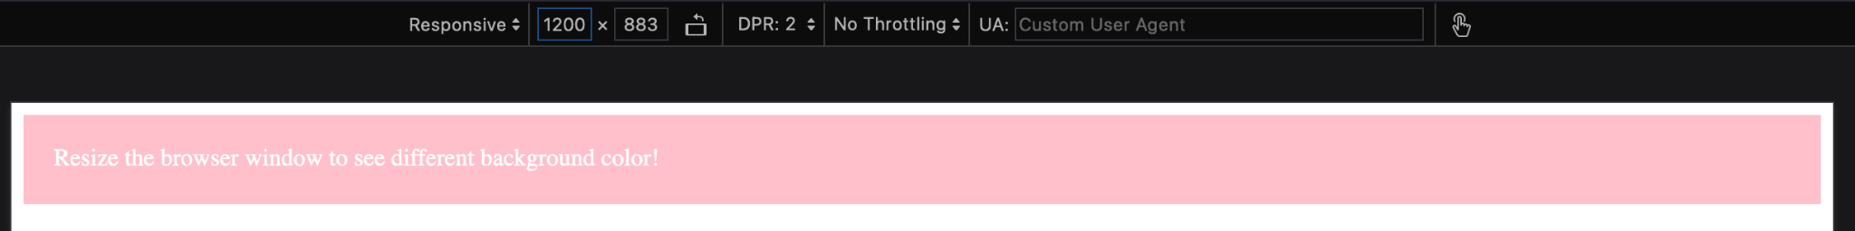
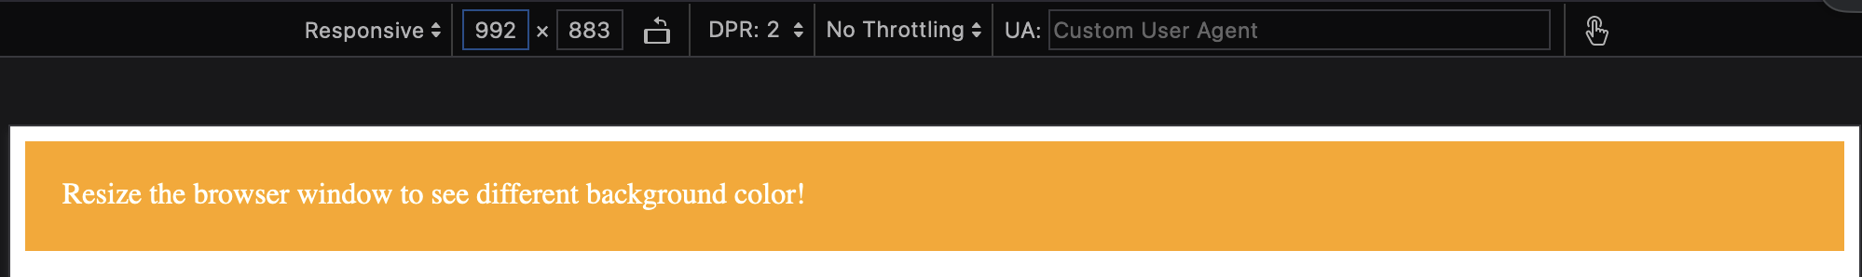
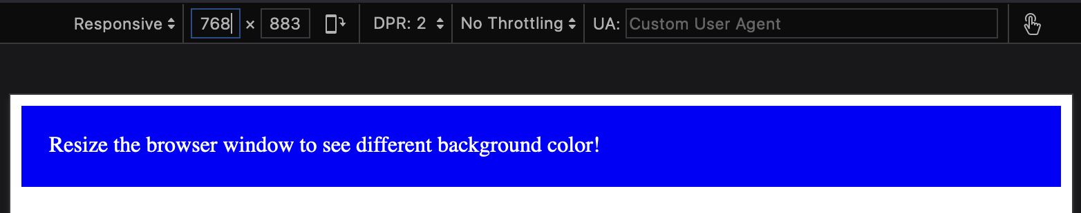
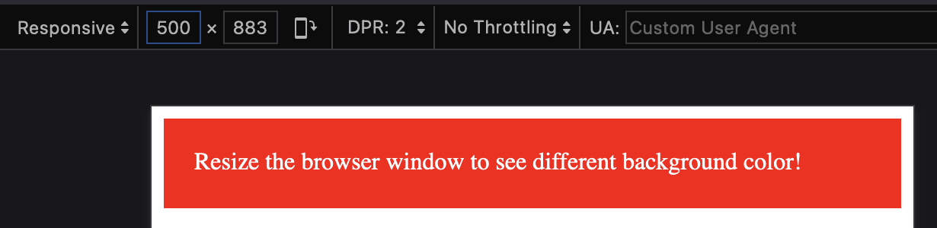
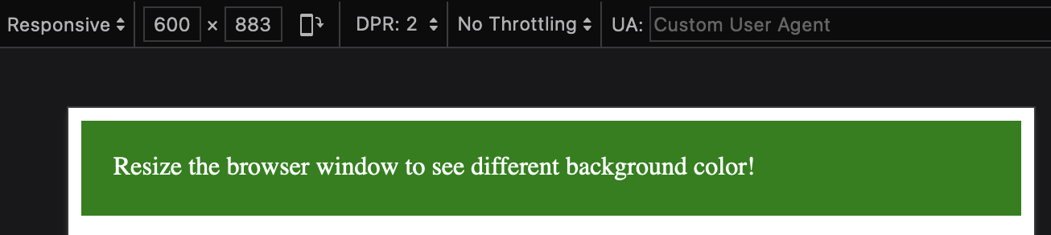

Slide 24
Orientation: Portrait and Landscape
<!DOCTYPE html>
<html>
<head>
<meta name="viewport" content="width=device-width, initial-scale=1.0">
<style>
body {
background-color: lightgreen;
}
@media only screen and (orientation: landscape) {
body {
background-color: lightblue;
}
}
</style>
</head>
<body>
<p>Portrait: lightgreen, Landscape: lightblue</p>
</body>
</html>

Slide 25
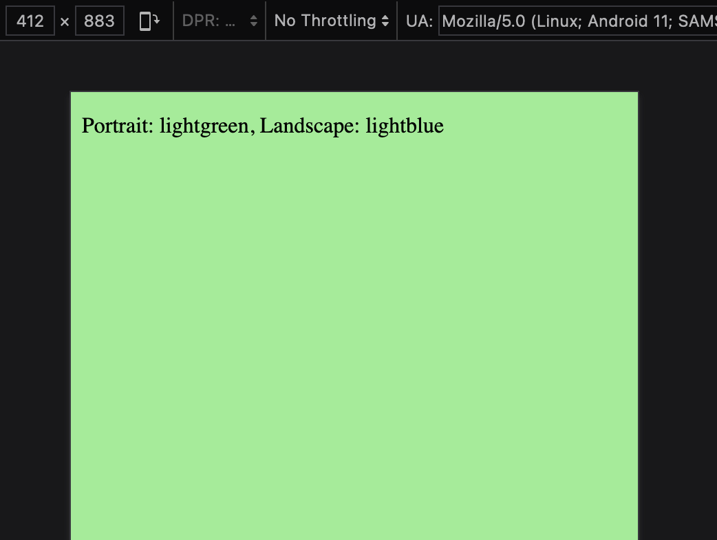
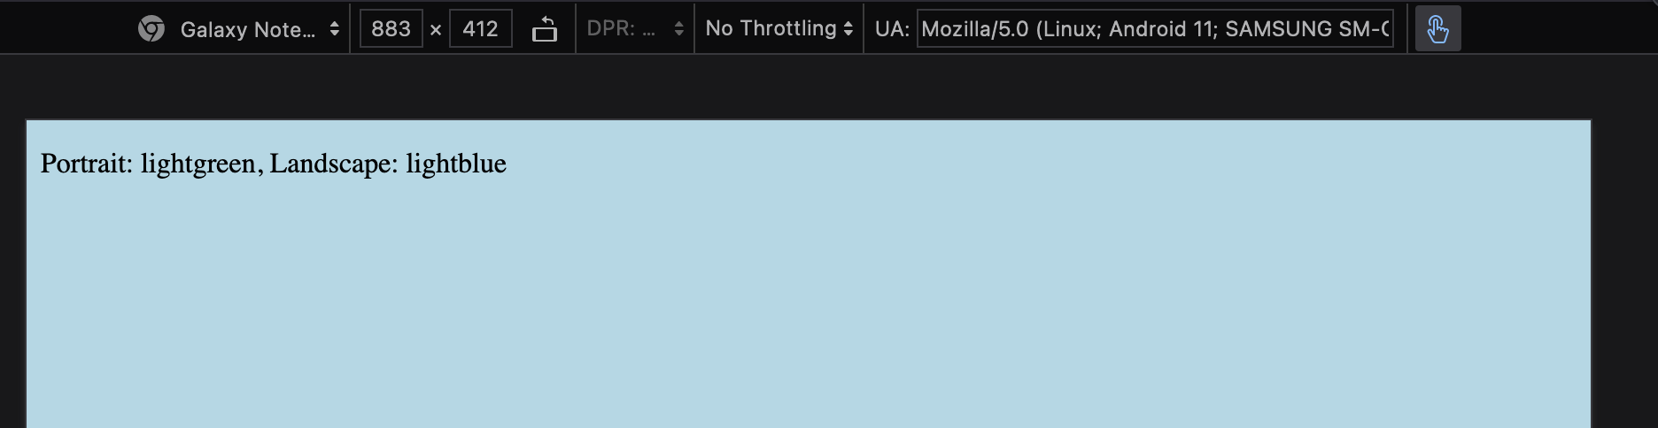

Slide 26
Steps of creating a responsive web
Ensure all HTML elements have box-sizing property set to border-box
Think about how to design the page contents, how many columns or rows and the percentage
Calculate responsive columns percentage
Use media query to split device breakpoints

Slide 27
Columns percentage assuming 12 columns
Width of a screen is considered as 100%. There are 12 columns, so
1 column = 100 / 12 = 8.33%
2 columns = 16.66%
3 columns = 25%
4 columns = 33.33%
5 columns = 41.66%
6 columns = 50%
7 columns = 58.33%
8 columns = 61.66%
9 columns = 75%
10 columns = 83.33%
11 columns = 91.66%
12 columns = 100%

Slide 28
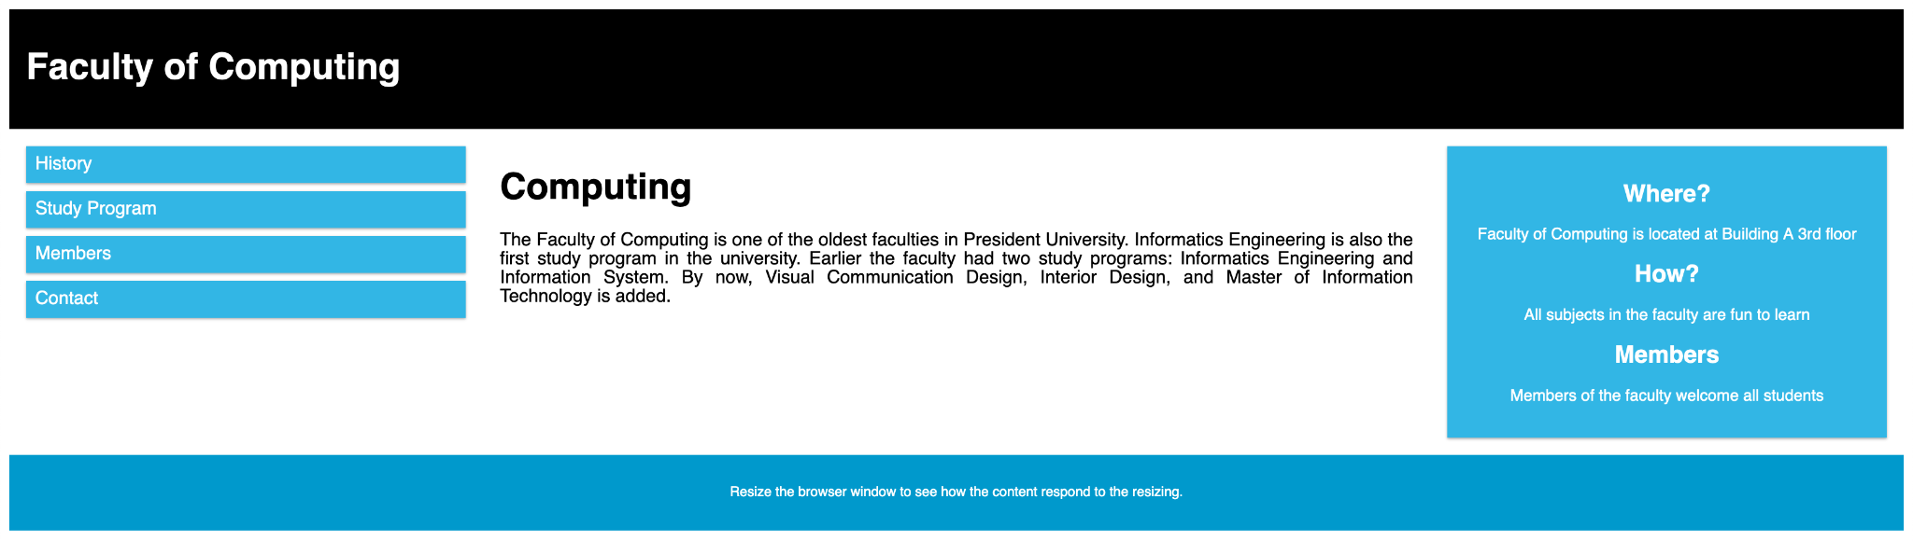
Target Desktop

Slide 29
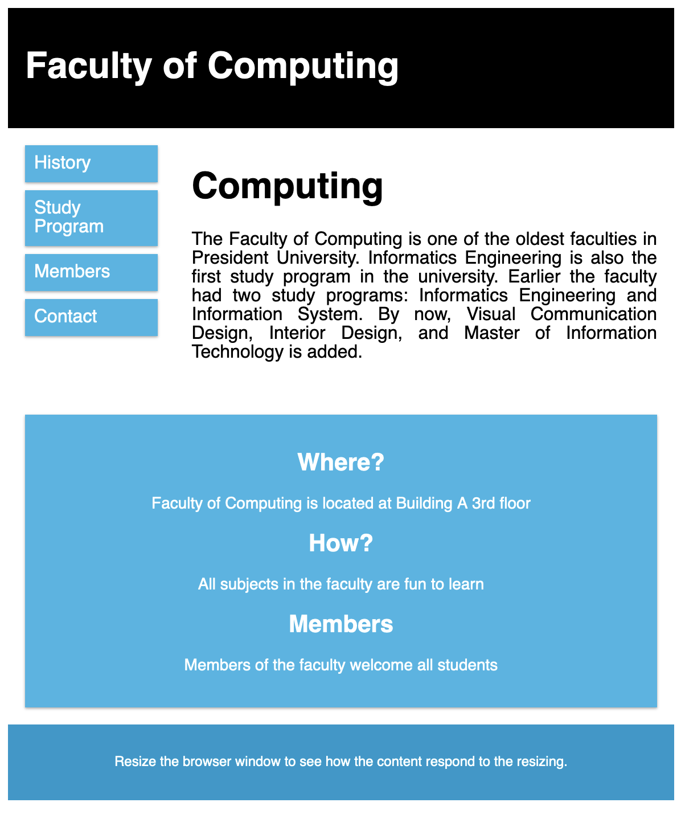
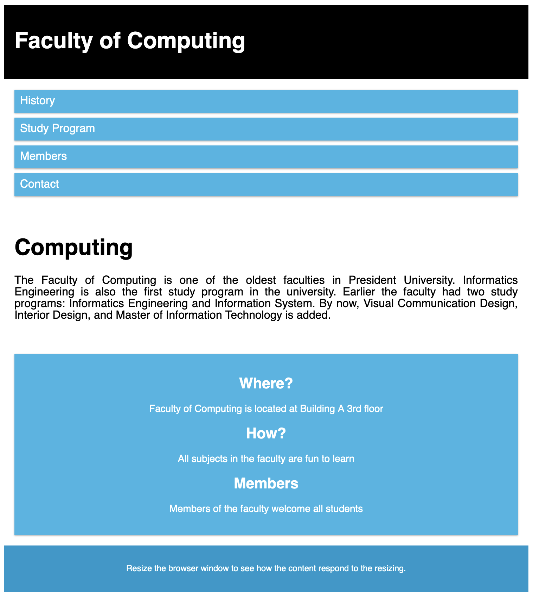
Target Tablet and Mobile

Slide 30
File: style.css
* {
box-sizing: border-box;
}
.row::after {
content: "";
clear: both;
display: table;
}
/* for all classes with col- */
[class*="col-"] {
float: left;
padding: 15px;
}
html {
font-family: "Lucida Sans", sans-serif;
}

Slide 31
.main {
text-align: justify;
}
.header {
background-color: black;
color: white;
padding: 15px;
}
.menu ul {
list-style-type: none;
margin: 0;
padding: 0;
}
.menu li {
padding: 8px;
margin-bottom: 7px;
background-color: #33B5E5;
color: white;
box-shadow: 0 1px 3px rgba(0, 0, 0, 0.12), 0 1px 2px rgba(0, 0, 0, 0.24);
}

Slide 32
.menu li:hover {
background-color: #0099CC;
}
.aside {
background-color: #33B5E5;
padding: 15px;
color: white;
text-align: center;
font-size: 14px;
box-shadow: 0 1px 3px rgba(0, 0, 0, 0.12), 0 1px 2px rgba(0, 0, 0, 0.24);
}
.footer {
background-color: #0099CC;
color: white;
text-align: center;
font-size: 12px;
padding: 15px;
}

Slide 33
/* mobile first */
[class*="col-"] {
width: 100%;
}
/* for tablets */
@media only screen and (min-width: 600px) {
.col-s-1 {width: 8.33%;}
.col-s-2 {width: 16.66%;}
.col-s-3 {width: 25%;}
.col-s-4 {width: 33.33%;}
.col-s-5 {width: 41.66%;}
.col-s-6 {width: 50%;}
.col-s-7 {width: 58.33%;}
.col-s-8 {width: 66.66%;}
.col-s-9 {width: 75%;}
.col-s-10 {width: 83.33%;}
.col-s-11 {width: 91.66%;}
.col-s-12 {width: 100%;}
}

Slide 34
/* for desktops */
@media only screen and (min-width: 768px) {
.col-1 {width: 8.33%;}
.col-2 {width: 16.66%;}
.col-3 {width: 25%;}
.col-4 {width: 33.33%;}
.col-5 {width: 41.66%;}
.col-6 {width: 50%;}
.col-7 {width: 58.33%;}
.col-8 {width: 66.66%;}
.col-9 {width: 75%;}
.col-10 {width: 83.33%;}
.col-11 {width: 91.66%;}
.col-12 {width: 100%;}
}

Slide 35
File: index.html
<!DOCTYPE html>
<html lang="en">
<head>
<meta charset="UTF-8">
<meta name="viewport" content="width=device-width, initial-scale=1.0">
<title>Responsive Web Design</title>
<link href="style.css" rel="stylesheet"/>
</head>
<body>
<div class="header">
<h1>Faculty of Computing</h1>
</div>

Slide 36
<div class="row">
<div class="col-3 col-s-3 menu">
<ul>
<li>History</li>
<li>Study Program</li>
<li>Members</li>
<li>Contact</li>
</ul>
</div>
<div class="col-6 col-s-9 main">
<h1>Computing</h1>
<p>The Faculty of Computing is one of the oldest faculties in President University. Informatics Engineering is also the first study program in the university. Earlier the faculty had two study programs: Informatics Engineering and Information System. By now, Visual Communication Design, Interior Design, and Master of Information Technology is added.</p>
</div>

Slide 37
<div class="col-3 col-s-12">
<div class="aside">
<h2>Where?</h2>
<p>Faculty of Computing is located at Building A 3rd floor</p>
<h2>How?</h2>
<p>All subjects in the faculty are fun to learn</p>
<h2>Members</h2>
<p>Members of the faculty welcome all students</p>
</div>
</div>
</div>
<div class="footer">
<p>Resize the browser window to see how the content respond to the resizing.</p>
</div>
</body>
</html>

Slide 38
Now try resizing the page
The result will vary depending on the screen pixels
This is not limited to only three devices, design on your needs

Slide 39
Real-World CSS
Bootstrap https://getbootstrap.com/
Uno CSS https://unocss.dev/
Tailwind CSS https://tailwindcss.com/
Pico CSS https://picocss.com/
SASS https://sass-lang.com/
LESS https://lesscss.org/
W3CSS https://www.w3schools.com/w3css/w3css_intro.asp
etc

Slide 40
References
https://www.w3schools.com/css/css_rwd_intro.asp

