Slide 1


Slide 2
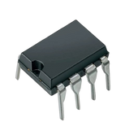
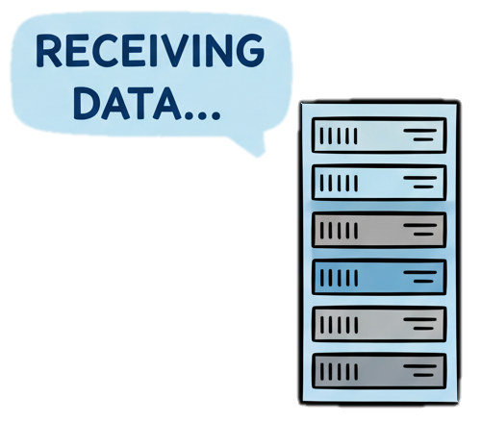


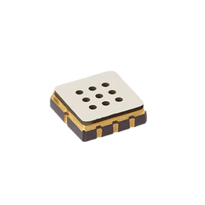
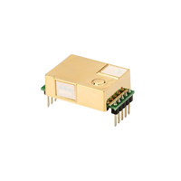




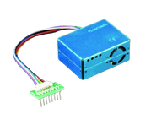
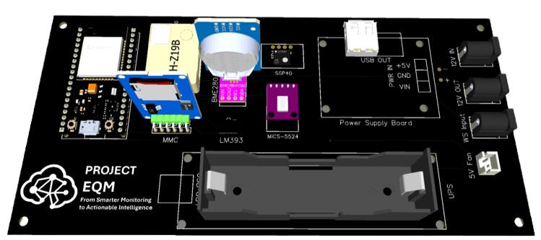



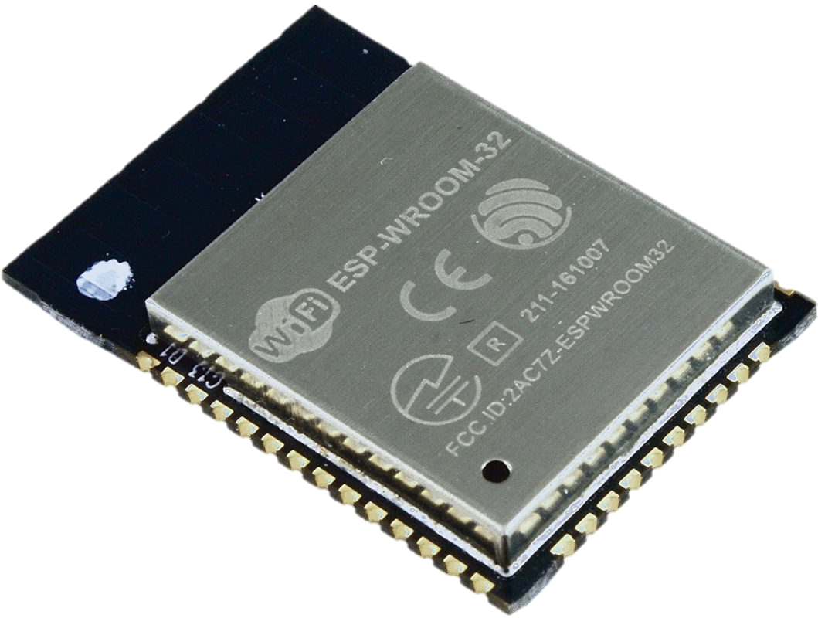
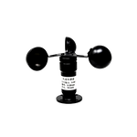

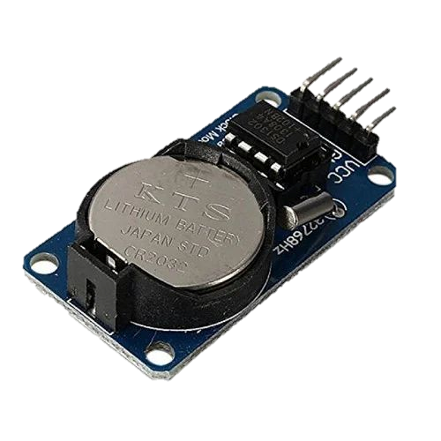
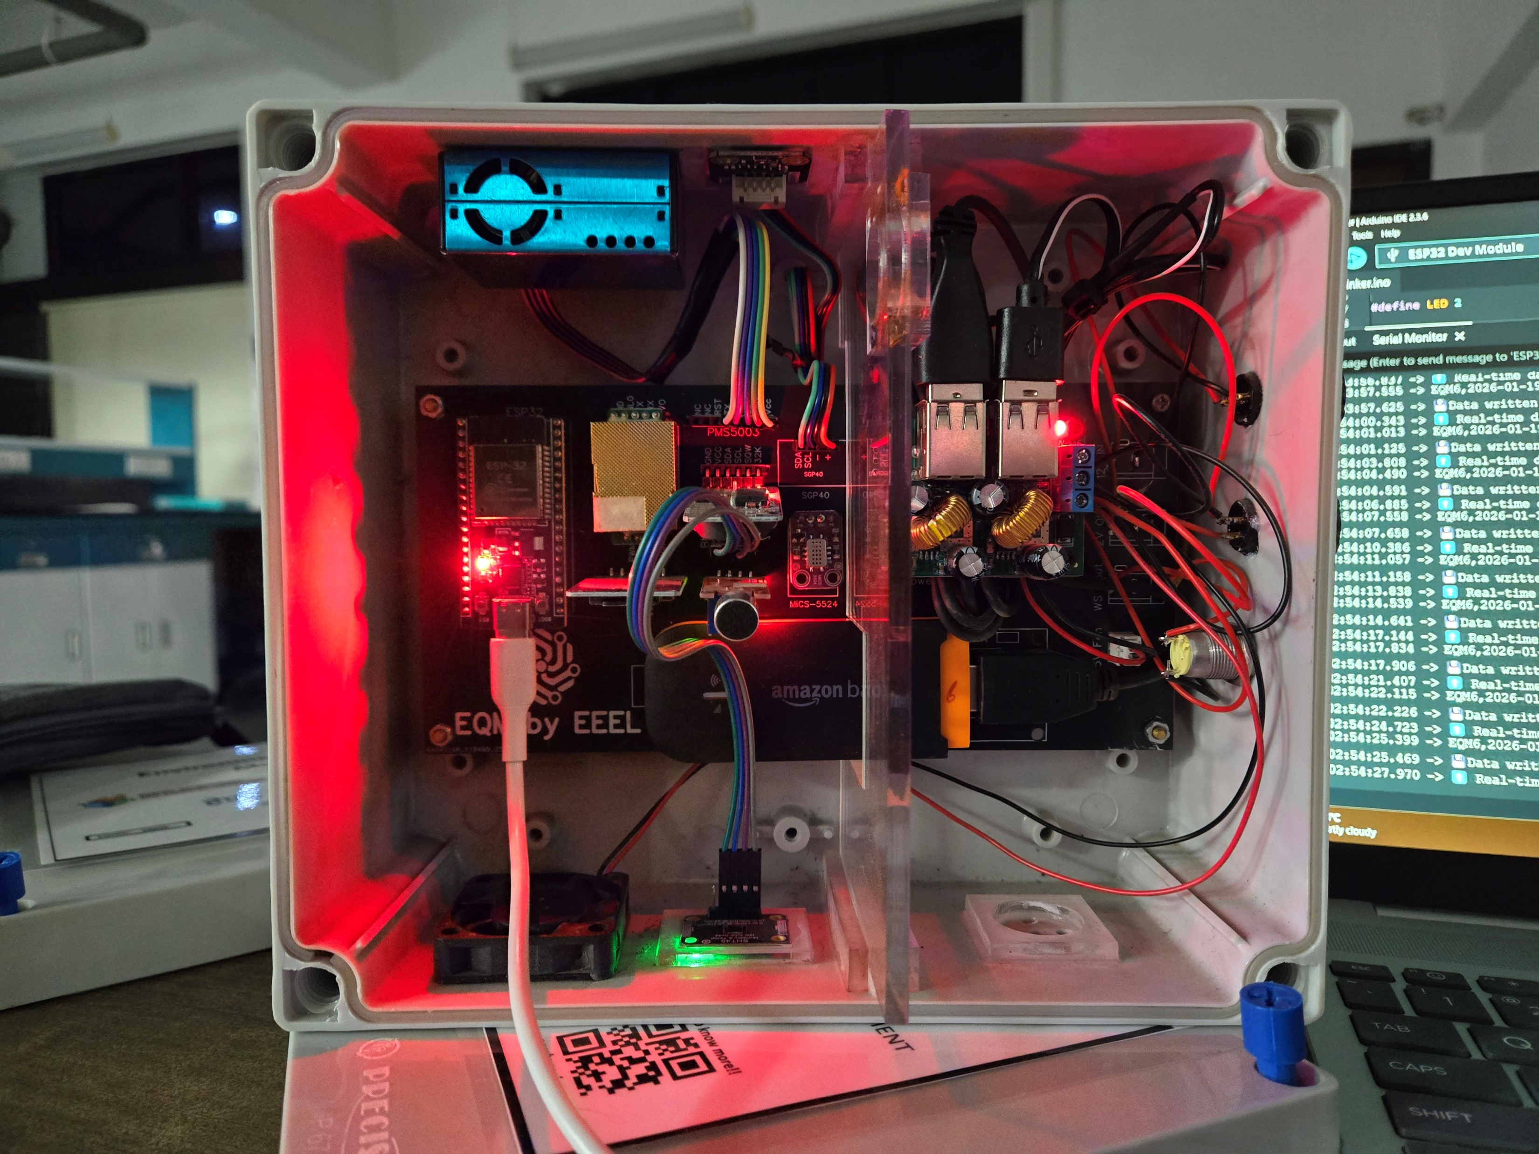
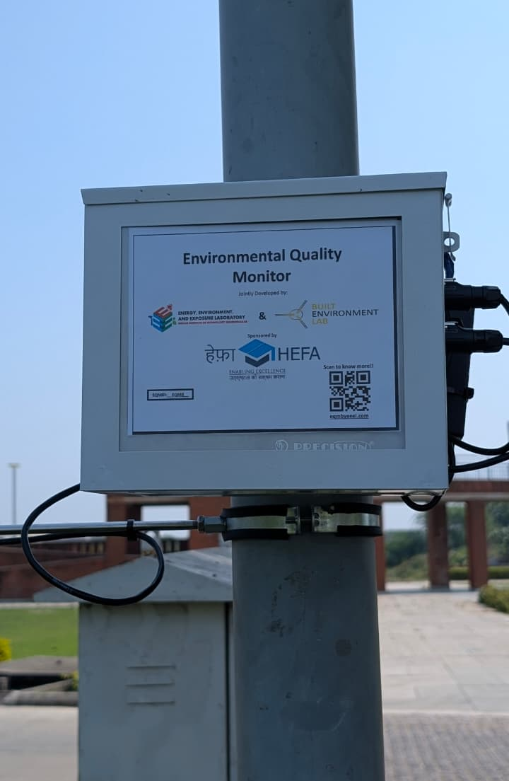
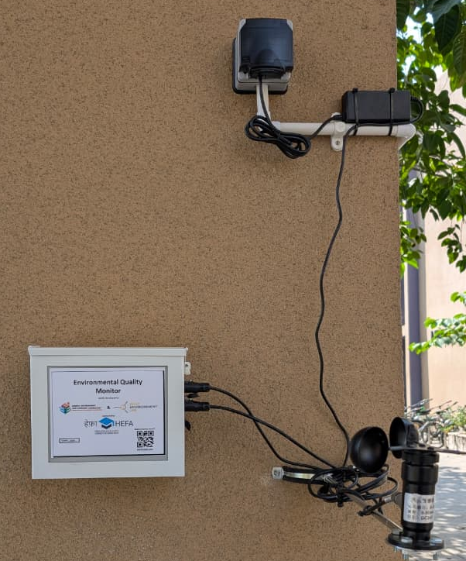
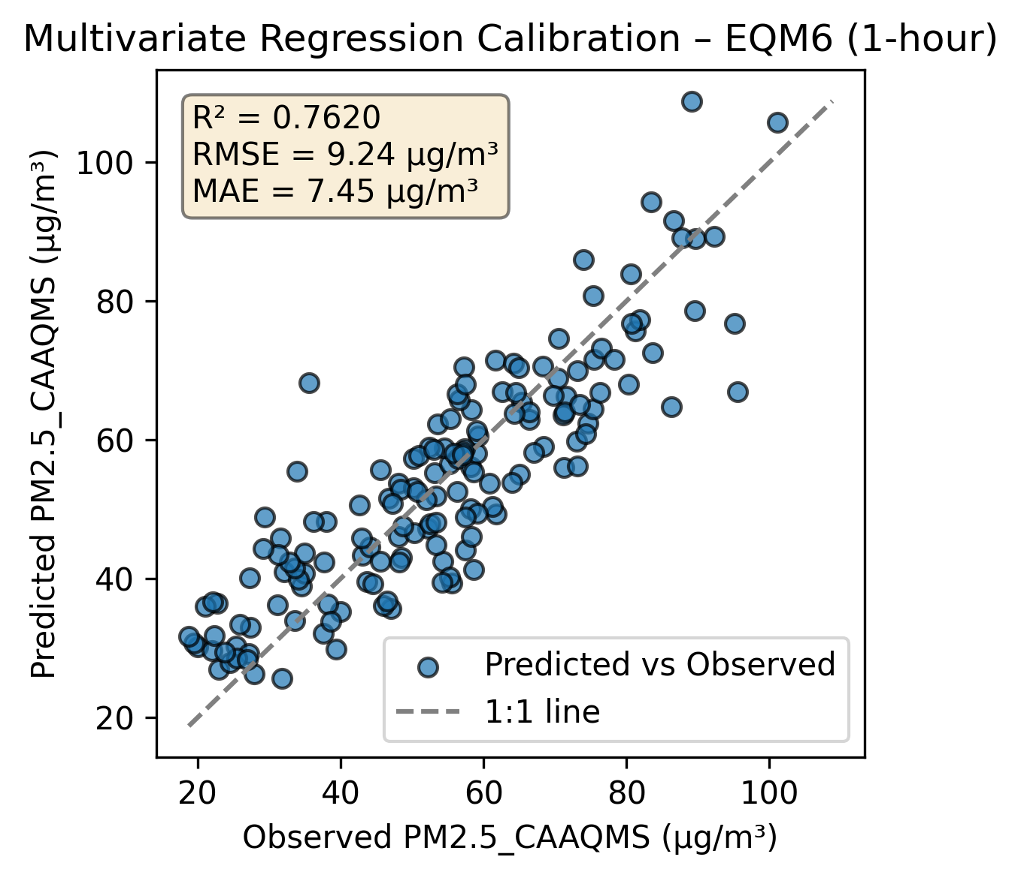
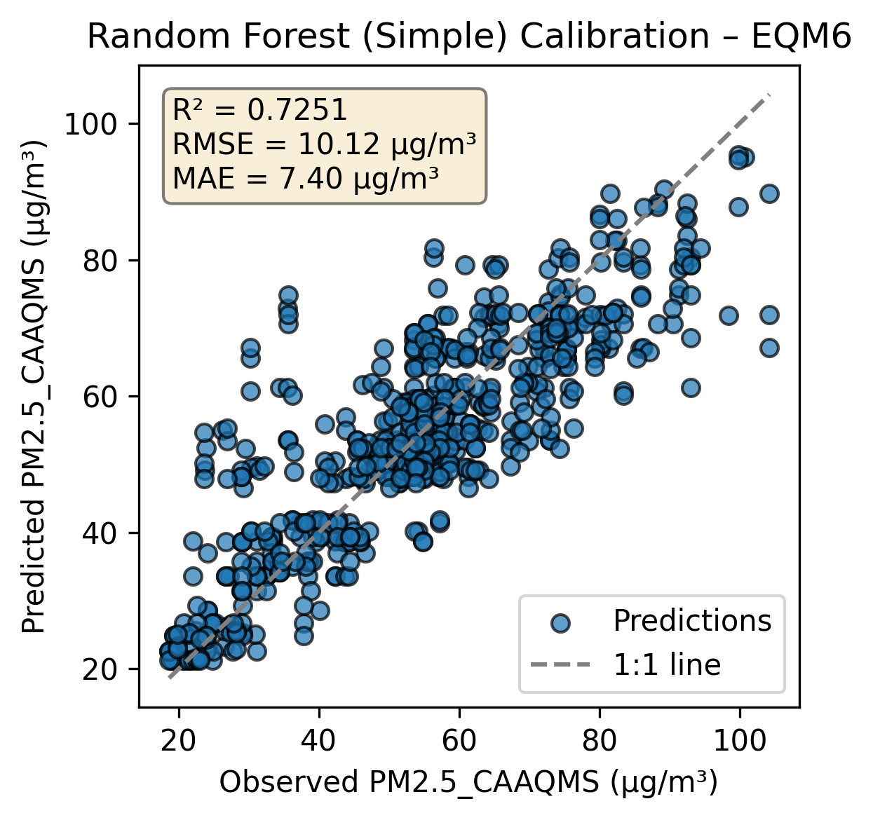
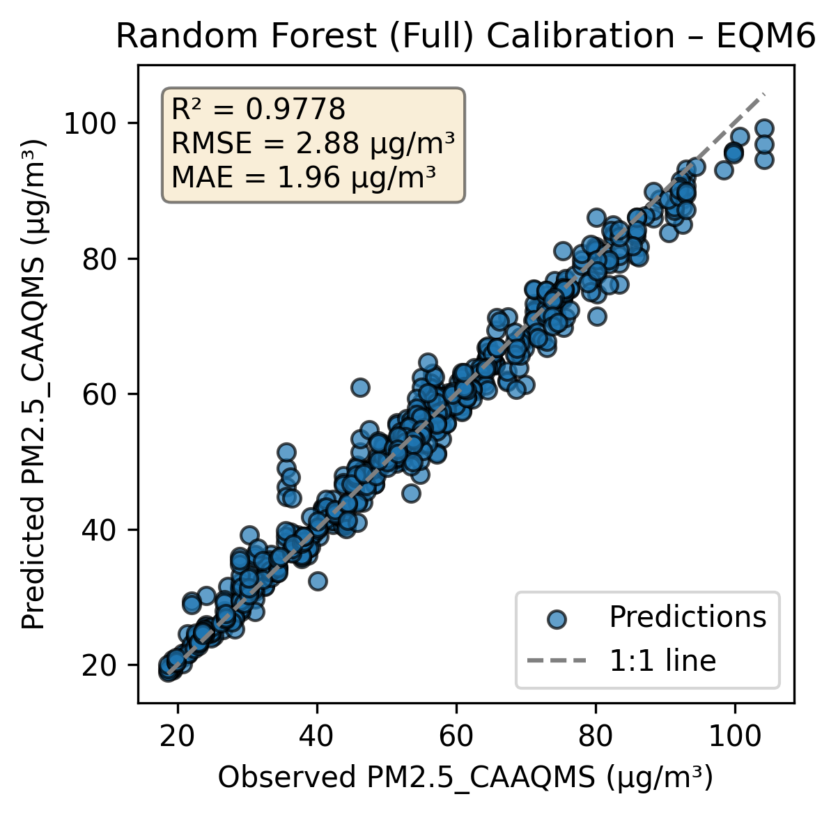
Development and Deployment of an Integrated Low-Cost Environmental Quality Monitor
Different Components of EQM
Network Architecture
CO
CO₂
Server
Noise
T, P, RH
PM
TVOC
EQM unit deployed in the field
QA/QC
Interactive Dashboard
Processor
Anemometer
SD
RTC
Calibration with Ref . Grade Instruments

Slide 3




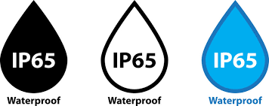





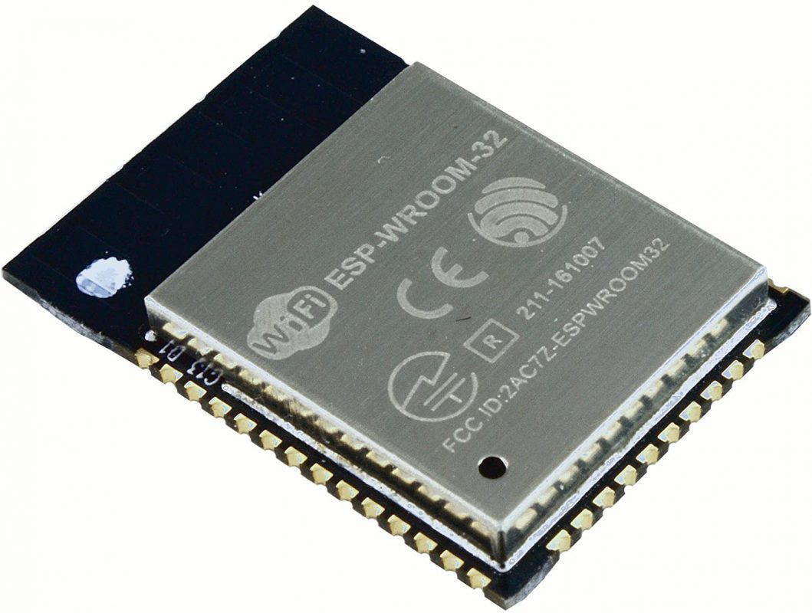


Robustness of the Device
Correlation validated between exposed and enclosed sensors (custom IP65 housing).
Optimized air channel and negative pressure for accurate sampling.
Balanced air-exchange rate for reliable readings.
Outlet
Inlet
Geometry of Device
Sensors: Multiple types tested; final selection based on stability and accuracy
Microcontroller: ESP32 (dual cores), 38 GPIO, strong processing
Power Components: Buck converter and adapters
Edge Storage
Sequential Database
Sync Feature
Hourly Backup
Fail-Safe Mechanism: Ensures data security and integrity
Hardware
Data Handling
Notes:
Choice of Hardware
Sensors: Multiple sensor types were tested; final selection based on best stability and accuracy.
Microcontroller: ESP32 chosen for sufficient GPIO pins, dual cores, strong processing power, and proven long-term reliability.
Power Components: Buck converter, UPS units, and power adapters selected based on overall system power requirements for stable operation.
Data Handling
Real-time data transmission to the server and local edge storage for redundancy.
Offline reliability: If the internet fails, unsent data is stored locally and automatically synced when connectivity returns.
Database reliability: Data stored in MongoDB (NoSQL) using flexible BSON format; hourly backups ensure data safety.
Device monitoring: Continuous network status check (online/offline monitoring).
Geometry of Device
Validated correlation between exposed and enclosed sensors using custom IP65 housing.
Proper air channel design and negative air pressure ensure accurate sampling and minimal particle loss.
Air exchange rate optimised for reliable readings and minimal pressure loss.
Colocation and Calibration
A standardised lab procedure developed for consistent calibration across all EQM units.
Ensures uniform sensor response and accuracy across the network.
A robust, self-reliable system with dependable hardware, fault-tolerant data management, and validated sensing performance.

Slide 4
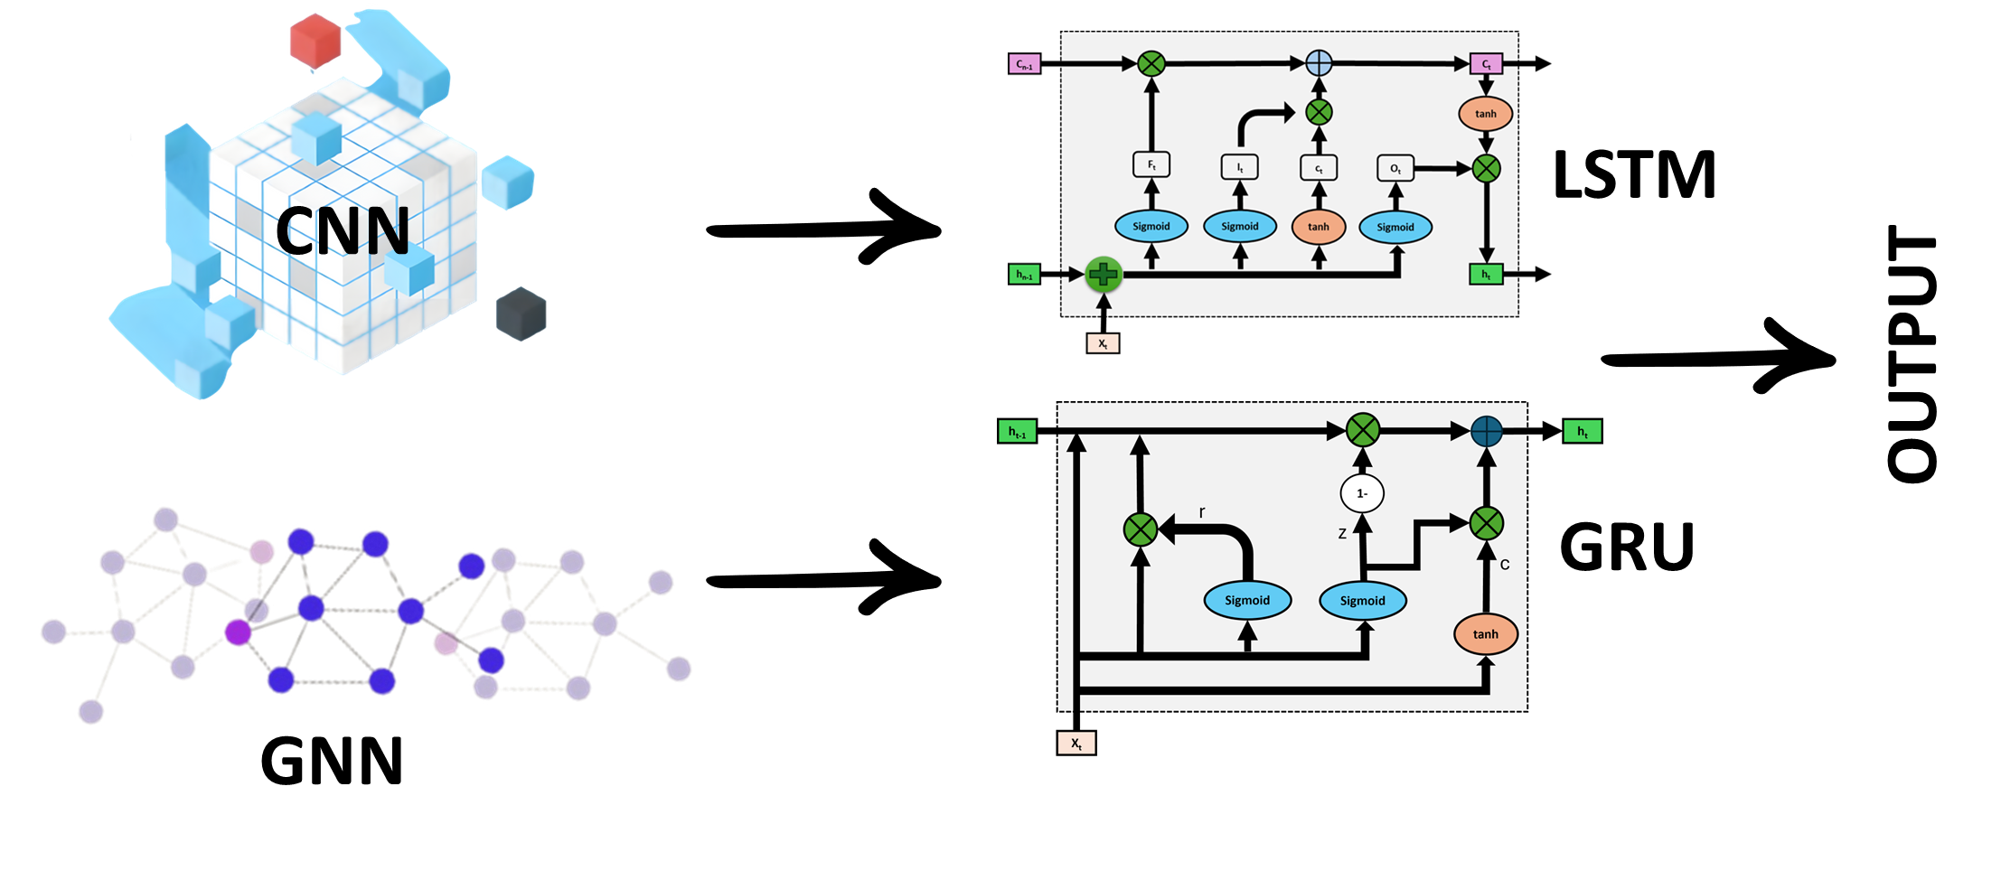
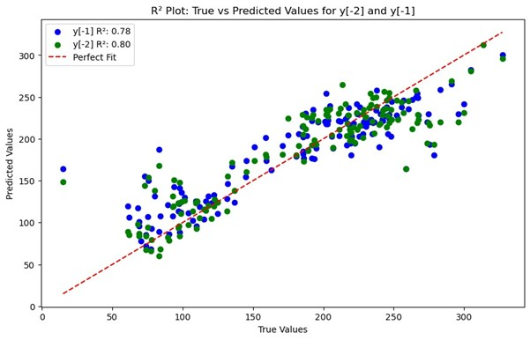
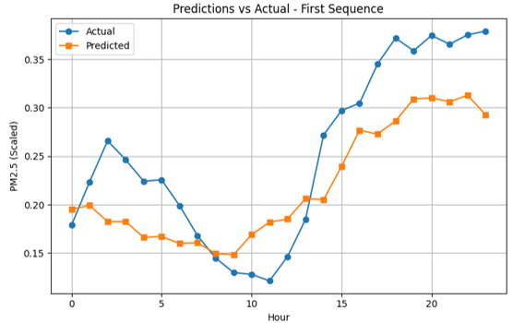
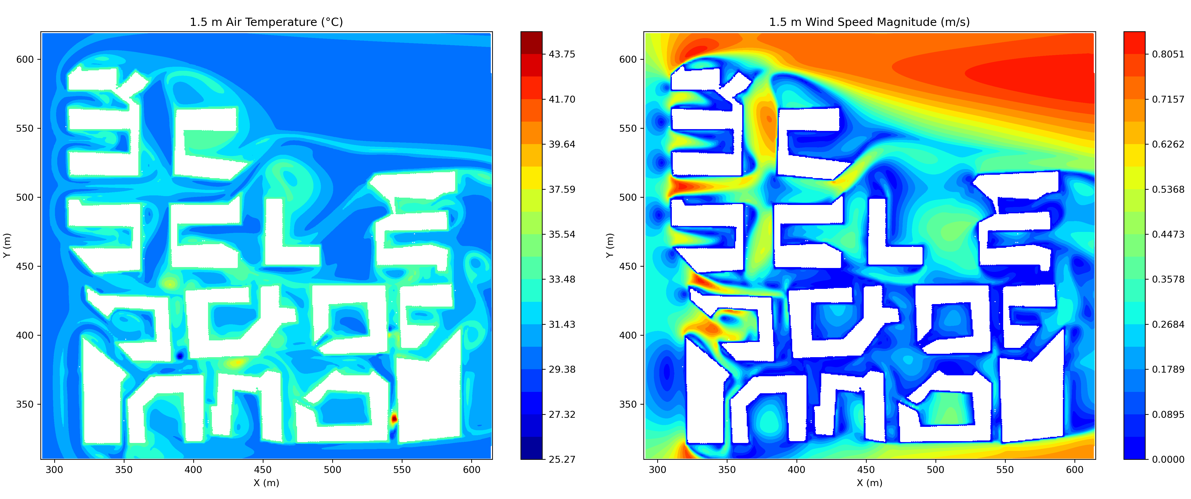
Turning Data into Insights
DL-based PM Forecasting
CFD-based Distribution

Slide 5
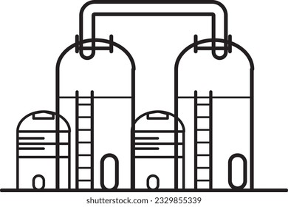
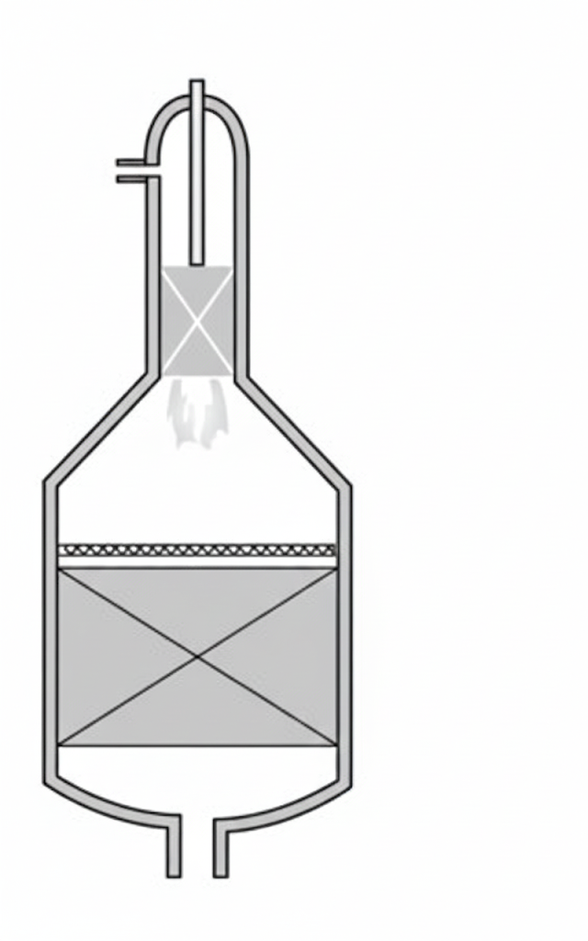


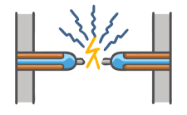
Hydrogen Production Pathways
Technology | Steam methane reformer | Auto thermal reformer | Electrolysis | Biomass gasification | Plasma pyrolysis
Feedstock | Natural gas | Natural gas | Water + RE | Biomass | Organic MSW / Biomass etc.
Key energy inputs | NG + steam | NG + steam | 47- 66 kWh/kg H₂ | Biomass + O₂/steam | Thermal plasma (1-2 kWh/kg waste)
Net emissions (kg CO₂e/kg H₂) | 10-12 | 2-6 | 0-2 | -5 to 0 | -1 to 2
Cost (USD/kg H₂) | 1-2 | 2-3 | 4-6 | 3-6 | 2.5-5.0
Key advantages | Cheapest, mature | Uses existing infra | Zero Scope-1 emissions | Carbon -ve | Waste disposal + H₂ + Carbon -ve potential
NG: Natural Gas, RE: Renewable Electricity

Slide 6
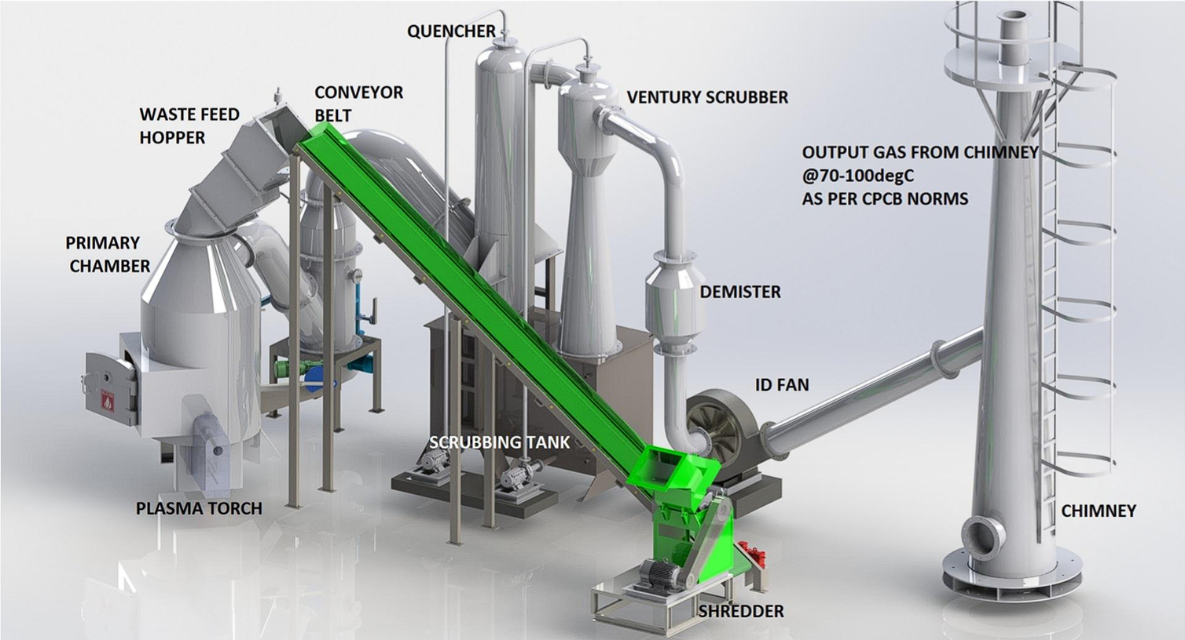
Plasma Pyrolysis from Waste to Hydrogen
Plasma pyrolysis achieves high-efficiency waste-to-syngas conversion (~80-85%) via ultra-high-temperature molecular dissociation.
Plasma arcs ~3,000 °C enable rapid dissociation, ~10× shorter residence times, and tar-free syngas.
Oxygen-deficient, high-temperature conditions ensure effective destruction of dioxins and furans.
Plasma Pyrolysis Process for Waste Treatment
The technology has been approved by the Central Pollution Control Board (CPCB) and the Ministry of Environment, Forest and Climate Change of India (MoEF & CC), and has been included in the Gazette of India on 28th March 2016.

Slide 7
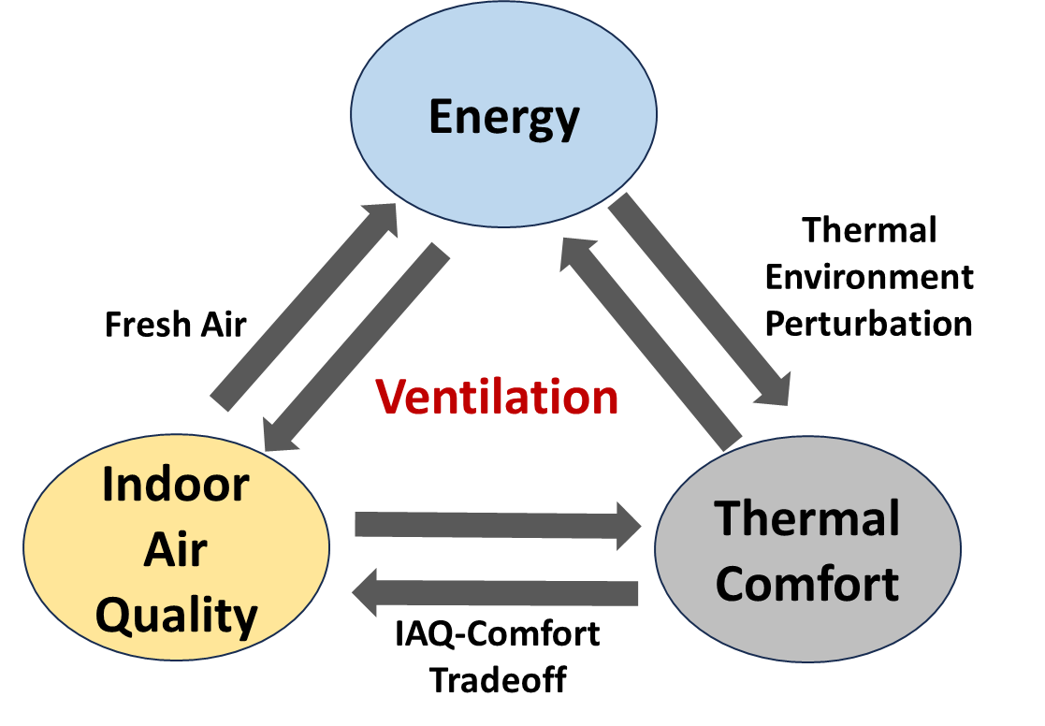
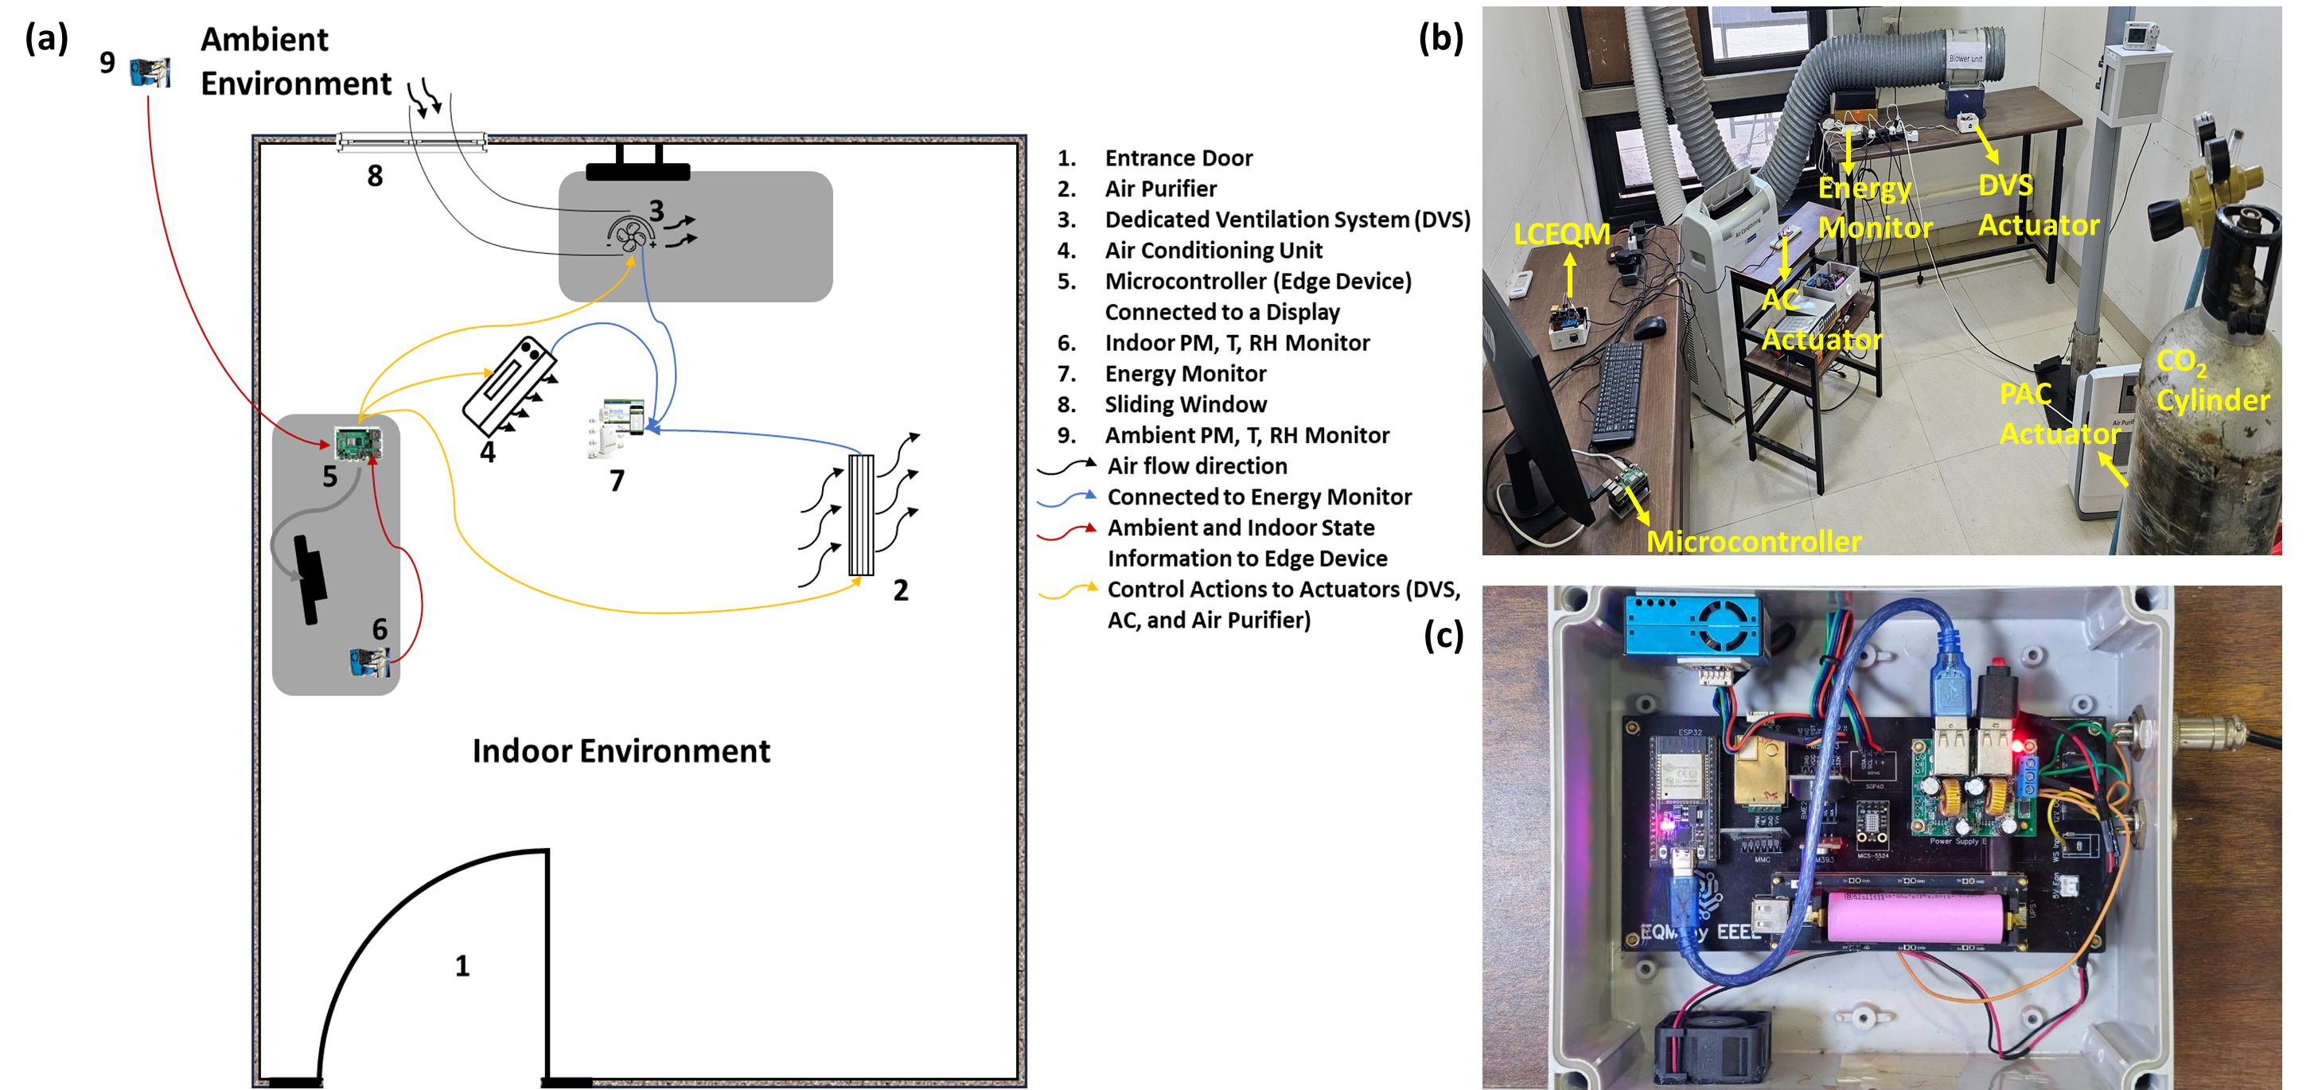
Intelligent Embedded System To Manage Indoor Environment and Energy Consumption

Slide 8
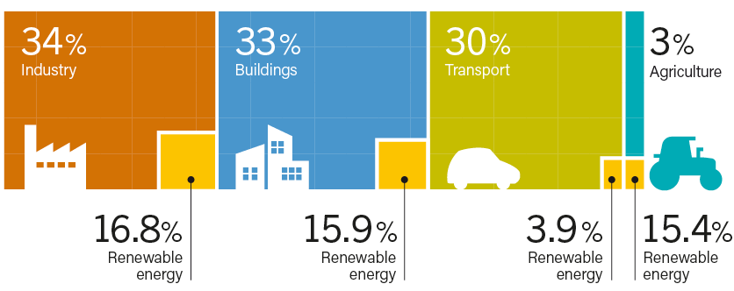
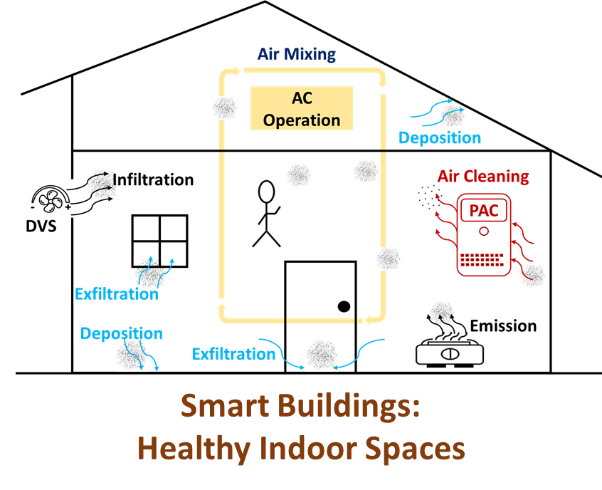

An Energy Efficient Indoor Environment Management System for Sustainable and Healthy Buildings
Background and Motivation
Real-world Deployment
Performance Evaluation
Complex interdependence of pollutant levels, energy use, and thermal comfort.
Traditional optimization algorithms constrained by modeling, computational, and learning challenges.
Source: REN Global Status Report, 2024
Agent based control achieved an average reduction of 62 ± 2 % in peak PM concentration.
Energy consumption decreased from 4.39 ± 0.27 kWh to 1.75 ± 0.31 kWh, corresponding to a reduction of ~60 ± 8%.
References
Mishra NK, Batra N., and Patel S. Optimizing Pollutant Exposure, Energy Consumption, and Thermal Comfort in a House via Deep Reinforcement Learning Control. Journal of Building Engineering 2025:114074.
https://doi.org/10.1016/J.JOBE.2025.114074
Scan to Know More

