Slide 1
Recipe Generator Web App
A MERN Stack Project
Presented by: Prince Kumar
Department of Computer Science & Engineering

Slide 2
Introduction
Recipe Generator Web App developed using MERN Stack.
Core feature: Suggest recipes based on available ingredients.
Integrates external API (Spoonacular) for recipe data.
Provides users with interactive and smart cooking solutions.
Focuses on user-friendly interface and seamless navigation.
Backend ensures secure handling of authentication and API keys.

Slide 3
Objectives
Provide an interactive and time-saving cooking assistant.
Suggest recipes dynamically based on entered ingredients.
Utilize MERN stack for full-stack web application development.
Implement secure backend with JWT authentication.
Deliver responsive, cross-platform user experience.
Enable recipe saving and grocery list generation for convenience.
Support dietary preferences and filter options in recipe search.

Slide 4
Scope of the Work
Defines boundaries of features in the first release.
Covers recipe search, recipe saving, and grocery list management.
Excludes advanced AI recommendations in current version.
Supports only web-based platform (mobile app planned for future).
Focuses on security and responsive design.
Provides room for scalability in later versions.

Slide 5
Technologies Used
Frontend: React.js for interactive UI.
Backend: Node.js with Express.js for REST APIs.
Database: MongoDB (NoSQL) for storing user and recipe data.
Authentication: JWT tokens for secure login and session management.
External API: Spoonacular API for recipe suggestions.
Version Control: Git & GitHub for code management.
Deployment: Can be hosted on platforms like Vercel, Heroku, or AWS.

Slide 6
System Architecture
MERN stack-based client-server architecture.
Frontend communicates with backend via REST APIs.
Backend acts as a secure middleware between frontend and Spoonacular API.
Database stores user details, saved recipes, and grocery lists.
Authentication handled by JWT for secure access.
Ensures modular and scalable design for future upgrades.

Slide 7
Key Features
Ingredient-based recipe search.
Display recipe details: steps, cooking time, nutrition, servings.
Save favorite recipes for easy access later.
Auto-generate grocery list from chosen recipes.
Dark mode for user-friendly interface.
Responsive design for desktop, tablet, and mobile devices.
Seamless and secure API integration.

Slide 8
Future Enhancements
AI-driven personalized recipe recommendations.
Multi-language UI and instructions for global accessibility.
Nutritional tracking with Google Fit/Apple Health integration.
User community: sharing recipes, comments, ratings.
Integration with smart kitchen devices (IoT).
Meal planning and calendar-based recipe scheduling.
Voice command integration for hands-free usage.

Slide 9
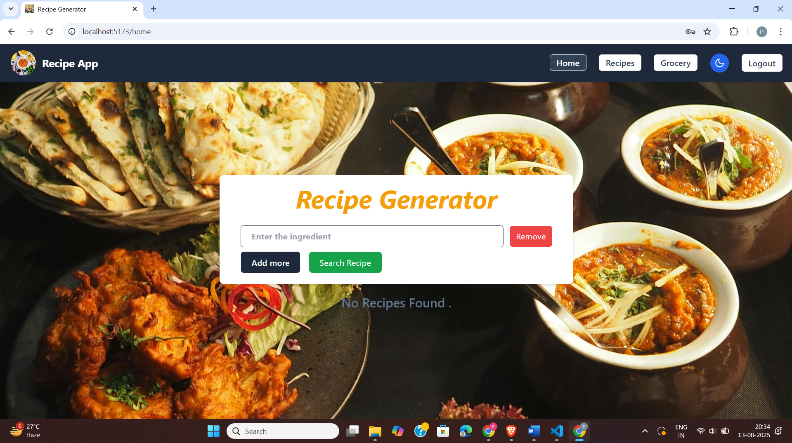
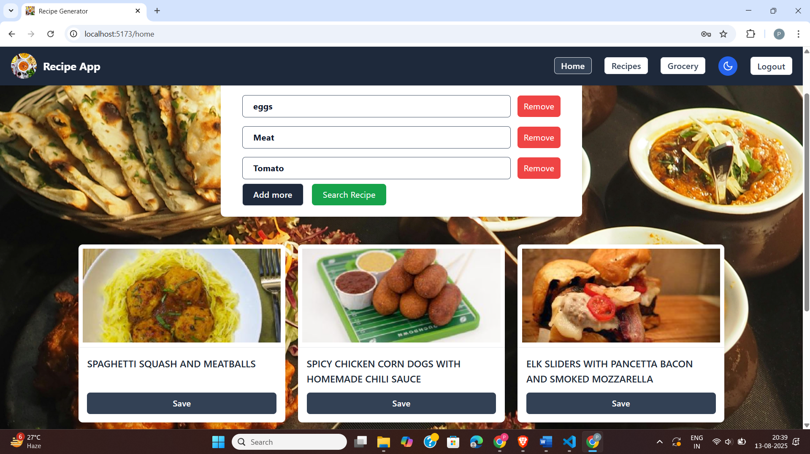
Screenshots
Home Page with navigation options. Recipe Search Page with results.

Slide 10
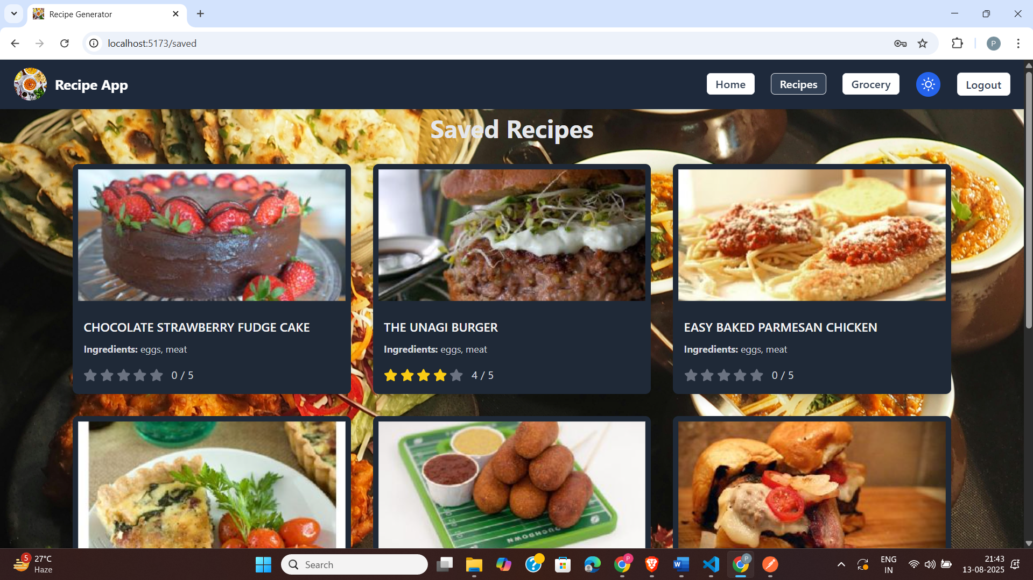
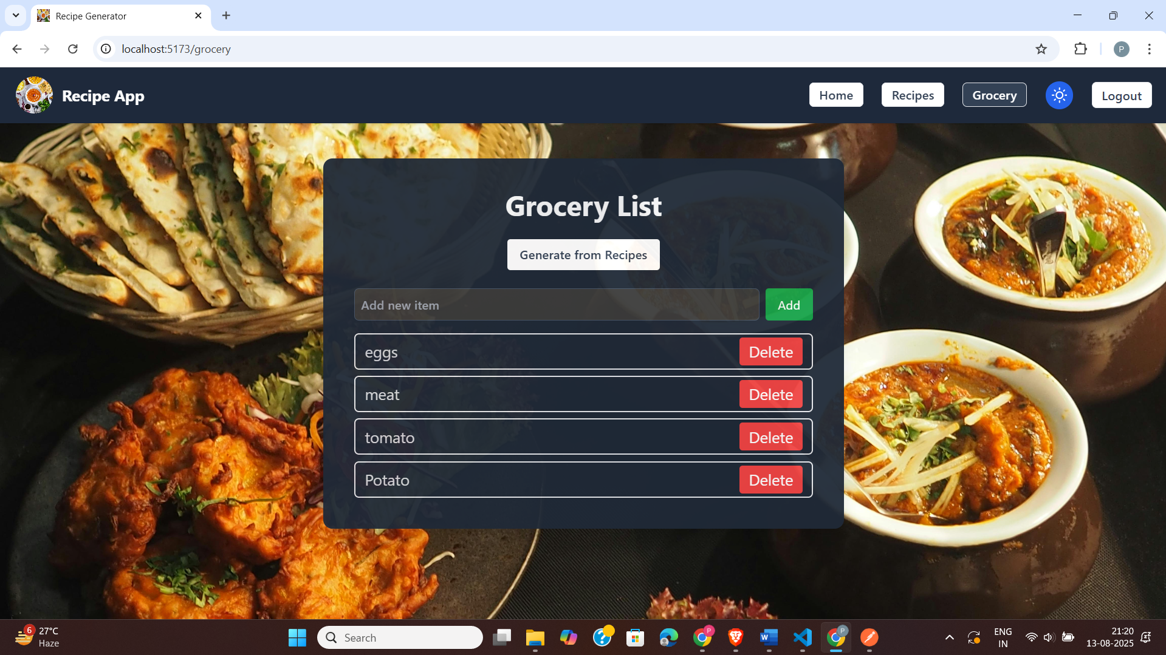
Screenshots
Saved Recipes Page. Grocery List Page with editable items.

Slide 11
Conclusion
The Recipe Generator Web App combines cooking and technology.
Provides users with smart meal suggestions based on ingredients.
Implements full-stack MERN development with secure backend.
Focuses on usability, scalability, and performance.
Future-ready for AI, IoT, and health integration.
Demonstrates practical application of MERN stack and API usage.

