Slide 1
Student Housing and Roommate Finder Database
Database Project for Housing Solutions in Kigali
PRESENTED BY: NZIZA Prince 26651

Slide 2
Introduction
Rising student population in Kigali poses housing challenges.
Difficulties in affordability, location, and compatibility.
No centralized housing platform available.
Our solution: A database-driven housing and roommate platform.

Slide 3
Problem Statement
Students face:
- Housing shortages
- Inadequate roommate matching
- Scattered listings and inefficient search
Landlords face:
- Difficulty reaching student renters
- Lack of tools for communication and transparency

Slide 4
Objectives
Provide an easy-to-use interface for students and landlords by Develop a system to manage:
- Users
- Properties
- Listings
- Roommate profiles
Develop advanced search filters for preferences.
Enable direct communication between users.
Incorporate a rating and review system.
Partner with landlords for student discounts.

Slide 5
Methodology & Approach
Tools used: PL/SQL, ER modeling.
Steps:
Defined entities and relationships.
Created relational tables with keys and constraints.
Structured database for scalability and integrity.
Key Database Tables
Users: Students and Landlords.
Properties: Rentals posted by landlords.
Roommates: Student preferences.
Listings: Connections between students and properties.
Reviews: Ratings and feedback.

Slide 6
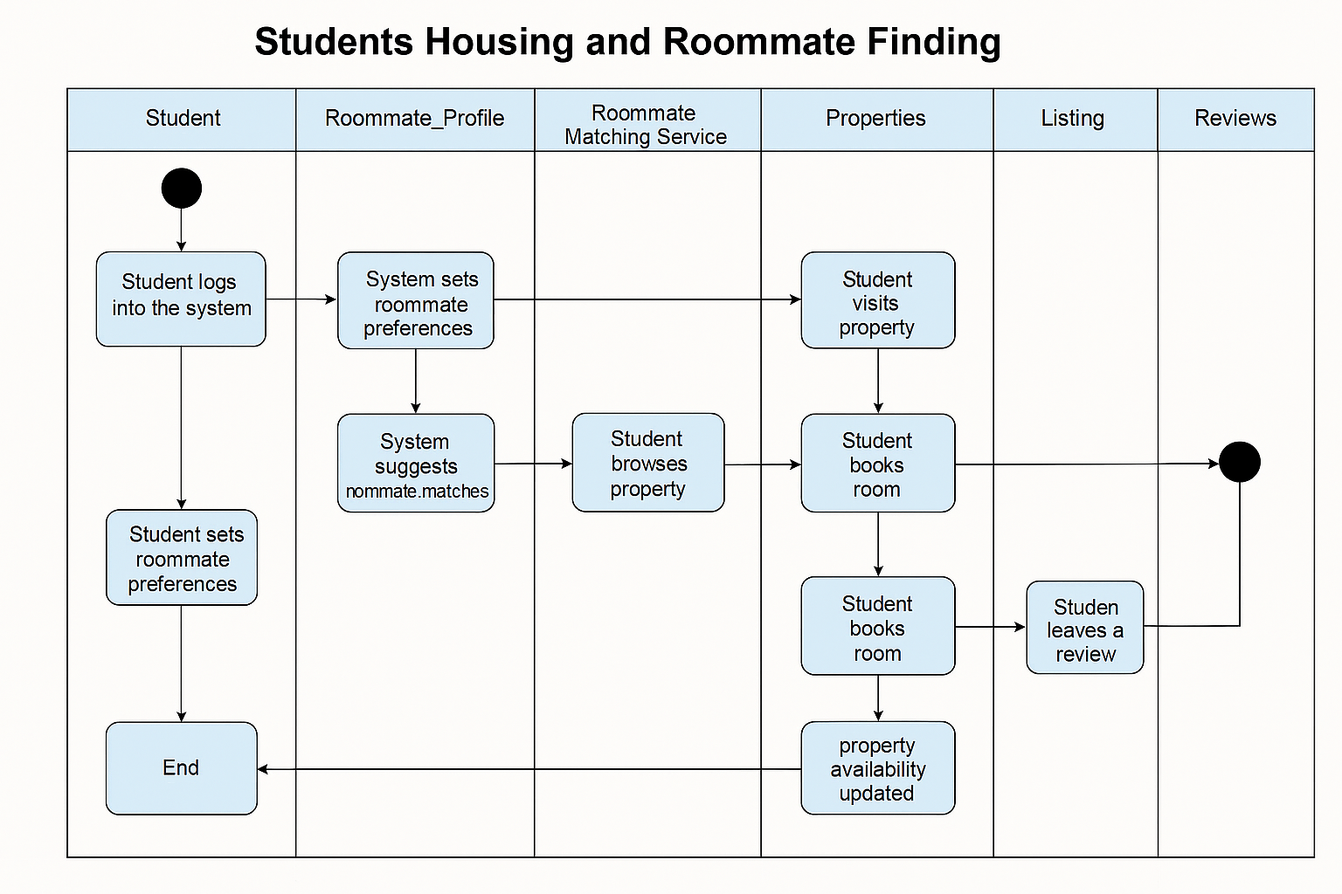
UML DIAGRAM

Slide 7
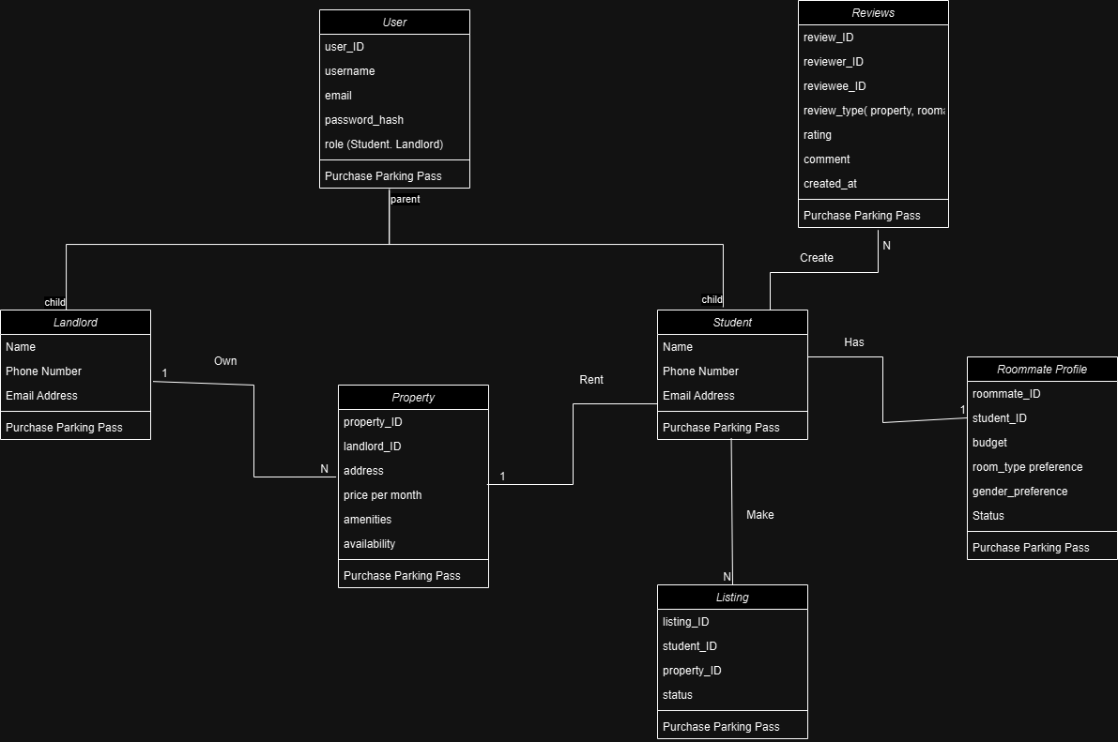
System Design
Entity-Relationship Diagram (ERD):

Slide 8
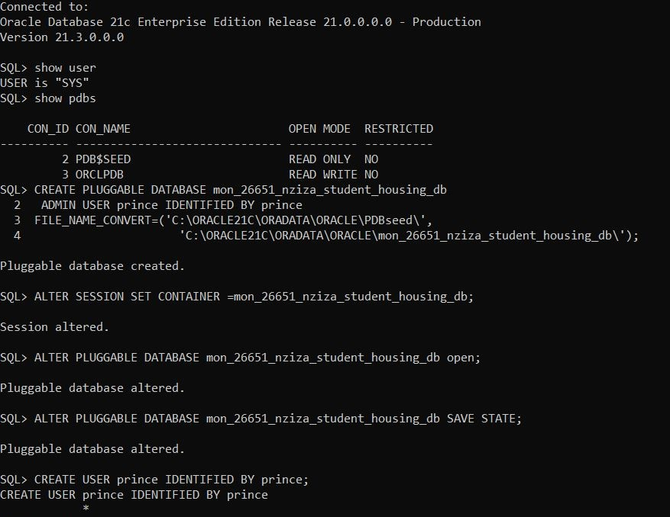
Creating the PDB

Slide 9
Conclusion, Recommendations & Future Work
Conclusion:
- Addresses key student housing challenges.
- Encourages transparency and trust.
Recommendations & Future Work:
- Expand to other urban centers.
- Integrate mobile functionality.
- Include payment gateway for rental transactions.

Slide 10
References & Acknowledgments
Oracle Database 21c PL/SQL User’s Guide and Reference: Oracle Docs
Oracle SQL Language Reference: SQL Reference
Oracle Audit Trail Concepts: Oracle Security Guide
Draw.io BPMN Standards: Draw.io
AUCA Capstone Project Guidelines 2025

