Slide 1


HACKATHON ‘21

Slide 2
PROBLEM STATEMENT
The traditional learning system had several issues when the covid pandemic started, I noticed a drastic shift of people opting for e-learning as opposed to traditional learning avenues which made online learning more of a necessity rather than an option. Now that the concept of traditional education has changed radically within the last couple of years. Being physically present in a classroom isn’t the only learning option anymore.
PROBLEMS WITH TRADITIONAL LEARNING
An Outdated System: Traditional learning systems might have updated course material over the years.
Lack of Individual Attention: A lack of individual attention combined with an outdated system results in the education system failing students who require more attention to understand concepts that others might comprehend easily.
Lack of Skill-based Education: Schools, colleges, and universities are fearful of drastic changes to how they approach their syllabus.

Slide 3
CONCEPT
Academy is an e-learning platform with interactive checkpoints, lessons and videos with certificates generated after each course which helps users to learn a variety of courses and concepts and practice them an prove their education.
Benefits of using Academy
More Comfortable Learning Environment: Academy enables the teacher and the student to set their own learning pace and make schedules that fits everyone’s agenda.
Can offer a wide selection of courses: Easy way to add infinite skills and subjects to teach and learn.
Automated Certification: Studying your program online is also a great option for getting an official certificate, diploma, or degree without physically setting foot on a university campus.
It’s accessible on web and on the go: Academy enables you to study or teach from anywhere in the world. This means there’s no need to commute from one place to another, or follow a rigid schedule.
It’s more cost-effective than traditional education.
Unlike in-person education methods, Academy tends to be more affordable. You can also save money from the commute and class materials. In other words, the monetary investment is less, but the results can be better than other options.

Slide 4
HOW THE SOLUTION WORKS
1. Required technology skills
Academy does require that users be able to read English proficiently. The following additional technology skills are required to use the Academy:
Ability to select items on the screen
Basic typing
Drag-and-drop items on the screen
2. Setting up an account
To set up an account, users need to provide the following information:
Email
Name
Password- read more about creating secure passwords here
3. Start learning a preferred course and earn a certificate
Click on Start learning
Select your preferred course
Interact with checkpoints, lessons and videos
Earn your certificate

Slide 5
TECHNOLOGY APPLIED
Academy started it’s course with awesome technologies listed below:
ASP.NET Core is supports creating RESTful services, also known as web APIs, using C#. To handle requests, a web API uses controllers. Controllers in a web API are classes that derive from ControllerBase.
HTML, CSS, and JavaScript are web technologies by which computers communicate with each other using markup languages and multimedia packages.
React (also known as React.js or ReactJS) is a free and open-source front-end JavaScript library for building user interfaces or UI components.
Entity Framework is a modern object-database mapper for .NET with works with many databases, including SQL Database. It supports LINQ queries, change tracking, updates, and schema migrations.
REST API is a representational state transfer application programming interface (API or web API) that conforms to the constraints of REST architectural style and allows for interaction with RESTful web services.
VS / VSCode is an integrated development environment (IDE) from Microsoft. It is used to develop computer programs, as well as websites, web apps, web services and mobile apps.

Slide 6

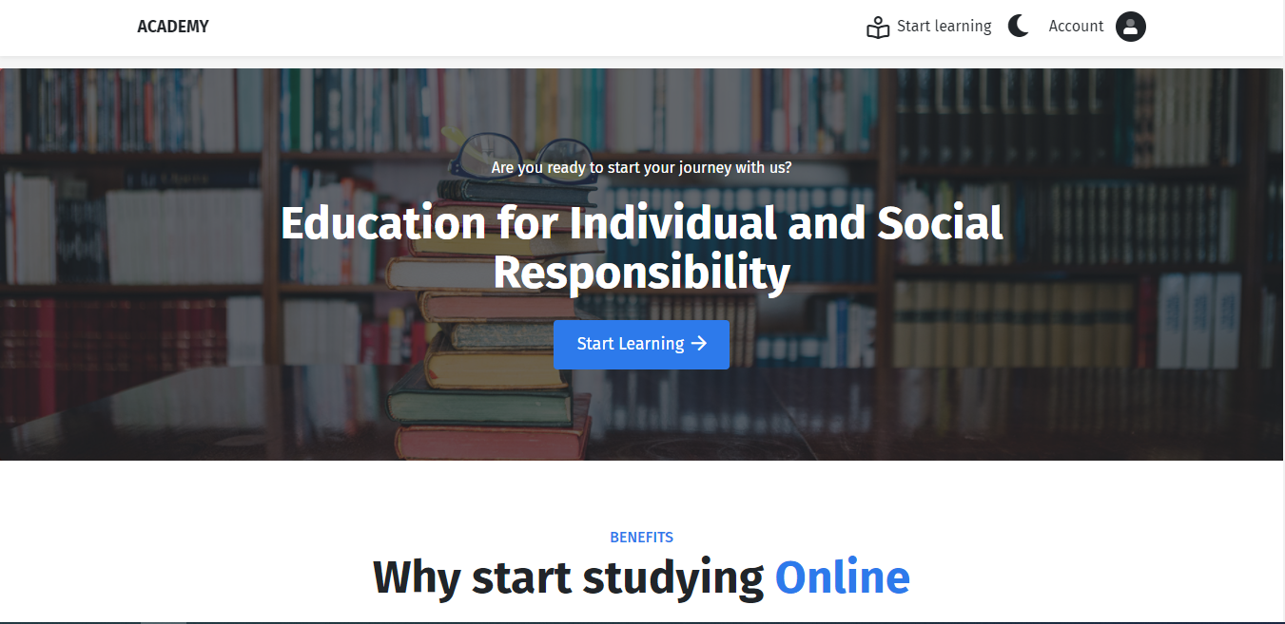
DEMO
https://academydemo.com
Admin Login:
Email: princeowusu.272@gmail.com
Password: academy@1234
Learner Login:
Email: yetrikokno@biyac.com
Password: academy@1234

Slide 7
THANK YOU
ANY QUESTIONS?

