Slide 1


Feature Extraction and Price Prediction for Mobile Phones
Project 4
Prince Kumar
Deadline: 10th March 2026

Slide 2
Project Objective
• Understand key features affecting mobile prices
• Perform feature extraction analysis
• Build machine learning model for price prediction
• Provide pricing strategy recommendations

Slide 3
Dataset Description
• Model
• Colour
• Memory
• RAM
• Battery Capacity
• Rear & Front Camera
• Processor
• AI Lens
• Price (Target Variable)

Slide 4
Data Exploration
• Checked data types and structure
• Identified numerical and categorical features
• Checked missing values
• Analyzed price distribution

Slide 5
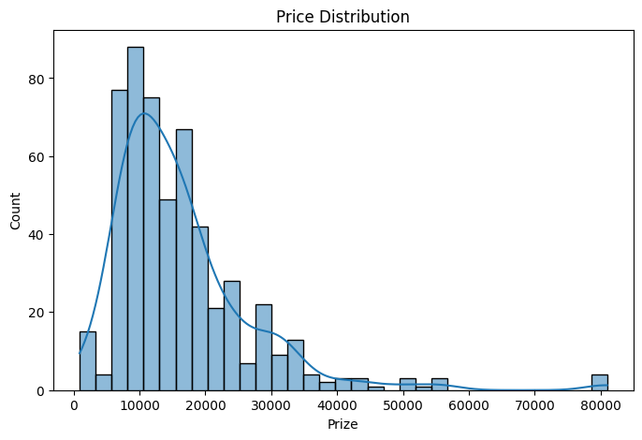
Data Exploration Graph
The right-skewed histogram will have a long tail on the right-hand side

Slide 6
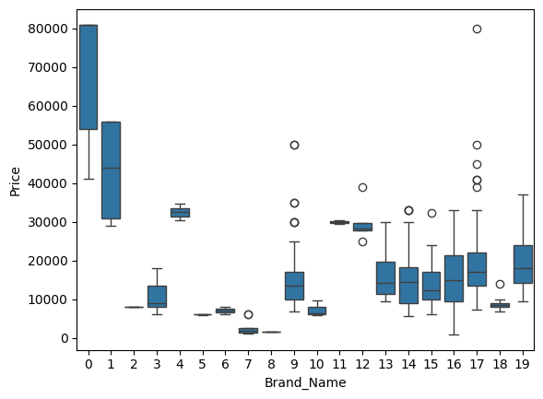
BRAND VS PRICE
Some brands tend to have higher price ranges compared to others.

Slide 7
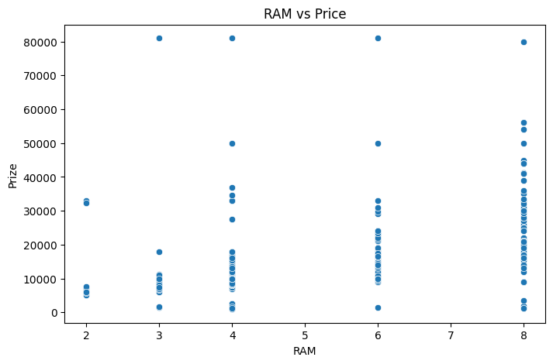
RAM VS PRICE
Phones with higher RAM generally have higher prices.

Slide 8
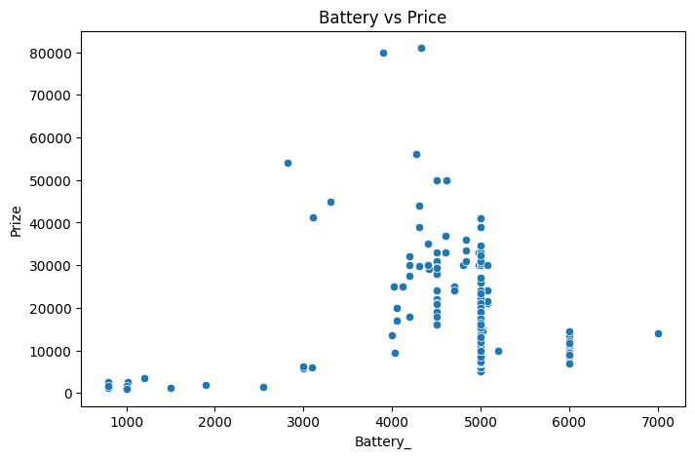
BATTREY VS PRICE
Phones with larger battery capacity often fall in higher price categories.

Slide 9

Data Preprocessing
• Handled missing values
• Removed outliers
• Converted categorical variables using One-Hot Encoding
• Prepared dataset for modeling

Slide 10
Feature Extraction Techniques
• Correlation Analysis
• Heatmap Visualization
• Random Forest Feature Importance
• Selected most influential features

Slide 11
Most Important Features
• RAM – Very High Impact
• Internal Memory – High Impact
• Processor – High Impact
• Rear Camera – Medium to High Impact
• Battery Capacity – Medium Impact
• Colour – Low Impact

Slide 12
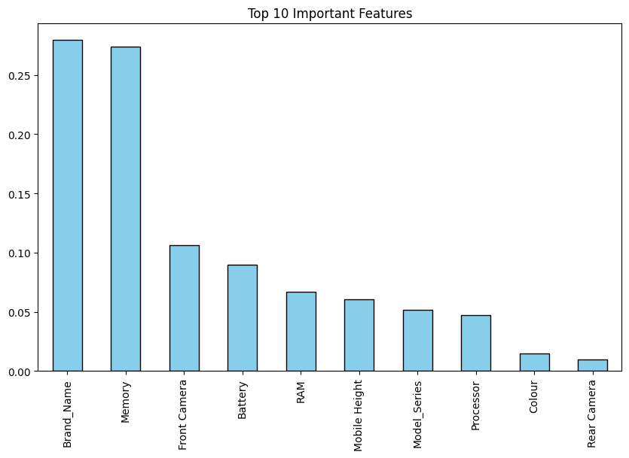
Feature Importance Graph
Yeh graph batata hai Model ke according kaunse 10 features sabse zyada price ko influence kar rahe hain
Random Forest model ka output hai

Slide 13
Model Building
• Train-Test Split (80-20)
• Linear Regression Model
• Random Forest Regressor
• Compared performance metrics

Slide 14
Model Evaluation Metrics
• Mean Absolute Error (MAE)
• Root Mean Squared Error (RMSE)
• Random Forest performed better
• Model provides accurate price predictions

Slide 15
Key Insights
• Technical specifications drive pricing
• Higher RAM & Processor increase price significantly
• Camera improvements increase premium pricing
• Cosmetic features have minimal impact

Slide 16
Business Recommendations
• Focus pricing strategy on RAM & Processor
• Promote high camera specs for premium segment
• Battery capacity as supporting feature
• Do not overprice based on colour variants

Slide 17
Conclusion
• Successfully built price prediction model
• Identified key influential features
• Random Forest model gives best results
• Insights help improve pricing strategy

Slide 18

THANK YOU

