Slide 1

Jenkins: The Automation Engine Behind CI/CD
A practical, no-fluff introduction to Jenkins for engineering students learning DevOps — covering architecture, pipelines, CI/CD concepts, and real enterprise workflows.
DEVOPS BASICS
CI/CD
OPEN SOURCE

Slide 2
The Problem → What Jenkins Actually Is
The Manual Work Problem
What Jenkins Actually Is
10 developers push code daily to GitHub. Every push needs: pull → compile → test → package → deploy — done manually.
The math: 15 min/push × 20 pushes/day = 5 hours/day wasted on repetitive, error-prone manual work. That's a full-time job just running builds.
Jenkins is an open-source automation server (written in Java) that orchestrates build, test, and deployment whenever source code changes — using a "Pipeline as Code" model, where the pipeline is a versioned file, not a UI click-through.
Jenkins is a 2011 fork of Hudson, after Oracle acquired Sun. It's the most widely used open-source CI/CD tool, and ships both a classic UI and a modern "Blue Ocean" pipeline visualizer.
🍽️ The Restaurant Analogy
📦 Pipeline as Code
📅 Born in 2011
Jenkins is the restaurant manager. An order comes in (code is pushed) → the manager automatically routes it to the chef, waiter, and cashier (build/test/deploy agents) — nobody has to be told manually. The kitchen runs itself.
The pipeline definition lives in a Jenkinsfile checked into the repo alongside the source code. It's versioned, reviewable, and reproducible — not a fragile set of UI configurations that only one person knows how to click through.
Forked from Hudson after Oracle's acquisition of Sun Microsystems. Over a decade of community development has produced 1,800+ plugins and integrations with virtually every tool in the DevOps ecosystem.

Slide 3
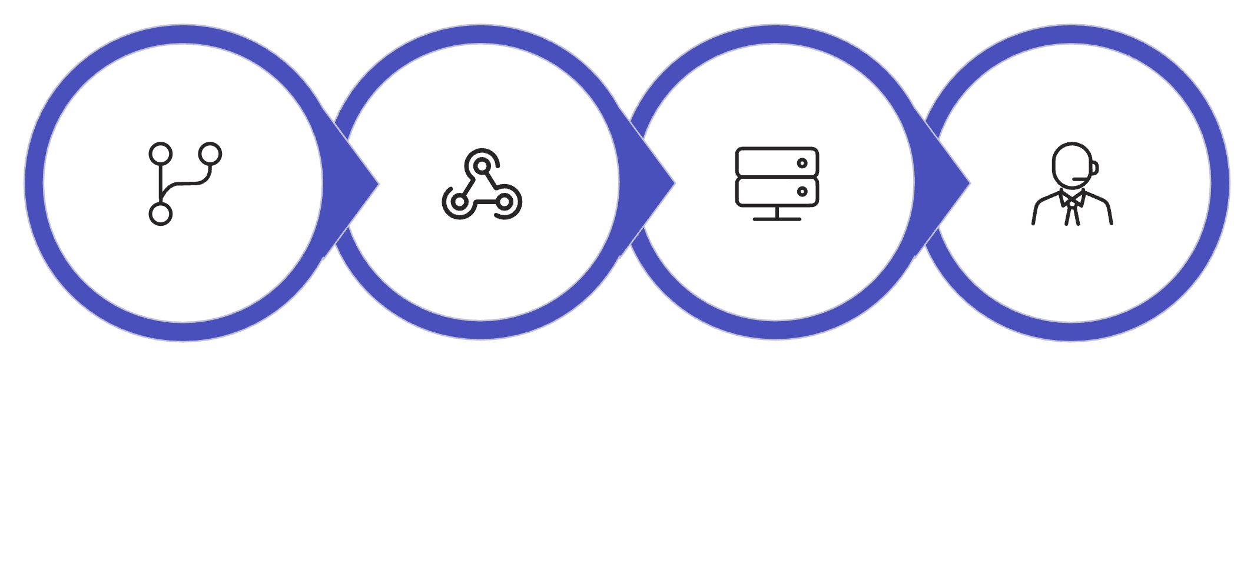
Architecture — Controller, Agents & the Trigger
Git Push
GitHub Webhook
Jenkins Controller
Build Agents
The Controller never runs heavy builds itself in production — it schedules and dispatches. Agents do the actual work, and can be static VMs or ephemeral pods spun up on demand.
Controller (Master)
Agents (Nodes)
Webhook vs Polling
Schedules jobs, stores config and credentials, serves the UI, and dispatches work to agents. In production setups, it does not run heavy builds itself — it's the brain, not the muscle.
Do the actual build/test/deploy work. Can be static VMs or ephemeral — the Kubernetes plugin spins up a fresh pod per build and destroys it afterward, keeping builds clean and scalable.
Webhook: GitHub pings Jenkins the instant code lands — Jenkins starts immediately. Polling: Jenkins checks GitHub every few minutes — slower, but used as a fallback when Jenkins can't be reached directly (e.g. behind a firewall).

Slide 4

Pipeline as Code — Job, Build, Jenkinsfile, Plugins
Core Terminology
Declarative vs Scripted Pipeline
Term
Meaning
Declarative
Scripted
Job
A configured task, e.g. "Build My Website"
Style
Structured, opinionated (pipeline {} block)
Full Groovy scripting, flexible
Build
One execution instance of a job (Build #47)
Best for
Most teams, easier to read and maintain
Complex conditional logic
Pipeline
The full sequence: Build → Test → Package → Deploy
Jenkinsfile
Text file, checked into the repo, defining the pipeline as code
Learning curve
Low
High
Plugin
Extension such as Git, Docker, Kubernetes, Slack, SonarQube — 1,800+ exist
For most teams starting out: use Declarative. Switch to Scripted only when you hit a wall with conditional logic that Declarative can't express cleanly.

Slide 5

Sample Declarative Jenkinsfile
pipeline {
agent any
environment {
DOCKER_TAG = "v${env.BUILD_NUMBER}"
}
stages {
stage('Build') {
steps {
sh 'mvn clean package'
}
}
stage('Test') {
steps {
sh 'mvn test'
}
}
stage('Docker') {
steps {
sh 'docker build -t app:$DOCKER_TAG .'
}
}
stage('Deploy') {
steps {
sh 'kubectl apply -f k8s/deployment.yaml'
}
}
}
post {
failure {
mail to: 'team@company.com',
subject: 'Build Failed'
}
}
}
What Each Block Does
agent any
Run on any available agent. In production you'd pin to a specific label like agent { label 'linux' }.
environment {}
Sets env vars for the whole pipeline. Here, DOCKER_TAG is auto-versioned using the build number.
stages {}
Each stage() maps to a visible step in the Blue Ocean UI — Build, Test, Docker, Deploy.
post { failure {} }
This is what makes CI "fast feedback" instead of a silent failure. The team gets an email the moment something breaks — not hours later.
Installation Demo
Setup Demo

Slide 6
CI / CD — Precisely, Not Loosely
Stage
What happens
Human involved?
CI – Continuous Integration
Every push is auto-built and auto-tested
No
CD – Continuous Delivery
App is packaged and staged, ready to ship
Yes — a human approves deployment
CD – Continuous Deployment
Passes tests and goes straight to production
No
Delivery vs Deployment — The Key Distinction
Live Demo — Try It Now
They differ only in whether a human approval gate exists before production. Most real companies use Continuous Delivery (auto-deploy to staging, manual approval for production) because of risk. Continuous Deployment is reserved for mature, well-tested pipelines.
New Item → Freestyle Project → name it "HelloWorld" → Execute Shell step:
echo "Hello Students"
date
pwd
Save → Build Now → console output appears instantly. This shows the Controller dispatching a shell step to an Agent in real time.

Slide 7
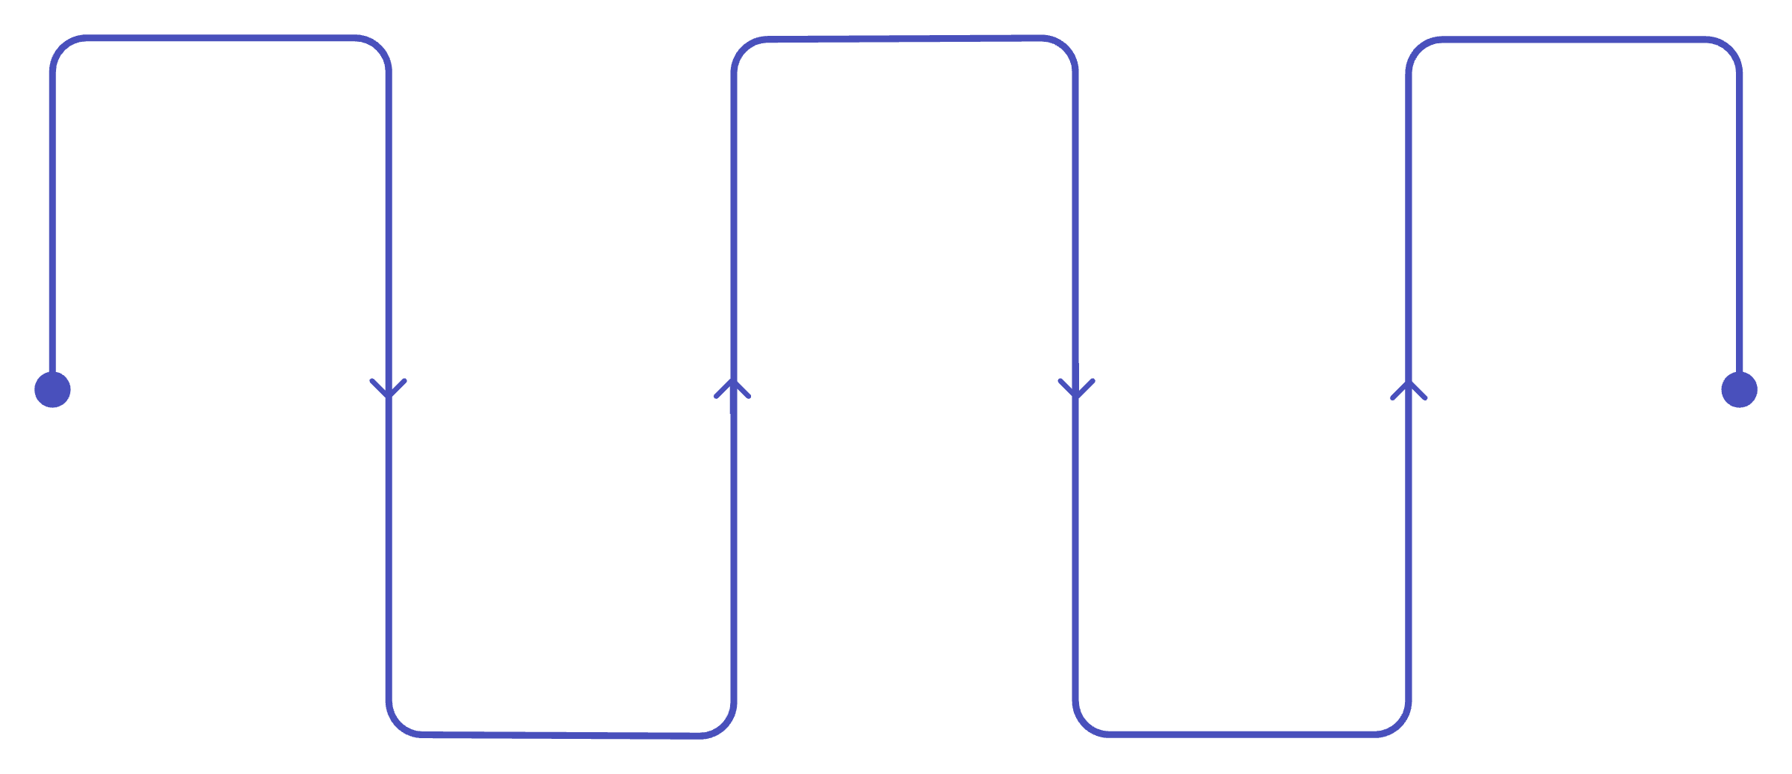
Enterprise Flow + Trade-offs
Dev
Quality Gate
Deploy
Commit code to GitHub
SonarQube checks coverage
Staging tests then manual approval
CI
Build & Push
Jenkins runs unit tests
Build Docker image and push
This is the full enterprise CI/CD flow. SonarQube acts as a quality gate — if code coverage or bug thresholds aren't met, the pipeline stops before a bad image ever gets built.
Advantages
Limitations
Free, open-source, huge plugin ecosystem
Initial setup and maintenance overhead
Massive community and integrations (Docker, K8s, SonarQube, Slack)
Controller can bottleneck if not scaled with agents
Distributed builds across many agents
Plugin conflicts and version drift are common
Pipeline-as-code is version-controlled and reviewable
UI is dated compared to GitHub Actions or GitLab CI
Self-hosted, full control over infrastructure and security
Requires managing your own servers, unlike SaaS CI tools

Slide 8
Recap + Interview Questions
The One-Paragraph Recap
Interview Questions — Test Yourself
Jenkins is the automation engine — triggered by a GitHub webhook, run as code via a Jenkinsfile, distributed across Controller and Agents — that turns a raw git push into a tested, deployed application with no manual steps.
1
Difference between Continuous Delivery and Continuous Deployment?
2
Controller vs Agent — who does what?
The Stack in One View
3
Declarative vs Scripted pipeline — when would you pick each?
01
4
What triggers a build after a GitHub push, and what's the fallback if that mechanism can't reach Jenkins?
Developer pushes code to GitHub
02
5
What's a Jenkinsfile, and why store it in the repo instead of Jenkins' UI?
Webhook triggers Jenkins Controller
03
6
Job vs Build — what's the difference?
Jenkinsfile defines what runs and where
7
Name 3 plugins and what each does.
04
Agents execute build, test, package, deploy
05
Notifications fire on pass or fail

Slide 9

Quick Reference — Everything on One Card
Key Numbers
Must-Know Terms
2011 — Jenkins forked from Hudson
1,800+ — available plugins
5 hrs/day — saved by automating 20 pushes
3 agent types — static VM, Docker, K8s pod
Job → configured task
Build → one run of a job
Jenkinsfile → pipeline as code, in the repo
Webhook → instant trigger from GitHub
Polling → fallback, checks on a schedule
CI vs CD
Architecture in Brief
CI → auto build + test on every push
Delivery → staged, human approves prod
Deployment → fully automated to prod
Most companies: Delivery (safer)
Controller → brain: schedules, dispatches, UI
Agent → muscle: runs the actual build
Declarative → pipeline {}, low curve
Scripted → full Groovy, high flexibility
The Jenkinsfile is the single most important concept to internalize. Everything else — agents, plugins, webhooks — exists to support what's defined in that file.

