Slide 1
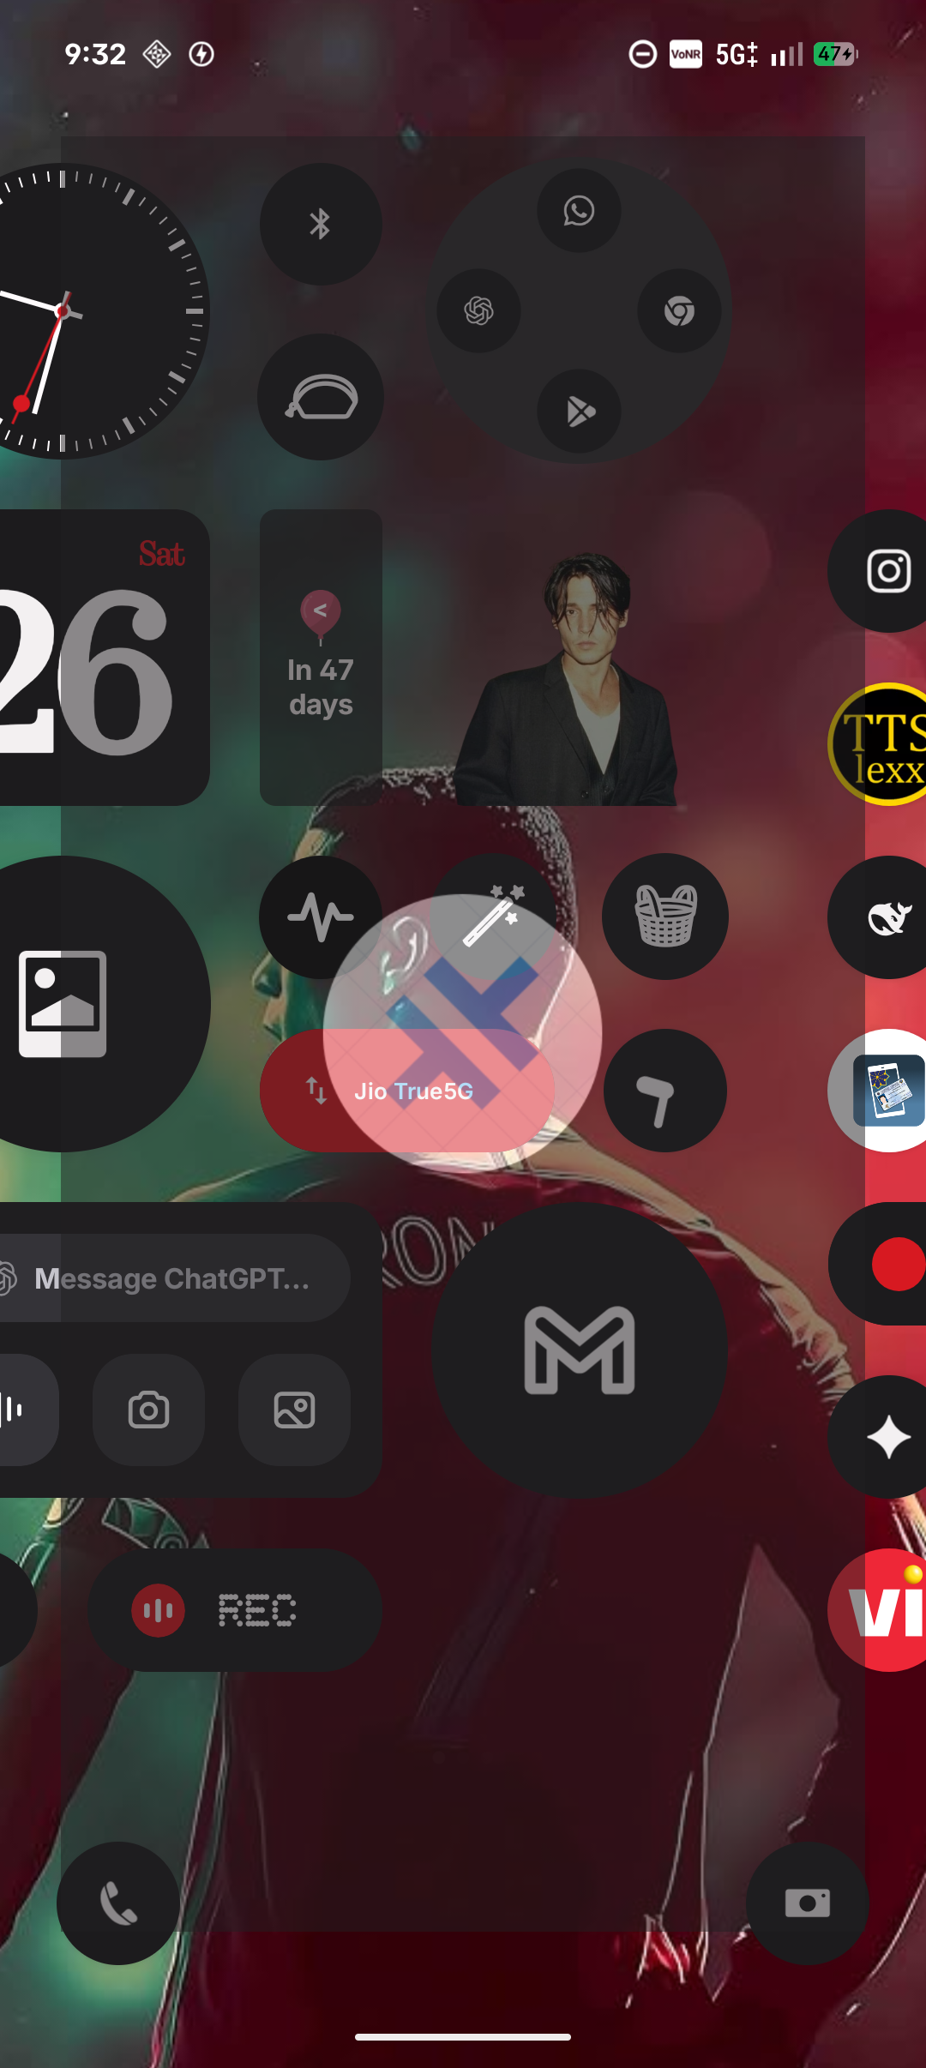
MCA PROJECT REVIEW · PHASE 1
AgroConnect
AI-Assisted Agricultural Community, Crop Health Diagnostics & Tele-Consultation Ecosystem
Prince Abraham Shaji
Reg. No: AJC25MCA-2051 · MCA 2025–2027
Project Guide: Ms. Sona Maria Sebastian
Amal Jyothi College of Engineering (Autonomous), Kanjirappally
AgroConnect Mobile Native Client
Notes:
Good morning respected panel members and my project guide Ms. Sona Maria Sebastian. I am Prince Abraham Shaji, registration number AJC25MCA-2051. Today, I present AgroConnect — an AI-powered agricultural social platform and tele-consultation system engineered to bridge the gap between farmers, agronomists, and regional knowledge.

Slide 2
PROBLEM ANALYSIS
Critical Challenges in Farmer Information Access
01
Fragmented Agricultural Advice
Farmers rely on scattered informal messaging groups and unverified forums. Information lacks scientific backing, local relevance, and accountability.
02
Delayed Disease Identification
Plant fungal infections and pest attacks spread rapidly across fields. Farmers struggle to identify pathology early, leading to severe yield destruction.
03
Inaccessible Agronomy Experts
Professional agricultural scientists and government officers are concentrated in urban research centers, making on-demand farm consultations difficult.
04
Lack of Transparent Governance
Traditional agricultural advisory services lack verifiable digital booking, audit histories, fair refund policies, and verified expert credentials.
AGROCONNECT · MCA PROJECT REVIEW
2
Notes:
To understand why AgroConnect is needed, consider the daily reality of a farmer in Kerala. When a fungal target spot appears on tomato leaves or rubber tree leaf fall occurs, the farmer has four major problems: 1) Unverified WhatsApp advice, 2) Delay in identifying plant diseases, 3) Inability to reach qualified agronomists, and 4) No accountable digital scheduling. This causes substantial economic crop loss.

Slide 3
MARKET GAP
Bridging the Gap: Existing Tools vs. AgroConnect
General Social Platforms
WhatsApp / Facebook Groups
❌ Unmoderated and noisy feeds
❌ No verified agronomist certification
❌ No structured consultation scheduling
❌ Zero agricultural diagnostic intelligence
❌ Location-blind content distribution
Single-Purpose AI Apps
Standalone Disease Scanners
⚠️ Isolated diagnosis without human followup
❌ No direct agronomist booking mechanism
❌ No community discussion or peer support
❌ No regional district-specific prioritization
❌ Requires multiple fragmented applications
AgroConnect Ecosystem
Unified Smart Platform
✅ District-first community knowledge feed
✅ PEA AI instant agronomist assistant
✅ Verified expert video consultation (Google Meet)
✅ Automated escrow-safe cancellation rules
✅ Admin-governed KYC accreditation
AGROCONNECT · MCA PROJECT REVIEW
3
Notes:
Why can't farmers simply use existing tools? General social networks are filled with noise and unverified advice. Standalone AI scanning apps give a probability score but provide no verified human agronomist to confirm it or prescribe treatments. AgroConnect uniquely brings peer community, instant AI triage, and real-time agronomist video appointments into one unified, governed application.

Slide 4
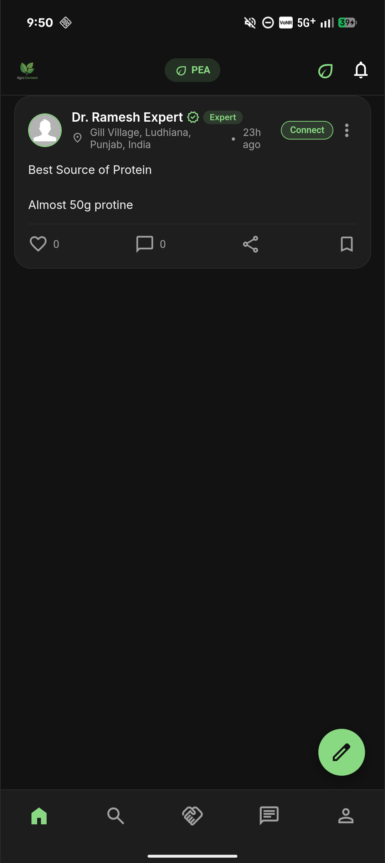
SYSTEM OVERVIEW
AgroConnect: Architecture & Core Pillars
A purpose-built agricultural ecosystem designed to empower farmers with localized intelligence, rapid plant disease guidance, and direct consultation with certified agronomists.
District-First Community
Feeds prioritized by farmer's district (Kannur, Kottayam, Pathanamthitta, Idukki).
PEA AI Smart Assistant
Instant agronomic intelligence on pest cycles, vermicompost, and disease symptoms.
Catch Up Tele-Consultations
Interactive calendar booking with Google Meet video rooms and automated refund logic.
Governance & Verification
Admin accreditation verifying expert degrees, CV PDFs, and broadcast oversight.
AgroConnect Mobile Feed Interface
AGROCONNECT · MCA PROJECT REVIEW
4
Notes:
Here we introduce AgroConnect. Built as an Android mobile app and web administration dashboard, it is structured around four primary pillars: 1) District-prioritized community feeds, 2) PEA, our AI agricultural assistant, 3) Catch Up expert consultation scheduling, and 4) An administrative oversight engine ensuring platform credibility.

Slide 5
USER ARCHITECTURE
Role-Based Ecosystem & Permission Matrix
Farmer (User)
Primary Agricultural Participant
• Register with phone, district & Google OAuth
• Publish photo & video crop field updates
• Query PEA AI for instant plant pathology advice
• Book verified agronomist consultation slots
• Chat directly or submit connection requests
Agricultural Expert
Verified Agronomist / Scientist
• Undergo KYC review (degree & PDF CV submission)
• Set custom consultation fees (e.g. ₹500/slot)
• Configure date & 30-minute availability slots
• Provide Google Meet consultation links
• Request platform broadcast announcements
Administrator
Platform Governance & Trust
• Review & approve/reject expert KYC applications
• Inspect uploaded CV resumes securely via storage
• Audit completed & cancelled consultation meetings
• Issue full/partial refunds with written audit logs
• Publish system-wide broadcast advisories
AGROCONNECT · MCA PROJECT REVIEW
5
Notes:
AgroConnect implements strict Role-Based Access Control enforced at the database level via PostgreSQL Row Level Security. Farmers interact with peers, consult PEA AI, and book experts. Experts manage their availability calendar, charge transparent fees, and join video calls. Administrators supervise the system, verify agronomist degrees, and handle cancellations and dispute refunds.

Slide 6
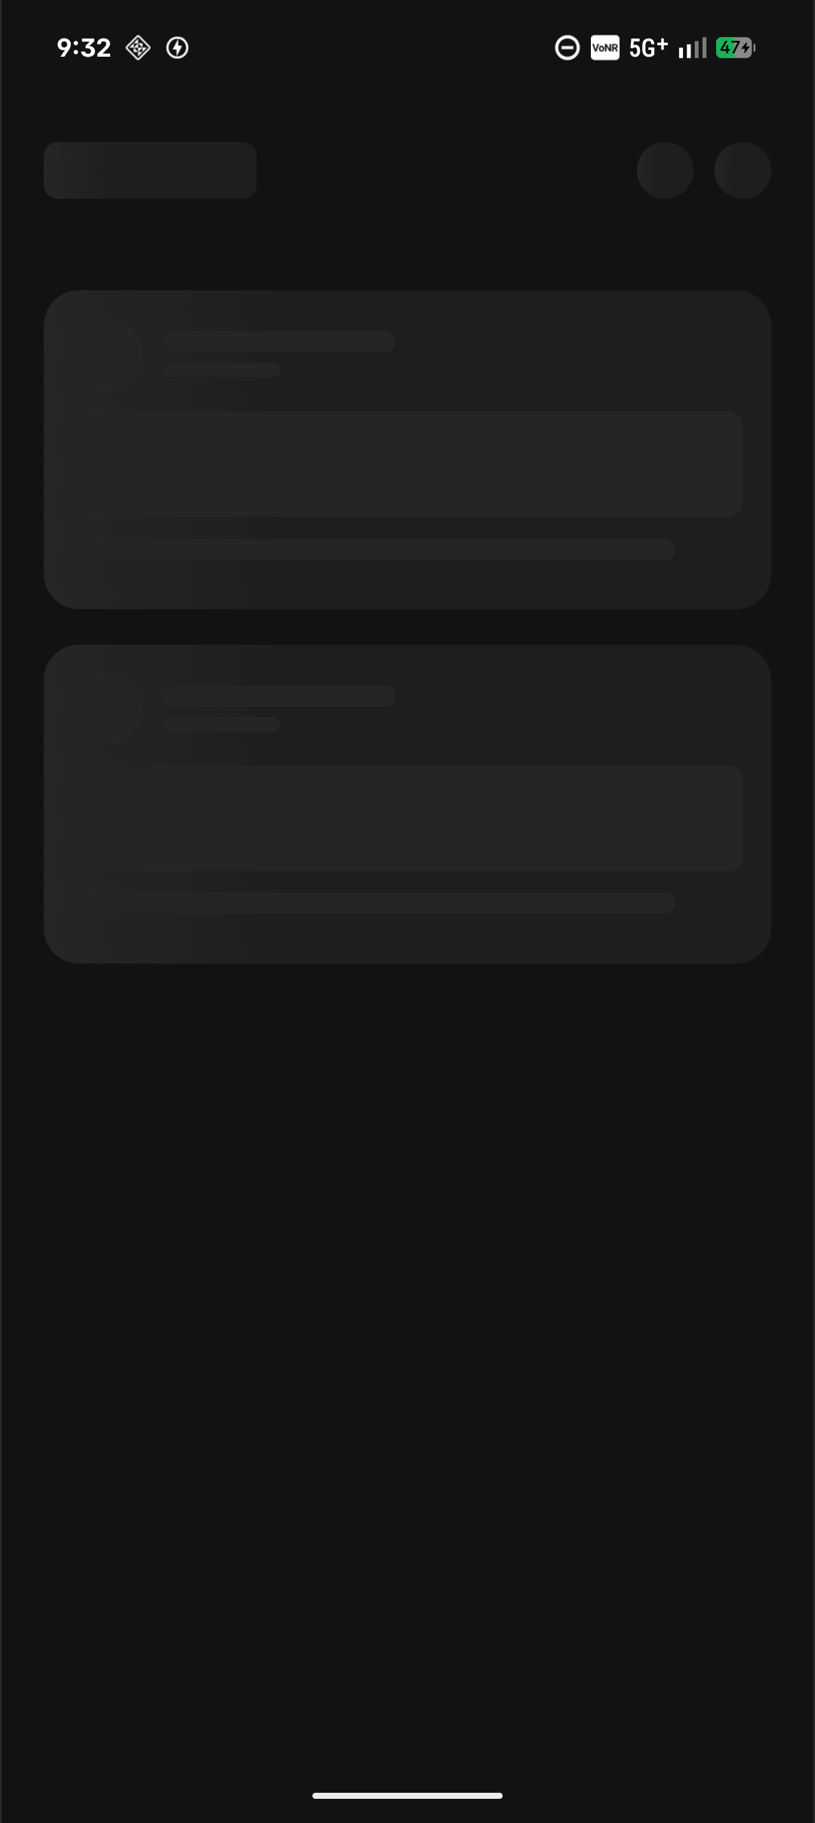
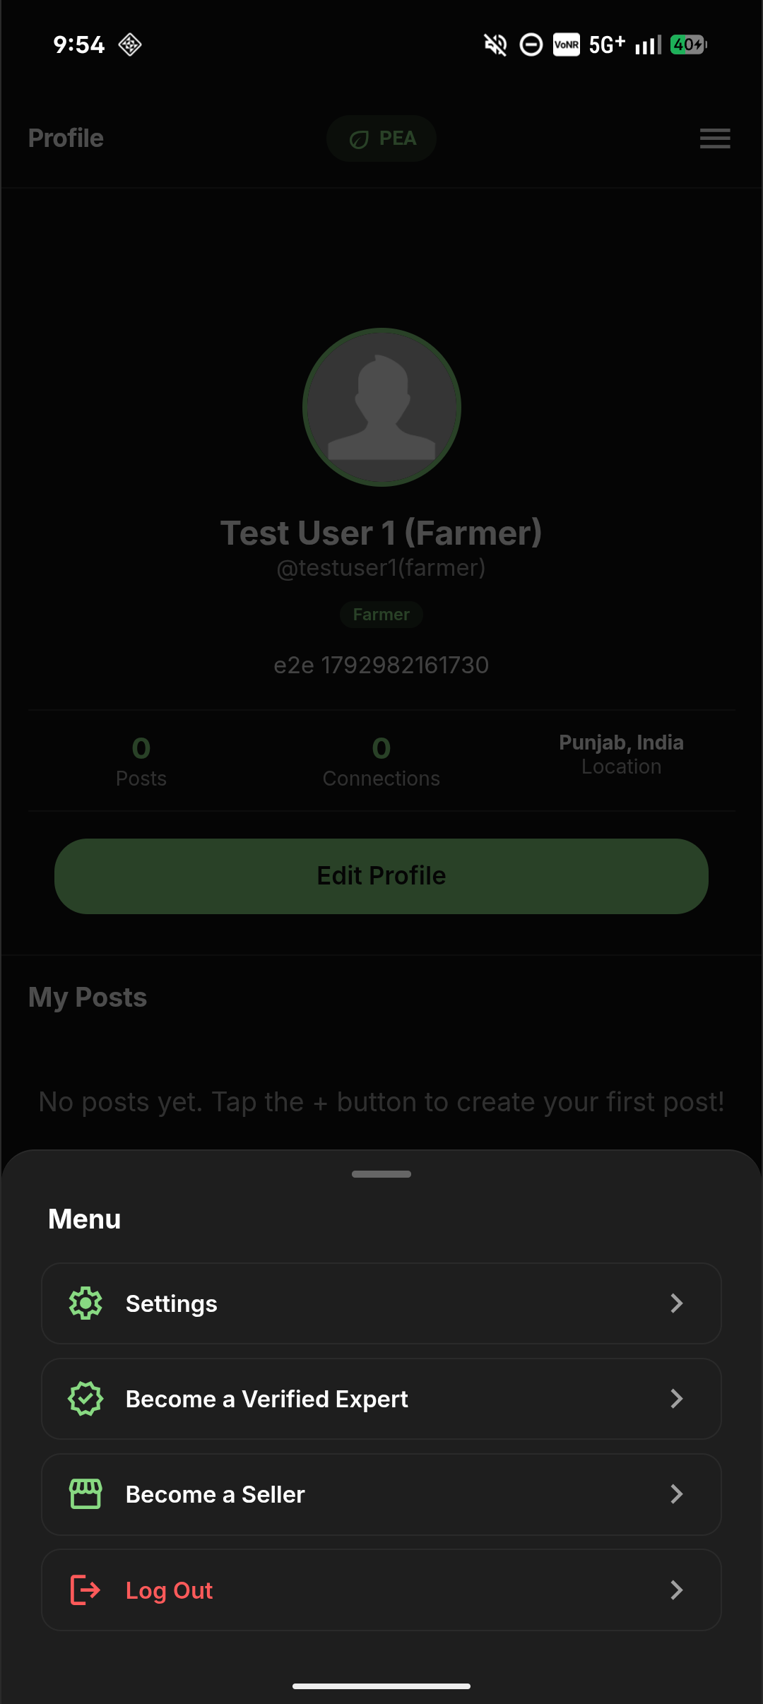
AUTHENTICATION & SETUP
Farmer Onboarding & Regional Personalization
1. Multiple Authentication Options
Supports secure Email/Password authentication and Google OAuth 2.0 with native Android deep linking.
2. Kerala District Localization
Tailored specifically for Kerala agriculture. Farmers select from four launch agricultural districts: Kannur, Pathanamthitta, Idukki, and Kottayam.
3. Privacy-First Approach
Eliminates intrusive background GPS tracking. Regional context is established strictly through user-selected district preferences.
4. Profile Management
Displays farmer bio, connection count, and active posts while enabling straightforward profile editing.
Login / Sign In
Farmer Profile
AGROCONNECT · MCA PROJECT REVIEW
6
Notes:
Here we see the onboarding process. Farmers can register using standard credentials or Google OAuth. Crucially, instead of invasive continuous GPS tracking, we let farmers choose their district among four initial regions in Kerala: Kannur, Pathanamthitta, Idukki, and Kottayam. This district selection drives our smart localized recommendation engine.

Slide 7
COMMUNITY FEED
District-First Feed Architecture
Hyper-Local Context Priority
A farmer from Kottayam immediately sees agricultural advisories and pest observations from Kottayam first, ensuring immediate relevance to their climate.
PostgreSQL Server-Side Sorting
Implemented via a specialized database stored procedure (RPC) rather than slow client filtering, sorting matching district records ahead of statewide posts.
Stable Keyset Pagination
Eliminates duplicate items or skipped posts across infinite scrolling, preserving feed performance even over 2G/3G rural networks.
Peer & Expert Collaboration
Farmers post field queries, and verified agronomists answer directly with a distinctive green verified badge.
District-Prioritized Feed on Android
AGROCONNECT · MCA PROJECT REVIEW
7
Notes:
Slide 7 shows our district-first feed algorithm in action. Agricultural advice is climate-dependent — weather in Idukki is vastly different from Kannur. Our database query automatically prioritizes posts authored within the farmer's registered district, ensuring that immediate disease warnings and local market shifts appear right at the top.

Slide 8
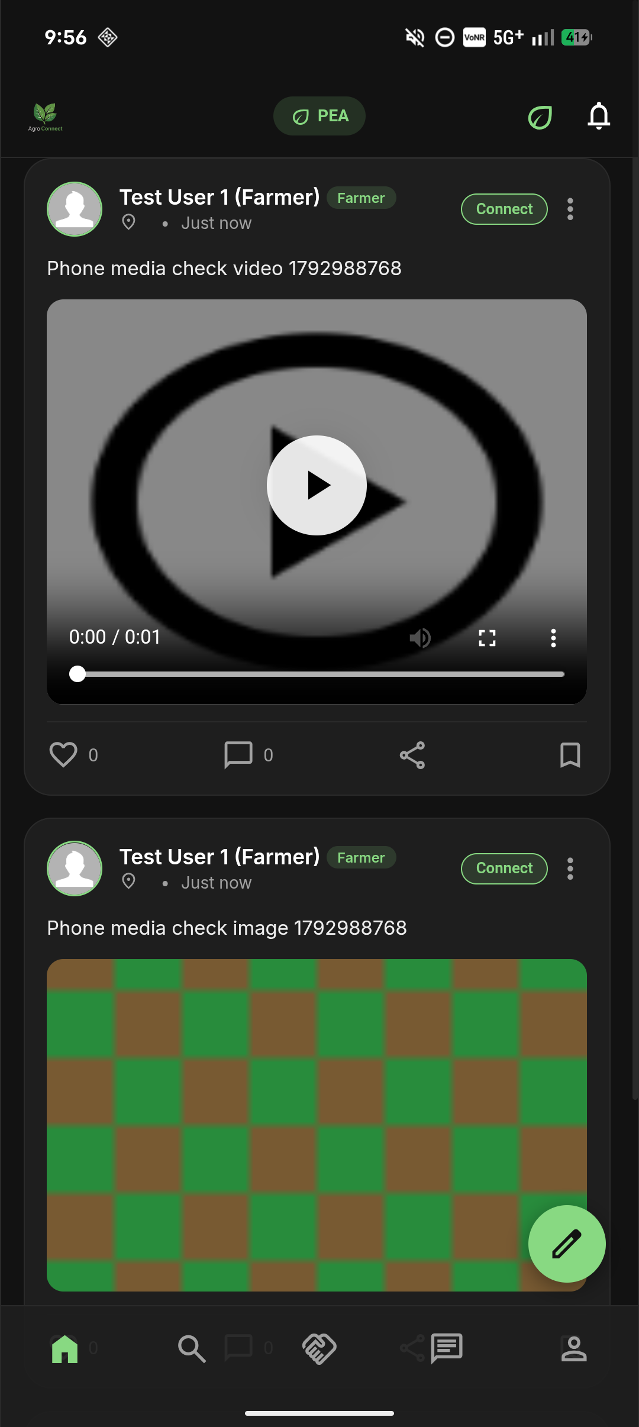
SOCIAL INTERACTION
Multimedia Posts & Field Observations
Video & Image Field Uploads
Farmers can record video walkthroughs of crops showing pest movement, or upload high-resolution photos of damaged foliage directly into Supabase Storage.
Interactive Engagement
Community likes, bookmarks, and threaded discussions allow farmers across districts to share pest control tips and cultivation experiences.
Safe Storage Architecture
Media assets reside in isolated Supabase storage buckets (`post-images`, `post-videos`). Public directory listing is strictly blocked to maintain data integrity.
Instant Agronomist Feedback
Verified agronomists monitor local feeds and provide verified guidance on farmer posts.
Crop Video Observation Card
AGROCONNECT · MCA PROJECT REVIEW
8
Notes:
Static photos often fail to capture agricultural problems like insect infestations. AgroConnect supports embedded video walkthroughs directly inside feed cards, as shown on the right. Storage policies prevent anonymous listing, and all media is streamed efficiently over standard HTML5 video.

Slide 9
INTELLIGENT ASSISTANCE
PEA: AI-Powered Agricultural Assistant
Instant First-Line Agricultural Support
Accessible 24/7 directly from the app header. Answers crop troubleshooting questions in real time without human wait delays.
Structured Domain Knowledge
Built on curated agronomic rules covering organic compost, biological pest control, soil fertility, and crop rotation cycles.
One-Tap Prompt Suggestions
Offers quick-start prompt chips for common regional queries such as 'Identify Tomato Early Blight' or 'How to make Vermicompost'.
Markdown Formatting
Renders structured agronomic recommendations with bullet points, bold pathogen names, and clear step-by-step instructions.
🌱 PEA Assistant Chat Preview
PEA Assistant:
Hello! I am PEA, your personal Agro Connect AI Assistant. What would you like to troubleshoot today?
Farmer:
How do I make Vermicompost at home?
PEA Assistant:
### Vermicomposting Setup 🪱
1. Drill breathing holes in a 50L bin.
2. Add wet cardboard/coco-coir bedding.
3. Introduce Red Wiggler worms.
4. Feed vegetable scraps (avoid citrus & dairy).
5. Harvest worm castings after 2-3 months.
AGROCONNECT · MCA PROJECT REVIEW
9
Notes:
Slide 9 introduces PEA, our interactive AI farming assistant. Accessible with one tap from the header, PEA provides immediate first-line answers. Farmers who may not know technical pathogen names can ask in plain language, and PEA returns structured advice on organic farming, biological treatments, and soil health.

Slide 10
CROP HEALTH DIAGNOSTICS
Plant Pathology & Disease Triage Workflow
1. Field Symptom
Farmer observes target spot lesions or leaf yellowing on crop foliage.
2. AI Pathology Triage
PEA matches symptom patterns to known fungal pathogens (e.g. Alternaria solani).
3. Organic Treatment
Prescribes biological controls (copper fungicides, Bacillus subtilis, mulch).
4. Expert Verification
Farmer books a tele-consultation with a plant pathologist if damage persists.
CASE STUDY: Tomato Early Blight (Alternaria solani) Diagnostic Response
• Symptoms Identified: Dark concentric rings on older lower leaves, surrounding yellow halo, progressive defoliation.
• Organic Remediation: Morning spray of bio-fungicides (Bacillus subtilis), lower foliage pruning, organic straw mulching.
• Cultural Prevention: Implement strict 3-year crop rotation avoiding Solanaceae family plants (potatoes, eggplants).
• Safety Protocol: The system explicitly instructs the farmer to escalate to verified agronomists for severe bacterial wilts.
AGROCONNECT · MCA PROJECT REVIEW
10
Notes:
Slide 10 details our plant pathology triage workflow. Rather than functioning as an unguided black-box diagnosis, AgroConnect combines symptom matching with concrete agronomic recommendations (biological controls and 3-year crop rotation). If a condition is severe, it smoothly directs the farmer to human agronomist consultations.

Slide 11
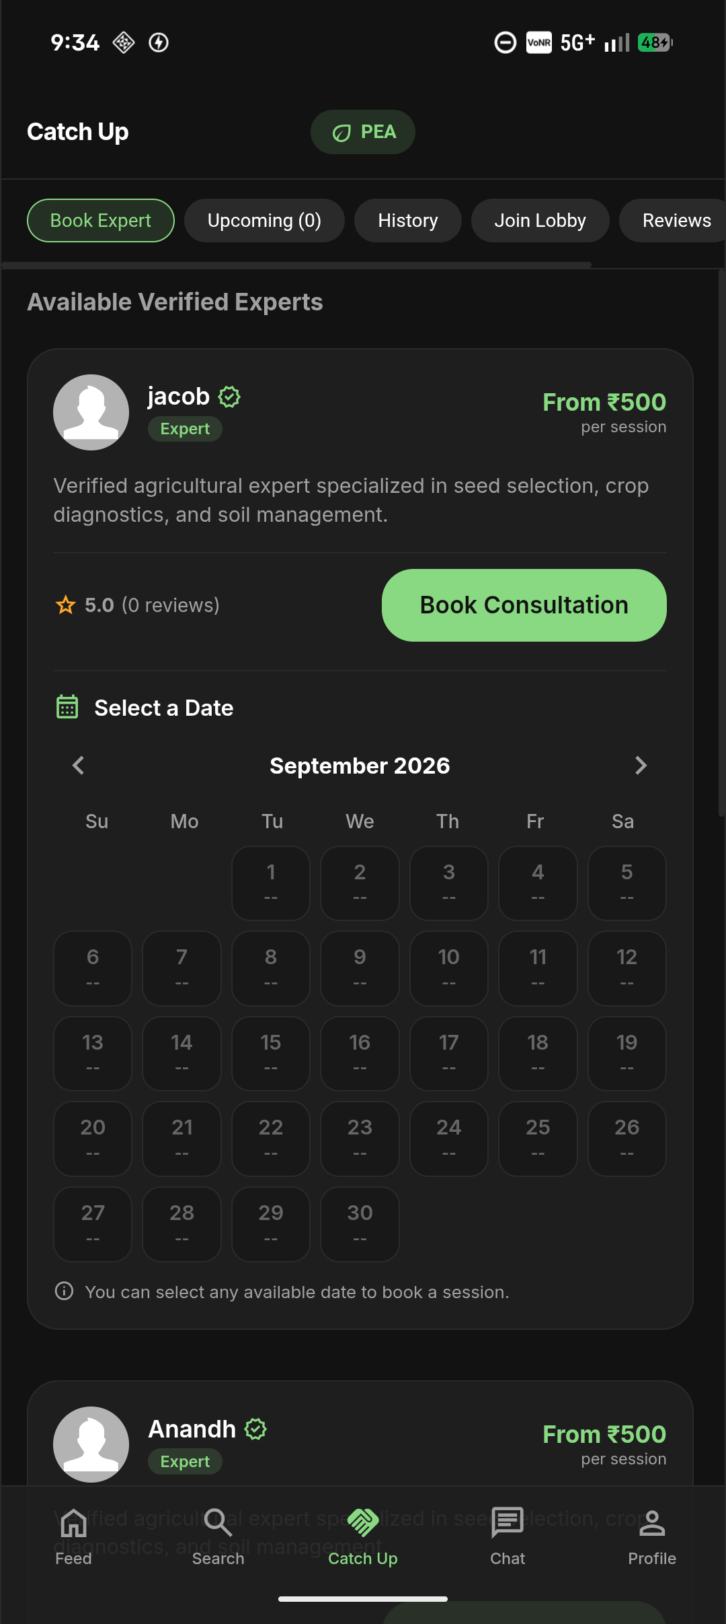
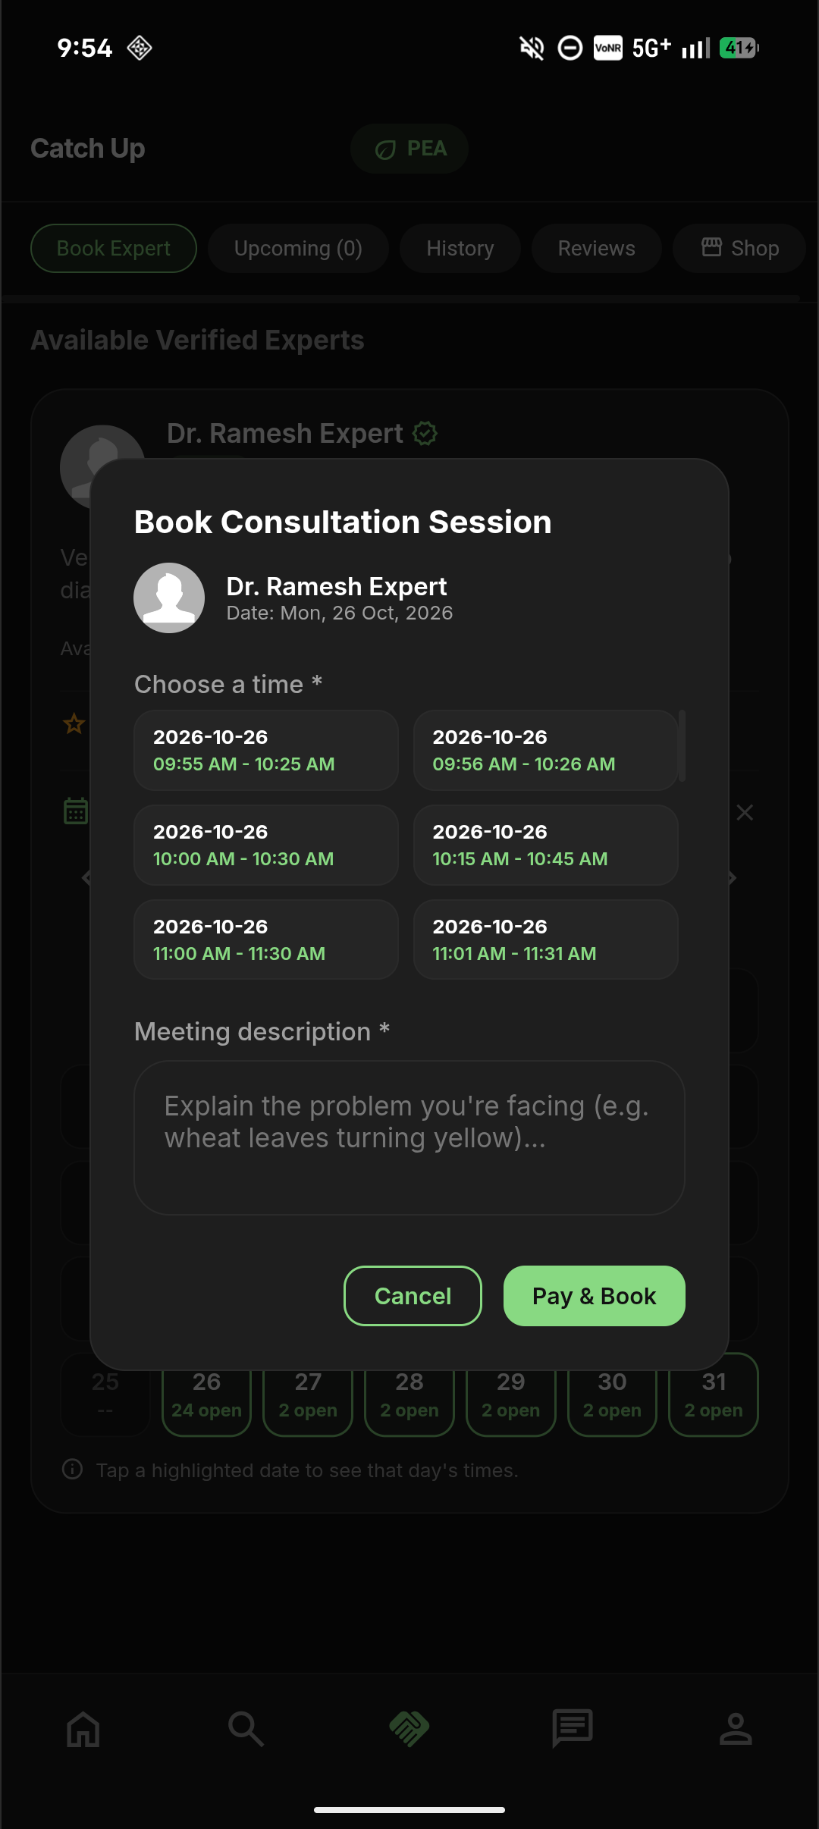
EXPERT CATCH UP
Agronomist Discovery & Calendar Scheduling
Verified Agronomist Profiles
Farmers browse certified experts with ratings, specializations (soil fertility, plant pathology), and experience years.
Transparent Fee Schedules
Each agronomist lists their exact consultation fee (e.g. ₹500.00). No hidden costs or unverified surcharges.
Dynamic Slot Reservation
Experts configure available consultation dates and 30-minute time intervals. PostgreSQL database locks prevent double booking.
Issue Description Pre-Submission
Farmers enter a summary of their crop issue prior to booking, allowing the agronomist to prepare before the consultation.
Verified Experts List
Available Slots
AGROCONNECT · MCA PROJECT REVIEW
11
Notes:
In Slide 11, we explore our 'Catch Up' expert scheduling module. Farmers browse certified agronomists by district, view transparent fees, and select calendar dates. When an appointment slot is picked, PostgreSQL atomic transactions guarantee that no two farmers can book the same slot simultaneously.

Slide 12
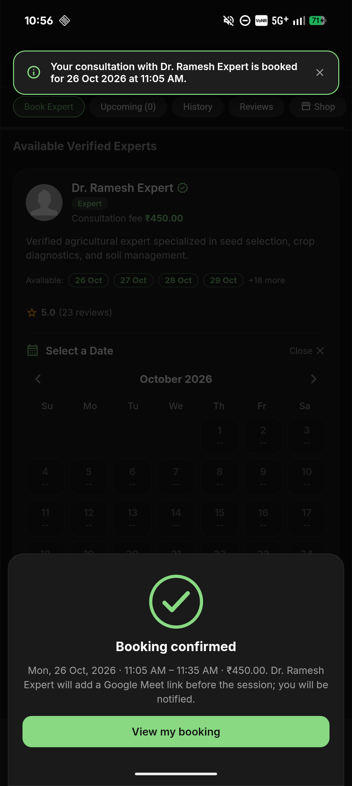
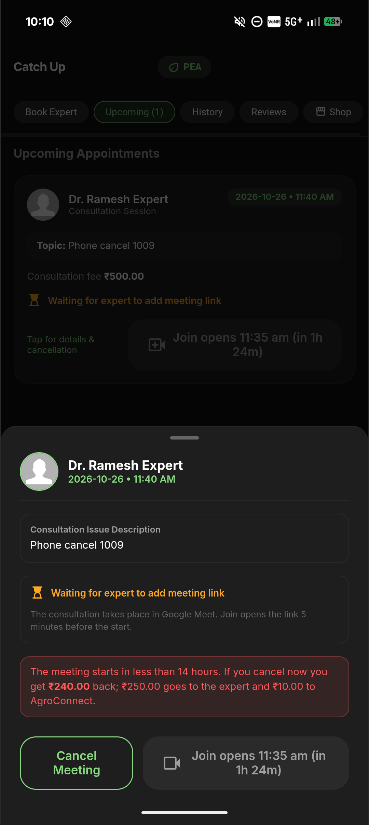
BOOKING ECONOMICS
Demonstration Checkout & Cancellation Policies
Simulated Escrow Checkout
A demonstration payment checkout simulates transaction workflows without exposing farmers to real financial risk during prototype testing.
The 14-Hour Cancellation Threshold
Farmers cancelling ≥14 hours before slot start receive an automatic 100% full refund.
Fair Expert Compensation (<14 Hours)
Cancellations inside 14 hours allocate 50% to the expert for reserved time, 2% platform fee, and 48% refunded to the farmer.
Unconditional Expert / No-Show Refunds
If an expert cancels at any time or fails to provide a meeting link within 5 minutes of start, the farmer receives an immediate 100% refund.
Demo Payment Simulation
Server Refund Terms
AGROCONNECT · MCA PROJECT REVIEW
12
Notes:
Fairness and financial trust are vital for rural adoption. Slide 12 displays our booking cancellation logic, fully executed on the PostgreSQL server. We implement a strict 14-hour threshold: cancelling early gives a 100% refund. Late cancellations give 50% to the expert for reserved time. If an expert no-shows, the farmer is refunded 100% automatically.

Slide 13
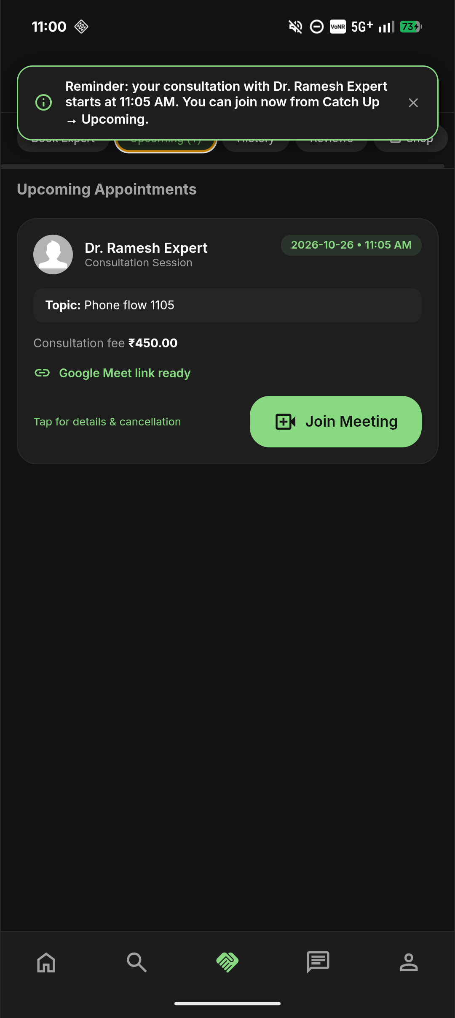
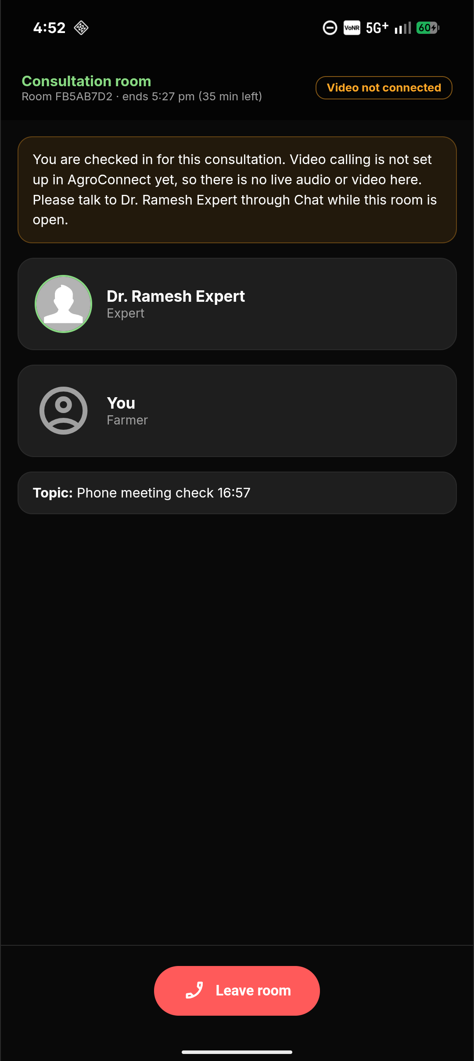
VIDEO CONSULTATION
Real-Time Tele-Consultations via Google Meet
Native Google Meet Integration
Eliminates third-party video licensing costs. Experts paste an authenticated Google Meet link validated server-side.
Automated Join Window Enforcement
The 'Join Meeting' button unlocks 5 minutes before scheduled start time and stays active for the duration of the slot.
No-Show Protection
If an agronomist fails to provide a meeting link within 5 minutes past start, the system flags a no-show and triggers an automated refund.
Post-Consultation Reviews
Following completed sessions, farmers submit 1-to-5 star ratings and written reviews, building trusted regional reputations.
Join Window Enabled
Google Meet Room
AGROCONNECT · MCA PROJECT REVIEW
13
Notes:
Rather than relying on proprietary embedded videoSDKs that strain rural bandwidth and inflate hosting bills, AgroConnect integrates standard Google Meet links. The server enforces join timing: the link is concealed until 5 minutes before the call, opening directly in the phone's native Google Meet application.

Slide 14
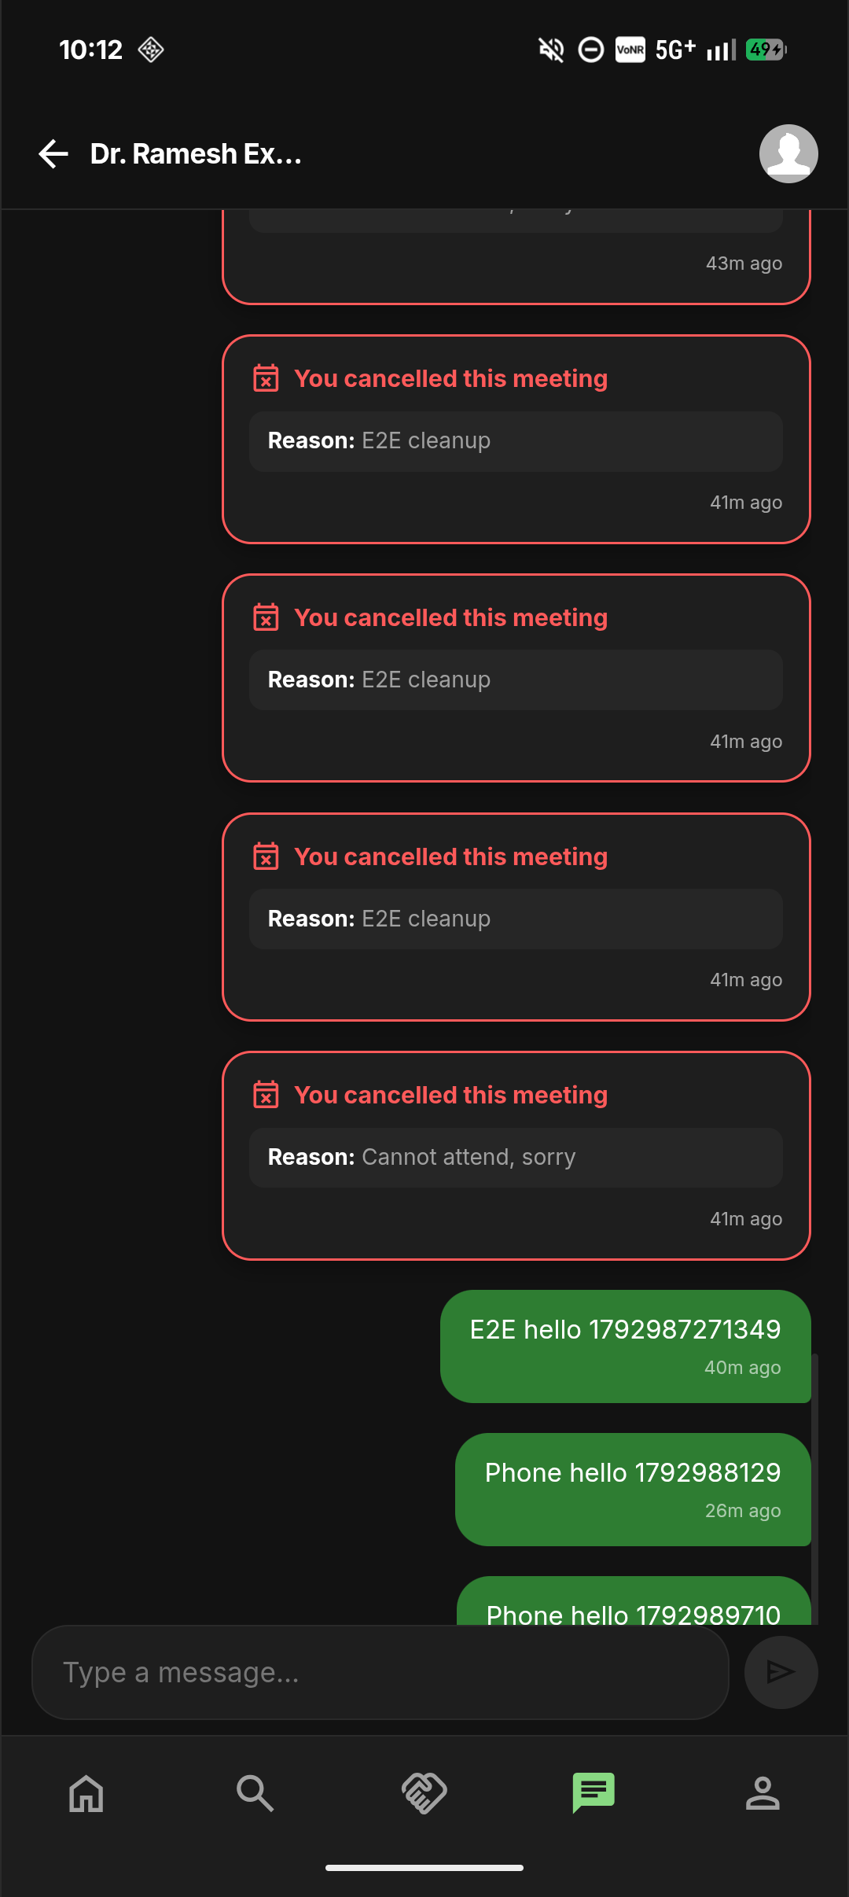
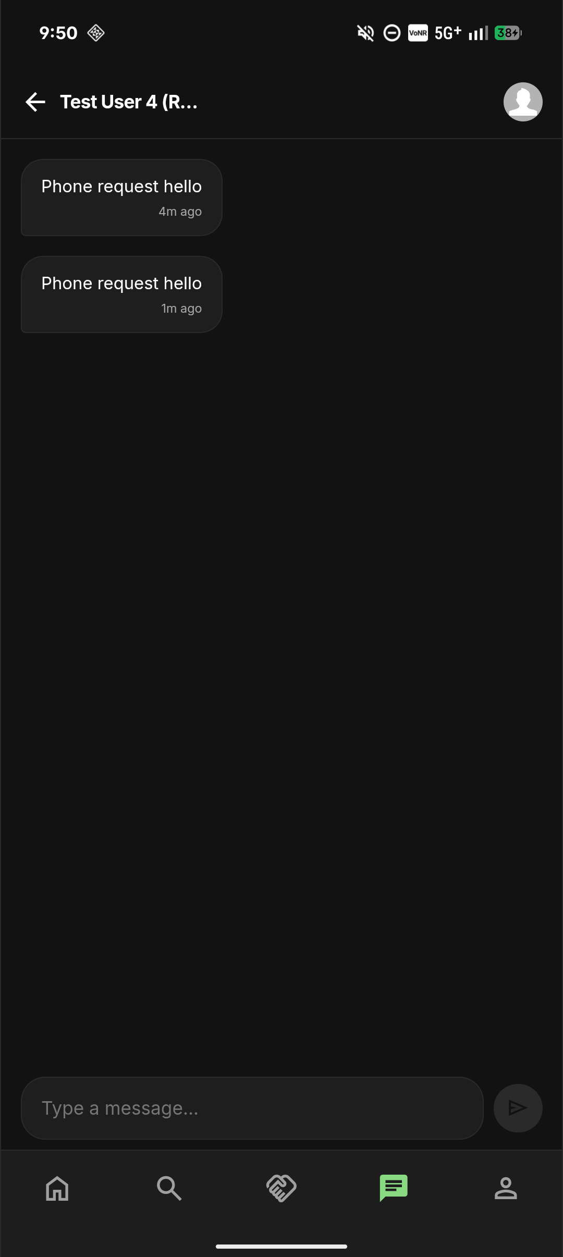
DIRECT COMMUNICATION
Private Messaging & Connection Request Workflow
Two-Tier Messaging Protection
Prevents unsolicited spam. First messages from unconnected users appear in a distinct 'Message Requests' inbox.
Visual Blue Notification Dot
The request icon illuminates a blue badge only when pending requests exist, disappearing once reviewed.
One-Click Accept or Decline
Recipients can Accept (moving the chat to the main inbox) or Decline (silently dismissing without alerting the sender).
RPC-Governed Table Security
Client apps never write directly to messaging tables. All text passes through PostgreSQL stored procedures that sanitize input and enforce length limits.
Active Consultation Chat
Request Accepted
AGROCONNECT · MCA PROJECT REVIEW
14
Notes:
In Slide 14, we examine our messaging architecture. To protect agronomists and farmers from unsolicited harassment, we enforce a two-tier message request system. Unconnected users land in requests. Once accepted, they move smoothly into the main conversation list. All messages are handled via PostgreSQL RPCs, preventing direct table manipulation.

Slide 15
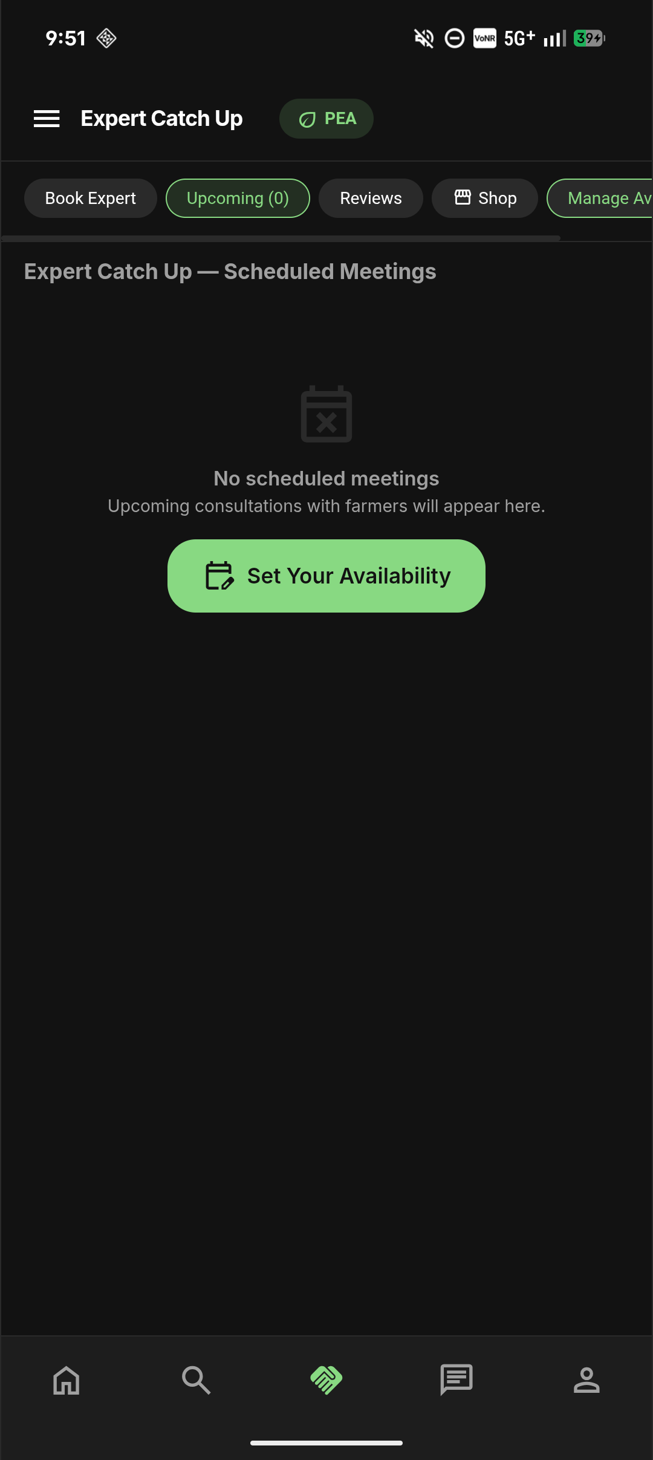
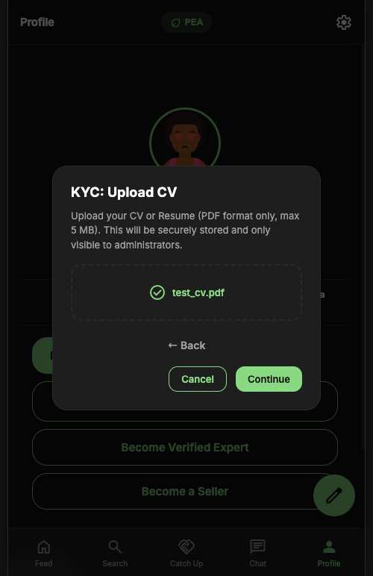
EXPERT ONBOARDING
Agronomist Accreditation & KYC Verification
Rigorous Accreditation Flow
Users applying to become verified experts must submit their university degree (e.g. B.Sc Agriculture), specialization, and experience details.
Mandatory Resume / CV PDF Upload
Applicants upload a valid PDF CV directly into an isolated Supabase storage bucket (`expert-cvs`).
Storage Access Control
CV resumes are strictly confidential. Anonymous and unauthenticated access is rejected by RLS; only authorized administrators can view documents.
Atomic Role Elevation
Upon admin approval, the system transitions `profiles.role` to 'Expert' and creates the `experts` record in a single database transaction.
Expert CV Submission
Approved Expert Console
AGROCONNECT · MCA PROJECT REVIEW
15
Notes:
A critical differentiator for AgroConnect is trust. Anyone can claim to be an agronomist on social media. On AgroConnect, an expert must upload their educational degree and professional CV in PDF format. The CV bucket is private; only verified administrators can view it, preventing fake agronomists from misleading farmers.

Slide 16
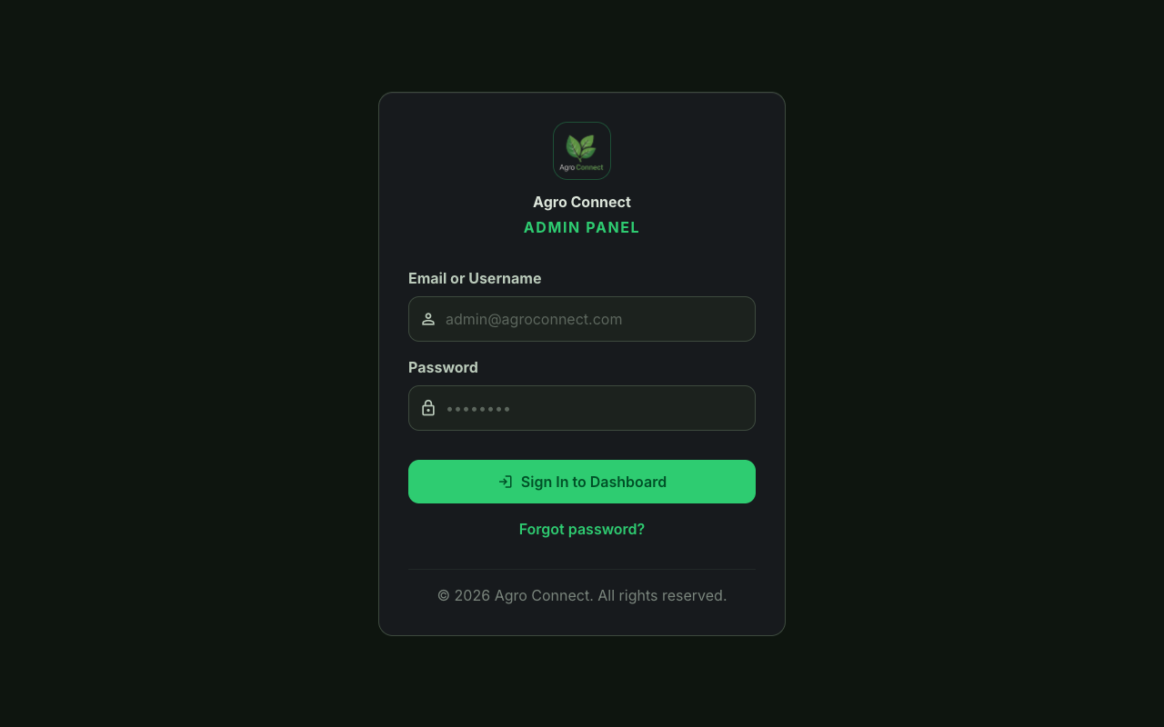
ADMIN OPERATIONS
Centralized Administration & Platform Governance
Dedicated Web Administration Portal
Hosted independently on Render Static Cloud, providing administrators full oversight without cluttering the mobile app.
KYC Application Queue
Admins review pending agronomist applications, inspect PDF CVs, and approve or reject submissions with reason notes.
Consultation Session Audits
Complete ledger of all booked, completed, and cancelled meetings with full refund tracking and commission accounting.
Platform-Wide Broadcast Alerts
Admins broadcast critical regional warnings (e.g. monsoon alerts, locust swarms) to all farmers or targeted districts.
Admin Web Dashboard Interface
AGROCONNECT · MCA PROJECT REVIEW
16
Notes:
Slide 16 presents the Admin Dashboard. Built with React and Tailwind CSS and hosted on Render, it allows administrators to inspect user accounts, process expert applications, audit consultations, and broadcast emergency agricultural announcements across districts.

Slide 17
END-TO-END WORKFLOW
Integrated User Journey & Operational Workflow
01
Step 1: Onboard & Localize
Farmer registers via Email or Google OAuth and picks their Kerala district (Kannur, Pathanamthitta, Idukki, Kottayam).
02
Step 2: Community & AI Triage
Farmer reviews local district feed for crop updates; queries PEA AI for immediate pest and soil troubleshooting.
03
Step 3: Agronomist Booking
For persistent crop diseases, farmer selects a verified agronomist, reviews fee (₹500), and reserves a calendar slot.
04
Step 4: Secure Video Session
Join button activates 5 minutes before time; farmer and agronomist conduct video call on Google Meet.
05
Step 5: Completion & Review
Agronomist marks consultation complete; farmer posts feedback rating; automated ledger updates platform audit logs.
AGROCONNECT · MCA PROJECT REVIEW
17
Notes:
Slide 17 illustrates how all modules form a single connected journey: A farmer registers and sets their district; browses local advice and consults PEA AI; if an issue requires human diagnosis, books an agronomist; meets securely on Google Meet; and finishes with transparent ratings and automated transaction auditing.

Slide 18
TECHNICAL ARCHITECTURE
Full-Stack System Architecture & Technology Stack
Client Tier (Mobile & Web)
• Mobile Native: Apache Cordova / Ionic Capacitor targeting Android SDK 36
• Frontend Engine: React 18 SPA with Vite bundler & Tailwind CSS
• Design System: Custom dark mode with Material Symbols and responsive touch UI
• Performance: Optimized chunking, local asset caching, offline splash handling
Cloud & Backend Tier
• Admin Hosting: Render Cloud Static Site with automatic SPA fallback (404.html)
• Backend Platform: Supabase Cloud PaaS (PostgREST API, Realtime WebSockets)
• Authentication: Supabase GoTrue API (Email/Password & Google OAuth 2.0)
• Media Storage: Supabase Cloud Storage (post-images, post-videos, expert-cvs)
Data & Security Tier (PostgreSQL)
• Database Engine: PostgreSQL hosted on Supabase Cloud (`mgreapakfchcxcrauheq`)
• Logic Enforcement: PL/pgSQL stored procedures (`SECURITY DEFINER` pinned path)
• Access Control: Row Level Security (RLS) policies on every table with deny-by-default
• Automation: pg_cron scheduled lifecycle tasks for meeting closure & reminders
AGROCONNECT · MCA PROJECT REVIEW
18
Notes:
Here is the complete architectural stack. The client tier uses React 18 packaged with Capacitor into an Android APK. The web admin dashboard runs on Render Static Cloud. The backend is powered by Supabase with PostgreSQL, enforcing all business logic via PL/pgSQL stored procedures and Row Level Security.

Slide 19
QUALITY ASSURANCE
Testing, Verification & Deployment Results
Automated Test Suite (PGlite) — 115 Tests Passed · 0 Failures
• Unit & Database Integration: Verified across 37 test suites using in-memory PostgreSQL (PGlite).
• Consultation RPC Verification: Tested booking atomicity, reminder delivery, and no-show processing.
• Financial Refund Reconciliations: Full 14-hour boundary test verifying exact percentage distributions.
• Role Security Protections: Privilege escalation attacks, self-promotion, and anonymous reads blocked.
End-to-End Browser Tests (Playwright) — 3 E2E Suites Passed · Chrome
• Negative Authentication Checks: Verified invalid credentials return user-friendly errors without API key failure.
• Publishable Key Hardening: Eliminated legacy JWT 'Invalid API key' failure on production Supabase endpoints.
• Deep-Link Routing: Tested SPA 404 fallback ensuring direct route refreshes (e.g. /users) load cleanly.
Physical Device Deployment (Android 16) — Verified on Realme/Oppo AIN065
• Package Identity: `com.agroconnect.app` · Version 1.1 (versionCode 2) built with JDK 17 & Gradle 9.2.1.
• Live On-Device Execution: Streamed install via ADB; zero crashes or unhandled exceptions in Android logcat.
• Real Data Verification: Successfully rendered live Kerala district feed, verified expert cards, and profile views.
AGROCONNECT · MCA PROJECT REVIEW
19
Notes:
Verification is evidence-based, not assumed. We executed 115 database integration tests with 100% pass rates, verifying atomic slot reservations and financial refund rules. Browser E2E tests verified key hardening, and we successfully installed and verified the native build on a physical Android 16 device.

Slide 20
CONCLUSION & NEXT STEPS
Project Summary & Future Horizons
Planned Future Enhancements
• Computer Vision Model Integration
Deploy on-device TensorFlow Lite models for offline leaf disease classification.
• Multilingual Vernacular Support
Voice-assisted query input and audio playback in Malayalam for older farmers.
• IoT Telematics Integration
Connect soil moisture and NPK telemetry sensors for proactive irrigation scheduling.
• Payment Gateway Onboarding
Integrate live Razorpay/UPI gateway to transition demo escrow into commercial production.
Thank You!
AgroConnect demonstrates how modern cloud platforms, regional localization, and AI assistance can modernize rural agriculture.
Prince Abraham Shaji
Reg. No: AJC25MCA-2051
Amal Jyothi College of Engineering
Questions & Discussion
AGROCONNECT · MCA PROJECT REVIEW
20
Notes:
In conclusion, AgroConnect delivers a cohesive, verified digital platform connecting farmers with certified agronomists and AI insights. Future enhancements will introduce computer vision on-device leaf scanning and Malayalam voice queries. Thank you to the panel and my guide Ms. Sona Maria Sebastian. I now invite your questions and feedback.

