Slide 1
TEAM 1 MENTAL HEALTH ANALYSIS
JAN 13th 2018
GROUP MEMBERS:
Aiyana Liz Mathew, Aruna Amaresan, Aswathy Mohan, Michael Ilelaboye

Slide 2
AGENDA
GOALS
SOURCES, ASSUMPTIONS & CONSTRAINTS
APPROACH
FINDINGS & NEXT STEPS (UX DEMO)
THE PROCESS (DEMO)
CHALLENGES AND OPPORTUNITIES

Slide 3
GOALS
Identify how different factors affect Mental Health across all US population
Identify how Mental Health vary across US (vs. New Jersey)
The US - By State
The US – By Rural vs Urban
By Gender
By Age
By Race
By Employment Status
Check Trends Across last 5 years for Mental Health factors in the same areas (2012-16)
Finally, check hypothesis & Identify Target groups
Notes:
Talk about benefits of this research later on – just keep this in mind while we focus on the rest Helpful in targeting campaigns
You can do across any state based on what can be done

Slide 4
APPROACH: THE JOURNEY & MILESTONES
Milestone 3
Milestone 5
Milestone 7
Cleansing Complete
(5 years ~ 2 Million Records)
Visualize Plots and
Interactive UX Choropleth Maps
Presentation Ready
& Next Steps
Milestone 1
Milestone 2
Problem Description & Objectives Defined
Source Selection
Milestone 4
Milestone 6
Mental Health Score
Computation
Summarize Findings
& Inferences
Nov 7
Dec 20
Problem Exploration
Data Cleansing
Analysis
Findings & Next Steps
6 days
Today
PROBLEM & SOURCE
18 days
DECIDE & CLEANSE
24 days
Decide best source datasets
Un-biased and Un-skewed was key
Looked at Kaggle, Data.Gov & CDC
Decision on handling Nulls & others
Mapping of FIPS code to State Code
Processed last 5 year
Picked 32/275 (11%) columns
Mapping of SAS Metro Status Code to Rural vs Urban
ANALYZE & PLOT
16 days
INTERPRET & VISION
25 days
Deciding Mental Health State by a “Mental Health” score
Using libraries that provide interactive UX like ipywidgets, plotly, seaborn and others
More than 50+ graphs generated
Patterns across years
Patterns in NJ vs US (Similarities vs Differences)
Conclusions & Next Steps
Notes:
How do you define who is a person with good mental health state vs worse mental health state
Focussed on questions that related to these factors – We also had many calcualted variables SAS data that need to be parsed
Talk briefly about leaflet libraries that allows to put Choropleth Maps of US with data info
CDC goes to great length to look at all kinds of data across many many facyors – we researched on scientific papers that shares factors that historically seem to affect mental health state more and ensure to use questions that relate to those factors to pull in data

Slide 5
SOURCES, ASSUMPTIONS & CONSTRAINTS
Sources:
CDC (Center for Disease Control and Prevention) has a BRFSS system that collects telephone surveys across 50 US states, D.C., Guam and Puerto Rico (LAN & Mobile lines)
Assumptions:
Reliable Data Survey System – In Existence for 33 years (~468K+ records on average across 5 years)
Number of Questions – Not all respondents willing to answer all significant questions (Appx. 275 questions per year)
Constraints:
Any survey: Susceptible to State of mind at that particular instant of time of survey respondent
Phone survey: Susceptible to human error
Notes:
The average records yearly is 467,841
CDC is a federal agency that conducts and supports health promotion, prevention and preparedness activities in the United States, with the goal of improving overall public health
Constraint – take any data with a pinch of salt when reviewing it – caveats to be aware off
CDC goes to great length to look at all kinds of data across many many facyors – we researched on scientific papers that shares factors that historically seem to affect mental health state more and ensure to use questions that relate to those factors to pull in data
Talk about benefits of this research later on – just keep this in mind while we focus on the rest – at the end talk about benefits and how this can be sued at end Helpful in targeting campaigns

Slide 6
APPROACH: TOCHECK: IF WITH PROCESS MANAGING DATA VOLUME – STATS
Year | Volume of Records | File Sizes (SAS XPT files) (Initial) | % Reduction (↓) in “Cleansed Files” Sizes (Final )
2012 | 471,860 | 0.85 GB | 0.06 GB (↓ 93%)
2013 | 486,843 | 0.80 GB | 0.06 GB (↓ 93%)
2014 | 460,590 | 0.65 GB | 0.06 GB (↓ 90%)
2015 | 437,462 | 1.14 GB | 0.05 GB (↓ 96%)
2016 | 482,451 | 1.07 GB | 0.06 GB (↓ 94%)
Notes:
How do you define who is a person with good mental health state vs worse mental health state
Focussed on questions that related to these factors – We also had many calcualted variables SAS data that need to be parsed
CDC goes to great length to look at all kinds of data across many many facyors – we researched on scientific papers that shares factors that historically seem to affect mental health state more and ensure to use questions that relate to those factors to pull in data

Slide 7
APPROACH: DEFINTION OF “MENTAL HEALTH” STATE
“Mental Health Score”: 23 Variables used to calculate it. Factors Included in coming up with a score:
Sleep Deprivation Levels
Chronic Disease Conditions
General Health – Including BMI + Physical Inactivity
Income
Depression Related Factors (Chronic Depression, StressDays, DepressedDays)
Smoking Frequency
Alcohol Consumption Frequency
Incase of Women - Pregnancy
Emotional Support Availability & Life Satisfaction
Result: Weighted Average Mental Health Score with higher weights given for factors historically found to highly impact “mental health” state.
Example: Stress and Depression
Higher Mental Health Score means Highly Impacted Mental Health State
Notes:
How do you define who is a person with good mental health state vs worse mental health state
Focussed on questions that related to these factors – We also had many calcualted variables SAS data that need to be parsed
Wallah and the result is TOD: If possible put picture of answer man
CDC goes to great length to look at all kinds of data across many many facyors – we reserached on scientific papers that shares factors that historically seeem to affect mental health state more and ensure to use questions that relate to those factors to pull in data

Slide 8
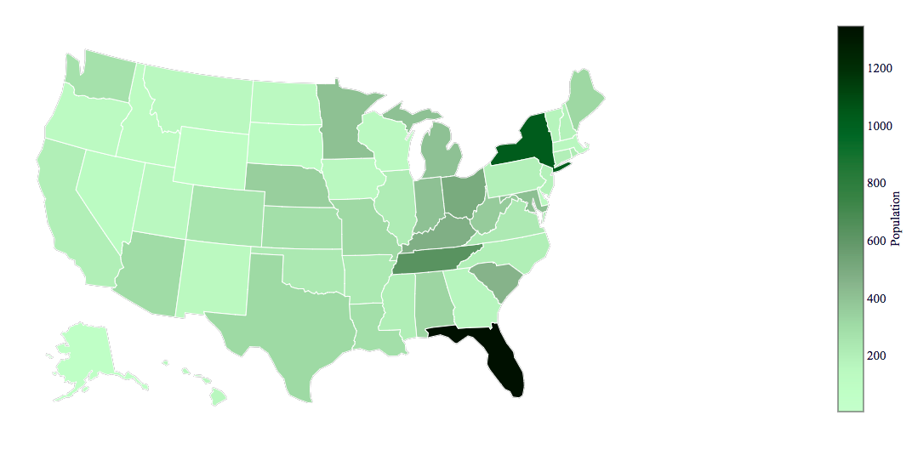
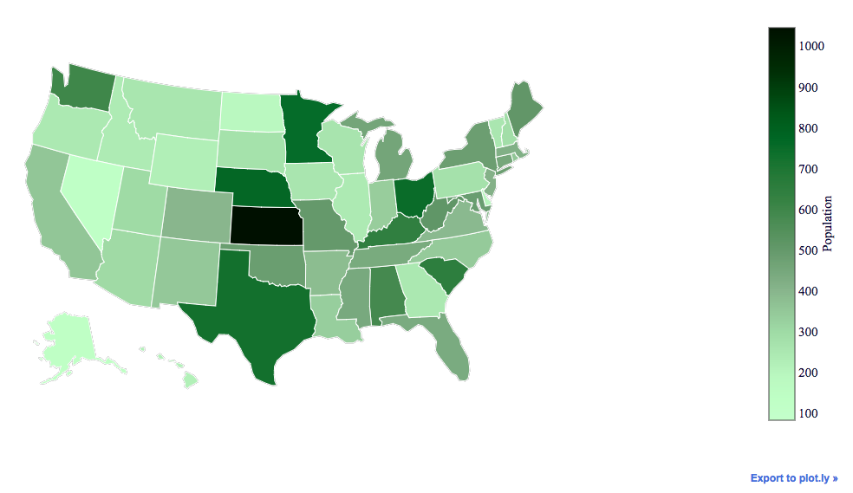
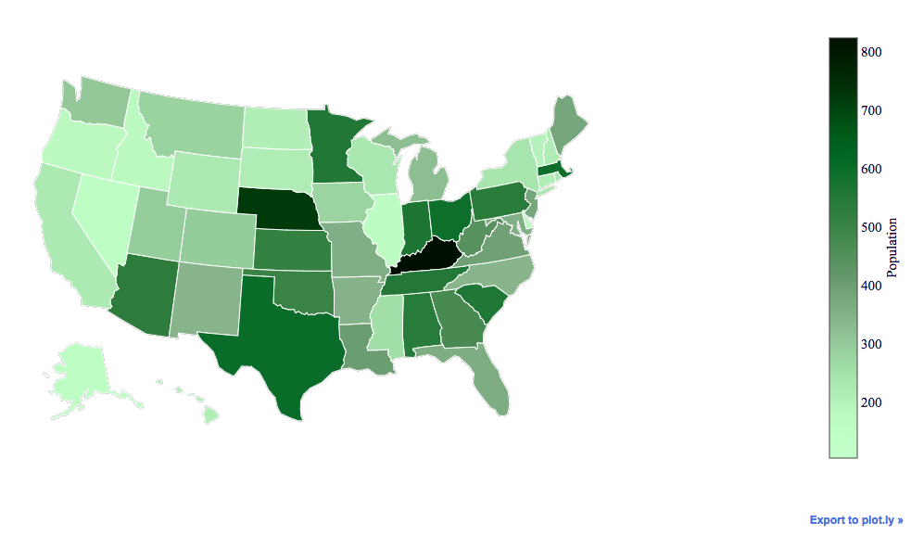
FINDINGS: MENTAL HEALTH STATE BY YEAR ACROSS US STATES (For details, click here)
2016
Year | Highly Impacted State | Least Impacted State | NJ
2012 | Ohio | Alaska | ↓ 64%
2013 | Florida | Alaska | ↓ 80%
2014 | Kentucky | Nevada | ↓ 54%
2015 | Kansas | Nevada | ↓ 60%
2016 | Florida | Alaska | ↓ 85%
Notice that Alaska and Nevada are always least impacted states whereas Highly Impacted varies
East vs West nuances
NJ vs. Highly Impacted State
Interactive UX Demo
2014
2015
Notes:
https://plot.ly

Slide 9
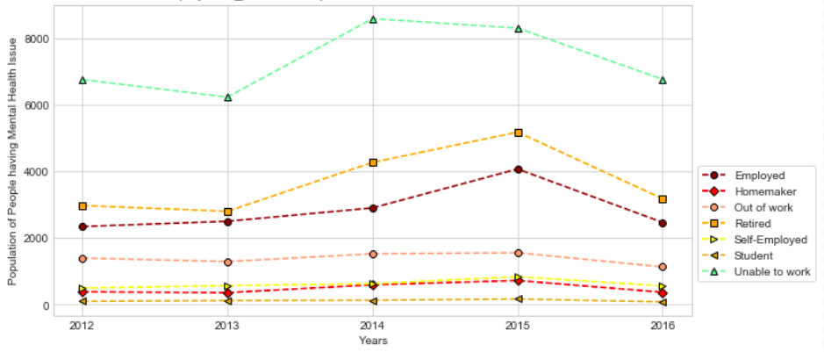
FINDINGS: MENTAL HEALTH ACROSS YEARS BY EMPLOYMENT STATE
By Employment State
Unable to work vs out of work
Higher Mental Health scores for Unable to work group.
Lowest scores – Students
Jump in 2014-15 attributed to External factors. E.g., the 2008 housing crisis impact till 2016 Q1
Notes:
Recession time – (TBD)Mentally retarded folks that ar unemployed
After 2008 depression impacted folks till 2016 Q1 (link here - MS)
How do you define who is a person with good mental health state vs worse mental health state
Focussed on questions that related to these factors – We also had many calcualted variables SAS data that need to be parsed
CDC goes to great length to look at all kinds of data across many many facyors – we reserached on scientific papers that shares factors that historically seeem to affect mental health state more and ensure to use questions that relate to those factors to pull in data

Slide 10
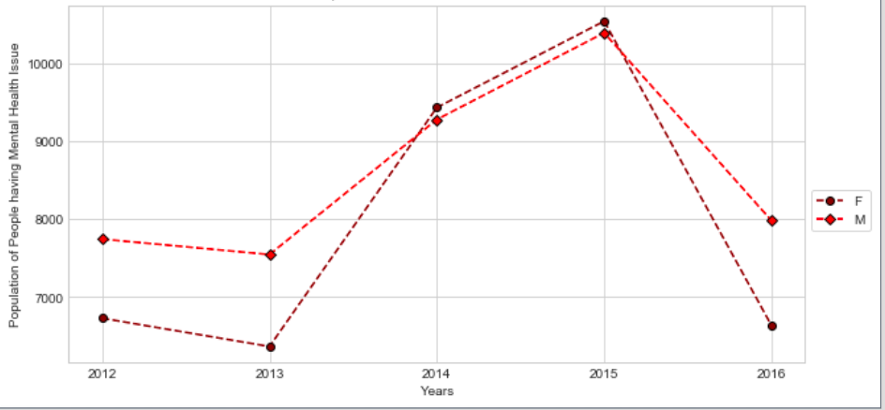
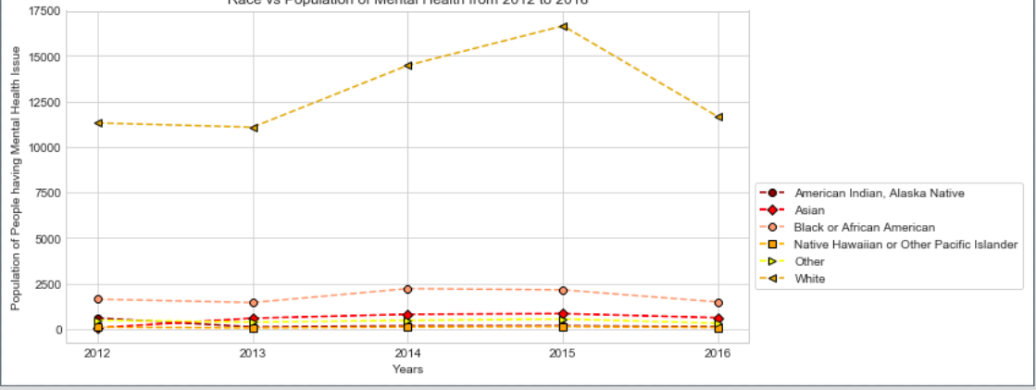
FINDINGS: MENTAL HEALTH ACROSS YEARS BY GENDER AND RACE
By Gender
Females more highly impacted than males except in 2014-15
Count of White Americans impacted more than other races. Seconded by African-Americans. Count negligible in others
Constraint: Reason for above – Possible that the Phone survey may have been with more white Americans than folks of other race or ethnicity – Need to Investigate
By Race
Notes:
Recession time – (TBD)Mentally retarded folks that ar unemployed
After 2008 depression impacted folks till 2016 Q1 (link here - MS)
How do you define who is a person with good mental health state vs worse mental health state
Focussed on questions that related to these factors – We also had many calcualted variables SAS data that need to be parsed
CDC goes to great length to look at all kinds of data across many many facyors – we reserached on scientific papers that shares factors that historically seeem to affect mental health state more and ensure to use questions that relate to those factors to pull in data

Slide 11
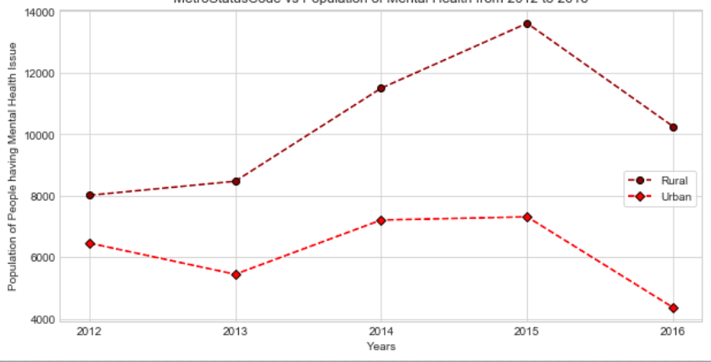
FINDINGS: MENTAL HEALTH ACROSS YEARS BY RURAL vs. URBAN & AGE
Rural vs Urban
Counter to Expectation – Trends across years shows Rural areas more highly impacted
This may be different state stats (see here)
Investigate more on here.
By Age Buckets – Highly Impacted are in age-range of 55-59. Least impacted are in age range of 18-24. For details click here.
Notes:
Recession time – (TBD)Mentally retarded folks that ar unemployed
After 2008 depression impacted folks till 2016 Q1 (link here - MS)
How do you define who is a person with good mental health state vs worse mental health state
Focussed on questions that related to these factors – We also had many calcualted variables SAS data that need to be parsed
CDC goes to great length to look at all kinds of data across many many facyors – we reserached on scientific papers that shares factors that historically seeem to affect mental health state more and ensure to use questions that relate to those factors to pull in data

Slide 12
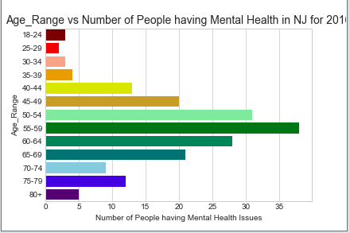
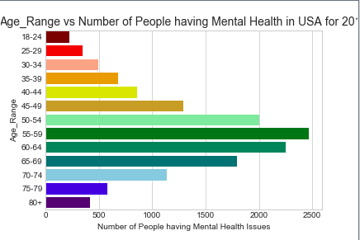
FINDINGS: MENTAL HEALTH BY YEAR On Age (US vs NJ) For details, click here.
By Age Range (NJ)
By Age Range (US)
Year | Highly Impacted Age (NJ) | Highly Impacted Age (US)
2012 | 60-64 | 55-59
2013 | 65-69
2014 | 55-59
2015 | 50-54
2016 | 55-59
Comparison of NJ vs US trends 60 different charts done across 5 years (12 per year)
In NJ and the nation: Lowest impacted Age range continues to be steady at 18-24 age
In NJ vs US: The Highly impacted age range increase from 2012-14 and then settled
Notes:
No Student population in 2016: https://github.com/arunasunder/Team1_MentalHealth/blob/master/Analysis_Output/2016/Employment_Status%20vs%20Mental%20Health_NJ%20for%202016.png
Recession time – (TBD)Mentally retarded folks that ar unemployed
After 2008 depression impacted folks till 2016 Q1 (link here - MS)
How do you define who is a person with good mental health state vs worse mental health state
Focussed on questions that related to these factors – We also had many calcualted variables SAS data that need to be parsed
CDC goes to great length to look at all kinds of data across many many facyors – we reserached on scientific papers that shares factors that historically seeem to affect mental health state more and ensure to use questions that relate to those factors to pull in data

Slide 13
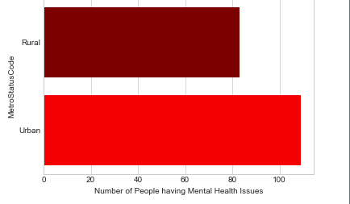
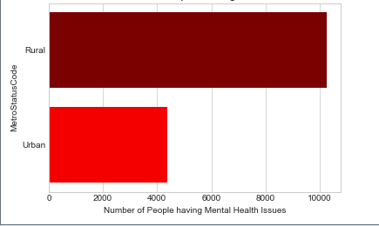
FINDINGS: MENTAL HEALTH BY YEAR On Rural vs Urban (US vs NJ) For details, click here.
Rural vs Urban (NJ)
Rural vs Urban (US)
Across last 5 years, NJ has always shown Urban population as more highly impacted than Rural population – This is in contrast to US trends
Notes:
No Student population in 2016: https://github.com/arunasunder/Team1_MentalHealth/blob/master/Analysis_Output/2016/Employment_Status%20vs%20Mental%20Health_NJ%20for%202016.png
Recession time – (TBD)Mentally retarded folks that ar unemployed
After 2008 depression impacted folks till 2016 Q1 (link here - MS)
How do you define who is a person with good mental health state vs worse mental health state
Focussed on questions that related to these factors – We also had many calcualted variables SAS data that need to be parsed
CDC goes to great length to look at all kinds of data across many many facyors – we reserached on scientific papers that shares factors that historically seeem to affect mental health state more and ensure to use questions that relate to those factors to pull in data

Slide 14
SUMMARIZED FINDINGS & NEXT STEPS
Summarized Findings:
Across States:
West vs East Nuances
In NJ vs US Analysis:
On Gender: Male are more highly impacted across years compared to Female (narrow margin)– In Contrast to US except for 2016. Looks like US is following the trend seen in NJ
On Health Coverage: Contrast to belief, Population density having health coverage seem to be highly impacted than people with no coverage (Trends similar in NJ and US)
On Employment State: NJ Trends follow the nation trend of high impact seen with population unable to work (vs) lowest impact in Students
On Race: NJ Trends follows suit with national trend
Jump in 2015 across the board – Higher stress reported across America External factors – e.g. After effects of housing crisis over many years, discrimination
Conclusions:
The Target group for mental Health related marketing campaigns would be white Americans who are unable to work and have health coverage. The age range and targeting rural vs urban areas would depend on state vs nation wide campaigns
Notes:
How do you define who is a person with good mental health state vs worse mental health state
Focussed on questions that related to these factors – We also had many calcualted variables SAS data that need to be parsed
CDC goes to great length to look at all kinds of data across many many facyors – we reserached on scientific papers that shares factors that historically seeem to affect mental health state more and ensure to use questions that relate to those factors to pull in data

Slide 15
NEXT STEPS
Investigate the factors influencing jump in 2015 more
Investigate reason for Rural vs Urban impacts across US
Focusing on Drugs – Target ads to the target group identified
From a Governmental aspect: See why the health coverage is not truly showing a impact is a better mental health score.
Investigate why the highly impacted states changes across years
Notes:
How do you define who is a person with good mental health state vs worse mental health state
Focussed on questions that related to these factors – We also had many calcualted variables SAS data that need to be parsed
CDC goes to great length to look at all kinds of data across many many facyors – we reserached on scientific papers that shares factors that historically seeem to affect mental health state more and ensure to use questions that relate to those factors to pull in data

Slide 16
THE PROCESS
Data Cleansing (Show Code)
Analysis & Plots
Calculate Variable =
Smoker(10) + Alcoholic(10)+ General Health(10)+ Sleep Deprivation(10)+Chronic Disease(10)+BMI(10)+Physical Inactivity(10)+ Pregnancy(10) +Income(5) + Emotional Support Availability(2.5)+ Life Satisfaction(2.5)
To convert to a score of 20: AverageDepression=[Chronic_Depression(10)+StressDay(10)+DepressedDays(10)]*(2/3)
Total Weight=[( Calculate Variable + AverageDepression(20))/110(female)] or 100(male)]*100
Libraries used: UX Choropleth Maps, plotly, pandas, numpy, seaborn, matplotlib
Demo (Interactive Bar graph, UX Maps and Line graphs )
Notes:
FACTS BEHIND THE FIGURES
How do you define who is a person with good mental health state vs worse mental health state
Focussed on questions that related to these factors – We also had many calcualted variables SAS data that need to be parsed
CDC goes to great length to look at all kinds of data across many many facyors – we reserached on scientific papers that shares factors that historically seeem to affect mental health state more and ensure to use questions that relate to those factors to pull in data

Slide 17
CHALLENGES & OPPORTUNITIES
Challenges:
Original Scope included effectiveness of Drugs and governmental policies - Narrowed it down
Massive volume of Data and managing to work with it on gitHub
Exploration of APIs and which would work best for the Dataset we are looking at
Summarizing the findings across 100+ graphs and sharing inferences
Opportunities:
Investigate Gun control policies and security regulations in areas having the target group population higher in number
Investigate how governmental policies can help target group that are unable to work
Notes:
How do you define who is a person with good mental health state vs worse mental health state
Focussed on questions that related to these factors – We also had many calcualted variables SAS data that need to be parsed
CDC goes to great length to look at all kinds of data across many many facyors – we reserached on scientific papers that shares factors that historically seeem to affect mental health state more and ensure to use questions that relate to those factors to pull in data

