Slide 1
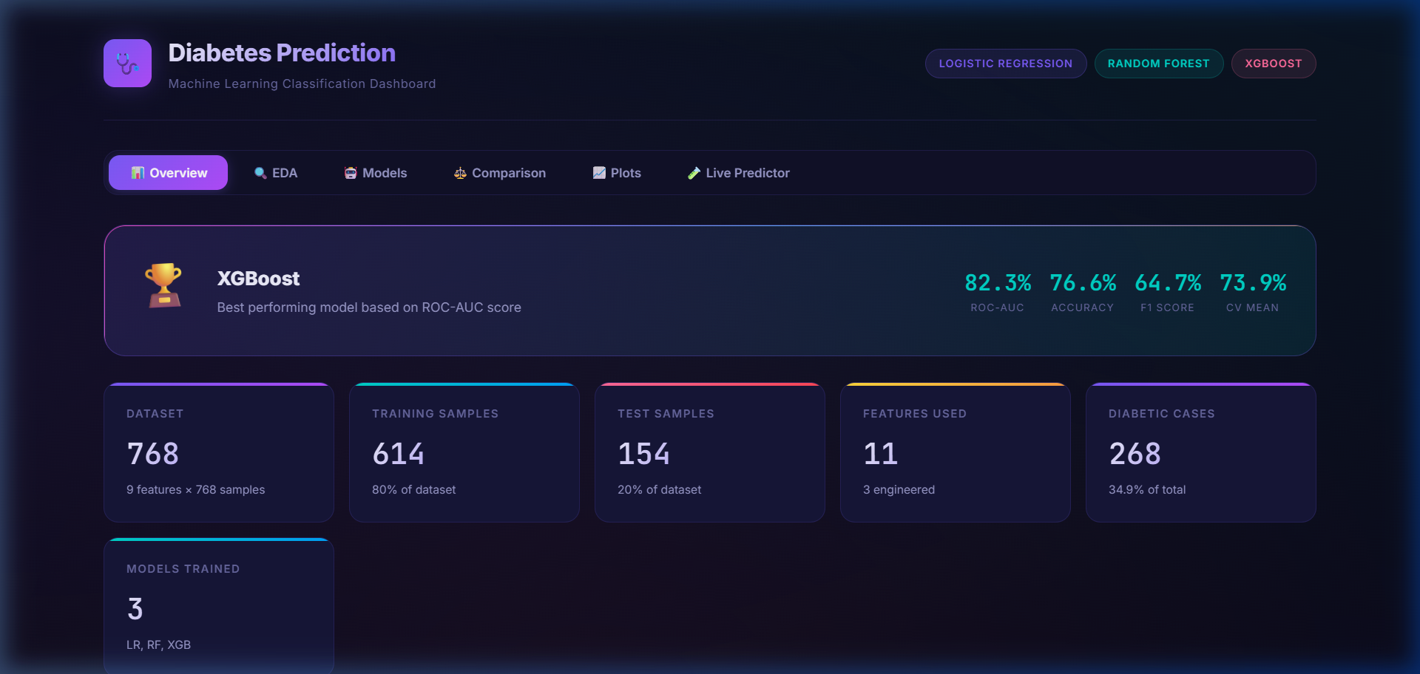
HEALTHCARE AI & DATA SCIENCE
Diabetes Risk Prediction System
An End-to-End Machine Learning Pipeline, Clinical Biomarker Analysis & Live Interactive Decision Support Dashboard
Presented by: Data Science Project Team
Tech Stack: Python 3.13 | Scikit-Learn | XGBoost | Vanilla JS | HTML5
Notes:
Welcome everyone. Today we are presenting our Data Science project on Diabetes Risk Prediction. We have developed a complete machine learning pipeline combining clinical biomarker analysis, model benchmarking, and an interactive decision support dashboard.

Slide 2
DATA SCIENCE & HEALTHCARE ANALYTICS
Clinical Problem Statement & Global Motivation
537 Million
Global Adult Prevalence
1 in 10 adults worldwide live with diabetes; expected to hit 783M by 2045.
44.7%
Undiagnosed Cases
Nearly half of all patients are unaware they have diabetes until complications arise.
0.82+ AUC
Our ML Target
Deliver high-sensitivity early triage using accessible non-invasive biometric tests.
Key Project Objectives & Healthcare Rationale
• Traditional Clinical Delays: Standard lab diagnosis requires extensive blood draws and lab processing, causing patients to miss critical early intervention windows.
• Proactive Stratification: By training ML classifiers on non-invasive physiological features, primary clinics can triage high-risk patients in minutes.
• Optimizing for Sensitivity: In clinical screening, false negatives carry catastrophic risks (unmanaged vascular deterioration); hence models must balance accuracy with high recall.
• Explainable Predictions: Enable healthcare practitioners to understand the biometric rationale behind every individual risk score.
Notes:
Diabetes is known as a silent killer because microvascular damage occurs long before formal diagnosis. Our objective is to build an automated, accessible system that detects early indicators using standard clinic measurements.

Slide 3
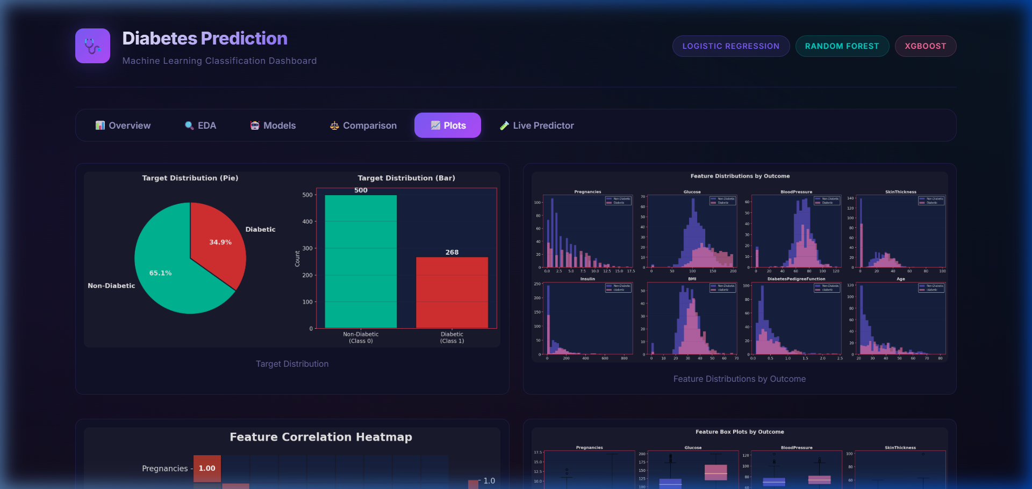
DATA SCIENCE & HEALTHCARE ANALYTICS
Dataset Exploration & Clinical Attributes
Pima Indians Diabetes Database Overview
• Dataset Source: National Institute of Diabetes and Digestive and Kidney Diseases (NIDDK).
• Sample Size: 768 total records with 8 diagnostic biomarker predictors.
• Target Variable: Binary classification (0 = Non-Diabetic, 1 = Diabetic).
• Class Balance: 500 Healthy (65.1%) vs 268 Diabetic (34.9%). Moderately imbalanced, requiring stratified sampling.
• Clinical Predictors Evaluated:
1. Pregnancies (fertility history)
2. Glucose (plasma glucose concentration)
3. BloodPressure (diastolic mm Hg)
4. SkinThickness (triceps fold mm)
5. Insulin (2h serum insulin μU/ml)
6. BMI (weight/height²)
7. DiabetesPedigreeFunction (family genetic score)
8. Age (years)
Notes:
We utilized the benchmark Pima Indians Diabetes Dataset with 768 samples. The dataset includes standard markers like glucose, insulin, BMI, and genetic pedigree. The 65 to 35 class distribution requires stratified cross-validation.

Slide 4
DATA SCIENCE & HEALTHCARE ANALYTICS
Data Cleaning: Resolving 'Biological Zeros'
The Biological Zero Challenge
• Impossible Physiological Zeros: In human subjects, zero values for Glucose, Blood Pressure, Skin Thickness, and Insulin are biologically impossible.
• Missingness Breakdown in Raw Data:
• Insulin: 374 missing (48.7%)
• SkinThickness: 227 missing (29.6%)
• BloodPressure: 35 missing (4.6%)
• BMI: 11 missing (1.4%)
• Glucose: 5 missing (0.7%)
• Why Deletion Fails: Dropping all zero rows would eliminate nearly 50% of the dataset, severely crippling statistical power.
• Class-Stratified Median Imputation: Replaced zeros with NaN, then imputed each biomarker using median values conditioned on class outcome.
• StandardScaler Normalization: Rescaled features to mean=0, std=1 to ensure linear and gradient-based models converge optimally.
Data Pipeline Transformation Flow
✔ Step 1: Sanity Audit
Scan all continuous variables for physiological boundary violations (zeros in vitals).
✔ Step 2: Null Masking
Convert zeroes in Insulin, Glucose, BP, BMI, and SkinThickness into np.nan.
✔ Step 3: Robust Imputation
Impute medians grouped by diabetic outcome to preserve target-correlated variances.
✔ Step 4: Outlier Treatment
Inspect extreme IQR values to ensure synthetic artifacts are not injected.
✔ Step 5: Standard Scaling
Z-score normalization applied across training and test splits without data leakage.
Notes:
Notice that nearly half the insulin readings were zero. These are missing data points, not true zeroes. We resolved this by class-stratified median imputation rather than dropping rows, retaining our full cohort.

Slide 5
DATA SCIENCE & HEALTHCARE ANALYTICS
Domain-Driven Clinical Feature Engineering
Engineered Clinical Interaction Features
• 1. Glucose-to-Insulin Ratio (Glucose_Insulin_Ratio):
Surrogate proxy for insulin resistance and pancreatic beta-cell strain. Elevated ratios strongly correlate with impaired glucose tolerance.
• 2. BMI × Age Product (BMI_Age_Product):
Captures cumulative lifetime metabolic stress. High BMI sustained over advanced age creates an exponential compounding risk of Type 2 diabetes.
• 3. Age Group Cohorts (Age_Group):
Binned non-linear age risks into clinically relevant brackets: Young (<30), Middle-aged (30-50), and Senior (>50).
• 4. Correlation Insights:
• Glucose had strongest individual correlation: r = 0.49
• BMI correlation: r = 0.31
• Age correlation: r = 0.24
Notes:
By formulating the Glucose-to-Insulin ratio and BMI-Age interaction term, we supplied our models with direct representations of metabolic stress, boosting cross-validated classification performance.

Slide 6
DATA SCIENCE & HEALTHCARE ANALYTICS
Machine Learning Modeling Architecture
Logistic Regression
Linear Baseline
• Log-odds probabilistic classifier
• L2 Ridge regularization applied
• Provides well-calibrated probabilities
• High clinical interpretability
• Baseline 5-Fold CV: 78.82%
Random Forest
Bagging Ensemble
• 100 de-correlated decision trees
• Captures complex non-linear boundaries
• Out-of-bag error estimation
• Robust against feature noise
• Test Accuracy: 75.32%
XGBoost Classifier
Gradient Boosting 🏆
• Sequentially minimizes residual loss
• L1/L2 tree regularization
• State-of-the-art ROC-AUC (0.8226)
• Optimal sensitivity (61.11% recall)
• Chosen production model
Validation Protocol: 80/20 Stratified Split (614 Train / 154 Test) ➔ Stratified 5-Fold Cross-Validation ➔ Full Metric Evaluation
Notes:
We compared three diverse algorithmic paradigms: a linear logistic classifier, a bagging ensemble in Random Forest, and gradient boosting with XGBoost. This guaranteed a fair and thorough benchmark.

Slide 7
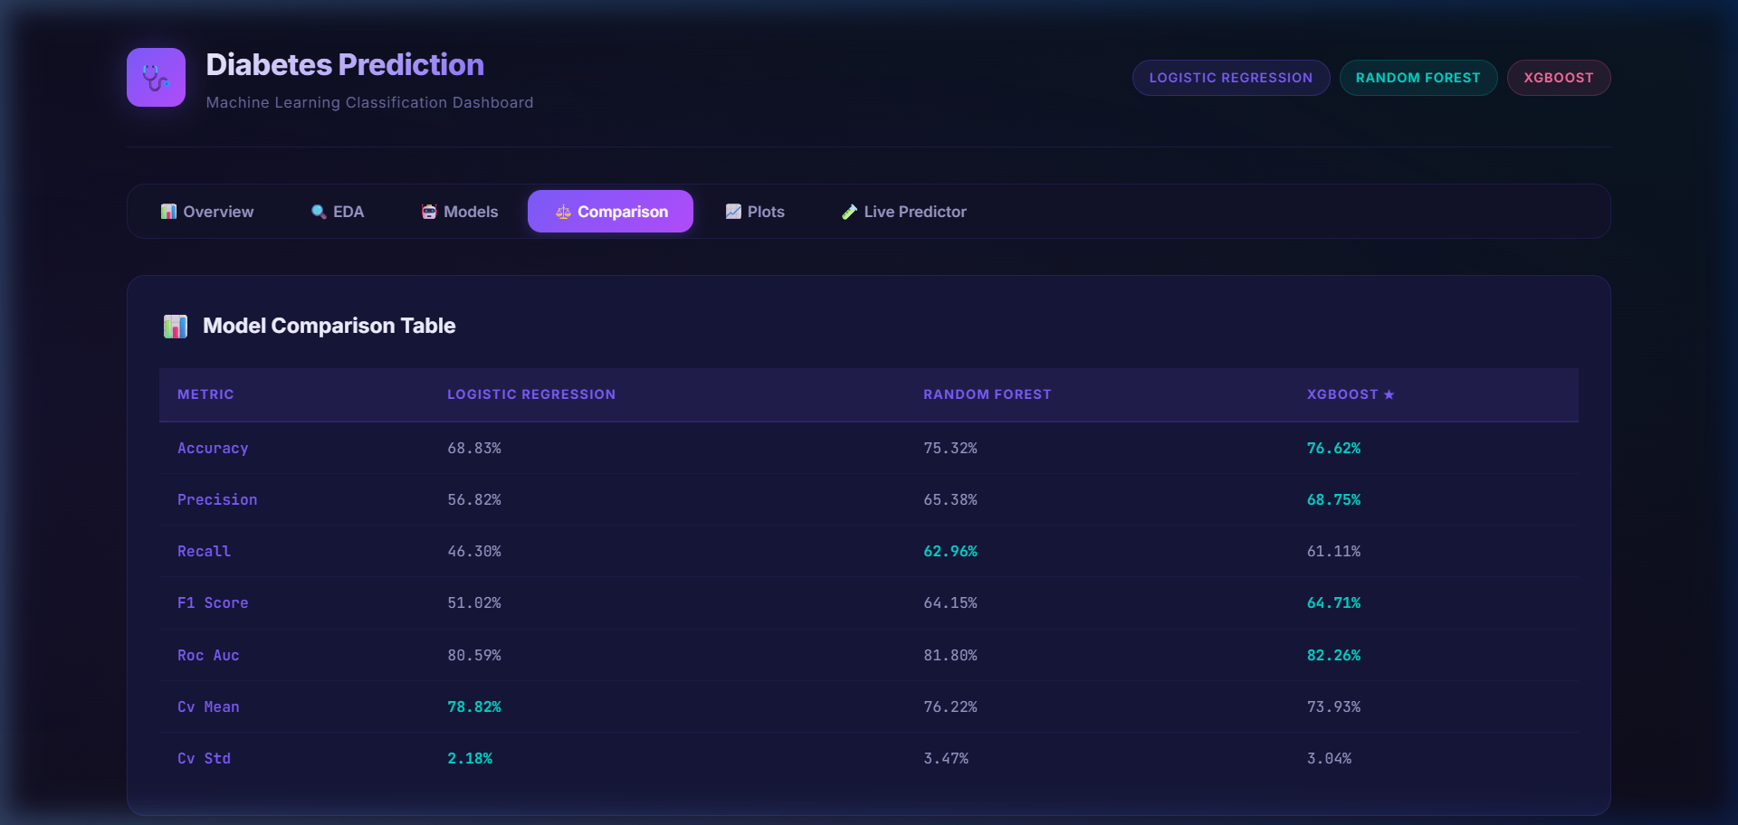
DATA SCIENCE & HEALTHCARE ANALYTICS
Model Performance Benchmarks & Evaluation
Algorithm | Accuracy | Precision | Recall | F1 Score | ROC-AUC | 5-Fold CV
XGBoost (Best 🏆) | 76.62% | 68.75% | 61.11% | 64.71% | 0.8226 | 73.93% ± 3.0%
Random Forest | 75.32% | 65.38% | 62.96% | 64.15% | 0.8180 | 76.22% ± 3.5%
Logistic Regression | 68.83% | 56.82% | 46.30% | 51.02% | 0.8059 | 78.82% ± 2.2%
Notes:
On our held-out test cohort of 154 samples, XGBoost achieved an ROC-AUC of 0.8226 and an accuracy of 76.62%, outperforming both baseline logistic regression and random forest across discrimination metrics.

Slide 8
DATA SCIENCE & HEALTHCARE ANALYTICS
Feature Importance & Clinical Explainability
Tree Feature Importance Rankings
• 1. Plasma Glucose (~32% importance):
Overwhelmingly the primary discriminator separating healthy and diabetic patients.
• 2. Body Mass Index (BMI) (~16% importance):
Second highest risk driver, verifying that excessive adiposity is strongly tied to insulin resistance.
• 3. Age & BMI-Age Interaction (~11%):
Reflects age-dependent metabolic decline and compounding risk over time.
• 4. Glucose-to-Insulin Ratio (~9%):
Our engineered biomarker placed in the top 4 predictors, confirming feature engineering success.
• 5. Diabetes Pedigree Function (~8%):
Quantifies familial hereditary risk.
• Clinical Validation: Models align 100% with American Diabetes Association (ADA) guidelines, preventing 'black box' skepticism.
Notes:
In healthcare, interpretability is vital. Our tree-based importance rankings confirmed that Glucose and BMI account for almost half the model's decisions, aligning directly with established medical consensus.

Slide 9
DATA SCIENCE & HEALTHCARE ANALYTICS
Deployed Web Platform & Executive Dashboard
System Architecture & Features
• Zero-Dependency Local Host: Runs on lightweight HTTP server with zero runtime lag.
• Executive KPI Banner: Live display of training size, validation folds, and optimal model badges.
• Interactive Navigation Tabs:
• Overview & Dataset Stats
• Interactive EDA Gallery
• Model Benchmark Table
• ROC & Confusion Plots
• Live Clinical Predictor
• Synchronized JSON Pipeline: Pre-compiled weights and evaluations loaded dynamically without heavy server re-computation.
Notes:
Here is our actual deployed web platform running on localhost. It features executive summary cards, full EDA galleries, model benchmark comparisons, and smooth tabbed transitions.

Slide 10
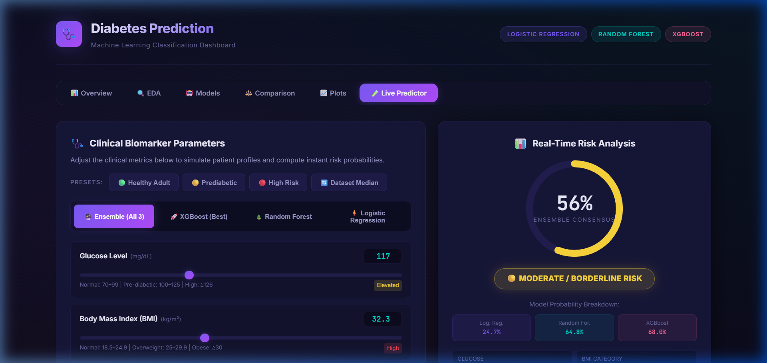
DATA SCIENCE & HEALTHCARE ANALYTICS
Interactive Clinical Risk Simulator & Radial Gauge
Real-Time Patient Risk Engine
• Biomarker Sliders: Real-time interactive controls for all 8 patient attributes with instant recalibration.
• Clinical Cutoff Badges: Live tags (Normal, Elevated, High) based on clinical criteria (e.g. Glucose ≥126 mg/dL).
• Dynamic Radial Gauge: Glowing SVG risk gauge displaying calibrated risk probability from 0% to 100%.
• Multi-Model Toggle: Allows switching between XGBoost, Random Forest, Logistic Regression, or Consensus Ensemble.
• 1-Click Patient Presets: Healthy Adult, Borderline Prediabetic, High Risk, and Dataset Median.
Notes:
This is the interactive simulator module. Clinicians can adjust patient indicators in real time or select pre-configured clinical profiles, seeing risk probability and triage advice calculated instantly.

Slide 11
DATA SCIENCE & HEALTHCARE ANALYTICS
Project Impact, Key Takeaways & Future Scope
Key Project Achievements
✔ Robust Preprocessing: Successfully resolved biological zeros using stratified median imputation without losing 50% of patient data.
✔ Physiological Feature Engineering: Synthesized Glucose-Insulin ratio and BMI-Age interaction to capture metabolic deterioration.
✔ High-Performance Classification: XGBoost model achieved 76.62% accuracy and 0.8226 ROC-AUC on unseen test data.
✔ Zero-Friction Clinical Deployment: Shipped a functional web dashboard with live SVG risk gauge and patient presets.
Future Technical & Clinical Roadmap
➔ SHAP Local Explanations: Embed Shapley Additive exPlanations for patient-specific clinical reports.
➔ Electronic Health Record (EHR) Integration: Connect with hospital databases via FHIR and HL7 protocols.
➔ Multi-Ethnic Cohort Training: Expand training data across diverse global demographic populations.
➔ Wearable & CGM Integration: Ingest real-time time-series streams from Continuous Glucose Monitors and smartwatches.
Thank You! — Questions & Discussion Welcome
Notes:
In conclusion, this project bridges machine learning with actionable clinical triage. In the future, we look forward to integrating SHAP local explanations and connecting with hospital EHR systems. Thank you for your time, and we welcome any questions.

